Slide 1
Module-1
Basic C programming concepts

Slide 2
History of C Standards
1) K&R C
In 1978, Brian Kernighan and Dennis Ritchie published the first edition of The C Programming Language. This book, known to C programmers as "K&R", served for many years as an informal specification of the language.
2) ANSI C and ISO C (C89 or C90)
ANSI (American National Standards Institute) is the primary organization for encouraging the development of technology standards in the United States.
In 1983, the American National Standards Institute (ANSI) formed a committee, to establish a standard specification of C. In 1989, the C standard was ratified as ANSI X3.159-1989 "Programming Language C". This version of the language is often referred to as ANSI C, Standard C, or sometimes C89.
Notes:
The American National Standards Institute (ANSI, /ˈænsi/ an-see) is a private non-profit organization that oversees the development of voluntary consensus standards for products, services, processes, systems, and personnel in the United States.
The organization's headquarters are in Washington, DC. ANSI's operations office is located in New York City.
The International Organization for Standardization (ISO) is an international standard-setting body composed of representatives from various national standards organizations. Founded on 23 February 1947, the organization promotes worldwide proprietary, industrial and commercial standards. It is headquartered in Geneva, Switzerland and as of 2015 works in 163 countries.

Slide 3
History of C Standards
In 1990, the ANSI C standard (with formatting changes) was adopted by the International Organization for Standardization (ISO) as ISO/IEC 9899:1990, which is sometimes called C90. Therefore, the terms "C89" and "C90" refer to the same programming language.
3) C99
The C standard was further revised in the late 1990s, leading to the publication of ISO/IEC 9899:1999 in 1999, which is commonly referred to as C99
4) C11
The latest C standard is ISO/IEC 9899:2011, also known as C11 as the final draft was published in 2011.

Slide 4
Example

Slide 5
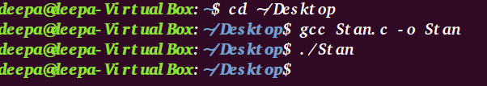
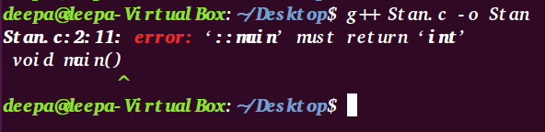
Example
On compiling the program with gcc compiler on Ubuntu
On compiling the program with g++ compiler on Ubuntu

Slide 6
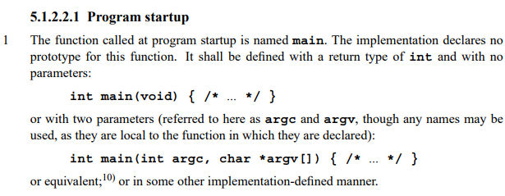
Example

Slide 7
Books
Yashwant Kanetkar, “Let Us C”.
Schaum Series, “Data Structure”.
Ellis Horowitz and Sartaz Sahni, “Data Structure using C”.
P.K. Sinha and P.K. Sinha, “Computer Fundamentals”
Reference Books
E Balaguruswamy, “Programming in ANSI C”.

Slide 8
Course Plan
Module 1: Basic C programming concepts | Module 4: Queue, Stack and Linked List
Module 2: Pointers and Functions | Module 5: Searching, Sorting and File Handling
Module 3: Array, Structure and Union

Slide 9
Module 1: Basic C programming concepts
Algorithm, Pseudo code and Flow-chart
Program Development steps, Use of translators, Linkers, Loaders, Editors and Locaters
Structure of C program, A Simple C program, Identifiers, Data types, Sizes of Data Types
Size-of operator, Modifiers, Use of values.h and limits.h
Variables, Declaration vs. Definition, Types of Variables, Global vs. Local Variable, Literals, Constants & Qualifiers
Arithmetic operators, Relational and Logical operators
Assignment operators, Increment and Decrement operators, Conditional operator, Bit-wise operators
Expressions, Precedence and Order of evaluation (Associativity), Type conversions
if statements, Conditional expressions, Input-output statements, statements and blocks
Loops: while, do-while, for statements
Switch statements, break, continue, goto and labels
Reflection & Discussion

Slide 10
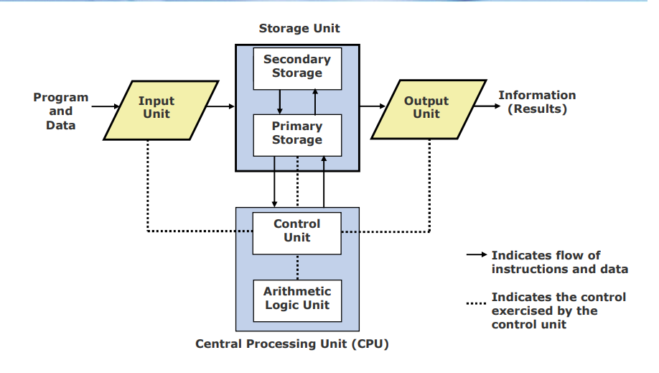
Basic Organization of a Computer System
Notes:
Explain >> sum= a+b
Byte: a unit of memory size
1GB= 2³⁰ bytes
A bit (short for binary digit) is the smallest unit of data in a computer. A bit has a single binary value, either 0 or 1. Although computers usually provide instructions that can test and manipulate bits, they generally are designed to store data and execute instructions in bit multiples called bytes

Slide 11
Algorithm
An algorithm is simply a solution to a problem. An algorithm presents the solution to a problem as a well defined set of steps or instructions.
Qualities of a good algorithm
Inputs and outputs should be defined precisely.
Each steps in algorithm should be clear and unambiguous.
Algorithm should be most effective among many different ways to solve a problem.
An algorithm shouldn't have computer code. Instead, the algorithm should be written in such a way that, it can be used in similar programming languages.
Notes:
When a computer is used for solving a particular problem, the steps to the solution should be communicated to the computer. This makes the study of algorithms a very important part in computer science. An algorithm is executed in a computer by combining lot of elementary operations such as additions and subtractions to perform more complex mathematical operations. But translating the idea of the algorithm in to computer code is not straight forward. Specially, converting an algorithm in to a low level language such as assembly language could be very tedious than using a high level language such as C or Java.

Slide 12
pseudocode
A set of specific instructions which are very similar to computer code, but not specific to any one computer.
Pseudocode allows to include control structures such as while, if,if then-else, repeat-until, for, case etc., which are present in many high level languages.
While algorithms can be written in natural language, pseudocode is written in a format that is closely related to high level programming language structures.
Additionally, transforming an algorithm presented in pseudocode to programming code could be much easier than converting an algorithm written in natural language.
Notes:
Pseudo-code is a general way of describing an algorithm. Pseudo-code does not use the syntax of a specific programming language, therefore cannot be executed on a computer. But it closely resembles the structure of a programming language and contains roughly the same level of detail.

Slide 13
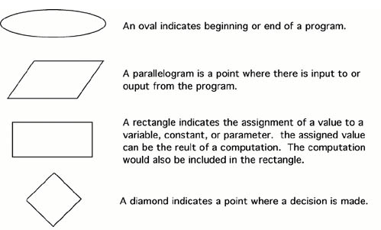
Flow chart
A flowchart is a pictorial representation of an algorithm in which the steps are drawn in the form of different shapes of boxes and the logical flow is indicated by interconnecting arrows.
The boxes represent operations and the arrows represent the sequence in which the operations are implemented.
Flowchart Symbols

Slide 14
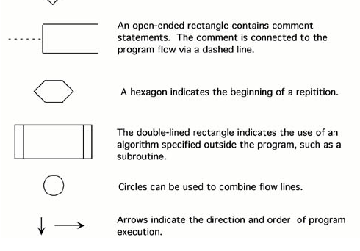
Flow chart

Slide 15
Activity
Let's say that you have a friend arriving at the airport, and your friend needs to get from the airport to your house. What are the algorithms that you might give your friend for getting to your home:

Slide 16
Possible Solutions?
The taxi algorithm:
Go to the taxi stand.
Get in a taxi.
Give the driver my address.
The call-me algorithm:
When your plane arrives, call me.
Meet me outside the airport.
The bus algorithm:
Outside baggage claim, catch bus for ISBT Dehradun
On reaching Dehradun ISBT catch bus for ballupur.
Get off on ballupur.
Walk two blocks north to my house.

Slide 17
Choosing the best Algorithm
All four of these algorithms accomplish exactly the same goal, but each algorithm does it in completely different way. Each algorithm also has a different cost and a different travel time. Taking a taxi, for example, is probably the fastest way, but also the most expensive. Taking the bus is definitely less expensive, but a whole lot slower. You choose the algorithm based on the circumstances.

Slide 18
Example-1
Ques: Write an algorithm, pseudocode and draw corresponding flow chart to determine a student’s final grade and indicate whether it is passing or failing. If final grade is less than 40, student is considered as fail. The final grade is calculated as the average of four marks.

Slide 19
Example-1
Ans: Algorithm:
1. Input set of marks
2. Find the average by adding the marks and dividing them by 4
3. if average is less than 40 then display fail otherwise pass
Pseudocode:
1. Input set of 4 marks a,b,c,d
2. Compute average as (a+b+c+d)/4
3. if (average<40) then
display fail
else display pass

Slide 20
Example-2
Q)Write an algorithm and pseudocode and draw a corresponding flow chart to print the sum of the digits of a given number
Ans: Algorithm:
Input a Number
Initialize Sum to zero
While Number is not zero
Get Remainder by Number Mod 10
Add Remainder to Sum
Divide Number by 10
Print sum

Slide 21
Example-2
pseudocode :
Step 1: Input N
Step 2: Sum = 0
Step 3: While (N != 0)
Rem = N % 10;
Sum = Sum + Rem;
N = N / 10;
Step 4: Print Sum

Slide 22
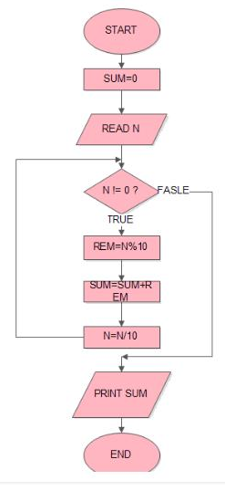
Example-2
Flow Chart

Slide 23
Questions?
Write an algorithm, pseudocode and draw corresponding flow chart for the Questions given below:
1)Find the sum of all the multiples of 3 or 5 below 1000.
2) find all the roots of a quadratic equation ax²+bx+c=0
3) find the largest among three different numbers entered by user.
4)Determine and Output Whether Number N is Even or Odd
5)Calculate the remainder, and the quotient of two given numbers.
6) Generate even numbers between 100and 200.

Slide 24
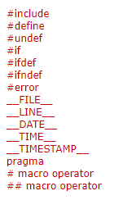
Compiling and executing a ‘C’ code
#include <stdio.h>
#define SOMETHING "Hello World"
int main()
{
/* Using a macro to print 'Hello World'*/
printf(“Hi”);
printf(SOMETHING);
return 0;
}
gcc Test.c -o Test.exe
gcc -E -o Test.i Test.c
Preprocessor directive
Notes:
The 'Hello World!' program is created with help of a text editor and saved as Test.c.
The Test.c program code is stored in a file as a sequence of bytes. Each byte has a value corresponding to some character. The first byte has the value 35 that corresponds to the character '#', for example. Likewise, the second byte has the integer value 105, which corresponds to the character 'i', and so on.

Slide 25
Compiling and executing a ‘C’ code
There are four main stages through which a source code passes in order to finally become an executable. The four stages for a C program to become an executable are the following:
Pre-processing
Compilation
Assembly
Linking

Slide 26
Compiling and executing a ‘C’ code
1) Preprocessing: This is the very first stage through which a source code passes. In this stage the following tasks are done:
Expansion of the included files
Macro substitution
Comments are stripped off
The first observation is that the argument to printf() now contains directly the string “Hello World” rather than the macro.
The second observation is that the comment that we wrote in our original code is not there.
The third observation is that the comment that we wrote in our original code is not there. This proves that all the comments are stripped off.
gcc -E Test.c -o Test.i
Notes:
During compilation of a C program the compilation is started off with preprocessing the directives (e.g., #include and #define). The preprocessor (cpp - c preprocessor) is a separate program in reality, but it is invoked automatically by the compiler. For example, the #include <stdio.h> command in line 1 of Test.c tells the preprocessor to read the contents of the system header file stdio.h and insert it directly into the program text. The result is another file typically with the .i suffix. In practice, the preprocessed file is not saved to disk unless the -save-temps option is used.
This is the first stage of compilation process where preprocessor directives (macros and header files are most common) are expanded. To perform this step gcc executes the following command internally.

Slide 27
Compiling and executing a ‘C’ code
2) Compilation:In this phase compilation proper takes place. The compiler (ccl) translates Test.i into Test.s. File Test.s contains assembly code. You can explicitly tell gcc to translate Test.i to Test.s by executing the following command.
gcc -S Test.i
The command line option -S tells the compiler to convert the preprocessed code to assembly language without creating an object file. After having created Test.s we can see the content of this file. While looking at assembly code we may note that the assembly code contains a call to the external function printf.
3) Assembly: Here, the assembler (as) translates Test.s into machine language instructions, and generates an object file Test.o. You can invoke the assembler at your own by executing the following command.
gcc Test.s -o Test.o

Slide 28
Compiling and executing a ‘C’ code
The above command will generate Test.o as it is specified with -o option. And, the resulting file contains the machine instructions for the classic "Hello World!" program, with an undefined reference to printf.
4) Linking: This is the final stage in compilation of "Hello World!" program. This phase links object files to produce final executable file. An executable file requires many external resources (system functions, C run-time libraries etc.). Regarding our "Hello World!" program you have noticed that it calls the printf function to print the 'Hello World!' message on console. This function is contained in a separate pre compiled object file printf.o, which must somehow be merged with our helloworld.o file. The linker (ld) performs this task for you. Eventually, the resulting file helloworld is produced, which is an executable. This is now ready to be loaded into memory and executed by the system.
Notes:
Note: stdio.h holds information about the I/O stuff, the actual code for it will be in the runtime library (though you rarely have to link that library specifically since the compiler will try to take care of it for you). Because you usually link with the compiler (i.e., the compiler invokes the linker for you), it knows that you're probably going to need the C run time library.
On a normal Unix system, if you do not instruct it otherwise, [GCC] will look for headers requested with #include <file> in: C:\Program Files (x86)\CodeBlocks\MinGW\include
Source: http://www.mingw.org/wiki/includepathhowto

Slide 29
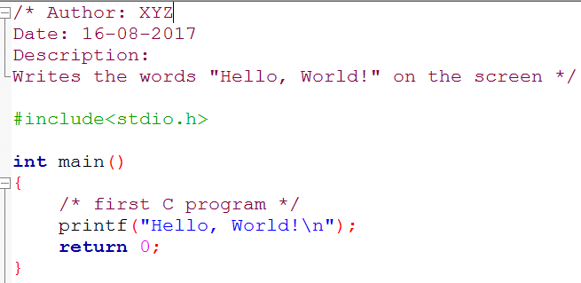
Sample Code of C “Hello World” Program

Slide 30
Structure of C program
Documentations (Documentation Section): The Documentation section usually contains the collection of comment lines giving the name of the program, author’s or programmer’s name and few other details.
Preprocessor Statements (Link Section): It links predefined functions in library files into your program
Global Declarations : used to define those variables that are used globally within the entire program and is used in more than one function
The main() function
Local Declarations
Program Statements & Expressions
User Defined Functions

Slide 31
Structure of C program
* Comments */ | This is a comment block, which is ignored by the compiler. Comment is used anywhere in program to add info about program or code block, which can be helpful for programmer to understand the code easily in feature.
#include<stdio.h> | This is a preprocessor command to include the header file stdio.h in the program before compiling the source-code.
int main()
main() | The main() is the main function where program execution begins. Every C program must contain only one main function.
Braces | TCurly braces which shows how much the main() function has its scope.
printf() | It is a predefined (already written and compiled) function in C, which prints text on the screen
return 0 | At the end of the main function returns value 0.

Slide 32
Identifiers

Slide 35
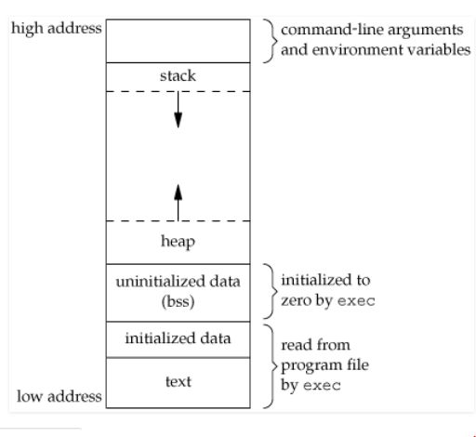

Slide 36
A typical memory layout of a running process
1. Text Segment: which contains executable instructions. the text segment is often read-only, to prevent a program from accidentally modifying its instructions.
Initialized Data Segment: contains the global variables and static variables that are initialized by the programmer.
data segment is not read-only, since the values of the variables can be altered at run time.
This segment can be further classified into initialized read-only area and initialized read-write area.
Example: A global C statement int debug=1 would be stored in initialized read-write area. And a global C statement like const char* string = “hello world” makes the string literal “hello world” to be stored in initialized read-only area and the character pointer variable string in initialized read-write area.
Notes:
Static : storage specifier and const is a type qualifier.

Slide 37
Uninitialized Data Segment: Uninitialized data segment, often called the “bss” segment, named after an ancient assembler operator that stood for “block started by symbol.
Data in this segment is initialized by the kernel to arithmetic 0 before the program starts executing.
Stack: The stack area traditionally adjoined the heap area and grew the opposite direction; when the stack pointer met the heap pointer, free memory was exhausted.
the stack grows and shrinks as functions push and pop local variables
there is no need to manage the memory yourself, variables are allocated and freed automatically
the stack has size limits
stack variables only exist while the function that created them, is running
Notes:
What is the stack? It's a special region of your computer's memory that stores temporary variables created by each function (including the main() function). The stack is a "LIFO" (last in, first out) data structure, that is managed and optimized by the CPU quite closely. Every time a function declares a new variable, it is "pushed" onto the stack. Then every time a function exits, all of the variables pushed onto the stack by that function, are freed (that is to say, they are deleted). Once a stack variable is freed, that region of memory becomes available for other stack variables.
The advantage of using the stack to store variables, is that memory is managed for you. You don't have to allocate memory by hand, or free it once you don't need it any more. What's more, because the CPU organizes stack memory so efficiently, reading from and writing to stack variables is very fast.
A key to understanding the stack is the notion that when a function exits, all of its variables are popped off of the stack (and hence lost forever). Thus stack variables are local in nature. This is related to a concept we saw earlier known as variable scope, or local vs global variables. A common bug in C programming is attempting to access a variable that was created on the stack inside some function, from a place in your program outside of that function (i.e. after that function has exited).
Another feature of the stack to keep in mind, is that there is a limit (varies with OS) on the size of variables that can be store on the stack. This is not the case for variables allocated on the heap.
Heap: The heap is a region of your computer's memory that is not managed automatically for you, and is not as tightly managed by the CPU. It is a more free-floating region of memory (and is larger). To allocate memory on the heap, you must use malloc() or calloc(), which are built-in C functions. Once you have allocated memory on the heap, you are responsible for using free() to deallocate that memory once you don't need it any more. If you fail to do this, your program will have what is known as a memory leak. That is, memory on the heap will still be set aside (and won't be available to other processes). As we will see in the debugging section, there is a tool called valgrind that can help you detect memory leaks.
Unlike the stack, the heap does not have size restrictions on variable size (apart from the obvious physical limitations of your computer). Heap memory is slightly slower to be read from and written to, because one has to use pointers to access memory on the heap. We will talk about pointers shortly.
Unlike the stack, variables created on the heap are accessible by any function, anywhere in your program. Heap variables are essentially global in scope.

Slide 38
Variables created on the stack will go out of scope and are automatically deallocated.
Much faster to allocate in comparison to variables on the heap.
Implemented with an actual stack data structure.
Stores local data, return addresses, used for parameter passing.
Can have a stack overflow when too much of the stack is used (mostly from infinite or too deep recursion, very large allocations).
Data created on the stack can be used without pointers.
You would use the stack if you know exactly how much data you need to allocate before compile time and it is not too big.
Usually has a maximum size already determined when your program starts.
Stored in computer RAM just like the stack.
In C++, variables on the heap must be destroyed manually and never fall out of scope. The data is freed with delete, delete[], or free.

Slide 39
Slower to allocate in comparison to variables on the stack.
Used on demand to allocate a block of data for use by the program.
Can have fragmentation when there are a lot of allocations and deallocations.
In C++ or C, data created on the heap will be pointed to by pointers and allocated with new or malloc respectively.
You would use the heap if you don't know exactly how much data you will need at run time or if you need to allocate a lot of data.
Responsible for memory leaks.
Notes:
The idea behind int was that it was supposed to match the natural "word" size on the given platform: 16 bit on 16-bit platforms, 32 bit on 32-bit platforms, 64 bit on 64-bit platforms, you get the idea. However, for backward compatibility purposes some compilers prefer to stick to 32-bit inteven on 64-bit platforms.

Slide 40
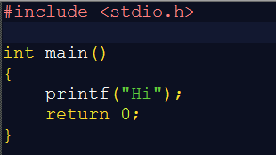



Slide 41
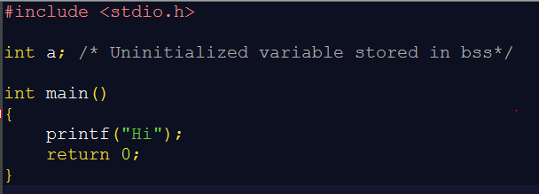
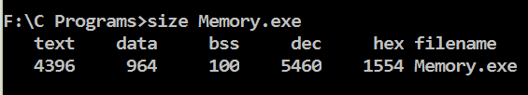

Slide 42
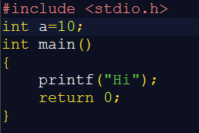


Slide 48
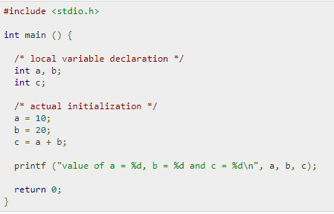
Local and Global variables
Local variables: Variables that are declared inside a function or block are called local variables. Local variables are not known to functions outside their own. Example: Here all the variables a, b, and c are local to main() function.

Slide 49
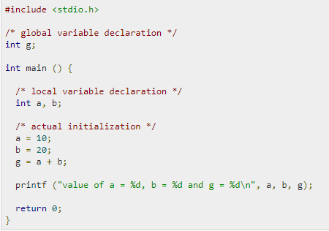
Local and Global variables
Global variables: They are defined outside a function, usually on top of the program. Global variables hold their values throughout the lifetime of your program and can be accessed inside any functions defined for the program.

Slide 50
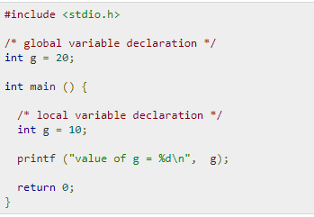
Local and Global variables
Note: A program can have same name for local and global variables but the value of local variable inside a function will take preference.
Example:
Notes:
Output: value of g= 10

Slide 51
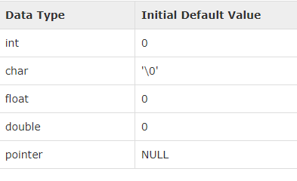
Initializing Local and Global Variables
When a local variable is defined, it is not initialized by the system, you must initialize it yourself. Global variables are initialized automatically by the system
It is a good programming practice to initialize variables properly, otherwise our program may produce unexpected results, because uninitialized variables will take some garbage value already available at their memory location.

Slide 52
Operators in C
Operators: operators as symbols that helps us to perform specific mathematical and logical computations on operands.
1) Arithmetic Operator: Operators used to perform arithmetic/mathematical operations on operands. Examples: (+, -, *, /, %,++,–). Arithmetic operator are of two types:
Unary Operators: Operators that operates or works with a single operand are unary operators. For example: (++ , –)
Binary Operators: Operators that operates or works with two operands are binary operators. For example: (+ , – , * , /)

Slide 53
! (logical negation),
~ (one’s complement or bitwise negation)
– (unary minus),
+ (unary plus),
& (addressof),
* (dereferencing),
++ (pre-increment),
— (pre-decrement),
sizeof operator,
(type) or cast operator
All Unary Operators have associativity from Right to Left.

Slide 54
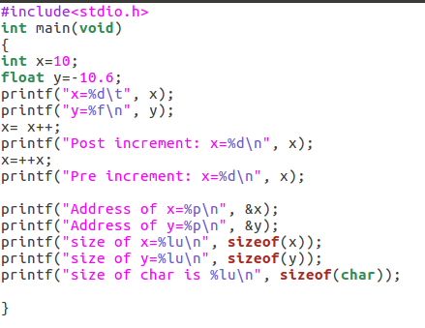

Slide 55
Unary arithmetic operators:
unary minus
The minus operator changes the sign of its argument. A positive number becomes negative, and a negative number becomes positive.
Increment
It is used to increment the value of the variable by 1. The increment can be done in two ways:
prefix increment In this method, the operator preceeds the operand (e.g., ++a). The value of operand will be altered before it is used.
Operator name | Type of operand | Result
+ or - | Arithmetic
~ | Integer
! | scalar

Slide 56
The result of the logical negation operator ! is 0 if the value of its operand compares unequal to 0, 1 if the value of its operand compares equal to 0. The result has type int. The expression !E is equivalent to (0==E).

Slide 57
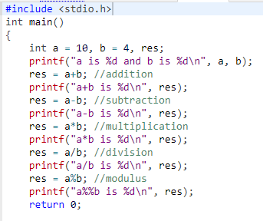
Example-1
Notes:
Output:
a is 10 and b is 4
a+b is 14
a-b is 6
a*b is 40
a/b is 2
a%b is 2

Slide 58
Example-2
Some operators (the unary operator ~, and the binary operators <>, &, ^, and |, collectively described as bitwise operators) are required to have operands that have integer type. These operators yield values that depend on the internal representations of integers, and have implementation-defined and undefined aspects for signed types.

