Slide 2
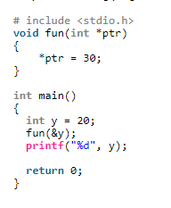
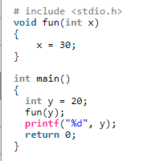
Pointers
Example1: Pointers allow different functions to share and modify their local variables.

Slide 3
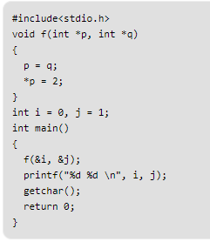
Pointers
Example2: Assignment of pointers of the same type

Slide 4
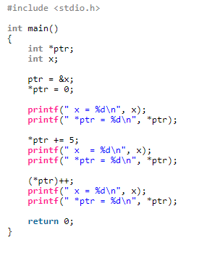
Pointers
Example3
Notes:
x = 0 *ptr = 0 x = 5 *ptr = 5 x = 6 *ptr = 6

Slide 5
Double Pointer (Pointer to Pointer) in C
Double Pointer (Pointer to Pointer) in C
Pointer points to a location in memory and thus used to store address of variables. So, when we define a pointer to pointer. The first pointer is used to store the address of second pointer. That is why they are also known as double pointers.
How to declare a pointer to pointer in C?
Declaring Pointer to Pointer is similar to declaring pointer in C. The difference is we have to place an additional ‘*’ before the name of pointer.
Syntax:
int **ptr; // declaring double pointers

Slide 6
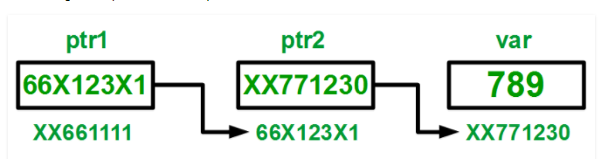
The above diagram shows the memory representation of a pointer to pointer. The first pointer ptr1 stores the address of the second pointer ptr2 and the second pointer ptr2 stores the address of the variable.

Slide 7
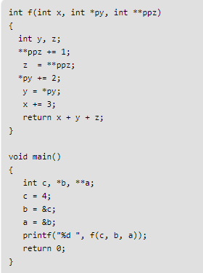
Pointers
Example4:

Slide 8
void pointer in C
A void pointer is a pointer that has no associated data type with it. A void pointer can hold address of any type and can be typcasted to any type.
int a = 10;
char b = 'x';
void *p = &a; // void pointer holds address of int 'a'
p = &b; // void pointer holds address of char 'b'

Slide 9
Advantages of void pointers:
1. malloc() and calloc() return void * type and this allows these functions to be used to allocate memory of any data type (just because of void *)
int main(void)
{
// Note that malloc() returns void * which can be
// typecasted to any type like int *, char *, ..
int *x = malloc(sizeof(int) * n);
}
Note that the above program compiles in C, but doesn’t compile in C++. In C++, we must explicitly typecast return value of malloc to (int *).
2. void pointers in C are used to implement generic functions in C. For example compare function which is used in qsort().

Slide 10
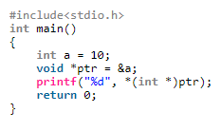
Some Interesting Facts
void pointers cannot be dereferenced. For example the following program doesn’t compile.
#include<stdio.h>
int main()
{
int a = 10;
void *ptr = &a;
printf("%d", *ptr);
return 0;
}
}
Solution
Notes:
10

Slide 11
Pointer Arithmetic in C Programming
Valid Pointer Arithmetic Operations
Assignment of pointer of same type
Adding or subtracting a pointer and an int
Subtracting or Comparing two pointers to members of the same array
Assigning or comparing to zero
Invalid Pointer Arithmetic Operations
Division of two pointers.
Multiplication of two pointers.

Slide 12
Pointer Arithmetic
Incrementing a Pointer
Let ptr be an integer pointer which points to the memory location 5000 and size of an integer variable is 32-bit(4 bytes). Now, when we increment pointer ptr
ptr++;
it will point to memory location 5004 because it will jump to the next integer location which is 4 bytes next to the current location. Incrementing a pointer is not same as incrementing an integer value. On incrementing, a pointer will point to the memory location after skipping N bytes, where N is the size of the data type(in this case it is 4).
ptr++ is equivalent to ptr + (sizeof(pointer_data_type)).
"Incrementing a pointer increases its value by the number of bytes of its data type"

Slide 13
A character(1 bytes) pointer on increment jumps 1 bytes.
An integer(4 bytes) pointer on increment jumps 4 bytes.
This is a very important feature of pointer arithmetic operations which we will use in array traversal using pointers.
The C standard doesn’t allow pointer arithmetic with void pointers.

Slide 14
Decrementing a Pointer
Similarly, Decrementing a pointer will decrease its value by the number of bytes of its data type. Hence, after
ptr--;
ptr will point to 4996.
ptr--; is equivalent to ptr - (sizeof(pointer_data_type)).

Slide 15
Adding a number N to a pointer leads the pointer to a new location after skipping N times size of data type.
ptr + N = ptr + (N * sizeof(pointer_data_ype))
For example, Let ptr be a 4-byte integer pointer, initially pointing to location 5000.
Then ptr + 5 = 5000 + 4*5 = 5020. Pointer ptr will now point at memory address 5020.
Subtracting Numbers from Pointers
Subtracting a number N from a pointers is similar to adding a number except in Subtraction the new location will be before current location by N times size of data type.
ptr - N = ptr - (N * sizeof(pointer_data_ype))
For example, Let ptr be a 6-byte double pointer, initially pointing to location 5000.
Then ptr - 3 = 5000 - 6*3 = 4982. Pointer ptr will now point at memory address 4982.

Slide 16
Subtracting Pointers
The difference between two pointer returns indicates “How apart the two Pointers are. It gives the total number of elements between two pointers. For example, Let size of integer is 4 bytes. If an integer pointer 'ptr1' points at memory location 10000 and integer pointer 'ptr' points at memory location 10008, the result of ptr2 - ptr1 is 2.

Slide 17
Syntax
Returning control from function that does not return value: return;
Returning control from function that returns value: return <value>;
The return value could be any valid expression that returns a value:
a constant
a variable
a calculation, for instance (a + b) * c
call to another function that returns a value

Slide 18
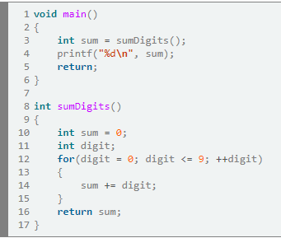
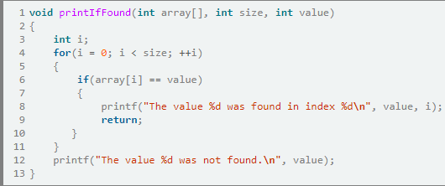
return statement in void function
Notes:
Using the return statement in void functions
Note that in the first example we didn’t need to use the return statement in the main function. If a function is defined as “void” it does not need to return a value. Such functions return control automatically when they reach the end of their body.
Still, we can use “return;” to end their execution from any point of their body.
In second example, we use the return keyword to interrupt the function printIfFound. This accomplishes two things:
Stops the execution of unnecessary for iterations
Prevents the function from printing the "not found" message when we find the value.

Slide 19
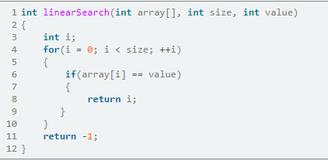
Returning a value
If a function is defined to return a value it must use the return statement.
It must also make sure that each possible outcome returns a value. This could get tricky if your routine has nested constructions and you are not careful.
Notes:
If you forget the return -1; you’ve got a problem. In C many compilers will allow such “broken” code to compile, but it will not work properly. Such bugs could be hellish to find and fix. For this reason you need to plan very carefully your branches.

Slide 20
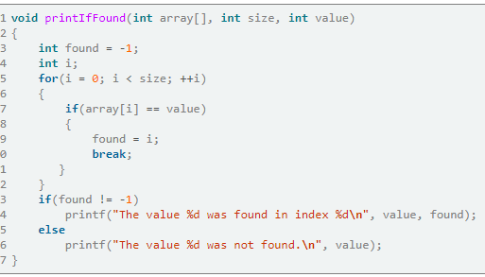
Good practices
Most of the time a routine should use only one return statement at the end of the function’s body.
To accomplish this end your loops with a break statement and
Keep the result in a local variable
An exception would be if you need to exit from nested loops and the use of multiple breaks and conditions makes code harder to read.

Slide 21
Returned values of printf() and scanf()
In C, printf() returns the number of characters successfully written on the output and scanf() returns number of items successfully read.
For example, below program prints geeksforgeeks 13
int main()
{
printf(" %d", printf("%d", "geeksforgeeks"));
getchar();
}

Slide 22
Irrespective of the string user enters, below program prints 1.
int main() { char a[50]; printf(" %d", scanf("%s", a)); getchar(); }

Slide 23
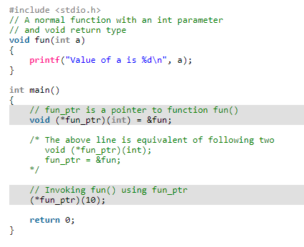
Function pointer in C
In C, like normal data pointers (int *, char *, etc), we can have pointers to functions. Following is a simple example that shows declaration and function call using function pointer.
Notes:
Why do we need an extra bracket around function pointers like fun_ptr in above example? If we remove bracket, then the expression “void (*fun_ptr)(int)” becomes “void *fun_ptr(int)” which is declaration of a function that returns void pointer.

Slide 24
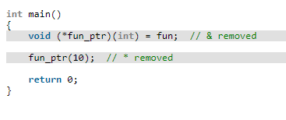
1) Unlike normal pointers, a function pointer points to code, not data. Typically a function pointer stores the start of executable code. 2) Unlike normal pointers, we do not allocate de-allocate memory using function pointers. 3) A function’s name can also be used to get functions’ address. For example, in the below program, we have removed address operator ‘&’ in assignment. We have also changed function call by removing *, the program still works.

Slide 25
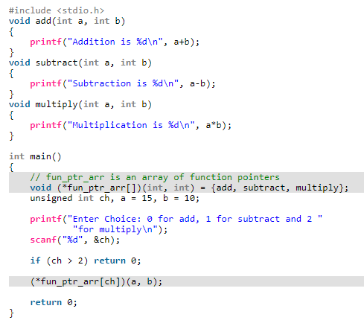
Notes:
4) Like normal pointers, we can have an array of function pointers. Below example in point 5 shows syntax for array of pointers. 5) Function pointer can be used in place of switch case. For example, in below program, user is asked for a choice between 0 and 2 to do different tasks.

