Slide 1
Lakehouse is not only for Big Data
Notebook Examples :https://github.com/djouallah/Fabric_Notebooks_Demo

Slide 2
Mimoune Djouallah (mim)
Member of Microsoft Fabric CAT team since Dec 2023
PowerBI user . ( Ex Construction Planner, Oil & Gas and renewable)
https://datamonkeysite.com/ (blogs about PowerBI, Fabric, BigQuery, Primavera )
Twitter @mim_djo
LinkedIn : https://www.linkedin.com/in/mimounedjouallah/

Slide 3






An Example of a Lakehouse architecture
Single SaaS lake for the whole organization
Single open format used by all workloads to store and query data
Automatically indexed for discovery, MIP labels, lineage, PII scans, sharing, governance and compliance
Data
Factory
Analytics
Databases
Real-Time Intelligence
Power BI
OneLake

Slide 4
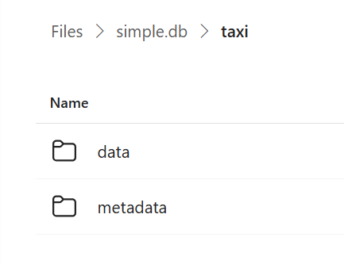
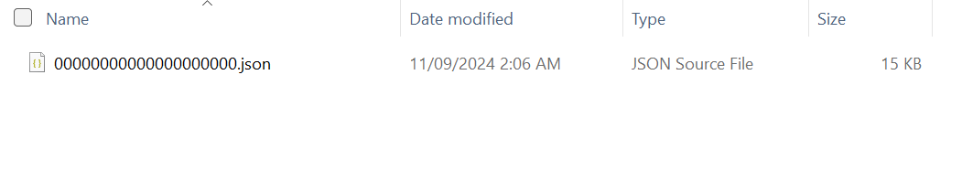
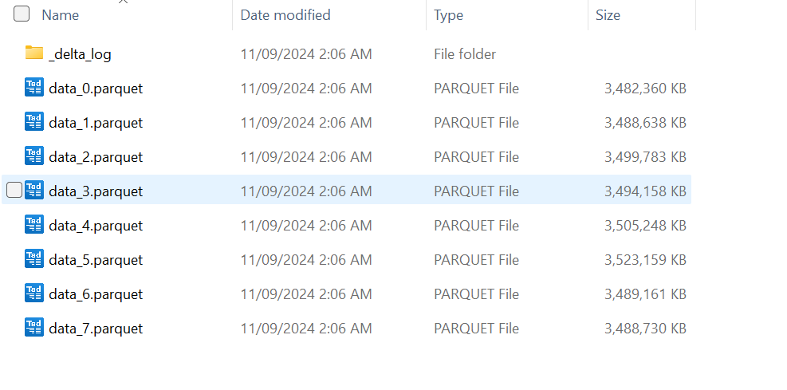
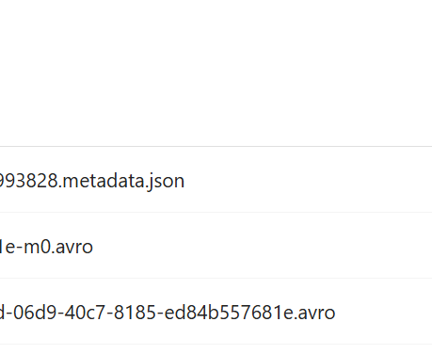
Open Table Format (Iceberg vs Delta)

Slide 5
Let’s talk about Cloud DWH

Slide 6
Python runs everywhere
Spark Notebook : distributed system , can run in single node though
Python Notebook : Fabric Notebook, Google Colab
Cloud functions : AWS lambda, Google Cloud function, Fabric user data function, Azure function
Your Laptop, Your BI tools ☺

Slide 7
Why this Talk ?
For distributed system, Spark is pretty much the standard
For Python : I did not have any clarity who is good at what ?
Solution : just run tests, ignore any talking points.

Slide 8
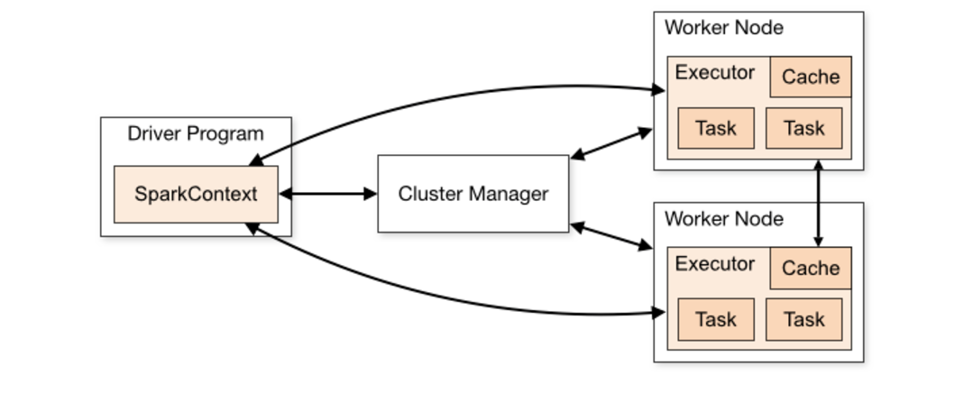
Spark architecture

Slide 9
Spark Native Executions?
Spark
Native Execution Engine
Executed in the JVM
Executed natively
Row based
Column based
https://github.com/apache/incubator-gluten/blob/main/docs/velox-backend-support-progress.md

Slide 10
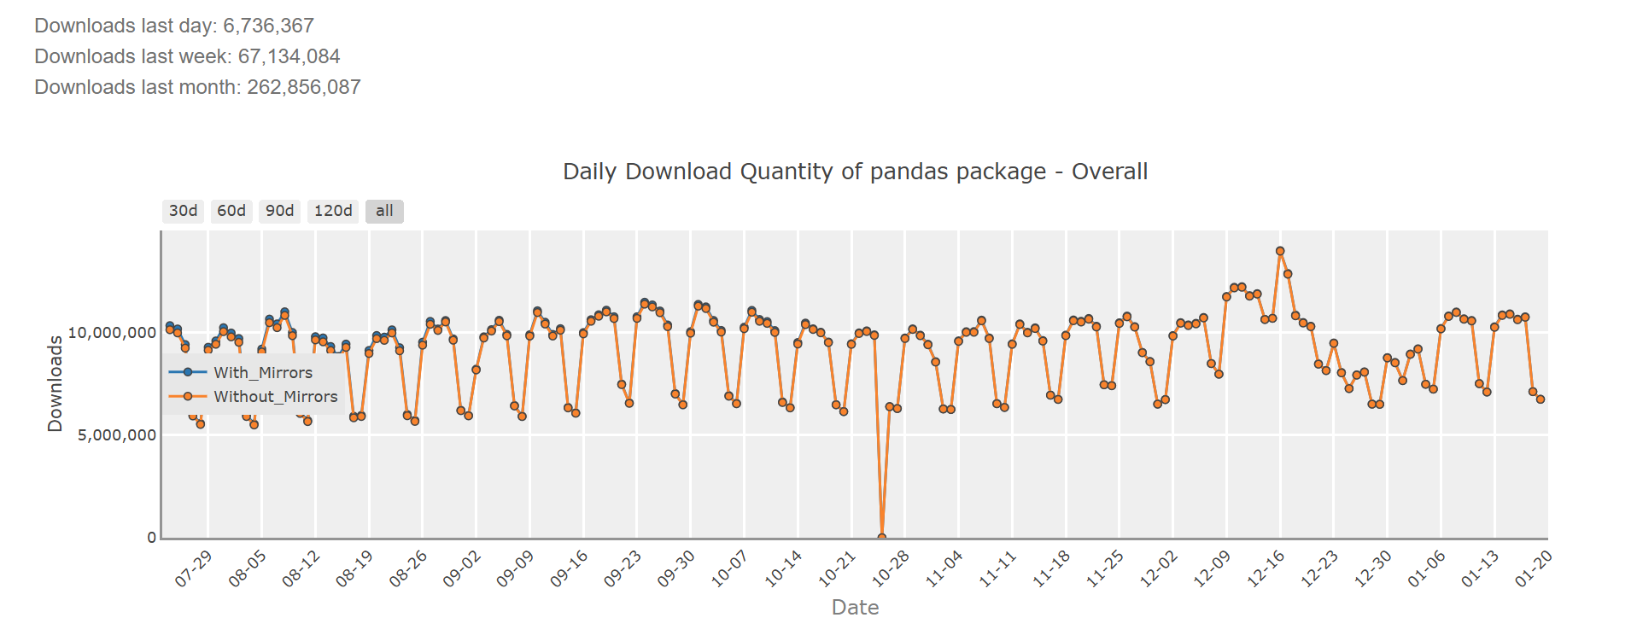
You can’t ignore Pandas

Slide 11
Established Players
Pandas
Apache Spark(*)
Foundational (**)
Apache Pyarrow
Apache Datafusion
Rising Stars
DuckDB(*)
Polars
Players to watch
Daft(*)
Chdb
* Streaming Execution Engines; The Pipeline csv –transformation-delta table does not need to fit in memory
** not really user facing but a building block for other tools (Delta_rs, Iceberg_rust etc)

Slide 12
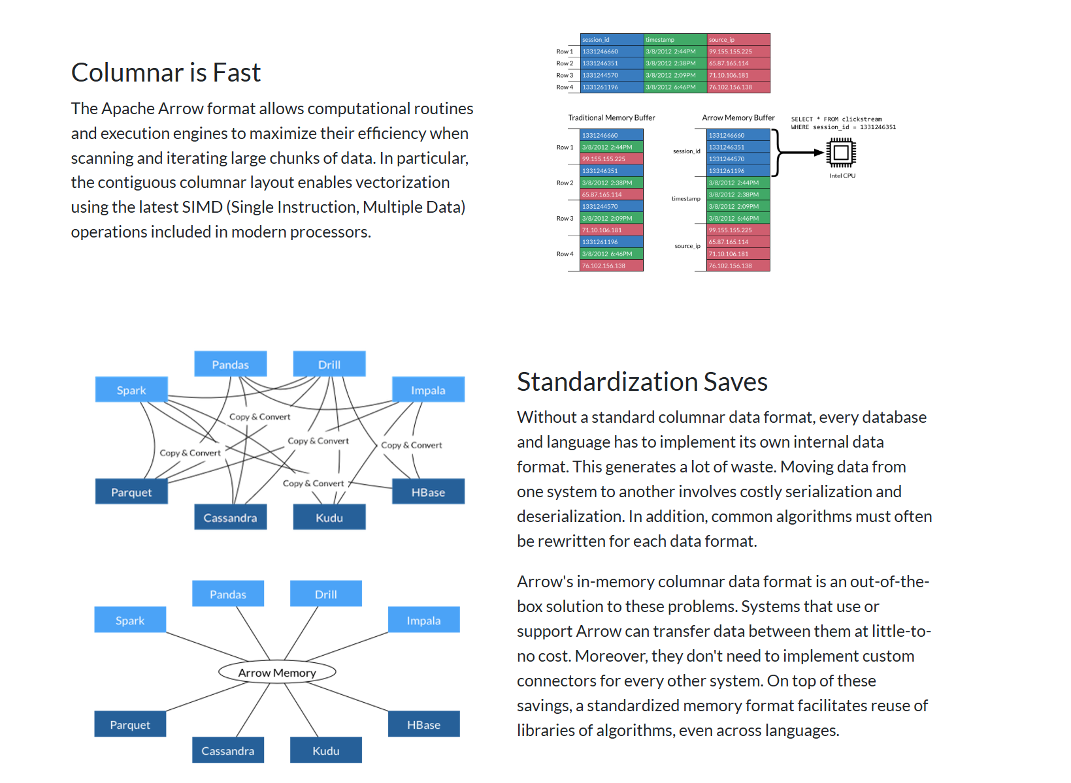

Slide 13
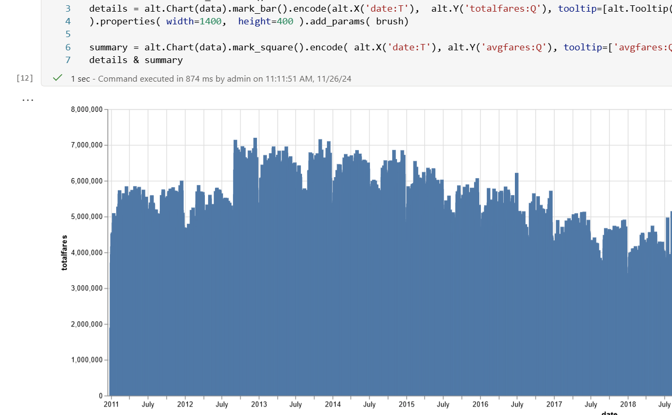
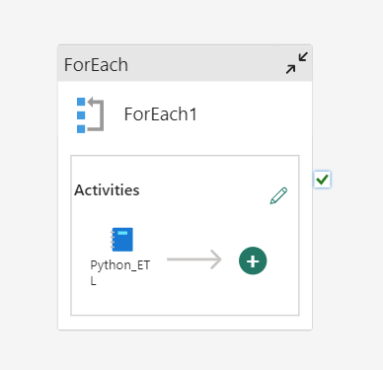
Data Preparation
Ad hoc exploration

Slide 14
Interactive Analytics
Just use PowerBI ☺ , sorry I meant your favourite BI tool

Slide 15
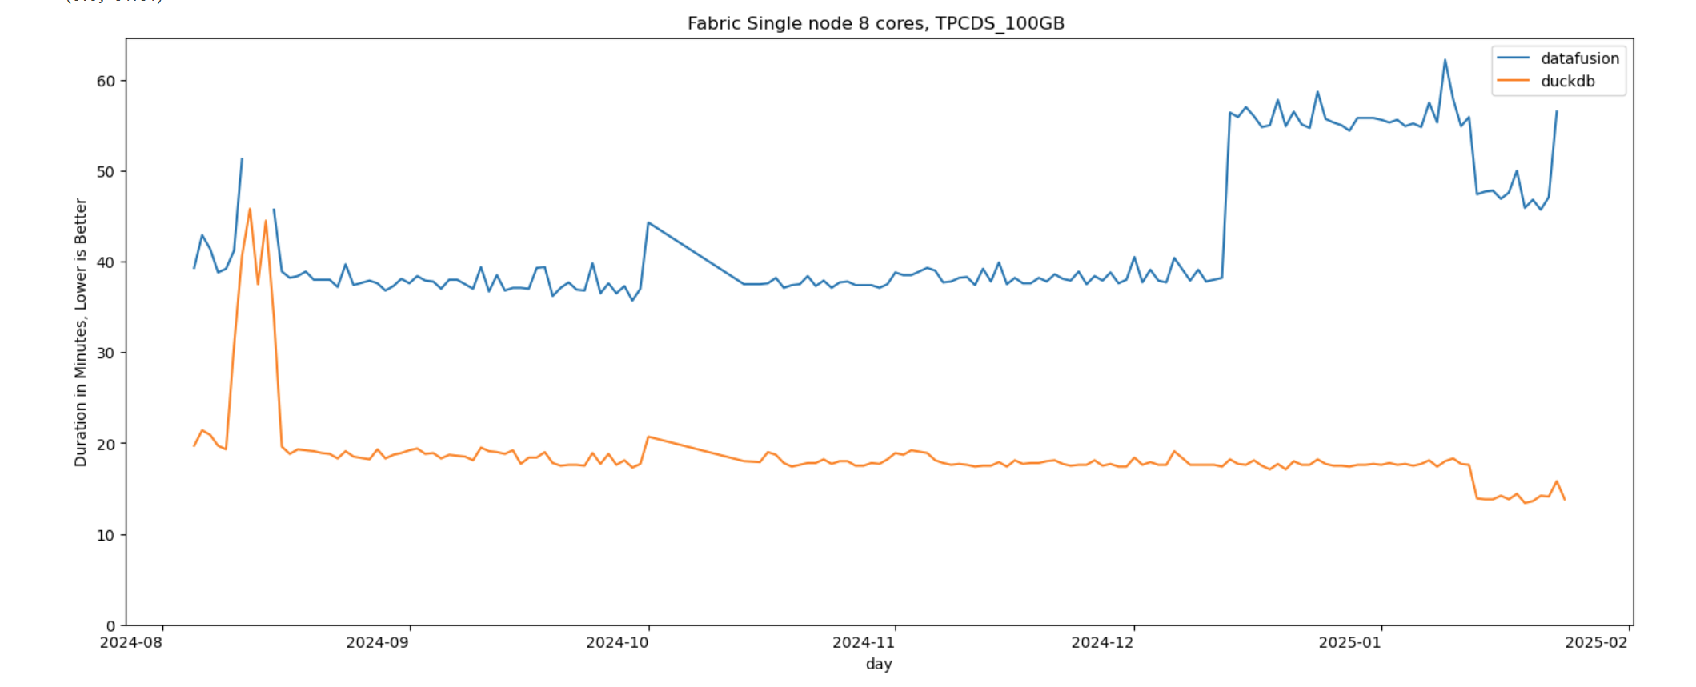

Slide 16
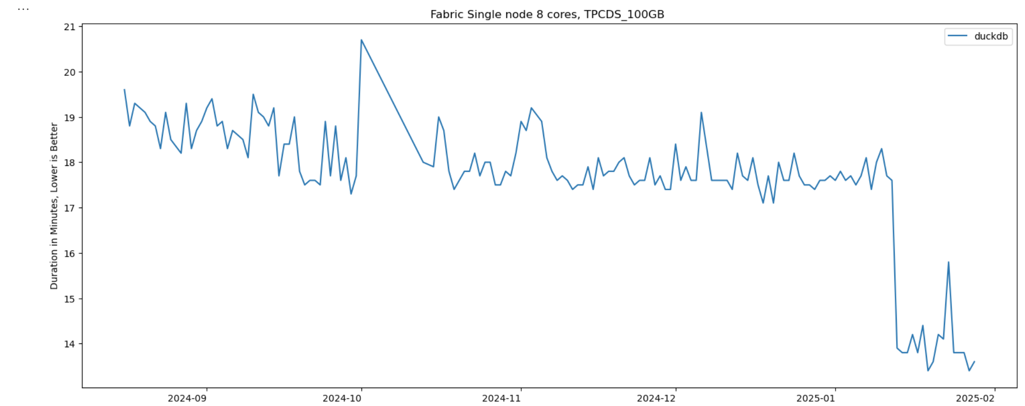

Slide 17
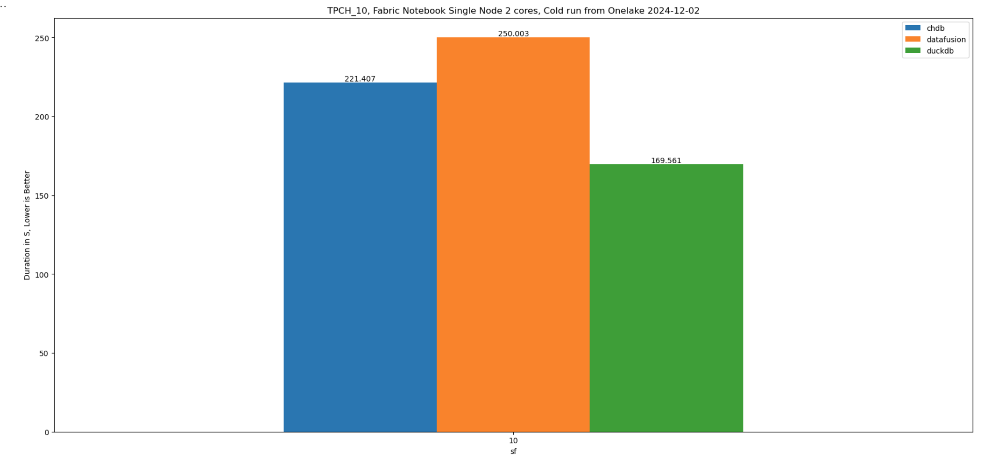

Slide 18
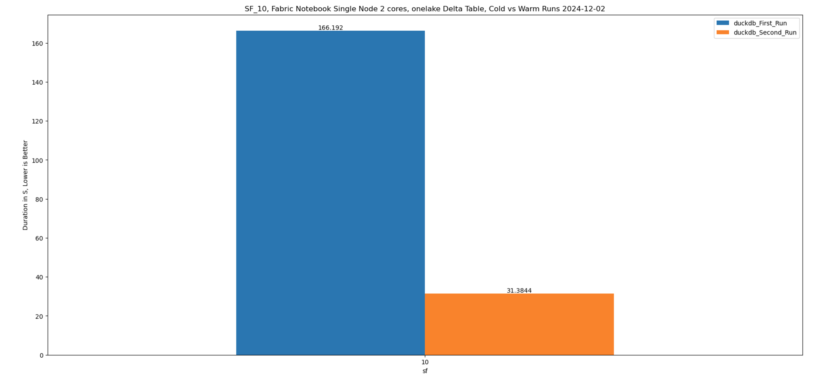
Exceptional results when using disk cache

Slide 19
Data Preparation

Slide 20
Real life use case, Australian Electricity market
7 years' worth of data, 2300 files, 100 GB CSV uncompressed, untidy data
Only the last 2 months are archived
https://github.com/djouallah/Fabric_Notebooks_Demo/blob/main/ETL/Light_ETL_Python_Notebook.ipynb

Slide 21
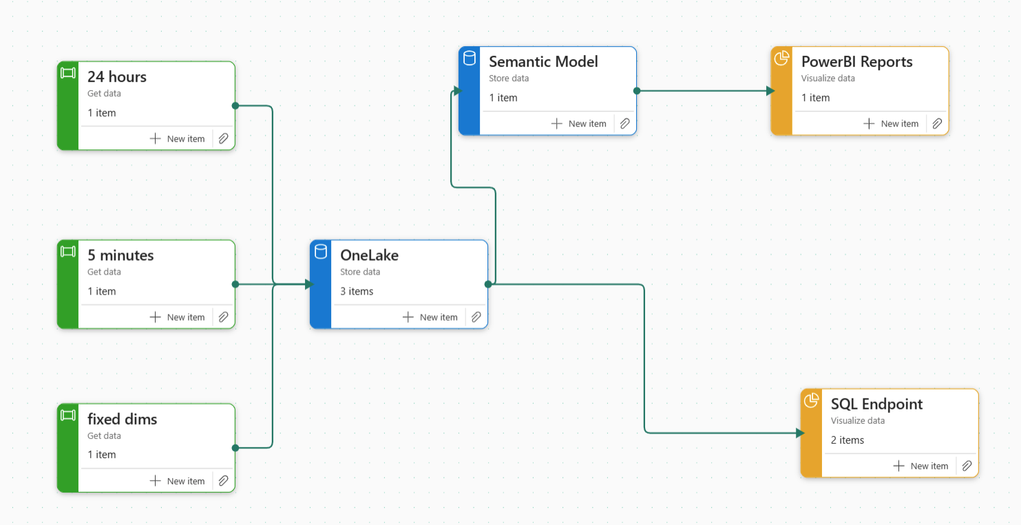
Data preparation is basically transforming raw data(Json, csv) into a good quality Parquet files

Slide 22
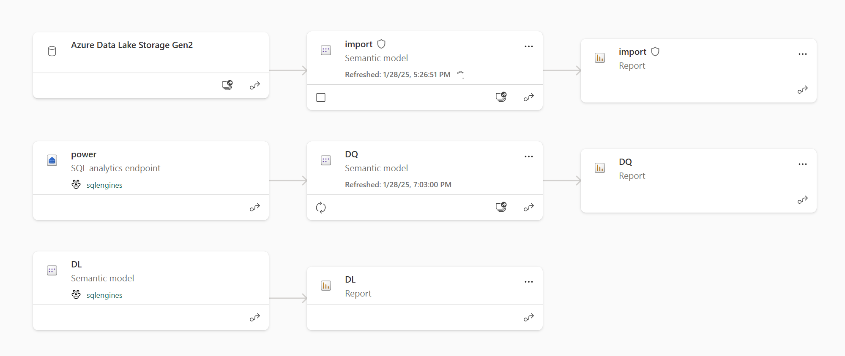

Slide 23
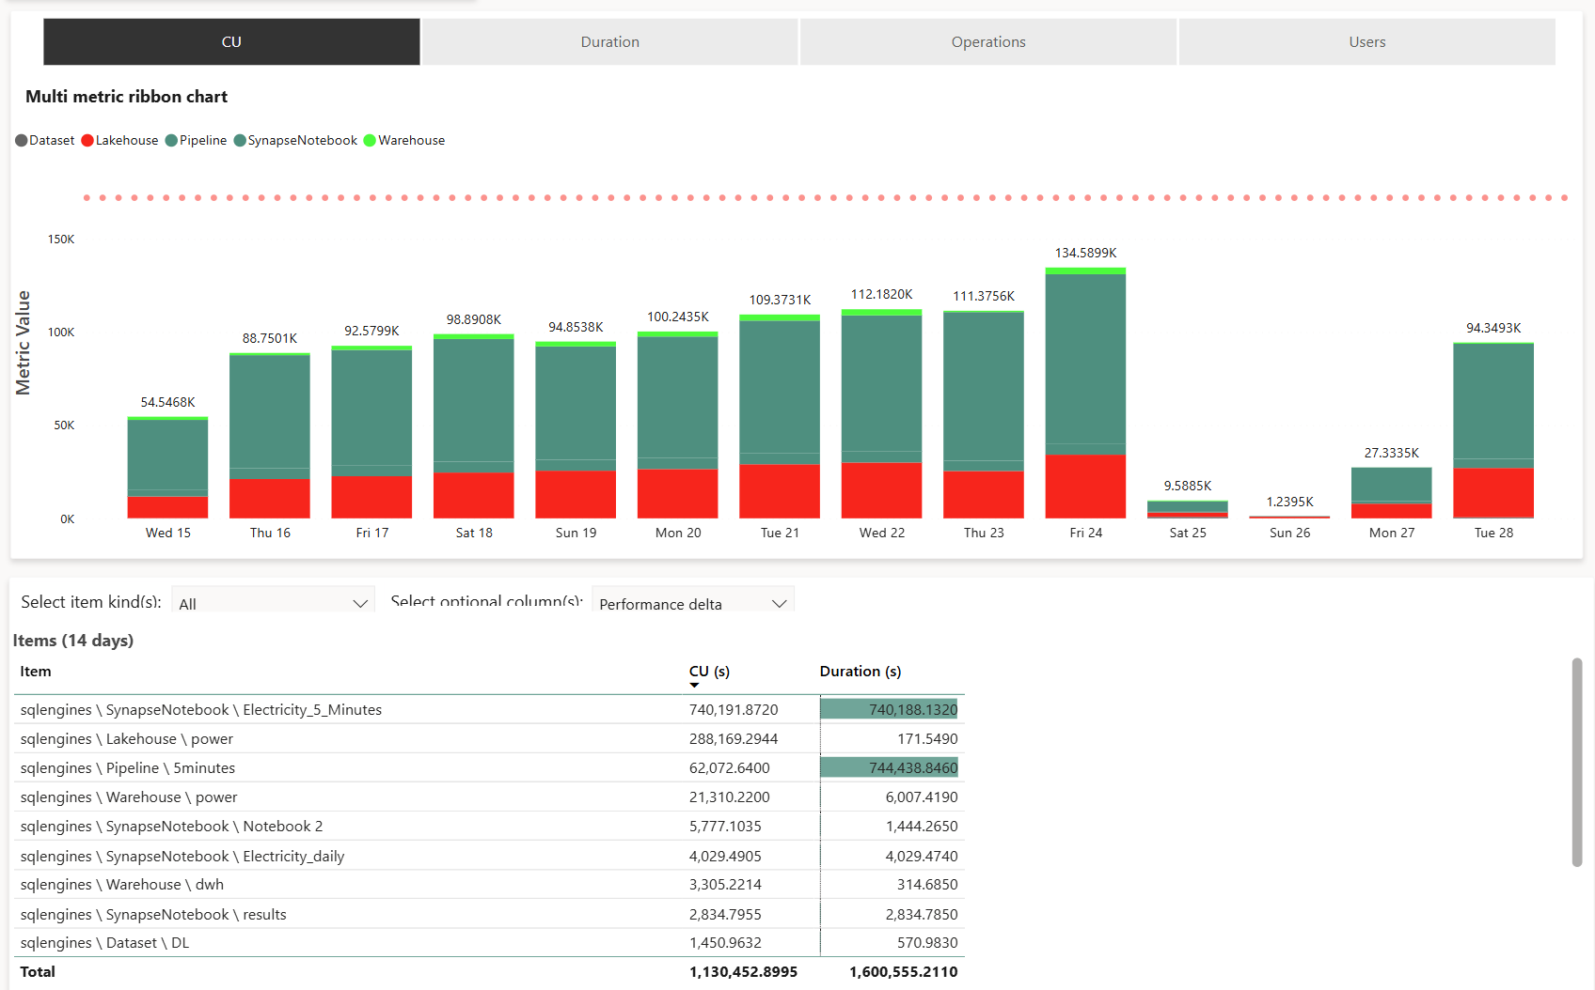

Slide 24
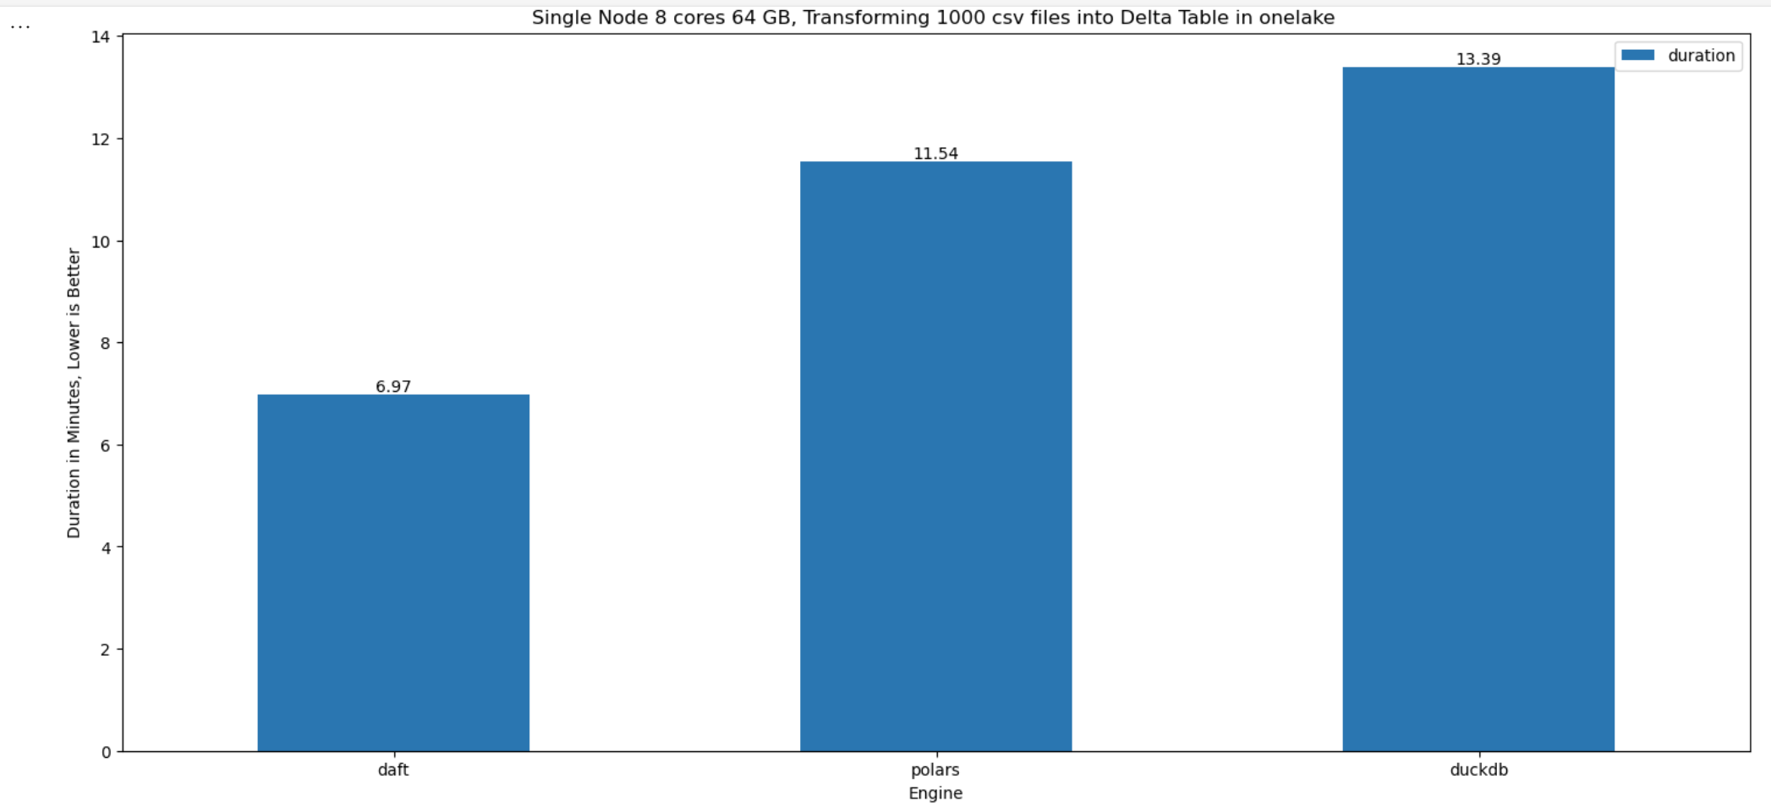

Slide 25
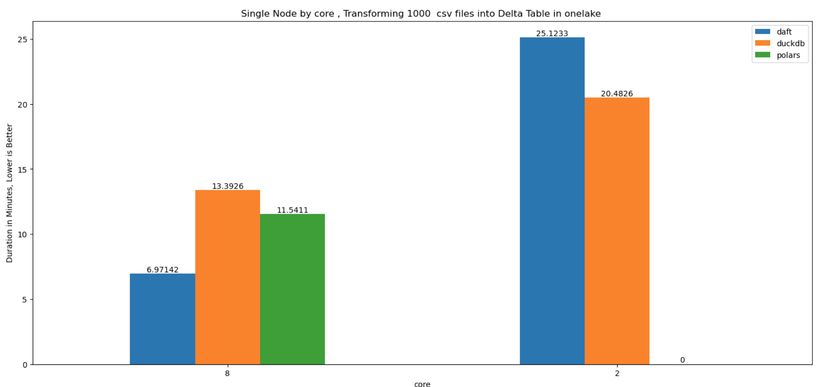

Slide 26
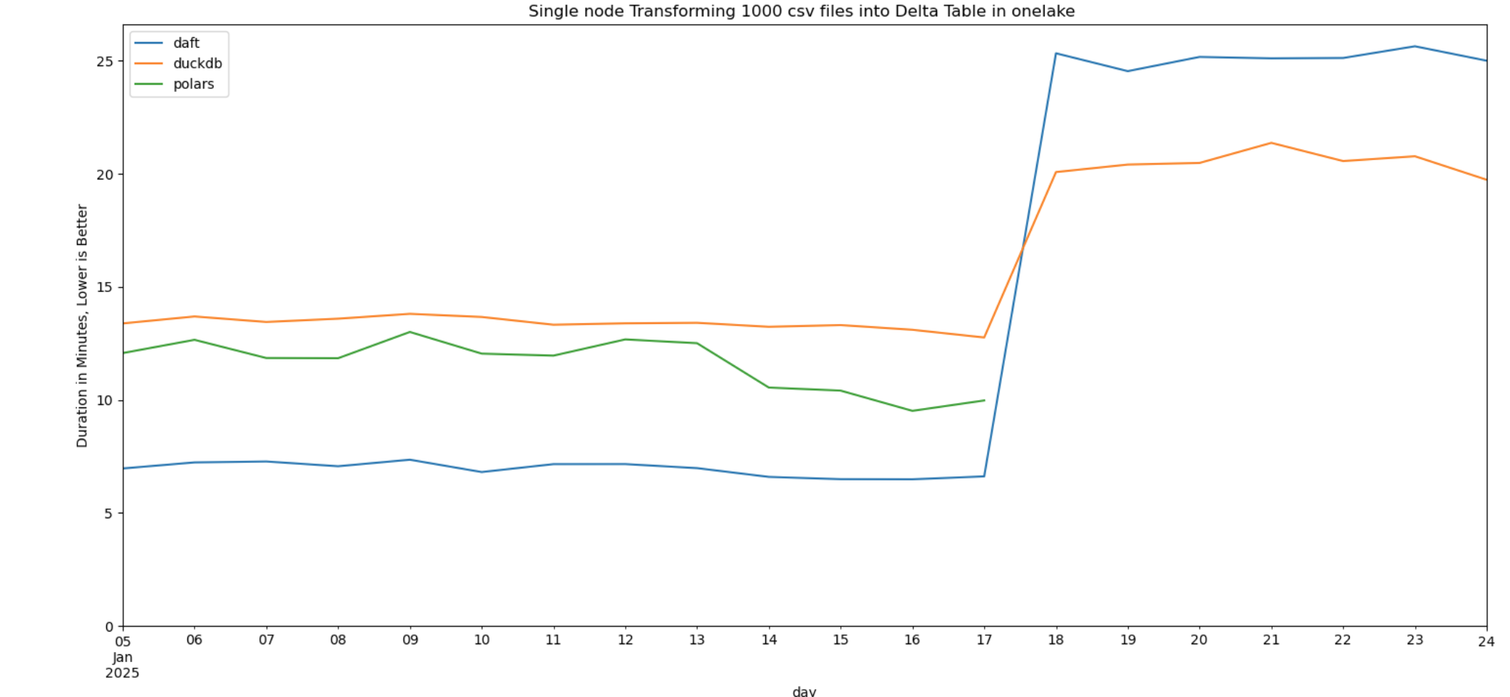

Slide 27
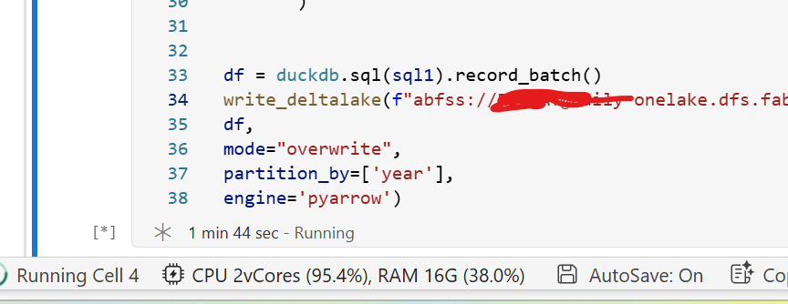
The Magic of streaming engines

Slide 28
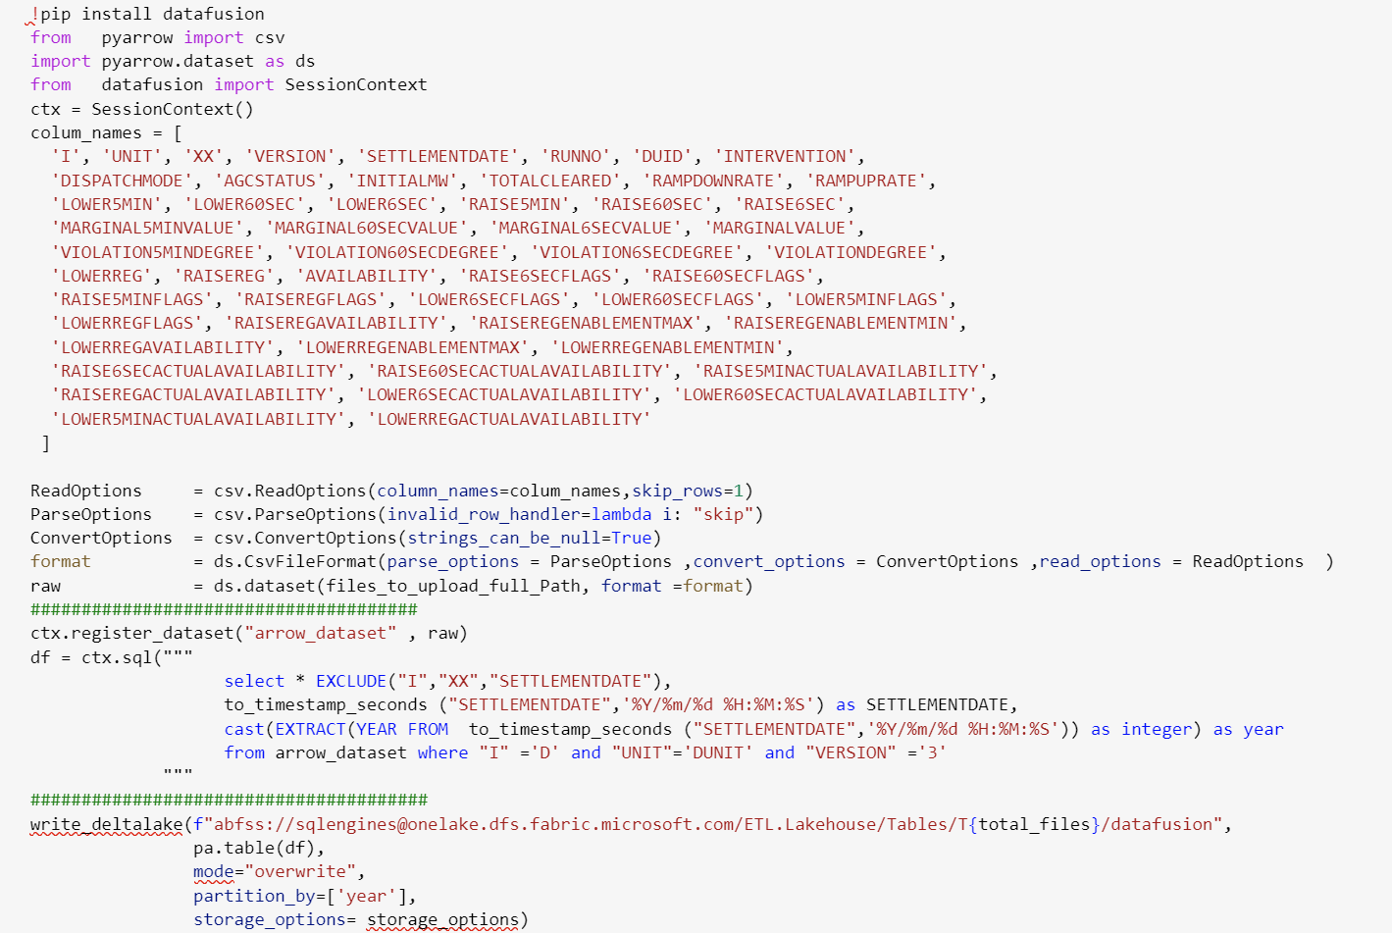
The Future is not composable data stack

Slide 29
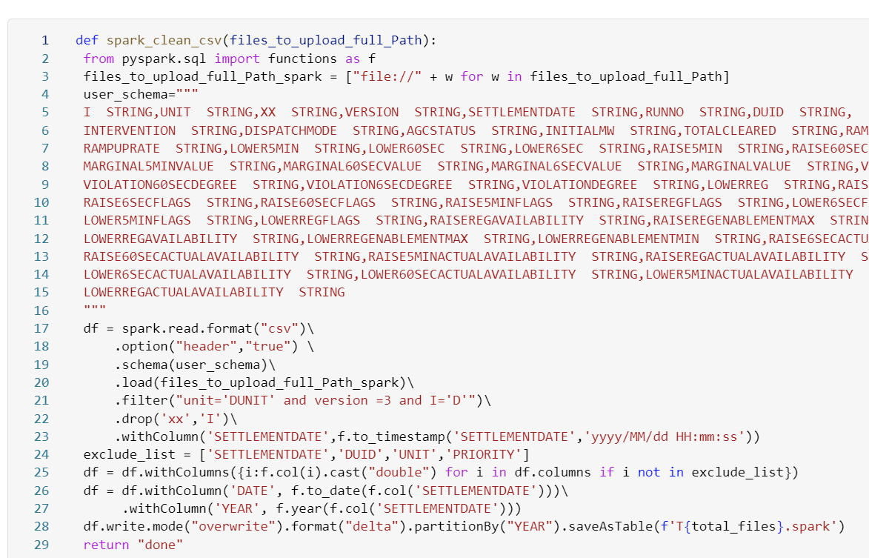
Integrated stack is the way to go

Slide 30
The Role of AI in Data Processing
AI-Generated Code: Most of the code in this presentation was written with AI assistance.
Quality Improvement: AI has significantly improved code quality, though it’s not yet perfect.
Cost Efficiency: LLM (Large Language Model) inference is becoming more affordable.
Bias : unfortunately, LLM tend to Favor more popular Libraries ☹

Slide 31
Open Table formats like Delta and Iceberg, more efficient Engines, more mature AI will change how we do data preparation.
Focus on Business Logic, The machine will do the rest

