Slide 1
Python Data Engines: State of the Union 2026
Every Python data engine looks impressive when you throw a 64-core machine at it. That is not this talk.

Slide 2

About me
Mimoune Djouallah
Microsoft · Fabric CAT team
Brisbane, Australia
Ex construction planner
linkedin.com/in/mimounedjouallah
A personal project. My own opinions.
Notes:
Mimoune Djouallah. I work for Microsoft, in the Fabric CAT team, from Brisbane. Before data, I was a construction planner. This is a personal project, and everything here is my own opinion. The QR code is my LinkedIn.

Slide 3
Agenda
01 What changed since 2025
02 Iceberg
03 The engines
04 What does “fast” mean?
05 Real-life use case
06 What I learned

Slide 4
One job out of many
Read and serve
Explore
Complex calculations
Dashboards and BI queries on tables that already exist.
Ad-hoc questions in a notebook.
Science, simulations, ML features.
Streaming
Embedded
Data engineering
Events in, results out, all the time.
An engine inside an app or a browser.
Read raw files, transform, MERGE, write tables. Every day, unattended.
This talk: data engineering only.
Notes:
A Python engine does a lot of jobs: serving dashboards, exploring in a notebook, complex calculations for science or ML, streaming, running inside an app. All valid, and not this talk. This talk is about one job: data engineering. Read raw files, transform them, MERGE into tables that keep growing, write Iceberg, every day, with nobody watching. So when I say an engine works, I mean it works for that.

Slide 5
What changed since 2025
SQL
Polars SQL went from a side feature to all 99 TPC-DS-like queries.
Given enough time, every DataFrame library becomes a database.
Iceberg
Iceberg is the new baseline.
Last year most of these engines couldn’t write a table; now they all write Iceberg.
AI
It’s very good at reproducing bugs.
Python engines aren’t niche anymore. They’re mainstream, and a bit boring.
Notes:
I gave this talk last year: Life Beyond Pandas, 2 cores, Delta. This is what changed. SQL. Polars: The surprise of the year. I knew Polars as a DataFrame library, with SQL on the side. Now it runs all 99 TPC-DS-like queries in SQL at scale factor 100 in 1,167s, the fastest of every engine here; next is StarRocks at 1,969s, on the same 4-core box. On 2.0.0-rc.2 its streaming engine killed the runner at TPC-H-like SF30. What changed is optimizer work on 2.0 and main between August and October 2026: join reordering that uses scan statistics (#28985, #29038), dynamic predicates for hash joins (#29312), bloom filters pushed into the probe side (#29423). Before that, joins ran in the order the SQL wrote them, and TPC-DS star joins suffered most. It also fixed most of the SQL gaps I reported. This is a main build, not a release. Given enough time, every DataFrame library becomes a database. Iceberg. Very important. The expectation has changed: supporting Iceberg is now a no-brainer, and a missing feature is treated as a bug. Polars accepts SQL parity gaps as bugs. That's interesting. The biggest change since the 2025 talk (Life Beyond Pandas, 2 cores, Delta). Last year every engine wrote through delta-rs: the scorecard's native table SQL syntax row was red for DuckDB, Polars, Daft, chDB and DataFusion, and in the streaming CSV write LakeSail and DataFusion failed while Polars loaded everything in memory. This year every engine writes Iceberg itself, and with SQL. Python engines that run SQL and write Iceberg are the new normal. AI. It's very good at reproducing bugs: it drafts the repro, I check it, one bug per issue. Python engines aren't niche anymore. They're mainstream, and a bit boring.

Slide 6
The DataFrame API used to be a pain point. For a couple of months now, I don’t care.
Notes:
The DataFrame API used to be my biggest pain point: a different syntax for every engine, and no standard. For a couple of months now, I don't care.

Slide 7
Iceberg
02
All engines are equal, as long as they speak the same spec.
Notes:
Not long ago your data lived inside an engine. Changing engine meant migrating.

Slide 8
How we got here
1990s
2010s
The warehouse
The cloud warehouse
Storage and compute in one product. The engine owns the data.
Elastic compute, but the tables live inside one vendor.
Warehouse · still here
The closed lakehouse
An open table format, but no direct access to the storage.
Closed lakehouse · still here
2006
2017
Now
Big data: Hadoop
Open table formats
The open lakehouse
Open files, but you need the cluster to read them.
Tables in object storage, but writing one needs a Java cluster.
A REST catalog: any engine reads and writes, even a Python library.
Open lakehouse · still here
Nothing replaced anything: three lines, all alive. This talk is about the bottom one.
Notes:
Three lines, side by side, and none of them replaced another. The warehouse: 1990s, storage and compute in one product, the engine owns the data; 2010s, the cloud warehouse, elastic compute, but the tables live inside one vendor. It's still here. The lake: 2006, Hadoop, open files, but you need the cluster to read them, because in 2006 the network was the bottleneck; 2017, open table formats, Iceberg started at Netflix, tables in object storage, but writing one still needed a Java cluster. Then it splits. The closed lakehouse: an open table format, but no direct access to the storage; you go through the vendor. The open lakehouse: a REST catalog, and any engine reads and writes the same tables, even a library in a Python process. All three are still here. This talk is about the bottom one.

Slide 9
Break of gauge
North · 4 ft 8½ in
South · 5 ft
South · 4 ft 9 in
break of gauge
Before 1886, freight crossing North to South was unloaded and reloaded, or each car was lifted onto new wheels.
31 May – 1 June 1886: the South moved one rail on more than 11,000 miles of track, in 36 hours.
The trains were fine. The track wasn’t shared.
Notes:
An analogy. Before 1886, American railroads ran on two track widths: the North on 4 feet 8 and a half inches, the standard, most of the South on 5 feet. A train could not cross. At every meeting point, freight was unloaded and reloaded by hand, or each car was jacked up and put on new wheels. The trains were fine; the track wasn't shared. Then, on 31 May and 1 June 1886, the South changed gauge: crews moved one rail about three inches, to 4 feet 9 inches, close enough to the standard, on more than 11,000 miles of track, in about 36 hours. From then on, any train ran on any track. Iceberg is the gauge. Before, your data lived inside an engine, and changing engine meant migrating: unloading and reloading. With Iceberg and a REST catalog, any engine runs on any table.

Slide 10
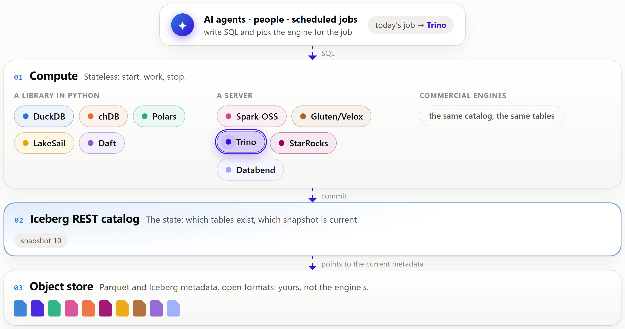
The open lakehouse
Notes:
From the dashboard's Overview. Files in an object store, the state in a catalog, compute in any engine, and none of them owns the data. The job moves from engine to engine; every one commits to the same catalog. Small projects now get treated the same as big commercial and veteran open-source ones.

Slide 11
The catalog is the referee
Bucket
Stateless runtimes
Stateless runtimes
Catalog · table
CSV files
new files
snapshot x+1
read
commit ✓
snapshot x+2
write
Job A
write
Job A
starting
batch 1 of 3
batch 2 of 3
batch 3 of 3
commit
done
done
new files
snapshot x+1
✕ refused
Job B
commit ✓
Job B
starting
batch 1 of 3
batch 2 of 3
batch 3 of 3
commit refused
commit again
done
keeps the files
keeps nothing
keeps nothing
keeps the table
Two jobs start at the same time, each in a new stateless runtime. Both start from snapshot x.
Job A writes its first file. Readers do not see it.
Job B writes too. The two jobs do not block each other.
Both keep writing files. Nothing is visible yet.
Job A is done first and commits: snapshot x+1.
Job B is done and commits on top of snapshot x. The table is now at x+1, so the catalog refuses the commit.
Job A only added files, so nothing clashes. Job B commits again on top of x+1: snapshot x+2. Its files are not written again.
Both jobs stop. Snapshot x+2 has the files of both jobs. If both jobs had changed the same files, the retry would fail.
Notes:
From the Concurrency tab. Two jobs write at the same time, each in a stateless runtime, both from snapshot x. Job A commits first. Job B commits on top of x; the table is at x+1, so the catalog refuses it. Job A only added files, so nothing clashes: job B commits again on top of x+1, and its files are not written again. We'll see in the Iceberg grid that concurrent appends work on almost every engine.

Slide 12
The engines
03
16 engines tried, one catalog, one small box.
Notes:
Every engine I tried counts, including the ones that didn't make it. 11 are in the bench: nine run the SQL suites, and Daft and pandas run the ETL. 5 were tried and not added: Apache Doris, Firebolt Core, DataFusion Comet, DataFusion, pg_lake. Each one is on the Engines tab with the reason.

Slide 13
Disclosure: what this runs on
Compute
Catalog
Free GitHub runners
OneLake Catalog
4 cores · 16 GB
Free through my job :)
~105 GB free disk
Notes:
Free GitHub runners, 4 cores / 16 GB, and about 105 GB of free disk once the preinstalled toolchains are deleted: that's where every engine spills. OneLake Catalog, because I get it free through my job.

Slide 14
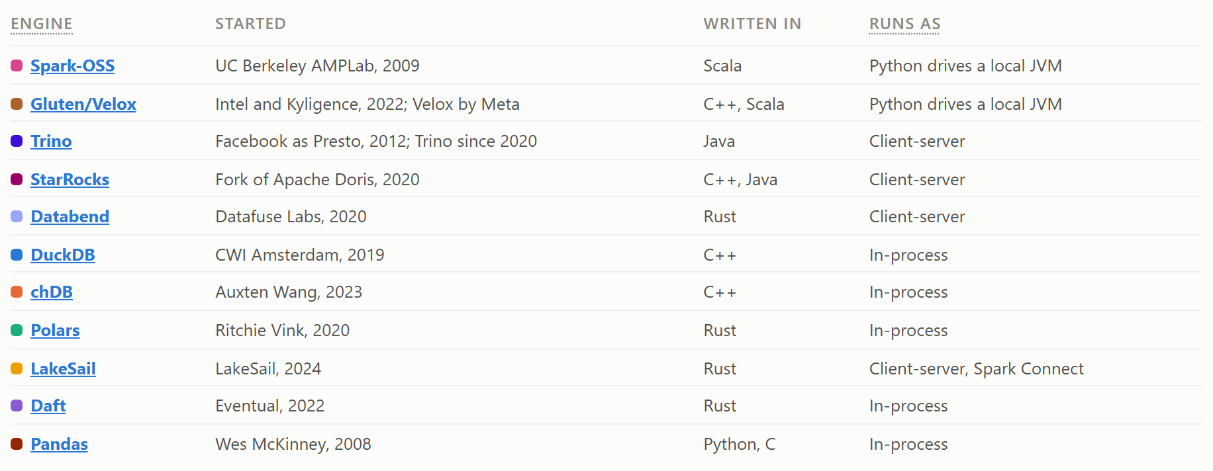
Who they are
Notes:
From the dashboard's Engines tab: who started each engine, what it's written in and how it runs (the tab also has who governs it, the licence and how you install it). The subject is the Python engines: DuckDB, Polars, chDB, LakeSail. The cluster engines are there as a reference: Spark, Spark with Gluten/Velox, Trino, StarRocks, Databend. All of them talk to the same catalog; none of them needed anything special.

Slide 15
Why DataFusion isn’t here
It’s everywhere: LakeSail and DataFusion Comet are built on it.
The Python package has no Iceberg: no catalog, no scan, no write.
Iceberg support is a separate repo, apache/datafusion-iceberg: Rust only, no release yet.
datafusion-python#1097
Notes:
DataFusion is everywhere: LakeSail and DataFusion Comet are built on it. But as an engine you use directly from Python, not really. The Python package has no Iceberg support: no catalog, no scan, no write (datafusion-python#1097). The Iceberg table provider is a separate repo, apache/datafusion-iceberg: it reads and writes, but it is Rust only and has no release yet. So it is not in the bench.

Slide 16
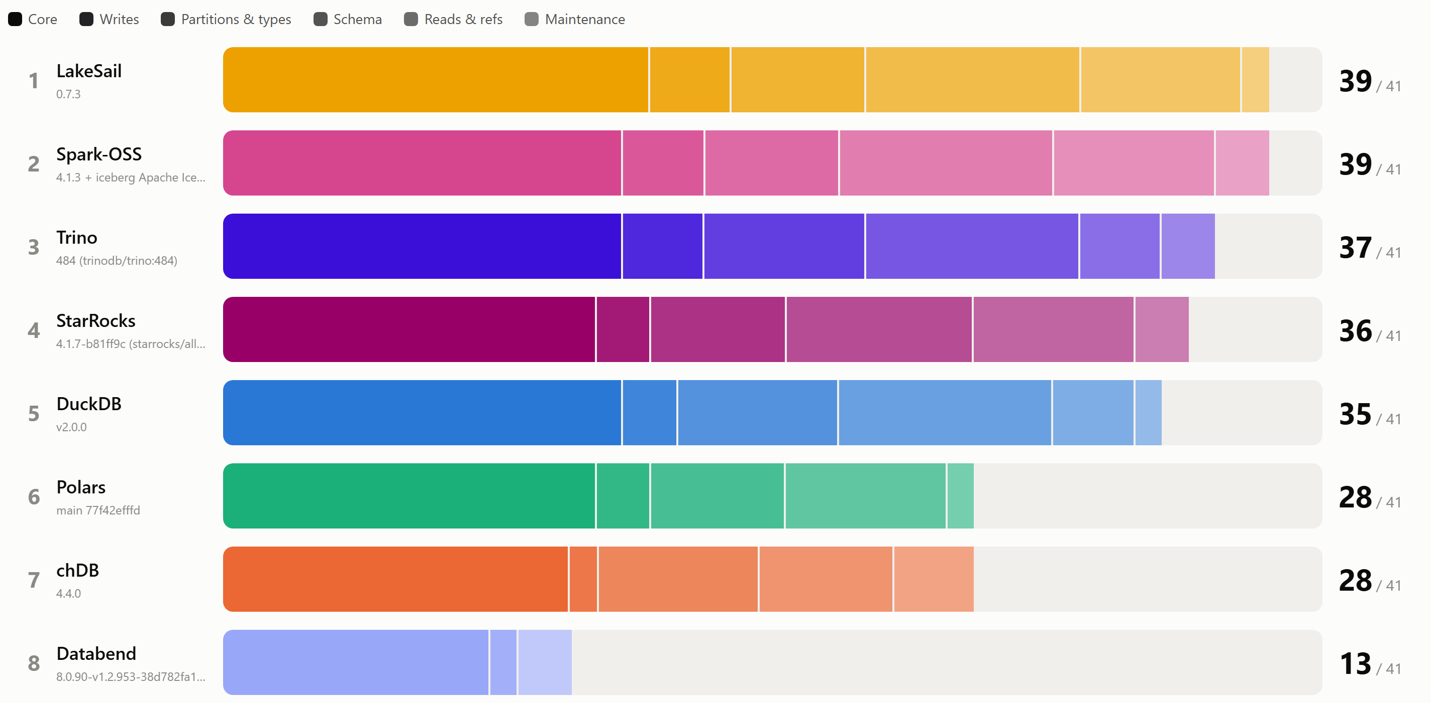
Iceberg support, ranked
Polars: 6 on 25 Oct (2.1.0), 28 now (main). StarRocks joined at 36.
Notes:
From the Iceberg support Overview: every operation on the grid, run against the same catalog, one bar per engine, a segment per group. Spark-OSS 39, LakeSail 39, Trino 37, StarRocks 36, DuckDB 35, chDB 28, Polars 28, Databend 13, out of 41. This moved a lot in the last two weeks. Polars 2.1.0 did 6 on 25 Oct; the Polars main build does 28: CREATE TABLE AS SELECT, INSERT, DELETE, TRUNCATE, INSERT OVERWRITE, partitioned tables and transforms, schema changes, concurrent writers. Still missing on Polars: UPDATE, Concurrent writer: UPDATE loses nothing, MERGE with two actions (UPDATE + INSERT), Nested types: struct, list, map, Partition evolution, Sort order evolution, MAX from the metadata, no data file read, Time travel, Metadata tables, Create branch, Create tag, Compaction, Rewrite manifests. StarRocks joined the grid at 36. A missing feature is now treated as a bug.

Slide 17
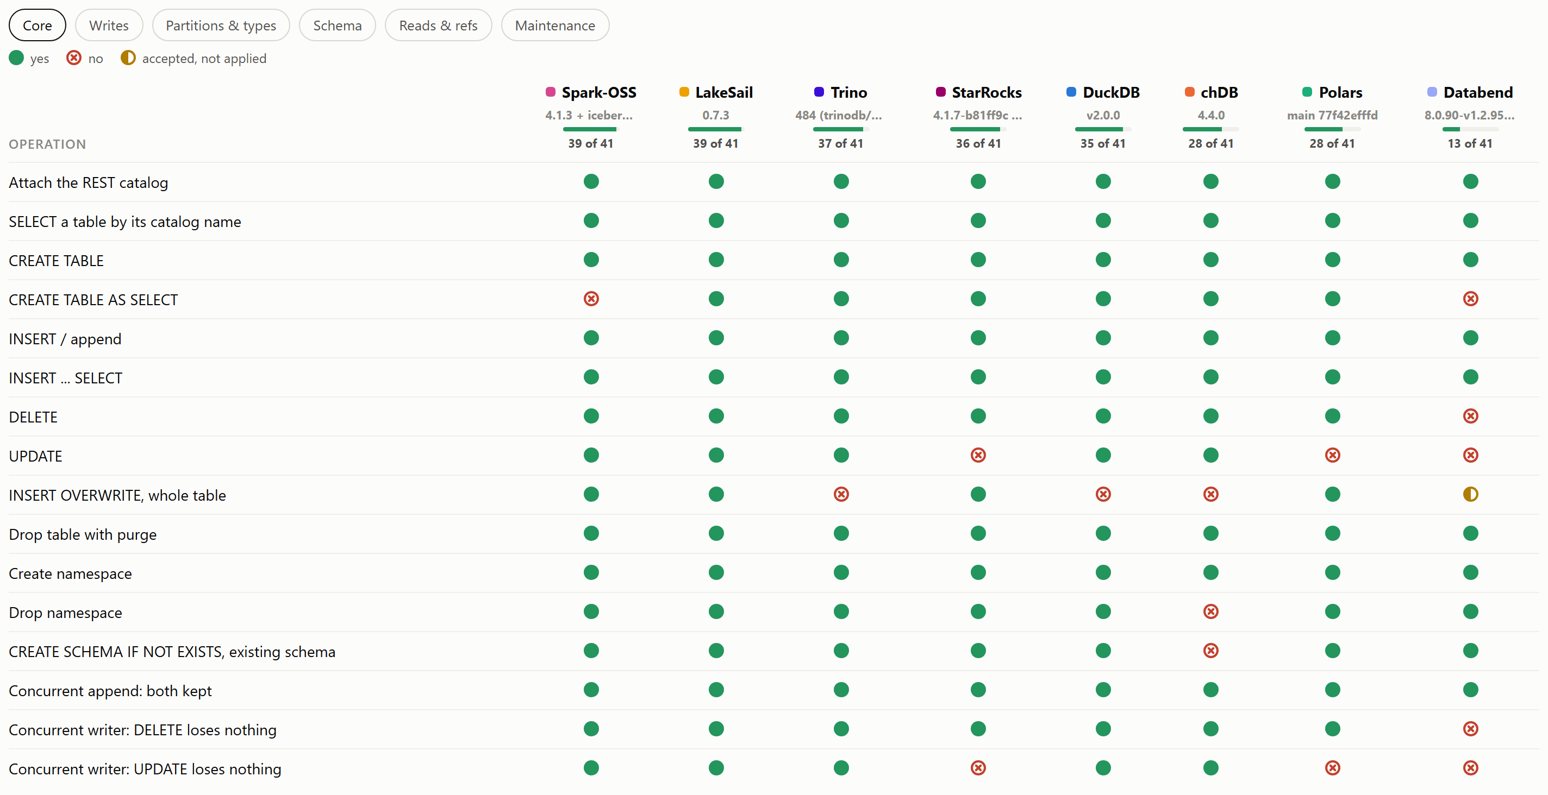
The Iceberg support grid
Notes:
Speed doesn't matter if the engine can't do your operation. The good news first: attach, create, append, DELETE, namespaces and concurrent appends work almost everywhere. Then the differences: who does UPDATE, MERGE with two actions, INSERT OVERWRITE, partition evolution, branches and tags, compaction. StarRocks is new on the grid: no UPDATE and no MERGE with two actions yet. Polars main closed most of its gaps in two weeks; still no UPDATE, MERGE or time travel. Pick on this, not on speed. Side note: Spark has the best fault tolerance and the widest coverage.

Slide 18
What does “fast” mean?
04
The best query is no query.

Slide 19
File skipping
Query
WHERE sale_date = '2026-03-14'
row groups to read: 1 of 36
Manifest list
manifest list
Manifest files
month = Jan
month = Feb
month = Mar
Data files
1–10
11–20
21–31
1–10
11–20
21–31
1–10
11–20
21–31
Row groups
11–13
14–15
16–18
19–20
1 row group of 36, before a single row was read.
Notes:
File skipping is what makes things fast. From the File pruning tab: one day, 14 March, from a quarter, 9 files of 4 row groups. The manifest list holds each manifest's partition range, so January and February are skipped unopened. The March manifest has min and max per file: only days 11-20 can hold the 14th. The Parquet footer has min and max per row group: read 1 of 4. 1 row group of 36, before a single row was read. Some engines answer MAX from the metadata without reading a data file at all.

Slide 20
The importance of sorting data
Query
WHERE sale_date = '2026-03-14'
row groups to read: 12 of 36
Manifest list
manifest list
Manifest files
month = Jan
month = Feb
month = Mar
Data files
1–10
11–20
21–31
1–10
11–20
21–31
1–31
1–31
1–31
Row groups
1–31
1–31
1–31
1–31
Random order: every March file spans days 1–31, so 12 row groups instead of 1.
Notes:
But file skipping only works if the data is reasonably well sorted. The same table written in random order: every March file spans days 1 to 31, so min and max rule nothing out under the partition, and you read 12 row groups instead of 1. The statistics only help if the data is laid out for them: sort on what you filter.

Slide 21
The small-file problem
The same 1 GB of data, written two ways.
8 files of 128 MB
8,000 files of 128 KB
8 opens, 8 footers,
8 manifest entries.
8,000 opens, 8,000 footers,
8,000 manifest entries.
Every file costs a request to storage before a single row is read.
Compact into a few big files. Iceberg’s default target is 512 MB.
Notes:
A general one, not from the bench. Take the same 1 GB of data and write it two ways: 8 files of 128 MB, or 8,000 files of 128 KB. The engine pays per file before it reads a single row: a request to object storage, a Parquet footer to read, an entry in the manifest to plan with. With 8 files that overhead is noise. With 8,000 it is most of the run: the engine spends its time opening files, not reading them. Small files also mean tiny row groups, so worse compression and less work per vector, and bigger manifests, so slower planning. They come from frequent small appends, streaming, small MERGEs, and too many partitions. The fix is compaction: rewrite small files into big ones, which Iceberg calls rewrite_data_files, and batch your writes. Iceberg's default target file size is 512 MB. Who can compact is on the Iceberg grid.

Slide 22
Q64 on DuckDB 2.0: a bad guess
Out of memory
0.0 s
20.5 s
41.1 s
61.6 s
82.2 s
103 s
123 s
144 s
164 s
185 s
205 s
226 s
DuckDB 2.0
✗ 247 s
TPC-DS-like SF 100
spilled 90 GiB
out of memory
~288M
~288M
~288M
~288M
~288M
~288M
~288M
~26B
~2.0M
~2.0M
~3.2 trillion
⋈
⋈
⋈
⋈
⋈
⋈
⋈
Σ
⋈
Σ
~29M
~15K
~402
~1.0K
~1.0M
store_ret…
date_dim
store
promotion
~7.2K
~7.2K
⋈
~20
~144M
~144M
~91M
~3.6M
⋈
Σ
⋈
~14M
~41K
~41K
⋈
~249M
~2.0M
~2.0M
~2.0M
~2.0M
~2.0M
~2.0M
~2.0M
⋈
⋈
⋈
⋈
⋈
×
Σ
~47 quadrillion
~47 quadrillion
~73K
~73K
~1.9M
~1.0M
~1.9M
~3.2 trillion
⋈
↓
date_dim
date_dim
customer_…
~7.2K
~7.2K
customer_…
~3.2 trillion
⋈
~20
cross_sal…
income_ba…
DuckDB 2.0 guesses a ≠ join makes 249M rows and runs it early, on its own. It makes about 3 trillion.
Notes:
From the Query plans tab, one plan per slide. TPC-DS-like Q64 at scale factor 100: derived from the standard 99-query decision-support benchmark, not audited. The same statistics that skip files pick the join order. DuckDB 2.0 guesses a not-equal join makes 249M rows, so it runs it early, on its own; it makes about 3 trillion. It runs out of memory after 247 s with 90 GiB spilled.

Slide 23
Q64 on the DuckDB nightly: fixed upstream
0.0 s
8.4 s
16.8 s
25.2 s
33.7 s
42.1 s
50.5 s
58.9 s
67.3 s
75.7 s
84.1 s
92.5 s
DuckDB nightly
✓ 101 s
TPC-DS-like SF 100 · peak memory 8.0 GiB · largest intermediate result 1.9M rows
done
85K
8.5K
7.3K
7.2K
7.1K
7.1K
7.1K
7.1K
7.1K
5.5K
5.5K
⋈
⋈
⋈
⋈
⋈
⋈
⋈
⋈
⋈
Σ
29M
731
402
1.9M
1.0K
1.0M
store_ret…
date_dim
store
customer_…
promotion
7.2K
7.2K
⋈
20
107K
11K
153
153
⋈
14M
204K
204K
⋈
2.0M
1.9M
1.9M
1.9M
1.9M
1.9M
⋈
⋈
⋈
⋈
⋈
73K
73K
1.9M
1.0M
2.9K
466
466
date_dim
date_dim
customer_…
7.2K
7.2K
2.6K
⋈
20
cross_sal…
income_ba…
duckdb#27493 prices ≠ as nearly a cross product, so it is checked inside a hash join. Done in 101 s, no step above 1.9M rows.
Notes:
Same query, same data, same machine. duckdb#27493 estimates a not-equal join as nearly a cross product instead of as a selective range join, so the optimizer stops running it on its own and checks it inside a hash join. The nightly answers in 101 s with nothing spilled, and no step makes more than 1.9M rows. With it, DuckDB passes all 99 queries at scale factor 100 for the first time.

Slide 24
Real-life use case
05
The only one that matters.

Slide 25
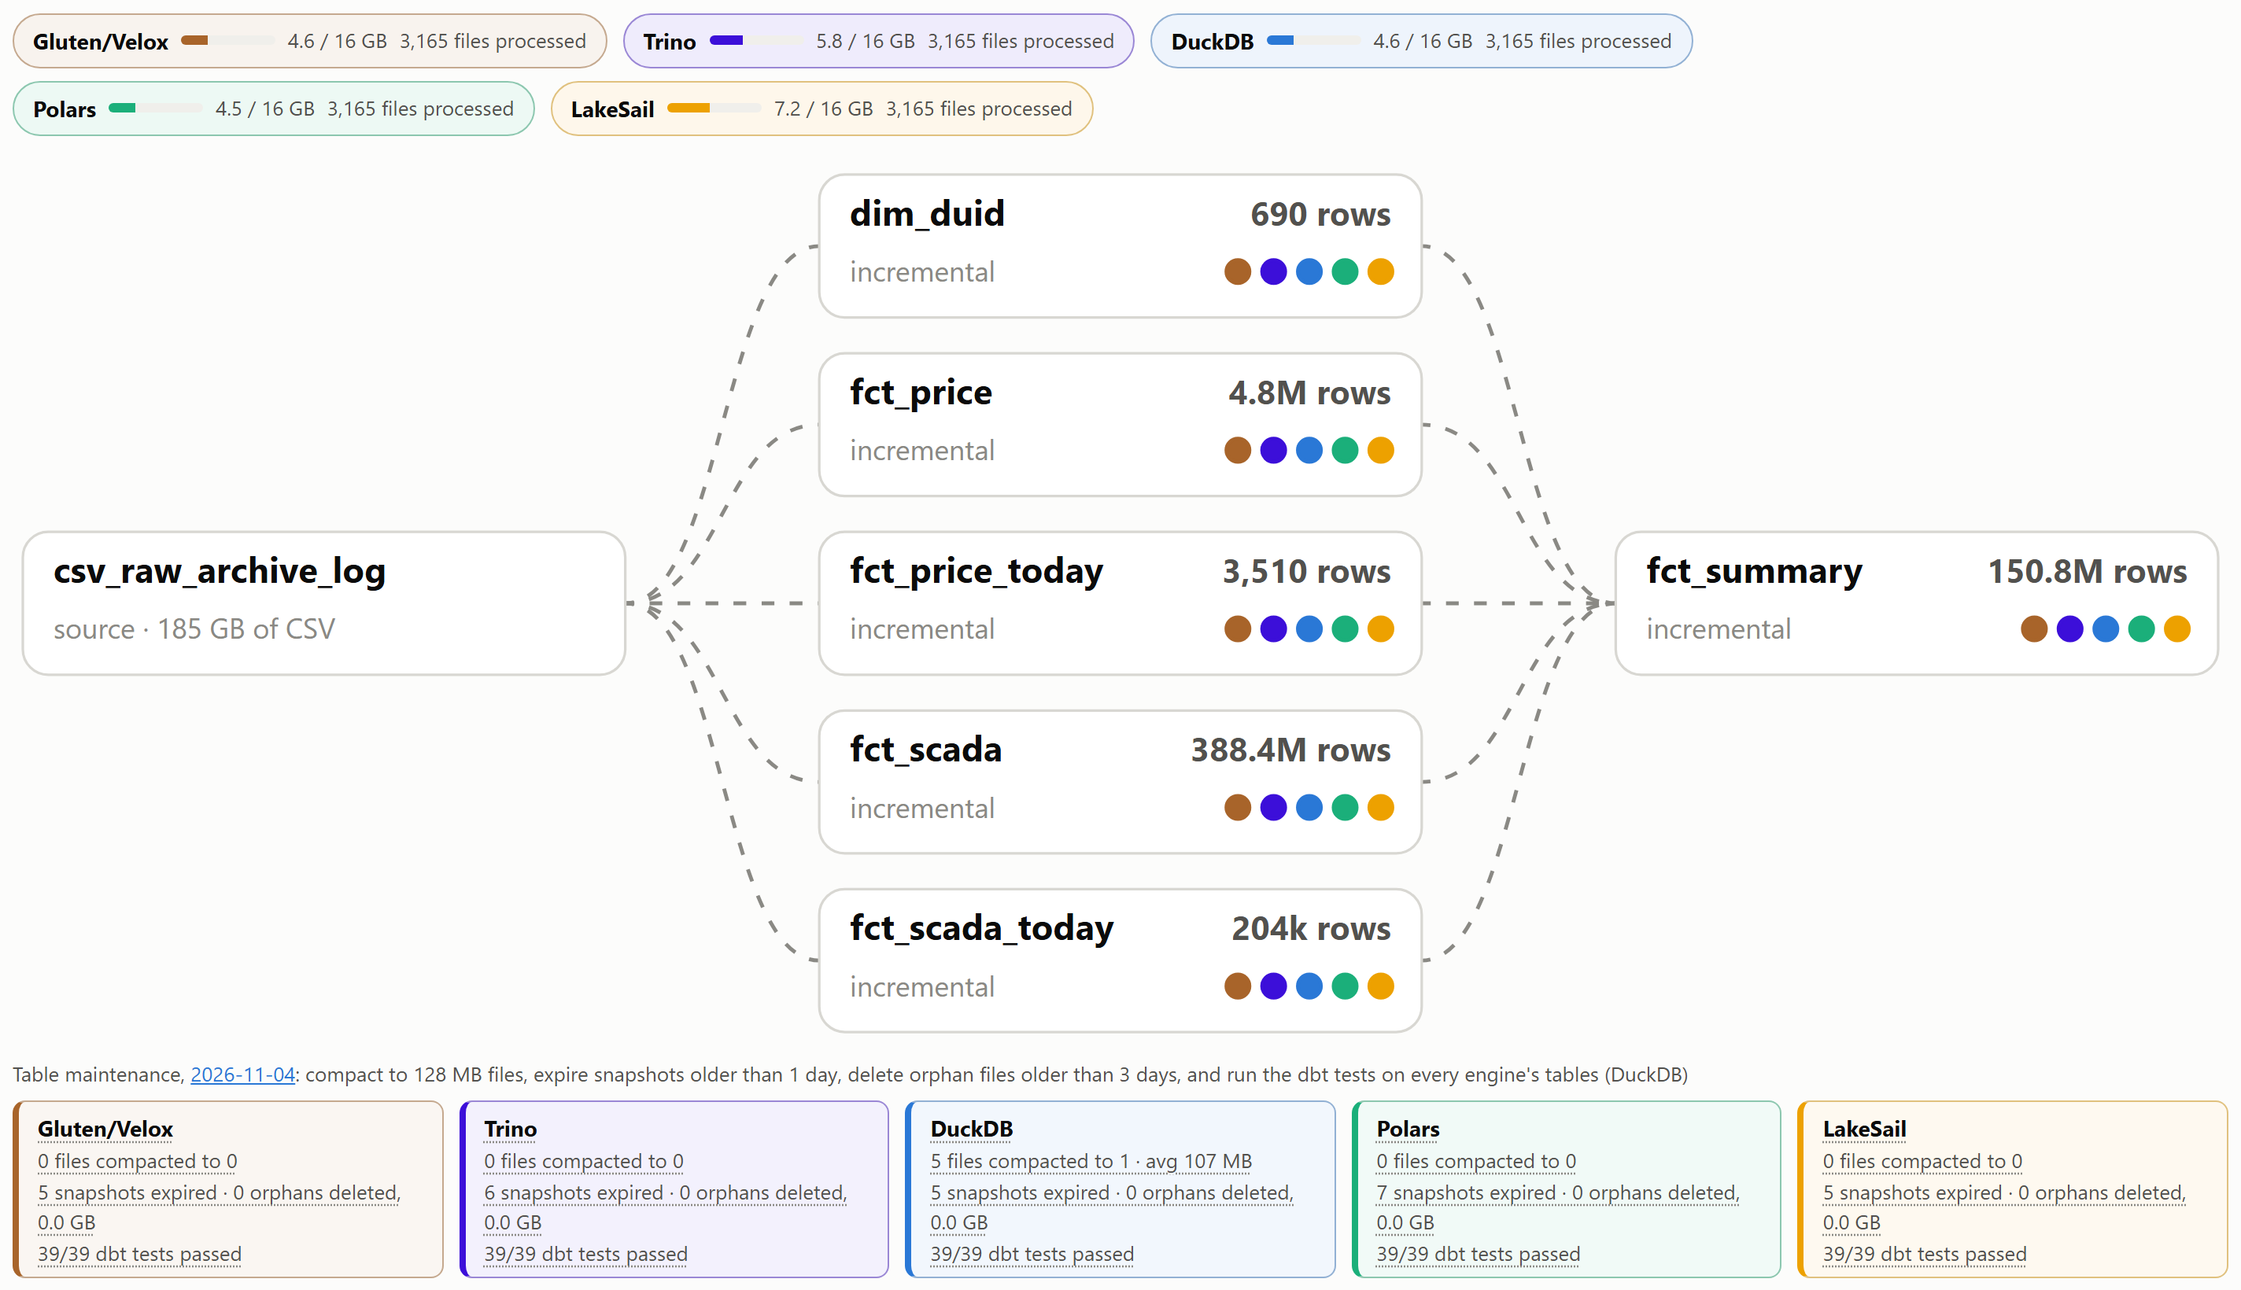
Notes:
From the dashboard's Real workload tab: one dbt project, incremental with MERGE, never reset. The source is 185 GB of AEMO CSV files (measured 2026-10-22). Same dbt project, five engines, same catalog; Iceberg made that a config change. This is the real-life benchmark: dbt orchestrates the SQL, every model is written to Iceberg. One run tests reading files, GROUP BY, complex MERGE on composite keys, writing Iceberg, incremental builds on tables that keep growing, and how well each dbt adapter is implemented. Spark and Trino, which is obvious; DuckDB, Polars and LakeSail did it too. I hope next year more engines join. Real life is boring: DuckDB went from a dead runner at 100 files to 360 by staging through a view. Find your one thing by running your own workload.

Slide 26
Same code, two engines
LakeSail
models/aemo/spark/
Spark + Gluten/Velox
Rust · DataFusion · Spark Connect
6 models, one copy
JVM · C++ underneath
sail:
type: spark
method: session
schema: mart
threads: 1
gluten:
type: spark
method: session
schema: mart
threads: 1
Same Iceberg tables, same catalog
203s · 6 of 6 models · dbt-spark 1.11.0
327s · 6 of 6 models · dbt-spark 1.11.0
dbt + Iceberg: a new way to do data engineering.
The code and the tables stay. The engine is a target in profiles.yml.
Notes:
Here is how far dbt goes. LakeSail is Rust, built on DataFusion, and speaks Spark Connect. Spark with Gluten is the JVM with Velox, C++, underneath. They share no code. In profiles.yml their targets are the same four lines: type spark, method session. And they run the exact same SQL files, the spark folder of the project, 6 models, not one line changed between them. Both write the same Iceberg tables in the same catalog. Last run: LakeSail 203s, Gluten 327s, every model built on both. That's the paradigm: the code and the tables stay, the engine is a target in profiles.yml. I was scared of Jinja; AI made me a dbt believer. I don't write the models, I review the tests.

Slide 27
Why real life is hard
A minor feature can be a blocker
Append only works in a demo
A ragged CSV: 53 fields on one row, about 120 on the next. If the reader can’t take it, nothing runs.
Runs overlap. Two appends of the same files both commit, and the rows land twice. A MERGE on the key keeps one copy.
Spill to disk is the real bottleneck
The adapter matters as much as the engine
The merge doesn’t fit in 16 GB of RAM, so it goes to disk: up to 3 GB in one run. No spill, and the runner dies.
dbt decides how the batch is staged: a temp table or a view. Same SQL, very different memory.
Every one of these can stop an engine, whatever its benchmark says.
Notes:
A TPC run reads clean Parquet and answers queries. The real workload has to do all of this, every run. A minor feature can be a blocker: an AEMO daily file holds several record types, so a 53-field row sits next to rows of about 120 fields. One engine's CSV reader refused the file outright until it got an option to accept short rows; every engine needed its own options. Append only works in a demo: runs overlap, and two appends of the same files both commit, so the rows land twice. A MERGE on the key keeps one copy, which is why every model is an incremental MERGE on a composite key into tables that only grow. Spill to disk is the real bottleneck: the merge doesn't fit in 16 GB of RAM, so it goes to disk, up to 3 GB in the last run. An engine that can't spill doesn't slow down, it takes the runner with it. The dbt adapter is as important as the engine: it decides how the batch is staged, a temp table or a view. Same SQL, same engine, very different memory.

Slide 28
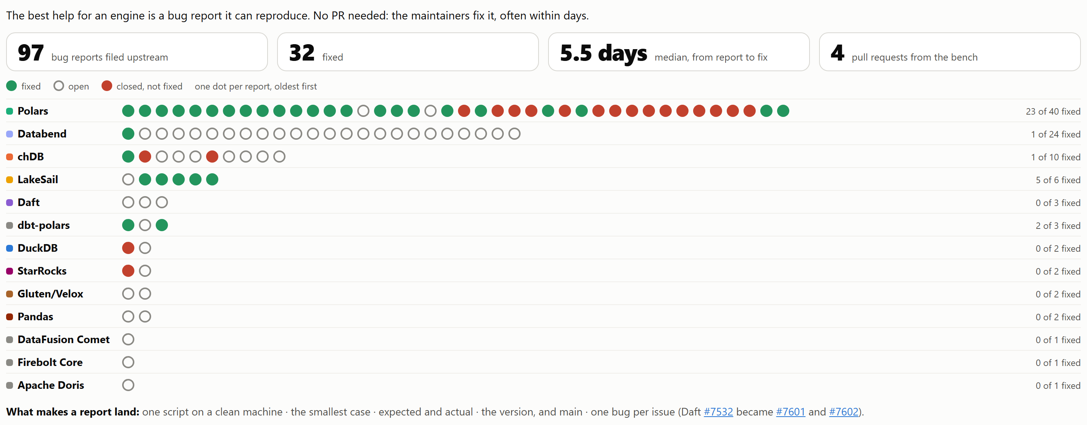
Every report, one dot each
Notes:
From the dashboard's Bug reports tab: one dot per report, oldest first. 97 reports filed, 32 fixed, 5.5 days median from report to fix. The best help for an engine is a bug report it can reproduce. AI makes the repro cheap: it drafts, I check, one bug per issue. Polars fixed 23 of 40, and went from crashing at SF30 to finishing everything at SF100.

Slide 29
What I learned
06

Slide 30
Read less
On a small box, bytes off storage cost more than CPU.
Cache your reads
Filter on a date, not a file name
370 s → 92 s
failed → 168 s
DuckDB, TPC-DS-like SF10 cold: file cache off, then on.
Sail’s merge. Iceberg cuts string bounds to 16 characters; dates are never cut.
Notes:
The cache: on a small box the bottleneck is getting bytes off storage, not CPU, and later queries re-read the same files. DuckDB with its file cache off, same wheel, same run, one line changed: TPC-DS-like SF10 cold goes from 92.1 s to 370.3 s, TPC-H-like SF10 from 44.3 s to 80.2 s, 1.8 to 4x from the cache alone. It's the only cache DuckDB turns on by itself; Velox's and Trino's are off by default, and turning Velox's on took Gluten's TPC-H-like SF10 cold run from 249.6 s to 123-160 s. Cache reads, not writes: a write isn't done until its files are in storage and the catalog commit points to them. The filter: each merge filtered on the source file name, and it skipped nothing. Iceberg writers cut string bounds to 16 characters by default, truncate(16), and every AEMO file name starts PUBLIC_DAILY_20, so every data file may match every batch. Sail's spill grew with the table, 12.7, 14.2, 20.9, 57.3, then 64.1 GB, and the run failed (39712751864). Filtering on the batch's DATEs too, which are never cut, took Sail's fct_scada from a failure at 65.5 GB of spill (39723305966) to 168 s (39735439145). Same result, no reset. A prefix shared by every value, names, URLs, paths, makes a useless filter column.

Slide 31
Distributed engines run fine on one small box
Each on one 4-core, 16 GB runner.
StarRocks · TPC-H-like SF300
Spark, Velox underneath · TPC-DS-like SF100
3,943s
5,762s
A Java front end and a C++ back end, sharing one VM.
3.7× faster than Spark’s own engine, same SQL. Never ran out of memory here.
Notes:
StarRocks is not a library you pip install, it's a proper distributed system: a front end in Java, which parses, plans and holds the catalog, and a back end in C++, which executes. Normally they run on separate machines. Here both share one 4-core, 16 GB runner in the single-node allin1 image, capped at 15 GB, and Python talks to it over the MySQL protocol. It finishes TPC-H-like SF300 in 3,943s. Spark with Velox underneath, through Gluten, same SQL: TPC-H-like SF30 in 385s against 1,440s on Spark's own engine, 3.7×, and 2.4× to 9.8× across TPC-DS-like. It finishes TPC-DS-like SF100 in 5,762s. It runs on a fixed budget, 9 GB off-heap plus 3 GB heap, and not one of its failures at any scale came from memory: they were expired credentials, and at TPC-H-like SF300 the disk. It's the Spark leg of the real workload, and the result the other engines are checked against. AI did its setup: Apache's nightly bundle with pyspark pinned to 4.1.1, and five fixes to read the catalog's storage, each found by a smoke run (apache/gluten#10488 among them). Both have a memory budget. Without one, Polars 2.0.0-rc.2 and Sail took the whole runner down. Spark is adapting, all in open source: Gluten, Comet.

Slide 32
Engine execution nuances
One value, 96.07385, cast from DOUBLE to DECIMAL(18,4)
Spark
DuckDB
96.0739
96.0738
Out of 3.08M rows: DuckDB differs from Spark on 6,716, Polars on 85,090. Each by 0.0001.
Same SQL, not the same behaviour. The fix: DECIMAL(18,5), nothing rounds.
Notes:
The real workload's fct_summary cast a DOUBLE to DECIMAL(18,4). AEMO publishes five decimals, so about 2.7% of the rows are a tie at the fourth decimal, like 96.07385. The SQL was the same on every engine; the behaviour was not. Spark rounds the published number half up: 96.0739. DuckDB multiplies by 10,000 first, lands on 960738.4999999999 and rounds down: 96.0738. Polars rounds ties to even, so about half go down. Out of 3.08M rows, DuckDB differed from Spark on 6,716 and Polars on 85,090, every one by exactly 0.0001. Moving SQL between engines is not only vocabulary: the same statement can behave differently. The fix was simple: DECIMAL(18,5). AEMO's five decimals fit, nothing rounds, and every engine stores the same value. Filed: duckdb/duckdb#27503 (open) and pola-rs/polars#30074 (open).

Slide 33
My use case used to work with only 1 engine. Now we have 5. That’s progress.
🦆
⭐
⛵
🐻‍❄️
🐰
Notes:
My use case used to work with only one engine. Now 5 finish it. That's progress. These engines work, and that's the story. To make it work you need a whole ecosystem: Iceberg support, the catalog, a dbt adapter, spill to disk.

Slide 34
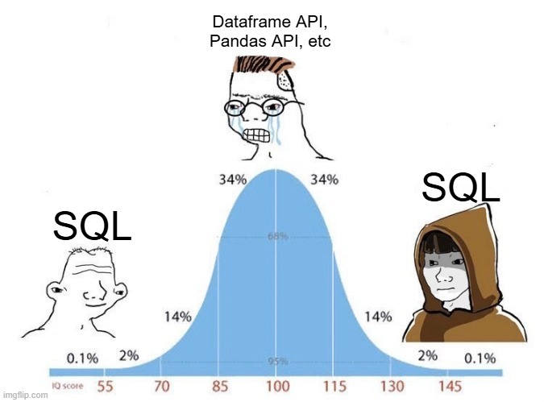

Slide 35

Thank you
Questions? · djouallah.github.io/lakehouse_benchmark
Scan for the code: github.com/djouallah/lakehouse_benchmark
Notes:
Questions?

