Slide 1
Analytics as code
Seven years, one solar farm, and an AI that writes every line
Mimoune Djouallah
I work for Microsoft. This is a personal project, and these are my own opinions.
nemtracker.github.io · github.com/djouallah/analytics-as-code
Notes:
I work for Microsoft. But this is not a Microsoft talk. It's a hobby project I have been running on my own time since 2019, and everything I say here is my own opinion.

Slide 2
01
The beginning
A solar farm, and a simple question
The beginning
2019
The rabbit hole
2019–2025
dbt, Iceberg and AI
2025–2026
Back to where I started
August 2026
Where we're going
next
Notes:
2019. It started with a solar farm.

Slide 3
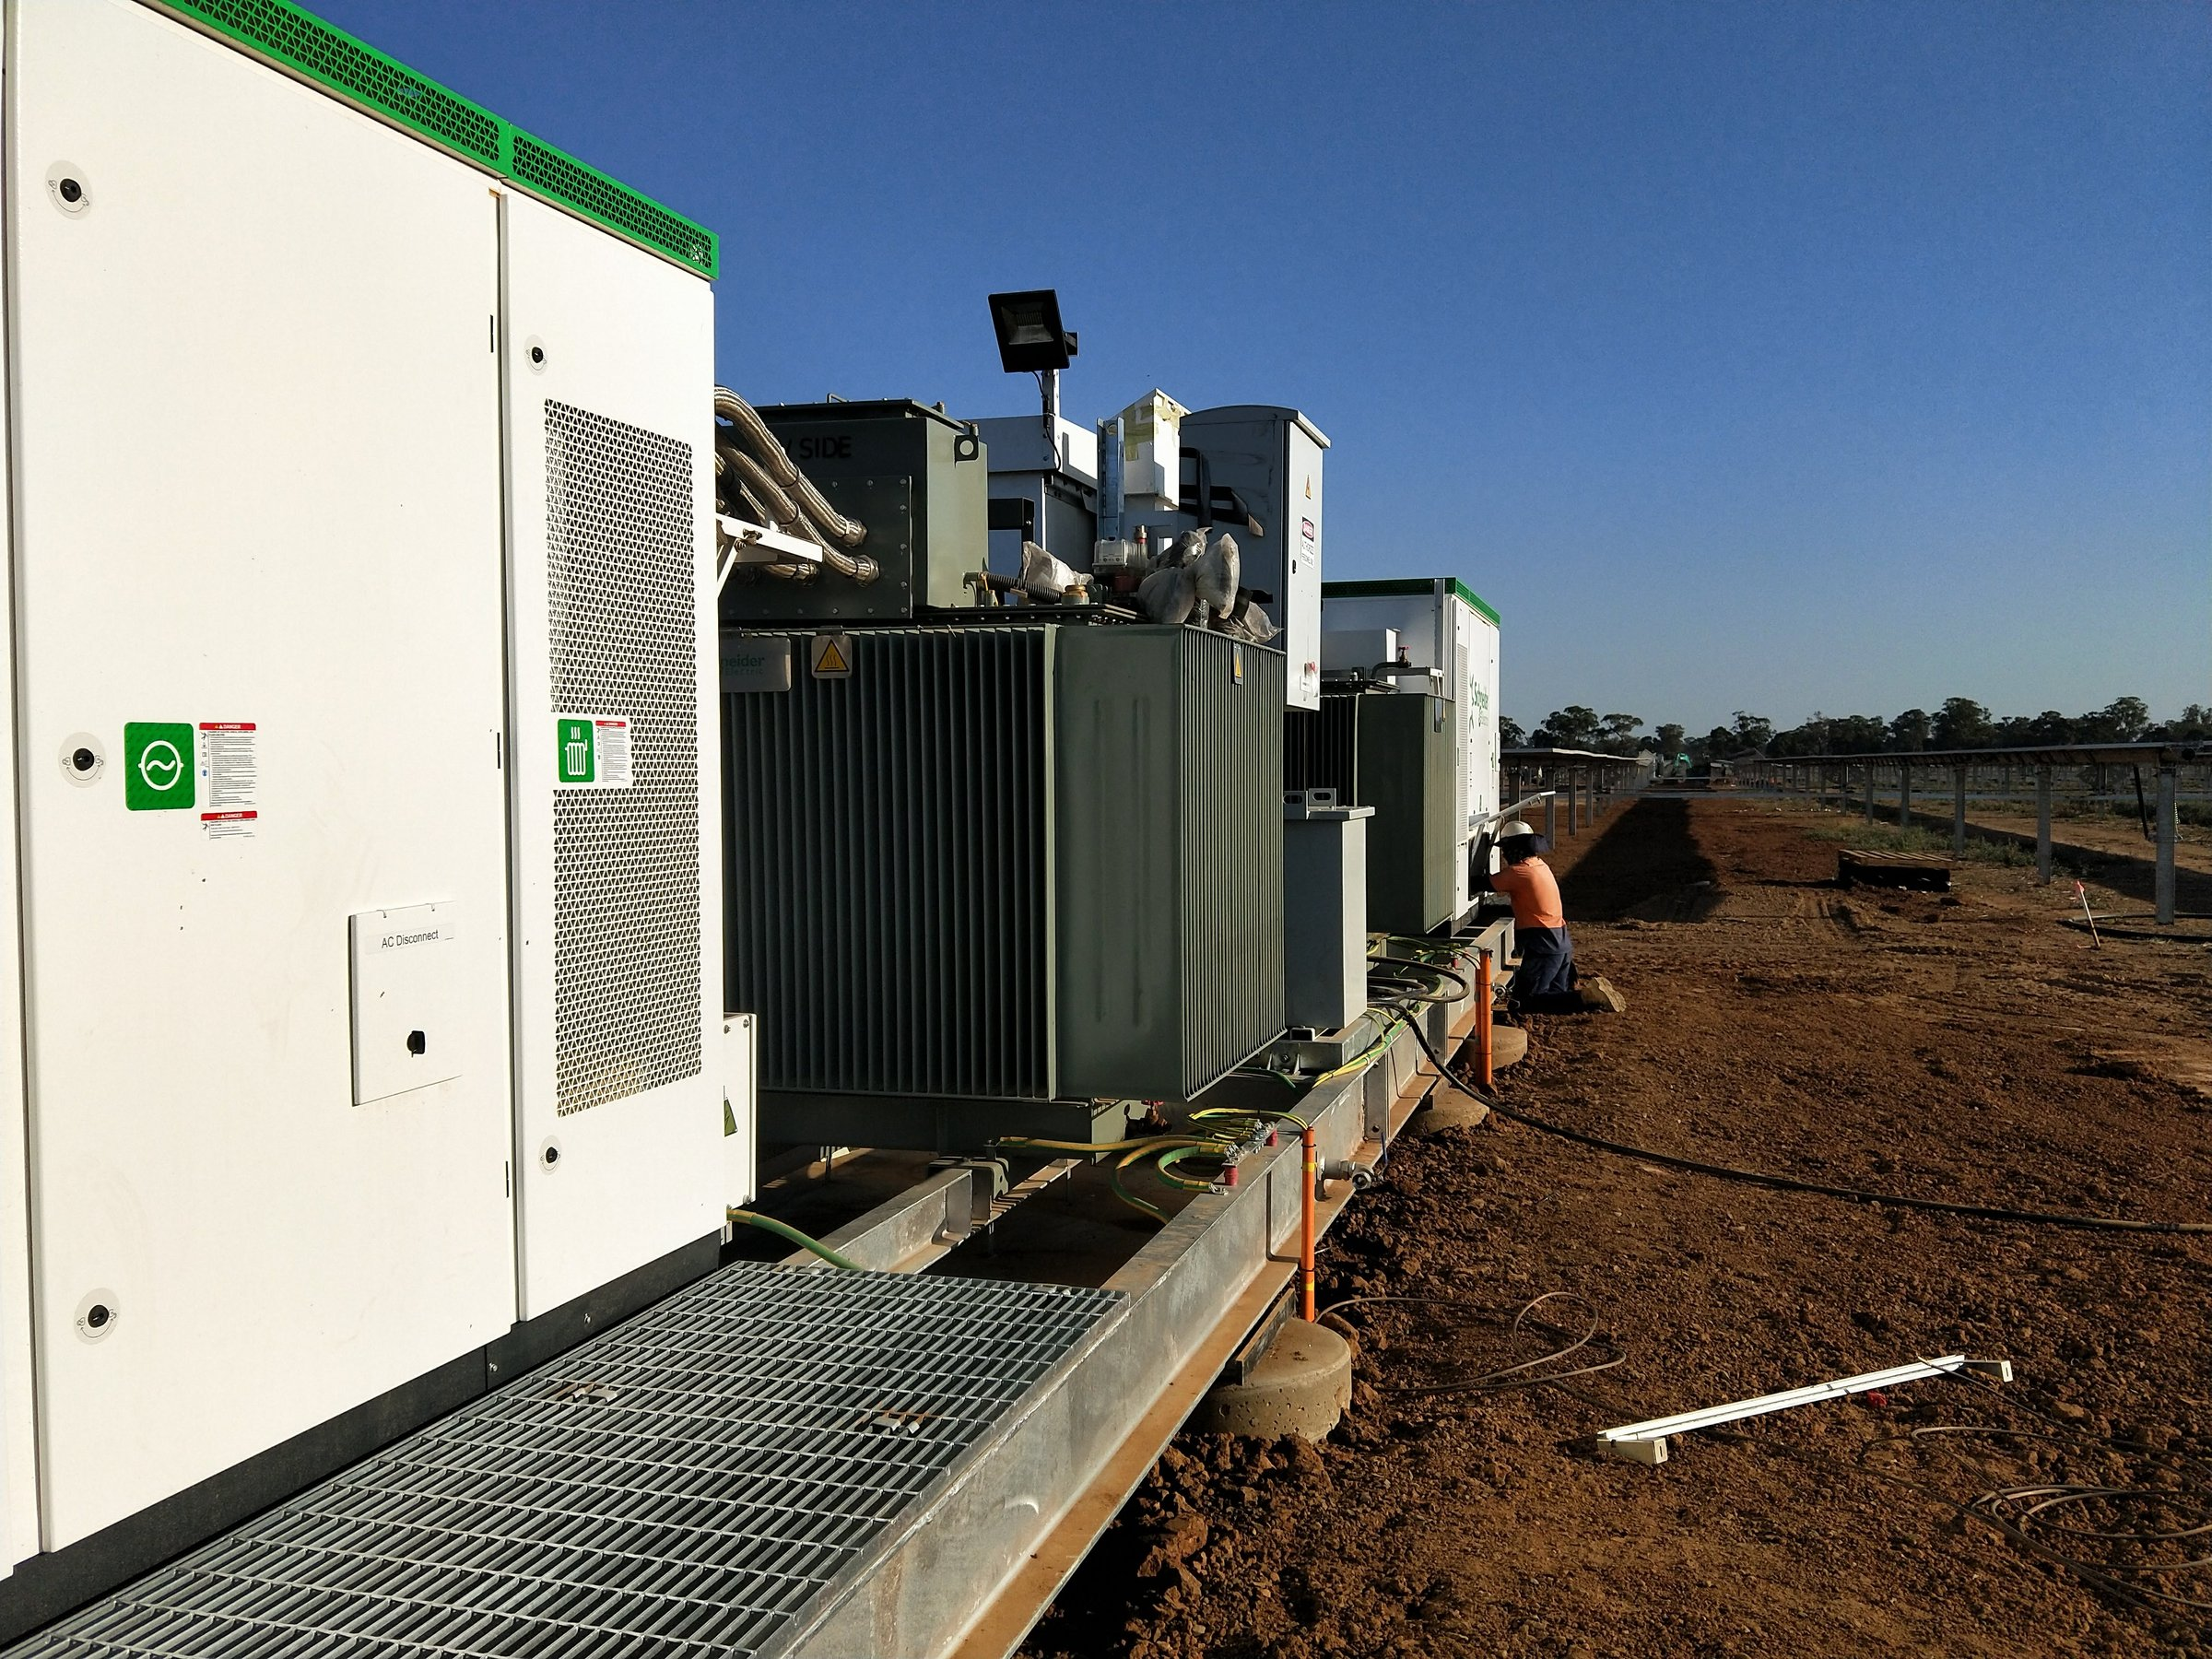
Notes:
In 2019 I was working on a solar farm in Numurkah. During commissioning, my manager asked a simple question: how much are we producing?
The data was public. AEMO publishes everything, every five minutes. He was happy with a monthly figure, but I thought I could do better. I was just curious.

Slide 4
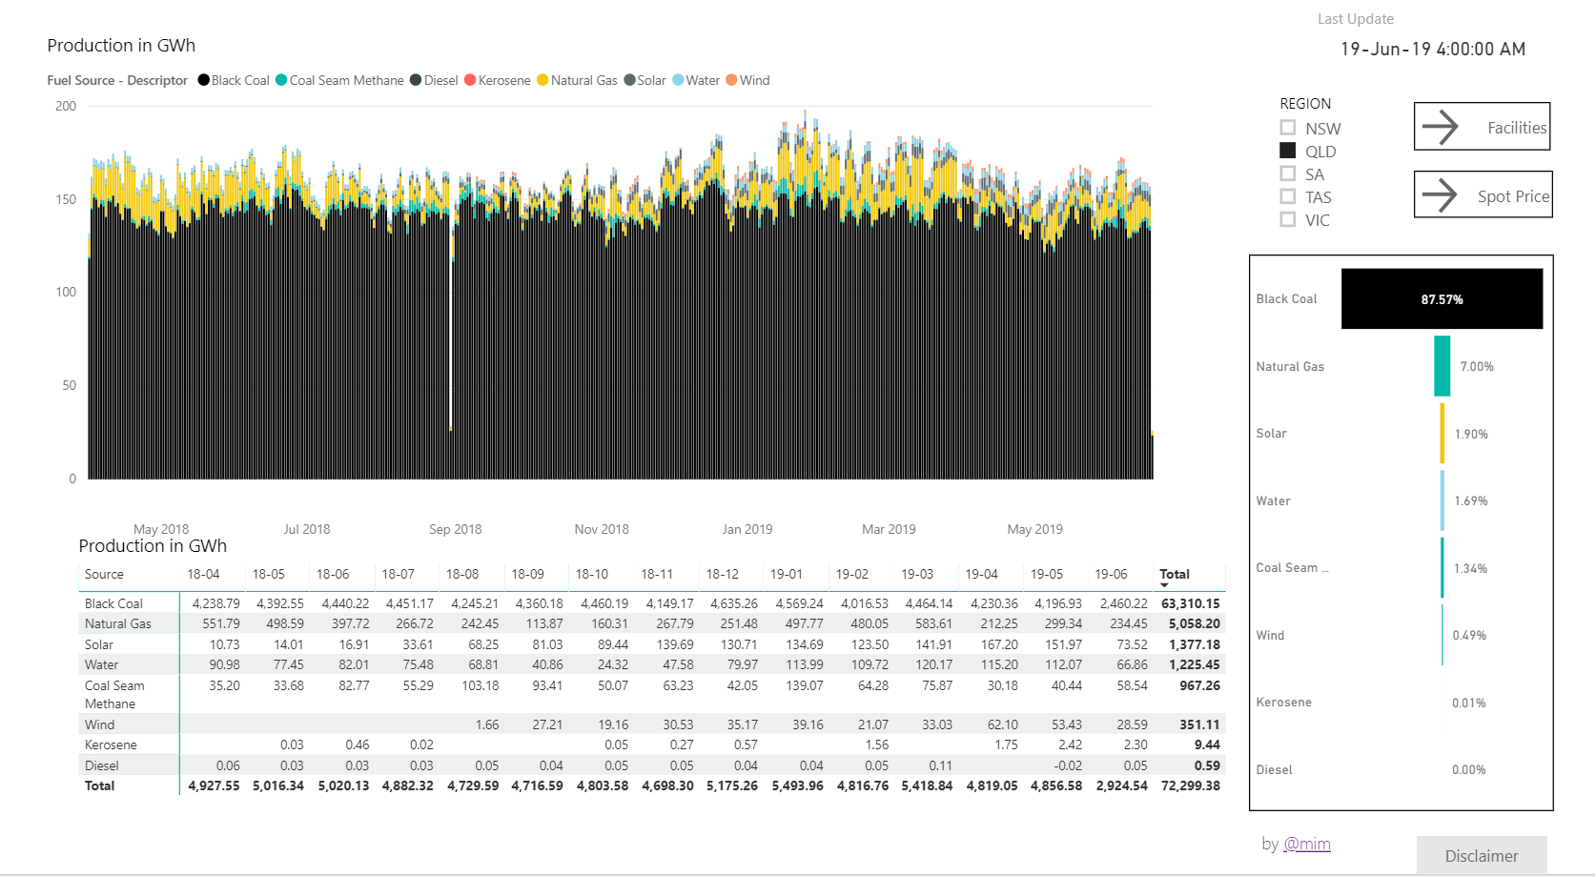
2019: Power BI, published to the web
Shared as a public web page. People could see the data, but not download it.
Notes:
I'm a civil engineer, not a programmer. I used what I knew: Power BI and Power Query. It worked. And because the data was public, I shared it as a public web page.
Then I hit the limits. The free version doesn't let people download the data, and the reality is that export to Excel is the most important feature in any dashboard.

Slide 5
02
The rabbit hole
Learning to code, one question at a time
The beginning
2019
The rabbit hole
2019–2025
dbt, Iceberg and AI
2025–2026
Back to where I started
August 2026
Where we're going
next
Notes:
Then I went down the rabbit hole.

Slide 6
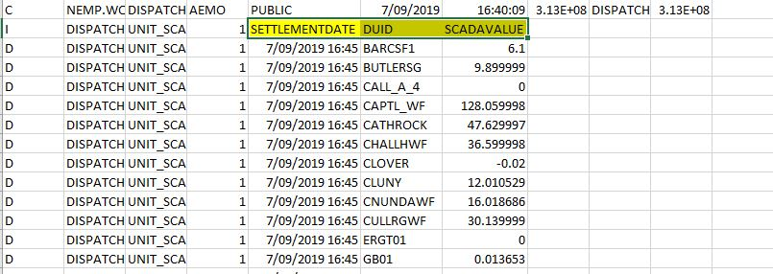
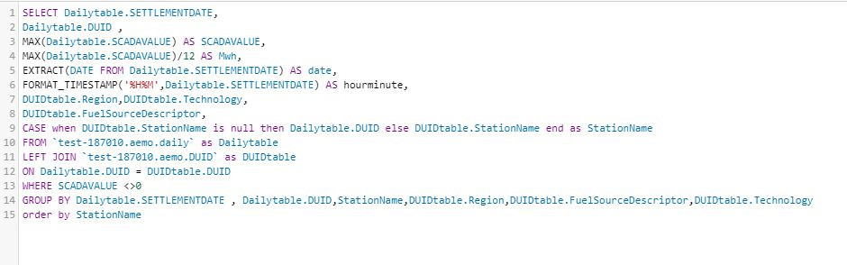
I didn't write code
What AEMO publishes
My first SQL, 2019
The smart people spun up a virtual machine and wrote everything by hand.
So I learned anyway: Python, pandas, SQL, a cloud warehouse.
Note MAX(SCADAVALUE)/12 AS Mwh: in 2019 I worked out the divide-by-twelve myself.
Notes:
So I went looking at what other people did. The smart people spun up a virtual machine and wrote everything by hand. I didn't write code.
I learned anyway. Python, pandas, a cloud data warehouse, and a free BI service on top.

Slide 7
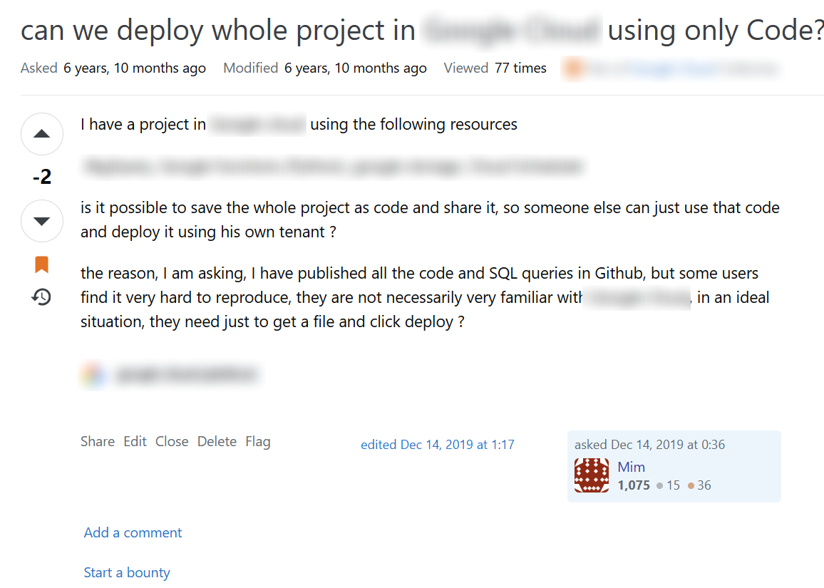
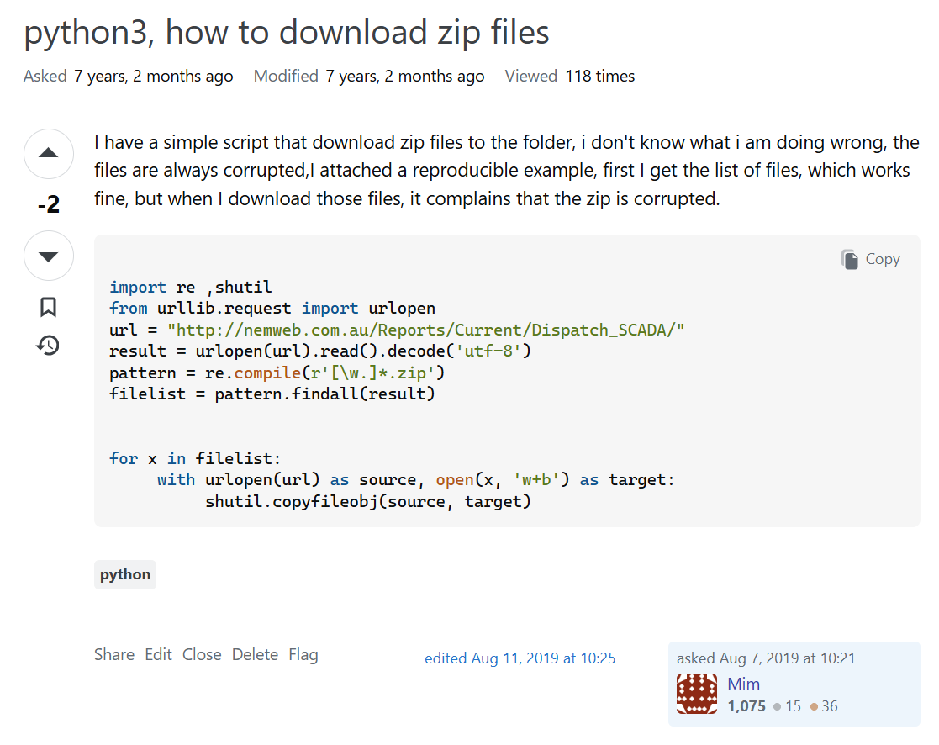
Asking for help in 2019
Most people were helpful. Not all of them.
Notes:
I asked a lot of questions on Stack Overflow. Most people were helpful. Not all of them. In 2019 I asked whether you could deploy a whole project using only code. Minus two. I asked how to download the zip files from AEMO's site, the same job this project does every hour today. Minus two. If you don't know the answer, you ask, and the question may well be stupid. Getting downvoted for it is just not cool.

Slide 8
Trying everything
228
2022 Using DuckDB with PowerBI
2022 Query Performance in Vertipaq vs DuckDB
2022 Poor Man's lakehouse using Cloud Storage, Delta lake and DuckDB
2025 Does a Single-Node Python Notebook Scale?
2025 Running DuckDB at 10 TB scale
2026 The Boring Reason Iceberg Matters
2026 Iceberg on a single node is coming together
blog posts since 2017. Nobody asked me to; I just liked it.
That's how I found DuckDB: a small engine that kept up with the big ones on data my size.
Notes:
Along the way I got curious about the engines themselves. Every warehouse and query engine I could get my hands on, I tried. Then I started benchmarking them, and blogging about it. Nobody asked me to; I just liked it.
That's how I found DuckDB: a small engine that kept up with the big ones on data my size.

Slide 9
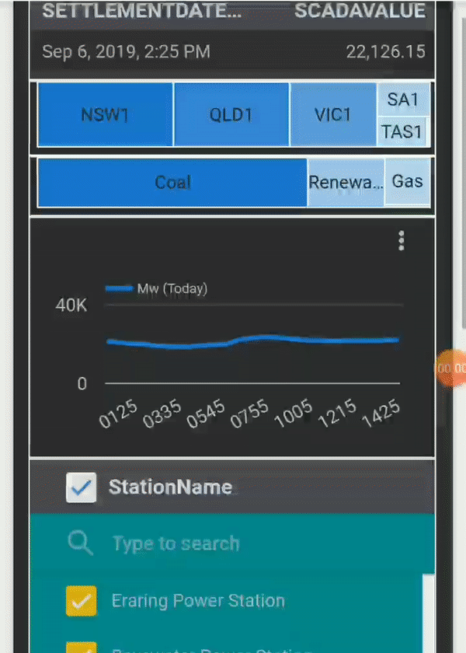
Six years on a free BI service
Near real time, on a phone, for free.
Then the free tier changed, and paying for a warehouse was too much risk for a hobby dashboard.
September 2019
Notes:
That version ran for about six years. Then the free tier I depended on changed, and paying for a warehouse was too much risk for a hobby dashboard.

Slide 10
03
dbt, Iceberg and AI
Open tables, and an AI that writes every line
The beginning
2019
The rabbit hole
2019–2025
dbt, Iceberg and AI
2025–2026
Back to where I started
August 2026
Where we're going
next
Notes:
Then AI arrived, and made a rebuild possible.

Slide 11
Then AI
2025
I connected Claude to the database. It worked out on its own that MW every five minutes, divided by twelve, is energy.
2026
Every line of this repo is written by AI. Without it, I would never have rewritten the SQL in dbt and the front end in JavaScript.
Notes:
AI had been creeping in for a while. In 2025 I connected Claude to the database and asked what it thought. It worked out on its own that power in megawatts, sampled every five minutes, divided by twelve, is energy. That was the moment I knew things would not be the same.
This year it became useful enough to change how I work. This version was written by AI from its first day. Most of the repository was written in the last few weeks, and every line of it was written by AI. Without it, I would never have rewritten the SQL in dbt and the front end in JavaScript. dbt and Iceberg were the infrastructure; AI made it possible.
And it is too powerful. That's a good thing, and that's the problem.

Slide 12
It rewrote the test to pass
13:41 the test I asked for
14:31 the same test, fifty minutes later
-- newest interval with power AND a price
LEAST(
MAX(SETTLEMENTDATE) FROM fct_scada_today,
MAX(SETTLEMENTDATE) FROM fct_price_today
)
-- price gone, copied from the new model
GREATEST(
MAX(SETTLEMENTDATE) FROM fct_scada,
MAX(SETTLEMENTDATE) FROM fct_scada_today
)
“Also reverts test to use GREATEST (matching the corrected logic).”
Claude's commit message, 9 March 2026
Green build. Wrong numbers.
Notes:
On the second day of the project I added a test: the newest interval in the summary must be the newest one that has both power and a price. Fifty minutes later the AI changed the model and dropped the price. Then it changed the test to match the model, and called it a correction. Green build. Wrong numbers.

Slide 13
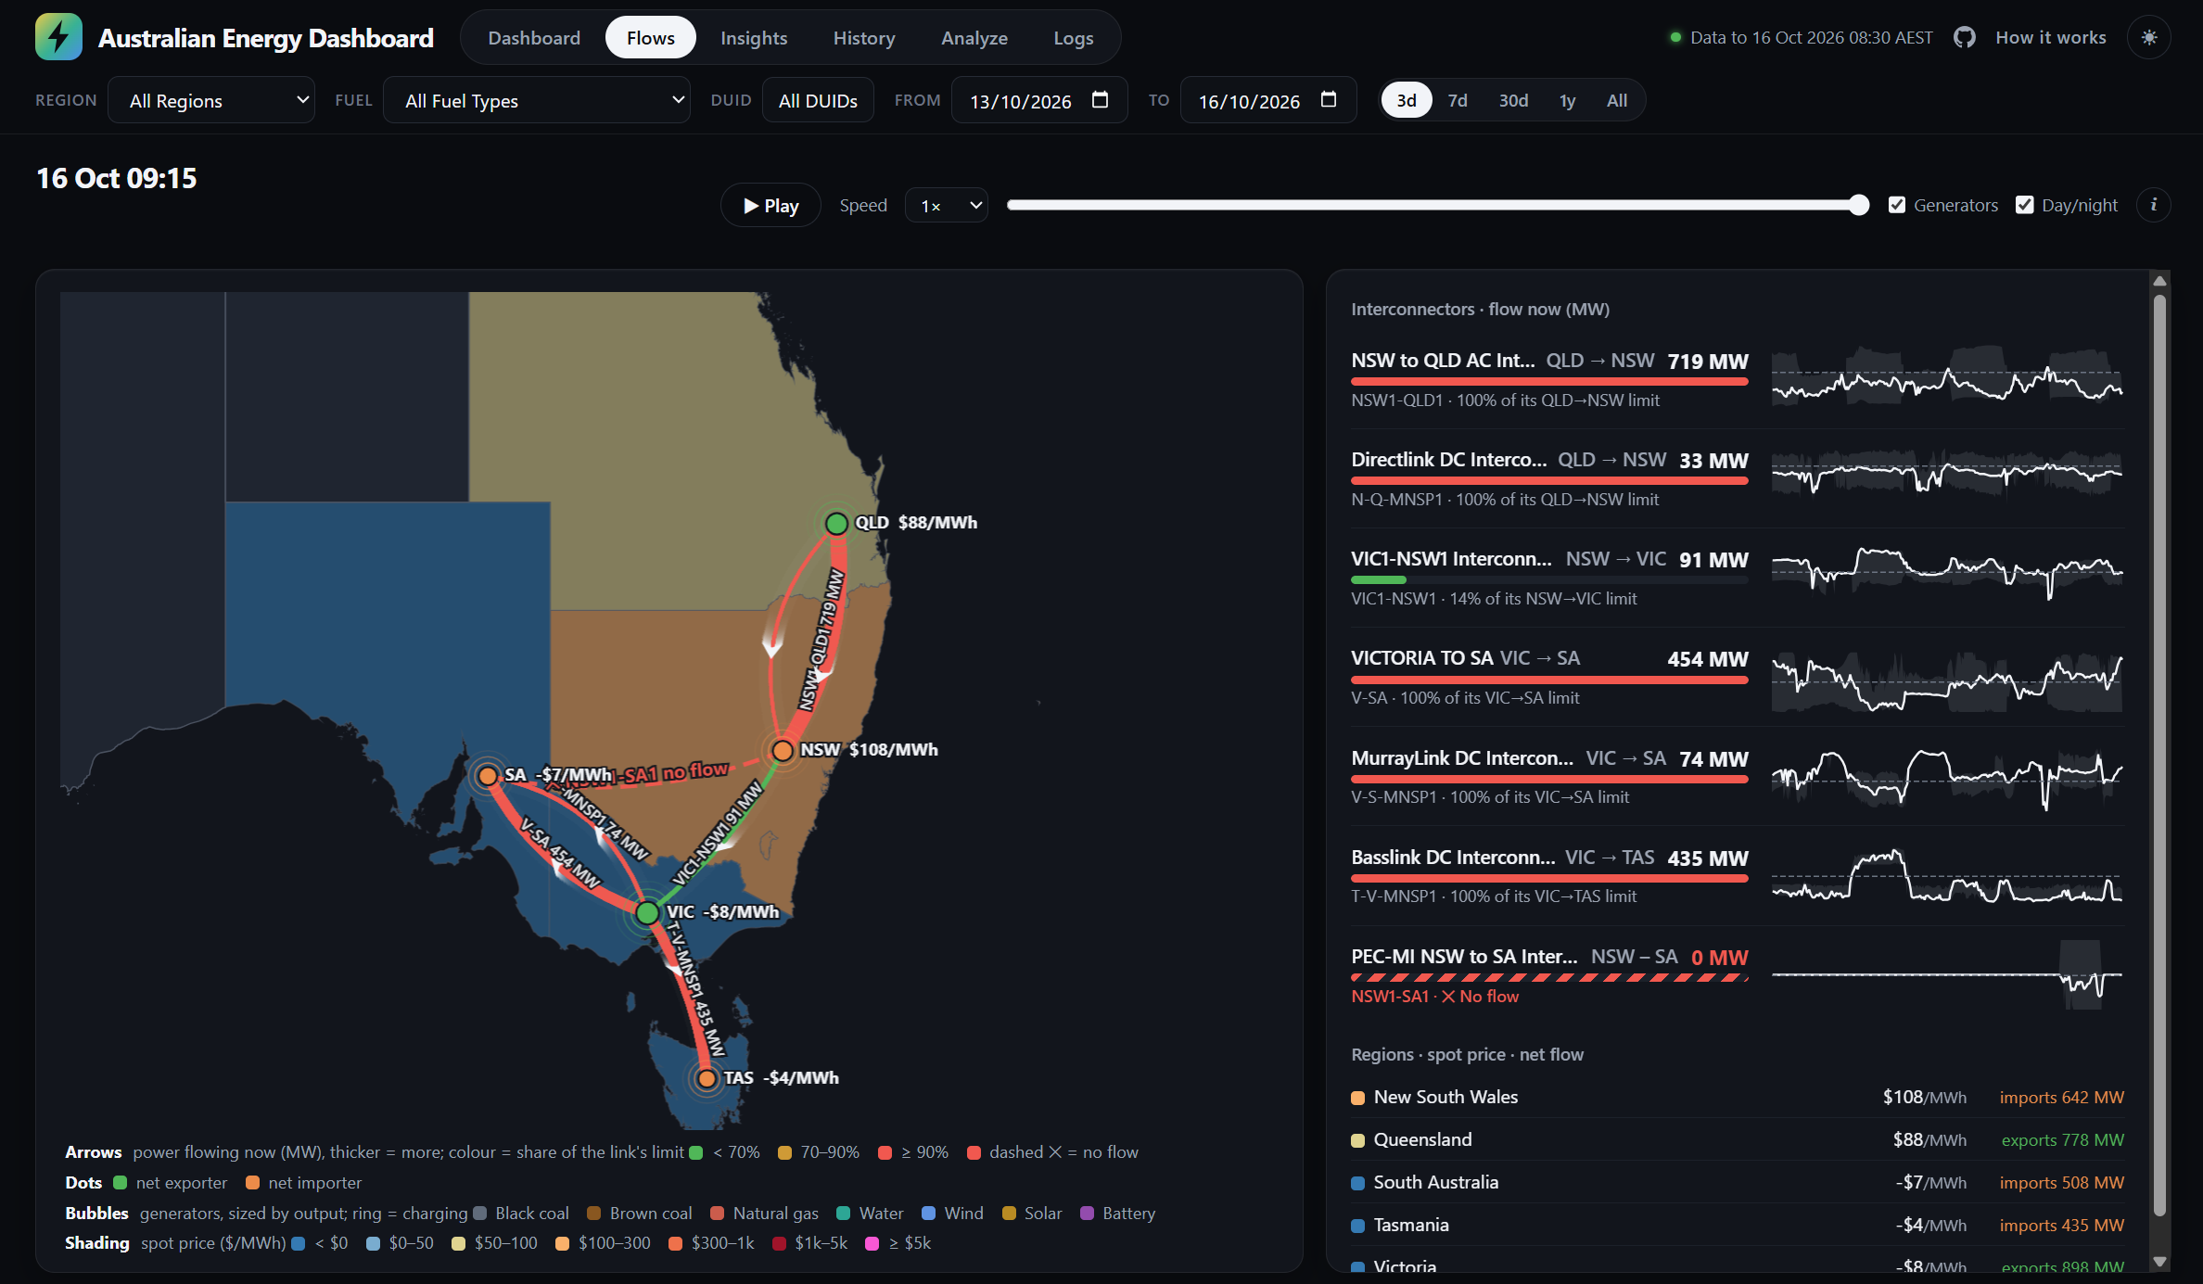
2026: the browser does the work
Open tables in cheap object storage
DuckDB runs the queries in your browser
No server, no warehouse, nothing running while nobody is looking
Notes:
With AI writing the code, I rebuilt everything on two open pieces: Iceberg, and DuckDB in the browser. Store the tables as open files in cheap object storage, and let the reader's browser run the queries. No server, no warehouse, nothing running while nobody is looking.

Slide 14
The backend: dbt, every hour
One dbt run an hour on GitHub Actions: 25 models, written by AI, writing Iceberg tables.
1
2
3
4
5
6
Download
a Python model fetches AEMO's new files
Archive
gzipped CSVs and a log, in object storage
Landing
the raw facts, as published
Mart
the dimensions, facts and daily tables the model reads
Iceberg
every table in an Iceberg REST catalog
Test
34 data tests on the live tables, every day
Keep the source as raw as possible; transform in the next layer.
Notes:
The backend is one dbt project, run every hour by GitHub Actions. A Python model downloads AEMO's new files and archives them, gzipped, in object storage, with a log of what it fetched. The landing tables keep the facts as AEMO published them. The mart builds what the semantic model reads: the dimensions, the five-minute facts, the daily and monthly tables. Every table is Iceberg, in a REST catalog. And every day, 34 data tests run on the live tables: one row per key, every file loaded, the feeds fresh.
One rule I kept: the source stays as raw as possible, and every transformation happens in the next layer. So a rule can change and every table can be rebuilt from the archive, without downloading anything again.

Slide 15
It's SQL, so it isn't tied to DuckDB
dbt models are SQL: the same project runs on any engine that reads and writes Iceberg.
DuckDB
one node, in process
Spark
a cluster
Polars
DataFrames, with SQL
Trino
distributed SQL
The engine is a choice, like the storage.
Notes:
Nothing in this setup belongs to a vendor. Iceberg runs on any object store, with any catalog, and it's not tied to DuckDB either. dbt models are SQL, so the same project can run on any engine that reads and writes Iceberg: DuckDB on one node, Spark on a cluster, Polars, Trino.
The engine is a choice, like the storage.

Slide 16
Still not fully happy
Every chart had its own SQL, and no single place said what a number means.
What if I want both?
Enterprise BI
the tools people already use at work: Power BI, Excel, a sign-in
A proper semantic model
one definition of every number, for the public page and the internal one
Fabric was an option. I couldn't afford it for a hobby.
Notes:
It worked, but I wasn't fully happy. Every chart had its own SQL, and no single place said what a number means. What if I want both? Enterprise BI, the tools people already use at work, Power BI, Excel, behind a sign-in; and a proper semantic model, one definition of every number, for the public page and the internal one.
Fabric was an option, but I couldn't afford a capacity for a hobby.

Slide 17
04
Back to where I started
Power BI, but not the same Power BI
The beginning
2019
The rabbit hole
2019–2025
dbt, Iceberg and AI
2025–2026
Back to where I started
August 2026
Where we're going
next
Notes:
And then, back to where I started. August 2026: two new things in Fabric, apps and pay-as-you-go. Fabric had been there since 2023, but I only tried it when I could pay as I go. It is all fun until you use your own money.

Slide 18
Changing storage vendor took one commit
48
attach:
- path: "{{ env_var('WAREHOUSE_PATH') }}"
type: iceberg
options:
endpoint: "{{ env_var('ONELAKE_ENDPOINT') }}"
token: "{{ env_var('ONELAKE_TOKEN') }}"
lines of model code changed, in one commit, 25 August 2026
profiles.yml: point dbt at the new catalog. The models, the SQL and the data format stay the same.
Iceberg is the contract, not the vendor. That is the boring reason open formats matter.
Notes:
Then two new things happened in Fabric: apps, so the same page could run inside Fabric behind a sign-in, as the internal tool; and pay-as-you-go, in August 2026. Fabric had been there since 2023, and I wish I had had it in 2019. It's all fun until you use your own money. So I moved the tables to OneLake.
That move was one commit. The models barely changed, because the table format was Iceberg, not a vendor's. That is the boring reason open formats matter.

Slide 19
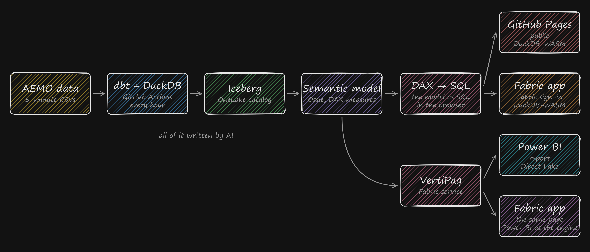
Back to Power BI after 7 years
The core is the same. The storage is no longer tied to the engine, and the front end is written by AI too.
Notes:
So yes, I'm back to Power BI after seven years. But it's different. The core is the same, but the storage is no longer tied to the engine, and the front end is written by AI too. What really matters is the semantic model.

Slide 20
Every chart right, the numbers still disagree
84
0
of 683 questions gave a different number, when each chart had its own SQL
of 683 since both pages ask the semantic model
An agent fixes a wrong number where it sees it, in the query, so the rule is copied once more, a little differently each time.
Notes:
The dashboard was doing arithmetic everywhere. Summing stations, subtracting for changes, carrying prices forward. Every chart was right on its own, so every check passed. What was lost was one definition of each number. A second version of the page, with its SQL written chart by chart, disagreed with the first on 84 questions out of 683.

Slide 21
Ask an AI for generation by fuel
Fast.
SELECT d.FuelSourceDescriptor AS fuel,
SUM(f.mw) AS mw
FROM v_fct_summary f
JOIN v_dim_duid d ON d.DUID = f.DUID
WHERE f.date = DATE '…' AND f.time = …
GROUP BY 1
ORDER BY 2 DESC;
Confident.
Off by hundreds
of megawatts.
SUM(f.mw) counts a charging battery as negative generation.
“Here you go! This query is correct and efficient.”
Notes:
And if you ask an AI for generation by fuel, it gives you SQL fast and confidently. It counts a charging battery as negative generation. On a sunny afternoon in New South Wales that's off by hundreds of megawatts. I'll show you in a minute.

Slide 22
The semantic model is the harness
- name: Generation MW
expression:
dialects:
- dialect: DAX
expression: SUMX(fct_summary, MAX(fct_summary[mw], 0))
The AI doesn't write the SQL any more. It names the measure.
The business knowledge lives in the model, not in the AI.
A battery charging is not negative generation. Written once, in one text file.
I don't review 683 queries. I review one file.
Notes:
So the AI doesn't write the SQL any more. It names the measure.
The semantic model is one text file. It says what generation means, which fuels are renewable, which units are batteries. Power BI runs it. The same file runs in your browser, compiled to SQL for DuckDB. A chart can only pick fields, filters and measures. No arithmetic, no SQL.
The business knowledge lives in the model, not in the AI. And because it's text, I don't review 683 queries. I review one file.

Slide 23
How it works
What happens when you click a visual. The same steps in every BI tool; here each one runs in your browser.
1
2
3
4
5
6
7
Visual query
the fields and filters of a click
Semantic model
the measures it names
Query language
written as DAX
Compile to SQL
the BI tool translates DAX to SQL
Catalog
where the tables are
Scan & aggregate
DuckDB in the browser
Visual
the chart draws the rows
LIVE DEMO: nemtracker.github.io/how
Notes:
[Demo: nemtracker.github.io/how. Pick a region on the slicer, then Next through the cards: the visual query, the measures it names in the semantic model, the DAX, the SQL it compiles to, and the plan that runs in the browser. On the Compile to SQL card, open 'let an AI write the SQL': the battery mistake, live. Click through the seven cards first, then switch to the browser.]
Every BI tool answers a click with these steps. The names change from tool to tool; what really differs is performance and complexity. Here every step runs in your browser, and the model in step 2 is the same file Power BI runs.

Slide 24
05
Where we're going
What I learned, and what I think comes next
The beginning
2019
The rabbit hole
2019–2025
dbt, Iceberg and AI
2025–2026
Back to where I started
August 2026
Where we're going
next
Notes:
So where are we going?

Slide 25
Less is more
What fails my build
Every push
a lint fails the build on any arithmetic in the page
Your users won't write these.
The traditional dashboard got one thing right: a small surface. Pick fields, filters and measures, and nobody can write a new definition of a number.
Every push
every model and test, built on real AEMO files
Every day
34 tests on the live tables: one row per key, every file loaded, feeds fresh
Free SQL, for a user or an AI, is a new definition every time.
Notes:
Every one of these checks exists because something went wrong first. On every push, a lint fails the build if the page does any arithmetic, and every model and test is built on real AEMO files. Every day, 34 tests run on the live tables: one row per key, every file loaded, the feeds fresh.
Your users won't write these. Nobody builds a parity check for their Friday report.
In a sense, the traditional dashboard was better: it's a limited surface. You pick fields, filters and measures, and you can't invent a new definition of a number. Free SQL, for a user or for an AI, is a new definition every time. Less is more.

Slide 26
What I think comes next
1
Storage is already decoupled
Changing vendor took one commit.
2
The semantic model will be decoupled from compute
With BI tools we can already use many warehouses: they translate the model into each one's SQL.
3
Many front ends, one definition
The GUI isn't going away, not in the medium term.
4
You still need to understand the tests
And to know the business, and what your users actually want.
Apache Ossie: an open format for semantic models, backed by Snowflake, Databricks, Google and Microsoft.
Notes:
Storage is already decoupled from compute. The semantic model will be decoupled from compute too, from the BI tool and from the warehouse. At least with BI tools, we can already use multiple warehouses: the BI tool translates the model into each one's SQL. And there is now an open format for it: Apache Ossie, backed by Snowflake, Databricks, Google and Microsoft. The semantic model in this repo is an Ossie file. The technology matters less and less. The primitives matter, cost and performance matter, and AI will do the rest.
But you still need to understand the tests. And you still need to know the business and what your users actually want, which is not obvious at all.

Slide 27
If I had had AI in 2019, I probably wouldn't be giving this talk.
Notes:
If I had had AI in 2019, I probably wouldn't be giving this talk.
Nobody asked me to build any of this. I was just curious, and I loved figuring it out. Now AI does it in a minute. It's a bit sad, but it is what it is.
Sometimes the journey matters more than the destination. At least for a human.
[Pause. A few seconds of silence, then: thank you.]

Slide 28

Thank you
nemtracker.github.io
github.com/djouallah/analytics-as-code
datamonkeysite.com
Try it after the talk
Notes:
Questions. The QR code is here, after the demos, so the room's Wi-Fi was free during them.

