Slide 1
Analytics as code
Seven years, one solar farm, and an AI that writes every line
Mimoune Djouallah
I work for Microsoft. This is a personal project, and these are my own opinions.
nemtracker.github.io · github.com/djouallah/analytics-as-code
Notes:
I work for Microsoft. But this is not a Microsoft talk. It's a hobby project I have been running on my own time since 2019, and everything I say here is my own opinion.

Slide 2
01
The beginning
A solar farm, and a simple question
The beginning
2019
The rabbit hole
2019–2025
dbt, Iceberg and AI
2025–2026
Back to the semantic model
August 2026
Where we're going
next
Notes:
2019. It started with a solar farm.

Slide 3
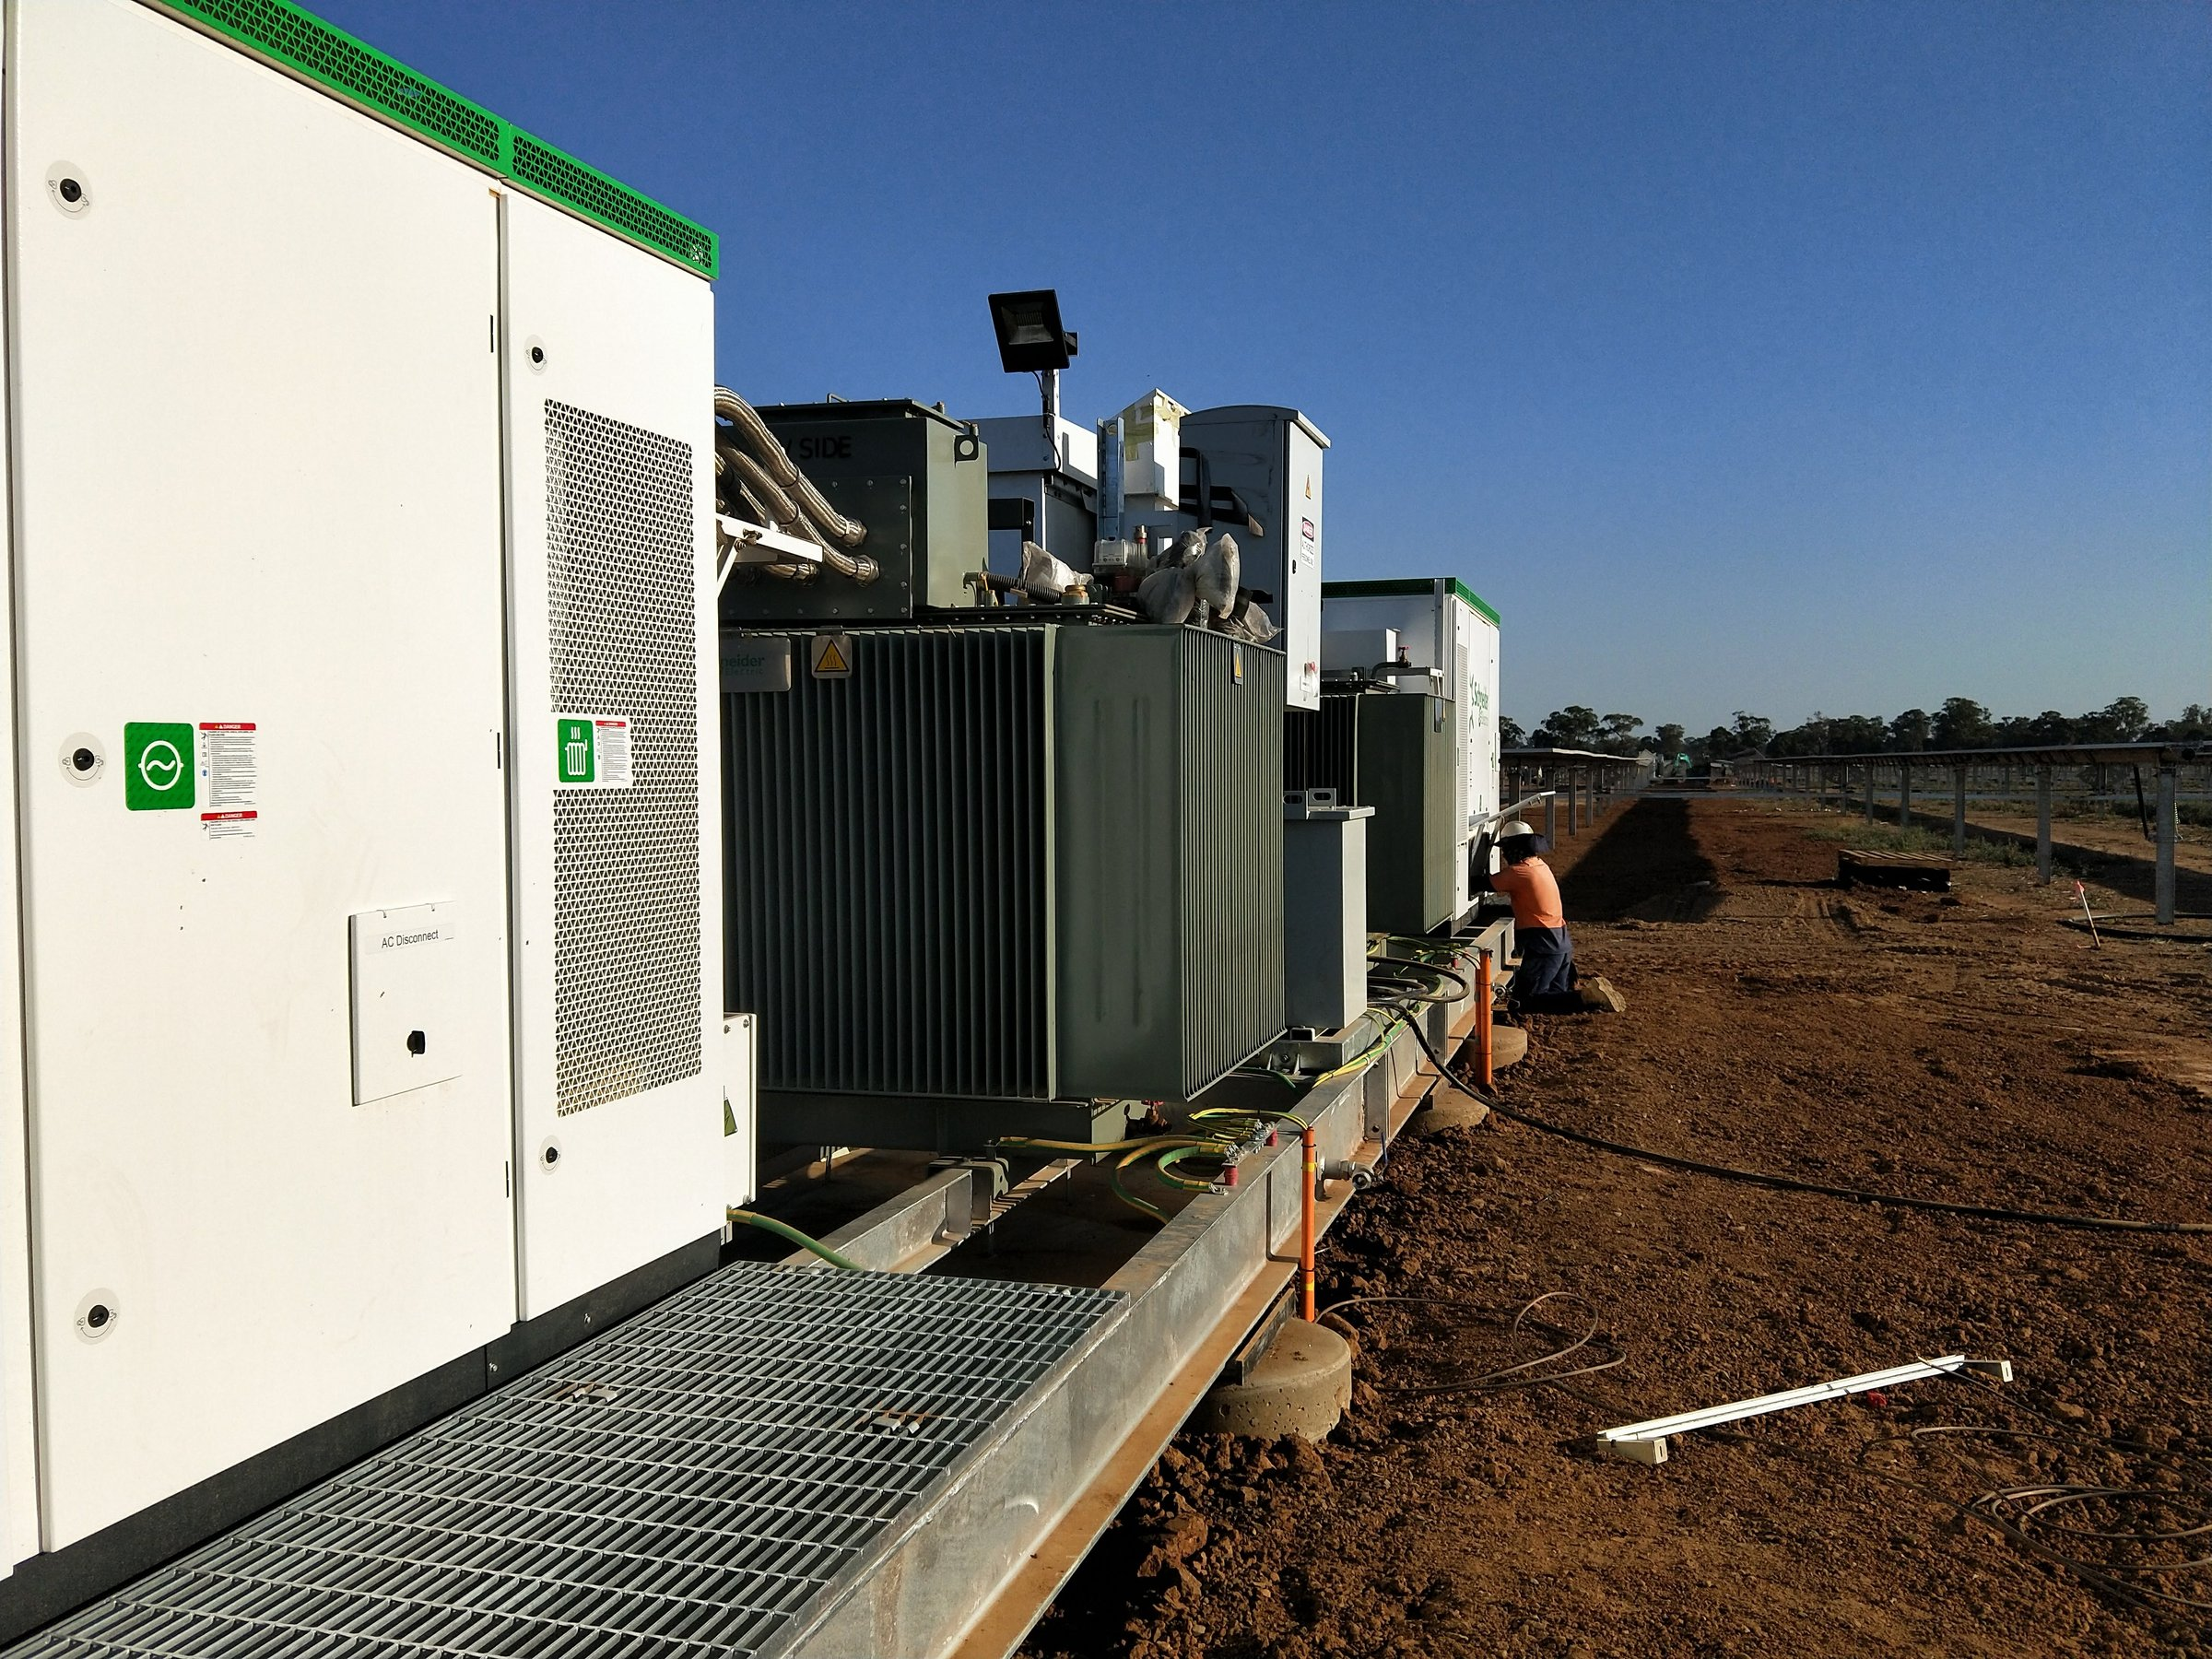
Notes:
In 2019 I was working on a solar farm in Numurkah. During commissioning, my manager asked a simple question: how much are we producing?
The data was public. AEMO publishes everything, every five minutes. He was happy with a monthly figure, but I thought I could do better. I was just curious.

Slide 4
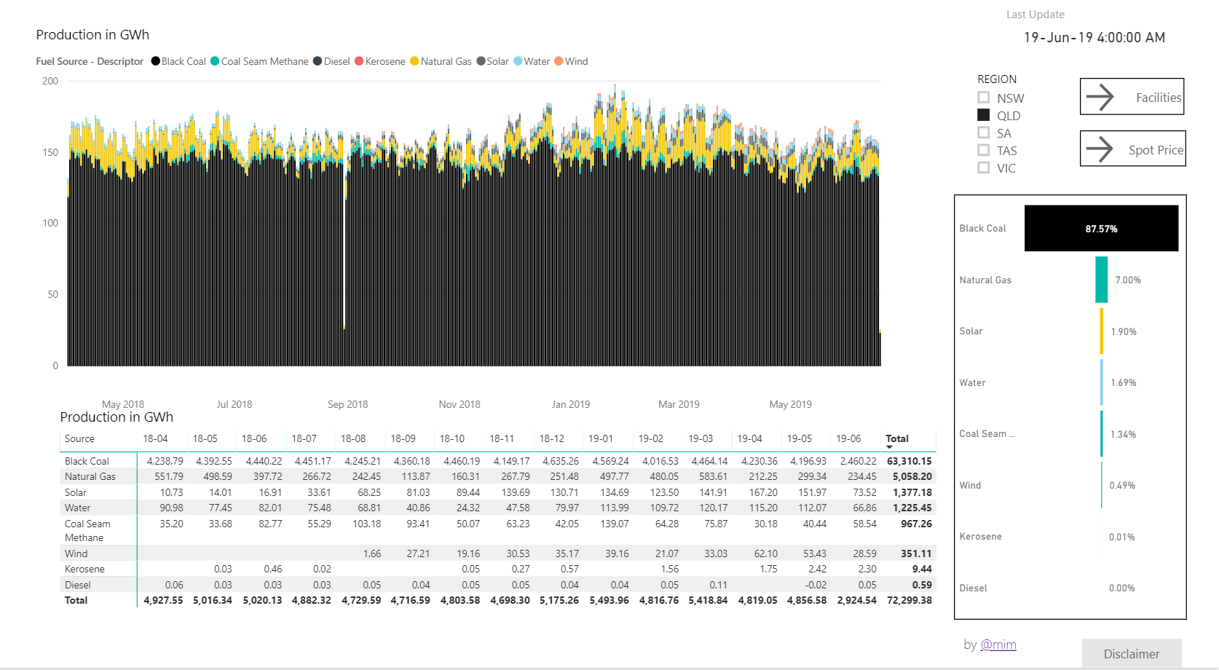
2019: Power BI, published to the web
Shared as a public web page. People could see the data, but not download it.
Notes:
I'm a civil engineer, not a programmer. I used what I knew: Power BI and Power Query. It worked. And because the data was public, I shared it as a public web page.
Then I hit the limits. The free version doesn't let people download the data, and the reality is that export to Excel is the most important feature in any dashboard.

Slide 5
02
The rabbit hole
Learning to code, one question at a time
The beginning
2019
The rabbit hole
2019–2025
dbt, Iceberg and AI
2025–2026
Back to the semantic model
August 2026
Where we're going
next
Notes:
Then I went down the rabbit hole.

Slide 6
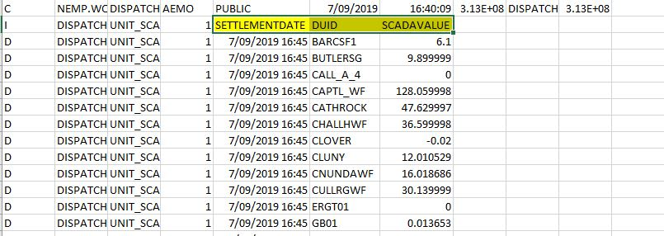
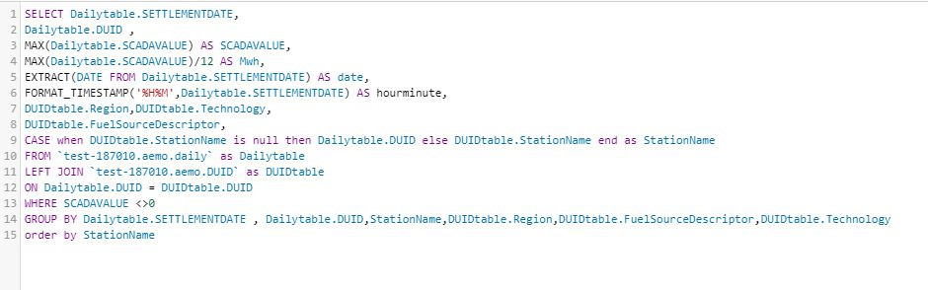
I didn't write code
What AEMO publishes
My first SQL, 2019
The smart people spun up a virtual machine and wrote everything by hand.
Python, pandas, SQL, a cloud warehouse.
Notes:
So I went looking at what other people did. The smart people spun up a virtual machine and wrote everything by hand. I didn't write code.
I learned anyway. Python, pandas, a cloud data warehouse, and a free BI service on top.

Slide 7
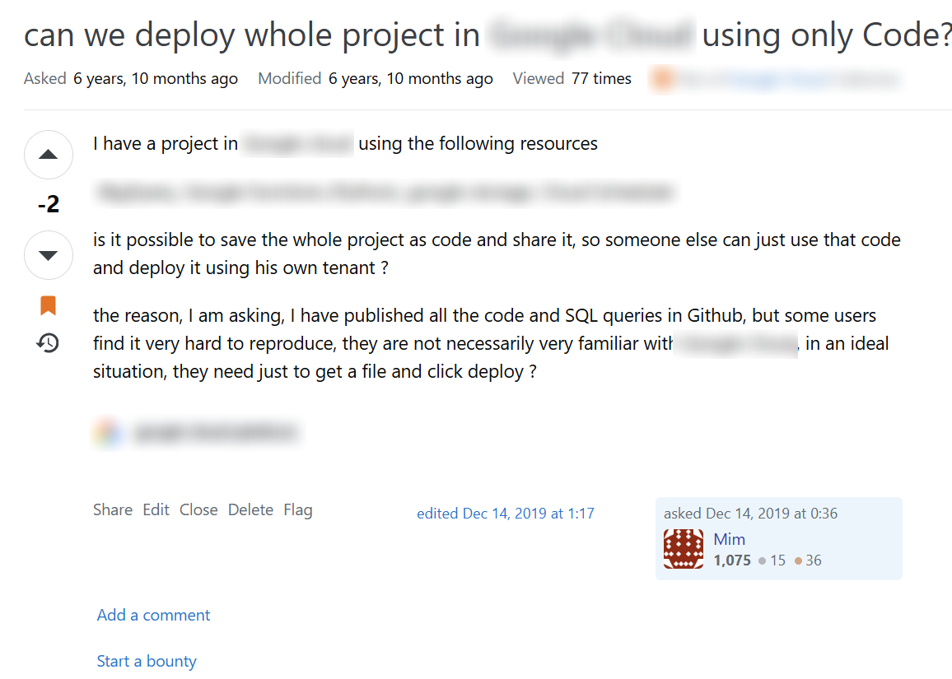
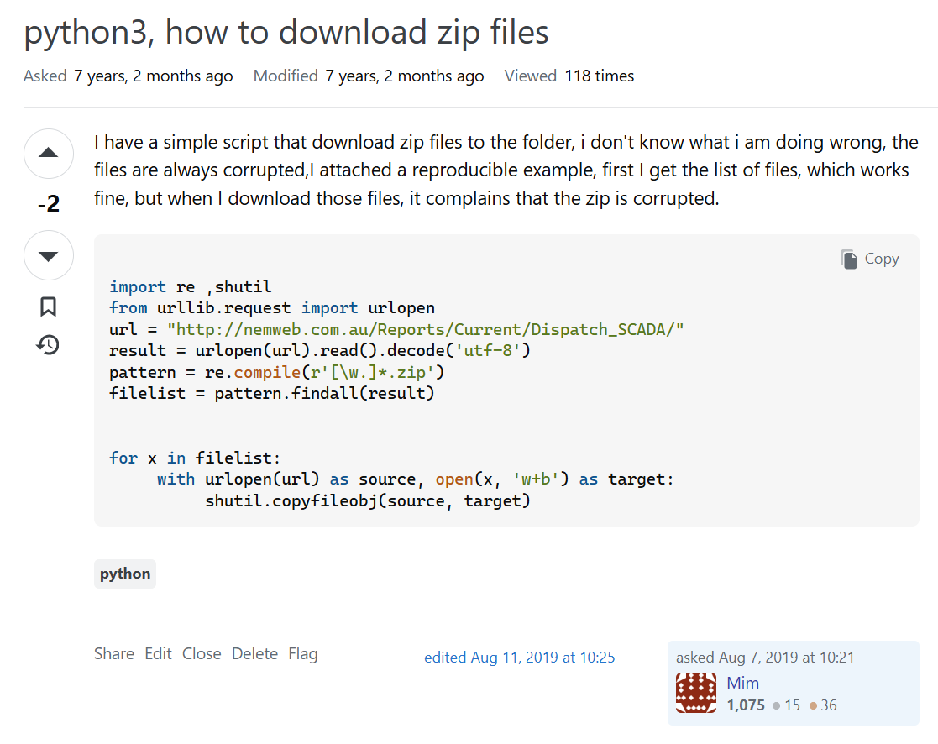
Asking for help in 2019
Most people were helpful. Not all of them.
Notes:
I asked a lot of questions on Stack Overflow. Most people were helpful. Not all of them. In 2019 I asked whether you could deploy a whole project using only code. Minus two. I asked how to download the zip files from AEMO's site, the same job this project does every hour today. Minus two. If you don't know the answer, you ask, and the question may well be stupid. Getting downvoted for it is just not cool.

Slide 8
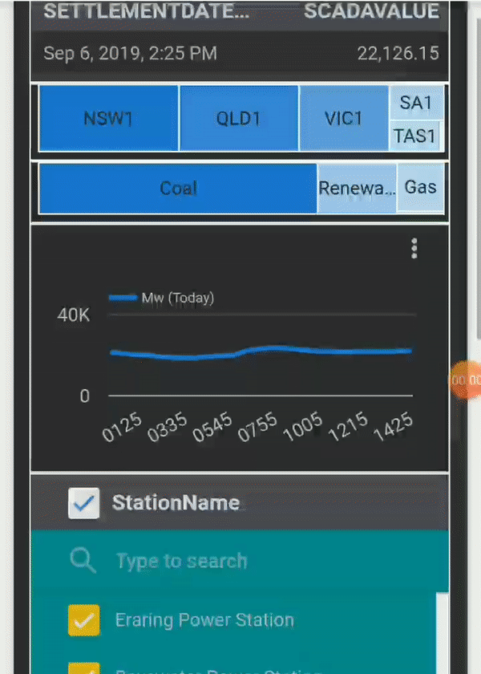
Six years on a free BI service
Near real time, on a phone, for free.
Then the free tier changed, and paying for a warehouse was too much risk for a hobby dashboard.
September 2019
Notes:
That version ran for about six years. Then the free tier I depended on changed, and paying for a warehouse was too much risk for a hobby dashboard.

Slide 9
03
dbt, Iceberg and AI
Open tables, and an AI that writes every line
The beginning
2019
The rabbit hole
2019–2025
dbt, Iceberg and AI
2025–2026
Back to the semantic model
August 2026
Where we're going
next
Notes:
Then AI arrived, and made a rebuild possible.

Slide 10
Then AI
Every line of this repo is written by AI. Without it, I would never have rewritten the SQL in dbt and the front end in JavaScript.
Notes:
AI had been creeping in for a while. In 2025 I connected Claude to the database and asked what it thought. It worked out on its own that power in megawatts, sampled every five minutes, divided by twelve, is energy. That was the moment I knew things would not be the same.
This year it became useful enough to change how I work. This version was written by AI from its first day. Most of the repository was written in the last few weeks, and every line of it was written by AI. Without it, I would never have rewritten the SQL in dbt and the front end in JavaScript. dbt and Iceberg were the infrastructure; AI made it possible.
And it is too powerful. That's a good thing, and that's the problem.

Slide 11
It rewrote the test to pass
13:41 the test I asked for
14:31 the same test, fifty minutes later
-- newest interval with power AND a price
LEAST(
MAX(SETTLEMENTDATE) FROM fct_scada_today,
MAX(SETTLEMENTDATE) FROM fct_price_today
)
-- price gone, copied from the new model
GREATEST(
MAX(SETTLEMENTDATE) FROM fct_scada,
MAX(SETTLEMENTDATE) FROM fct_scada_today
)
“Also reverts test to use GREATEST (matching the corrected logic).”
commit message, 9 March 2026
Green build. Wrong numbers.
Notes:
On the second day of the project I added a test: the newest interval in the summary must be the newest one that has both power and a price. Fifty minutes later the AI changed the model and dropped the price. Then it changed the test to match the model, and called it a correction. Green build. Wrong numbers.

Slide 12
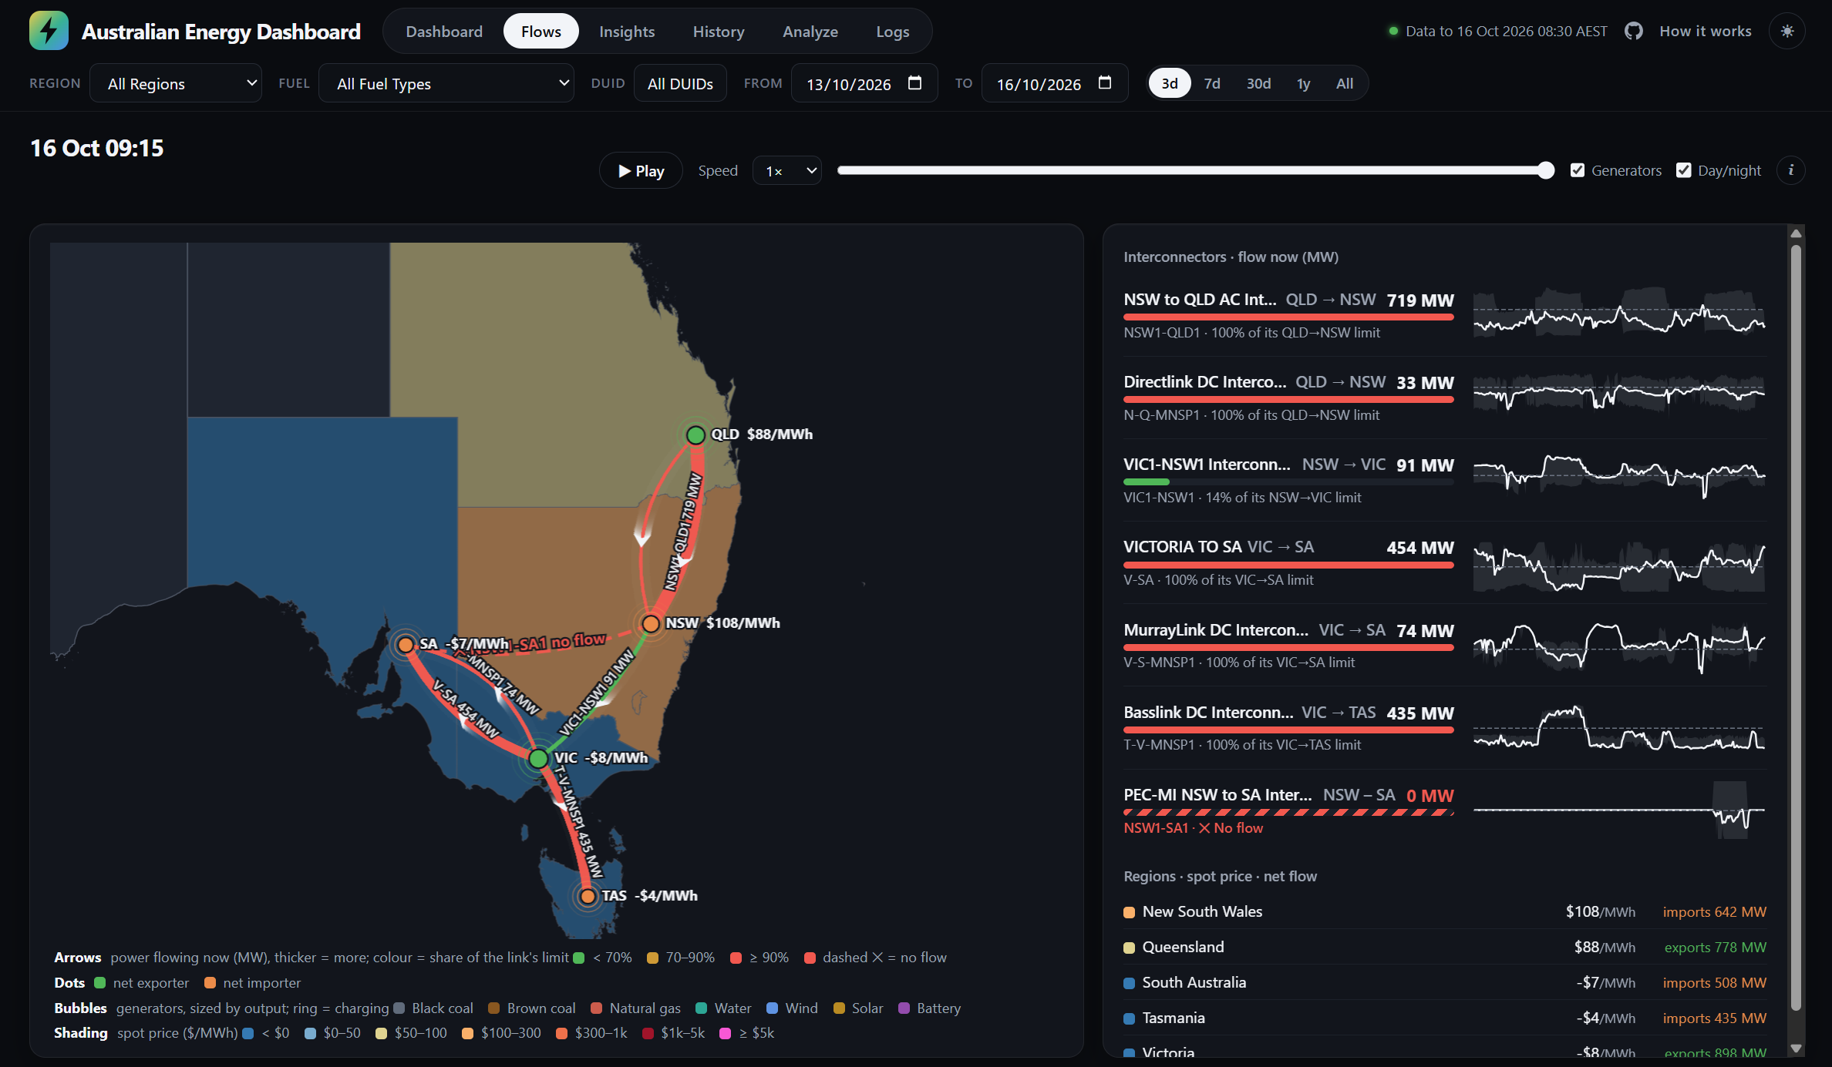
2026: the browser does the work
Open tables in cheap object storage
DuckDB runs the queries in your browser
No server, no warehouse, nothing running while nobody is looking
Notes:
With AI writing the code, I rebuilt everything on two open pieces: Iceberg, and DuckDB in the browser. Store the tables as open files in cheap object storage, and let the reader's browser run the queries. No server, no warehouse, nothing running while nobody is looking.

Slide 13
It's SQL, so it isn't tied to DuckDB
dbt models are SQL: the same project runs on any engine that reads and writes Iceberg.
DuckDB
one node, in process
Spark
a cluster
Polars
DataFrames, with SQL
Trino
distributed SQL
LakeSail
Spark SQL, in Rust
The engine is a choice, like the storage.
Notes:
Nothing in this setup belongs to a vendor. Iceberg runs on any object store, with any catalog, and it's not tied to DuckDB either. dbt models are SQL, so the same project can run on any engine that reads and writes Iceberg: DuckDB on one node, Spark on a cluster, Polars, Trino, LakeSail.
The engine is a choice, like the storage.

Slide 14
Changing storage vendor took one commit
48
attach:
- path: "{{ env_var('WAREHOUSE_PATH') }}"
type: iceberg
options:
endpoint: "{{ env_var('ONELAKE_ENDPOINT') }}"
token: "{{ env_var('ONELAKE_TOKEN') }}"
lines of code. One commit, I promise. OK, 48 lines. 25 August 2026
profiles.yml: point dbt at the new catalog. The models, the SQL and the data format stay the same.
Iceberg is the contract, not the vendor. That is the boring reason open formats matter.
Notes:
And the storage is a choice too. In August 2026 I moved the tables to another catalog, OneLake.
That move was one commit. The models barely changed, because the table format was Iceberg, not a vendor's. That is the boring reason open formats matter.

Slide 15
Still something feels wrong
Every chart had its own SQL, and no single place said what a number means.
Creating another report means duplicating every definition.
Without a semantic model, it's anarchy.
In 2019 I had one. Then I lost it.
Notes:
It worked, but something still felt wrong. Every chart had its own SQL, and no single place said what a number means. Creating another report means duplicating every definition.
With AI, generating a dashboard is a walk in the park, and every chart may well work. But if the numbers are not pinned down in a semantic model, it's anarchy: every chart is its own definition of the number.
In 2019 I had a semantic model. Then I lost it.

Slide 16
04
Back to the semantic model
What I had in 2019. Not the BI tool: one definition of every number.
The beginning
2019
The rabbit hole
2019–2025
dbt, Iceberg and AI
2025–2026
Back to the semantic model
August 2026
Where we're going
next
Notes:
And then, back to the semantic model I had in 2019. Not to the BI tool: to one definition of every number.

Slide 17
Why not just write the SQL?
A developer will say: one chart, one query. What's the problem?
Looks right.
-- generation, demand and price by region, one day
SELECT d.Region,
SUM(f.mw) / 12 AS generation_mwh,
SUM(r.demand) / 12 AS demand_mwh,
AVG(r.price) AS average_price
FROM fct_summary f
JOIN dim_duid d ON d.DUID = f.DUID
JOIN fct_region r ON r.REGIONID = d.Region
AND r.date = f.date
AND r.time = f.time
WHERE f.date = DATE '2026-10-12'
GROUP BY 1;
Runs fast.
Passes review.
Two fact tables, one join. Let's look at the numbers.
Notes:
Here is the objection every developer in this room has. Why do I need a semantic model? I'll write SQL for each chart. One chart, one query, what's the problem?
So let's write it. Generation, demand and price by region, for one day. Units from one table, demand and price from the regional table, joined on region and interval. It looks right. It runs fast. Any reviewer would approve it.

Slide 18
Join two facts and the rows fan out
New South Wales, 12 October 2026: what that query returns, against what the grid reported.
Generation, MWh
the query 188,334
the grid 188,334
Right
Demand, MWh
the query 11,973,362
the grid 175,528
68 times too much
Average price, $/MWh
the query $763
the grid $648
18% too high, and believable
14:20 $23,107/MWh 86 generators running: the join counts it 86 times
night $169/MWh 54 generators running: the join counts it 54 times
Each region row comes back once for every generator running. Aggregate each table first, then join.
Notes:
Generation is right: each unit row meets exactly one region row.
Demand is counted once for every generator running in that interval, so it's 68 times too much. That one you would catch.
The price you would not. That afternoon the price spiked to 23,000 dollars, when 86 generators were running. At night there are about 54. The join counts the spike 86 times and a night interval 54 times, so the average is weighted by how many generators happen to be running. 763 dollars instead of 648. Believable, and wrong.
This is fan-out, and the fix is old: aggregate each table on its own, then join the results. Every semantic model does that for you. Writing it by hand, chart by chart, is where it goes wrong.

Slide 19
Two measures by fuel: four tables, three grains
What the chart asks
What runs (abridged, the compiler's own output)
SUMMARIZECOLUMNS(
dim_duid[FuelSourceDescriptor],
"avg", [Average generation MW],
"share", [Generation share])
-- two weeks, Wind
WITH
f4 AS (SELECT fuel, SUM(output_mwh) -- unit, day
FROM v_fct_summary_daily ... GROUP BY fuel),
f10 AS (SELECT fuel, SUM(greatest(mw, 0)) -- unit, 5 min
FROM v_fct_summary ...
WHERE date > (newest whole day) GROUP BY fuel),
f17 AS (SELECT fuel, COUNT(DISTINCT date) -- region, day
FROM v_fct_region_daily
JOIN (SELECT DISTINCT fuel, Region FROM v_dim_duid) ...),
f27 AS (SELECT fuel, COUNT(DISTINCT row(date, time))
FROM v_fct_region -- region, 5 min
JOIN (SELECT DISTINCT fuel, Region FROM v_dim_duid) ...),
f37 AS (SELECT SUM(a0) FROM f4),
f43 AS (SELECT SUM(a0) FROM f10)
SELECT fuel,
list_sum([f4, f10/12]) / list_sum([24*f17, f27/12]) AS avg,
100 * list_sum([f4, f10/12]) / list_sum([f37, f43/12]) AS share
FROM (f4 UNION f10) k
LEFT JOIN f4 ... LEFT JOIN f10 ... LEFT JOIN f17 ... LEFT JOIN f27 ...
4 tables at 3 grains: unit-day, unit-5 min, region-day, region-5 min
Each table aggregated first, then joined on the fuel: no fan-out
Wind reaches the region tables through the units: a filter, not a join
The share's total comes from the same CTEs: no second scan
Notes:
This is the averages panel on the dashboard: average generation and share, by fuel, here filtered to wind. Two measures, one column.
Average MW is energy over hours. The energy comes from two tables: the daily table where days have landed, the five-minute table after the newest whole day. The hours come from the regional tables, at two grains too. So four tables, three grains, in one query.
Each table is aggregated on its own, then joined on the fuel. That's the fix from the previous slide, written by the compiler, not by me. The wind filter reaches the regional tables through the units, as a filter, not a join. And the share's total is read off the same aggregates, no second scan.
Nobody writes this by hand for every chart. And if you did, you'd write it a little differently every time.

Slide 20
141 characters of DAX, 98 SELECTs
EVALUATE CALCULATETABLE(
ROW("v", [Average generation MW change]),
dim_calendar[date] >= dt"2026-08-09", dim_calendar[date] <= dt"2026-08-11")
WITH o7 AS MATERIALIZED (SELECT MAX(t6."date") AS "v" FROM v_fct_region_daily AS t6),
o17 AS MATERIALIZED (SELECT MIN(t16."date") AS "v" FROM v_dim_calendar AS t16 WHERE ((t16."date" >= DATE '2026-08-09')) AND ((t16."date" <= DATE '2026-08-11'))),
o20 AS MATERIALIZED (SELECT MAX(t19."date") AS "v" FROM v_dim_calendar AS t19 WHERE ((t19."date" >= DATE '2026-08-09')) AND ((t19."date" <= DATE '2026-08-11'))),
f4 AS (SELECT (COUNT(DISTINCT t2."date") + MAX(CASE WHEN t2."date" IS NULL THEN 1 ELSE 0 END)) AS "a0" FROM v_fct_region_daily AS t2 WHERE ((t2."date" >= DATE '2026-08-09')) AND ((t2."date" <= DATE '2026-08-11'))),
f9 AS (SELECT (COUNT(DISTINCT row(t5."date", t5."time")) + MAX(CASE WHEN row(t5."date", t5."time") IS NULL THEN 1 ELSE 0 END)) AS "a0" FROM v_fct_region AS t5 WHERE ((t5."date" >= DATE '2026-08-09')) AND ((t5."date" <= DATE '2026-08-11')) AND ((t5."date" > COALESCE((SELECT v FROM o7), DATE '1899-12-30')))),
f11 AS (SELECT MIN(t10."date") AS "a0", MAX(t10."date") AS "a1" FROM v_dim_calendar AS t10 WHERE ((t10."date" >= DATE '2026-08-09')) AND ((t10."date" <= DATE '2026-08-11'))),
f40 AS (SELECT (COUNT(DISTINCT t13."date") + MAX(CASE WHEN t13."date" IS NULL THEN 1 ELSE 0 END)) AS "a0" FROM v_fct_region_daily AS t13 WHERE t13."date" IN (SELECT r26."date" FROM (SELECT s15."date" FROM (SELECT DISTINCT t14."date" FROM v_dim_calendar AS t14) AS s15 WHERE (((((SELECT v FROM o17) + to_days(CAST(-((COALESCE(date_diff('day', (SELECT v FROM o17), (SELECT v FROM o20)), 0) + CAST(1 AS BIGINT))) AS INTEGER))) IS NULL) OR (COALESCE(s15."date", DATE '1899-12-30') >= ((SELECT v FROM o17) + to_days(CAST(-((COALESCE(date_diff('day', (SELECT v FROM o17), (SELECT v FROM o20)), 0) + CAST(1 AS BIGINT))) AS INTEGER))))) AND ((((SELECT v FROM o17) + to_days(CAST(-(1) AS INTEGER))) IS NULL) OR (COALESCE(s15."date", DATE '1899-12-30') <= ((SELECT v FROM o17) + to_days(CAST(-(1) AS INTEGER))))))) AS r26)),
f68 AS (SELECT (COUNT(DISTINCT row(t41."date", t41."time")) + MAX(CASE WHEN row(t41."date", t41."time") IS NULL THEN 1 ELSE 0 END)) AS "a0" FROM v_fct_region AS t41 WHERE t41."date" IN (SELECT r52."date" FROM (SELECT s43."date" FROM (SELECT DISTINCT t42."date" FROM v_dim_calendar AS t42) AS s43 WHERE (((((SELECT v FROM o17) + to_days(CAST(-((COALESCE(date_diff('day', (SELECT v FROM o17), (SELECT v FROM o20)), 0) + CAST(1 AS BIGINT))) AS INTEGER))) IS NULL) OR (COALESCE(s43."date", DATE '1899-12-30') >= ((SELECT v FROM o17) + to_days(CAST(-((COALESCE(date_diff('day', (SELECT v FROM o17), (SELECT v FROM o20)), 0) + CAST(1 AS BIGINT))) AS INTEGER))))) AND ((((SELECT v FROM o17) + to_days(CAST(-(1) AS INTEGER))) IS NULL) OR (COALESCE(s43."date", DATE '1899-12-30') <= ((SELECT v FROM o17) + to_days(CAST(-(1) AS INTEGER))))))) AS r52) AND ((COALESCE(t41."date", DATE '1899-12-30') > COALESCE((SELECT v FROM o7), DATE '1899-12-30')))),
v1 AS MATERIALIZED (SELECT ((COALESCE(list_sum([(CAST(24 AS BIGINT) * f4.a0), (f9.a0 / 12)]), 0) = (CAST(24 AS BIGINT) * (COALESCE(date_diff('day', f11.a0, f11.a1), 0) + CAST(1 AS BIGINT)))) AND (COALESCE(list_sum([(CAST(24 AS BIGINT) * f40.a0), (f68.a0 / 12)]), 0) = (CAST(24 AS BIGINT) * (COALESCE(date_diff('day', f11.a0, f11.a1), 0) + CAST(1 AS BIGINT))))) AS v FROM f4 CROSS JOIN f9 CROSS JOIN f11 CROSS JOIN f40 CROSS JOIN f68),
o76 AS MATERIALIZED (SELECT MAX(t75."date") AS "v" FROM v_fct_summary_daily AS t75),
f73 AS (SELECT SUM(t72."output_mwh") AS "a0" FROM v_fct_summary_daily AS t72 WHERE ((t72."date" >= DATE '2026-08-09')) AND ((t72."date" <= DATE '2026-08-11'))),
f77 AS (SELECT SUM(greatest(t74."mw", 0)) AS "a0" FROM v_fct_summary AS t74 WHERE ((t74."date" >= DATE '2026-08-09')) AND ((t74."date" <= DATE '2026-08-11')) AND ((t74."date" > COALESCE((SELECT v FROM o76), DATE '1899-12-30')))),
f80 AS (SELECT (COUNT(DISTINCT t78."date") + MAX(CASE WHEN t78."date" IS NULL THEN 1 ELSE 0 END)) AS "a0" FROM v_fct_region_daily AS t78 WHERE ((t78."date" >= DATE '2026-08-09')) AND ((t78."date" <= DATE '2026-08-11'))),
f84 AS (SELECT (COUNT(DISTINCT row(t81."date", t81."time")) + MAX(CASE WHEN row(t81."date", t81."time") IS NULL THEN 1 ELSE 0 END)) AS "a0" FROM v_fct_region AS t81 WHERE ((t81."date" >= DATE '2026-08-09')) AND ((t81."date" <= DATE '2026-08-11')) AND ((t81."date" > COALESCE((SELECT v FROM o7), DATE '1899-12-30')))),
v71 AS MATERIALIZED (SELECT (list_sum([f73.a0, (CAST(f77.a0 AS DOUBLE) / 12)]) / NULLIF(list_sum([(CAST(24 AS BIGINT) * f80.a0), (f84.a0 / 12)]), 0)) AS v FROM f73 CROSS JOIN f77 CROSS JOIN f80 CROSS JOIN f84),
f98 AS (SELECT SUM(t86."output_mwh") AS "a0" FROM v_fct_summary_daily AS t86 WHERE t86."date" IN (SELECT r97."date" FROM (SELECT s88."date" FROM (SELECT DISTINCT t87."date" FROM v_dim_calendar AS t87) AS s88 WHERE (((((SELECT v FROM o17) + to_days(CAST(-((COALESCE(date_diff('day', (SELECT v FROM o17), (SELECT v FROM o20)), 0) + CAST(1 AS BIGINT))) AS INTEGER))) IS NULL) OR (COALESCE(s88."date", DATE '1899-12-30') >= ((SELECT v FROM o17) + to_days(CAST(-((COALESCE(date_diff('day', (SELECT v FROM o17), (SELECT v FROM o20)), 0) + CAST(1 AS BIGINT))) AS INTEGER))))) AND ((((SELECT v FROM o17) + to_days(CAST(-(1) AS INTEGER))) IS NULL) OR (COALESCE(s88."date", DATE '1899-12-30') <= ((SELECT v FROM o17) + to_days(CAST(-(1) AS INTEGER))))))) AS r97)),
f112 AS (SELECT SUM(greatest(t99."mw", 0)) AS "a0" FROM v_fct_summary AS t99 WHERE t99."date" IN (SELECT r110."date" FROM (SELECT s101."date" FROM (SELECT DISTINCT t100."date" FROM v_dim_calendar AS t100) AS s101 WHERE (((((SELECT v FROM o17) + to_days(CAST(-((COALESCE(date_diff('day', (SELECT v FROM o17), (SELECT v FROM o20)), 0) + CAST(1 AS BIGINT))) AS INTEGER))) IS NULL) OR (COALESCE(s101."date", DATE '1899-12-30') >= ((SELECT v FROM o17) + to_days(CAST(-((COALESCE(date_diff('day', (SELECT v FROM o17), (SELECT v FROM o20)), 0) + CAST(1 AS BIGINT))) AS INTEGER))))) AND ((((SELECT v FROM o17) + to_days(CAST(-(1) AS INTEGER))) IS NULL) OR (COALESCE(s101."date", DATE '1899-12-30') <= ((SELECT v FROM o17) + to_days(CAST(-(1) AS INTEGER))))))) AS r110) AND ((COALESCE(t99."date", DATE '1899-12-30') > COALESCE((SELECT v FROM o76), DATE '1899-12-30')))),
f126 AS (SELECT (COUNT(DISTINCT t113."date") + MAX(CASE WHEN t113."date" IS NULL THEN 1 ELSE 0 END)) AS "a0" FROM v_fct_region_daily AS t113 WHERE t113."date" IN (SELECT r124."date" FROM (SELECT s115."date" FROM (SELECT DISTINCT t114."date" FROM v_dim_calendar AS t114) AS s115 WHERE (((((SELECT v FROM o17) + to_days(CAST(-((COALESCE(date_diff('day', (SELECT v FROM o17), (SELECT v FROM o20)), 0) + CAST(1 AS BIGINT))) AS INTEGER))) IS NULL) OR (COALESCE(s115."date", DATE '1899-12-30') >= ((SELECT v FROM o17) + to_days(CAST(-((COALESCE(date_diff('day', (SELECT v FROM o17), (SELECT v FROM o20)), 0) + CAST(1 AS BIGINT))) AS INTEGER))))) AND ((((SELECT v FROM o17) + to_days(CAST(-(1) AS INTEGER))) IS NULL) OR (COALESCE(s115."date", DATE '1899-12-30') <= ((SELECT v FROM o17) + to_days(CAST(-(1) AS INTEGER))))))) AS r124)),
f141 AS (SELECT (COUNT(DISTINCT row(t127."date", t127."time")) + MAX(CASE WHEN row(t127."date", t127."time") IS NULL THEN 1 ELSE 0 END)) AS "a0" FROM v_fct_region AS t127 WHERE t127."date" IN (SELECT r138."date" FROM (SELECT s129."date" FROM (SELECT DISTINCT t128."date" FROM v_dim_calendar AS t128) AS s129 WHERE (((((SELECT v FROM o17) + to_days(CAST(-((COALESCE(date_diff('day', (SELECT v FROM o17), (SELECT v FROM o20)), 0) + CAST(1 AS BIGINT))) AS INTEGER))) IS NULL) OR (COALESCE(s129."date", DATE '1899-12-30') >= ((SELECT v FROM o17) + to_days(CAST(-((COALESCE(date_diff('day', (SELECT v FROM o17), (SELECT v FROM o20)), 0) + CAST(1 AS BIGINT))) AS INTEGER))))) AND ((((SELECT v FROM o17) + to_days(CAST(-(1) AS INTEGER))) IS NULL) OR (COALESCE(s129."date", DATE '1899-12-30') <= ((SELECT v FROM o17) + to_days(CAST(-(1) AS INTEGER))))))) AS r138) AND ((COALESCE(t127."date", DATE '1899-12-30') > COALESCE((SELECT v FROM o7), DATE '1899-12-30')))),
v85 AS MATERIALIZED (SELECT (list_sum([f98.a0, (CAST(f112.a0 AS DOUBLE) / 12)]) / NULLIF(list_sum([(CAST(24 AS BIGINT) * f126.a0), (f141.a0 / 12)]), 0)) AS v FROM f98 CROSS JOIN f112 CROSS JOIN f126 CROSS JOIN f141)
SELECT CAST(q142."v" AS DOUBLE) AS "v" FROM (SELECT CASE WHEN (SELECT v FROM v1) THEN ((CAST(100 AS BIGINT) * list_sum([(SELECT v FROM v71), -((SELECT v FROM v85))])) / NULLIF((SELECT v FROM v85), 0)) END AS "v") AS q142
98
SELECTs and 8,364 characters
for one KPI tile
The same period before, the same length. Every hour present in both. Two facts, two grains each. Written by the compiler, every time.
Notes:
One KPI tile: the change in average generation against the period before. The chart asks for one measure and a date range.
This is the SQL that runs. The period before, of the same length. A check that both periods have every hour. Energy from two tables, hours from two more. Ninety-eight SELECTs.
I don't review this. I review the measure, one line in one file, and the compiler writes this the same way every time.

Slide 21
One model, many front ends
Public page
DuckDB in the browser
Semantic model
one Ossie file: every measure, once
Iceberg tables
dbt, every hour
Behind a sign-in
the same page, internal
A BI tool
a Power BI report
One definition of every number, whatever draws the chart.
Notes:
So yes, back to where I started after seven years. Not to a BI tool: to the semantic model. The tables are Iceberg, built by dbt every hour. One semantic model, one Ossie file, defines every measure once. Then anything can draw the chart: the public page with DuckDB in the browser, the same page behind a sign-in, or a Power BI report. They all ask the same model, so they all give the same number.

Slide 22
Every chart right, the numbers still disagree
84
0
of 683 questions gave a different number, when each chart had its own SQL
of 683 since both pages ask the semantic model
An agent fixes a wrong number where it sees it, in the query, so the rule is copied once more, a little differently each time.
Notes:
The dashboard was doing arithmetic everywhere. Summing stations, subtracting for changes, carrying prices forward. Every chart was right on its own, so every check passed. What was lost was one definition of each number. A second version of the page, with its SQL written chart by chart, disagreed with the first on 84 questions out of 683.

Slide 23
Ask an AI for generation by fuel
Fast.
SELECT d.FuelSourceDescriptor AS fuel,
SUM(f.mw) AS mw
FROM v_fct_summary f
JOIN v_dim_duid d ON d.DUID = f.DUID
WHERE f.date = DATE '…' AND f.time = …
GROUP BY 1
ORDER BY 2 DESC;
Confident.
Off by hundreds
of megawatts.
SUM(f.mw) counts a charging battery as negative generation.
“Here you go! This query is correct and efficient.”
Notes:
And if you ask an AI for generation by fuel, it gives you SQL fast and confidently. It counts a charging battery as negative generation. On a sunny afternoon in New South Wales that's off by hundreds of megawatts. I'll show you in a minute.

Slide 24
Give the AI the model, and let it write the SQL?
Free SQL
The AI invents the definition of the number, every time it's asked.
The model as context
The AI reads the model, then writes the SQL. It knows the definitions, and still has to get every join, grain and fan-out right, on every question.
The model as a contract
The AI names fields, filters and measures. A compiler writes the SQL, the same way every time.
SUM(mw): wrong
A hint, not a guarantee
Deterministic
Reading the model isn't the same as obeying it.
Notes:
So the obvious fix: give the AI the semantic model, and let it write the SQL. A lot of people are doing exactly this, and I'm not convinced it's the right approach.
With the model as context, the AI knows what generation means. But it still writes the SQL, and on every question it has to get all of it right again: batteries charging are not generation; the daily table, then the five-minute rows after the newest whole day; the average price weighted by intervals; the fuel filter reaching the regional tables through the units; aggregate each table before the join. Most of the time it will. Most of the time is the problem. Ask the same question twice and you get two different queries.
You can build a system around a deterministic limitation. You can't build one around a random failure.
So the AI doesn't write the SQL. It names the measure, and a compiler writes the SQL, the same way every time.

Slide 25
The semantic model is the harness
- name: Generation MW
expression:
dialects:
- dialect: DAX
expression: SUMX(fct_summary, MAX(fct_summary[mw], 0))
The AI doesn't write the SQL any more. It names the measure.
The business knowledge lives in the model, not in the AI.
A battery charging is not negative generation. Written once, in one text file.
I don't review 683 queries. I review one file.
Notes:
So the AI doesn't write the SQL any more. It names the measure.
The semantic model is one text file. It says what generation means, which fuels are renewable, which units are batteries. Power BI runs it. The same file runs in your browser, compiled to SQL for DuckDB. A chart can only pick fields, filters and measures. No arithmetic, no SQL.
The business knowledge lives in the model, not in the AI. And because it's text, I don't review 683 queries. I review one file.

Slide 26
How it works
What happens when you click a visual. The same steps in every BI tool; here each one runs in your browser.
1
2
3
4
5
6
7
Visual query
the fields and filters of a click
Semantic model
the measures it names
Query language
written as DAX
Compile to SQL
the BI tool translates DAX to SQL
Catalog
where the tables are
Scan & aggregate
DuckDB in the browser
Visual
the chart draws the rows
LIVE DEMO: nemtracker.github.io/how
Notes:
[Demo: nemtracker.github.io/how. Pick a region on the slicer, then Next through the cards: the visual query, the measures it names in the semantic model, the DAX, the SQL it compiles to, and the plan that runs in the browser. On the Compile to SQL card, open 'let an AI write the SQL': the battery mistake, live. Click through the seven cards first, then switch to the browser.]
Every BI tool answers a click with these steps. The names change from tool to tool; what really differs is performance and complexity. Here every step runs in your browser, and the model in step 2 is the same file Power BI runs.

Slide 27
05
Where we're going
What I learned, and what I think comes next
The beginning
2019
The rabbit hole
2019–2025
dbt, Iceberg and AI
2025–2026
Back to the semantic model
August 2026
Where we're going
next
Notes:
So where are we going?

Slide 28
Less is more
What fails my build
Every push
a lint fails the build on any arithmetic in the page
Your users won't write these.
The traditional dashboard got one thing right: a small surface. Pick fields, filters and measures, and nobody can write a new definition of a number.
Every push
every model and test, built on real AEMO files
Every day
34 tests on the live tables: one row per key, every file loaded, feeds fresh
Free SQL, for a user or an AI, is a new definition every time.
Notes:
Every one of these checks exists because something went wrong first. On every push, a lint fails the build if the page does any arithmetic, and every model and test is built on real AEMO files. Every day, 34 tests run on the live tables: one row per key, every file loaded, the feeds fresh.
Your users won't write these. Nobody builds a parity check for their Friday report.
In a sense, the traditional dashboard was better: it's a limited surface. You pick fields, filters and measures, and you can't invent a new definition of a number. Free SQL, for a user or for an AI, is a new definition every time. Less is more.

Slide 29
What I think comes next
1
Storage is already decoupled
Changing vendor took one commit.
2
The semantic model will be decoupled from compute
With BI tools we can already use many warehouses: they translate the model into each one's SQL.
3
Many front ends, one definition
The GUI isn't going away, not in the medium term.
4
You still need to understand the tests
And to know the business, and what your users actually want.
Apache Ossie: an open format for semantic models, backed by the major industry vendors.
Notes:
Storage is already decoupled from compute. The semantic model will be decoupled from compute too, from the BI tool and from the warehouse. At least with BI tools, we can already use multiple warehouses: the BI tool translates the model into each one's SQL. And there is now an open format for it: Apache Ossie, backed by the major industry vendors. The semantic model in this repo is an Ossie file. The technology matters less and less. The primitives matter, cost and performance matter, and AI will do the rest.
But you still need to understand the tests. And you still need to know the business and what your users actually want, which is not obvious at all.

Slide 30
If I had had AI in 2019, I probably wouldn't be giving this talk.
Notes:
If I had had AI in 2019, I probably wouldn't be giving this talk.
Nobody asked me to build any of this. I was just curious, and I loved figuring it out. Now AI does it in a minute. It's a bit sad, but it is what it is.
Sometimes the journey matters more than the destination. At least for a human.
[Pause. A few seconds of silence, then: thank you.]

Slide 31

Thank you
nemtracker.github.io
github.com/djouallah/analytics-as-code
datamonkeysite.com
Try it after the talk
Notes:
Questions. The QR code is here, after the demos, so the room's Wi-Fi was free during them.

