Slide 1
Django Security Tips (and Tricks)

Slide 2
Django is designed to automatically protect you from the most common vulnerabilities:
SQL code injection
Cross Site Scripting (XSS)
Cross Site Request Forgery (CSRF)
HTTP Header injection
So you don't have to worry about security right?

Slide 3
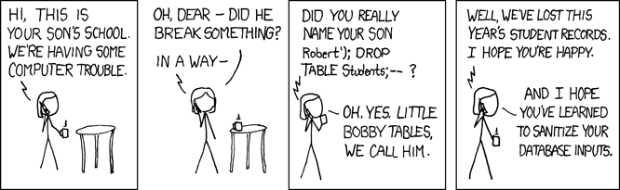
SQL injection
http://xkcd.com/327/

Slide 4
Django QuerySets automatically escape all special SQL characters.
Except in:
raw queries (Managers.raw, cursor.execute(), ...)
where and select arguments to extra()
User.objects.raw('SELECT * FROM users WHERE name = ' + name)
User.objects.raw('SELECT * FROM users WHERE name = %s' % name)
User.objects.raw('SELECT * FROM users WHERE name = %s', [name,])

Slide 5
Lesson learned (SQL Injection):
Never, never, NEVER use Python string concatenation (+) or string parameters interpolation (%) to pass variables to a SQL query string. Not even at gunpoint.
http://initd.org/psycopg/docs/usage.html#passing-parameters-to-sql-queries

Slide 6
XSS
Bob has a website where users can create their own profile pages
Mallory submit some javascript code in the description field of his profile page
Alice visits Mallory's profile page, Mallory's javascript get's executed and send Alice's cookies (sessionid) to Mallory's server.
Mallory can impersonate Alice on Bob's website

Slide 7
Django templating engine automatically escapes all special HTML characters.
django/utils/html.py
def escape(html):
"""
Returns the given HTML with ampersands, quotes and angle brackets encoded.
"""
return mark_safe(force_unicode(html).replace('&', '&amp;').replace('<', '&lt;').replace('>', '&gt;').replace('"', '&quot;').replace("'", '&#39;'))
Demo...

Slide 8
Lessons Learned (XSS)
- Always escape User Generated Content (UGC)
- Do NOT pass UGC through markup filters
- Django auto escape only protects you in HTML context! (inside HTML element content)
  Use urlize and escapejs template filters
  Do not output UGC anywhere else (CSS, HTML comments, ...)
  SESSION_COOKIE_HTTPONLY = True (Django 1.3)
http://www.owasp.org/index.php/XSS_(Cross_Site_Scripting)_Prevention_Cheat_Sheet
http://ha.ckers.org/xss.html

Slide 9
CSRF
Alice has admin rights on her Django site
Mallory has a website with a form that POST to Alice's website admin and create a new admin account. The form is automatically submitted via javascript.
Alice visits Mallory's website.
Mallory has admin rights on Alice's website.

Slide 10
In order to prevent forged POST requests, Django CSRF protection:
1. Generate a large random number (csrf token)
2. Set a cookie to the value of the csrf token
3. Make the csrf token available in the context so that it can be added to every form submission
4. For every POST, verify: COOKIES[csrf] == POST[csrf]
browser same origin policy → csrf cookie not available to Mallory.
Demo...

Slide 11
Lessons Learned (CSRF)
- Ensure non POST requests are side-effect free
- Enable the CsrfViewMiddleware in your settings
- Use @csrf_protect decorator in reusable apps
- Keep control of subdomains
- Upgrade to Django 1.3 or 1.2.5 (CSRF AJAX issue)
- Prevent XSS: if there is a XSS, there is a CSRF (MySpace Samy worm).

Slide 12
HTTP Header Injection
Bob has a website that redirect users back to the original page after login
http://bob.com/login?next=/blog/1/
When the user is already logged in, login step is skipped and redirection happen immediately
Mallory trick Alice into visiting:
http://bob.com/login?next=%0D%0A%0D%0A<script>...</script>

Slide 13
4. Alice receives the following HTTP Response
HTTP/1.0 302 FOUND
Location:
<script>...</script>
5. Mallory can impersonate Alice on Bob's website.

Slide 14
Django filters all HTTP Response Headers.
See HttpResponse.__setitem__ in django/http/__init__.py
Python Cookie module automatically quotes any non-text character
Looks like we really don't have to worry about HTTP Header injection when using Django! :-)

