Slide 1

Phase 4: Time Series
Daniel Journic

Slide 2
Contents
Business Problem
The Data
Process
Conclusion

Slide 3
Business Problem:
A high end real estate developer has tasked us with finding properties In PA to invest in towards building commercial properties.
Identify 5 zip codes for investment
Forecast potential growth

Slide 4
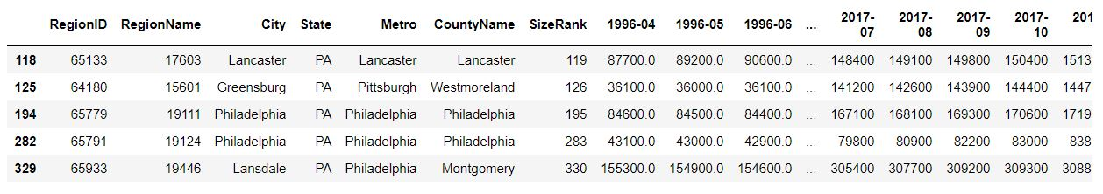
The Data
Zillow housing data:

Slide 5
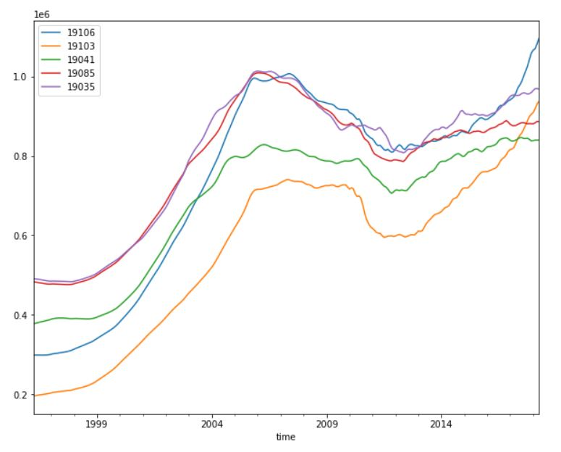
The Process
After melting the data, and plotting:

Slide 6
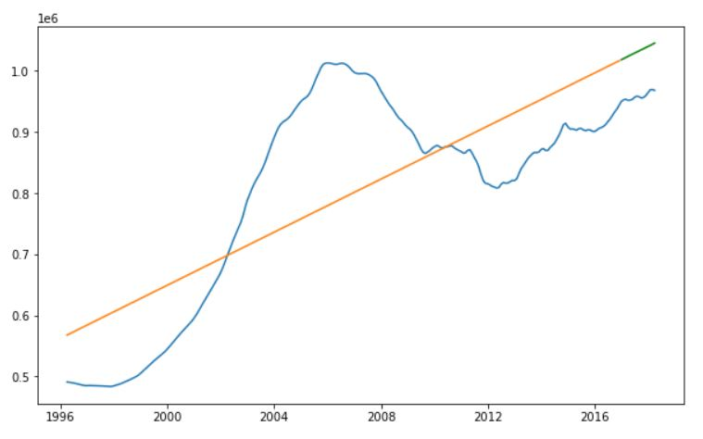
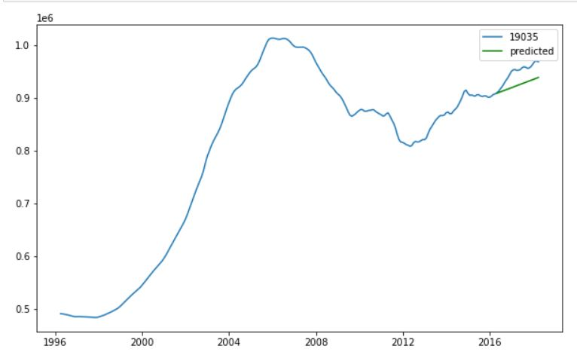
Process con’t
Baseline: Linear Regression
Auto Arima

Slide 7
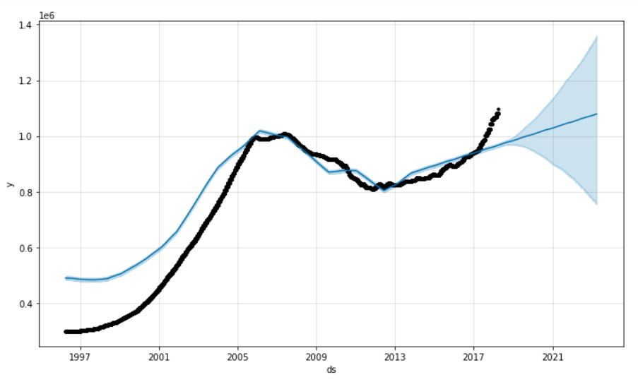
Process con’t
Prophet:

Slide 8
Conclusions
Obviously, ARIMA did better than LR
Still more work to do with Prophet, but it has potential

Slide 9
Thank you
Questions?
djournic@gmail.com

