Slide 1








IBM Data Scientist
Vladimir Kruzhkov
05.03.2021

Slide 2



OUTLINE
Introduction
Data
Methodology
Results and Discussion
Conclusion

Slide 3

INTRODUCTION
In this project, we will try to find the best place for a supermarket:
with a minimum number of supermarkets nearby
with no other supermarkets within a 100-meter radius
with a cost not exceeding the median

Slide 4

Data
Our research uses the following data sources:
data on rental offers for premises with an area of 260 to 500 square meters located on the 1st floor of buildings.
Link
the number of supermarkets, their location in each area will be obtained using the Foursquare API

Slide 5

METHODOLOGY
Data Collection
real estate rental offers (cian.ru)
FourSquare API
Data Wrangling
Data Analysis
Rental offers
Geolocations
Selection of optimal offers
Data Visualization

Slide 6
RESULTS

Slide 7
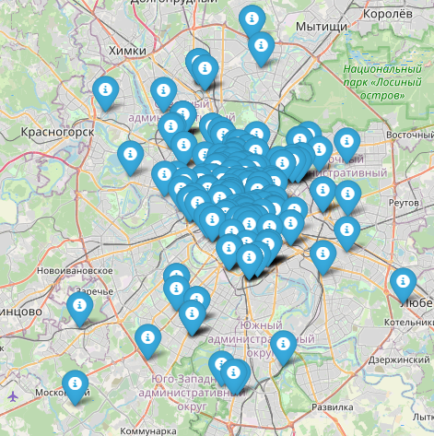
OFFERS

Slide 8
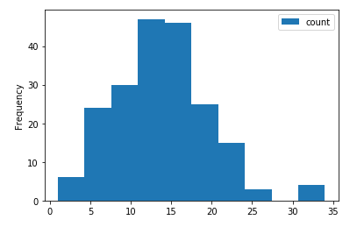
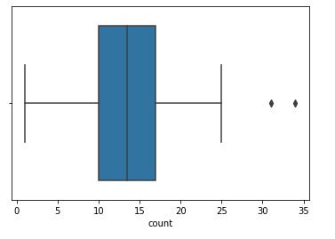
Supermarkets distribution

Slide 9
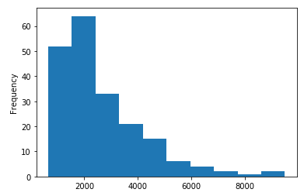
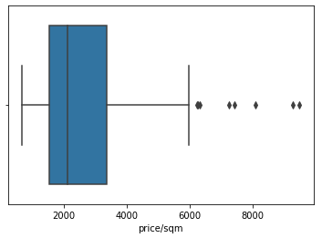
Distribution of the rental offer price

Slide 10
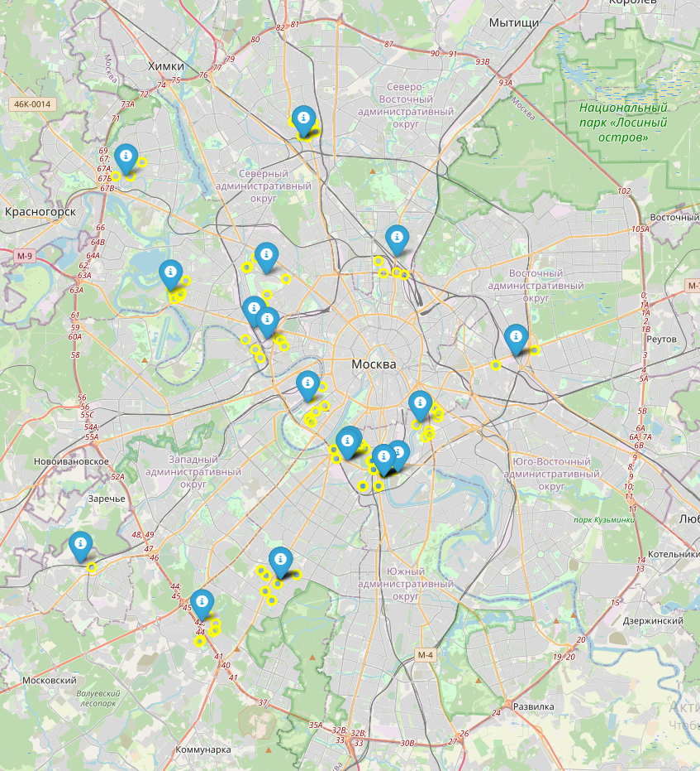
Rental offers and supermarkets

Slide 11
Results and Discussion
As a result of the study, 26 potential locations for the supermarket were selected out of 200 rental offers, according to the following parameters:
the options that are in competition in the lower quantile are selected
with no other supermarkets within a 100-meter radius
with a cost not exceeding the median

Slide 12

CONCLUSION
The aim of this project was to identify areas with a small number of supermarkets within the borders of Moscow, to help stakeholders narrow down the search for the optimal location for opening a new supermarket. By calculating the supermarket density distribution based on Foursquare data, we have created a set of locations that meet some basic requirements for nearby supermarkets

