Slide 1


EarthSight AI: Automated Satellite Imagery Analysis for Environmental Monitoring
Powered By
The Terrasentinels

Slide 2


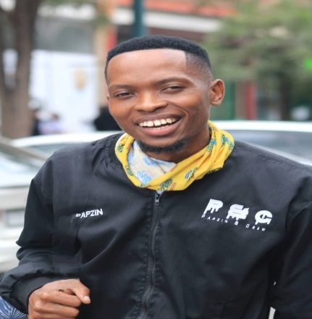
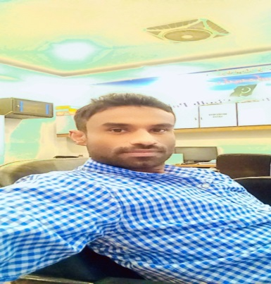


Team Terrasentinels
Team Lead Vikash Kodati (Engineer and Architect)
Letlhogonolo Fanampe
Computer Vision Specialist
Sumayyea Salahuddin
(Engineer and AI Developer)
WAQAS ALI
PRESENTATION
Shahzil Imran
AI & Python Programmer
Hamza Afzal Technical

Slide 3

The Problem “ The Environmental Challenge ”
“ Environmental changes are accelerating globally,
Manual monitoring is time-consuming and error-prone,
Delayed detection leads to irreversible damage,
Current solutions lack real-time analysis and scalability ”
The increasing need for real-time environmental monitoring due to climate change, urbanization, and illegal deforestation.
Traditional monitoring methods are slow, expensive, and often inaccurate.
Current solutions cannot handle large-scale geospatial datasets efficiently.

Slide 4

The solution
Our AI agent automates satellite imagery analysis to detect environmental changes
Leverages MindsDB for real-time analysis, Google Earth Engine for satellite data, and TensorFlow for pattern recognition
Focused on detecting anomalies in satellite telemetry data (NDVI) using Sentinel Hub for data fetching and MindsDB for anomaly detection
KEY FEATURES
Automated monitoring,
Anomaly detection,
Alert generation, and reporting for deforestation, urban expansion, and disaster response.
Real-time monitoring of environmental changes
Anomaly detection for rapid response
Large-scale geospatial data processing Integration with MindsDB for advanced analytics
Customizable alerts and reporting system

Slide 5
The solution
TECHNOLOGIES
MindsDB, ML models can automatically generate reports or trigger alerts for deforestation or other anomalies.
Pandas, clean, transform, and analyze large geospatial datasets. It's especially useful like satellite metadata, forest cover classification, and environmental reports.
NumPy, for processing image data from satellite images. such as normalizing image pixel values and transforming raw data into arrays for machine learning models.
CrewAI, used for collaborative AI development tools and APIs. leveraged for collaborative work, to develop, test, and share models effectively, especially in a project that involved handling complex geospatial data.
Matplotlib, for data visualization. visualize the results of satellite image. help present changes in land use, deforestation, and anomalies in a clear, visual format, making the data easier to interpret.
Rasterio, raster data, specifically geospatial images such as satellite photos. used to read and manipulate satellite imagery. It's especially useful for loading, cropping, and transforming geospatial raster data into formats that can be processed by our AI models.

Slide 6
Market Size & Business Value
“ Global Earth Observation market size: $4.5 billion in 2022, expected to reach $7.3 billion by 2027 (CAGR of 10.1%) ”
Target sectors:
Government agencies
Environmental organizations
Agriculture industry
Urban planners
Insurance companies
Value proposition:
Cost-effective monitoring of vast areas
Early detection of environmental issues
Data-driven decision making
Compliance with environmental regulations
Reduce costs and improve decision-making with real-time, automated insights from satellite data.

Slide 7
Revenue Stream
Scalable Revenue Model:
Subscription-based model: Offer monthly/annual subscriptions to access the platform for monitoring.
Custom analytics packages: Charge for specialized reports, custom insights, and region-specific monitoring services.
Data as a Service (DaaS): Offer real-time processed geospatial data to third-party applications.

Slide 8
Revenue stream
Environmental consultancies, construction companies, and agricultural firms
Local, State, or National Governments
Eco-conscious individuals or organizations , NGOs
B2G
B2C
B2B
Subscription-based access
Allowing them to monitor protected areas, national parks, and urban sprawl in real-time.
Governments can use the platform to track illegal deforestation or urban expansion, helping enforce land-use policies and prevent violations.
Providing governments with customized reports for large-scale urban planning, environmental monitoring, and disaster response.
Offer real-time geospatial data to government bodies for integration into policy frameworks, disaster management, and environmental regulation enforcement. Municipal governments could use DaaS to monitor land-use compliance and respond to environmental disasters like wildfires..
Consumer-tier subscription
tracking environmental changes in their local areas.
Individuals or organizations like community groups may want to track deforestation or urbanization in their vicinity.
A community might request a custom report on the deforestation status of a nearby forest to advocate for conservation efforts.
Although more suited for businesses, a light version of DaaS can be offered to consumers through apps, allowing them to access raw data on a small scale for their own analysis or personal projects.
Monthly/annual subscriptions
These businesses can monitor specific regions for deforestation, urban expansion, or natural disasters to ensure compliance and optimize land management.
Providing real-time geospatial data to companies offering environmental or urban planning services.
Geospatial analytics firms could integrate the data into their solutions to offer enhanced environmental monitoring to their own clients.
specialized reports, insights, and region-specific monitoring.

Slide 9
Next Steps , Backlogs
Roadmap and Backlog
Next Steps: Fine-tune models for land-use classification and anomaly detection.
Expand region-specific models for deforestation and disaster-prone areas.
Backlog: Improve scalability to process more satellite data.
Integrate with more data sources like drone imagery and LiDAR.

Slide 10
Working Demo
« Live Demo – AI in Action

