Slide 1
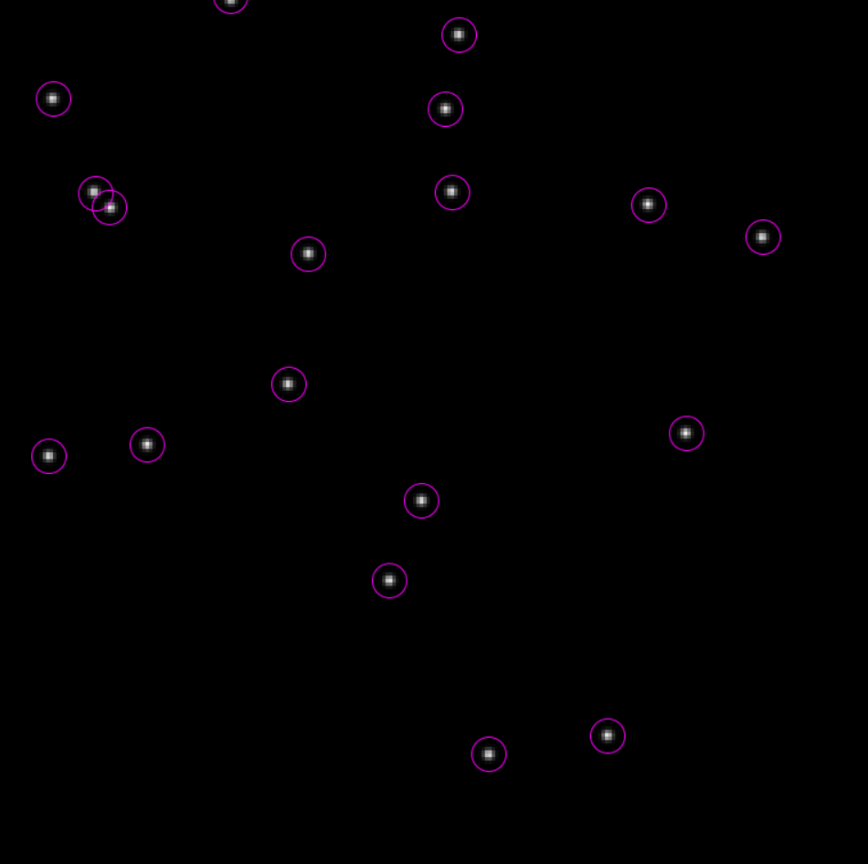
Object Detection
Detecting objects to be tracked

Slide 2
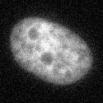

What is image segmentation?
Background labelled white
Background
Foreground labelled black
Foreground
Process of dividing image into regions
Assigning labels to each pixel
“Binary” or “Mask” Image

Slide 3
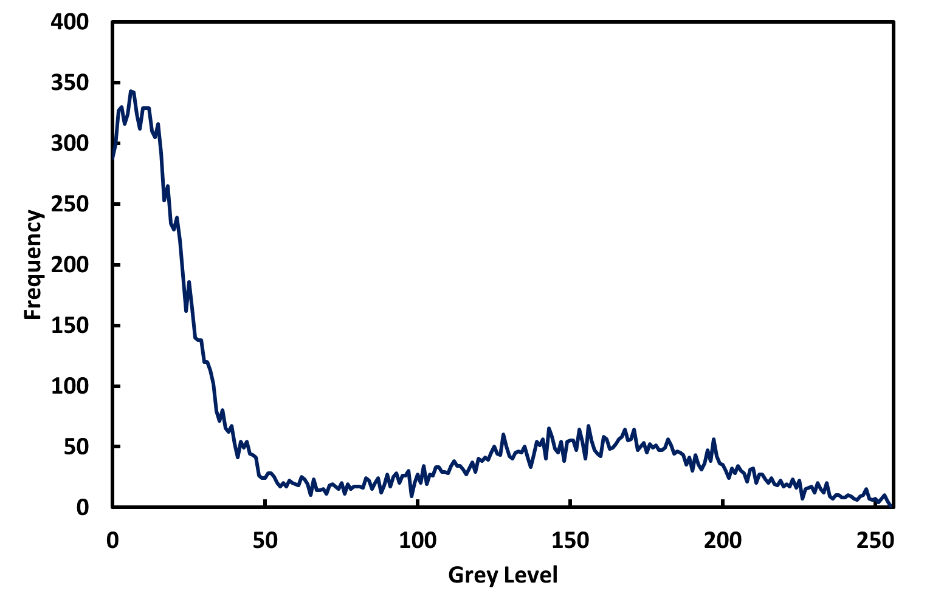
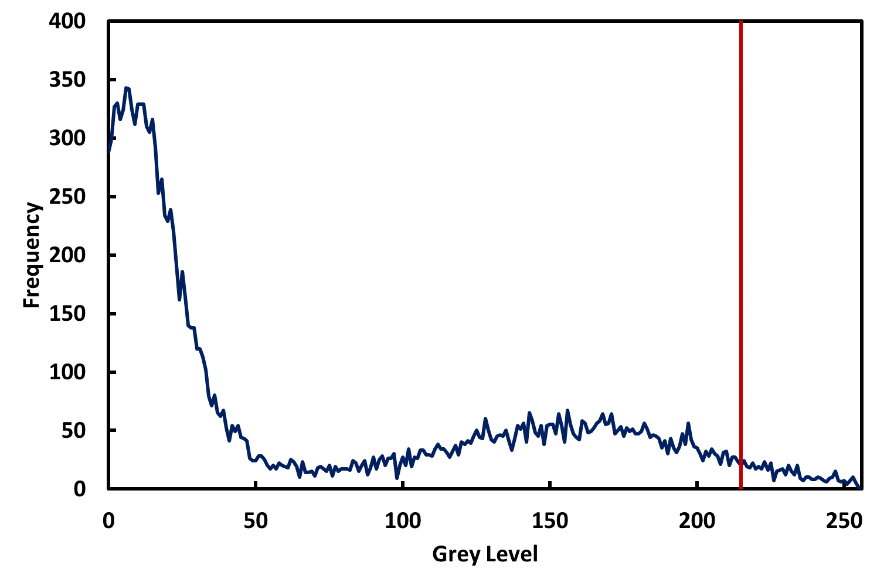
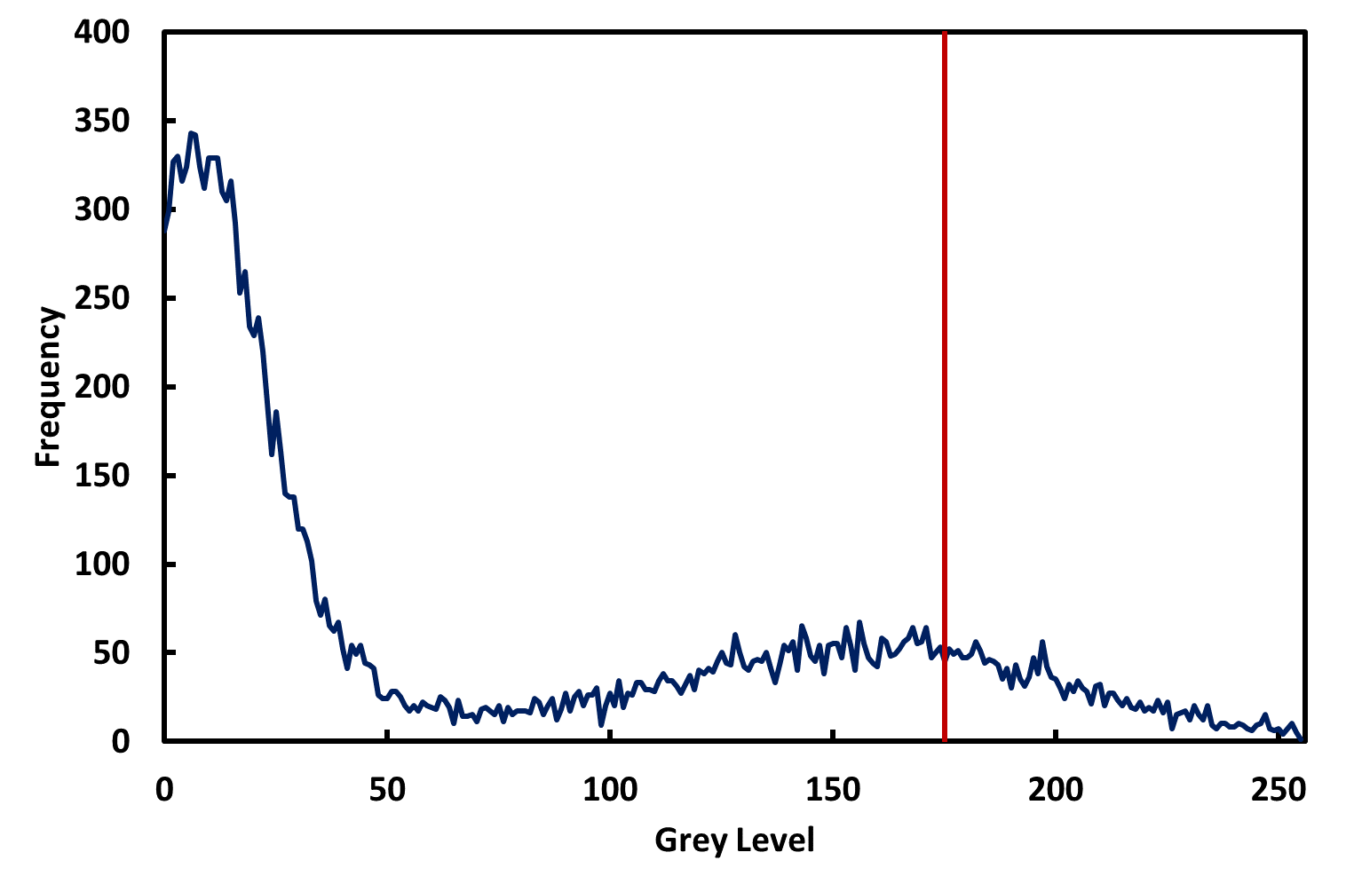
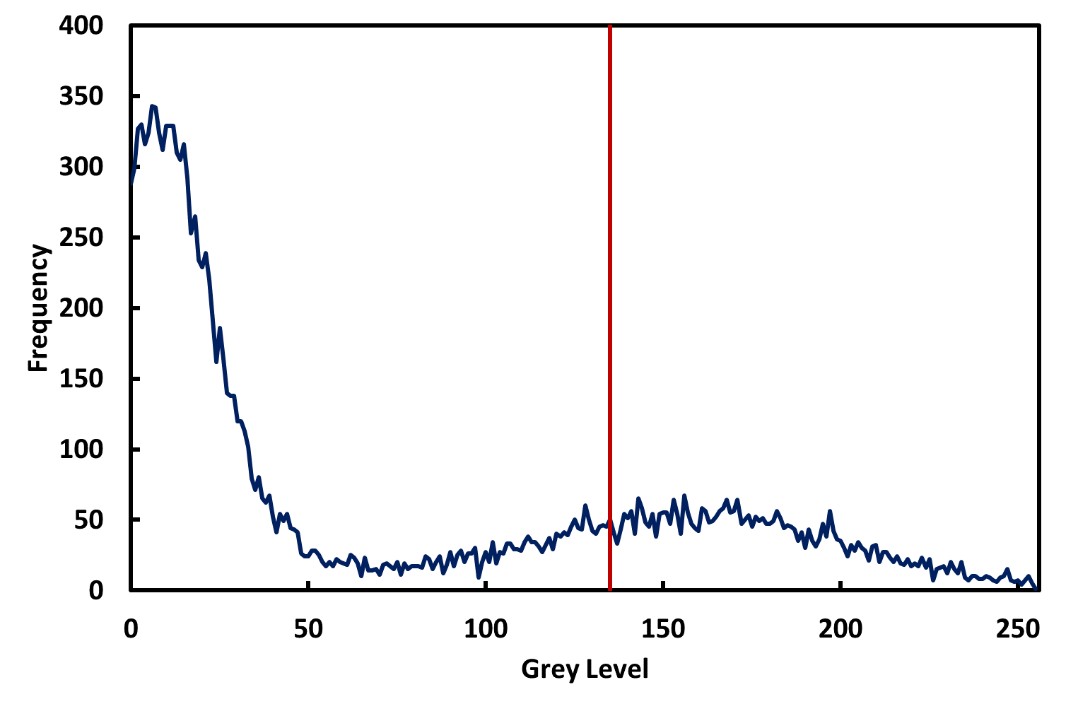
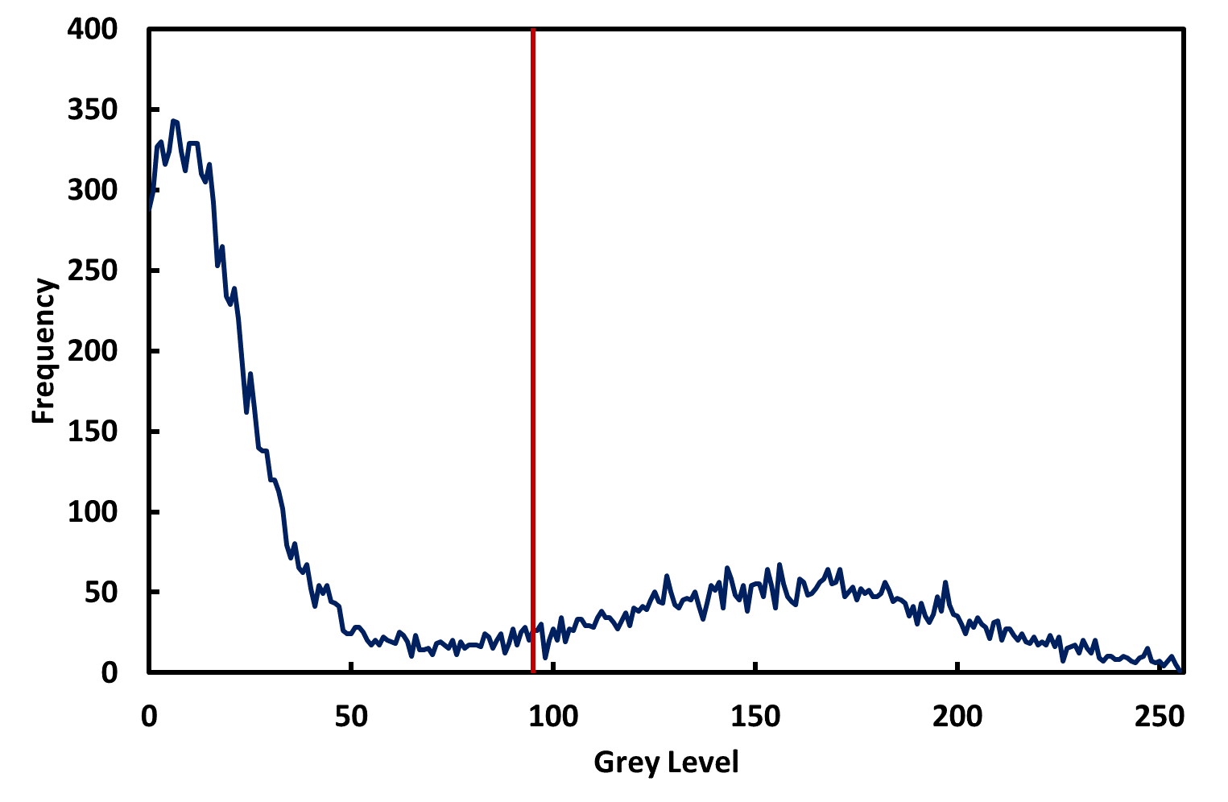



Background
Foreground
$$T> \frac{\text{Average} \text{of} \text{Foreground} \text{Pixels}+\text{Average} \text{of} \text{Background} \text{Pixels}}{2}$$
FIJI has several variations on this algorithm

Slide 4
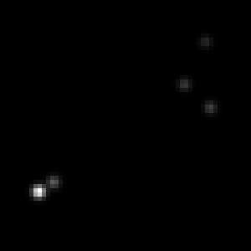
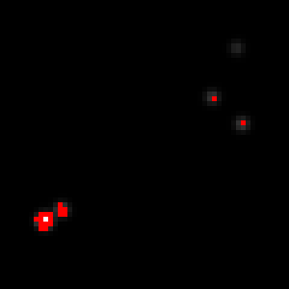
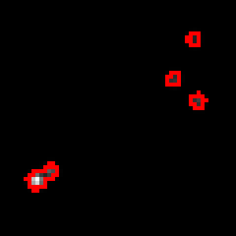
Can we segment particles this way?
If background is uniform and all exhibit similar intensity
Even then, not ideal:
Adjacent particles conjoined
Loss of localisation accuracy

Slide 5
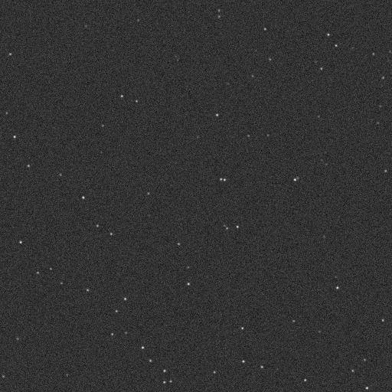
Demo 2 – detection by thresholding
Filter
Threshold
Analyze

Slide 6
Quiz 2 – detection by thresholding
Open the images in the Quiz 2 folder.
2 Points:
Using thresholding and the Particle Analyzer, how many particles can you detect in the two images?
2 Points:
Why do your answers almost certainly differ from the true value?

Slide 7
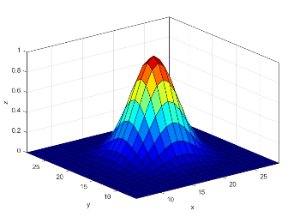
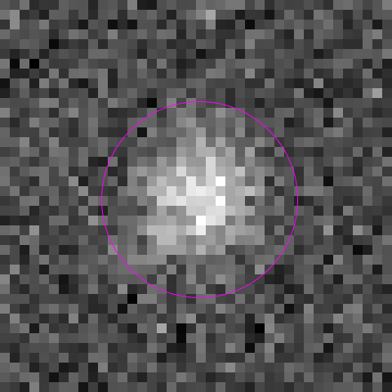
Other means of detection
0 | 0 | 0 | 1 | 0 | 0 | 0
0 | 1 | 6 | 10 | 6 | 1 | 0
0 | 6 | 29 | 50 | 31 | 7 | 1
1 | 11 | 52 | 90 | 55 | 12 | 1
0 | 7 | 33 | 57 | 35 | 8 | 1
0 | 2 | 7 | 13 | 8 | 2 | 0
0 | 0 | 1 | 1 | 1 | 0 | 0
Local maxima
Blobs
Gaussian (Point Spread Function)
Noise can complicate matters

Slide 8
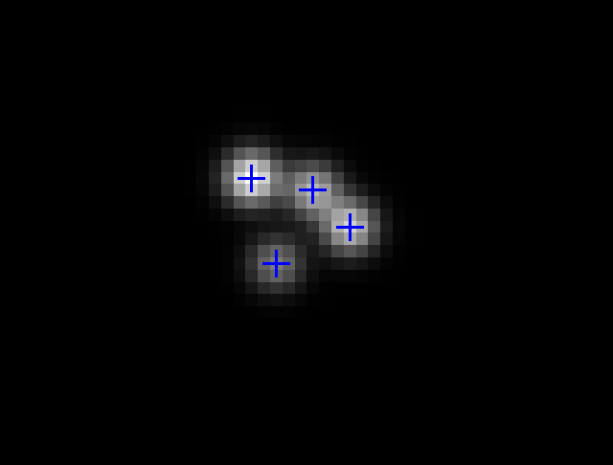
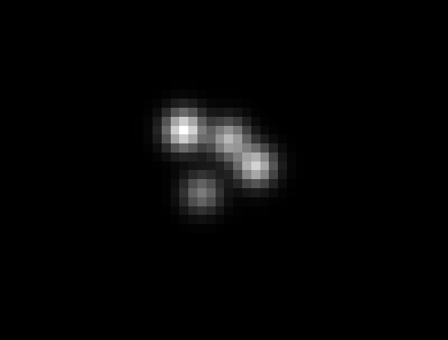
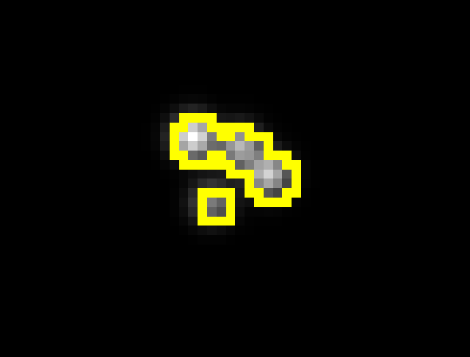
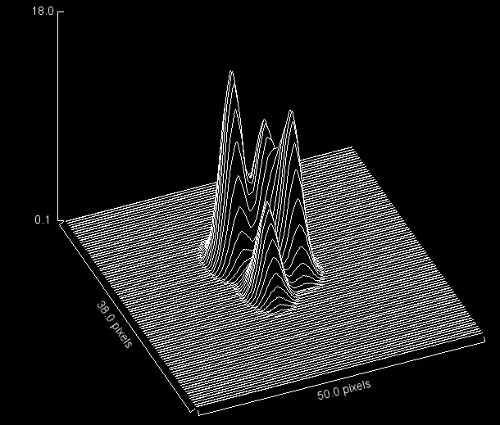
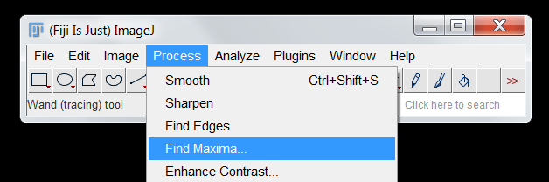
Local maxima detection

Slide 9

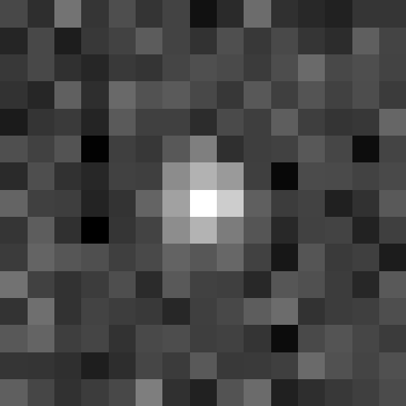
Detecting Local Maxima
33 | 21 | 54 | 25 | 36 | 24 | 31 | 8 | 19 | 50 | 22 | 18 | 15 | 25 | 25
17 | 34 | 13 | 26 | 31 | 43 | 31 | 23 | 37 | 26 | 34 | 25 | 20 | 44 | 32
26 | 33 | 23 | 17 | 27 | 24 | 32 | 37 | 34 | 28 | 36 | 49 | 34 | 36 | 31
23 | 18 | 44 | 22 | 49 | 38 | 42 | 34 | 25 | 41 | 29 | 39 | 30 | 36 | 28
12 | 24 | 27 | 17 | 42 | 30 | 30 | 20 | 34 | 29 | 44 | 29 | 24 | 26 | 47
37 | 30 | 38 | 1 | 29 | 26 | 41 | 84 | 22 | 29 | 30 | 41 | 33 | 6 | 31
20 | 36 | 23 | 18 | 30 | 29 | 65 | 83 | 72 | 29 | 4 | 35 | 34 | 30 | 34
47 | 30 | 29 | 16 | 23 | 46 | 75 | 84 | 81 | 44 | 28 | 31 | 15 | 23 | 41
24 | 43 | 22 | 0 | 25 | 31 | 65 | 83 | 58 | 39 | 18 | 30 | 31 | 16 | 29
27 | 47 | 40 | 37 | 29 | 34 | 46 | 40 | 48 | 30 | 11 | 40 | 27 | 29 | 13
53 | 30 | 23 | 28 | 36 | 20 | 41 | 30 | 29 | 18 | 40 | 37 | 28 | 18 | 42
24 | 51 | 23 | 31 | 28 | 26 | 18 | 29 | 34 | 43 | 50 | 23 | 28 | 29 | 36
41 | 46 | 29 | 32 | 23 | 34 | 36 | 29 | 30 | 24 | 6 | 34 | 39 | 32 | 27
25 | 24 | 22 | 14 | 21 | 33 | 27 | 41 | 26 | 27 | 29 | 49 | 38 | 32 | 37
44 | 33 | 23 | 28 | 34 | 58 | 22 | 15 | 38 | 50 | 15 | 22 | 26 | 29 | 35
0 | 0 | 0 | 1 | 0 | 0 | 0
0 | 1 | 6 | 10 | 6 | 1 | 0
0 | 6 | 29 | 50 | 31 | 7 | 1
1 | 11 | 52 | 90 | 55 | 12 | 1
0 | 7 | 33 | 57 | 35 | 8 | 1
0 | 2 | 7 | 13 | 8 | 2 | 0
0 | 0 | 1 | 1 | 1 | 0 | 0

Slide 10
Filtering Suppresses noise
33 | 21 | 54 | 25 | 36 | 24 | 31 | 8 | 19 | 50 | 22 | 18 | 15 | 25 | 25
17 | 34 | 13 | 26 | 31 | 43 | 31 | 23 | 37 | 26 | 34 | 25 | 20 | 44 | 32
26 | 33 | 23 | 17 | 27 | 24 | 32 | 37 | 34 | 28 | 36 | 49 | 34 | 36 | 31
23 | 18 | 44 | 22 | 49 | 38 | 42 | 34 | 25 | 41 | 29 | 39 | 30 | 36 | 28
12 | 24 | 27 | 17 | 42 | 30 | 30 | 20 | 34 | 29 | 44 | 29 | 24 | 26 | 47
37 | 30 | 38 | 1 | 29 | 26 | 41 | 84 | 22 | 29 | 30 | 41 | 33 | 6 | 31
20 | 36 | 23 | 18 | 30 | 29 | 65 | 83 | 72 | 29 | 4 | 35 | 34 | 30 | 34
47 | 30 | 29 | 16 | 23 | 46 | 75 | 84 | 81 | 44 | 28 | 31 | 15 | 23 | 41
24 | 43 | 22 | 0 | 25 | 31 | 65 | 83 | 58 | 39 | 18 | 30 | 31 | 16 | 29
27 | 47 | 40 | 37 | 29 | 34 | 46 | 40 | 48 | 30 | 11 | 40 | 27 | 29 | 13
53 | 30 | 23 | 28 | 36 | 20 | 41 | 30 | 29 | 18 | 40 | 37 | 28 | 18 | 42
24 | 51 | 23 | 31 | 28 | 26 | 18 | 29 | 34 | 43 | 50 | 23 | 28 | 29 | 36
41 | 46 | 29 | 32 | 23 | 34 | 36 | 29 | 30 | 24 | 6 | 34 | 39 | 32 | 27
25 | 24 | 22 | 14 | 21 | 33 | 27 | 41 | 26 | 27 | 29 | 49 | 38 | 32 | 37
44 | 33 | 23 | 28 | 34 | 58 | 22 | 15 | 38 | 50 | 15 | 22 | 26 | 29 | 35
6 | 8 | 10 | 9 | 8 | 7 | 4 | 1 | 4 | 9 | 6 | 1 | 0 | 3 | 4
3 | 5 | 5 | 5 | 7 | 9 | 7 | 5 | 7 | 9 | 8 | 6 | 6 | 8 | 8
2 | 4 | 4 | 4 | 8 | 10 | 10 | 9 | 9 | 10 | 11 | 11 | 10 | 10 | 10
1 | 3 | 5 | 6 | 10 | 12 | 11 | 10 | 9 | 10 | 12 | 12 | 10 | 10 | 10
1 | 3 | 4 | 4 | 8 | 11 | 13 | 13 | 11 | 10 | 11 | 10 | 8 | 7 | 11
5 | 6 | 3 | 1 | 5 | 12 | 21 | 25 | 19 | 11 | 8 | 9 | 6 | 5 | 9
8 | 7 | 3 | 0 | 5 | 17 | 34 | 43 | 35 | 17 | 7 | 6 | 6 | 6 | 9
11 | 9 | 4 | 0 | 6 | 21 | 41 | 53 | 43 | 22 | 8 | 5 | 4 | 5 | 9
11 | 11 | 6 | 1 | 6 | 18 | 34 | 43 | 35 | 18 | 7 | 5 | 4 | 3 | 5
13 | 13 | 9 | 6 | 7 | 13 | 22 | 25 | 21 | 12 | 7 | 7 | 6 | 4 | 4
15 | 14 | 9 | 7 | 7 | 9 | 12 | 13 | 12 | 10 | 9 | 9 | 7 | 6 | 7
14 | 13 | 9 | 7 | 6 | 6 | 7 | 8 | 9 | 9 | 10 | 9 | 8 | 8 | 10
13 | 12 | 7 | 5 | 5 | 7 | 8 | 8 | 8 | 7 | 7 | 9 | 10 | 10 | 10
11 | 8 | 4 | 3 | 6 | 9 | 9 | 8 | 8 | 7 | 6 | 9 | 10 | 10 | 11
14 | 9 | 4 | 5 | 10 | 14 | 9 | 6 | 10 | 11 | 6 | 5 | 7 | 9 | 11

Slide 11
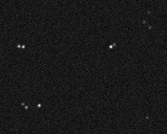
Demo 3 – Local Maxima Detection
Demonstrate benefits of local maxima detection versus thresholding

Slide 12
Quiz 3 – Local Maxima Detection
Open the images in the Quiz 3 folder.
1 Point:
Using the maxima finder, determine how many particles there are in Dots_1.ome.tif
1 Point:
Using a combination of filtering and the maxima finder, count the number of particles in Dots_2.ome.tif

Slide 13
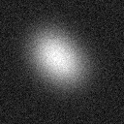
Gaussian Filtering is the basis for blob detection
For larger objects, a Laplacian-of-Gaussian (LoG) works quite well
Needs sufficient spatial resolution for edge detector
For smaller objects, a Difference-of-Gaussians (DoG) is better.
Rough approximation of LoG

Slide 14
Laplacian of gaussian

Slide 15
Effect of LoG Filtering
33 | 21 | 54 | 25 | 36 | 24 | 31 | 8 | 19 | 50 | 22 | 18 | 15 | 25 | 25
17 | 34 | 13 | 26 | 31 | 43 | 31 | 23 | 37 | 26 | 34 | 25 | 20 | 44 | 32
26 | 33 | 23 | 17 | 27 | 24 | 32 | 37 | 34 | 28 | 36 | 49 | 34 | 36 | 31
23 | 18 | 44 | 22 | 49 | 38 | 42 | 34 | 25 | 41 | 29 | 39 | 30 | 36 | 28
12 | 24 | 27 | 17 | 42 | 30 | 30 | 20 | 34 | 29 | 44 | 29 | 24 | 26 | 47
37 | 30 | 38 | 1 | 29 | 26 | 41 | 84 | 22 | 29 | 30 | 41 | 33 | 6 | 31
20 | 36 | 23 | 18 | 30 | 29 | 65 | 83 | 72 | 29 | 4 | 35 | 34 | 30 | 34
47 | 30 | 29 | 16 | 23 | 46 | 75 | 84 | 81 | 44 | 28 | 31 | 15 | 23 | 41
24 | 43 | 22 | 0 | 25 | 31 | 65 | 83 | 58 | 39 | 18 | 30 | 31 | 16 | 29
27 | 47 | 40 | 37 | 29 | 34 | 46 | 40 | 48 | 30 | 11 | 40 | 27 | 29 | 13
53 | 30 | 23 | 28 | 36 | 20 | 41 | 30 | 29 | 18 | 40 | 37 | 28 | 18 | 42
24 | 51 | 23 | 31 | 28 | 26 | 18 | 29 | 34 | 43 | 50 | 23 | 28 | 29 | 36
41 | 46 | 29 | 32 | 23 | 34 | 36 | 29 | 30 | 24 | 6 | 34 | 39 | 32 | 27
25 | 24 | 22 | 14 | 21 | 33 | 27 | 41 | 26 | 27 | 29 | 49 | 38 | 32 | 37
44 | 33 | 23 | 28 | 34 | 58 | 22 | 15 | 38 | 50 | 15 | 22 | 26 | 29 | 35
34 | 35 | 38 | 39 | 38 | 37 | 33 | 33 | 34 | 33 | 34 | 37 | 33 | 28 | 25
35 | 37 | 38 | 37 | 37 | 37 | 36 | 36 | 37 | 35 | 36 | 37 | 34 | 30 | 25
38 | 37 | 36 | 36 | 35 | 33 | 31 | 31 | 33 | 33 | 34 | 37 | 37 | 34 | 30
35 | 34 | 35 | 35 | 32 | 27 | 21 | 19 | 20 | 23 | 28 | 33 | 37 | 38 | 35
33 | 34 | 35 | 34 | 27 | 17 | 10 | 7 | 8 | 11 | 19 | 28 | 33 | 35 | 35
36 | 37 | 37 | 32 | 20 | 7 | 2 | 3 | 2 | 3 | 11 | 23 | 31 | 34 | 34
37 | 38 | 37 | 28 | 13 | 2 | 3 | 13 | 8 | 0 | 6 | 19 | 30 | 35 | 36
35 | 35 | 34 | 24 | 10 | 2 | 10 | 29 | 16 | 1 | 5 | 18 | 30 | 36 | 38
37 | 36 | 32 | 22 | 11 | 4 | 10 | 17 | 8 | 0 | 6 | 20 | 31 | 37 | 39
37 | 38 | 32 | 23 | 14 | 7 | 5 | 4 | 2 | 3 | 12 | 24 | 33 | 38 | 39
35 | 37 | 35 | 27 | 19 | 12 | 8 | 6 | 7 | 12 | 20 | 30 | 36 | 38 | 37
34 | 35 | 36 | 31 | 25 | 20 | 18 | 17 | 19 | 23 | 29 | 35 | 38 | 38 | 37
34 | 34 | 36 | 35 | 31 | 29 | 27 | 27 | 28 | 30 | 34 | 37 | 38 | 37 | 36
34 | 35 | 36 | 36 | 35 | 34 | 34 | 33 | 32 | 33 | 35 | 36 | 37 | 35 | 33
36 | 35 | 36 | 37 | 36 | 36 | 37 | 36 | 34 | 34 | 35 | 36 | 37 | 33 | 30

Slide 16
Effect of DOG Filtering
33 | 21 | 54 | 25 | 36 | 24 | 31 | 8 | 19 | 50 | 22 | 18 | 15 | 25 | 25
17 | 34 | 13 | 26 | 31 | 43 | 31 | 23 | 37 | 26 | 34 | 25 | 20 | 44 | 32
26 | 33 | 23 | 17 | 27 | 24 | 32 | 37 | 34 | 28 | 36 | 49 | 34 | 36 | 31
23 | 18 | 44 | 22 | 49 | 38 | 42 | 34 | 25 | 41 | 29 | 39 | 30 | 36 | 28
12 | 24 | 27 | 17 | 42 | 30 | 30 | 20 | 34 | 29 | 44 | 29 | 24 | 26 | 47
37 | 30 | 38 | 1 | 29 | 26 | 41 | 84 | 22 | 29 | 30 | 41 | 33 | 6 | 31
20 | 36 | 23 | 18 | 30 | 29 | 65 | 83 | 72 | 29 | 4 | 35 | 34 | 30 | 34
47 | 30 | 29 | 16 | 23 | 46 | 75 | 84 | 81 | 44 | 28 | 31 | 15 | 23 | 41
24 | 43 | 22 | 0 | 25 | 31 | 65 | 83 | 58 | 39 | 18 | 30 | 31 | 16 | 29
27 | 47 | 40 | 37 | 29 | 34 | 46 | 40 | 48 | 30 | 11 | 40 | 27 | 29 | 13
53 | 30 | 23 | 28 | 36 | 20 | 41 | 30 | 29 | 18 | 40 | 37 | 28 | 18 | 42
24 | 51 | 23 | 31 | 28 | 26 | 18 | 29 | 34 | 43 | 50 | 23 | 28 | 29 | 36
41 | 46 | 29 | 32 | 23 | 34 | 36 | 29 | 30 | 24 | 6 | 34 | 39 | 32 | 27
25 | 24 | 22 | 14 | 21 | 33 | 27 | 41 | 26 | 27 | 29 | 49 | 38 | 32 | 37
44 | 33 | 23 | 28 | 34 | 58 | 22 | 15 | 38 | 50 | 15 | 22 | 26 | 29 | 35
1 | 1 | 1 | 1 | 1 | 2 | 1 | 1 | 2 | 1 | 2 | 2 | 1 | 0 | 1
1 | 2 | 2 | 1 | 1 | 2 | 2 | 2 | 1 | 1 | 2 | 1 | 1 | 1 | 1
3 | 2 | 1 | 0 | 0 | 2 | 3 | 4 | 3 | 2 | 2 | 2 | 2 | 1 | 2
2 | 1 | 0 | 0 | 2 | 3 | 3 | 2 | 2 | 3 | 4 | 3 | 2 | 1 | 2
1 | 1 | 0 | 1 | 4 | 4 | 1 | 2 | 1 | 2 | 5 | 3 | 1 | 0 | 1
2 | 1 | 1 | 3 | 5 | 2 | 4 | 9 | 7 | 2 | 2 | 3 | 1 | 0 | 0
2 | 1 | 1 | 4 | 3 | 3 | 11 | 17 | 15 | 7 | 1 | 3 | 2 | 0 | 0
1 | 1 | 2 | 4 | 2 | 5 | 15 | 21 | 19 | 9 | 2 | 3 | 2 | 1 | 0
2 | 2 | 3 | 3 | 1 | 5 | 13 | 18 | 15 | 6 | 1 | 3 | 2 | 1 | 1
1 | 2 | 3 | 2 | 1 | 4 | 7 | 9 | 6 | 2 | 2 | 3 | 2 | 1 | 0
1 | 2 | 3 | 2 | 1 | 1 | 1 | 1 | 1 | 2 | 5 | 4 | 2 | 0 | 0
1 | 1 | 2 | 3 | 2 | 2 | 2 | 2 | 2 | 3 | 3 | 2 | 1 | 0 | 0
0 | 1 | 1 | 2 | 2 | 2 | 2 | 2 | 1 | 1 | 1 | 0 | 1 | 1 | 1
0 | 1 | 1 | 1 | 1 | 1 | 1 | 1 | 0 | 0 | 0 | 0 | 1 | 1 | 2
0 | 0 | 1 | 2 | 1 | 0 | 0 | 0 | 0 | 1 | 1 | 0 | 1 | 2 | 1

Slide 17
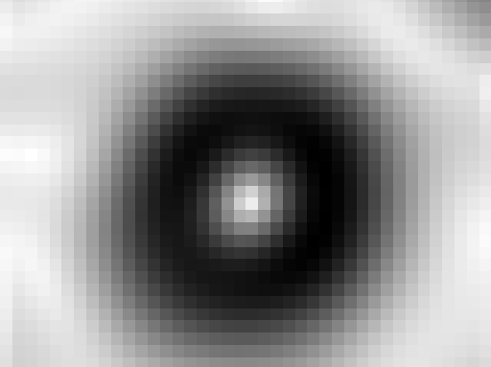
Demo 4 – BLOB Detection
Demonstrate principles of blob detection:
LoG Filtering
DoG Filtering

Slide 18
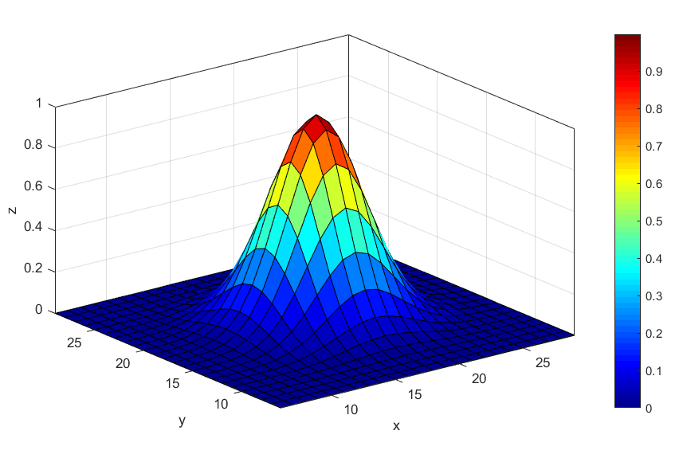
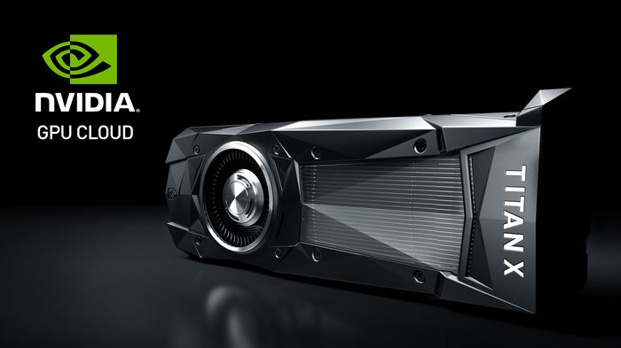
Gaussian Fitting
Fitting to “Point Spread Function”:
Most rigorous approach.
Accurate sub-pixel localisation
Computationally intensive
Only suitable for objects below diffraction limit (< approx. 250 nm)

Slide 19
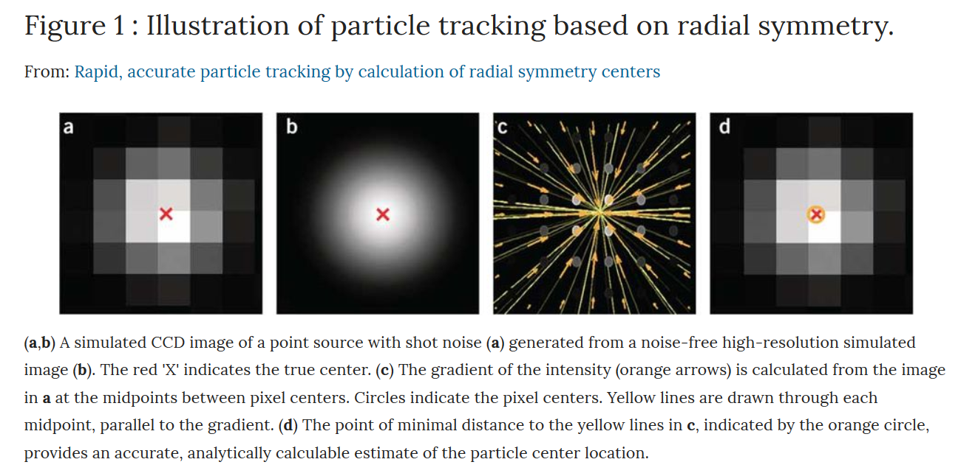
Other methods
Parthasarathy (2012), Nat Meth 9, 724–726

Slide 20
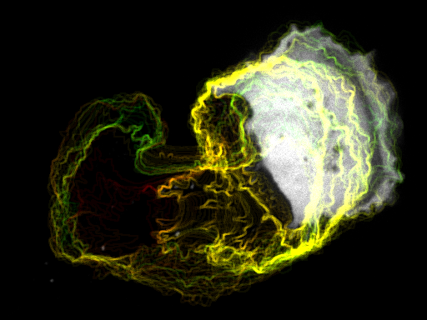
Tracking Cells
A few things to bear in mind

Slide 21
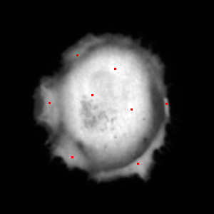
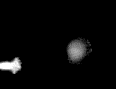

In theory, cells can be tracked in a similar manner
However….
Cells have more than one single maximum
Representing cells as single points loses morphological information
Cells often come into contact with one another

Slide 22
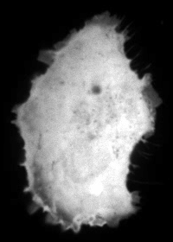

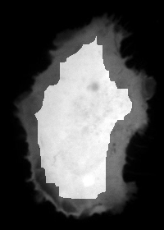
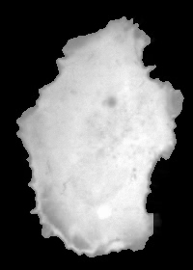
Region-growing Algorithm
Growth terminates when p_{x,y} < T_{g}
Shrink
Regrow
Frame t
Frame t + 1

Slide 23
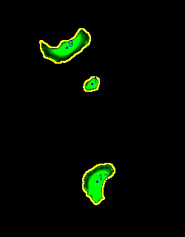
Implicitly tracks cells from frame to frame
Can deal with a certain amount of cell-cell contact
Morphology of cells can be measured at each frame
Frame rate needs to be high
High cell density will cause problems

Slide 24
Demo 6 - Tracking Cells

Slide 25



SW302 ● david.barry@crick.ac.uk

