Slide 1
Sharknadoes Project 2
Group Members:
Jayden Le Blanc
Daniel Petrella
Max Tipton
Dave Damon
Visualizations of Shark Attacks from around the world

Slide 2
01 Found Data Source from Shark Research Institute website and downloaded to a csv file
02 Use jupyter notebooks to clean data frame and create SQLite database file
03 Create Flask App to create .json file
04 Use the json file to populate graphs
05 Display graphs on a webpage
Process

Slide 3
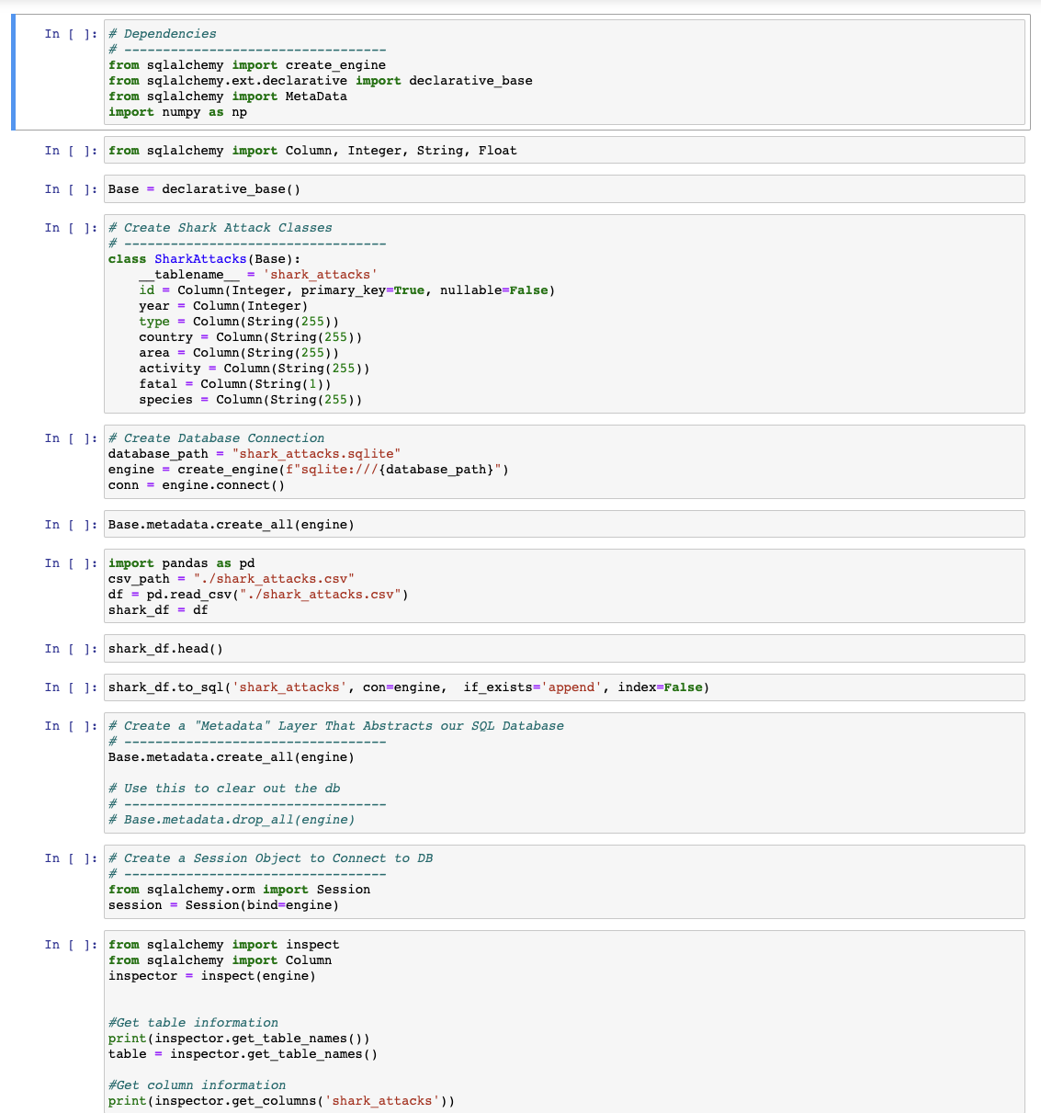
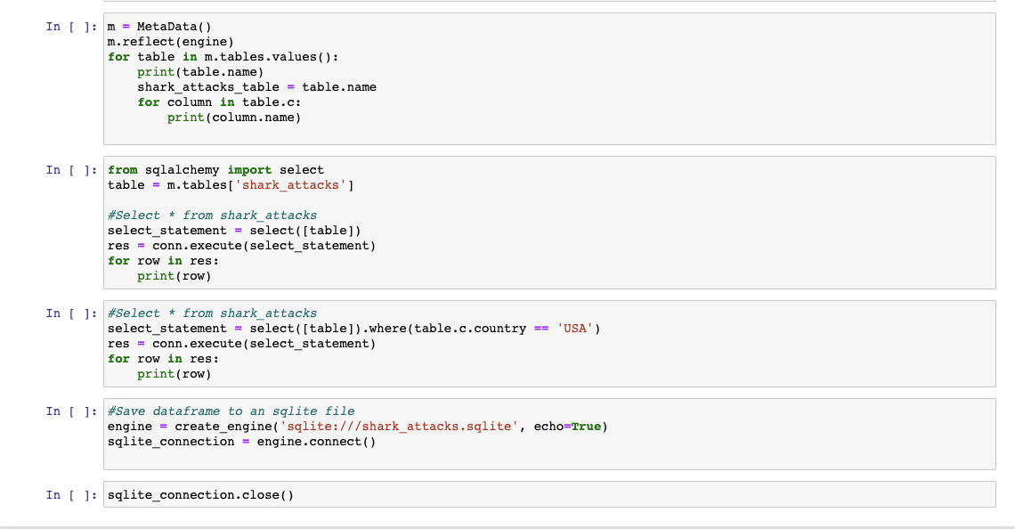
Jupyter Notebook

Slide 4
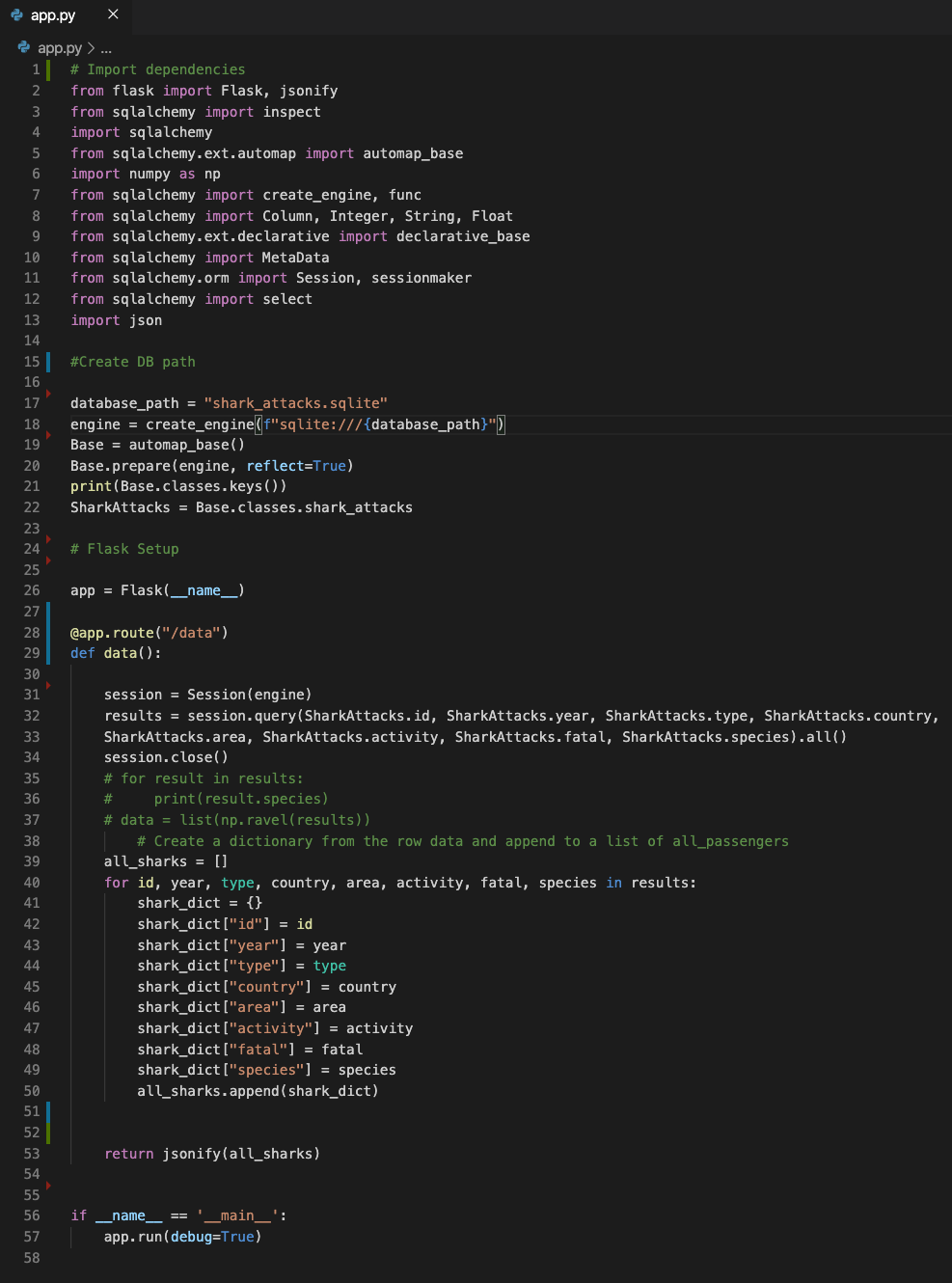
Flask App

Slide 5
Difficulties & what could have been
Populating the graphs using the flask app & .json
Replaced with your own text
Replaced with your own text
Replaced with your own text

Slide 6
THANK YOU

