Slide 1


Getting Started with GitHub Actions
Daniel Redman
DevOps Architect – GitHub
github.com/djredman99
Notes:
Hey y’all!
I’m Dan Redman, a DevOps Architect with the GitHub FastTrack team. In my day job, I go out and help people get more “dev-opsy” with GitHub, and I am thrilled to be here today to talk to you about Getting Started with GitHub Actions. Feel free to mention me on Twitter and tweet out comments or reactions during the presentation.
My assumptions about the audience are:
- You know nothing, or very little about GitHub Actions
Therefore, I’m going to be starting with the basics, but don’t worry, for those of you that do have some GitHub Actions knowledge, I have a real world demo, complete with pull request and deployment automation, as well as slack integration. So there is something for everyone. I also have another talk I give, called Advanced GitHub Actions, where I dive deep into more advanced topics.

Slide 2
Before we begin…..
GitHub mobile app:
https://github.com/mobile/
Navigate to this repo
https://github.com/mickeygoussetorg/intro-to-github-actions-talk
Notes:
Now before we get started, I want to warn you ahead of time that my final demo is an audience participation demo. In order to participate, you’ll need to be able to access my repo, which I have listed on the screen. Don’t worry, I’ll show it again.
I’d encourage you to download the GitHub mobile app and use it, but you can also use a web browser on any device. The GitHub mobile app, if you haven’t used it, is a great way to interact with the different aspects of GitHub, directly from your phone. I tend to use it daily.

Slide 3









































GitHub is the largest developer platform on Earth
65M+
200M+
1,000s
1B+
3M+
72%
Developers
Private and public
repositories
Top open source
communities
Contributions
per year
Organizations
Fortune 500
companies
The most innovative companies
The top open source projects
Leading global enterprises
Largest DevOps ecosystem
Notes:
Don’t know who GitHub is? We are the largest developer platform on Earth. We have built our platform through our experience with millions of developers, thousands of open source communities, thousands of enterprise customers, and hundreds of ISV ecosystem partners. We support all developers from the individual maintainer with free public and private repos at GitHub.com and up to thousands of developers via GitHub Enterprise which is available in both a cloud and server model.

Slide 4
What is DevOps
Develop
DevOps is the union of people, process, and products to enable continuous delivery of value to your end users.
DevOps
Operate
Deliver

Slide 5
What are GitHub Actions?
#1
CI on GitHub
10,000+
Actions in GitHub Marketplace
Custom workflows triggered on any GitHub event
Not just for CI/CD
Workflows stored as yml files
Live logs and visualized workflow execution
Community powered workflows
Linux, macOS, and Windows hosted runners
Self hosted runners
Built-in secret store
GitHub Enterprise Server support
Any platform, any language, any cloud
Events
Trigger
Workflows
Use
Actions

Slide 6
Why GitHub Actions is(are?) Important To You – Some Stats
Open Source projects using GitHub Actions merged 34% more pull requests
Open Source projects using GitHub Actions decreased time to merge by 18%
Notes:
Open source communicites also leverage the value of automation. Automation accelerates software delivery by helping teams automate their workflow, leaving more tiem to focus on the most critical work. Open soruce projects that use GitHub Actions to automate their pull requests saw faster software delivery and better collaboration

Slide 7
Terminology
Notes:
Let’s discuss some basic terminology, to level set the field, before we start looking at demos
GitHub Actions – The official name for the automation feature that comes with GitHub. AND.. It can be used for a lot more than CI/CD!
GitHub Runner – An “agent” service that is responsible for doing the work of a Job in a Workflow. GitHub has two options: a hosted service where we run the Runners AND Runners that you maintain yourself on infrastructure you control. For self-hosted runners, you will be responsible for the machine they run on, the tools that are installed, etc.
Workflow – An automation orchestration, represented as a yaml file in your repo, that coordinates one-to-many jobs
Job – A series of steps, that a single GitHub Runner (hosted or self-hosted)
Step – An individual task within a Job. (ex: run a shell script, login to a container registry, push a npm package to the GitHub Package Registry). A step could also be to call an “Action”
Action – An encapsulation of functionality for the purpose of reusability. (ex: I want to build a containerized app (any language) and push it to “our” standard company registry while only having to supply a DockerFile). Can be from the community (Marketplace) or you can write your own custom Action and use from your own repo (or publish it to the Marketplace and share it with the world!)
Reusable Workflow – Another reusability option that allows an entire Workflow (1-to-many-jobs) to be used as the Job of another Workflow. **Note: Reusable workflows cannot call other reusable workflows (currently anyway)
Trigger – The event that has caused a Workflow to run

Slide 8
Terminology
GitHub Actions – The official name for the automation feature that comes with GitHub. AND.. It can be used for a lot more than CI/CD!
GitHub Runner – An “agent” service that is responsible for doing the work of a Job in a Workflow. GitHub has two options: a hosted service where we run the Runners AND Runners that you maintain yourself on infrastructure you control. For self-hosted runners, you will be responsible for the machine they run on, the tools that are installed, etc.
Workflow – An automation orchestration, represented as a yaml file in your repo, that coordinates one-to-many jobs
Job – A series of steps, that a single GitHub Runner (hosted or self-hosted)
Step – An individual task within a Job. (ex: run a shell script, login to a container registry, push a npm package to the GitHub Package Registry). A step could also be to call an “Action”
Action – An encapsulation of functionality for the purpose of reusability. (ex: I want to build a containerized app (any language) and push it to “our” standard company registry while only having to supply a DockerFile). Can be from the community (Marketplace) or you can write your own custom Action and use from your own repo (or publish it to the Marketplace and share it with the world!)
Reusable Workflow – Another reusability option that allows an entire Workflow (1-to-many-jobs) to be used as the Job of another Workflow. **Note: Reusable workflows cannot call other reusable workflows (currently anyway)
Trigger – The event that has caused a Workflow to run

Slide 9

Key Components
SECRETS
Workflow
Job 1
Runner 1
Step 1
Action
Run Action
Events
Trigger
Log Results
Step 2
Action
Job 2
Runner 2
Step 1
Action
Run Action
Environments
Log Results
Step 2
Action

Slide 10

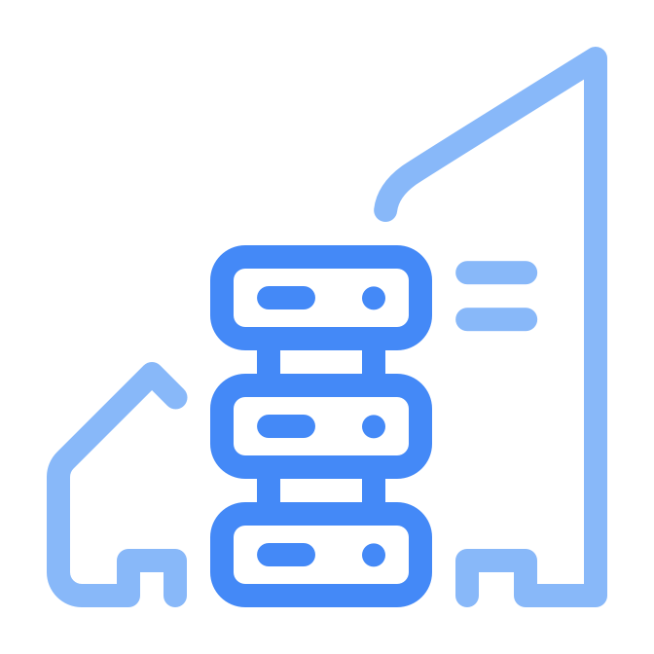
Runners
Runners
GitHub-hosted runner
Self-hosted runner
https://github.com/actions/runner

Slide 11
Quick summary
Events
Events trigger workflows, e.g. a push to a branch
Workflows contain one or more jobs, which contains one or more steps
These steps can reference actions or execute commands
The term “GitHub Actions” include all components, not just the Actions themselves
trigger
Workflows
reference
Actions

Slide 12
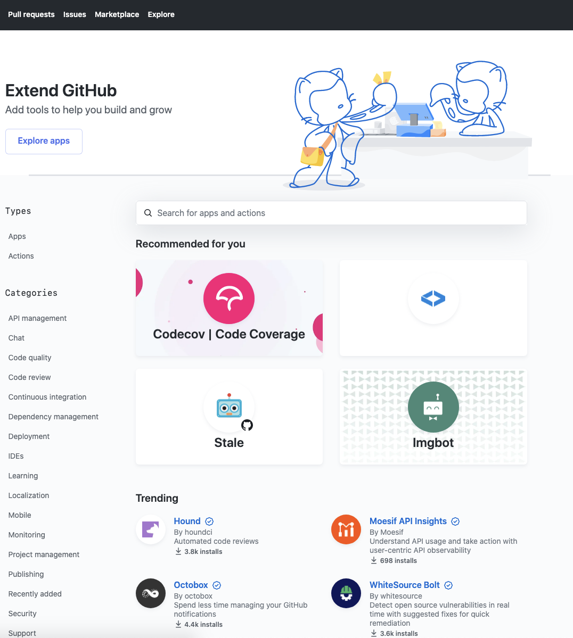

GitHub Marketplace
Discover open-source Actions across multiple domains
> 10,000 Actions (and counting)
Verified creators
Reference these Actions directly in your workflow
Integrated into the GitHub editor

Slide 13
Writing your own Actions
./path/to/action/action.yml
name: “Hello Action”
description: “Greet someone”
author: “octocat@github.com”
inputs:
MY_NAME:
description: “Who to greet”
required: true
default: “World”
outputs:
GREETING:
description: “Full greeting”
runs:
using: “docker”
image: “Dockerfile”
branding:
icon: “mic”
color: “purple”
3 types of Actions
JavaScript
Docker
Composite
Metadata defined in action.yml file
Inputs
Outputs
Branding
Pre/Post Scripts

Slide 14
Links you should have open
(When building your workflows)
Workflow syntax for GitHub Actions - GitHub Docs
Contexts - GitHub Docs
Environment variables - GitHub Docs
Events that trigger workflows - GitHub Docs
Notes:
There are others that are very useful as well but the live right next to all of these in our Docs and are easy to find

Slide 15
That’s enough to get us started…
Demos
Hello, World (of course)
Hello, World (Matrix-style)
Everyone gets a job
Context can be important
Notes:
Demos 1 - 4

Slide 16
Ok, let’s do this for reals…
.NET Core MVC App
On PR, will execute build/test to verify clean code
On Push to Main:
Build app
Deploy to DEV and QA at the same time
Manual approval to PROD

Slide 17
Now let’s have a little fun….
Remember:
https://github.com/mickeygoussetorg/intro-to-github-actions-talk
Go star the repo and let’s see what happens

Slide 18
Resources
https://github.com/sdras/awesome-actions
https://docs.github.com/en/actions/reference
https://github.com/mobile/
Notes:
Universe
Octoreport
Mobile app
Link to Elvis’s birthplace

Slide 19

Q&A
Daniel Redman
https://github.com/djredman99
Email: djredman99@github.com

