Slide 1
IBM University Engagement Project Submission
“College Admission Agent: RAG-Powered Applicant Support with IBM Granite”

Slide 2

Project Tile – College Admission Agent (RAG-Based)
Domain of Project – Education
Student Name | Recent Passport Photo | Email ID | Mobile number [WhatsApp]
JRIMBHONI DAS |  | djrimbhoni23@gmail.com Or djrim2312@gmail.com [AICTE] | 8653398060

Slide 3
Problem Statement -
Problem Statement : College Admission Agent (RAG-Based)
The Challenge
College admission departments face heavy volumes of repetitive applicant inquiries regarding eligibility criteria, entrance cutoffs, tuition fees, document verification, and critical deadlines. Traditional inquiry channels (email desks, phone lines, static websites) often lead to delayed responses, high administrative overhead, and student confusion caused by fragmented or outdated information. Standard conversational chatbots frequently suffer from hallucinations, providing unverified or incorrect dates, cutoffs, and fee structures.
The Objective
Build an intelligent, automated College Admission Assistant using Retrieval-Augmented Generation to provide real-time, 24/7 applicant support. The solution should:
Grounded, Hallucination-Free Answers – Ground all model responses strictly in institutional policies and official admission handbooks.
Interactive Natural-Language Interface – Let prospective students ask questions and get accurate answers on courses, eligibility, scholarships, and schedules.
RAG Retrieval Pipeline – Retrieve and summarize admission policies, eligibility criteria, fee structures, and FAQs from verified institutional sources.
Application & Deadline Guidance – Help applicants with course selection, application steps, fee structure, and important deadlines.
End-to-End Build with IBM Bob – Develop, test, and deploy the entire solution using the IBM Bob autonomous AI assistant inside VS Code.

Slide 4
Proposed Solution -
Proposed Solution: College Admission Agent (RAG-Based)
The proposed solution is a RAG-powered College Admission Agent built using LangChain, IBM watsonx.ai, and Granite Models to provide grounded, real-time applicant support. The system addresses challenges in eligibility queries, application guidance, fee structures, and deadline tracking through an intelligent, retrieval-first architecture.
At its core, the solution uses a Retrieval-Augmented Generation (RAG) pipeline to fetch accurate policy data from official admission handbooks and institutional databases. This data is embedded using Granite embeddings and stored in a local Chroma vector database, enabling the system to retrieve and summarize eligibility criteria, cutoffs, and fees.
The end-to-end pipeline consists of five stages:
Document Ingestion & Chunking parses official admission documents (handbooks, fee schedules, branch cutoffs) into overlapping semantic chunks.
Vector Indexing vectorizes chunks using IBM Granite embeddings and persists them into a local Chroma vector database.
RAG Retrieval Engine runs semantic similarity search to retrieve the top matching chunks of verified institutional data for each applicant query.
Granite-Powered Reasoning synthesizes the retrieved context and query through a guarded system prompt, answering accurately or deferring to the admission office if data is unavailable.
The solution includes an interactive web interface and deployment layer — a lightweight FastAPI backend that serves the REST API and chat interface, packaged for deployment on serverless IBM Cloud infrastructure.
LangChain is used to orchestrate the retrieval and reasoning workflow, while watsonx.ai ensures scalable model deployment, embeddings, and AI governance. Granite models power reasoning, summarization, and grounded response generation.
Overall, this solution delivers an end-to-end, hallucination-resistant admission assistant that boosts transparency, accessibility, and efficiency for prospective students and admission staff alike.

Slide 5
Technology Used
IBM Bob (VS Code Extension) – For autonomous coding, environment management, and execution
IBM Granite Foundation Model – ibm/granite-3-1-8b-base / ibm/granite-4-h-small via watsonx.ai – for natural language understanding, reasoning, and grounded generation
IBM Cloud Lite – watsonx.ai Runtime / Watson Machine Learning and IBM Cloud Code Engine provide a reliable, secure, and scalable environment for deploying the Admission Agent.
RAG (LangChain) – Retrieves real institutional data first, then generates grounded, hallucination-free answers, making the Admission Agent more trustworthy and effective.
Embedding Model (watsonx.ai) - ibm/granite-embedding-107m-multilingual / ibm/granite-embedding-278m-multilingual for model deployment, embeddings, and AI governance
Vector Database & Backend – ChromaDB (local persistence) for RAG-based admission-policy retrieval, served via FastAPI + Uvicorn on Python 3.11

Slide 6
System components Used -
1) Chat / Query Input – Interface where applicants enter natural-language questions about courses, eligibility, fees, or deadlines.
2) IBM watsonx Granite Agent - Processes retrieved context and the user query through a guarded system prompt to generate grounded admission answers.
3) Name of IBM Granite model - ibm/granite-3-1-8b-base / ibm/granite-4-h-small → Fast, efficient for real-time admission responses
4) Chat output -Displays AI-generated responses such as eligibility criteria, cutoffs, fee details, and deadlines, or defers to the admission office when data is unavailable.
5) Vector Store (ChromaDB) - Stores and retrieves embedded admission handbooks, fee schedules, and cutoff datasets for RAG-based retrieval.
6) FastAPI + Uvicorn backend serving the REST API and chat interface.

Slide 7
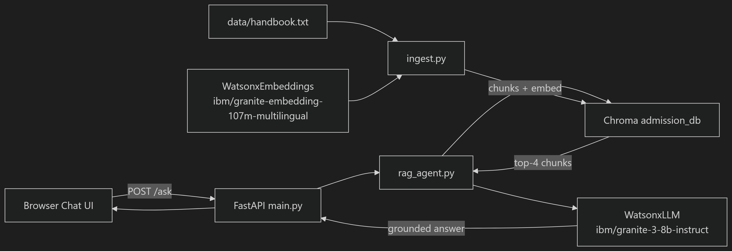
Architecture blueprint

Slide 8

Role of Agentic AI in the solution
Role of Agentic AI in the College Admission Agent
Agentic AI enables the Admission Agent to function as an intelligent, autonomous system rather than a simple chatbot. Using IBM watsonx.ai and IBM Granite models, it autonomously retrieves, reasons over, and responds to applicant queries end to end.
The agent performs each stage of the RAG pipeline on its own—chunking documents, running semantic retrieval, and generating a grounded response—while working within a guarded system prompt that ensures efficient task execution and accurate results.
Agentic AI also brings context awareness, understanding the applicant's query intent to pull the most relevant policy chunks. It supports graceful deferral, routing the applicant to the admission office whenever verified data is unavailable rather than guessing.
Additionally, the agent operates continuously through the FastAPI backend, enabling 24/7 availability and consistent, policy-grounded decision-making.
Overall, Agentic AI makes the system proactive, accurate, and trustworthy, acting like a tireless digital admission counselor that helps applicants navigate the admission process with confidence.

Slide 9
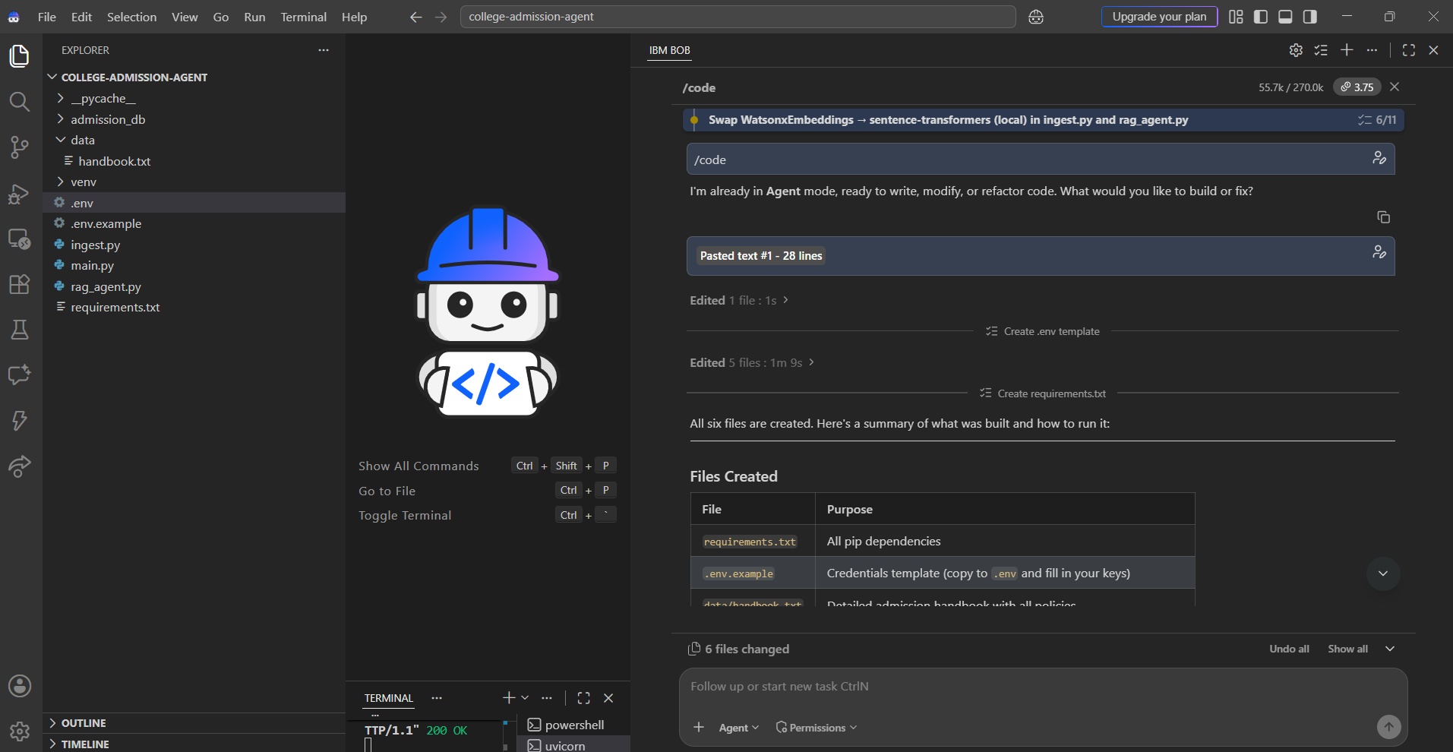

Slide 10
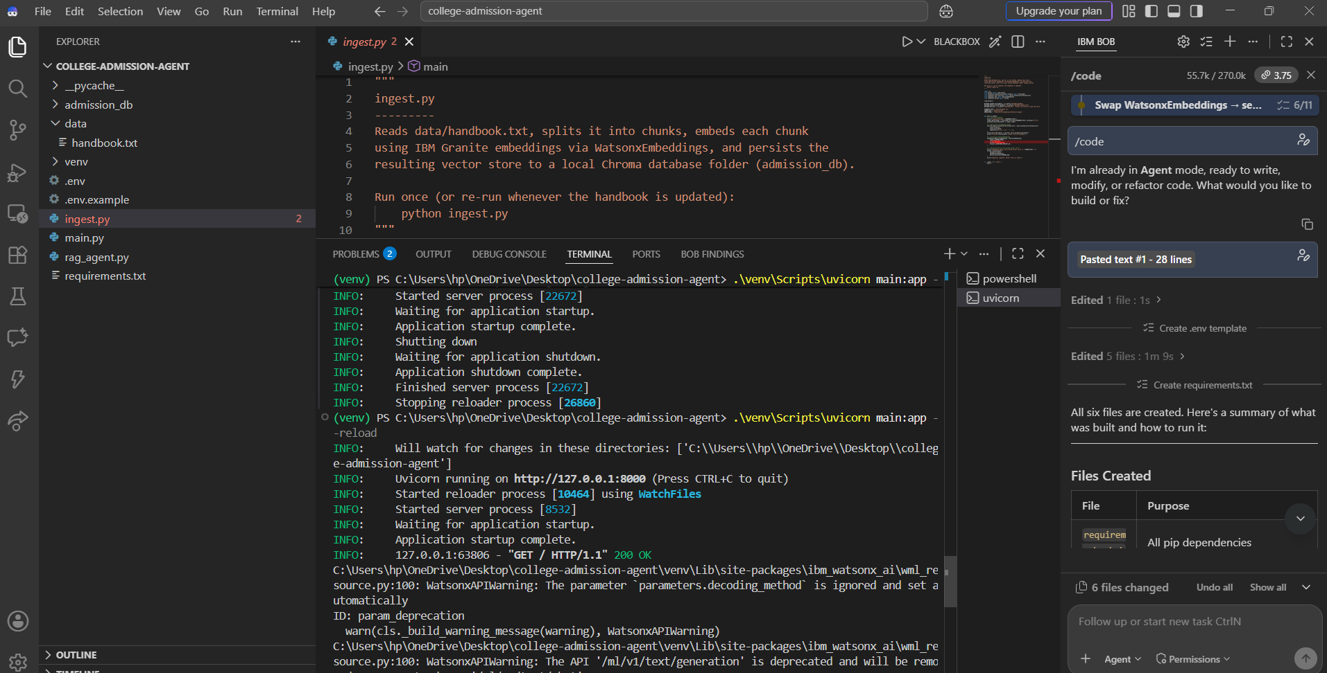

Slide 11
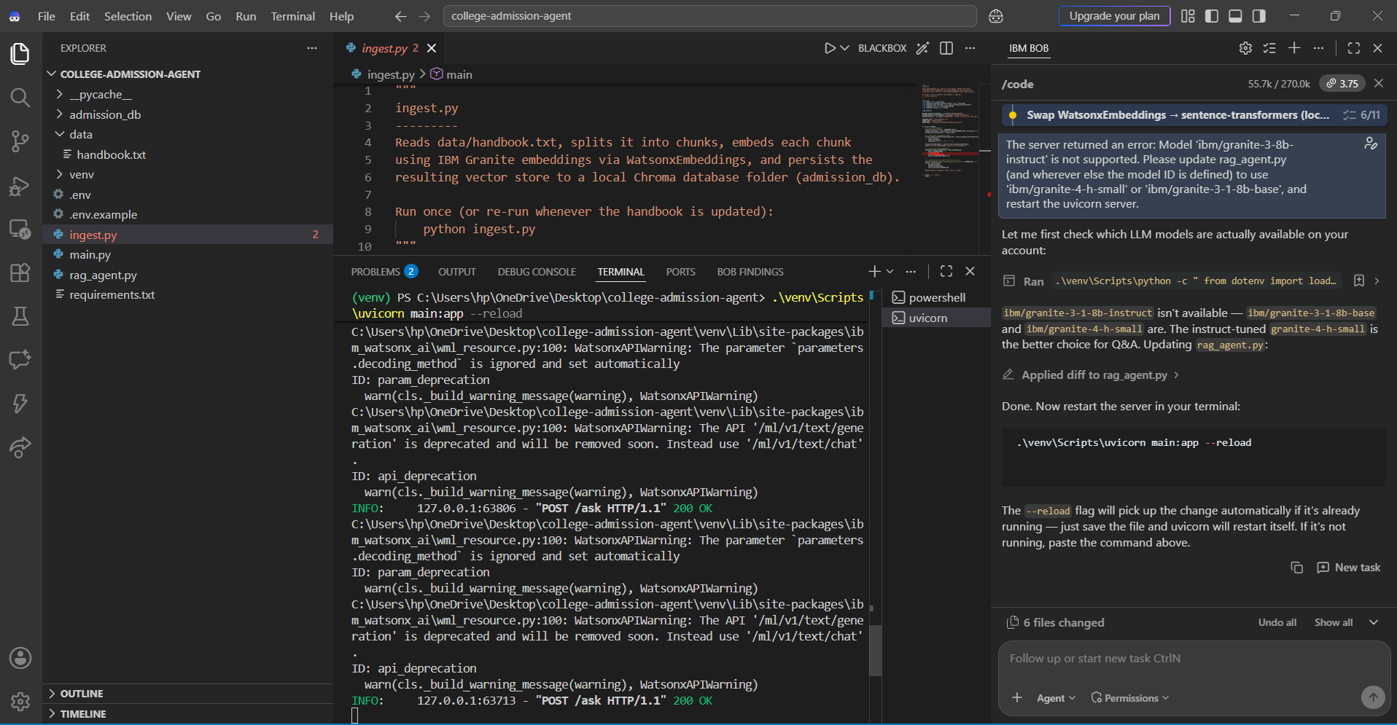

Slide 12
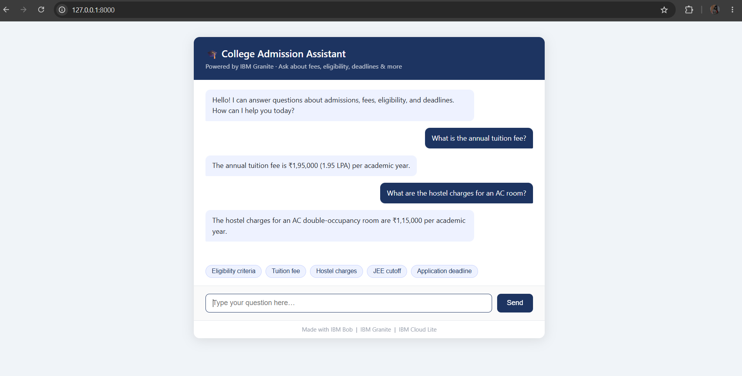

Slide 13
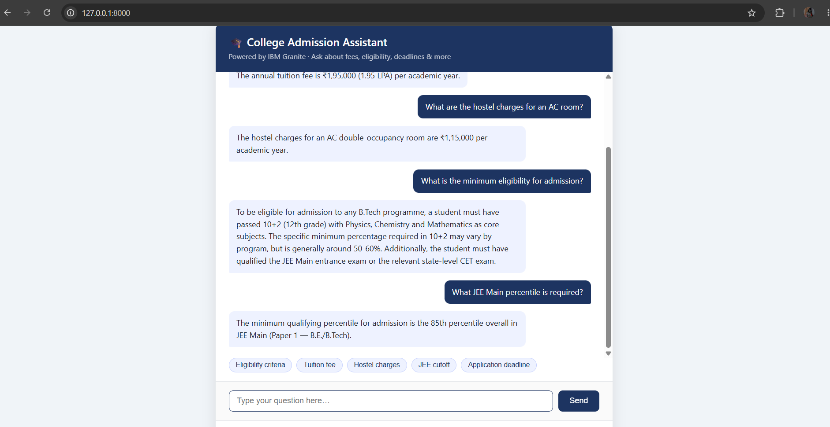

Slide 14
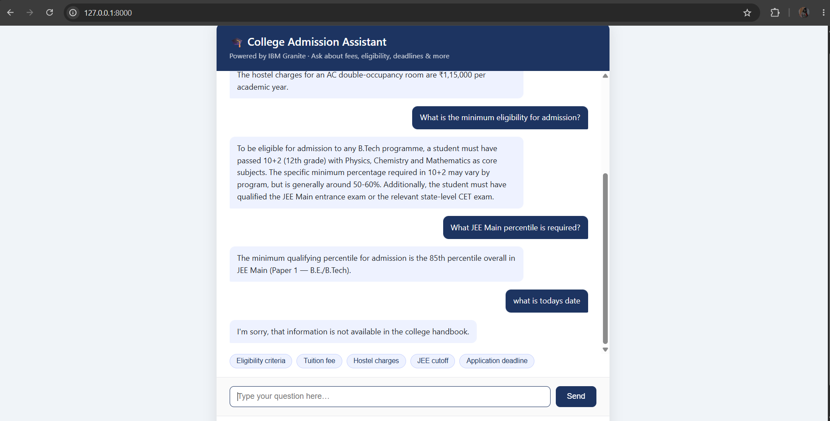

Slide 15
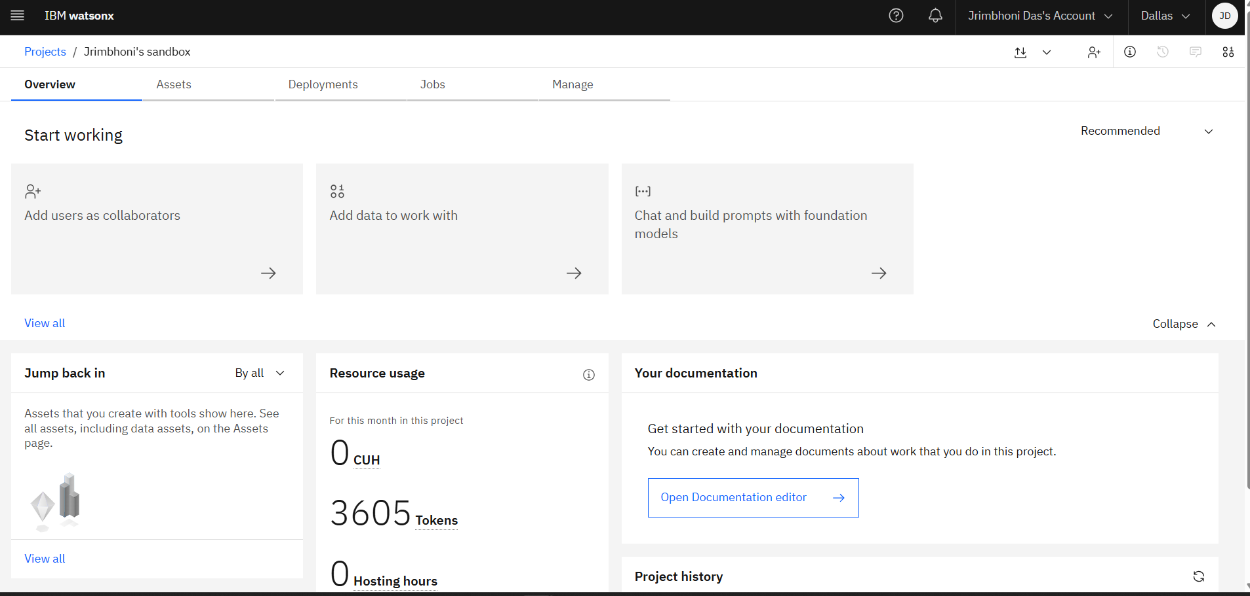
Token Usage
3,605 token are used
·
·
·

Slide 16
Novelty and Uniqueness
The proposed College Admission Agent stands out by combining Agentic AI, RAG, and strict grounding into a single, hallucination-resistant system.
Autonomous Agentic Workflow – Instead of a static FAQ bot, an autonomous agent retrieves, reasons, and responds end to end for each applicant query.
RAG-Based Accuracy – Integrates real-time policy retrieval with AI generation, reducing misinformation and ensuring trustworthy answers.
Guarded, Grounded Responses – Answers strictly from institutional handbooks, deferring to the admission office when data is unavailable.
Semantic Chunking & Indexing – Overlapping semantic chunks and Granite embeddings keep retrieval precise across large policy documents.
24/7 Multi-Channel Access – A FastAPI-backed web chat interface gives applicants round-the-clock support.
Reduced Administrative Load – Automates repetitive inquiries on eligibility, cutoffs, fees, and deadlines, freeing staff for complex cases.
Scalable & Enterprise-Ready – Built on IBM watsonx.ai with IBM Granite models on serverless IBM Cloud infrastructure, ensuring reliability and governance.
This makes the solution a smart, transparent, and always-available admission assistant, not just a static FAQ page.

Slide 17
Git Hub Link
My Github profile link : https://github.com/djrimbhoni
The working Github URL of my project – https://github.com/djrimbhoni/college-admission-agent-final
·
·
·

Slide 18
Future Scope
1.Integration with Official Student Information Systems –
The agent can be integrated with the college's Student Information System (SIS) and application portal to provide applicant-specific status updates, such as document verification progress and seat allotment, instead of only general policy answers.
2.AI-Powered Voice Assistant & Multilingual Support –
Enhancing the system with a voice-enabled assistant and support for multiple regional languages will improve accessibility. Applicants can interact naturally in their preferred language, making the solution more inclusive for students from diverse linguistic backgrounds.
·
·
·

Slide 19
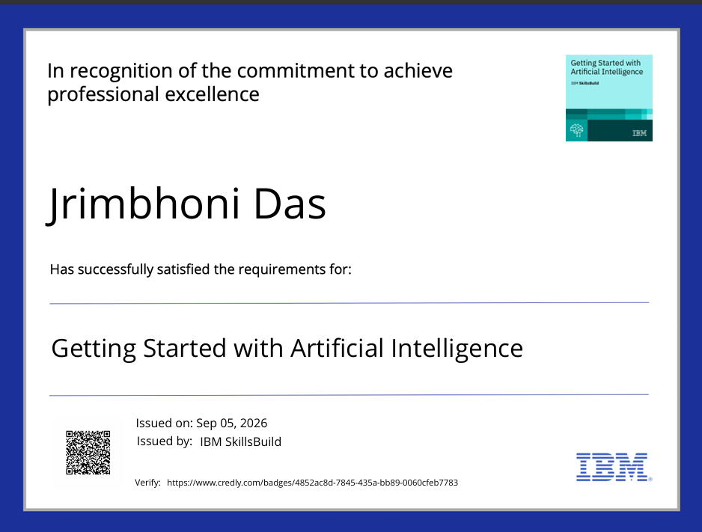
Certificates Earned:

Slide 20
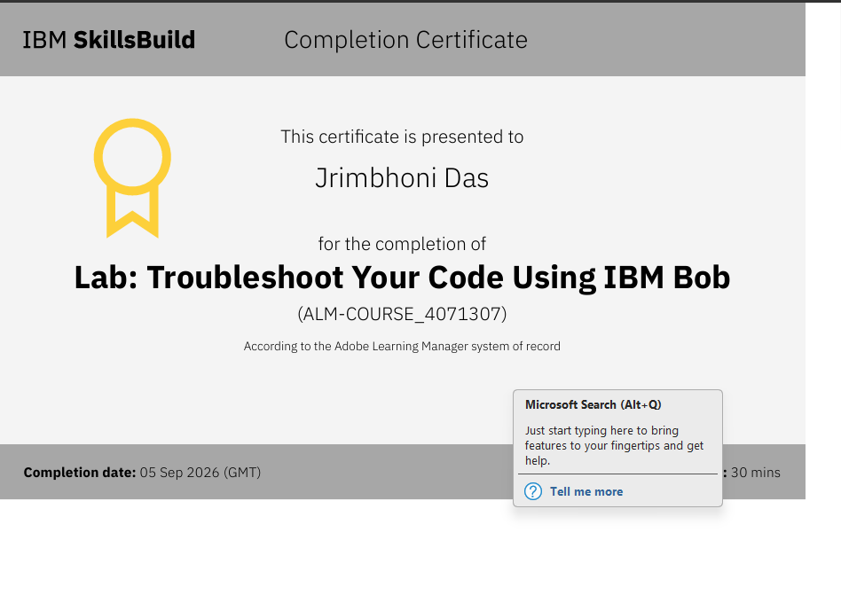
Certificates Earned:​
IBM BOB Certificate

Slide 21


