Slide 1
OpenStack Storage Diagnostics and Monitoring Tools
Tools for : Enterprise-ready OpenStack Enterprise-ready Helion
29 Aug 14
Timothy Virgo

Slide 2
Agenda
Goals & Scope
☹ ☺
Problems & Opportunities
Users & Use cases
Big Ideas
ARCHI
TECTURE

Slide 3
Goals Management tools that create:
Enterprise-ready Openstack
Enterprise-ready Helion
Enterprise-ready = | SCALABILITY + RELIABILITY + MANAGEABILITY | Data Center scale + Data center reliability + Low cost of management by IT generalist

Slide 4
Openstack basics

Slide 5
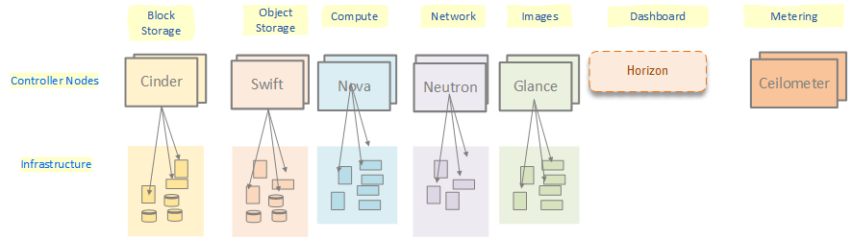
Openstack parts (some of them)
we are here

Slide 6
Our task

Slide 7
Scope
Diagnostics – detection, alerts, assistance | HP Storage in Openstack | 3PAR StoreVirtual Generic Logical volume model
Performance – monitoring, alerts, assistance
Paths, architectural approach | Helion, Openstack | Solutions applicable to more than just Openstack storage

Slide 8
The Problems
Scale | Datacenter scale
Mix-n-match Components | Switches, hosts, arrays, fabrics, storage etc.from multiple vendors.
Structure | Distributed – multiple controller nodes, devices, drivers, management tools Dynamic – infrastructure devices and device types come and go at run time
Stovepipes | Tools and information mostly in stovepipes (Cinder, Swift, Nova, Neutron, etc.), but: Diagnostics/troubleshooting must cross stovepipes/devices Performance data naturally crosses stove pipes (VM, compute node, network, fabric, storage)
Target customer: IT Generalist | Can’t rely on specialized knowledge of storage or other parts of infrastructure
Openstack solution style | Distributed, multi-vendor, open source. Pluggable stacks of management tools. Stack components from different vendors

Slide 9
The Opportunities
#1 Sales Inhibitor = alerts + docs + nothing “Support of the product: Hard to understand what is going on just by relying on alerts and product documentation.” (3PAR customer survey) For Openstack problem x many device types x many vendors
Open stack log style: Openstack logs are scattered around controller nodes Different errors on different node logs Obscure log messages - developer friendly Have to look on different logs to pull together diagnostic picture. E..g., look in Nova logs for Cinder/storage installation errors
Stovepiped tools Current tools tend to look at only one node type, (Cinder, Swift, etc)

Slide 10
The Users
Service manager | Monitor reports on SLA metrics
Cloud Administrator | Monitor performance vs SLAs Anticipate/fix performance and capacity issues Resolve cloud/workload problems, outages Install cloud service and device management software / fix packs / upgrades
HP Field Support | Offline diagnosis of problems and performance

Slide 11
Diagnostics Use Cases
Controller Node Health | Server Processes APIs Message queues Config files
Infrastructure Access | Drivers Credentials Dev mgr APIs Driver/API versions Config files
Infrastructure Health | Arrays Switches Ports Storage pools Volumes --Drill down boundary?-- Drives Cages Fans/power supplies, etc
Troubleshooting trees | Affected elements Drill down tree Deep link to dev mgr
Operation checks | Proactive checks – are common operations possible?
Failure pattern analysis | Devices/paths with unusual failure rates
Diags bundle | Snapshot of: Logs Config files Device health Performance Paths

Slide 12
Performance Use Cases
Capacity: thresholds , alerts | volume thin provisioning state array Tenant
Speed: thresholds, alerts | volume port
QOS: spec errors, compliance alerts | volume path – ports switches, hosts
Capacity: trends, threshold predictions | volume path – ports switches, hosts
Affinity: status, suggestions | Measure and report how close the storage node is to the host consuming it. Suggest affinity improvements.
Load balancing: status | For StoreVirtual clusters: Show the distribution of load across clusters. Correlate load with affinity Report on load balancing status and problems

Slide 13
Transparency use cases
Write diag messages in user’s terms | Add meaning to error messages and log messages – convert to users’ terminology Proactively check for causes
Give diagnostic hints | Suggest diagnostic next steps
Enable drill down | Provide drill down path from alerts to log entries to device managers
Add User comments | Provide a way for the user to add comments/notes/history of actions to alerts and log entries.

Slide 14
Openstack basics

Slide 15
Openstack parts (some of them)
we are here

Slide 16
and now….

Slide 17
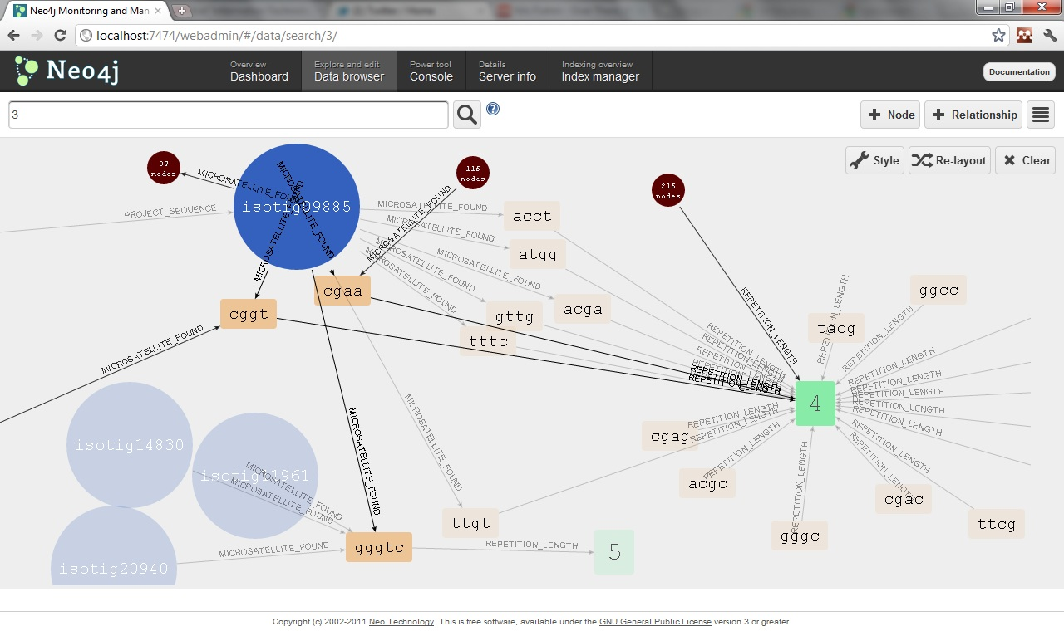
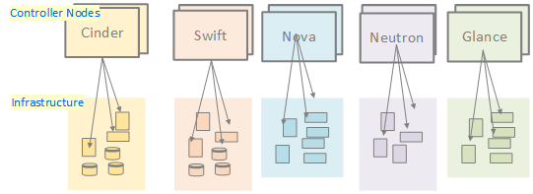
The Big Idea
User Interface Crosses Stack Boundaries
Diagnostics – Show and tell the user: What the fault is. What it means. Where it is. What other components are affected by it. The troubleshooting path. How to fix it (sometimes) Links to the UIs involved in fixing it.
Performance Monitoring – Show and tell the user: What the performance of a component or path is. The related connectors and components on the path Where to look for bottlenecks. The analysis or troubleshooting path. Links to the UIs involved.
UI Conceptually graph -based. T
his is not the real thing
Do this across OpenStack service boundaries, and down into the infrastructure.
Behind the scenes we have to pull this together without depending on a huge central model of everything – OpenStack doesn’t work that way

Slide 18
here’s how we do that

Slide 19
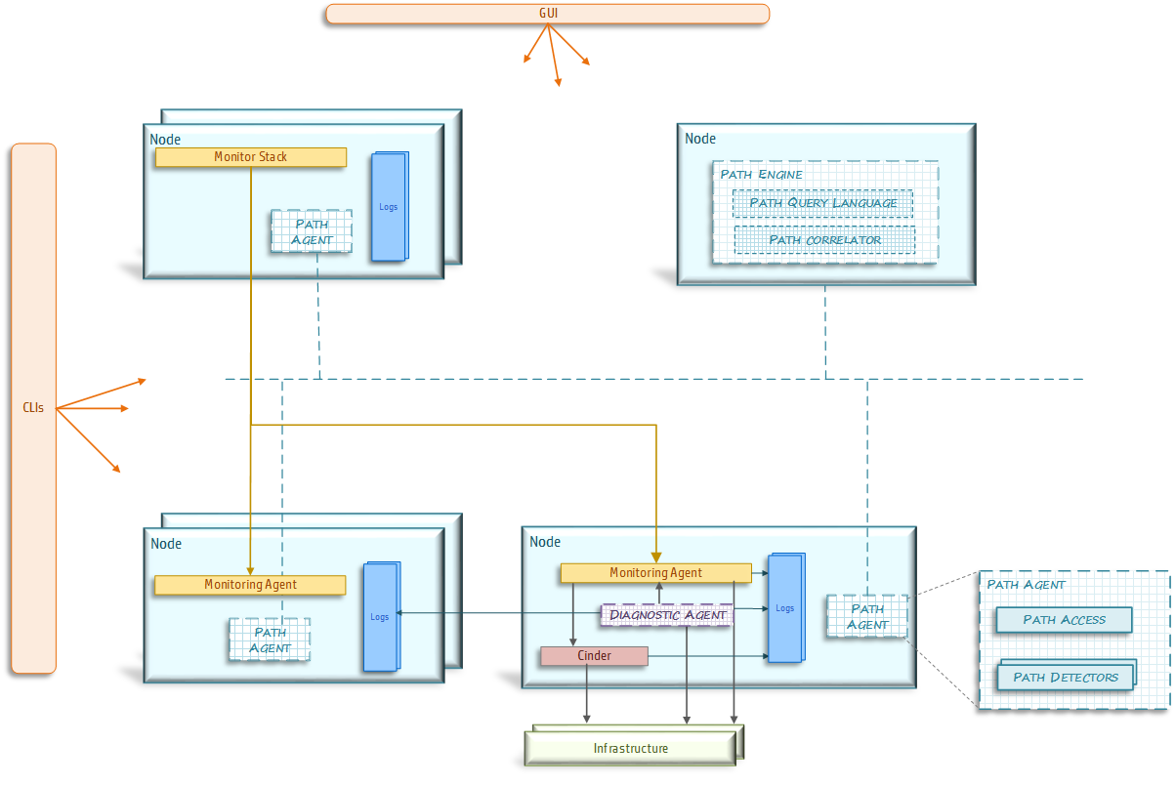
Overall Design: snapshot

Slide 20
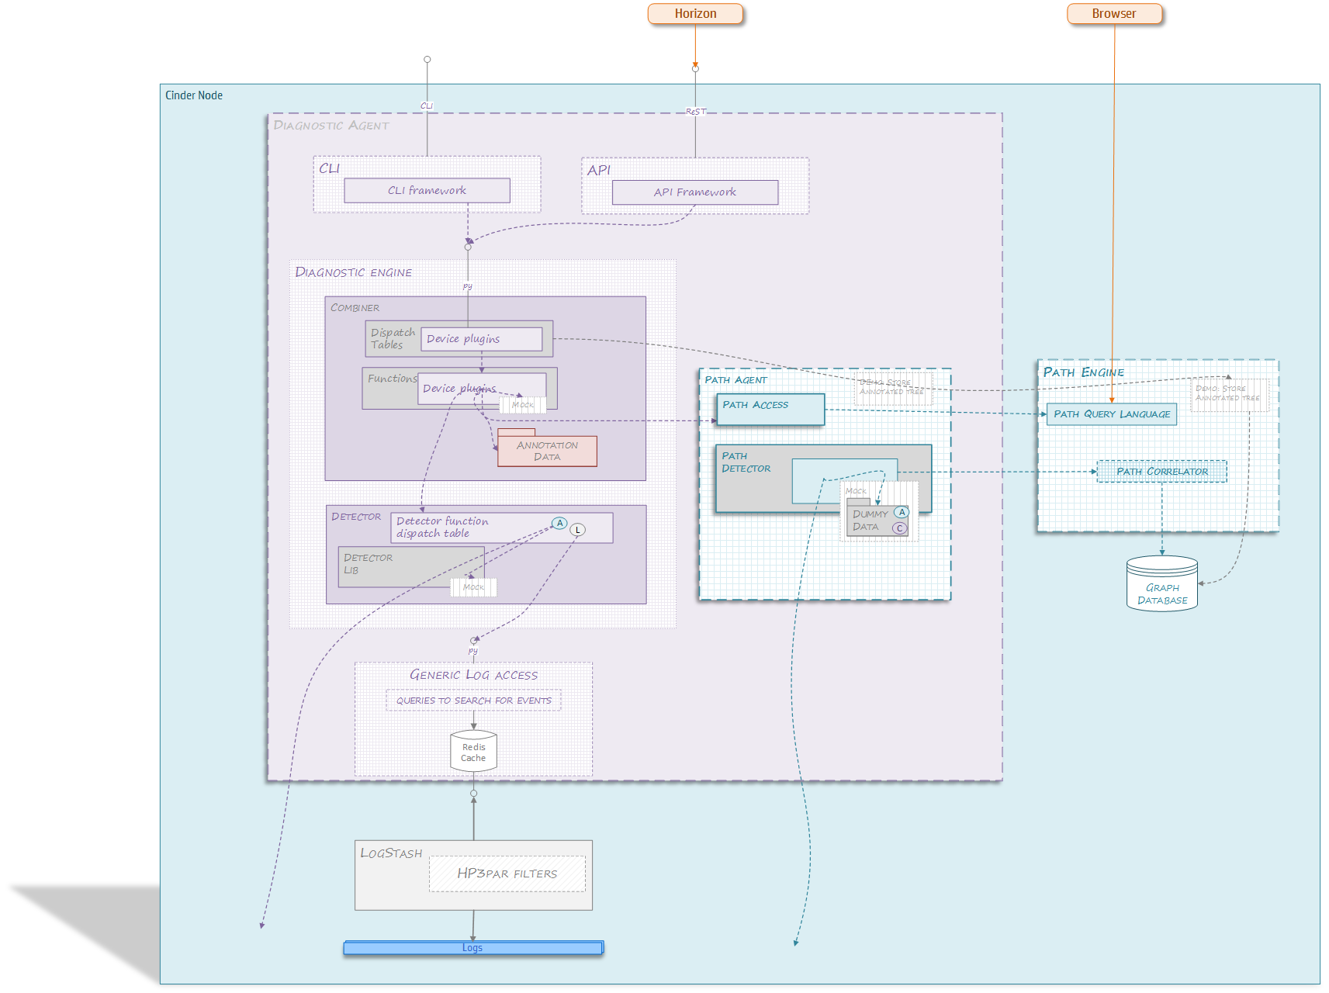
Diagnostic agent design

Slide 21
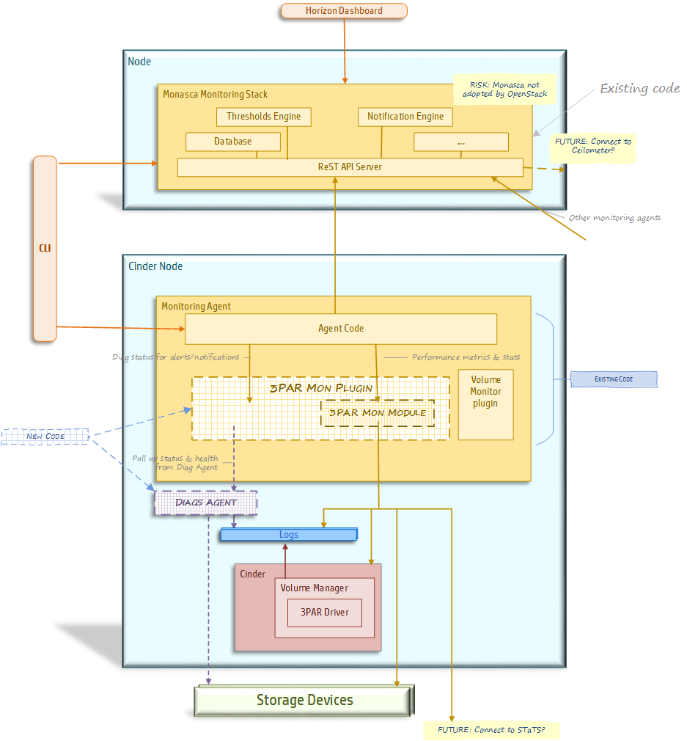
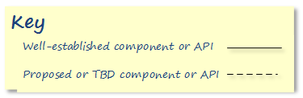
Monitoring: Design snapshot
Openstack concepts reported up
Drill down and out for device-specific concepts

Slide 22
Path models

Slide 23
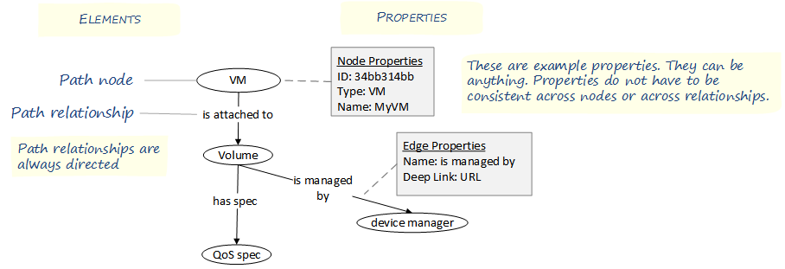
Path models: what they are-
Cypher Query Language Path-based queries | MATCH (a231d2: 3PAR CPG) --> (3PAR vol) --> (Cinder Vol) -->(Host)<--(VM)<--(ten: tenant) RETURN ten
Notes:
relationshp vs node

Slide 24
Path Model: Key Design Ideas
Use a property graph database | Model the entities and relationships of an OpenStack installation as a directed property graph.
Model Everything | Include everything: Tenants VMs, Volumes, Networks, storage zones Openstack nodes, their processes & files Infrastracture managers and elements |  | Annotate freely -- add properties to nodes and relationships from different stacks: performance, infrastructure access – deep linking, status connection cost
Use to represent and analyze: | Status trees | status of entities and connections.
 | Effects trees | what components are affected by a fault or an alert. What client elements might be affected
 | Troubleshooting trees | what components might be contributing to a fault.
 | Performance maps | mapping the peformance on paths from consumer to storage source
 | Affinity maps | mapping the relationship between VMs and storage
 | Load balancing maps | representing the distribution of load on various elements

Slide 25
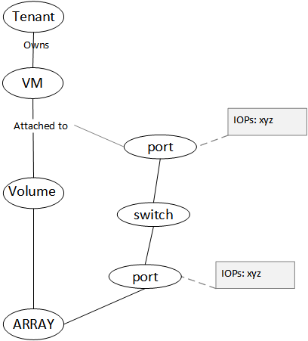
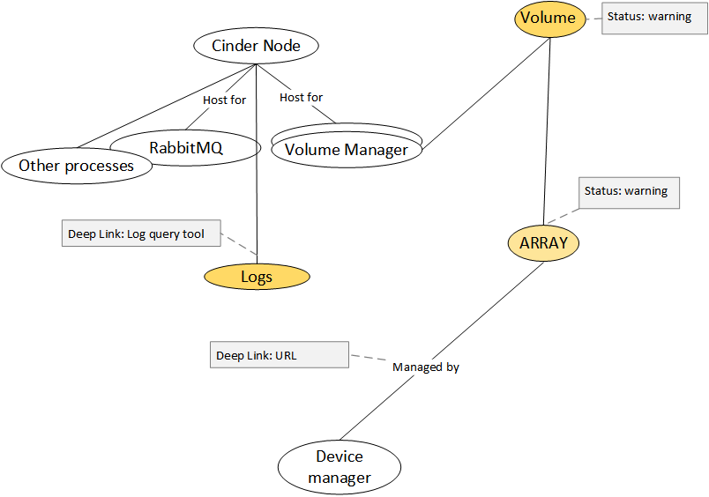
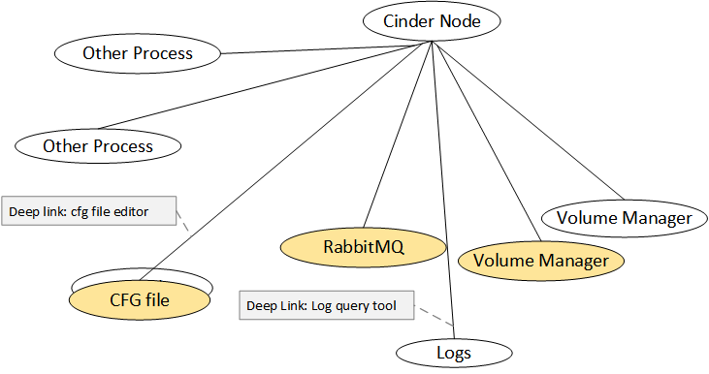
Example uses of Path Data
Property graphs make it easy to represent and query OpenStack structures.
Performance : show the performance along a data path
Troubleshooting: where to look next, and how to get there
Troubleshooting:
Show problems with components on a controller node

Slide 26
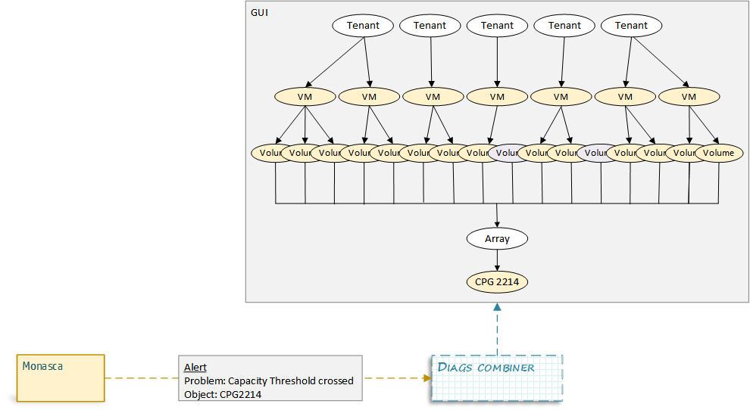
Example uses of Path Data
Show the context and consequences of an alert from an independent source
4
1
2
3

Slide 27
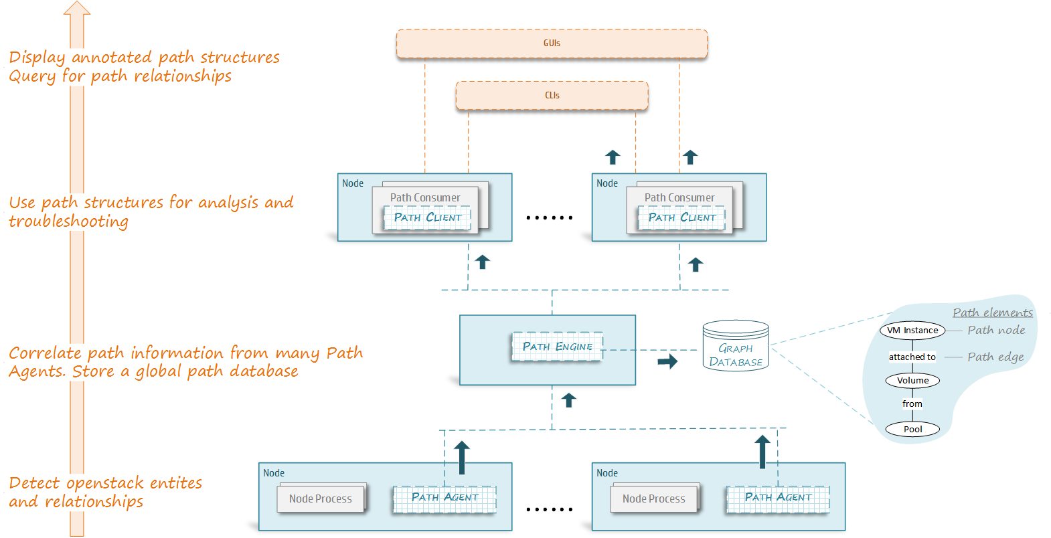
Overview of Path Service

Slide 28
Background

Slide 29
Architecture Approach
Adopt Helion components or designs where possible | Monasca provides most infrastructure needed for monitoring & alerts Use plugin -> agent -> database design pattern
Extend Helion ideas where necessary | Helion logging stack not enough for diags use cases. We’ll add: - agent/plug-in model - Horizon dashboard - CLIs
Separate diags and monitoring stacks | Diags feed into monitoring stack for alerts and notifications
Don’t assume Helion stacks always there | Basic agents/plugins must work without Helion stacks

Slide 30
Data Approach
Focus on diagnosing the openstack part of problems - allow drill down to device specfics
Pass generic info up into Higher levels of openstack Convert device –specific data to generic data CPG > storage pool for example
Leave detailed device specific monitoring and diags to device specific tools such as STaTS – may connect to them to get info, but pass it up only having made it generic.

Slide 31
Contribution Path
Prototype | Try design ideas
Incubation | Harden design ideas Put into Helion Add diags to Monasca
Open source | Release generic design as open Source
Open Stack | Get generic design into Open Stack

Slide 32
Helion Stacks

Slide 33
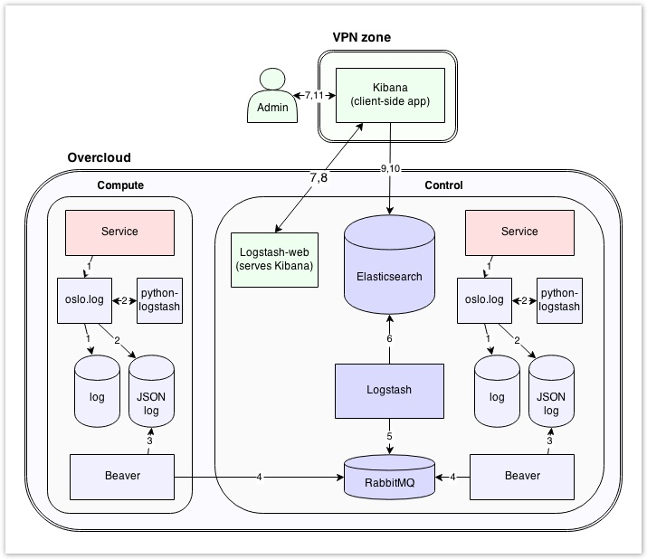
Helion Logging Architecture
http://wiki.hpcloud.net/display/core/Logging
http://wiki.hpcloud.net/display/iaas/COS+Arch+-+Logging
Component |  | Definition
Kibana | open source | analytics/ search dashboard for ElasticSearch
ElasticSearch | open source | Search/analytics engine
LogStash | open source | Log scrubbing/parsing to JSON
Beaver | open source | Log centralizer

Slide 34
Helion Stacks: Monitoring as a Service
Project Name: Monasca (MONaaS - Monitoring as a Service)
Type: Open Source. Helion project.
Status: Dev-complete.
Release plans:
On Helion release cycle.
Will ship with Enterprise edition first.
Will ship with community edition later
Aim to integrate with OpenStack by 2015
Contact: Roland Hochmuth. Fort Collins
Clients | Horizon Dashboard | CLI client
Monitoring Nodes | Notifications and Queries Threshold engine Alert Database ReSTful API
Controller Nodes | Agent Device plugins
Features:
Metrics gathering and reporting for OpenStack
Highly scalable and available.
Real-time thresholding and alarming.
Notifications
Historical metrics queries (Vertica at the moment )
Complex alarm rules
Multi-tenanted

Slide 35
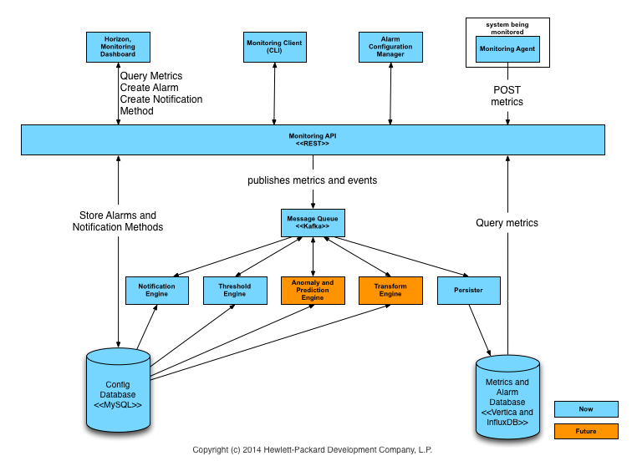
Monasca Architecture
https://github.com/hpcloud-mon/mon-arch

