Slide 1

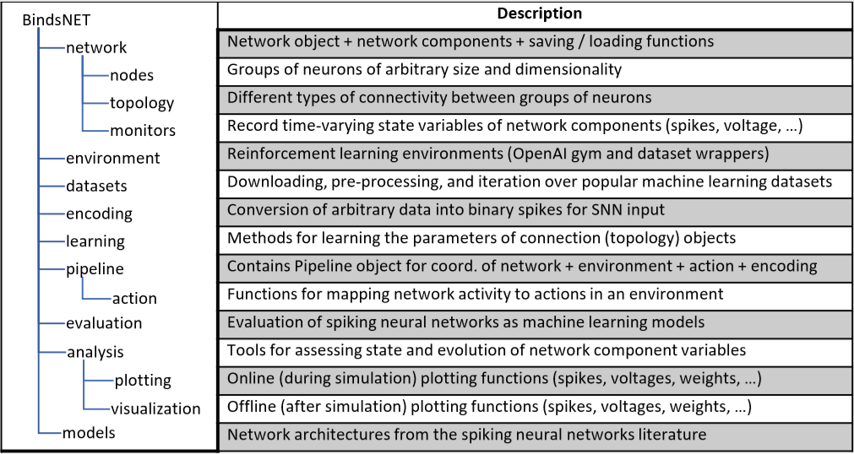
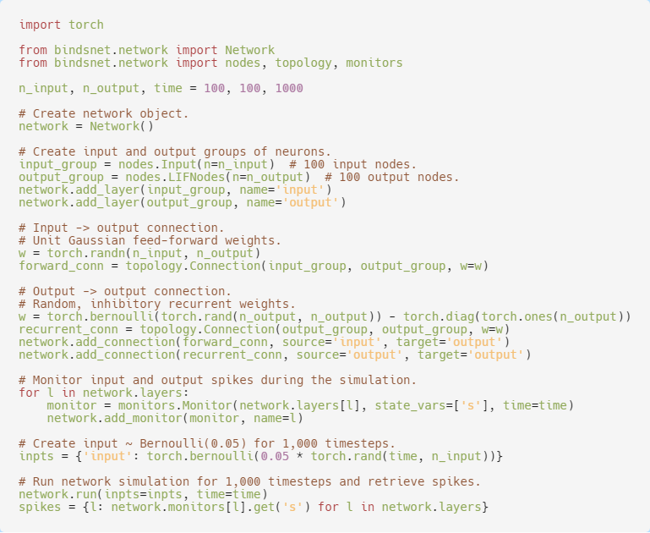
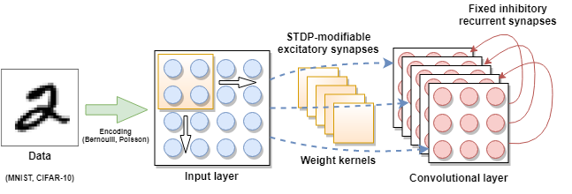

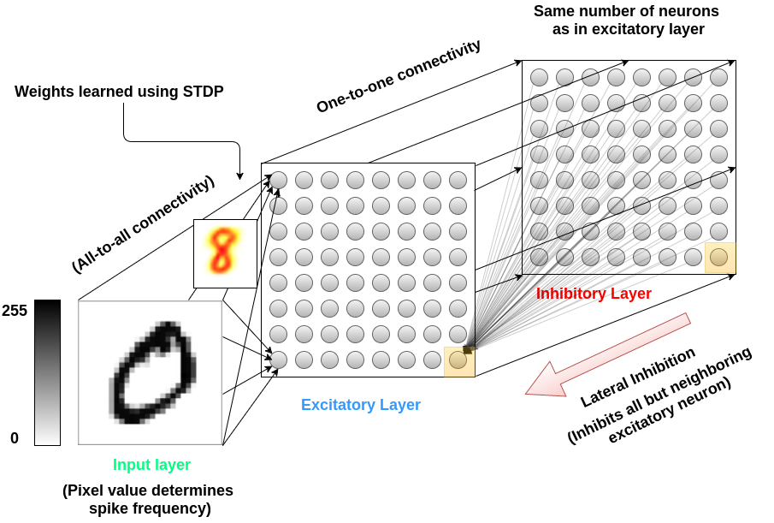
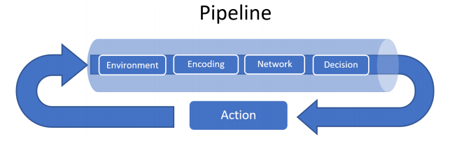
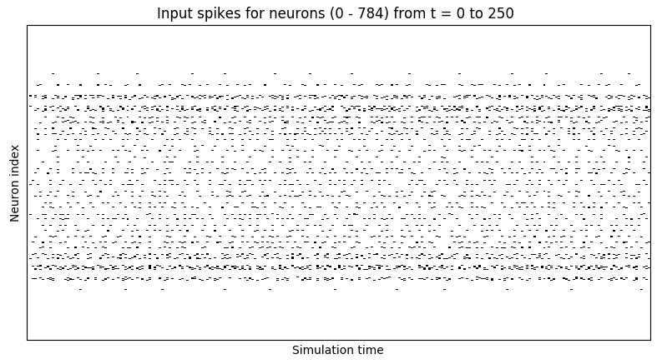



BindsNET: An ML-oriented spiking networks library built with PyTorch
https://github.com/Hananel-Hazan/bindsnet
Daniel J. Saunders, Hananel Hazan, Hassaan Khan, Hava T. Siegelmann, Robert Kozma
What is BindsNET?
Clock-driven spiking neural networks (SNN) simulator
Oriented towards ML + RL
User-friendly syntax + fast prototyping
Functional (rather than exact) dynamics
Run on CPUs, GPUs, or both
Inherits performance + functionality of PyTorch
What’s in the library?
Network: Central data structure; handles simulation of various SNN components
Learning rules: Hebbian learning, STDP, reward-modulation; local updates
Pipeline: Coordinates network + environment
ML datasets + RL environments
Why spiking neurons?
More biologically plausible than ANN neurons
Useful for modeling neuronal circuits + brains
Speedup + power reduction on neuromorphic chips
Naturally incorporates time by integrating input
Weight updates as needed; ANN updates every step
A
C
E
D
B
A: Example SNN architecture; B: Example network building + simulation script; C: Two-layer
convolutional SNN; D: Schematic of Pipeline object; E: Poisson encoding of MNIST digit for 250 timesteps
How is PyTorch used?
torch.Tensor object: Linear algebra + tensor ops
torch.nn module: Advanced network operations
torch.distributions module: Generating spike data
torch.save, load: Save / load params to / from disk
torchvision.datasets: Planned integration!
ML + RL approach
Unsupervised: Hebbian / associational rules
Supervised: Force certain neurons to spike
RL: Reward signal modulates learning rules
Competitive inhibitory connections
Cooperative excitatory connections

