Slide 1

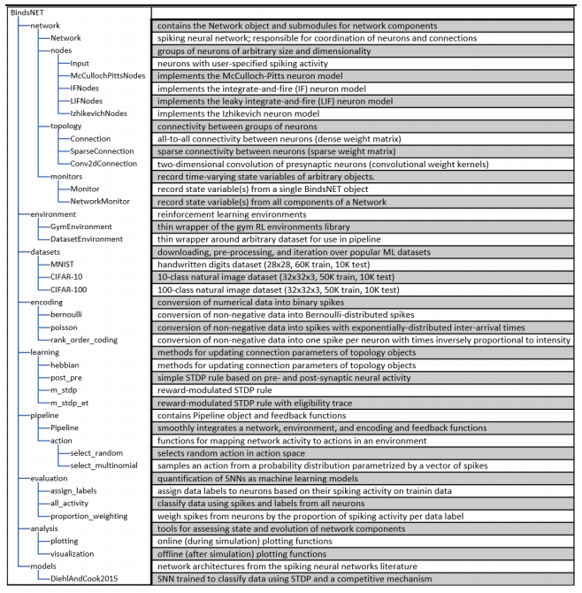
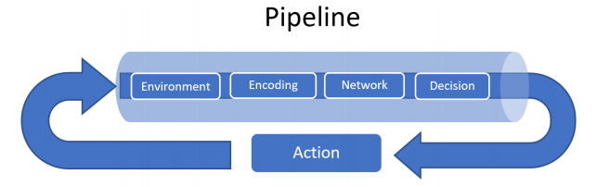
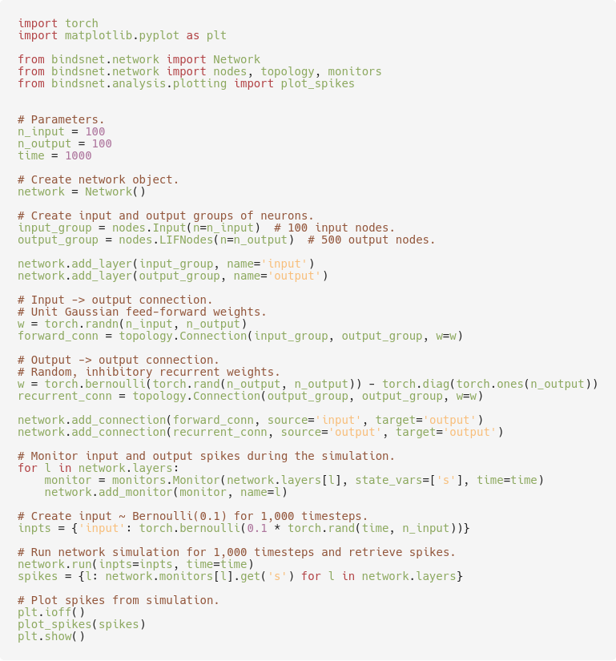
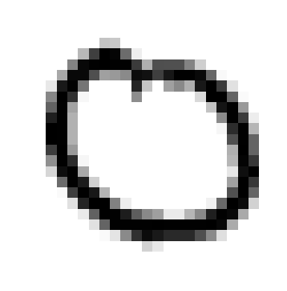
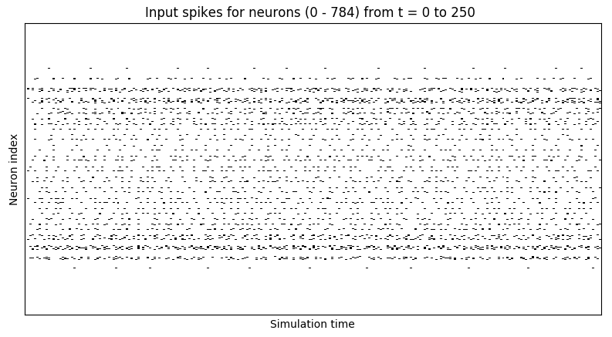
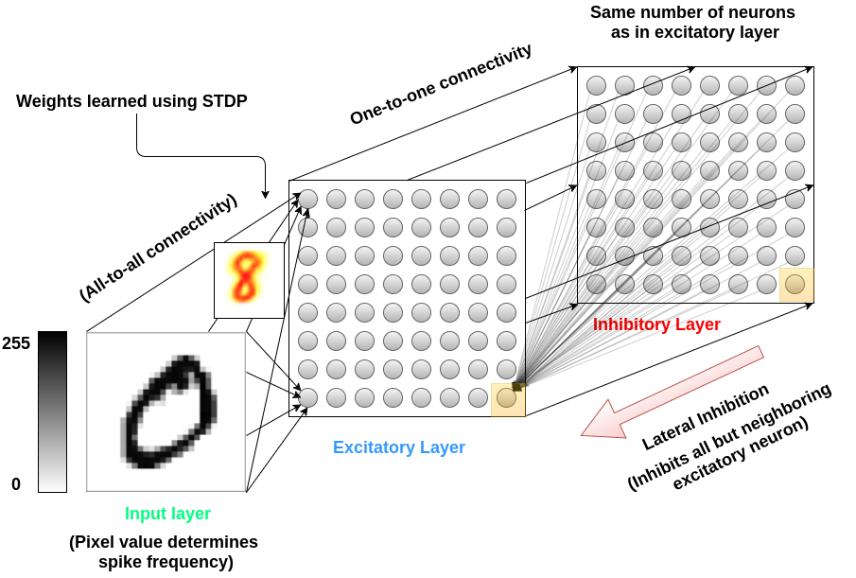
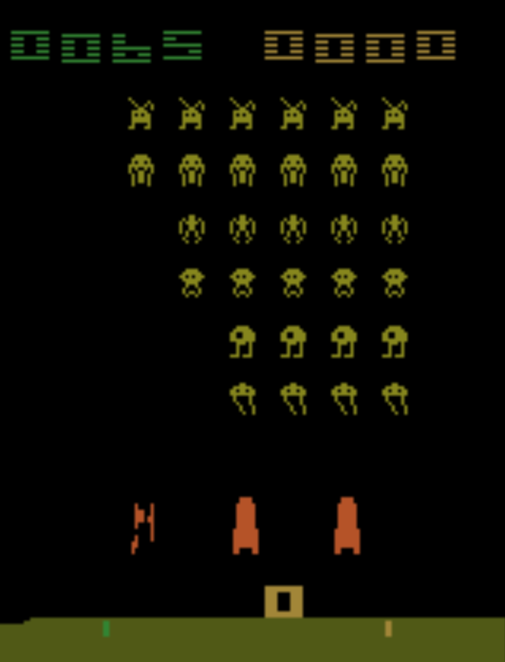
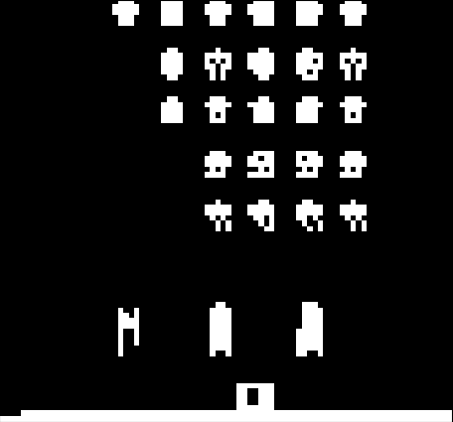
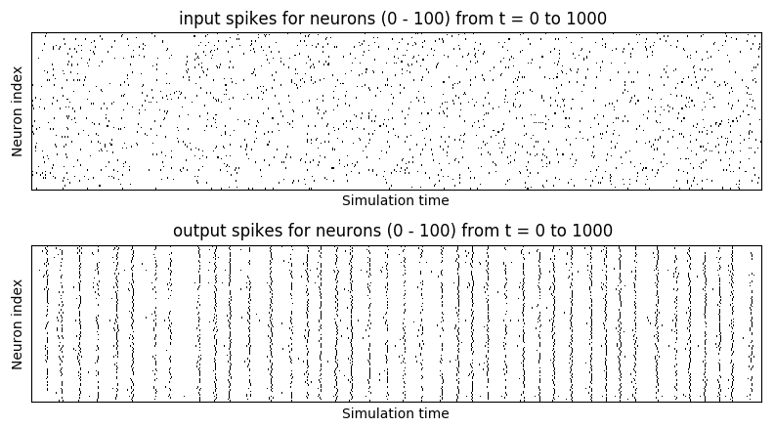



BindsNET: An ML-oriented spiking networks library built with PyTorch
https://github.com/Hananel-Hazan/bindsnet
Daniel J. Saunders, Hananel Hazan, Hassaan Khan, Hava T. Siegelmann, Robert Kozma
What is BindsNET?
Clock-driven spiking neural networks (SNN) simulation
Oriented towards ML + RL
User-friendly syntax + fast prototyping
Functional (rather than exact) dynamics
Run on CPUs, GPUs, or both
Inherits performance + functionality of PyTorch
What’s in the library?
Network: Coordinates simulation of network components
Nodes / Connections: Groups of neurons and connections between them
Learning rules: Hebbian learning, STDP, reward-modulated STDP, back-prop (?)
Datasets: Popular machine learning datasets
Encoding: Converts real-valued data into spikes
OpenAI gym integration: Converts gym environment outputs into spiking inputs
Pipeline: Coordinates a network, dataset / environment, encoding, and action function
Plotting: Interactive plots of state variables during network simulation
Models: Experimental SNN architectures
How is PyTorch used?
torch.Tensor object: Linear algebra + tensor ops
torch.nn module: Advanced network operations
torch.distributions module: Generating spike data
torch.save, load: Save / load params to / from disk
torchvision.datasets: Planned integration!
A
A
B
E
D
C
F
A: BindsNET package structure; B: Schematic of Pipeline object; C: Example SNN architecture; D: Example network building + simulation script + spike outputs; E: Poisson encoding of MNIST digit for 250 timesteps; F: Pre-processed version of OpenAI gym’s Space Invaders environment.
Why spiking neurons?
More biologically plausible than ANN neurons
Useful for modeling neuronal circuits + brains
Speedup + power reduction on dedicated hardware
Communicates with all-or-nothing spikes
Naturally incorporates time by integrating input
ML + RL approach
Unsupervised: Hebbian / associational rules
Supervised: Force class-specific neurons to spike
RL: Reward signal modulates learning rules
Competitive inhibitory connections
Cooperative excitatory connections

