Slide 1

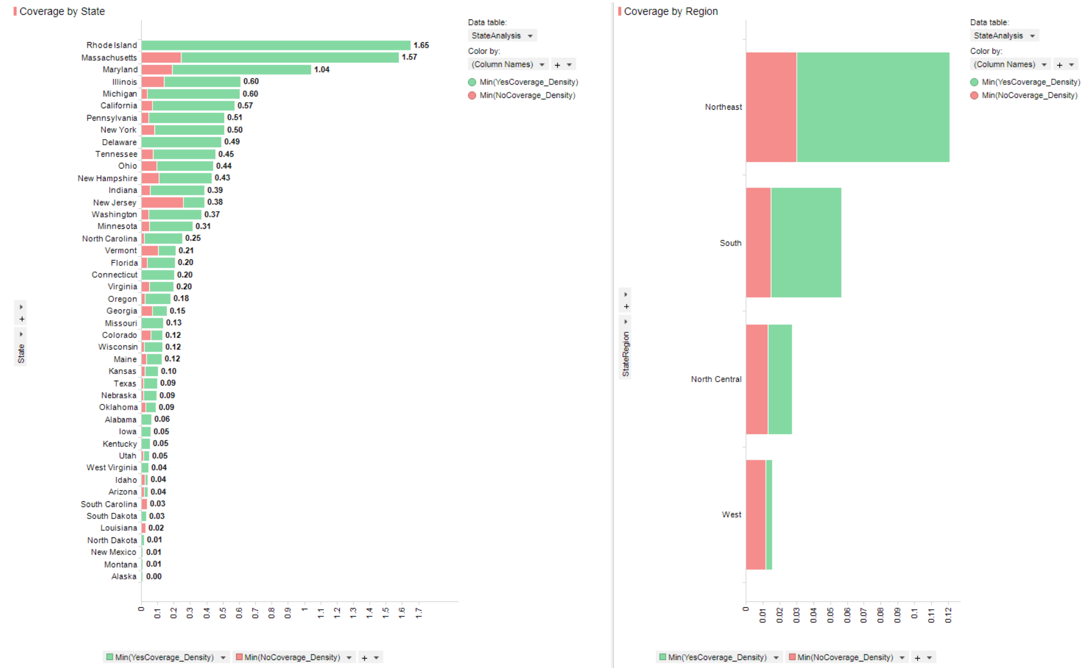
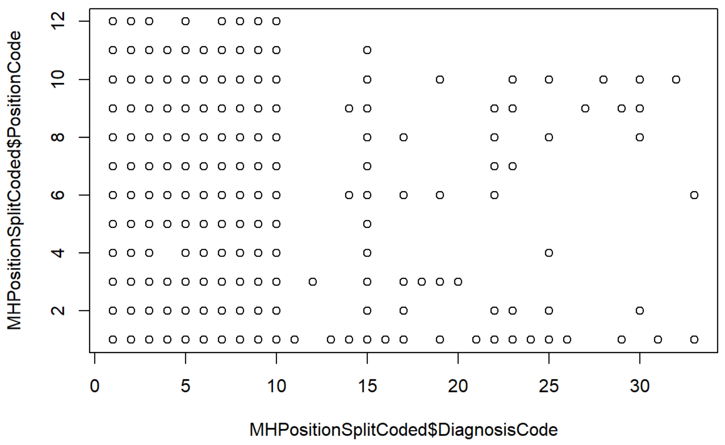
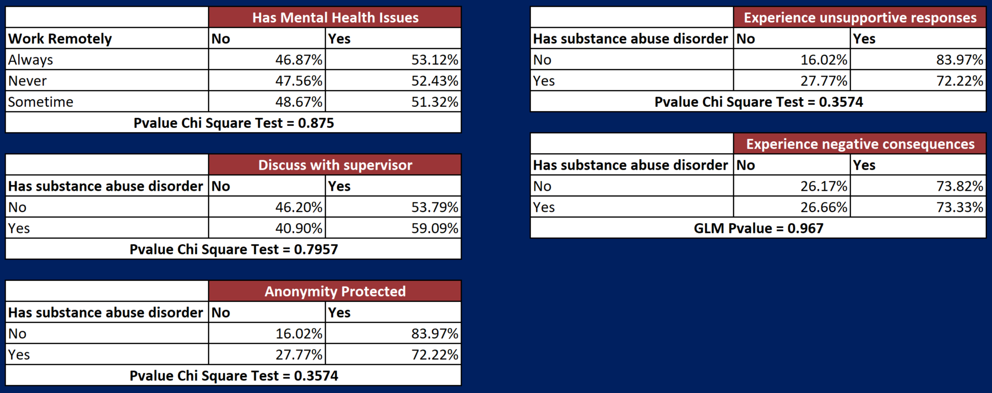
Mental Health in the Workplace
Daniel Serna and James Vasquez
Master of Science in Data Science
Southern Methodist University, Dallas, TX 75275, USA
Introduction
Pictures and Tables
Mental health has become an issue that has brought it self from the shadows into the forefront of the social and traditional news outlets.
The study addressed shows the responses of 1,433 individuals through the US with roles in a technology function.
Figures: figures go great in the center column
Overlay: it’s OK to have the figures intrude into the surrounding boxes.
Tables: tables may go well in the center, off center or in place of one of these boxes
Balance: the biggest point of a poster is to balance this means the figures and tables but also the boxes
Text: text is great but an entire poster of text is really hard for someone to read and understand. I should understand the work reading only headers and figures and tables
Main Topics
The team set out to investigate several topics
  Mental health coverage in the US
  Mental health issues with certain functions
  Substance abuse disorders and mental health issues
Do as I Say
This is simply a representation of what you should have in your poster.
Follow the template.
Keep font sizes as they are.
Work and be creative within the confines of this hot mess
When in doubt, ask.
Problem
Do certain technology job roles line up with specific mental health diagnoses?
Is mental healthcare coverage higher in certain states?
Are there higher reports of mental health issues for remote workers?
Do workers with substance abuse disorder feel more or less willing to discuss their issue with their supervisor when compared to other disorders?
Do workers with substance abuse disorder report that their anonymity was more or less protected when compared to other mental health issues?
Do workers with substance abuse disorder report that they have more experience with unsupportive response when compared to other mental health issues?
Do workers with substance abuse disorder report that they experience negative consequences for divulging mental health issues?
Not as I Do
This is not a very good story.
Your goal is to make this pretty and informative.
Tell your story and break some eggs, but just make sure you have accomplished the task of a poster.
Conclusions
Conclusion 1 – don’t number your conclusions. Simply state them
Conclusion 2, each conclusion is its own bullet point
Conclusion 3 and be sure to have three. All good things come in threes including your primary conclusions from your work.

