Slide 1
Creating Figures for Bimodal Paper

Slide 2
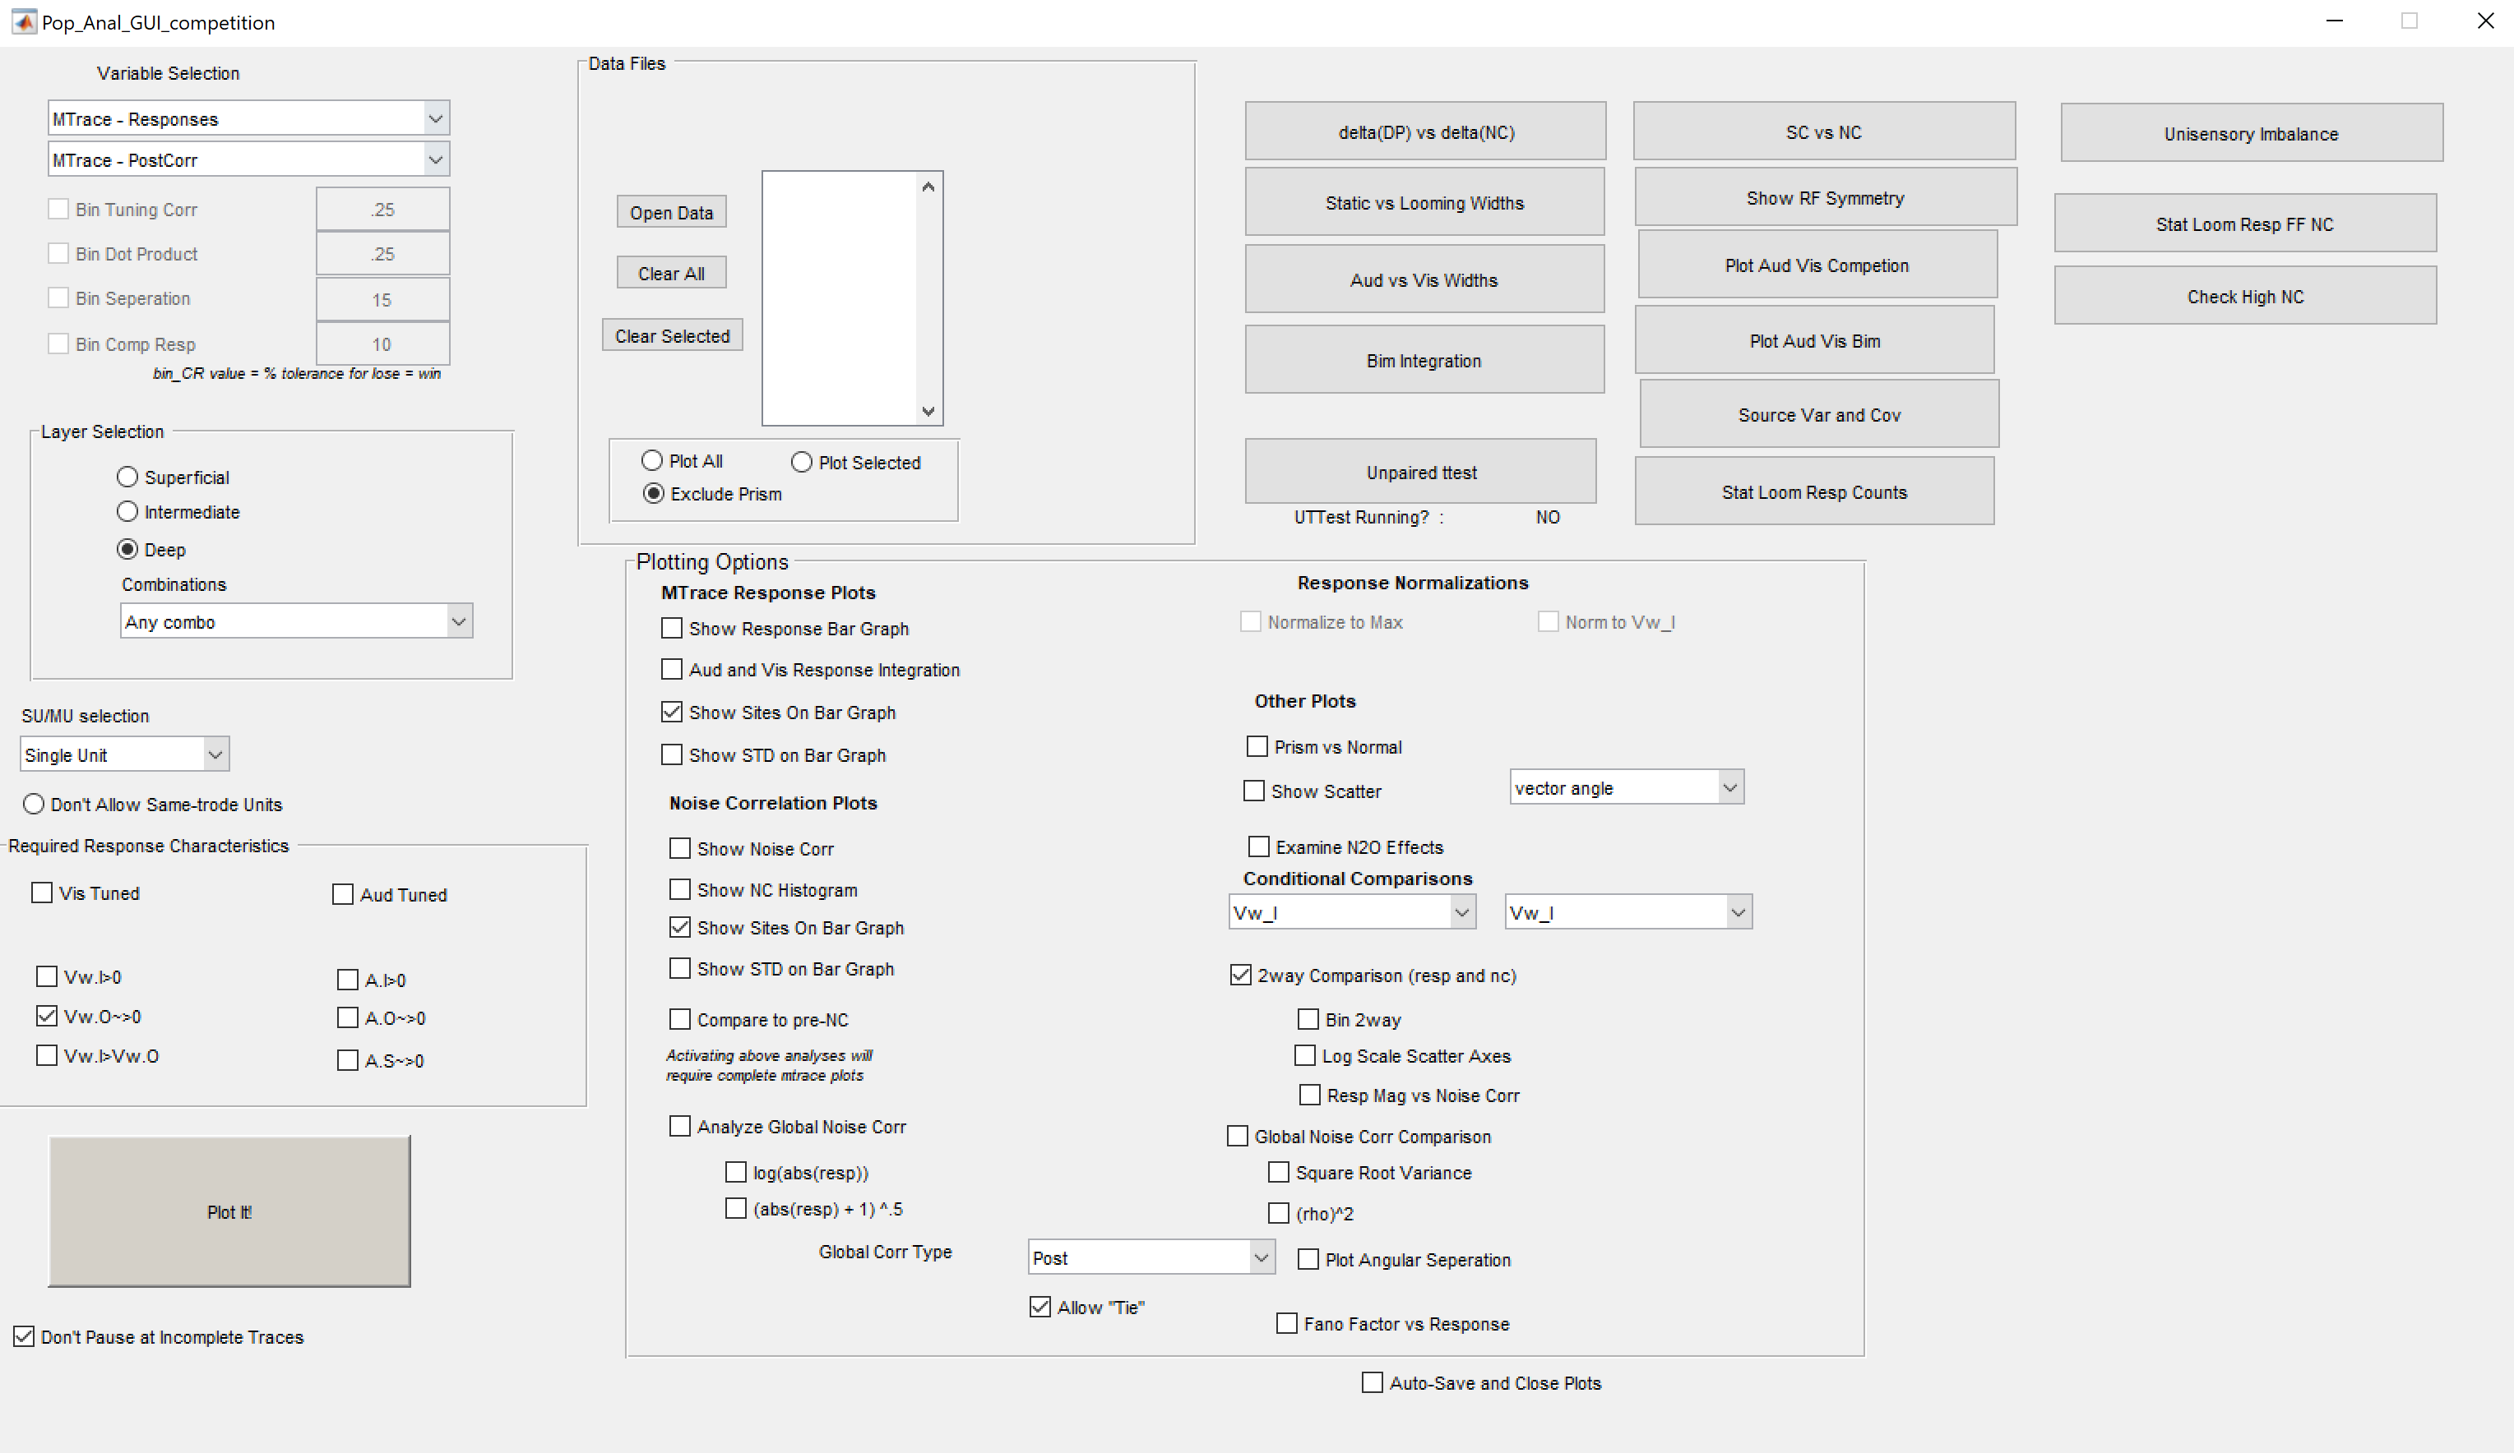
Pop_Anal_GUI_competition (Population analysis graphical user interface for assessing competition)
Run this function to bring up the GUI

Slide 3
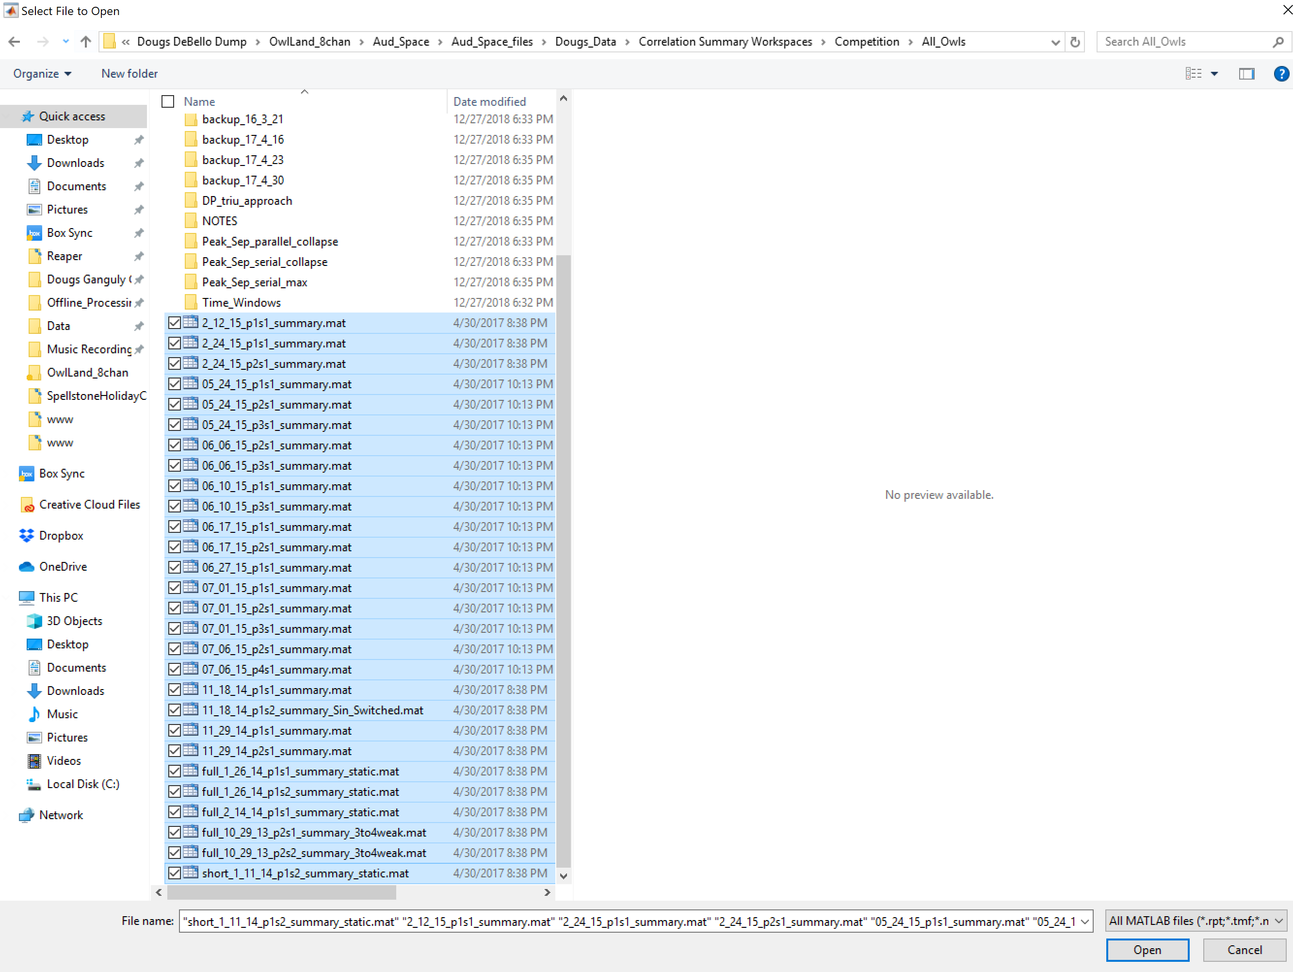
Click “Open Data”
Navigate to .. \OwlLand_8chan\Aud_Space\Aud_Space_files\Dougs_Data\Correlation Summary Workspaces\Competition\All_Owls
Select all the .mat files in this folder and press “open”

Slide 4
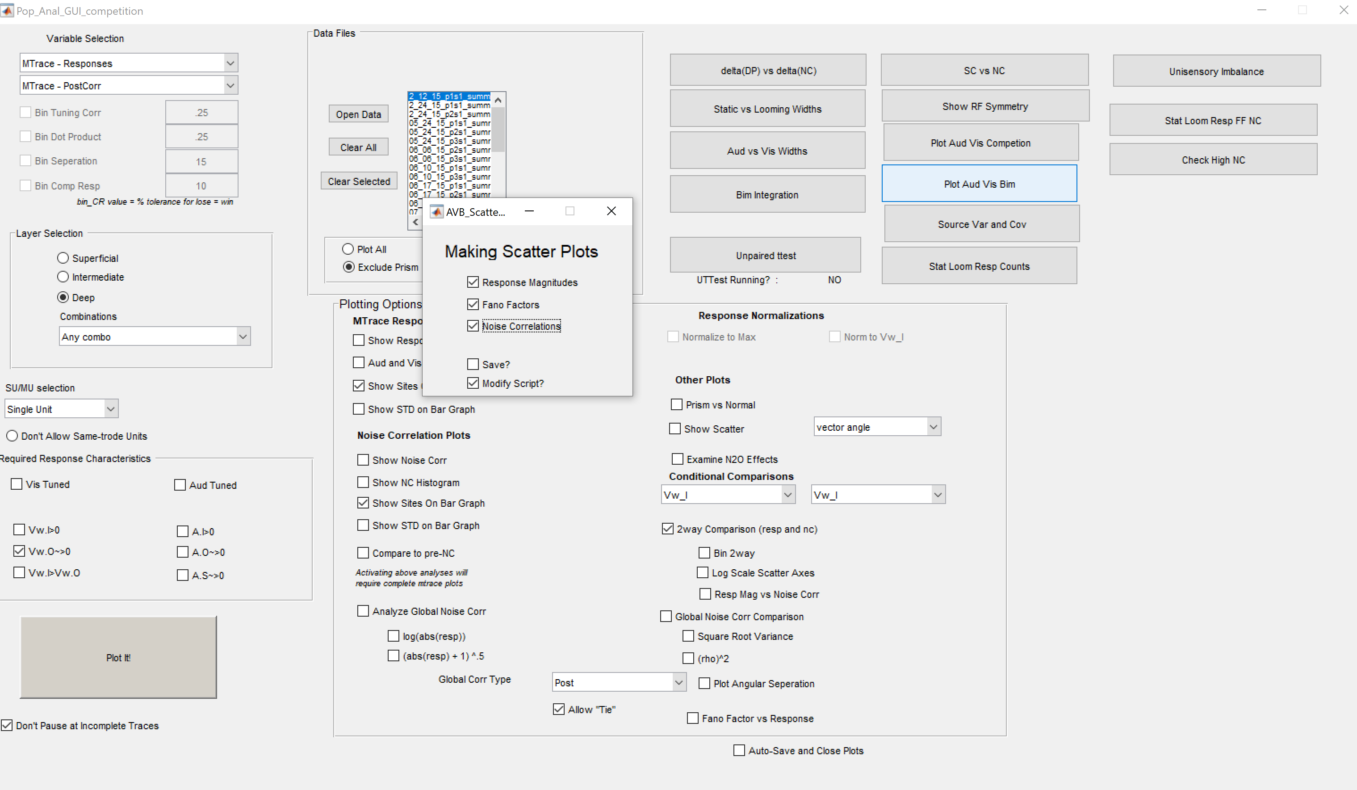
Click Plot Aud Vis Competition
Select which of the three classes of plot you want to make
If you check “Save?” you will be directed to save your figures in a folder of your choice
If you click “Modify script?” you will be brought to the function that generates the figures
Did some clicking around and I’m pretty sure past-Doug did a good job of making all these other buttons work with minimal effort. Looks like you should be able to re-generate figures from both the Bimodal and Visual Salience papers using these various buttons. Except for the simulation figures, I think I have another set of functions for those if you ever need them

