Slide 1
System Verilog Stopwatch
Waseem Orphali
Antonio Jimenez
Pengfei He
Devon Stedronsky
Notes:
WO

Slide 2
Agenda
1
Overview
2
Planning
3
Specification and Requirements
4
Module Development
5
Functional Verification
6
Lifecycle Data
7
Project Insights
Notes:
WO

Slide 3
Overview
Notes:
WO

Slide 4
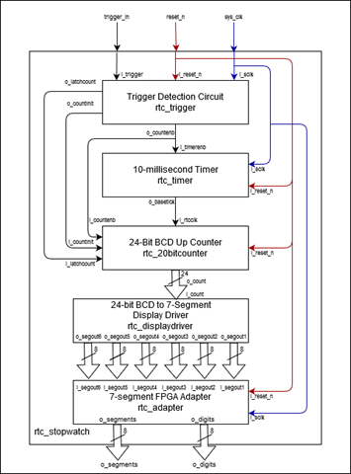
Overview
Project Purpose
Implement RTC Stopwatch project using System Verilog
Implement DO254 standards documentation
Implement project planning and version control standards
Project Scope
Documentation and traceability meeting DO254 standards
Version control using gitflow branching strategy
Project management using Jira
Implement RTL code to Xillinx Artix-7 FPGA board
Notes:
WO

Slide 5
Planning
Notes:
PH

Slide 6
Planning
Two phases were planned containing a total of nine stages to complete the project
Phase 1 (Preparation): Deadline
Planning and Organization ------------------- 06/05/2020
Research and Functionality Description -- 06/10/2020
Requirement Generation --------------------- 06/11/2020
Phase 2 (Development):
Module Development ------------------------- 06/12/2020
Module Verification ---------------------------- 06/16/2020
Top Level Implementation -------------------- 06/17/2020
Functional Verification ------------------------ 06/17/2020
Synthesis and FPGA Implementation ------ 06/18/2020
Final ------------------------------------------------ 06/18/2020
Jira Project
Notes:
PH

Slide 7
Tools Used
Project Management:
Jira
Version Control:
GitHub
Coding
Notepad++
Vivado's text editor
Simulation and Implementation
Xilinx Vivado Design Suite
Nexys A7100T development board
Notes:
PH

Slide 8
Specifications and Requirements
Notes:
AJ

Slide 9
System Specification
100Mhz system clock input
Active low reset
Trigger input button controls start/stop/resume
7-segment display shows time elapsed
Format – MM:ss:mm
Display rolls back to 00:00:00 after one hour
Five submodules
Trigger detection
Timer (clock divider)
Counter
7 Segment
BCD data conversion
Display adapter
Notes:
AJ

Slide 10
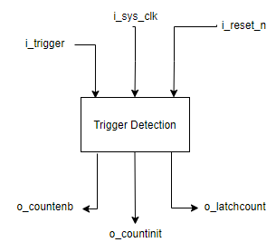
Trigger Detection Requirements
Disables Counter and timer module when active low signal is sent to i_reset_n
Initializes counter module when an active low signal is sent to i_reset_n
Enables/Disables counter and timer module when rising edge is sent to i_trigger
Debounces the signal sent to the i_trigger input
Notes:
AJ

Slide 11
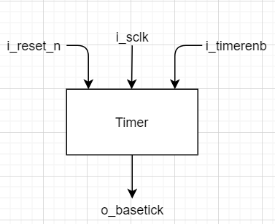
Timer Requirements
Initialization
Internal counter is set to value of 1
Output 'o_basetick' outputs 0
Maximum value of counter 'MAX_COUNT' is 500000
Timer-Enable
Timer module takes 100 Mhz clock as input and outputs a 100 Hz clock
Internal counter increments by 1 on the rising edging of 'i_sclk' when 'i_timerenb' and 'i_reset_n' are 1
Output 'o_basetick' is toggled when counter reaches MAX_COUNT and internal counter is reset to 0
Timer-Reset
Internal counter is set to value of 1
Output 'o_basetick' outputs 0
Notes:
PH

Slide 12
24-bit Counter Requirements
4-bit BCD counter submodule
Low-active reset and initialization conditions
Parameterizable rollover count and flag output controls the maximum count allowed
Increments on the rising edge of 'i_rtcclk' when 'i_countenb' and 'i_latchcount' are set to 1
Output 'o_bcdcount' outputs the current value of the counter
System Verilog allowed the module to use the output directly instead of using internal signals
24-bit BCD counter module
4-bit BCD counter submodules are instantiated for each display digit
Each instance takes the less significant digit's rollover flag as its input clock
The least significant digit takes the 10ms timer output as the input clock ('o_basetick')
Digits rollover at counts of 9 or 5 depending on the digit being displayed
Output 'o_count' combines all instance outputs to a single bus
Notes:
DS

Slide 13
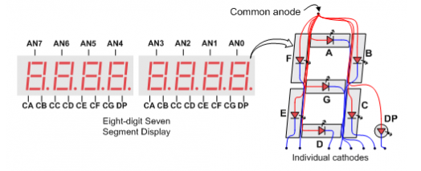
7 Segment Display Requirements
Takes 24-bit BCD input coming from the counter
Splits the input BCD to six separate digits
Converts each BCD digit into its corresponding 7-segment display code:
0 => 11000000
1 => 11111001
2 => 10100100
3 => 10110000
4 => 10011001
5 => 10010010
6 => 10000010
7 => 11111000
8 => 10000000
9 => 10010000
Notes:
WO

Slide 14
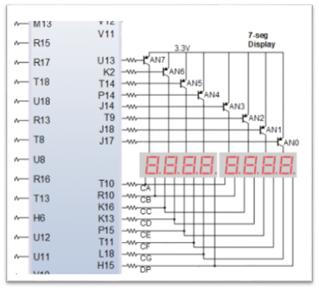
7 Segment Adapter Requirements
Takes in the six digits coming from the 7-segment display module, each represented as 7-segment code
Module keeps all segments and digits turned on when reset is active
Enables every digit on the display for
one millisecond at a time by enabling
the anode connected to the specific digit
Takes a total of six milliseconds to cycle
through the six digits being used
Notes:
WO

Slide 15
Module Development
Notes:
WO

Slide 16
Module Development
Submodule based design
Concurrent development aided by version control
I/O and internal signals defined by specifications and requirements
All source files developed following defined coding standards
Each submodule was developed independently
Preliminary testing was done to ensure compiling before pushing to working branch
A separate team member developed test cases and functional verification of each module
Top level source file development was not blocked by module development
Detailed requirements and specifications allowed for delays in module development while still generating code for the top-level implementation
Notes:
WO

Slide 17
Functional Verification
Notes:
PH

Slide 18
Test Bench and Module Verification
Each team member created test cases and a test bench for other team member's module
Each module's original owner reviewed test cases and the test results for their module
Reviews and edits to the documentation were committed to feature branches before the final versions were merged to the develop branch
Test cases are traceable back to their parent requirement as per requirements standards
Test case tags are directly referenced in test bench console outputs
Each test case was tested with a separate procedure, usually separated in the testbench by resetting the DUT module
The test cases document for each module was updated with:
Pass/Fail and actual results
Git commit tag corresponding to the last edits made to the source files when debugging
Two methods of testing were used as necessary:
Assert statements in the testbench and displaying the test result in the TCL console
Observing the simulation waveform
TCL console output indicates the expected time and output data for each test case
Notes:
PH

Slide 19
Lifecycle Data
Notes:
AJ

Slide 20
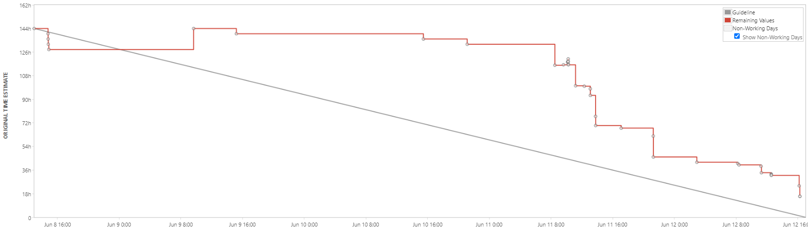
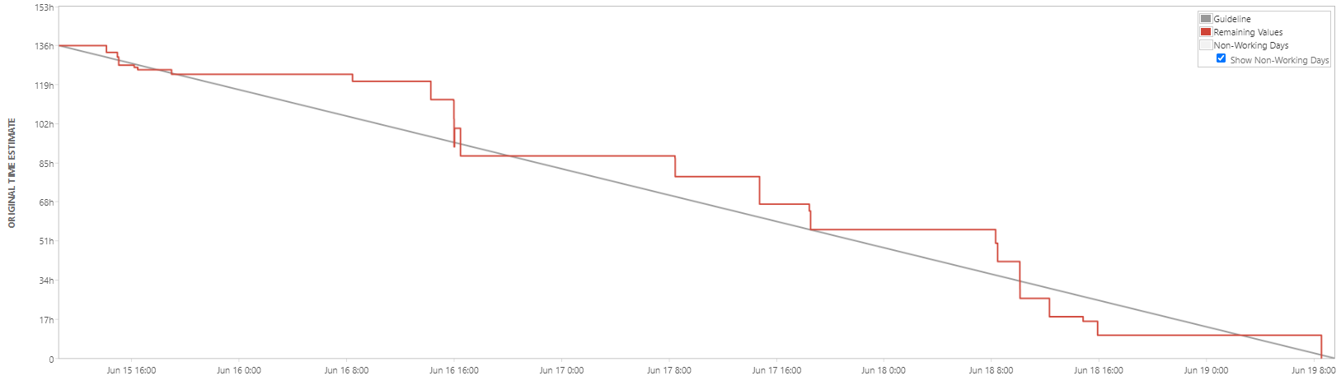
Sprint Burndown Charts
Notes:
AJ

Slide 21
Lifecycle Data
HDP and Joint Milestones
Schedule
Standards
Specifications
Requirements
Requirements Review
Test Cases
Test Case Review
Module Verification Review
Test Results
Notes:
AJ

Slide 22
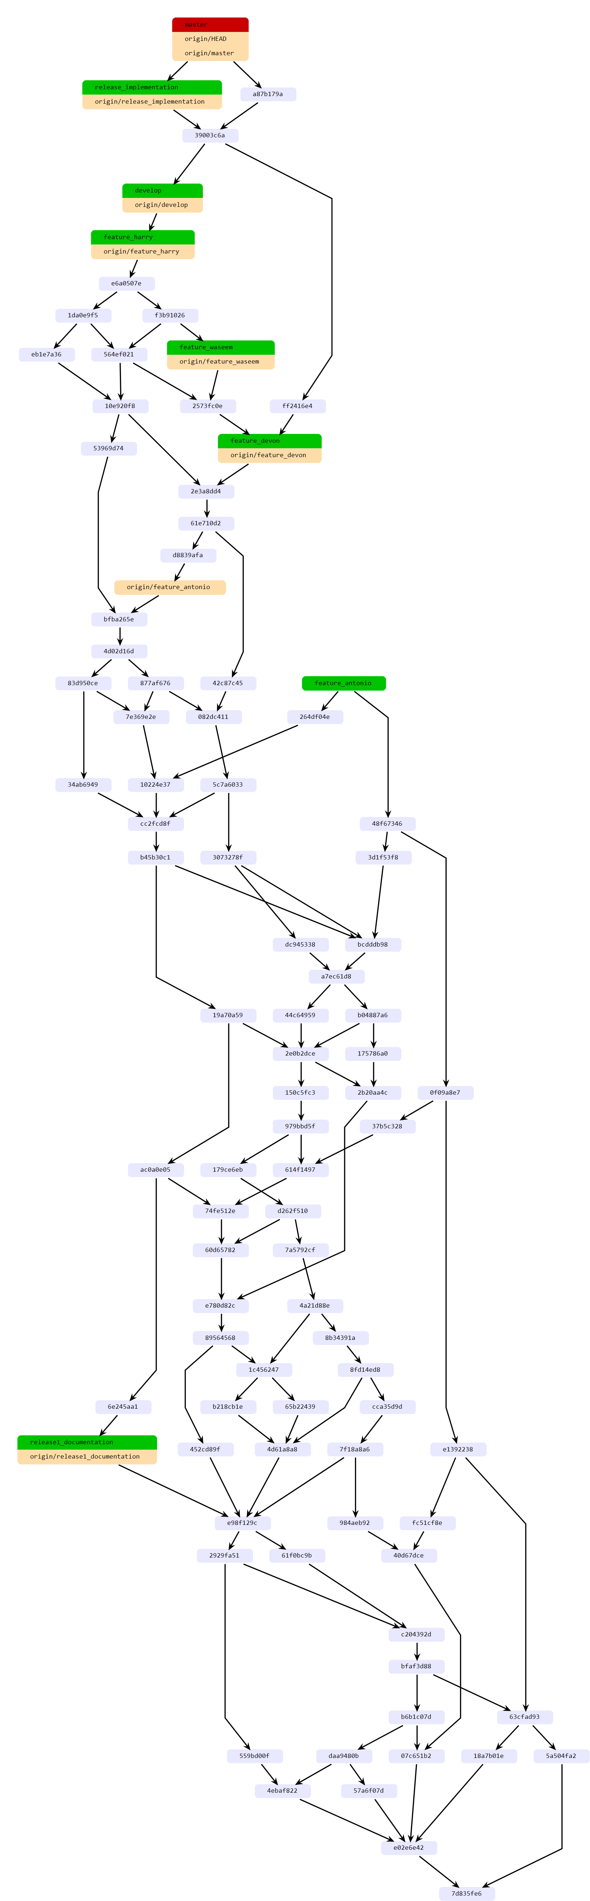
GitHub Statistics
1830 lines of code in final release
Source files and testbenches
134 total commits to master branch
2 release branches
25 merged pull requests
67 unique commits
82 unique cloners
GitHub Repository
Notes:
DS

Slide 23
Project Insights
Notes:
DS

Slide 24
Insights
GitHub management
Add commit naming conventions to configuration standards
More restriction on merging to working branch
Squashing commits
Separating documentation and coding feature branches
Jira Project Management
Using Jira on a smaller time scale to better manage schedule and task changes
More granularity in workload assignment
Documentation tracking and change requests
High-level system requirements
Unable to verify exhaustively
Notes:
DS

