Slide 1
The Impact of Diabetic Testing on Diabetic patient readmission
David Susman

Slide 2

Are hospitals monitoring and testing patients with diabetes?
Hospitals are now beginning to be reimbursed be payers based on their patient readmission rate.
Due to that hospitals are being more proactive in attempting to prevent patient readmissions, especially with populations that can be maintained easily.
One of those populations of interest are those patients that have being diagnosed with diabetes.
An important and standard metric in monitoring the diabetic population is ensuring that they have had at least one hemoglobin A1c (HbA1c) measurement.
If a patient is maintaining their A1c levels, once diagnosed with diabetes, the cost for a hospital is minimal versus the much higher expenses around hospital readmission

Slide 3
Using various clinical data point such as the testing and results of the HbA1c test will reduce hospital readmission rates for the diabetic population.
Hypothesis

Slide 4
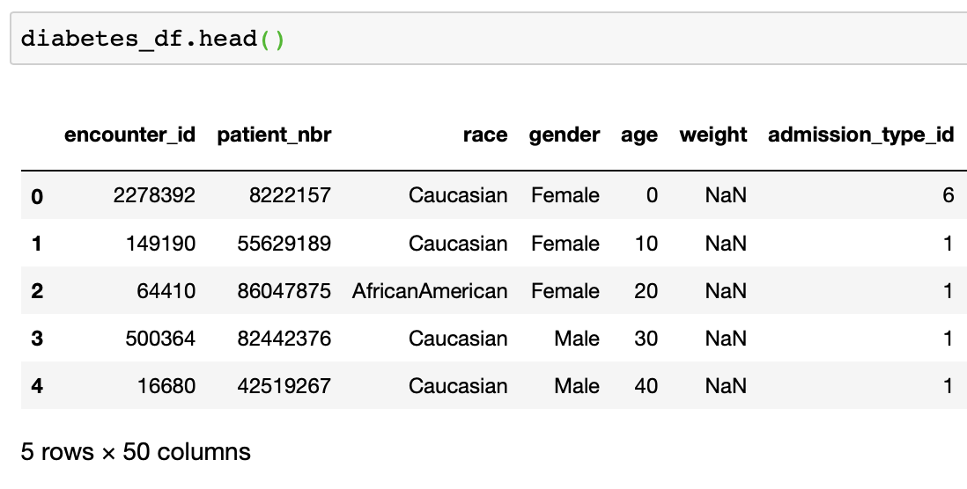
Objective
Partial sample:
Predict if HbA1c testing on know diabetic patients impacts their readmission to a hospital
DATA
https://archive.ics.uci.edu/ml/datasets/Diabetes+130-US+hospitals+for+years+1999-2008
Includes data around patient demographic, various diagnosis records, medications, HbA1c testing and patient readmission
Data set is made of only patients who have been diagnosed with diabetes

Slide 5
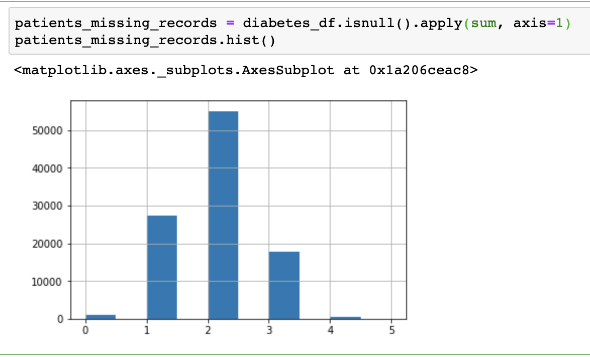
Preparing the data
Based on the number of records out of the 50 possible columns that have NULL values it appears that the majority of the patients have within 0 to 4 records out of 50 missing so I made sure to avoid those columns

Slide 6


Any diabetic patients who did not have a A1c test performed during their inpatient stay, A1Cresult = 0
Any diabetic patients who had a A1c test with result within normal limits, A1Cresult = 5
Any diabetic patient who had a A1c test with results between 7-7.9%, A1Cresult = 7
Any diabetic patient who had a A1c result greater then 8%, A1Cresult = 8
Any diabetic patient who was not readmitted after their inpatient stay, readmitted = 0
Any diabetic patient who was readmitted for any period of time, readmitted = 1

Slide 7
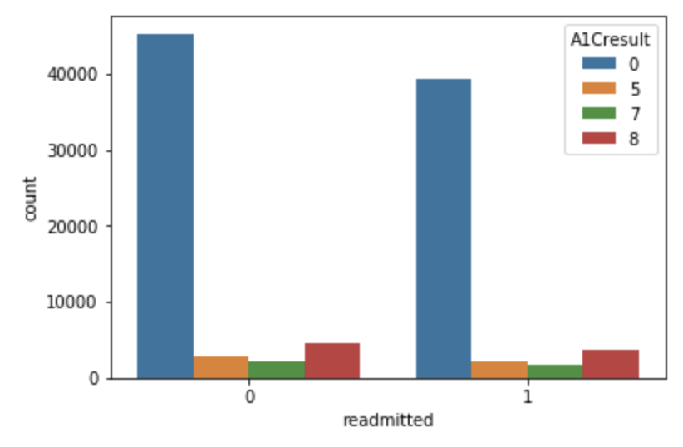
Analysis
Based on the population in the data set the majority (83.3%) of diabetic patients, whether they were readmitted or not, never had a A1c test performed during their inpatient stay at the hospital
Of the patients that were readmitted, 84.1% never had a A1c test performed.
Compare that to the patients who were readmitted and had a A1c level of 8 and are at high risk of complications associated with diabetes at 7.9%

Slide 8
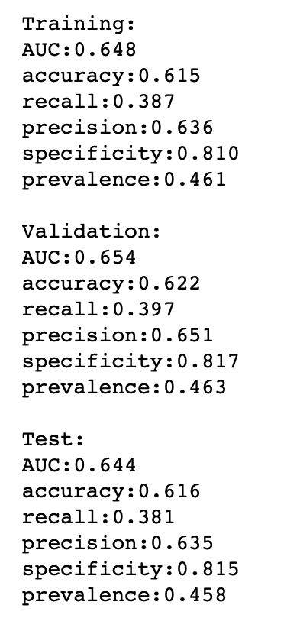
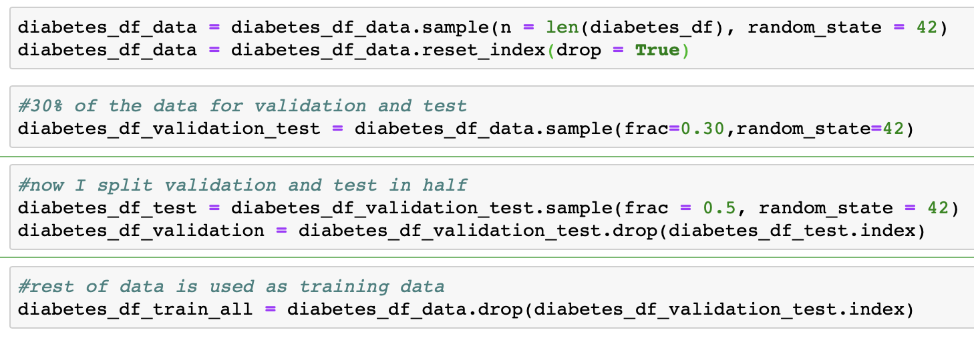
Using Logistic regression against Training, validation and Test Data
I was able to shuffle the data and train it based on 70% of the data, 15% for validation, 15% test.
With our binary classifier we were able to predict the probability of a patient with diabetes to be readmitted. On our test data we had a AUC of 0.64 and using this model we were able catch 38% of the patient readmissions.

Slide 9
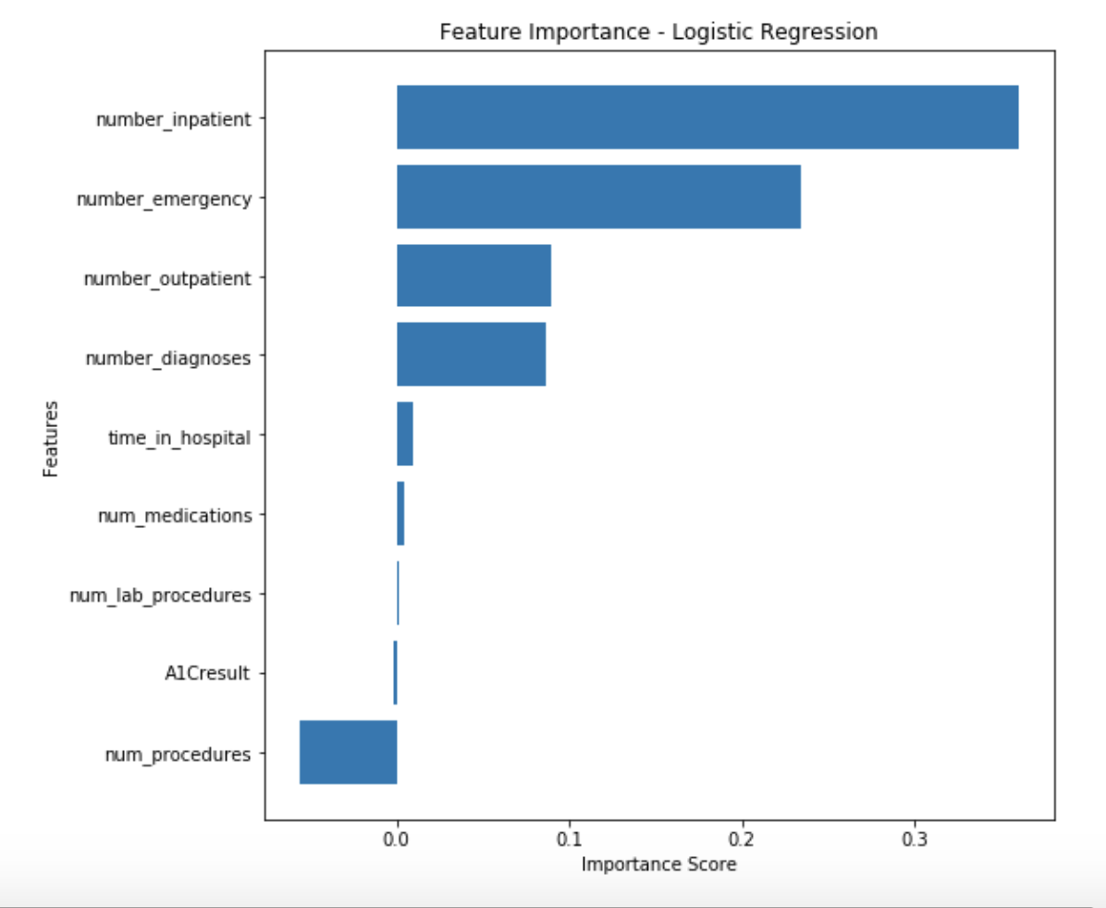
A1C Result vs other features
Oddly enough, it appears that A1Cresults has a negative coefficient for predicting readmission, while the number of inpatient admission in the year prior has the highest positive coefficient, followed by the number of emergency and outpatient visits

Slide 10
Conclusion
Based on my results it appears that there are more influential factors then just the patient HbA1c testing to determining if a patient is likely to be readmitted
At the the time of this data set (1999-2008) HbA1c testing was only beginning to be monitored by hospitals to incentivize hospitals to being more proactive in the care and attempt to be more preventive in treatment of diabetic patients.
Now physicians are expected to maintain a threshold of 68% of their diabetic patients to have had a HbA1c test within the past year. Based on the data set hospitals were very far of that mark during at period at 16.7%.
Goes to show far we have come from then

