Slide 1
分布计算系统
Distributed Computing System
西北工业大学计算机学院 周兴社 杨刚

Slide 2

Distributed Communication
DCS Communication

Slide 3
Outline
Review basic network knowledge
Communication Type
  Basic type: NOS
  Advanced type :Middleware
    RPC/RMI
    MOM
    Stream
    Reliable Group Communication
    DSM
DCS Communication

Slide 4
Review basic network knowledge
DCS Communication

Slide 5
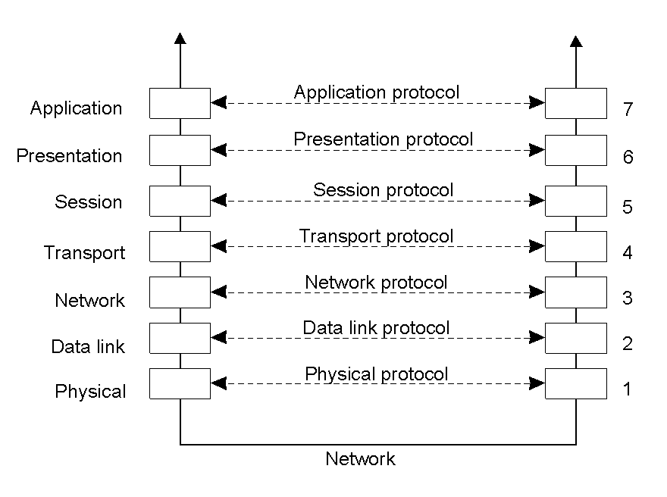
Reference Protocol Model
Layers, interfaces, and protocols in the OSI model.
DCS Communication

Slide 6
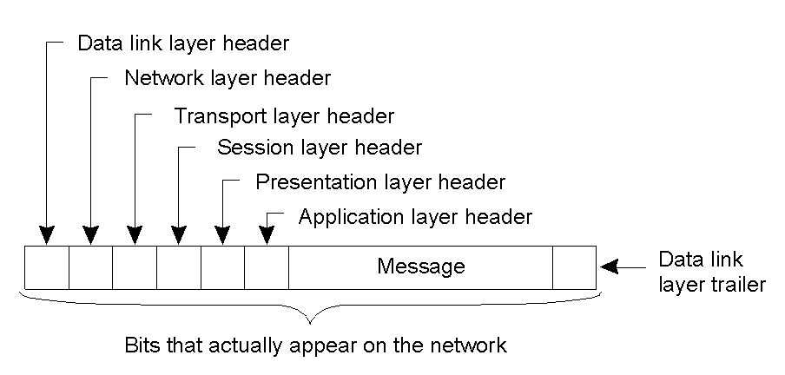
Message
A typical message as it appears on the network.
DCS Communication

Slide 7
Networking issues for Distributed Systems
Performance
  Latency, Data Transfer rate
Scalability
Reliability
Security
Mobility
Quality of Service
  The ability to meet deadline when transmitting and processing streams of real-time multimedia data.
Multicasting
DCS Communication

Slide 8
Link layer:
Ethernet
FDDI
ATM
Wireless
  WPAN: Bluetooth (IEEE802.15.1)
  WLAN: WiFI (IEEE 802.11)
  WMAN: WiMax(IEEE 802.6)
  WWAN: GSM,3G
DCS Communication

Slide 9
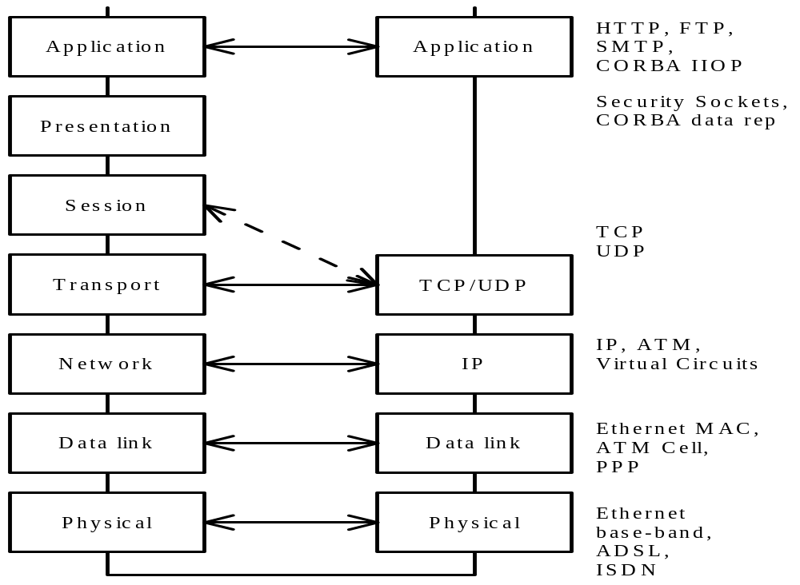
ISO VS. TCP/IP
IP
TCP/UDP
?
DCS Communication

Slide 10
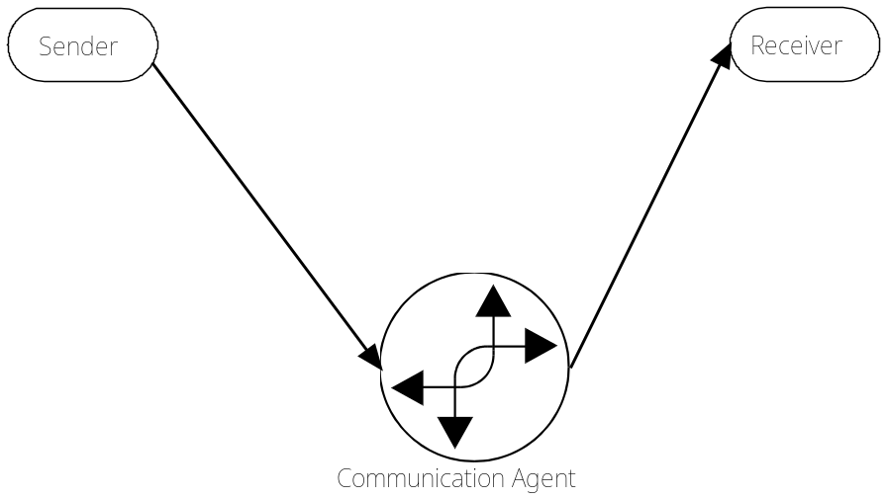
Communication Model & Semantic
Buffered vs. Unbuffered
  Buffered – Message buffered by Kernel first, then write into process’s AS
  Unbuffered – Message written into process’s AS directly
Blocked vs. Unblocked
  Blocked – perform the next action until communication complete
  Unblocked – perform the next action just start the communication and synchronize later.
Reliable vs. Unreliable
  Reliable – not also send message but also guarantee
  Unreliable – just send message
  Three level:
    at least once
    at most once
    exactly once
DCS Communication

Slide 11
Basic Type: NOS
DCS Communication

Slide 12
Simple C/S model(1)
Based TCP/IP and/or other IPC
Fall into NOS arch
Request-Reply manner
API interface:
  socket
  bind, connect, accept
  send, recv
DCS Communication

Slide 13
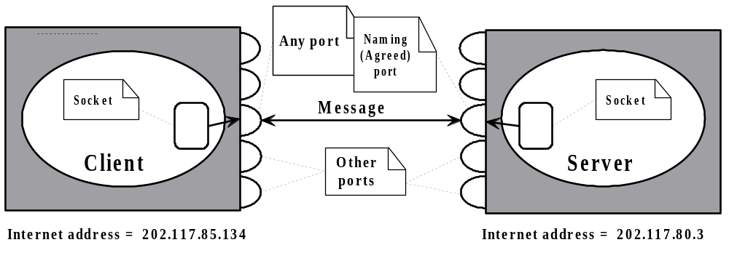
Simple C/S model(2)
DCS Communication

Slide 14
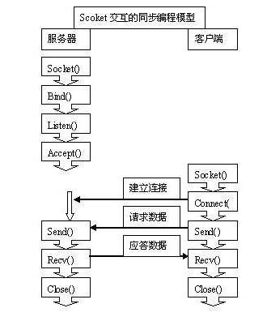
Simple C/S model(3)
DCS Communication

Slide 15
Simple C/S model(4)
Thinking:
  Problem
  How to represent data?
    Depend on the programmer
    int send(SOCKET s, const cahr* buf, int len, int flags)
    int recv(SOCKET s, char* buf, int len, int falgs)
  How to manage session?
    Depend on the programmer too
    manage port by itself
    select transport by itself
DCS Communication

Slide 16
Simple C/S model(5)
Advantages
  Simple, just need foundational NOS
  Flexible:
    Unicast, multicast, anycast or broadcast
    Stream/datagram
    Reliable/unreliable
    …
  Less footprint
    Real-time
    Embedded
    Mobile
  Customable
DCS Communication

Slide 17
Simple C/S model(6)
Disadvantage
  Need low-level knowledge about network
  Depend on programmer excessively
  Difficult to port and error-prone
  Non-transparent
  Spaghetti: Application logic and communication
  Private specification, non-openness
  …
DCS Communication

Slide 18

Homework
Design a distributed application which come up to the following demands:
  NOS based
    Server management and access a database contains the students’ score(c, Java, English,…)
    Client query somebody’s score as a record through server
  Client should be GUI style.
DCS Communication

Slide 19
Advanced type :Middleware
DCS Communication

Slide 20
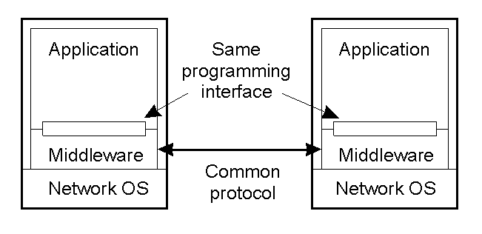
What is Middleware?
Middleware is a distributed system software layer that sits above the network
Operating system and below the application layer and abstracts the heterogeneity Of the underlying environment.
providing a programming interface
providing data exchange format
providing a protocol for interoperation
DCS Communication

Slide 21
Advanced type : RPC
DCS Communication

Slide 22
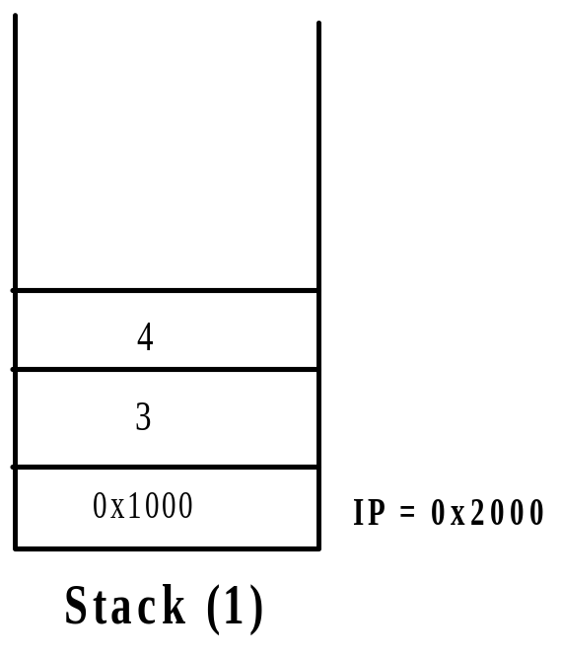
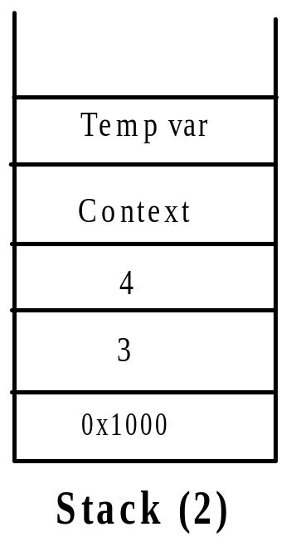
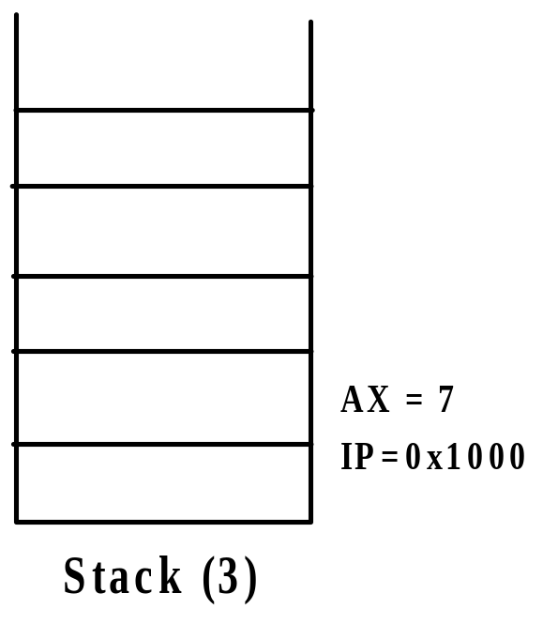
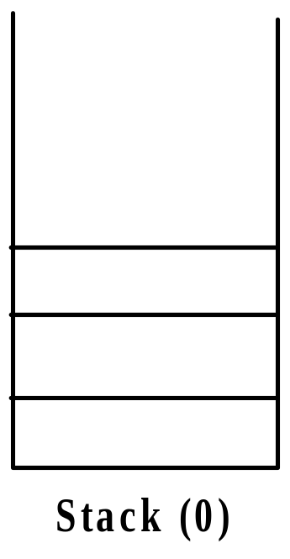
LPC
LPC: Local Procedure Call
Sample: int add(int a, int b);
Implementation based stack frame:
caller and callee in the same process
...
call add(3,4) // 1
movl ax, sum; // at 0X1000 4
...
int
add(int a, int b) // at 0x 2000 2
{
return a+b; // 3
}
DCS Communication

Slide 23
IPC
IPC: Inter Processes Communication
Main form:
  Shared memory
  Pipe
  Mailbox
  …
Object: just for information communication but function integration.
DCS Communication

Slide 24
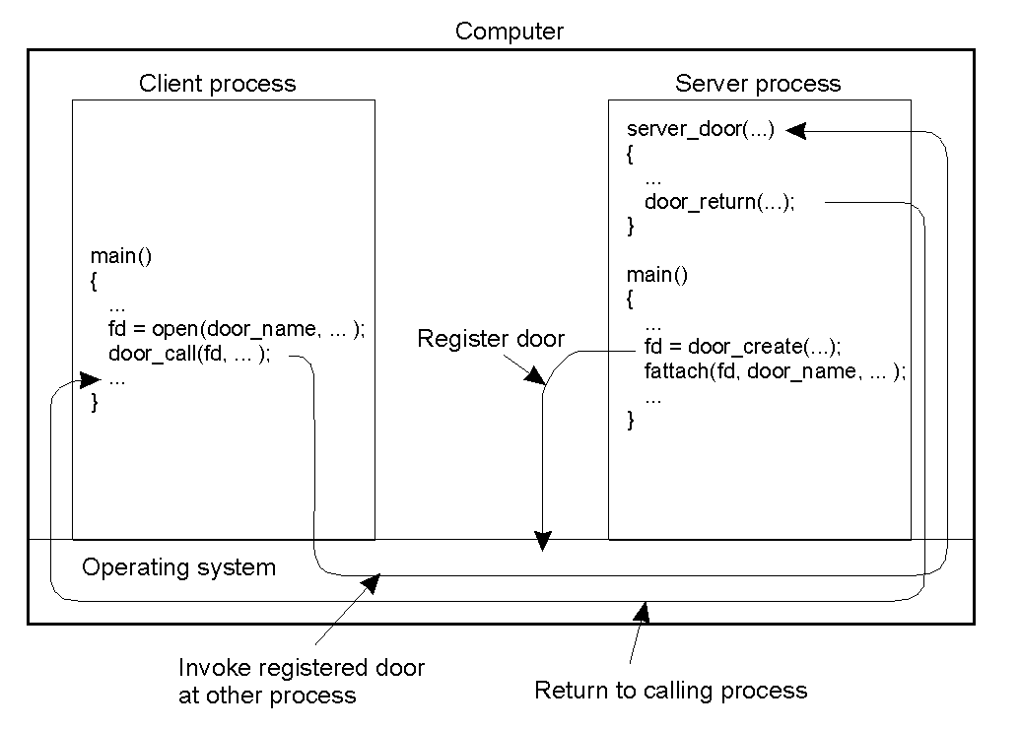
Doors
Origin form Spring and packed in Solaris 2.5
IPC like LPC
processes coexist in the same home
Like a LPC, but nonidentical
Communication details managed by Runtime
Based IPC
Thinking: improvement?
DCS Communication

Slide 25
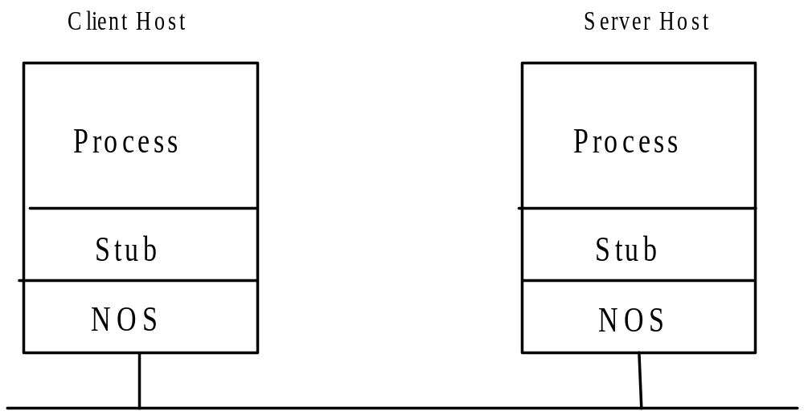
RPC
RPC: Remote Procedure Call
Let us think: to implement RPC, what problem should be resolved?
Model:
a process in host 1 calls a procedure of another process in host2
DCS Communication

Slide 26
RPC’s Details
Client procedure calls client stub in normal way
Client stub builds message, calls local OS
Client's OS sends message to remote OS
Remote OS gives message to server stub
Server stub unpacks parameters, calls server
Server does work, returns result to the stub
Server stub packs it in message, calls local OS
Server's OS sends message to client's OS
Client's OS gives message to client stub
Stub unpacks result, returns to client
DCS Communication

Slide 27
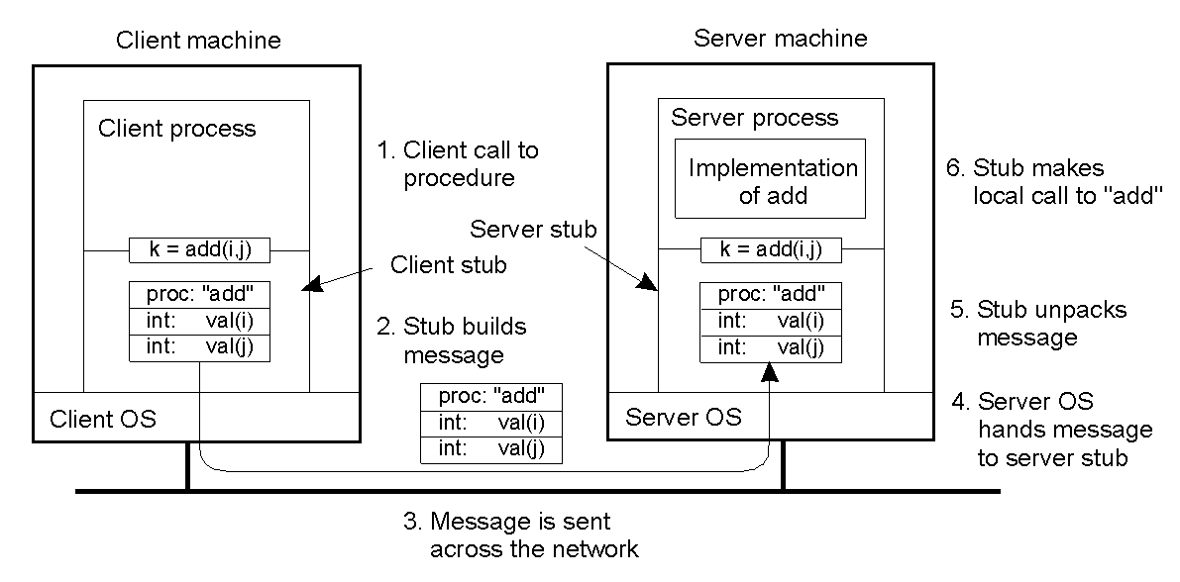
RPC’s Details
Steps involved in doing remote computation through RPC
DCS Communication

Slide 28
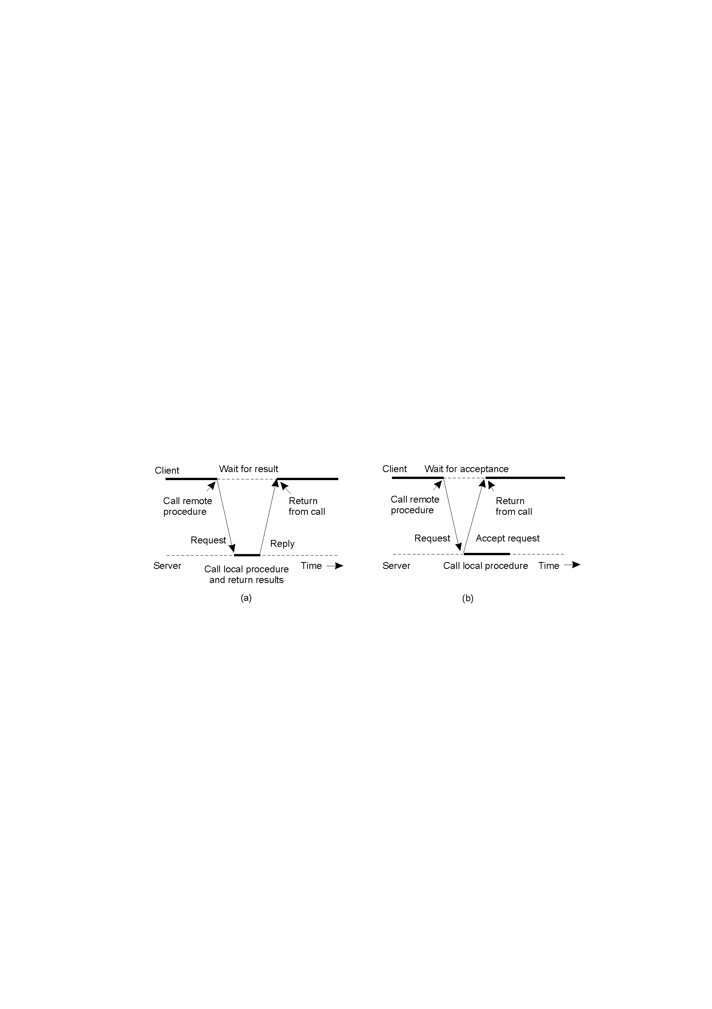
Synchronous and Asynchronous RPC
The interconnection between client and server in a traditional RPC
The interaction using asynchronous RPC
DCS Communication

Slide 29
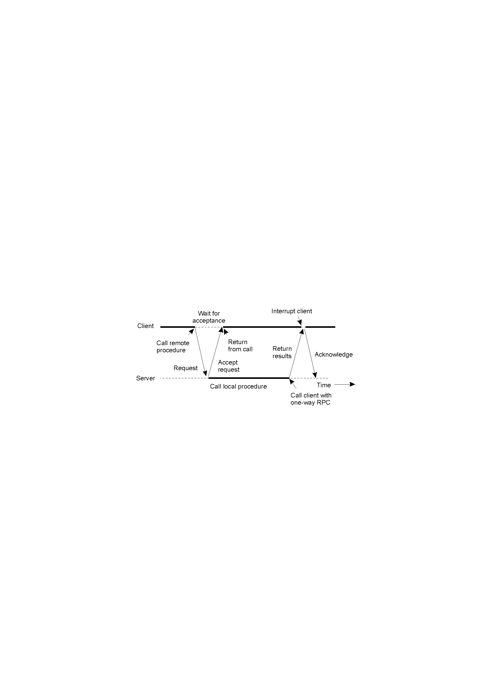
Asynchronous RPC
A client and server interacting through two asynchronous RPCs
DCS Communication

Slide 30
RPC’s technique: parameter passing
  Identify procedure
  by value vs. by reference
    in
    out
    inout
  heterogeneous data
    little endian vs. big endian
    different data represent
DCS Communication

Slide 31
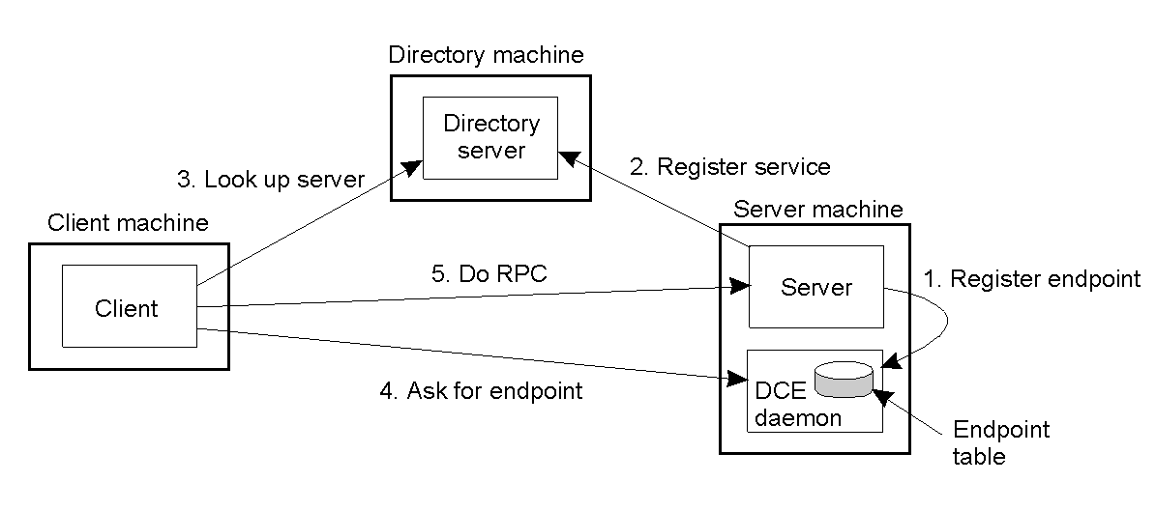
RPC’s technique: Binding
  Create a path between client and server
    Locate the server’s machine
    Locate the server( i.e., the correct process) on that machine
DCS Communication

Slide 32
RPC’s technique: Handing multi-requests
  dispatcher: Server have a dispatcher which interpret procedure name and dispatch the request to appropriate procedure
  Single thread:
    only one servicing thread
    queue-based
    FCFS/prior
  Multi-threads
    multi-threads simultaneous
    Concurrency service
DCS Communication

Slide 33
RPC’s technique: Handing error & exception
  error vs. exception
  exceptions
    can not locate server
    request msg lost
    reply msg lost
    server crash
    client crash
rebind
resend msg
resend msg/idempotent
depend on
depend on
DCS Communication

Slide 34
RPC’s technique: Reply
  How to reply a large message?
    split it to multiple small message
    send and wait
    blast
DCS Communication

Slide 35
RPC’s technique: Timing
  multiple timer management
  specify the timeout value
    too small
    too large
    adaptive
arising non-necessary resend
degrading performance and lost message
DCS Communication

Slide 36
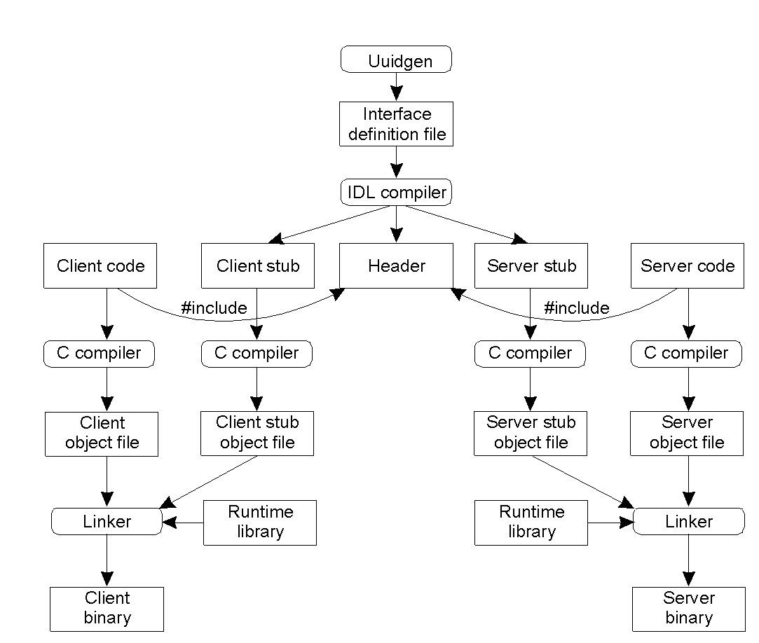
RPC’s Practice
The steps in writing a client and a server in DCE RPC
DCS Communication

Slide 37
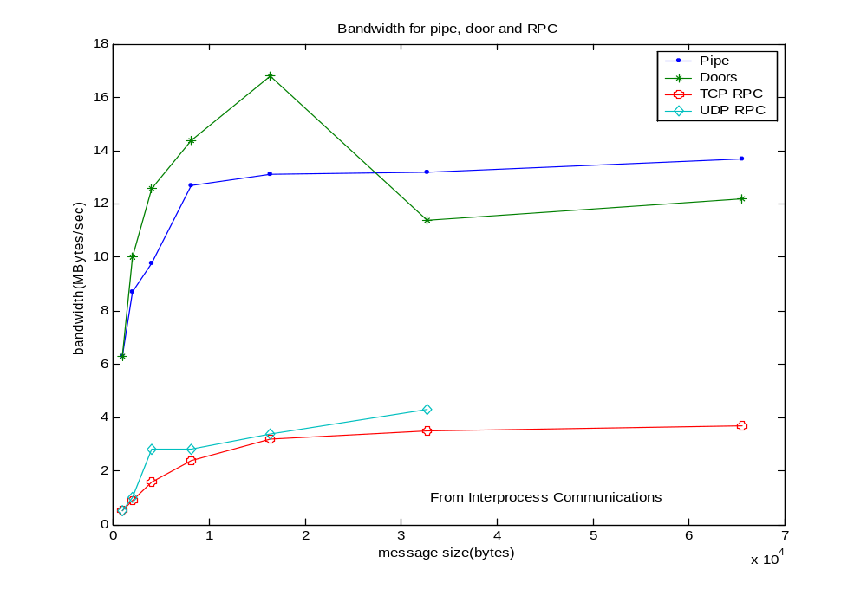
Performance Comparison:
DCS Communication

Slide 38
Advanced type : MOM
DCS Communication

Slide 39
What is MOM
MOM: Message-oriented Middleware
Advantage:
  Loose coupling
    Not need client and server on line at the same time
  Persistent delivery
  Scalability: 16.2Million concurrent queries per hour
  Availability:
Analogy :
  Post
  Email
Basic concepts
  Message consumer
  Message Producer
  Message Queuing System
DCS Communication

Slide 40
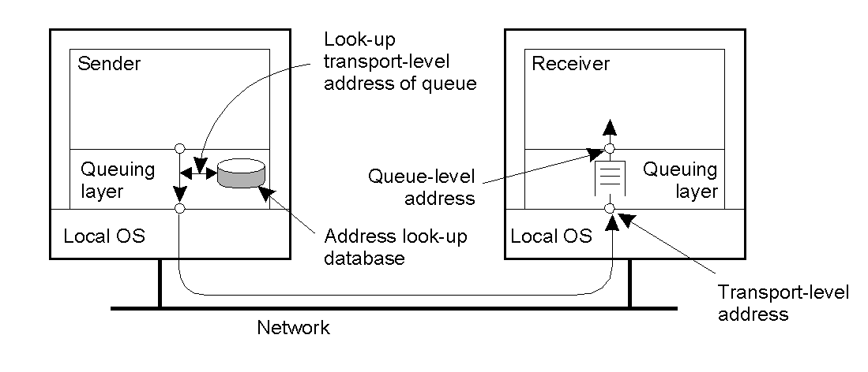
Essential Model
MOM: Message-Oriented Middleware
Goal: loosely-coupled communication
DCS Communication

Slide 41
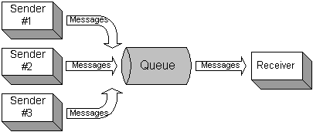
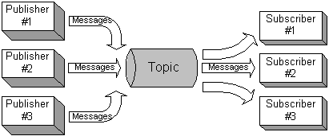
Messaging Model
Point to Point
Publish-Subscribe
DCS Communication

Slide 42
Decentralized Mom
Distributed directly
Distributed agent-based
Distributed store-forward-based
Federal
DCS Communication

Slide 43
Mainstream
IBM’s MQSeries
Microsoft Message Service
Sun’s JMS
…
DCS Communication

Slide 44
Advanced type : Stream
DCS Communication

Slide 45
Scheme Ⅱ: Middleware-based Model(5): Stream(1)
Mode:
  asynchronous transmission mode
  synchronous transmission mode
  isochronous transmission mode
Classify
  simple stream
  complex stream
DCS Communication

Slide 46
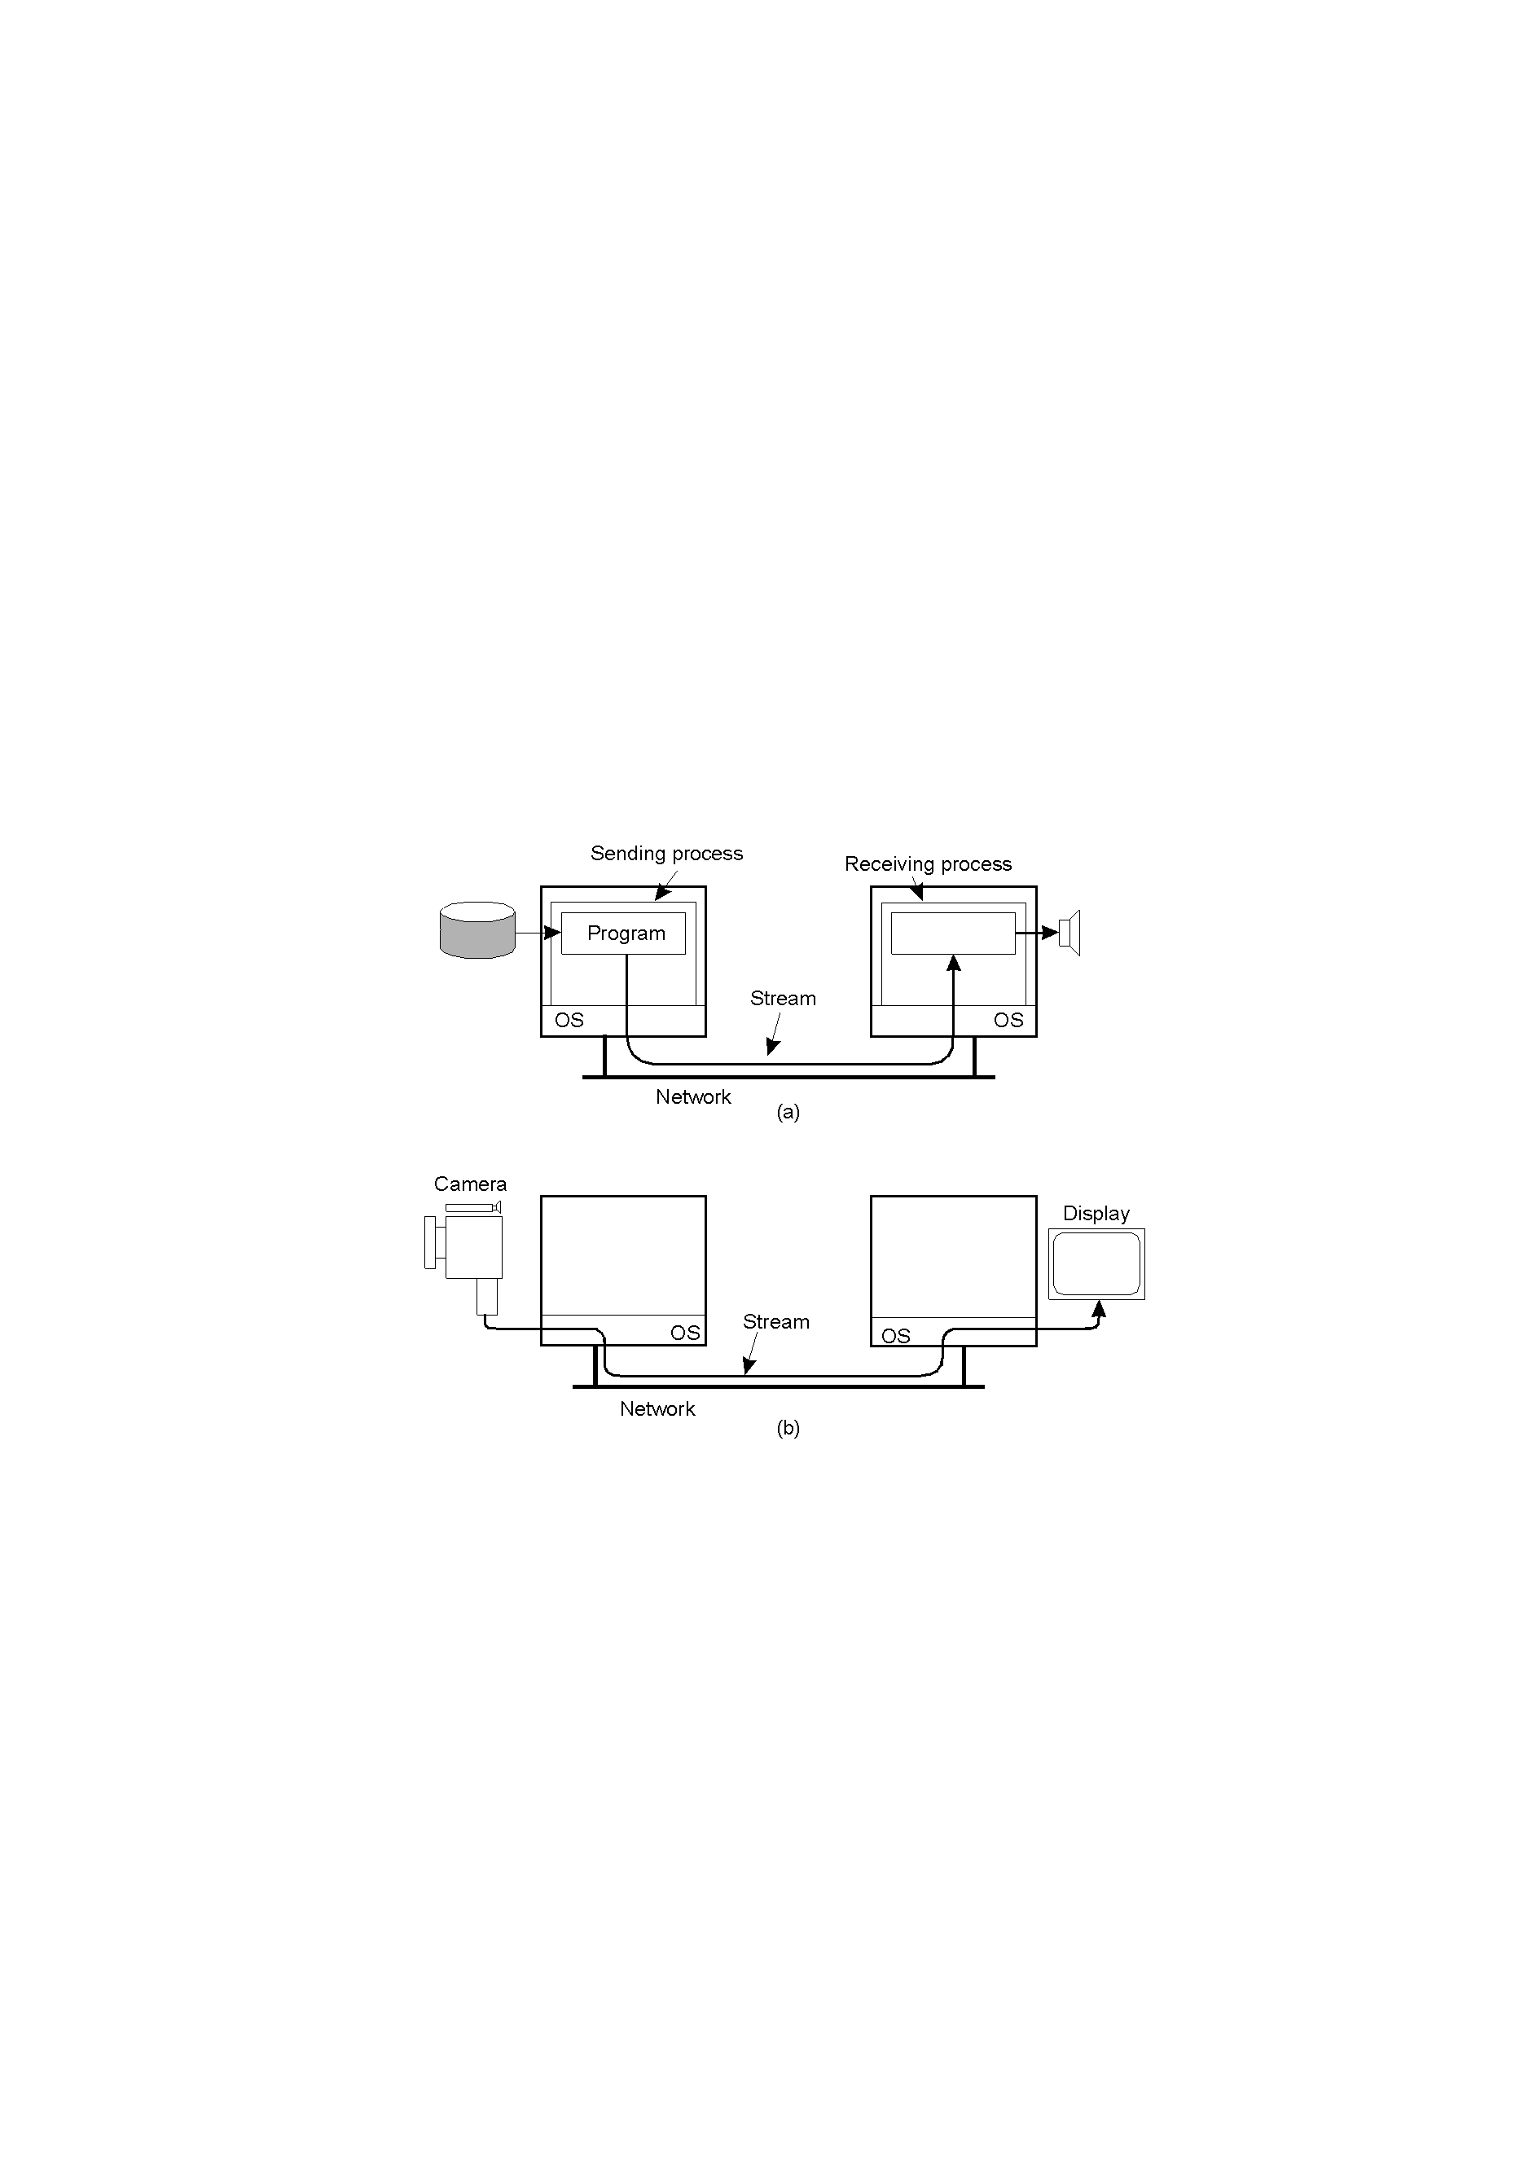
Model
Setting up a stream between two processes across a network.
Setting up a stream between two processes across a network.
DCS Communication

Slide 47
Scheme Ⅱ: Middleware-based Model(5): Stream(3)
2-35.2
Setting up a stream directly between two devices.
DCS Communication

Slide 48
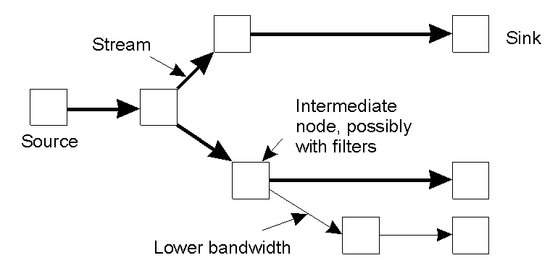
Multicasting Stream
An example of multicasting a stream to several receivers.
DCS Communication

Slide 49
Scheme Ⅱ: Middleware-based Model(5): Stream(5)
Characteristics of the Input | Service Required
maximum data unit size (bytes) Token bucket rate (bytes/sec) Toke bucket size (bytes) Maximum transmission rate (bytes/sec) | Loss sensitivity (bytes) Loss interval (μsec) Burst loss sensitivity (data units) Minimum delay noticed (μsec) Maximum delay variation (μsec) Quality of guarantee
A flow specification.
DCS Communication

Slide 50
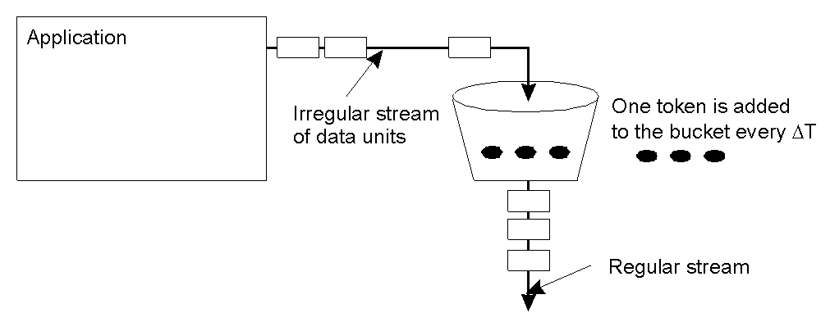
Scheme Ⅱ: Middleware-based Model(5): Stream(6)
The principle of a token bucket algorithm.
DCS Communication

Slide 51
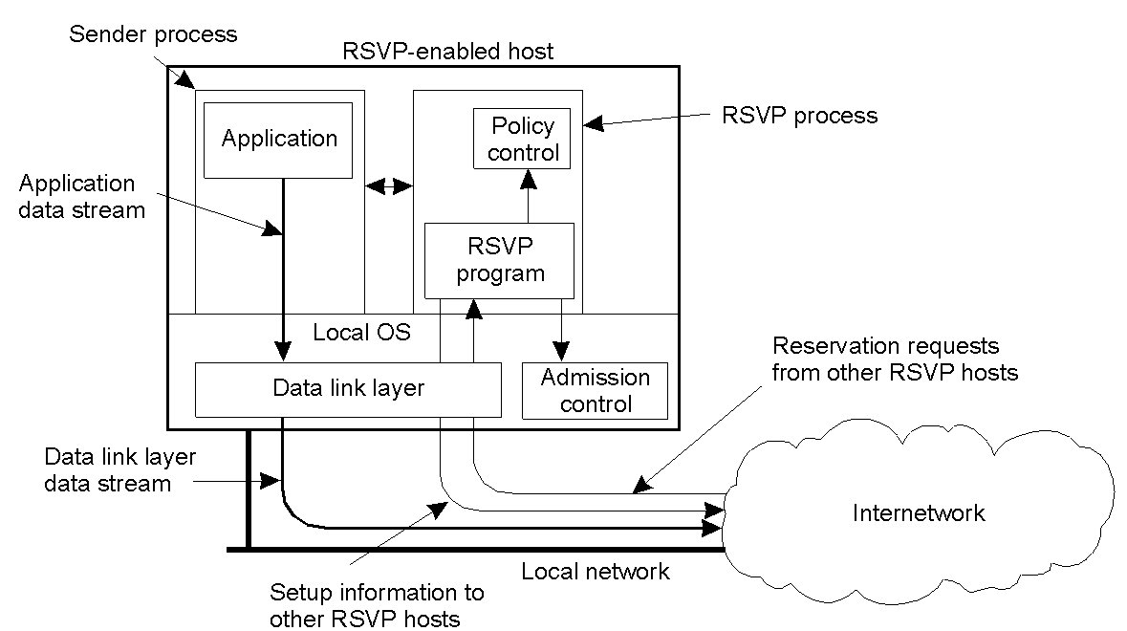
Scheme Ⅱ: Middleware-based Model(5): Stream(7)
The basic organization of RSVP for resource reservation in a distributed system.
Setting up a stream based QoS
DCS Communication

Slide 52
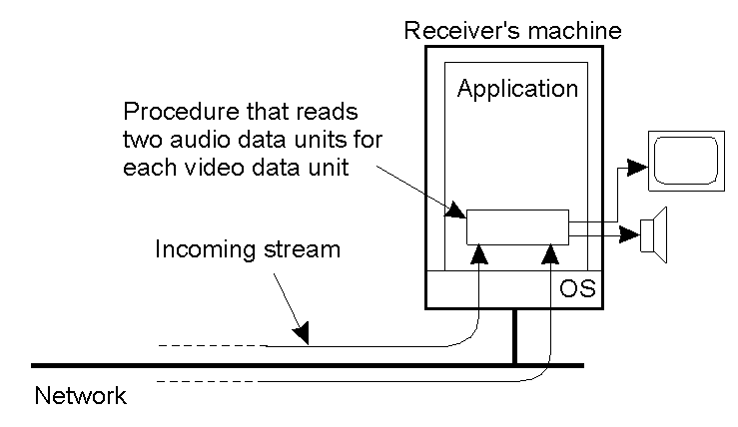
Scheme Ⅱ: Middleware-based Model(5): Stream(8)
Synchronization: on the level data unit
DCS Communication

Slide 53
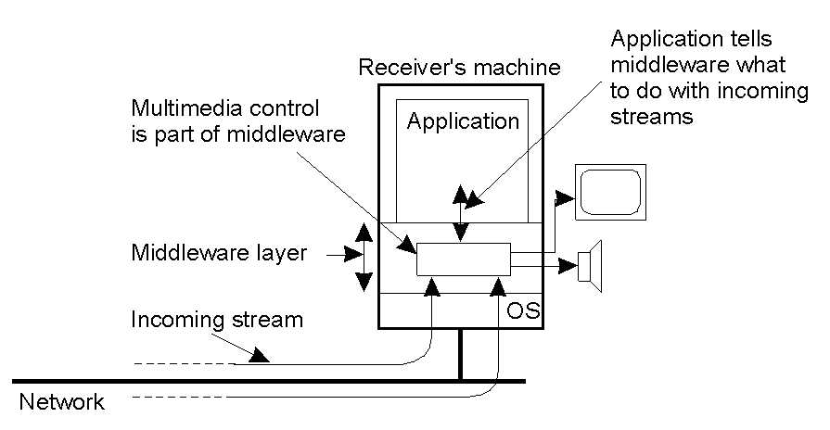
Scheme Ⅱ: Middleware-based Model(5): Stream(9)
The principle of synchronization as supported by high-level interfaces.
2-41
Synchronization: on the high level interface
DCS Communication

Slide 54
Extend
RPC
  Sun’s RPC
  Microsoft’s RPC
MOM
  Please search and read JMS’s specification
  Look for a JMS open-source implement and try it
DCS Communication

