Slide 1
分布计算系统
Distributed Computing System
西北工业大学计算机学院 周兴社 杨刚

Slide 2

Distributed Fault Tolerance

Slide 3
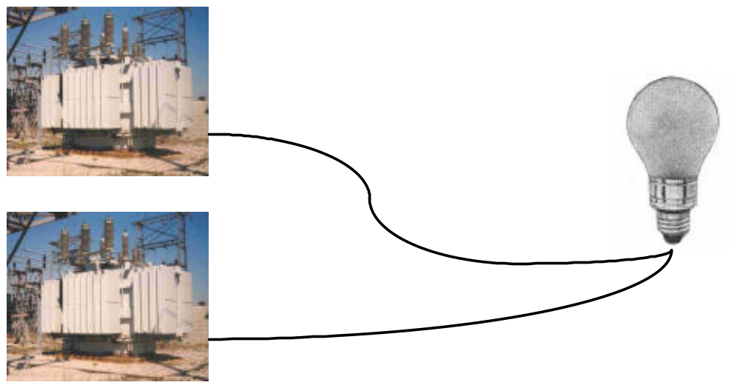
A simple case
How to guarantee a light is always on in a situation where power supply is failure-prone?

Slide 4
What is Dependable System?
Dependable System ‘s requirements:
  Availability
  Reliability
  Safety
  Maintainability
System ready to be used immediately
System can run continuously without failure
Nothing catastrophic happens when system temporarily fails to operation correctly
How easy a failed system can be repaired.

Slide 5
Background
Most DCSes should be Dependable System
  Military : C4I, Satellite Measure&Control System, Avionics System,…
  Finance or business: Bank information processing System, electronic commerce (EC),…
  Network Servicing System: ISP/ICP/ASP, Searching Engine, telecom manage system,…’

Slide 6
Popular ways to improving DCS’s dependability?
If all components are high dependability, maybe system itself is high dependability.
  Dedication system and high cost
  Just apply to some special system such as spaceflight, where some limits should be hold
    space
    weight
    power consumption
If a system possesses ability of failure tolerance, maybe the system is high dependability.
  Inherent resources redundancy
  New technology coming forth continually
    RAID
    Supper-speed network
    Cluster,P2P,Grid ……
  Exist possibility to construct a high dependability system using normal computers.
  excellent performance-cost ratio
  broad application domain
From the view of technology and economy, fault-tolerance is more important and promising .

Slide 7
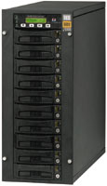
A view of RAID

Slide 8
Fail, error and fault
Fail
Error
Fault
A system is said to fail when it cannot meet its promised, in other words, it cannot provide some of all services correctly.
Error is a part of a system ‘s state that may lead to a failure.
Fault is error’s cause.

Slide 9
Faults classify
Transient fault:
Intermittent fault
Permanent fault
Occur once and then disappear. Ex: a bird fly through the beam of a microwave transmitters.
Sometime occurs, then vanishes, then appear. Ex: a loose contact on a connector .
Continues to exist until the faulty component is repaired. Ex: burnt-out chips, software bug, disk head crashes.

Slide 10
Failure Models
Type of failure | Description
Crash failure | A server halts, but is working correctly until it halts
Omission failure Receive omission Send omission | A server fails to respond to incoming requests A server fails to receive incoming messages A server fails to send messages
Timing failure | A server's response lies outside the specified time interval
Response failure Value failure State transition failure | The server's response is incorrect The value of the response is wrong The server deviates from the correct flow of control
Arbitrary failure (Byzantine failure) | A server may produce arbitrary responses at arbitrary times
From other viewpoint, we can classify failure models as follows:
fail-stop: whenever failure, stop service.
fail-silent: When failure, running continually.
  fail-safe: When failure, running continually but others can detect the abnormal situation.

Slide 11
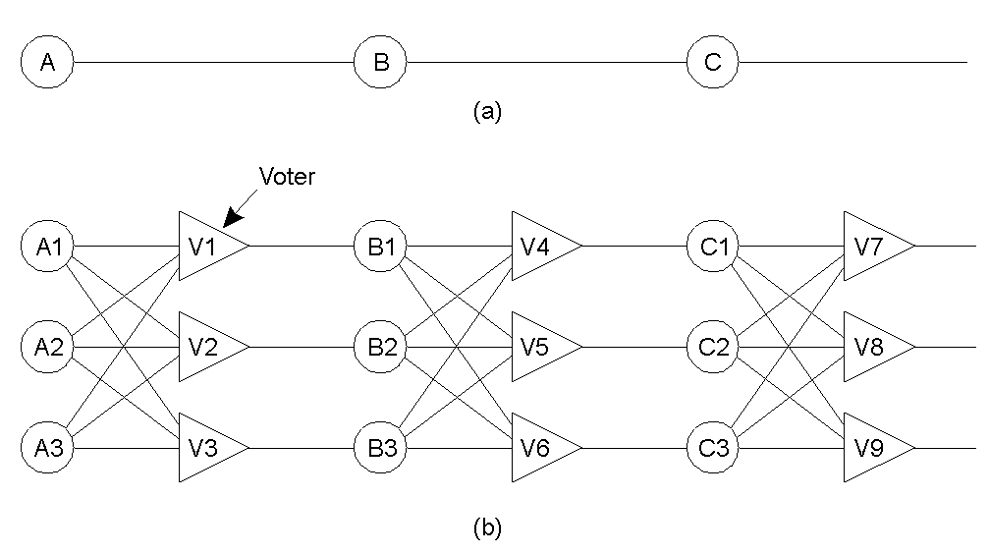
Principle of failure-tolerance
Triple modular redundancy

Slide 12
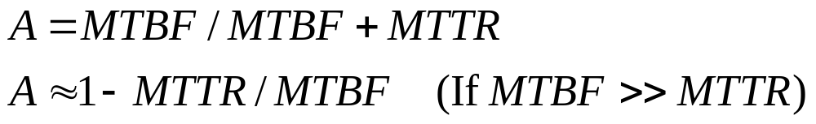
Dependable system’s indices
MTBF: Mean-Time Between Failure, apply for unrepairable system.
MTTR: Mean-Time To Repair, apply for repairable system.
Availability: the radio of normal operation in lifetime. And it become the popular index evaluating DCS’s dependability.

Slide 13
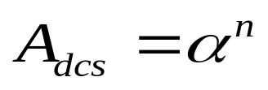
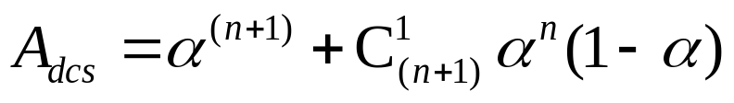
Evaluate fault-tolerance(1): Theory
Assumption
  A DCS consists of n process unit (PU), and all PE are in series.
  Every PU’s availability isα.
  Backup can replace every PE.
  Define system’s availability as A_{dcs}.
No backup
One backup
Two backups
Generally, r backups
  Please think about it.

Slide 14
Evaluate fault-tolerance(2): Example
Assumptions:
  α= 0.99, n = 10
No backup: A_{dcs}= (0.99)¹⁰=0.90438
One backup: A_{dcs}= (0.99)¹¹ + 11×(0.99)¹⁰ ×
(1-0.99)=0.99482
Two backup: A_{dcs} = 0.99979
Three backup: A_{dcs} = 0.99999; in 70days,fail 1m
in 11years,fail 1 hour

Slide 15
Fault-tolerance Policy Replication-based
each logical object is implemented by a collection of physical copies called replicas
  the replicas are not necessarily consistent all the time (some may have received updates, not yet conveyed to the others)
Policy Replication-based
  take advantage of the resources redundancy of DCS.
  Classify:
    Passive replication: backup method
    Active replication: vote method
Benefit form Replication:
performance enhancement
fault-tolerant service
availability improvement

Slide 16
Passive Replication
There just is a primary backup and others are secondary.
Clients contact with primary backup and the other backups can only contact with primary.
principle:
  Client send request to primary backup
  the primary backup processes the request and return the result to client.
  When primary backup crashes, a new primary will come into being
  Backup types
    Hot backup: all backups process client’s request synchronously, but only the primary’s result is allowed to return to client.
    Cold backup: Anytime only the primary backup processes client’s request and other backups idle. When primary backup operates abnormally, the backup is just started and replace previous primary backup.
    Warm backup: All backups start, but anytime only primary response client’s request and update the others’ state.

Slide 17
Warm backup(1): Flow
Client send request to the primary backup.
The primary backup accept the request and process it. When process finishes, it update its own state and send update message to the other backups.
When other backups get the update message they update their state and reply a ACK msg.
After collect all ACK message, the primary backup returns the result to client.
Client gets the result and continues running.

Slide 18
Warm backup(2): Switch
When detect the primary backup crashed, a new primary backup will be brought come being.
The time when the primary crashed:
  Before send update message to the other backup
  After send update message.
  After client get the result.
How to handle the problems above?
Thing: How to bring a new primary backup come being?
Please think for a few minutes and answer.

Slide 19
Active Replication
All backups’ statuses are equal.
principle:
  Client send request to all backups.
  All backups accept client’s request and process it respectively.
  When process finishes, every backup returns its result to client respectively.
  Last, client select only one among all results returned by backups according to special policy.
    First response
    Most agreement
    All agreement

Slide 20
Fault-tolerance Key(1): Reliable Group communication
Group communication
  Form one point to multiple points
  Ex: UDP multicast
With an eye to the DCS’ performance, communication among backups should utilize group communication.
Traditional group communication is unreliable and does not adapt to the requirement of fault-tolerance.
The key point to implement reliable group communication is synchronized algorithm
Please think about what problem we need solve when apply reliable group communication to distributed fault tolerance.

Slide 21
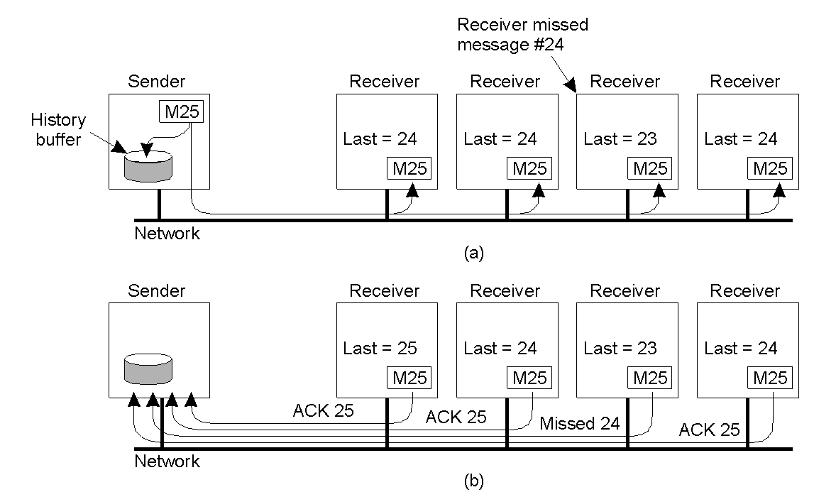
Basic Reliable-Multicasting Schemes
A simple solution to reliable multicasting when all receivers are known and are assumed not to fail:
(a) Message transmission
(b) Reporting feedback

Slide 22
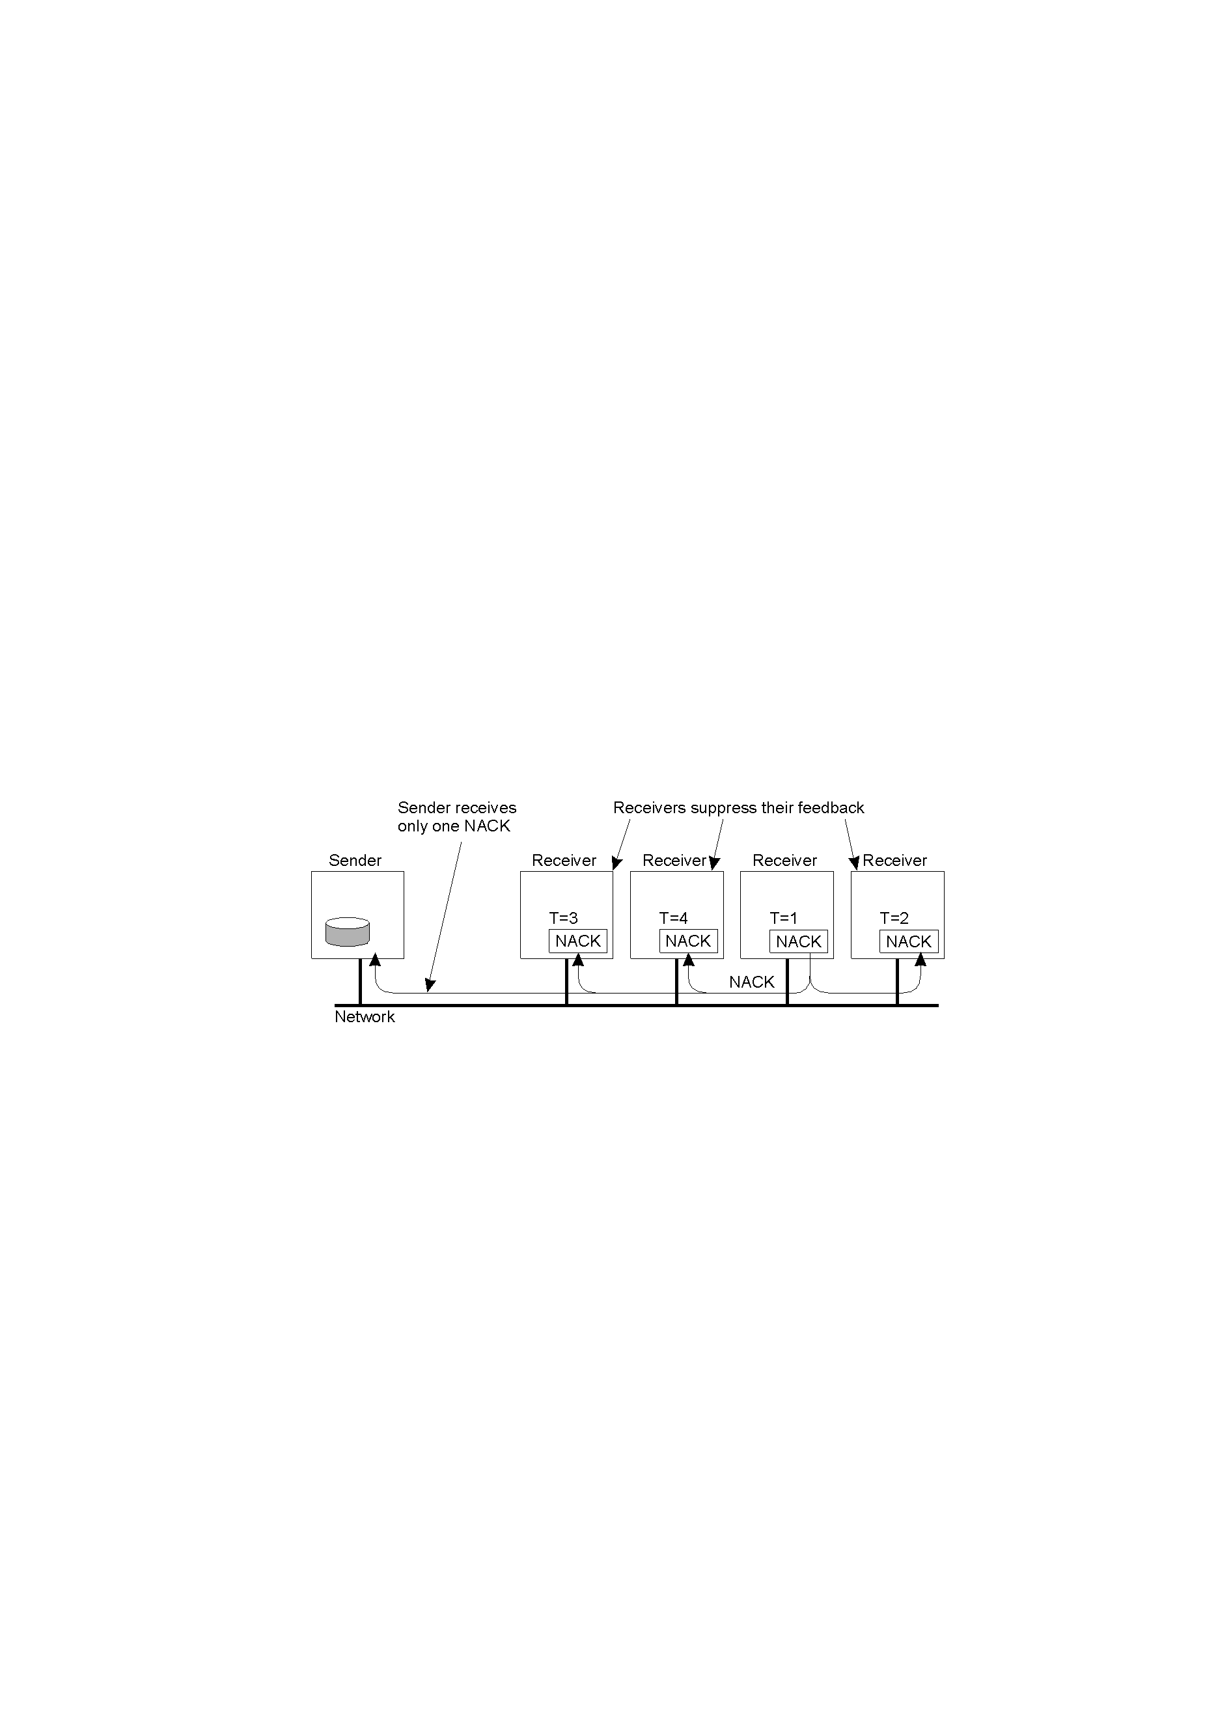
Nonhierarchical Feedback Control
Several receivers have scheduled a request for retransmission, but the first retransmission request leads to the suppression of others.

Slide 23
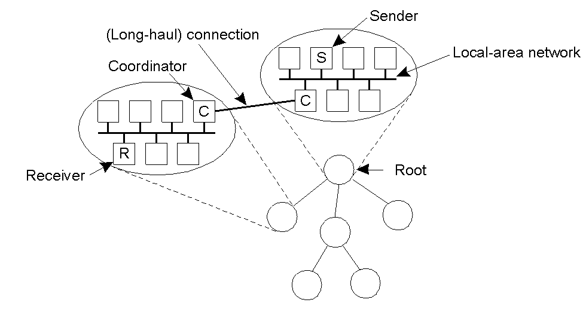
Hierarchical Feedback Control
The essence of hierarchical reliable multicasting:
(a) Each local coordinator forwards the message to its children.
(b) A local coordinator handles retransmission requests.

Slide 24
Fault-tolerance Key(2): Atomic Message
Atomic: When multicast a message all or none of receivers get it.
Signification: please refer to Warm backup(2): Switch.

Slide 25
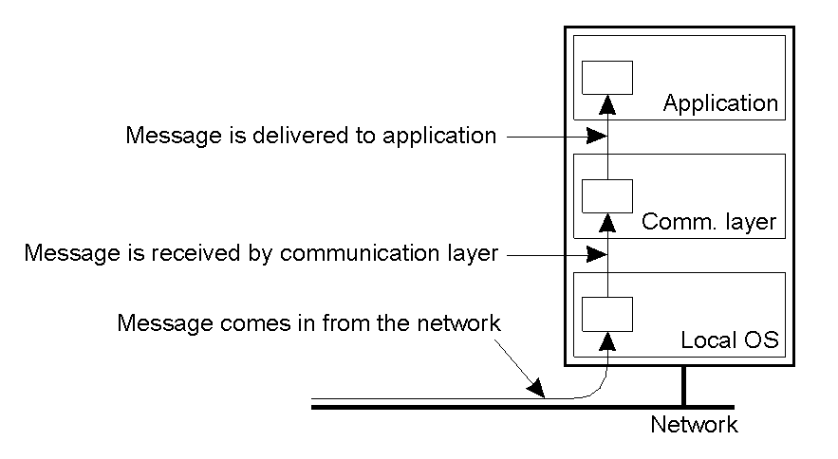
Virtual Synchrony (1)
The logical organization of a distributed system to distinguish between message receipt and message delivery

Slide 26
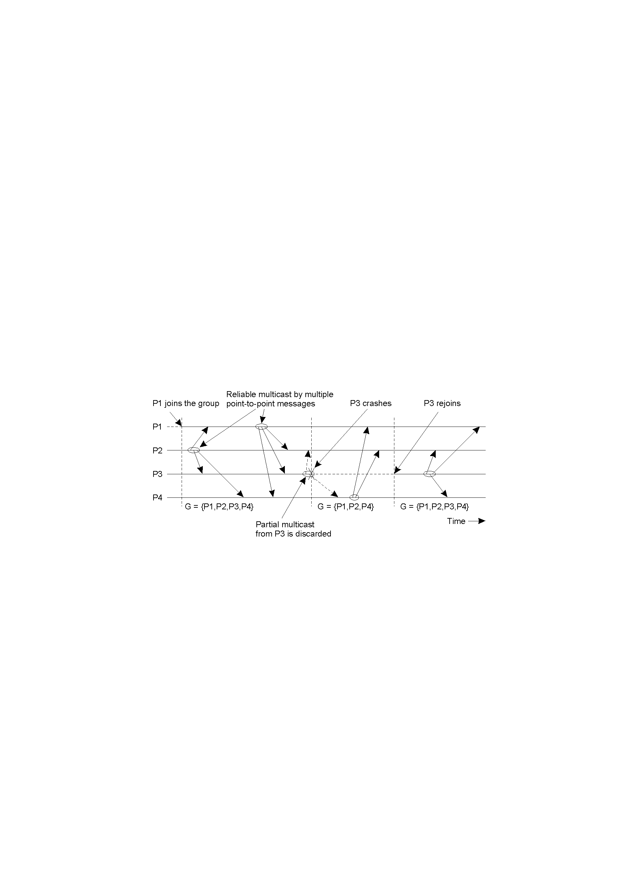
Virtual Synchrony (2)
The principle of virtual synchronous multicast

Slide 27
Message Ordering (1)
Process P1 | Process P2 | Process P3
sends m1 | receives m1 | receives m2
sends m2 | receives m2 | receives m1
Three communicating processes in the same group. The ordering of events per process is shown along the vertical axis.

Slide 28
Message Ordering (2)
Process P1 | Process P2 | Process P3 | Process P4
sends m1 | receives m1 | receives m3 | sends m3
sends m2 | receives m3 | receives m1 | sends m4
 | receives m2 | receives m2
 | receives m4 | receives m4
Four processes in the same group with two different senders, and a possible delivery order of messages under FIFO-ordered multicasting

Slide 29
Implementing Virtual Synchrony (1)
Multicast | Basic Message Ordering | Total-ordered Delivery?
Reliable multicast | None | No
FIFO multicast | FIFO-ordered delivery | No
Causal multicast | Causal-ordered delivery | No
Atomic multicast | None | Yes
FIFO atomic multicast | FIFO-ordered delivery | Yes
Causal atomic multicast | Causal-ordered delivery | Yes
Six different versions of virtually synchronous reliable multicasting

Slide 30
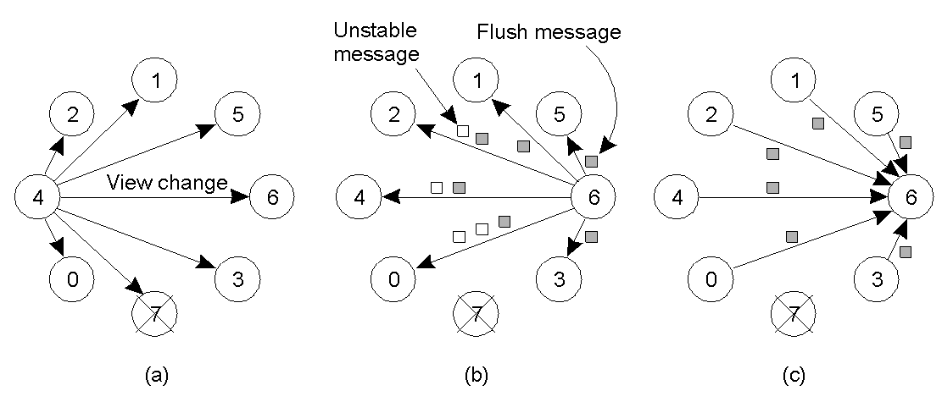
Implementing Virtual Synchrony (2)
(a) Process 4 notices that process 7 has crashed, sends a view change
(b) Process 6 sends out all its unstable messages, followed by a flush message
(c) Process 6 installs the new view when it has received a flush message from everyone else

Slide 31
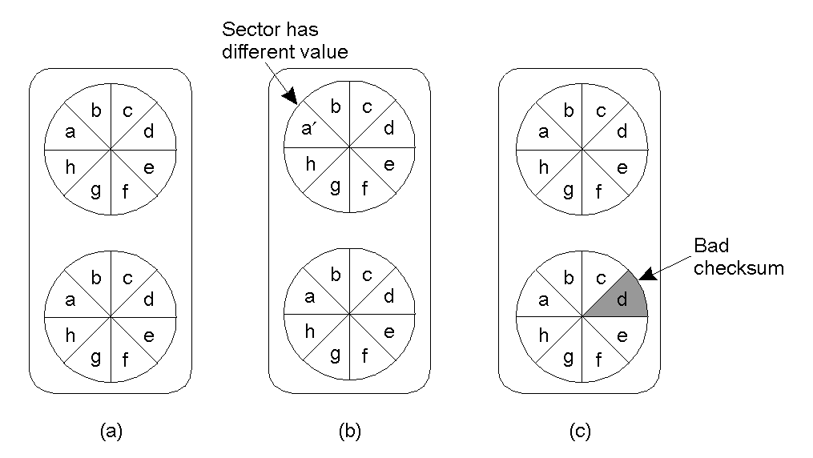
Recovery Stable Storage
(a) Stable Storage
(b) Crash after drive 1 is updated
(c) Bad spot

Slide 32
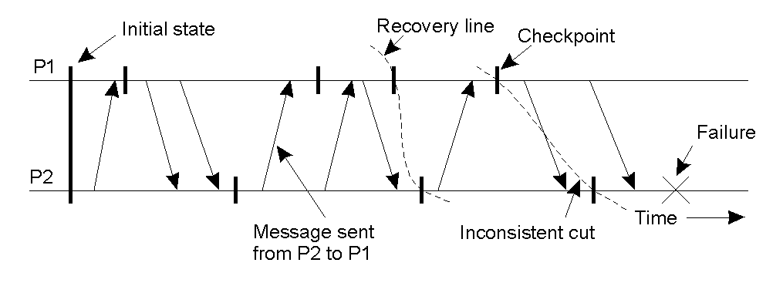
Checkpointing
A Recovery Line

Slide 33
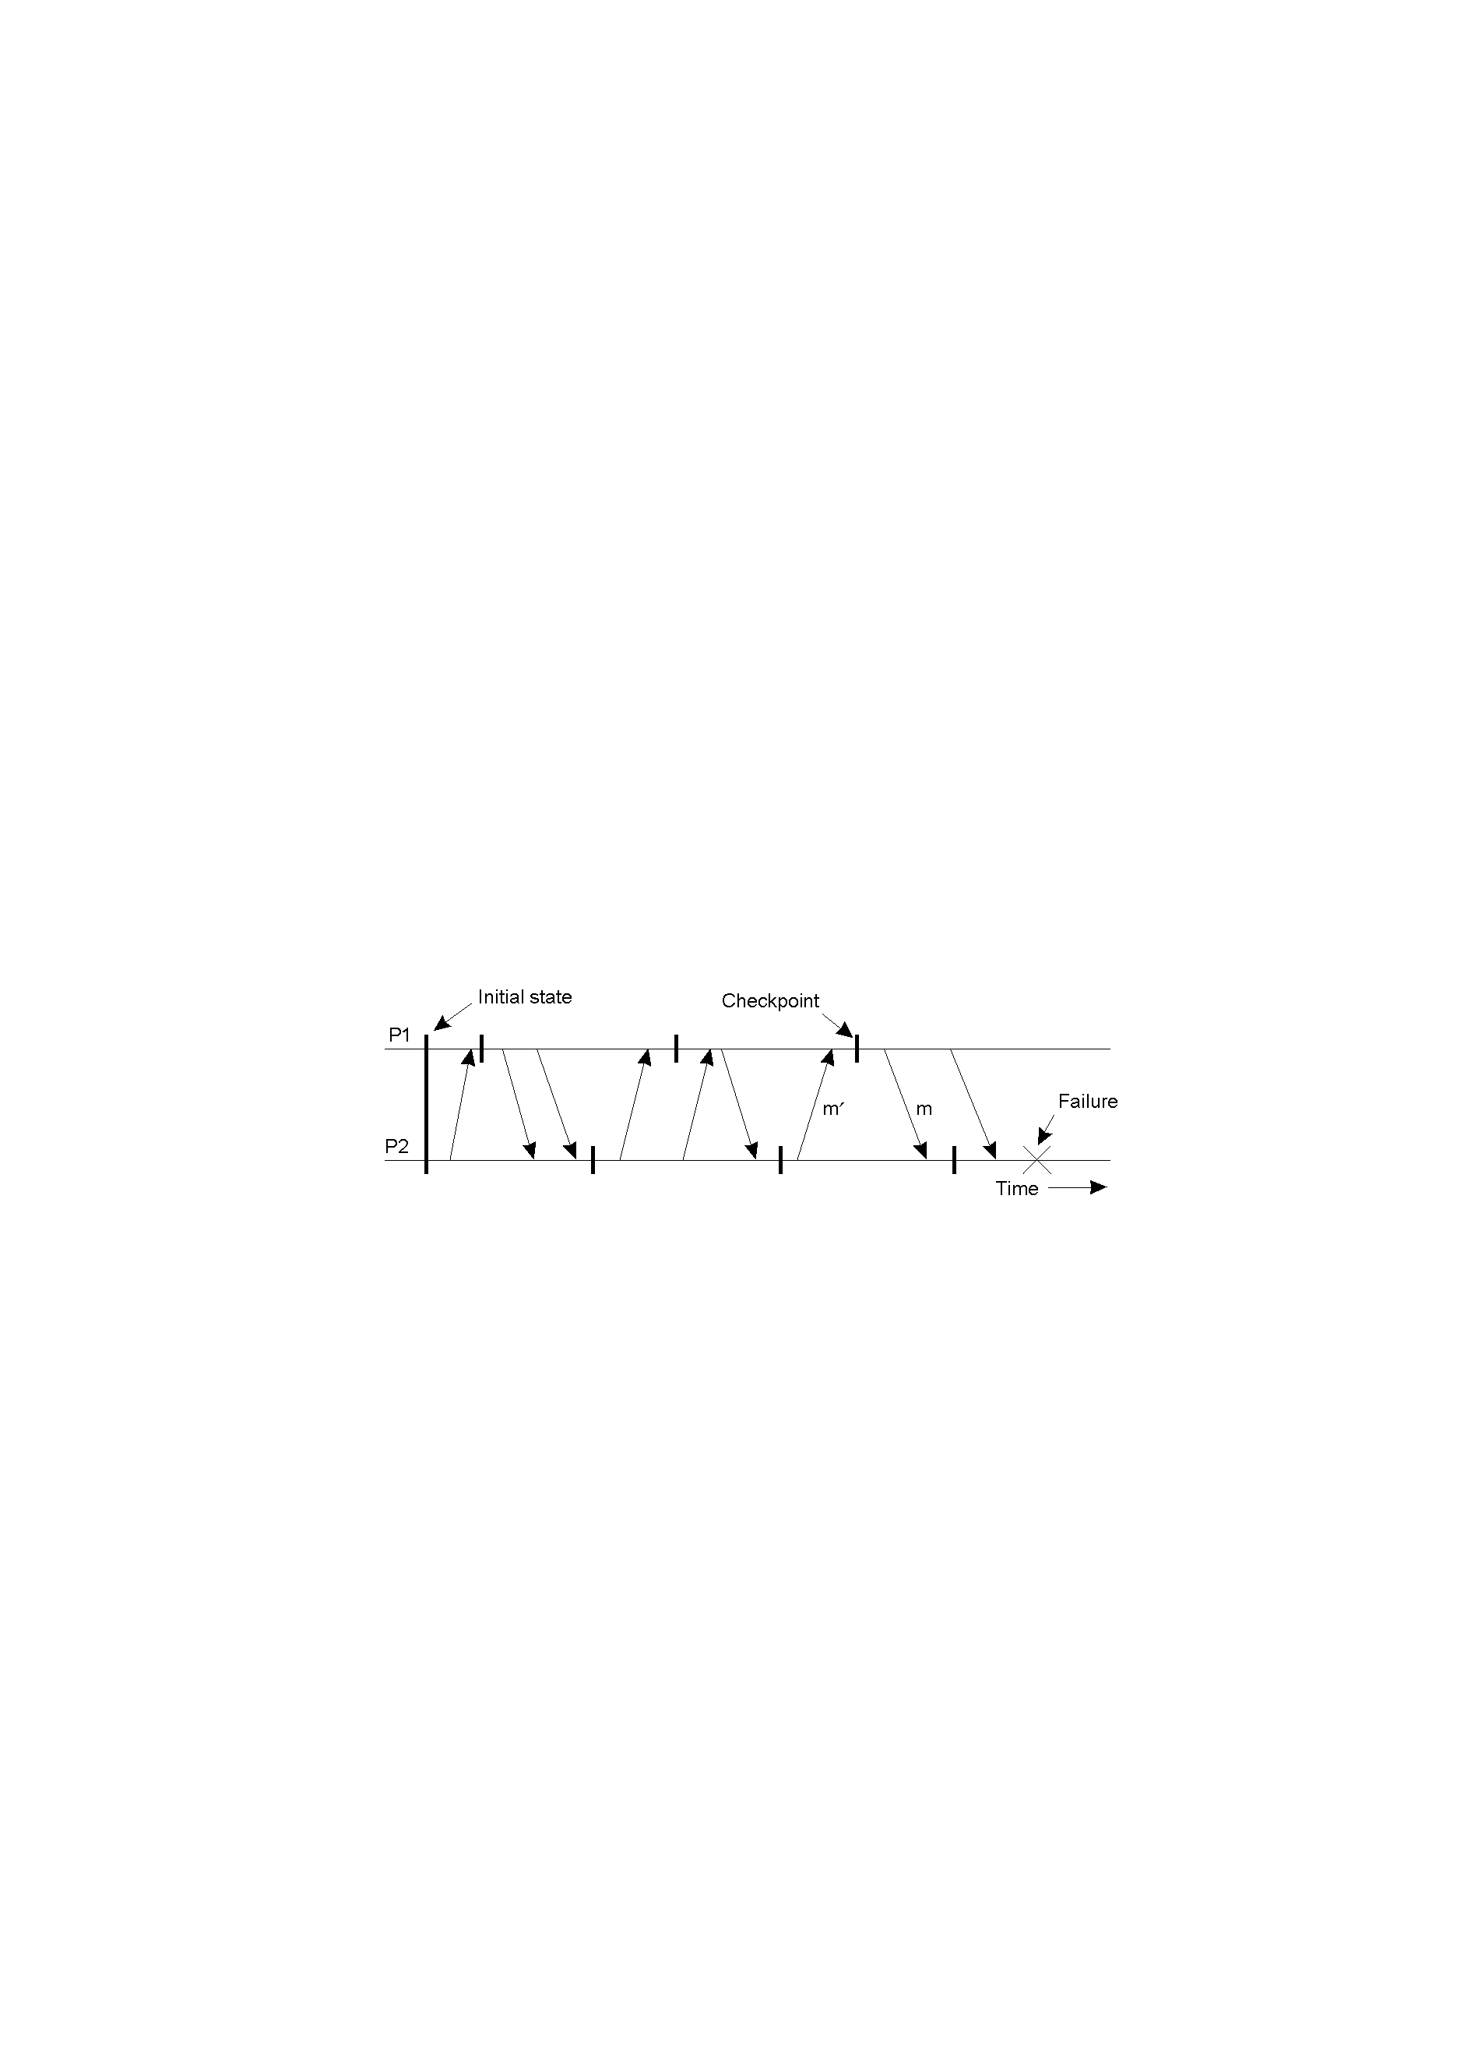
Independent Checkpointing
The domino effect.

Slide 34
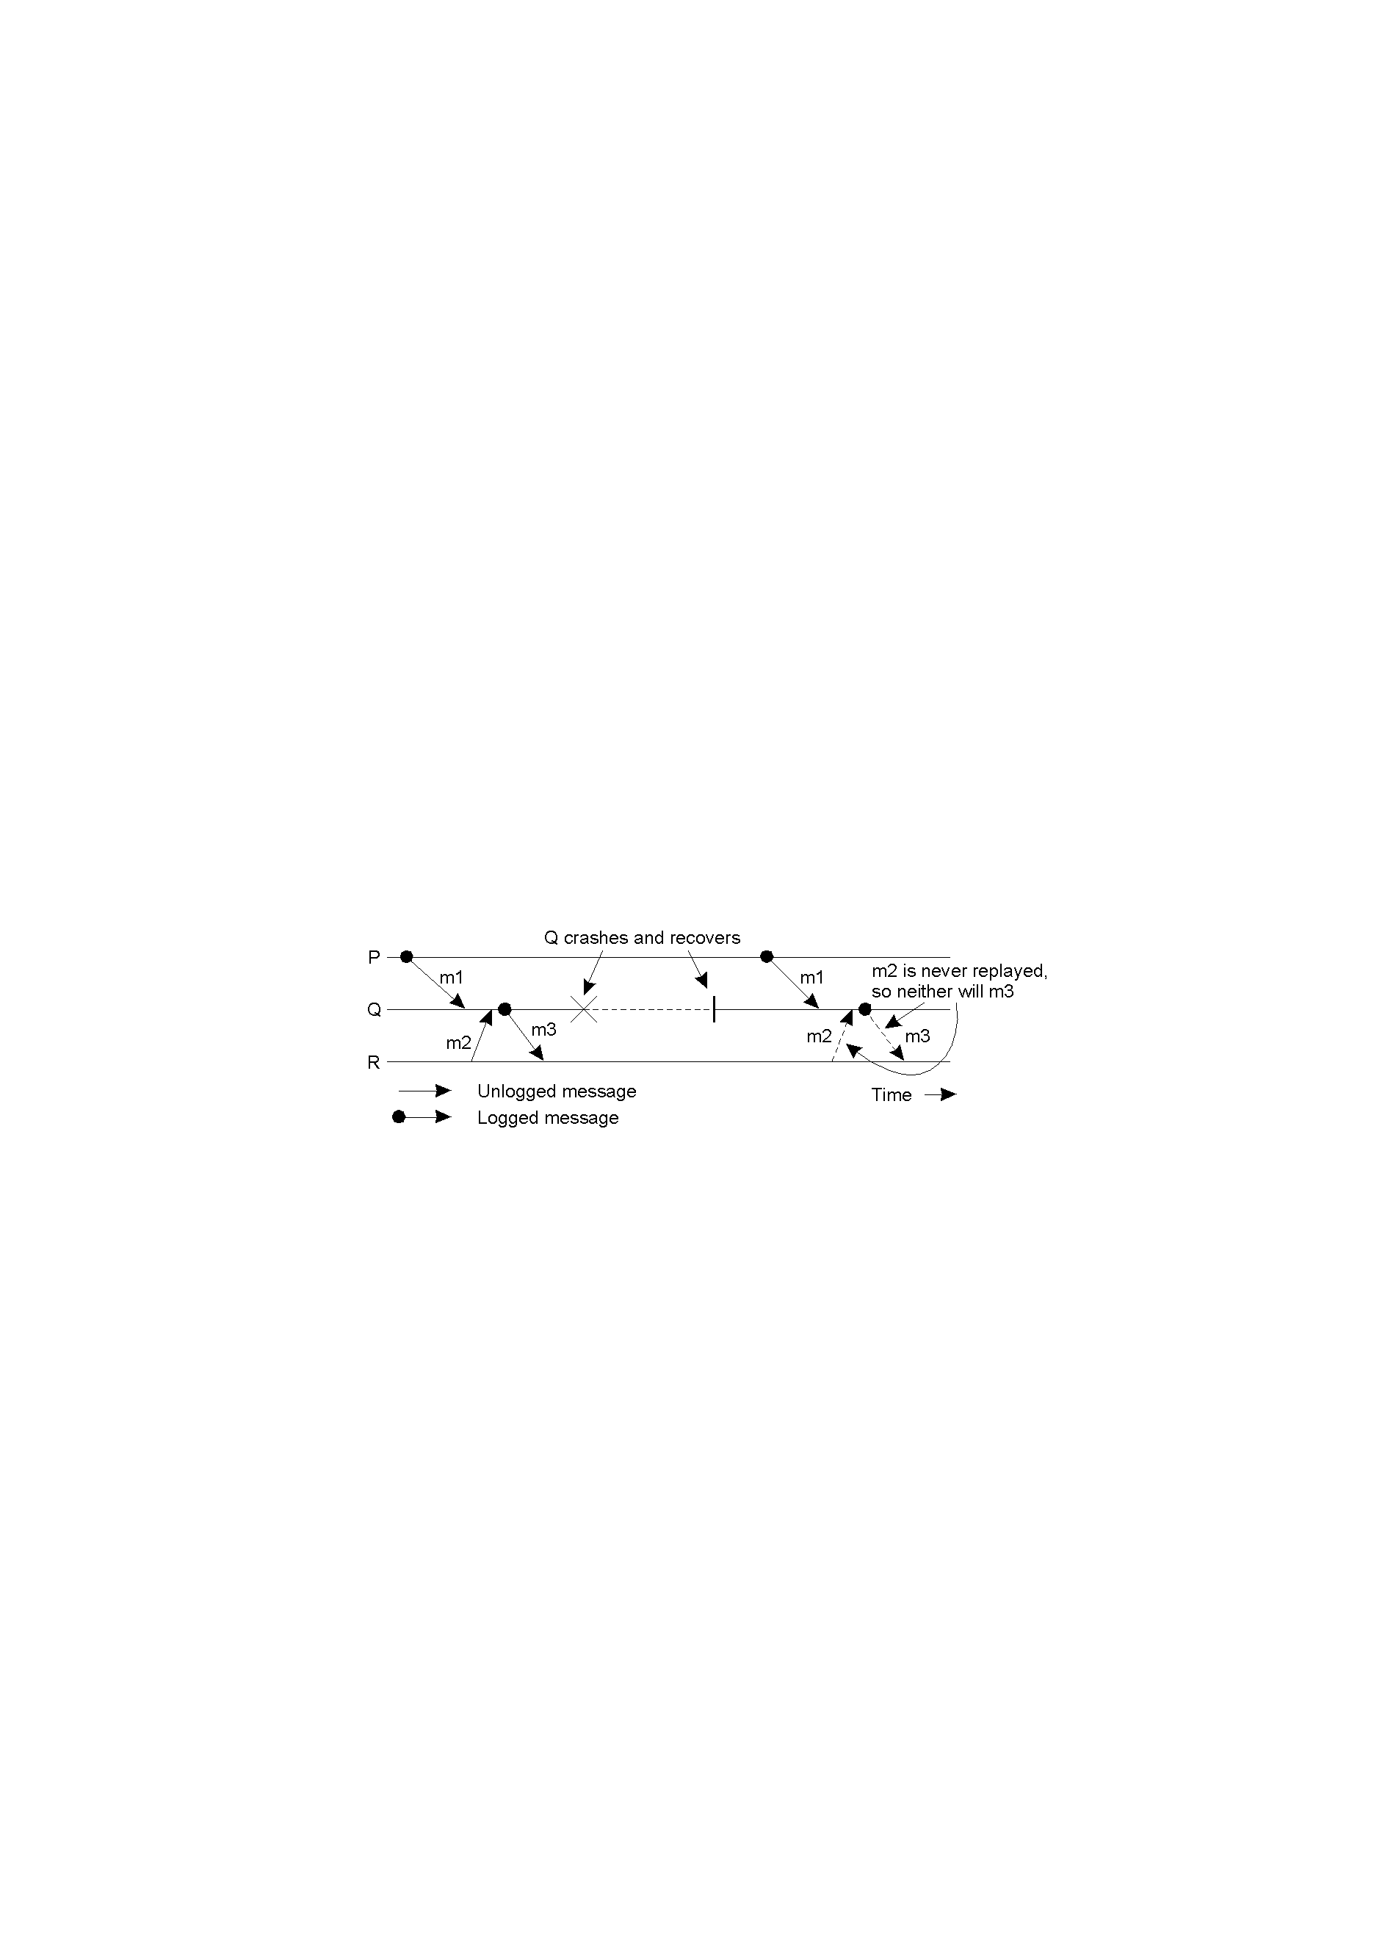
Message Logging
Incorrect replay of messages after recovery, leading to an orphan process.

Slide 35



