Slide 1
分布计算系统
Distributed Computing System
计算机学院 周兴社 杨刚
Notes:
分布计算系统

Slide 2
说在前面的话：
课程性质：硕士研究生学位课程
前驱课程：
  计算机操作系统
  计算机网络
  面向对象程序设计
课程学时：40学时
参考教材
  Distributed Systems –Principles and paradigms
  Andrew S. Tanenbaum 影印版 清华大学出版社
  Distributed Systems—Concept and Design
  George Coulouris 第3版影印 机械工业出版社
授课方式：
  课堂教授(70%)+自学(20%)+讨论(10%)
考试方式：半开卷考试
成绩分布：
考试(70%)+大作业(10%)+课堂表现(10%)+课题(10%)
DCS Preface
Notes:
分布计算系统

Slide 3
Some Tip about Homework
Deadline:
  A week after Final exam
Submit way:
  Tar your homework and send it to
    dcs.nwpu@gmail.com
Pattern
  Subject:
    DCS Homework 200? from CS college(homework’s name)
    Ex: DCS Homework 2007 from CS college(Helloworld over ICE)
  Content:
    A document decrypting your homework briefly
      Your homework’s goal
      Your homework’s structure
        Source code
        Binary code
        Example
        Design document
        …
      The authors of this homework
        Ordered by contribution
DCS Introduction

Slide 4

Introduction:
DCS Introduction
Notes:
分布计算系统

Slide 5
Evolvement of Computing
Host era 50S----80S Centralized Computing IBM360/370， Time-sharing Systems
PC era 80S---90Smid Decentralized Computing
  Wintel model;Open system(PCI,OEM)
  Rapid development in CPU/Memory/IO
  Innovation in User Interface and Software
  Computing model of early LAN is decentralized。
Network era 90S mid---- Network Computing
  Speedy development in Internet Early ;Web;Smart
  Broad applications;
  Distributed Computing is main model
DCS Introduction
Notes:
分布计算系统

Slide 6
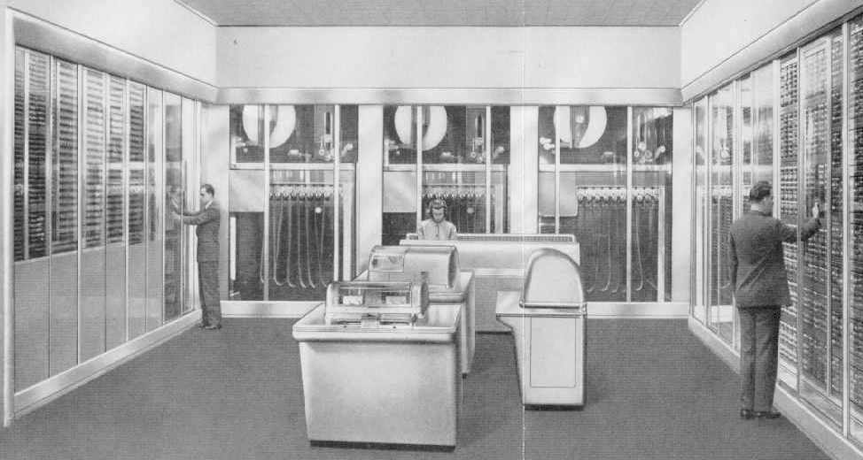
First Computer in World
DCS Introduction
Notes:
分布计算系统

Slide 7
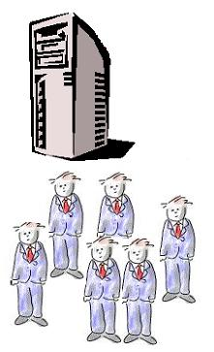
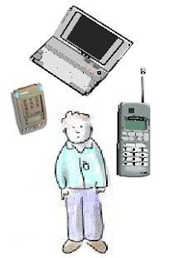

Size
Number
One computer for many people
One computer for each person
Many computers for each person
DCS Introduction
Notes:
分布计算系统

Slide 8
What is DCS?
A distributed system is:
A collection of independent computers that appears to its users as a single coherent system.
One in which components located at network computers communicate and coordinate their actions only by passing message.
DCS Introduction
Notes:
分布计算系统

Slide 9
Some Issues about DCS’s Def
Network type and size:
LAN、wireless Net、Intranet、Internet
DCS have MIMD feature
Node capability：
PDA, PC、workstation、Server、Cluster system,…
“computing”has broad meanings:
Science Computation ;Data Processing;
Information Service ;knowledge management;
DCS Introduction
Notes:
分布计算系统

Slide 10
DCS’ Characteristics:
Independent
Single view
Concurrency
No global clock
Heterogeneous
Independent failures
DCS Introduction
Notes:
分布计算系统

Slide 11
Why DCS come into being?(1)
More and more applications need powerful computing ability
Take full advantage of existing computing resources
Some applications have intrinsic distributed property
…
DCS Introduction
Notes:
分布计算系统

Slide 12
Why DCS come into being?(2)
Microelectronic technique
  Moore Law：the number of transistors we can fit on a chip (or semiconductor) will double every eighteen months (and therefore so will the potential power of our machines).
Communicating technique
  Gilder’s Law：bandwidth grows at least three times faster than computer power。
Software technique
  OO
  Component-based
  Agent …
Summary：DCS have excellent
performance-price ratio and broad
applying domain.
DCS Introduction
Notes:
分布计算系统

Slide 13
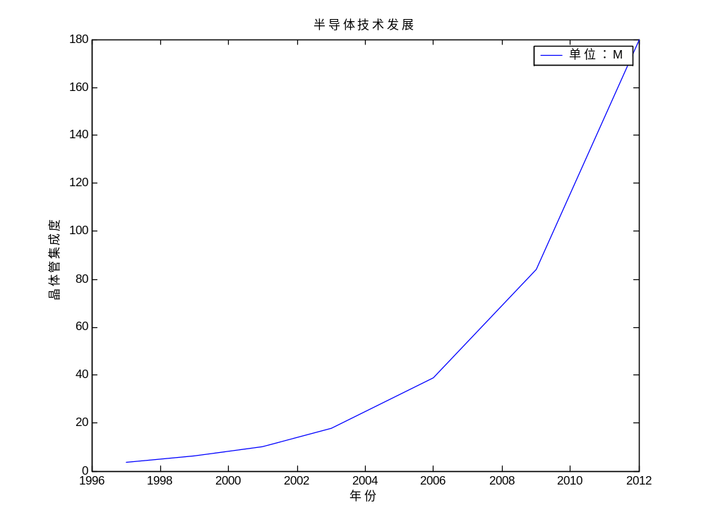
Moore Law
DCS Introduction
Notes:
分布计算系统

Slide 14
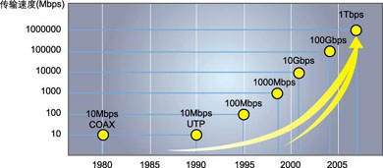
Gilder Law:
DCS Introduction
Notes:
分布计算系统

Slide 15
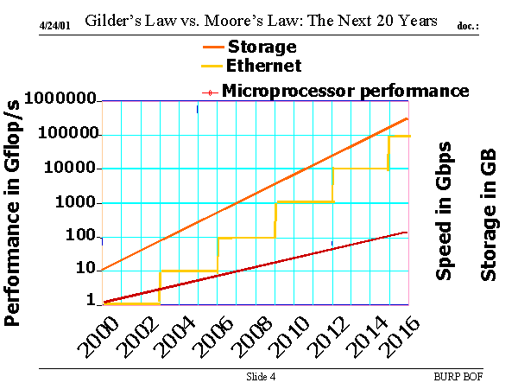
Gilder’s Law vs. Moore’s Law: the next 20 years
DCS Introduction
Notes:
分布计算系统

Slide 16
Some Examples of DCS
  Advanced High Performance computing Systems
  Cluster Computing Systems;
  Distributed Transaction Processing System EC,EG,National Series Gold-Information Engineering
  Networked Cooperating work Systems
  Multimedia Meeting;Workflow Management
  Remote cooperating design ;
  Distributed Communication System
  BBS、Electronic Society,Network Game
  Distributed Real-Time Systems
  Industry Control System ;Avionic Integrated System ;
  Distributed simulating System; C4I ;…….
DCS Introduction
Notes:
分布计算系统

Slide 17
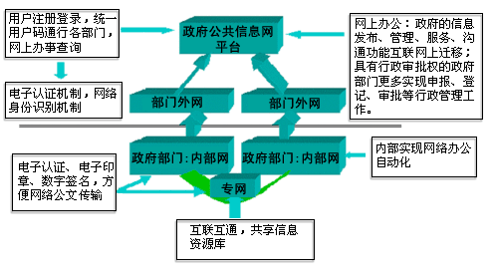
Electronic Government Systems
DCS Introduction
Notes:
分布计算系统

Slide 18
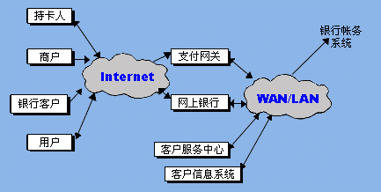
Electronic Commerce System
DCS Introduction
Notes:
分布计算系统

Slide 19
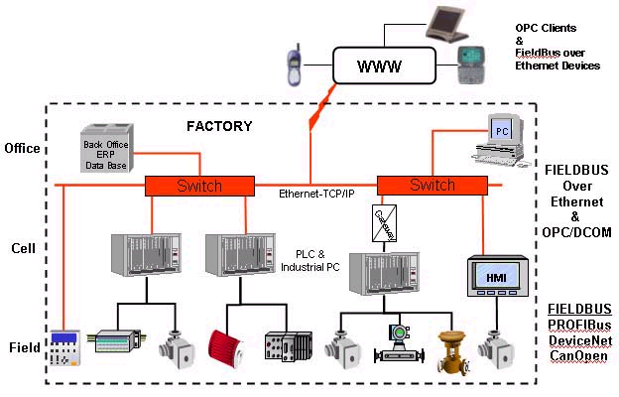
Industry Control Systems
DCS Introduction
Notes:
分布计算系统

Slide 20
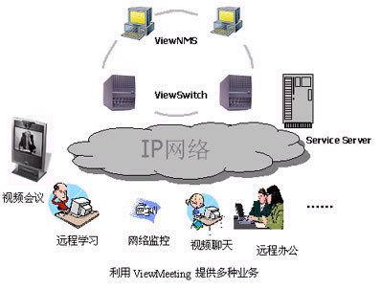
Multimedia Information System
DCS Introduction
Notes:
分布计算系统

Slide 21
New technologies About DCS
Grid Computing
P-P computing
Mobile computing
Automatic Computing
Pervasive Computing
Networked Embedded computing
DCS Introduction
Notes:
分布计算系统

Slide 22
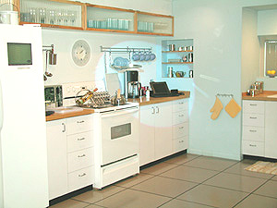
Smart home
DCS Introduction
Notes:
分布计算系统

Slide 23
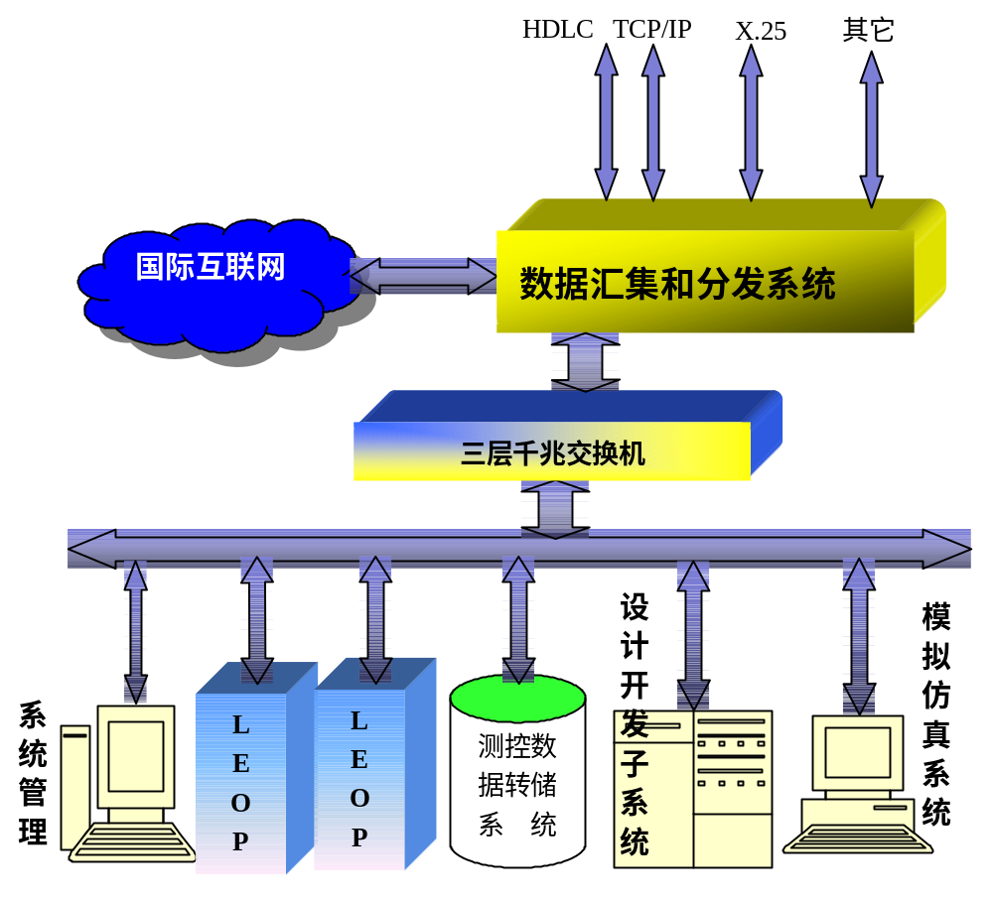
The Next Generation XSCS
DCS Introduction
Notes:
分布计算系统

Slide 24
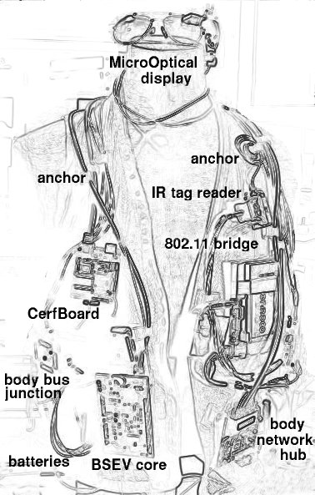
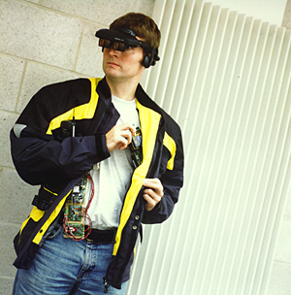
Wearable Computing
DCS Introduction
Notes:
分布计算系统

Slide 25
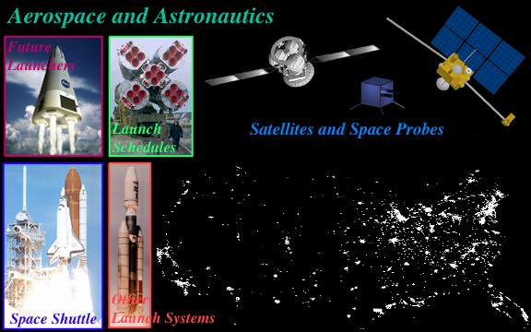
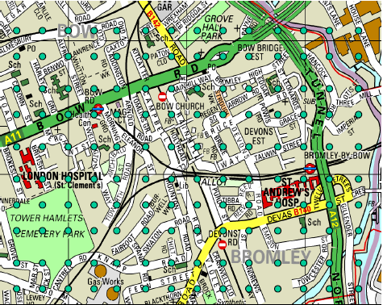
America’s GIG
DCS Introduction
Notes:
分布计算系统

Slide 26
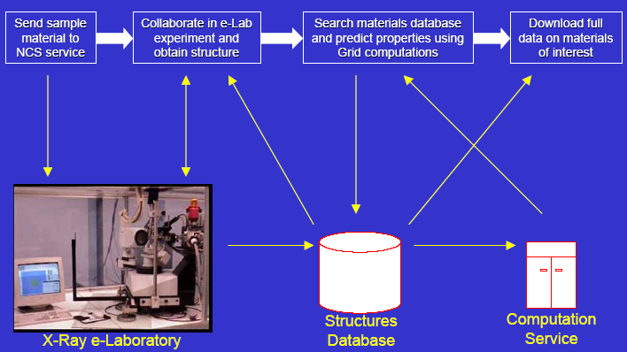
English’s E-Science
DCS Introduction
Notes:
分布计算系统

Slide 27
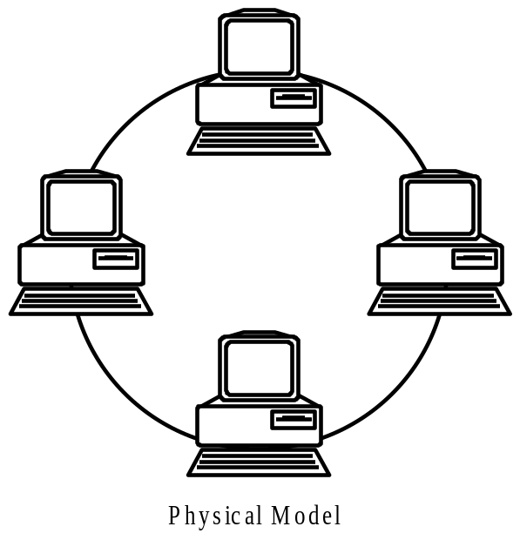
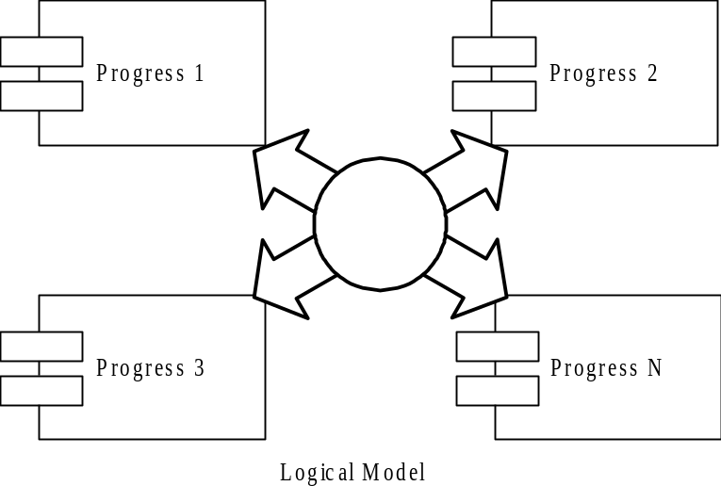
DCS’s Models
DCS Introduction
Notes:
分布计算系统

Slide 28
Exercise：
Compare distributed computing with parallel computing.
  Common
    …
  Difference
    …
Compare distributed system with networked system.
  Common
    …
  Difference
    …
DCS Introduction
Notes:
分布计算系统

Slide 29
DCS’ Goals(1): Resources Sharing
Access and share remote resources in a controlled way
Resources
  Hardware: processors, printer, storage,…
  Software: many type;costly resource
  Information: file, database, …
  …
Problems：
  Management Model
  Resources Naming
  Schedule Mechanism & Policies
DCS Introduction
Notes:
分布计算系统

Slide 30
DCS’s Goals(2): Openness
according to standard rules that describe the syntax and semantics of these service.
  Interoperability
  Portability
  Published Interface; standard
ISOs International Standard Organization
    TC==》SC==》WG（OS,MPEG, wireless comm ….）
    WD==》CD==》DCS==》IS ; $4Billion/Y
    COS Corporation for Open System
    OMG Object Management Organization, CORBA
    WFM （Workflow Management Organization
DCS Introduction
Notes:
分布计算系统

Slide 31
DCS’s Goals(3): Transparency
Just a single system view for users and applications
Different transparency in DCS
Thinking：The more Transparent, the better?
Transparency | Description
Access | Hide differences in data representation and how a resource is accessed
Location | Hide where a resource is located
Migration | Hide that a resource may move to another location
Relocation | Hide that a resource may be moved to another location while in use
Replication | Hide that a resource may be shared by several competitive users
Concurrency | Hide that a resource may be shared by several competitive users
Failure | Hide the failure and recovery of a resource
Persistence | Hide whether a (software) resource is in memory or on disk
It is a trade-off between a high transparency and the performance of a system.
DCS Introduction
Notes:
分布计算系统

Slide 32
DCS’s Goals(4):Scalability
Remain effectively and efficiently at different scales.
  Size: add more nodes and user to DCS
  Geography: users and resources lie far apart
  Management: administratively scalable
The best example:
Challenges:
  Controlling the cost of physical resources
  Controlling the performance lost
  Preventing software resources running out
  Avoiding performance bottlenecks
Computers In Internet
Date Computers Web Server
1979, Dec 188 0
1989,July 130,000 0
1999,July 56,218,000 5,560,866
Nations In Internet
Date Number
1991,Sep 31
1993,Apr 56
1995,Feb 86
1997,July 171
DCS Introduction
Notes:
分布计算系统

Slide 33
DCS’ Goals(5): Security
Security threats coexist with DCS
  Interception
  Interruption
  Modification
  Fabrication
  …
Two main challenges to DCS
  Denial of service attacks
  Security of mobile code
DCS Introduction
Notes:
分布计算系统

Slide 34
DCS’ Goals(6): Failure handling
Components failure coexists with DCS
Failure in DCS is partial
Challenges:
  Detecting failures
  Masking failures
  Tolerating failures, redundancy
  Recovery from failures
DCS Introduction
Notes:
分布计算系统

Slide 35
DCS’s Architecture: Three modes
System | Description | Main Goal
DOS | Tightly-coupled operating system for multi-processors and homogeneous multicomputers | Hide and manage hardware resources
NOS | Loosely-coupled operating system for heterogeneous multicomputers (LAN and WAN) | Offer local services to remote clients
Middleware | Additional layer atop of NOS implementing general-purpose services | Provide distribution transparency
DCS Introduction
Notes:
分布计算系统

Slide 36
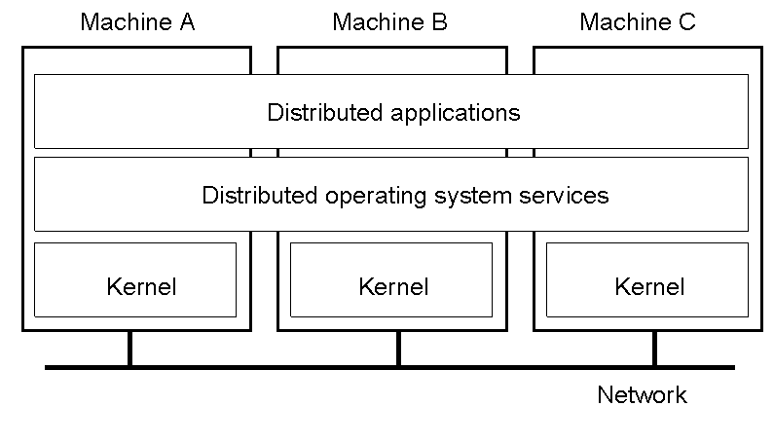
DCS’s Architecture(1):DOS
DCS Introduction
Notes:
分布计算系统

Slide 37
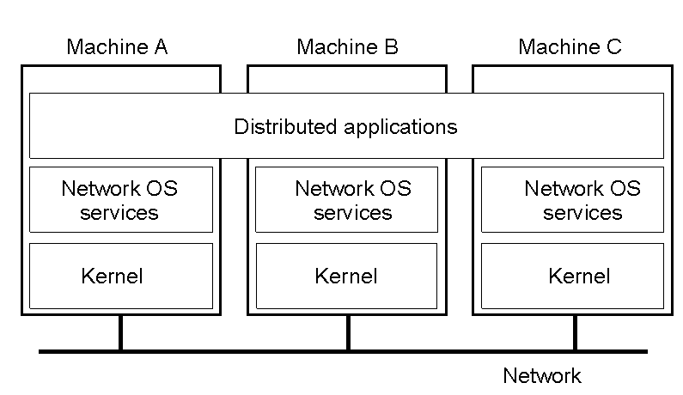
DCS’s Architecture(2):NOS
DCS Introduction
Notes:
分布计算系统

Slide 38

DCS’s Architecture(3): Middleware
DCS Introduction
Notes:
分布计算系统

Slide 39
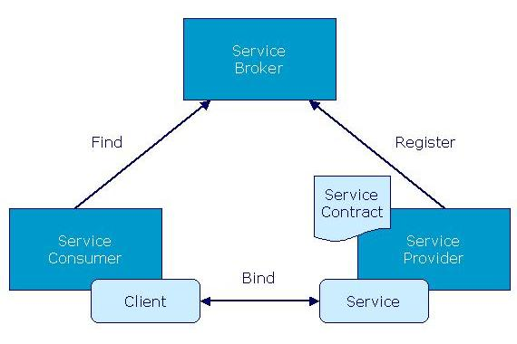
DCS’s Architecture(4): Trend
DCS Introduction
Notes:
分布计算系统

Slide 40
DCS’s Architecture(4):Comparation
Item | Distributed OS |  | Network OS | Middleware-based OS
 | Multiproc. | Multicomp.
Degree of transparency | Very High | High | Low | High
Same OS on all nodes | Yes | Yes | No | No
Number of copies of OS | 1 | N | N | N
Basis for communication | Shared memory | Messages | Files | Model specific
Resource management | Global, central | Global, distributed | Per node | Per node
Scalability | No | Moderately | Yes | Varies
Openness | Closed | Closed | Open | Open
A comparison between multiprocessor operating systems, multicomputer operating systems, network operating systems, and middleware based distributed systems.
DCS Introduction
Notes:
分布计算系统

Slide 41
The main issues:
Distributed Communications
  Case study: Communication Middleware
Distributed Naming
Distributed Synchronization
Distributed Resources Management
Distributed Faults Tolerance
Distributed Security
Distributed data management
Distributed transaction processing
DCS Introduction
Notes:
分布计算系统

Slide 42
Homework:
Please give a new case about DCS, and show its features.
Read some new papers (after 2002) about DCS and write a paper review:
  papers’ brief introduction
  problem(s) & technique(s)
  your overview/evaluation
  some improvements
  …
DCS Introduction
Notes:
分布计算系统

