Slide 1
分布计算系统
Distributed Computing System
西北工业大学计算机学院 周兴社 杨刚

Slide 2

Distributed Resources Management

Slide 3
Introduce
The power of workstation or server continues boost up
One the other side, the need for computing increases dramatically
  Simulation
  Weather forecast
  …
Frame or vector-computer has problem
  Cost
  Non-universal
  Un-maintenance
  Un-scalability
  …
Networking computer is new trend
  Better performance price ratio
  universal
  Maintenance
  Scalability
  EX: cluster computing, gird,…
Distributed resources management has become one of the most important research topics.
The keys of distributed resources management is:
(1) Model
(2) Load balancing or Loading share
Workstation model / processor pool model

Slide 4
WorkStation Model
Idea
  About 30% computer on network is idle at any time
  In evening, the data may be 70% or bigger.
  Organize and utilize these idle workstation to solve problems
  Ex: campus, corporation
UC Berkeley Unix
  rsh machine command

Slide 5
Problems about Workstation Model
Locate idle workstation
Start remote process
Restore when user comes back

Slide 6
Locate Idle Workstation
If there exist multiple idle workstation, which I will select?
Idle
  No login in
  No operation
  Loading less than threshold value
Locating
  Server-driven
  Client-driven
When a workstation goes idle, it declares it is usable by broadcast or registry.
User makes use of idle workstation through remote command.
When a user need make use of idle computing power, it issues a requirement message.
If a idle workstation can satisfy the requirement, it replies a message to user.

Slide 7
Server-driven Based Registry
Registry
Thinking:
How to implement Server-driven based broadcast?
Please compare both algorithm.
List of idle workstations
Registrar
2. Request idle workstation, get reply
1. Machine registers when it goes idle
4. Deregister
Home machine
Idle workstation
3. Claim machine
7. Process runs
5. Set up environment
Remote
Manager
6. Start process
8. Process exits
9. Notify originator

Slide 8
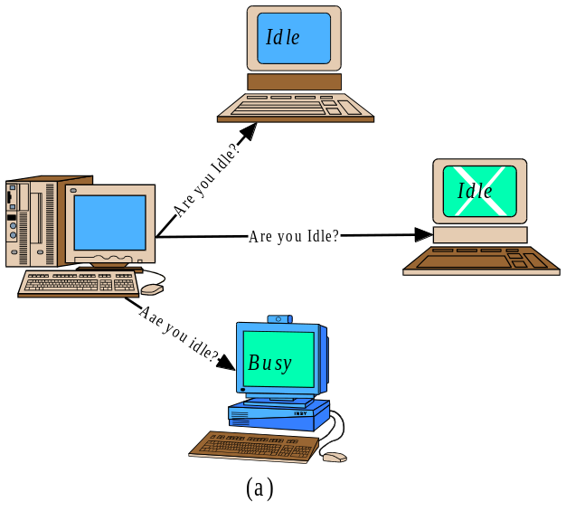
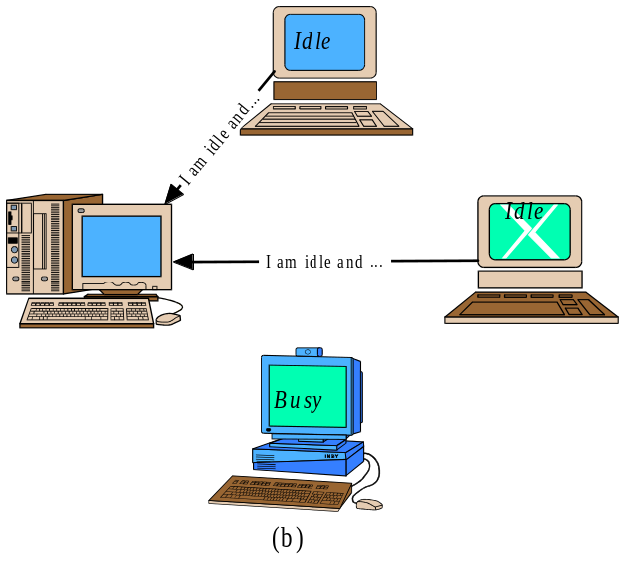
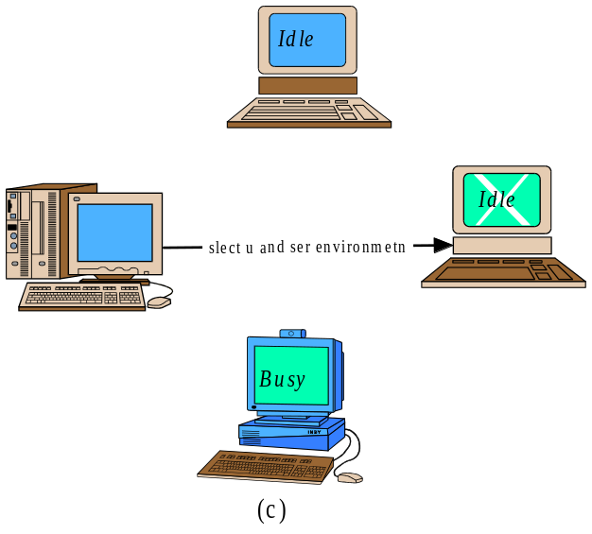
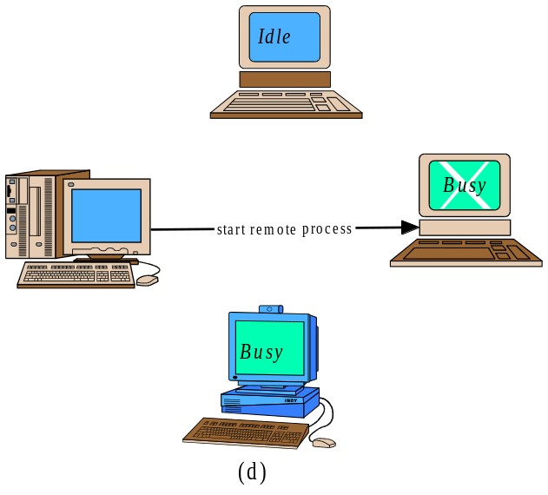
Client-Driven based broadcast
Thinking:
how to select a idle workstation?
Thinking:
compare client-driven model and server-driven model.

Slide 9
Restore when user come back
The simplest way: let alone
Just kill the process started by remote user
Find a new idle workstation and transmit the process to the new idle workstation
The third is the best but need some more research.

Slide 10

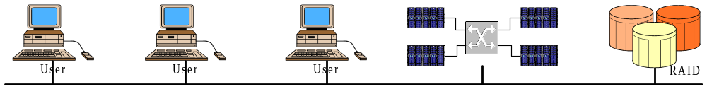
Processor Pool Model
Idea
  Organize a lot of processors as a pool
  Allocate processors according to user’s requirements
  Like traditional time-share system
  Quintessence: cluster
Thinking: compare Processor Pool Model and SMP model?

Slide 11
Key Problem about Processor Pool Model
Queuing Theory Analysis
  Given total input request rate k, service rate l, response time T, then T=1 /（l-k）
  Processor pool consists of n parallel processors: Tn=1/（nl-nk）=T/n
  When n small resources constitute a big resource, its processing ability increases n times, but its response time decreases n times
  If processing resource is distributed to small servers, its matching rate to random arriving request is lowered, and many servers will be idle.

Slide 12
Users
Input queue
Finished work
Computer
System can process μ requests/sec
Users generate a total of λ requests/sec

Slide 13
Other Models
Mixed model
  Combination of workstation model and processor pool model
  The workstation is responsible for interactive work, which can assure response timely, and processor pool’s responsibility is complicated computing work, which utilizes resource effectively.
Market Economy model
  Stimulate the relationship of provide-request, compete for the resource

Slide 14
Computing Resource Allocation
Allocation algorithm prerequisite
  Homogeneousness, code compatibility
  Processing resource is logically interconnected
Algorithm goal
  Improve resource utilizing rate
  Reduce average system response time
  Reasonable and effective load allocation sharing and balancing
Performance Criteria
  Scheduling result, such as minimum response time
  Algorithm overhead
  Algorithm robustness

Slide 15
Load Allocation Ways
Load Balancing
  Every processing node has equal load
  High overhead because of frequent system performance analysis
Load Sharing
  Prevent uneven phenomena in processing node
  Easy to realize, low overhead

Slide 16
A. Load Balancing
Suitably loaded
Suitably loaded
Suitably loaded
Suitably loaded
Location 1
Location 2
Location 3
Location 4
B. Acceptable Load Sharing
Suitably loaded
Over- loaded
Over- loaded
Suitably loaded
Location 1
Location 2
Location 3
Location 4
C. Unacceptable Load Sharing
Under- loaded
Under- loaded
Over- loaded
Over- loaded
Location 1
Location 2
Location 3
Location 4

Slide 17
Scheduling Algorithm
Assured & self-adaptive
Centralized & distributed
Local & global
Optimal & suboptimal

Slide 18
Assured & self-adaptive
Assured algorithm, based on the preknowledge of resource request and its relationship, is suitable for simple distributed system
Self-adaptive matches resource and load in the case of load changing dynamically with time

Slide 19
Centralized & distributed
Centralized means a processor acts as the resource allocator with responsibility for uniform resource allocation, which is the bottle-neck of the system
Distributed stores load information for nodes, and allocating resource by negotiation

Slide 20
Local & global
Local decides scheduling through local information, which is simple but not optimal
Global is based on all the load situation, which is of high performance but high overhead

Slide 21
Optimal & suboptimal
Optimal is ideal, very difficult
Suboptimal is realized

Slide 22
Charged for remote service
1
Over loaded
Usage Table
Location A
Location
Points
A 3 B 2 C -1
+1
Suitably loaded
-1
Location B
…
Centralized server
2
Under loaded
Receives credit for remote service
Location C
1. Please schedule this process remotely. 2. Here is a process to execute.

Slide 23
Charged for remote service
Over loaded current-charge = 12
1
Usage Table
Location A
Location
Points
A 3 B 2 C -1
+2
Suitably loaded current-charge = 7
-1
Location B
…
Centralized server
Under loaded current-charge = 2
2
Receives credit for remote service
Location C
1. Please schedule this process remotely. 2. Here is a process to execute.

Slide 24
Dynamical Scheduling Policy
Initiating policy
Transferring policy
Information Searching Policy
Selecting Policy
Orientation Policy

Slide 25
Initiating policy
SI: Sender Initiated, heavy-load nodes send out signal, requesting for load transfer
RI: Receiver Initiated, light-load nodes send out signal, inquiring whether there is any node asking for help
Performance compare: in the situation of light load, SI outgoes RI, vice versa.

Slide 26
Need CPU cycles? Just call
Won’t you please take a process
Please take some work
I’m free tonight
I have nothing to do
Help me please
I’m overload
Needhelp?
Help!
I’m bored
Machine decides that it has too much work
Machine advertises its availability
( a )
( b )

Slide 27
Transferring policy
Time: completing current process
Condition: according to load, heavy ones transfer, light ones accept
Controlling algorithm: threshold is related to the length of process queue, total computing time. It can be set according to average load or adjusted online dynamically.

Slide 28
Information Searching Policy
Key point: make sure about the amount and searching frequency of load information
  The more the information, the more easy to decide scheduling, with high overhead
  The less searching frequency, the more easy to lead to wrong choice because of delay
Usually –used information searching policy
  Broadcasting
  Period
  Inquiring
  Bidding

Slide 29
Selecting Policy
Happen when
  a new process begins
  A process in queue waits for run, but the time is not enough
  First select delayed process, then probable delayed process

Slide 30
Orientation Policy
Random: send out transfers, receivers decide whether to accept or not
Detect: decide acceptors according to feedback information
Bidding: select suitable node based on bidding information
Mixed: combine the above policy

Slide 31
A quintessence of distributed load sharing system--LSF
Introduction
  LSF (Load Sharing Facility): is developed by Canadian Platform Computing Corporation.
  Its CEO is the first doctor of computer science school of NWPU. Its products have formed a series of load sharing suite, occupying maximum market quotient, which is sold bundled with products of famous IT corporations.
  Now LSF is the factual industry standard of load sharing.

Slide 32
Performance and character
Goal: provide reliable, extendable advance methods fully utilized network resource
Function: provide various abilities for load management by scheduling, analyzing and supervising distributed application load
Mode: provide multiple OS functions in network layer, manage all the distributed computing resource, make the whole network look like a uniform virtual host or a super computer
Ingredients: six relatively independent components, support mainstream Operating Systems

Slide 33
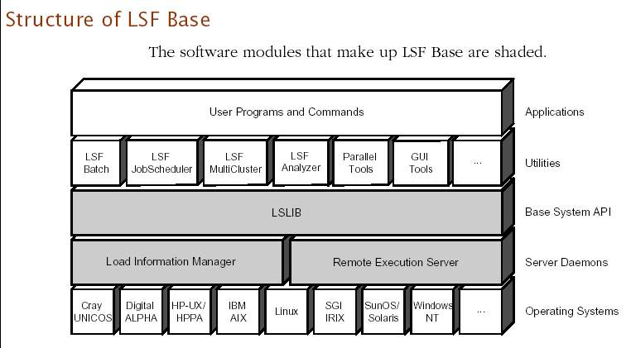
Structure of LSF Base

Slide 34
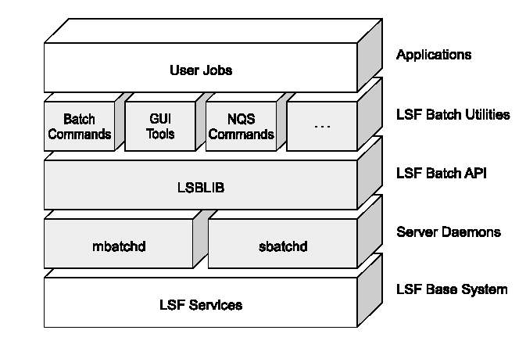
Structure of LSF Batch

Slide 35
Components Introduction
LSF Base: the foundation of load management, realize load information analysis and remote task executing
LSF Batch: provide batch job schedule in heterogeneous environments, assure load balancing of each workstation, suit for complicated scientific computation and engineering computation.
LSF Job Scheduler: provide job scheduling based on server group, driven by calendar or event, suit for automatic daily data processing.

Slide 36
Components Introduction
MulitiCluster: support load sharing in LAN & WAN, realize global resource sharing like UNIX/Windows NT which is transparent to users.
Analyzer: provide general load analysis, realize dynamic visual display of load activation, record the information for clearing bottle-neck phenomena and improving system performance
Make: distribute jobs to multiple hosts, reduce time overhead by executing parallel

Slide 37
Load Management Model
Physical cluster: close to each other geographically, easy to manage
Virtual cluster: combine geographically-disperse computers together according to requirements
Centralized management within a cluster, distributed management between clusters, which is propitious to reduce communication cost, and to prevent selecting conflict
A Mlim for a cluster, a slim for the other nodes, Mlim collects load information from slims

Slide 38
Load Information Description
Load is the tasks processing or waiting for processing and their resource overhead, whose description weighs the degree of the load. Load description in LSF is as following:
  Average length of ready queue
  Memory pages and disc exchange smoothly
  Accounts of login
  Minimum idle time of every users
  The former two are used to locate tasks, the others are spare

Slide 39
Load Information Obtainment
Read kernel information periodically(5 s), which is easy to be realized in UNIX
Compute the sum of utilized time by each CPU state
Compute average length of ready queue, consider relative speed of processors
Page exchange rate equals to total exchange divided by actual time sum, after calculating it, we should make it smooth
Compute smooth disc exchange rate
Obtain user information in OS: /etc/utmp

Slide 40
Load Information Transfer
Transfer inside a cluster
  Lims collect load information every 5 seconds
  Slims send information to Mlims driven by the combination of time and event
  Event-driven happens when a load variable exceeds some threshhold, or a load change exceeds some difference, or Mlims give sending back requests
  Mlims combine the information to get a load matrix

Slide 41
Load Information Transfer
Transfer between clusters
  Mlims send load matrix to the other Mlims under the condition of Mlim’s load exceeds the threshhold, or receives load information from slims, or the given time is arriving
  Mlims combine the receiving load information and its own to obtain system load information
  LSF adapts combination of centralized and distributed load information management

Slide 42
Load Information Utilization
LSF task allocation considers not only the load of computing resource, but also tasks’ resource requirements
Resource requirement in heterogeneous system consists of CPU, memory, I/O as general ones, and processors architecture, version of OS, special devices as peculiar ones
LSF divide the resource requirement into 8 categories

Slide 43
Task Location Process
Applications applying for remote execution use ls-placeofhosts() to send out task location request to Mlim, resource requirements and the number of processors inside
Mlim decides candidate processors according to task’s special requirements, order the candidates and feed back task location table to application
Mlim pre-schedules the selected processors to avoid selecting conflict
Application starts up the task after getting the task location table

Slide 44
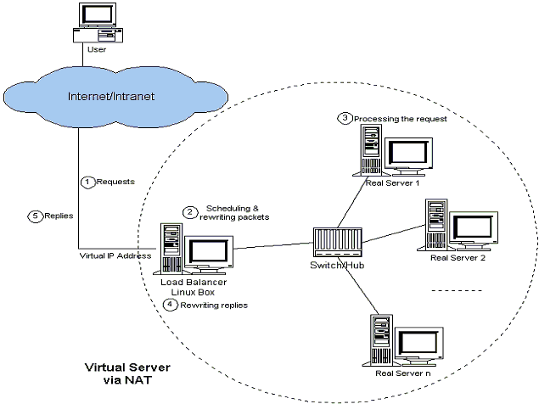

Slide 45
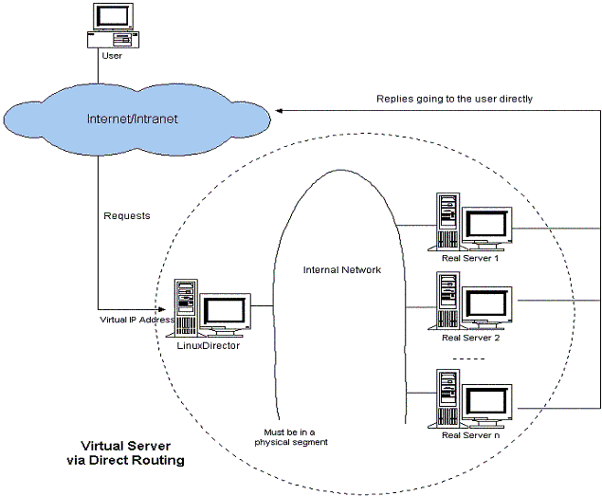

Slide 46
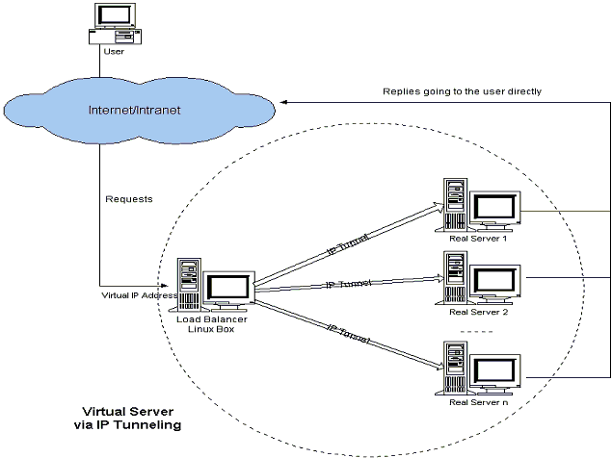

Slide 47
