Slide 1
分布计算系统
Distributed Computing System
西北工业大学计算机学院 周兴社 杨刚

Slide 2


Distributed Synchronization
DCS' Synchronization

Slide 3
Introduce
Synchronization is a foundational problem of computer sci&eng
Traditional ways
  Mutex, critical region, semaphore, monitor,…
  All this based on the shared memory and single global state
But in Distributed System
  No global clock and no accurate clock
  Information scattering in multiple host
  Decision based on local information
  Single point of fault
Clock synchronization is base of distributed synchronization.
DCS' Synchronization

Slide 4
Time is important
In the NFS client cache scheme,
do the client and server clocks need to be synchronized?
In the NFS client cache scheme,
what properties do we require from the clocks?
We need to measure time accurately:
  to know the time an event occurred at a computer
  to do this we need to synchronize its clock with an authoritative external clock
Algorithms for clock synchronization useful for
  concurrency control based on timestamp ordering
  authenticity of requests e.g. in Kerberos
There is no global clock in a distributed system
  this lectures discusses clock accuracy and synchronisation
Logical time is an alternative
  It gives ordering of events - also useful for consistency of replicated data
DCS' Synchronization
•

Slide 5
Clock and drift
Each computer in a DS has its own internal clock
  used by local processes to obtain the value of the current time
  processes on different computers can timestamp their events
  but clocks on different computers may give different times
  computer clocks drift from perfect time and their drift rates differ from one another.
  clock drift rate: the relative amount that a computer clock differs from a perfect clock
Even if clocks on all computers in a DS are set to the same time, their clocks will eventually vary quite significantly unless corrections are applied
When files are served by NFS, what properties does the
Unix make program require from the computer clocks?
What clock properties are required by the Unix make program when it uses local files?
DCS' Synchronization
•

Slide 6
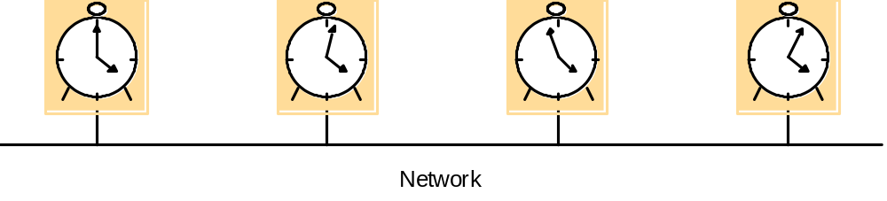
Computer clocks are not generally in perfect agreement
Skew: the difference between the times on two clocks (at any instant)
Computer clocks are subject to clock drift (they count time at different rates)
Clock drift rate: the difference per unit of time from some ideal reference clock
Ordinary quartz clocks drift by about 1 sec in 11-12 days. (10⁻⁶ sec/sec).
High precision quartz clocks drift rate is about 10-7 or 10-8 sec/sec
DCS' Synchronization

Slide 7
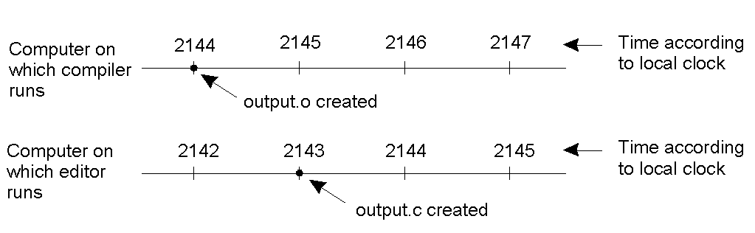
Error due to clock draft
When each machine has its own clock, an event that occurred after another event may nevertheless be assigned an earlier time.
DCS' Synchronization

Slide 8
Coordinated Universal Time (UTC)
International Atomic Time is based on very accurate physical clocks (drift rate 10⁻¹³)
UTC is an international standard for time keeping
It is based on atomic time, but occasionally adjusted to astronomical time
It is broadcast from radio stations on land and satellite (e.g. GPS)
Computers with receivers can synchronize their clocks with these timing signals
Signals from land-based stations are accurate to about 0.1-10 millisecond
Signals from GPS are accurate to about 1 microsecond
Why can't we put GPS receivers on all our computers?
DCS' Synchronization
•

Slide 9
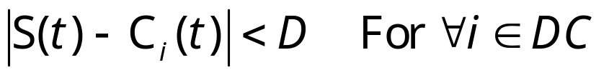
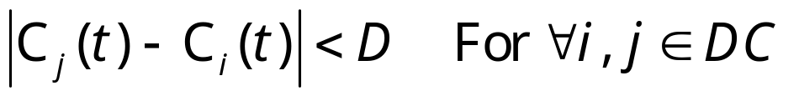
Synchronizing physical clocks
External synchronization
  A computer’s clock C_{i} is synchronized with an external authoritative time source S, so that:
  The clocks C_{i} are accurate to within the bound D.
Internal synchronization
  The clocks of a pair of computers are synchronized with one another so that:
  The clocks Ci and Cj agree within the bound D.
Internally synchronized clocks are not necessarily externally synchronized, as they may drift collectively
if A set of processes P is synchronized externally within a bound D, it is also internally synchronized within bound 2D
DCS' Synchronization
•

Slide 10
Clock correctness
Consider the 'Y2K bug' - what sort of clock failure would that be?
A hardware clock, H is said to be correct if its drift rate is within a bound ρ > 0. (e.g. 10⁻⁶ secs/ sec)
This means that the error in measuring the interval between real times t and t’ is bounded:
  (1 - ρ ) (t’ - t) ≤ H(t’) - H(t) ≤ (1 + ρ ) (t’ - t) (where t’>t)
  Which forbids jumps in time readings of hardware clocks
Weaker condition of monotonicity
  t' > t ⇒ C(t’) > C(t)
  e.g. required by Unix make
  can achieve monotonicity with a hardware clock that runs fast by adjusting the values of of α, β. C_{i}(t)= αH_{i}(t) + β .
a faulty clock is one that does not obey its correctness condition
crash failure - a clock stops ticking
arbitrary failure - any other failure e.g. jumps in time
DCS' Synchronization
•

Slide 11
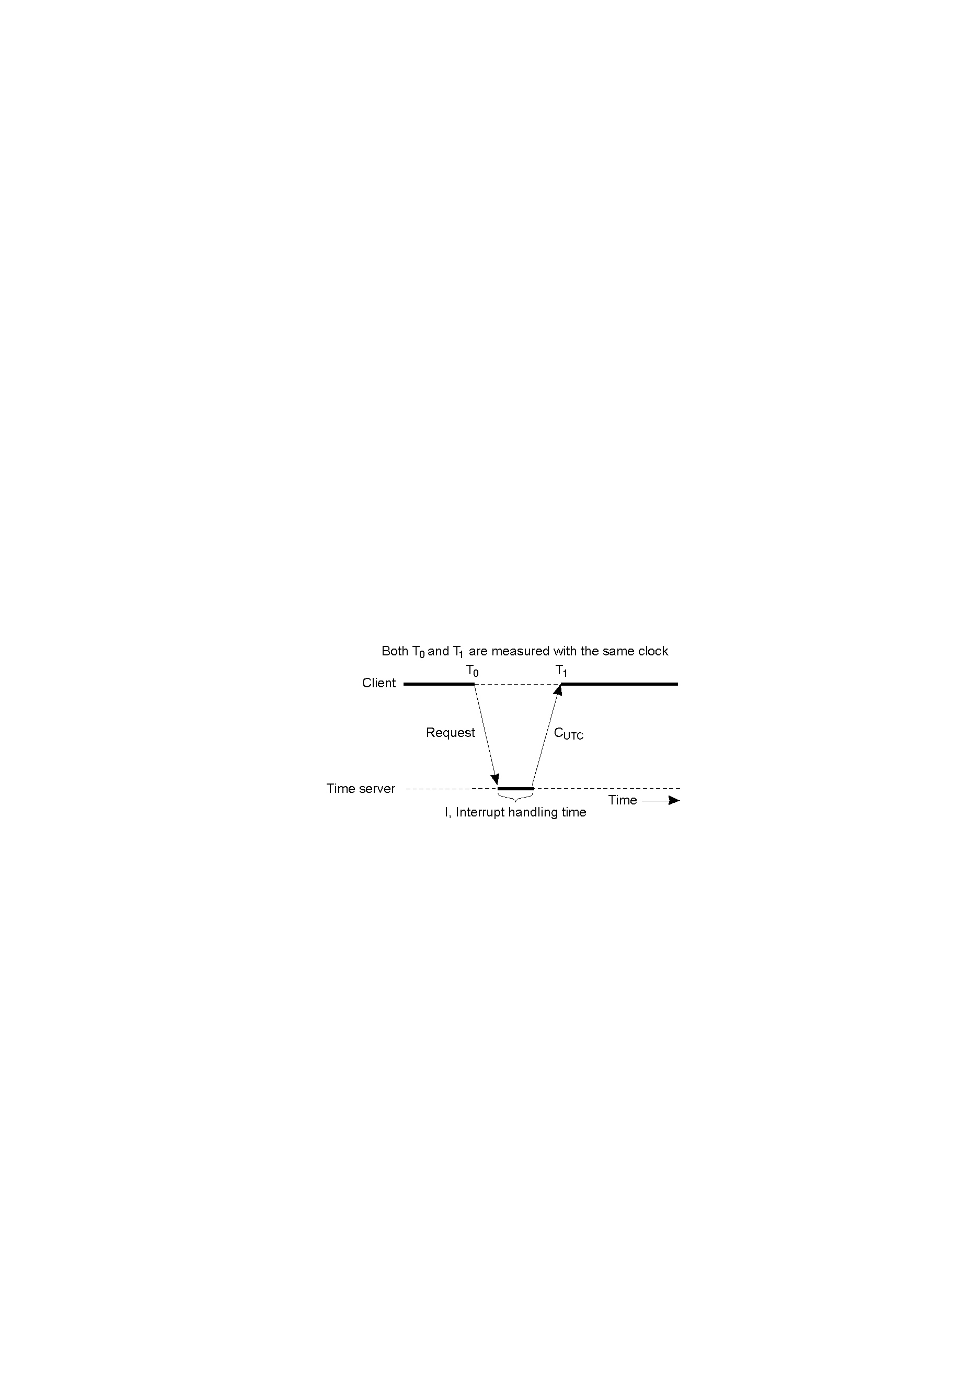
Cristian’s Algorithm
Just one host have UTC receiver
External synchronization algo
Used within intranet mostly
It is correct?
Problems:
time goes backward
cost time in net transmit
Single fault
Stepwise adjustment
T_{adj} = C_{utc} + (T₁ – T₀)/2
Use multiple server
DCS' Synchronization

Slide 12
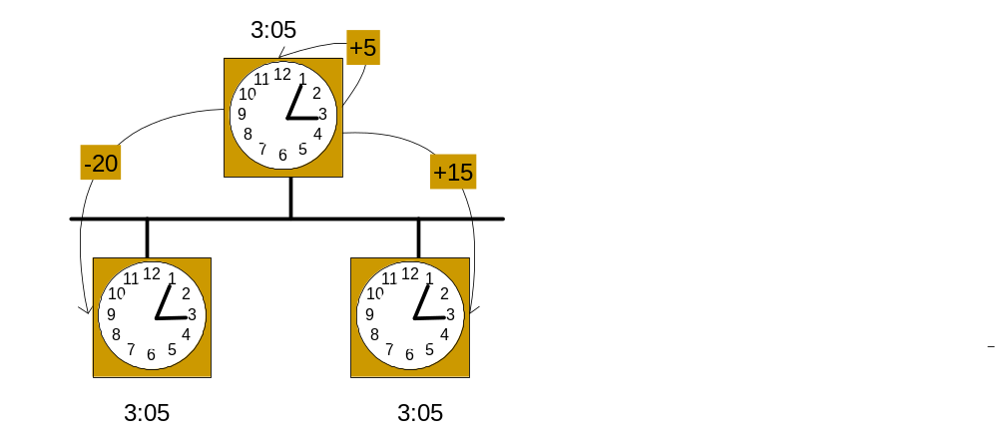
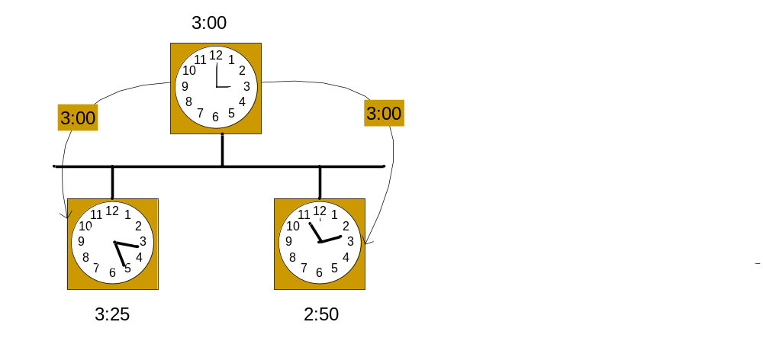
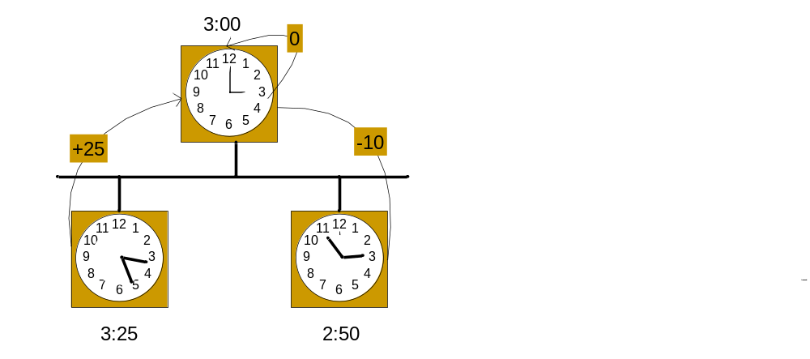
The Berkeley Algorithm
Not need UTC receiver
Internal synchronization algo
Used within intranet mostly
Problems:
time goes backward
cost time in net transmit
Single point of failure
average
DCS' Synchronization

Slide 13
Network Time Protocol (NTP)
A time service for the Internet - synchronizes clients to UTC
Reliability from redundant paths, scalable, authenticates time sources
Primary servers are connected to UTC sources
Secondary servers are synchronized to primary servers
Synchronization subnet - lowest level servers in users’ computers
1
2
2
3
3
3
Figure 10.3
DCS' Synchronization
•
Notes:
animates the points relaibility, primary and secondary servers

Slide 14
NTP - synchronisation of servers
The synchronization subnet can reconfigure if failures occur, e.g.
  a primary that loses its UTC source can become a secondary
  a secondary that loses its primary can use another primary
Modes of synchronization:
  Multicast
      A server within a high speed LAN multicasts time to others which set clocks assuming some delay (not very accurate)
  Procedure call
      A server accepts requests from other computers (like Cristiain’s algorithm). Higher accuracy. Useful if no hardware multicast.
  Symmetric
      Pairs of servers exchange messages containing time information
      Used where very high accuracies are needed (e.g. for higher levels)
RFC 1305
DCS' Synchronization
•

Slide 15
Messages exchanged between a pair of NTP peers
All modes use UDP
Each message bears timestamps of recent events:
  Local times of Send and Receive of previous message
  Local times of Send of current message
Recipient notes the time of receipt T_{i} ( we have T_{i-3}, T_{i-2}, T_{i-1}, T_{i})
In symmetric mode there can be a non-negligible delay between messages
Server B
T
i
-2
T
i-1
Time
Figure 10.4
m
m'
Time
Server A
T
i
-
3
T
i
•
DCS' Synchronization
Notes:
Local times of Send and Receive of previous message
Local times of Send of current message
Recipient notes the time of receipt ( we have T_{i-3}, T_{i-2}, T_{i-1}, T_{i})
In symmetric mode there can be a non-negligible delay between messages

Slide 16
Accuracy of NTP
For each pair of messages between two servers, NTP estimates an offset o, between the two clocks and a delay d_{i} (total time for the two messages, which take t and t’)
  T_{i-2} = T_{i-3} + t + o and T_{i} = T_{i-1} + t’ - o
This gives us (by adding the equations) :
  d_{i} = t + t’ = T_{i-2} - T_{i-3} + T_{i} - T_{i-1}
Also (by subtracting the equations)
  o = o_{i} + (t’ - t )/2 where o_{i} = (T_{i-2} - T_{i-3} + T_{i} - T_{i-1} )/2
Using the fact that t, t’>0 it can be shown that
  o_{i} - d_{i} /2 ≤ o ≤ o_{i} + d_{i} /2 .
  Thus o_{i} is an estimate of the offset and d_{i} is a measure of the accuracy
NTP servers filter pairs <o_{i}, d_{i}>, estimating reliability from variation, allowing them to select peers
Accuracy of 10s of millisecs over Internet paths (1 on LANs)
DCS' Synchronization
•
Notes:
from the above: o-oi = (t’-t)/2
therefore |o-oi| = |t’-t|/2
now |t’-t| <= |t’+t| = di therefore |o-oi| <=di/2. i.e. o-oi<=dii/2 or o<oi+di/2
also -o+oi<= di/2 i.e. oi-di/2 <= o

Slide 17
PTP: Precision Time Protocol
Standard for a Precision Clock Synchronization Protocol for Networked Measurement and Control Systems
Thanks the researcher from HP
  John C. Edsion
A bit of History
  Approved by the IEEE-SA Review Committee on 12 Sept. 2002
  Published on 8 Nov. 2002
DCS' Synchronization

Slide 18
PTP’s Objective
Sub-microsecond synchronization of real-time clocks in components of a networked distributed measurement and control system
Intended for relatively localized systems typical of industrial automation and test and measurement environments
Applicable to local areas networks supporting multicast communications (including but not limited to Ethernet)
Simple, administration free installation
Support heterogeneous systems of clocks with varying precision, resolution and stability
Minimal resource requirements on networks and host components
DCS' Synchronization

Slide 19

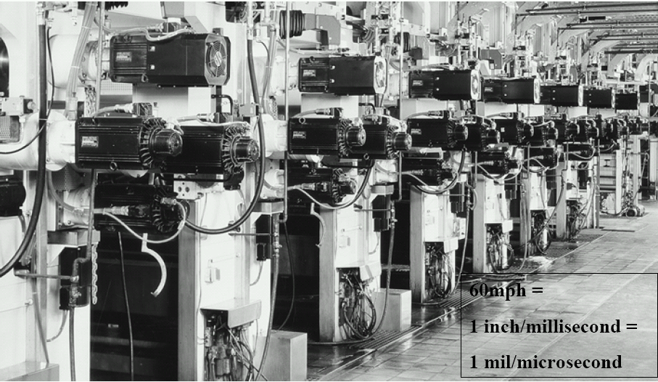
PTP: Where is being used?
DCS' Synchronization

Slide 20

PTP: Where is being used?(Cont.)
Military Flight Test
Power System
DCS' Synchronization

Slide 21
PTP: Principle
Hardware+Software
Master/sliver Model
  Any host can perform both Master and Sliver
Depend on network topology
  Based IP multicast communication
Details:
  How to determine the master?
  How to correct the offset?
  How to correct the delay?
DCS' Synchronization
Notes:
网络时钟同步的误差来源。

Slide 22
PTP: Self-Configuration
Select Master
  Best Master Algo
DCS' Synchronization

Slide 23
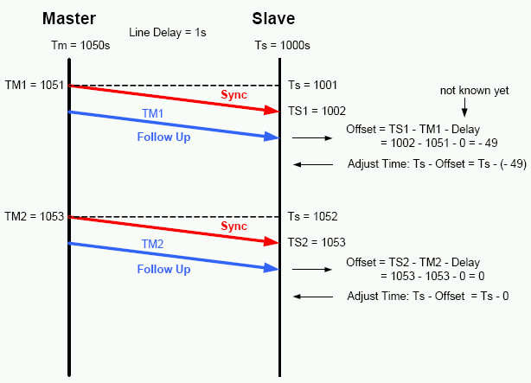
PTP: Offset Correction
DCS' Synchronization

Slide 24
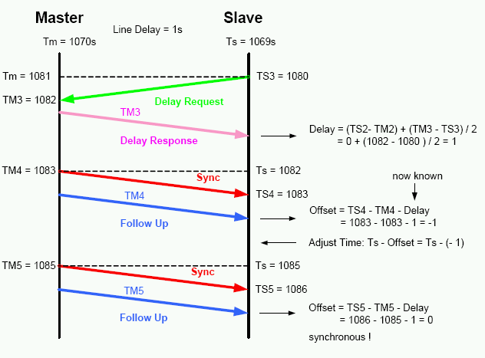
PTP: Delay Correction
DCS' Synchronization

Slide 25
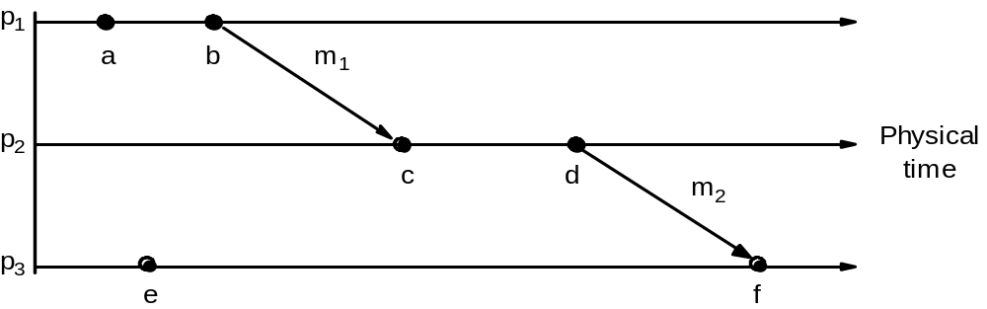
Logical time and logical clocks (Lamport 1978)
Instead of synchronizing clocks, event ordering can be used
a → b (at p1) c →d (at p2)
b → c because of m1
also d → f because of m2
  If two events occurred at the same process p_{i} (i = 1, 2, … N) then they occurred in the order observed by p_{i}, that is →  
  when a message, m is sent between two processes, send(m) happened before receive(m)
  The happened before relation is transitive
Not all events are related by →
consider a and e (different processes and no chain of messages to relate them)
they are not related by → ; they are said to be concurrent; write as a || e
DCS' Synchronization
•
Notes:
Animation explains the following:
In Figure 10.5 a -> b (at p1) c->d at p2 and b->c because of m1 also d-> f because of m2.
Not all events are related by -> (happened before) consider a and e. (different processes and no chain of messages to relate them)
Happened before relation - relation of causal ordering
HB1, HB2 and HB3 (page 397) are formal statements of the three points on the slide

Slide 26
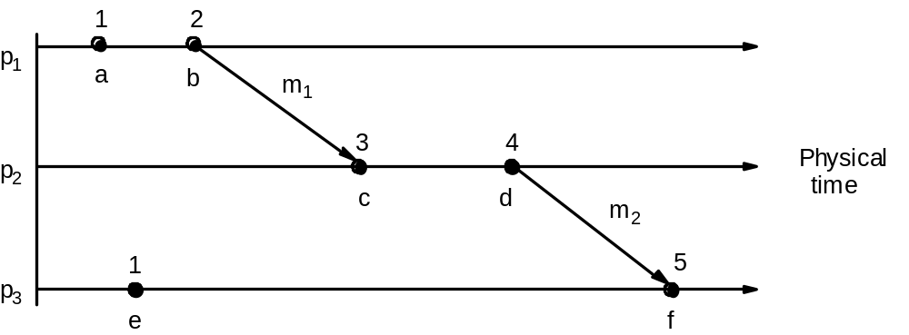
Lamport’s logical clocks
Give an example to show the converse is not true
e.g. L(b) > L(e) but b || e
A logical clock is a monotonically increasing software counter. It need not relate to a physical clock.
Each process p_{i} has a logical clock, L_{i} which can be used to apply logical timestamps to events
  LC1: L_{i} is incremented by 1 before each event at process p_{i}
  LC2:
  (a) when process p_{i} sends message m, it piggybacks t = L_{i}
  (b) when pj receives (m,t) it sets L_{j} := max(L_{j}, t) and applies LC1 before timestamping the event receive (m)
each of p1, p2, p3 has its logical clock initialised to zero,
the clock values are those immediately after the event.
e.g. 1 for a, 2 for b.
e →e’ implies L(e)<L(e’)
The converse is not true, that is L(e)<L(e') does not imply e →e’
for m₁, m₂ is piggybacked and c gets max(0,2)+1 = 3
DCS' Synchronization
•
Notes:
Discuss LC1 and LC2 for Figure 10.6 (same as 10.5).
Initially clocks all set to 0. (a -> 1) b->2 etc. For m1, 2 is piggybacked and c gets max(1,2) + 1. Same for m2.
Note e -> e’ implies L(e) < L(e’). Converse not true. E.g. events b and e.
(b || e) concurrent.

Slide 27
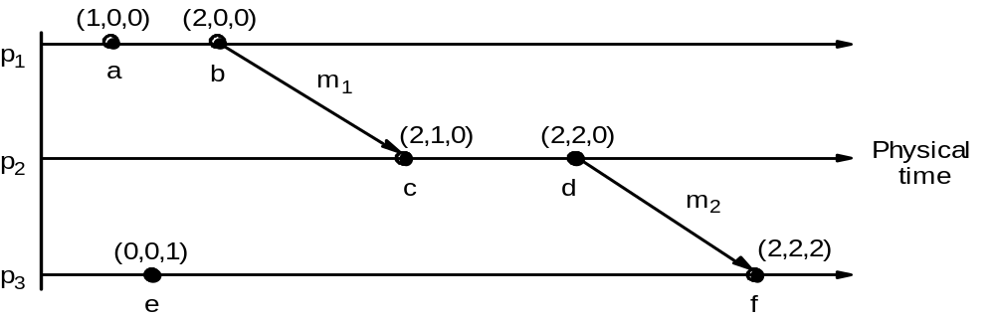
Vector clocks
Can you see a pair of parallel events?.
V_{i}[i]] is the number of events that p_{i} has timestamped
V_{i}ji] ( j≠ i) is the number of events at p_{j} that p_{i} has been affected by
c || e( parallel) because neither V(c) <= V(e) nor V(e) <= V(c).
Vector clock V_{i} at process p_{i} is an array of N integers
VC1:initially V_{i}[j] = 0 for i, j = 1, 2, …N
VC2:before p_{i} timestamps an event it sets V_{i}[i] := V_{i}[i] +1
VC3:p_{i} piggybacks t = V_{i} on every message it sends
VC4:when p_{i} receives (m,t) it sets V_{i}[j] := max(V_{i}[j] , t[j]) j = 1, 2, …N ( then before next event adds I to own element using VC2)
At p1 a(1,0,0) b (2,0,0) piggyback (2,0,0) on m1
At p2 on receipt of m1 get max ((0,0,0), (2,0,0)) = (2, 0, 0) add 1 to own element = (2,1,0)
Meaning of =, <=, max etc for vector timestamps - compare elements pairwise
Note that e →e’ implies L(e)<L(e’). The converse is also true.
Vector clocks overcome the shortcoming of Lamport logical clocks
(L(e) < L(e’) does not imply e happened before e’)
Vector timestamps are used to timestamp local events
DCS' Synchronization
•
Notes:
Following points animated :
Vector clocks overcome the shortcoming of Lamport logical clocks (L(e) < L(e’) does not imply e happened before e’) e.g. events e and c
Vector timestamps are used to timestamp local events.
Applied in schemes for replication of data e.g. Gossip (p 572), Coda (p585) and causal multicast
The rules VC1-VC4 are for updating vector clocks
Work through figure 10.7. At p1 a(1,0,0) b (2,0,0) send (2,0,0) on m1
At p2 on receipt of m1 get max((0,0,0), (2,0,0) = (2,0,0) add 1 -> (2,1,0).
Meaning of =, <=, max etc for vector timestamps.
Note that e-> e’ implies V(e) < V(e’). The converse is also true.
But c || e parallel) because neither V(c) <= V(e) nor V(e) <= V(c).

Slide 28
Clocks, events and process states
The 'happened before' relation is essential to understanding logical clocks
A distributed system is defined as a collection P of N processes pi, i = 1,2,… N
Each process pi has a state si consisting of its variables (which it transforms as it executes)
Processes communicate only by messages (via a network)
Actions of processes:
  Send, Receive, change own state
Event: the occurrence of a single action that a process carries out as it executes e.g. Send, Receive, change state
Events at a single process pi, can be placed in a total ordering denoted by the relation →i between the events. i.e.
  e →i e’ if and only if e occurs before e’ at pi
A history of process pi: is a series of events ordered by →i
  history(pi)= hi = <ei0, ei1, ei2, …>
DCS' Synchronization
•

Slide 29
Distributed Coordination
Coordination: let a set of entity to synchronize their or to agree on one or more values
A foundational problem of computer sci & eng
  Stand-alone: mutex, sem, monitor,…
Distributed environment
  Inherent need
  More complex
  Stand-alone salvations can not apply into distributed environment directly
Why?
We must develop some coordination algorithms for DCS.
DCS' Synchronization

Slide 30
Evaluate distributed algorithms
Traditional algorithm
  Space
  Time: O(1), O(n), O(lg(n)), O(n^{m}), O(m^{n})
Distributed algorithm
  Time and space are also necessary
  Number of message (NoM) is the most important
    Better algorithm: O(1), O(lg(n))
DCS' Synchronization

Slide 31
Distributed mutual exclusion
Critical section problem
Application-level protocol for executing a critical section
Requirements:
  ME1(safety): at most one process may execute in the critical section at a time
  ME2(livenes): Request to enter and exit the critical section eventually succeed
  ME3(fairness): All process have chance to execute in the critical section
  ME4(->ordering): If one request to enter the CS happened-before another, then entry to the critical section is granted in that before
Distributed mutual exclusion
Enter();
AccessResource();
Exit();
DCS' Synchronization

Slide 32
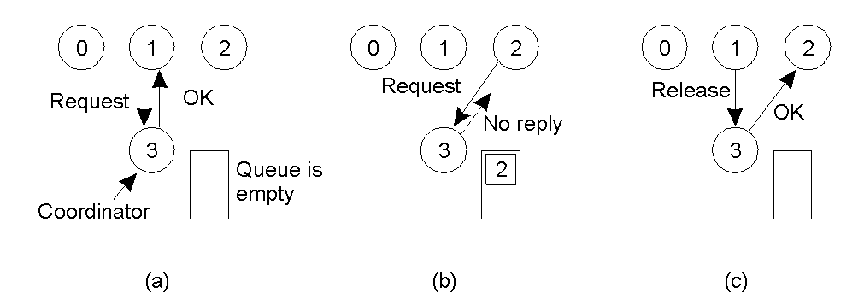
A Centralized Algorithm( Lamport )
There exists a Coordinator who hold all information about critical section and manage which process can enter critical section.
Thinking: the algorithm meets requirements of ME(1) – ME(4)?
Pros and cons?
(a) Process 1 asks the coordinator for permission to enter a critical region.
Permission is granted.
(b) Process 2 then asks permission to enter the same critical region. The coordinator does not reply.
(c) When process 1 exits the critical region, it tells the coordinator, when then replies to 2.
DCS' Synchronization

Slide 33
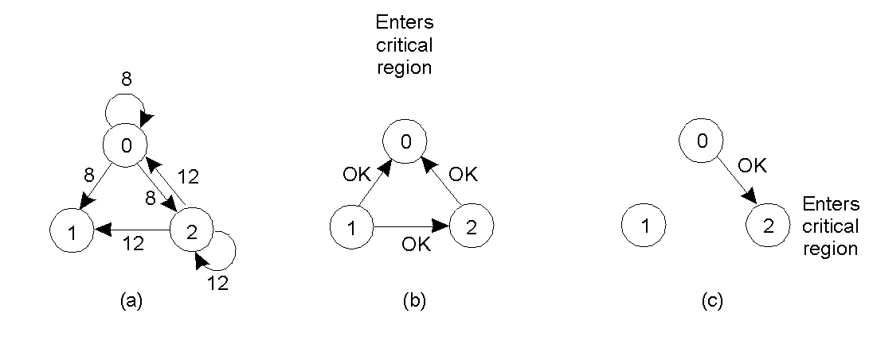
Distributed Algorithm (Ricart)
When a process want enter CS, it broadcast a message
(CS_name, Process_ID, Timestamp).
When a process get the message, it response according to the following rules:
(L1): if not in CS and not want to enter into CS, then just reply a OK message.
(L2): if always in CS, then not reply and queues the request.
(L3): If want to enter CS, then compares the message received and the message sent by itself.
(L3.1) if owned message -> message received, then not reply any message
and queues the incoming message.
(L3.2) if owned message <- message received, then reply a OK message.
Thinking: the algorithm meets requirements of ME(1) – ME(4)?
Pros and cons?
When a process exit CS, it send OK message to all processes on its queue and delete them all form the queue.
(a) Two processes want to enter the same critical region at the same moment.
(b) Process 0 has the lowest timestamp, so it wins.
(c) When process 0 is done, it sends an OK also, so 2 can now enter the critical region.
DCS' Synchronization

Slide 34
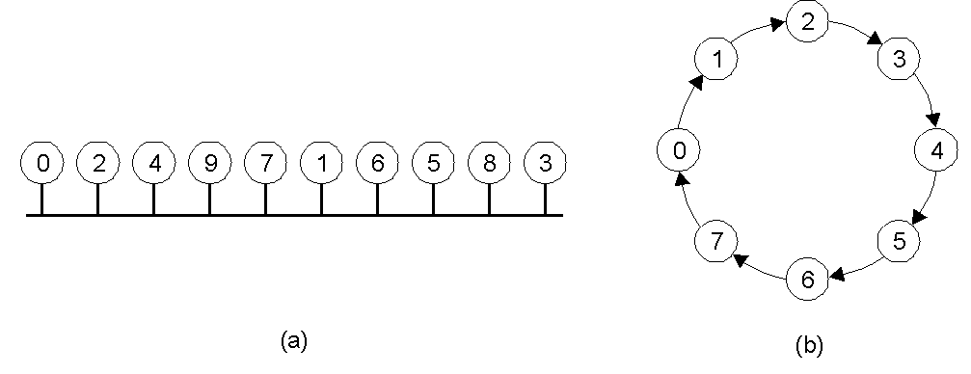
A Token Ring Algorithm
When the ring is initialized, process 0 is given a token, and the token circulates around the ring.
When a process acquires the token from his neighbor, it checks to see if it is attempting to enter a CS.
if so, then it enters the CS, does all work, and leave CS. After it has exited, it pass the token along the ring. It is not permitted to enter a second CS using the same token.
if not, just pass the token along.
Thinking: the algorithm meets requirements of ME(1) – ME(4)?
Problems:
(1) what to happen if token lost?
(2) what to happen if a process crash?
An unordered group of processes on a network.
A logical ring constructed in software.
DCS' Synchronization

Slide 35
Comparison
Algorithm | Messages per entry/exit | Delay before entry (in message times) | Problems
Centralized | 3 | 2 | Coordinator crash
Distributed | 2 ( n – 1 ) | 2 ( n – 1 ) | Crash of any process
Token ring | 1 to ∞ | 0 to n – 1 | Lost token, process crash
DCS' Synchronization

Slide 36
Election
Many distributed systems require one process to act as coordinator, initiator.
  EX: Lamport algorithm, token ring algorithm
Precondition
  All process of distributed system are distinguished.
  In default, we give a process with higher number a higher priority.
  Every process knows the others
  Every process does not know the others’ health.
Objective:
  Determine when to start a election
  Elect a coordinator, initiator or … on the basis of the agreeing of all processes.
DCS' Synchronization

Slide 37
Bully Algorithm (Garcia-Molina)
Time: When any process notices that the coordinator is no longer responding to request, it initiates an election.
A process, P, holds an election as follows:
(1) P sends an ELECTION message to all process with higher numbers.
(2) If no one responds, P wins the election and becomes coordinator.
(3) If one of the higher-ups answers, it taker over. And P’ s job is done.
The process win the election send all processes a announcing message telling that it is the new coordinator.
Evaluating:
best:
worst:
The process with the next higher number starts the election. (1) + (n-2)
The process with the minimum number starts the election.|
(n-2) + ∑_{(i=1)}^{(n-1)}(i)
DCS' Synchronization

Slide 38
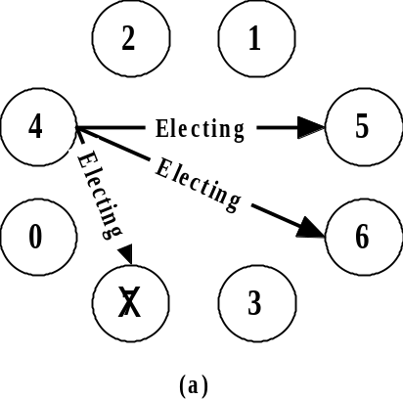
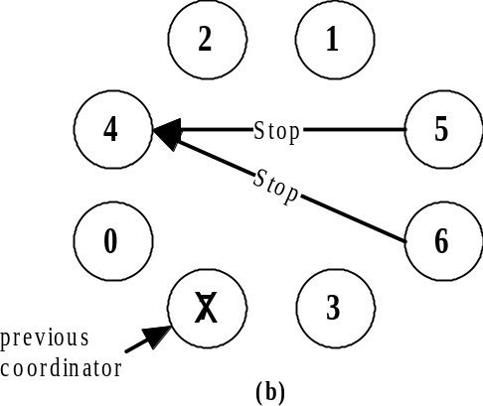
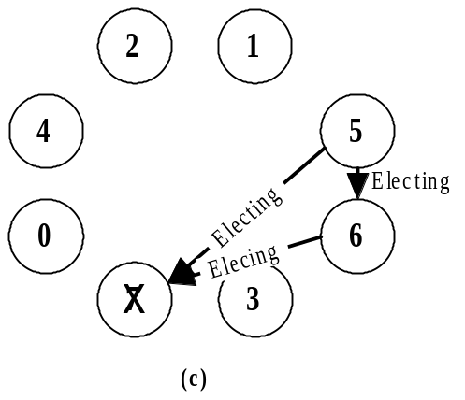
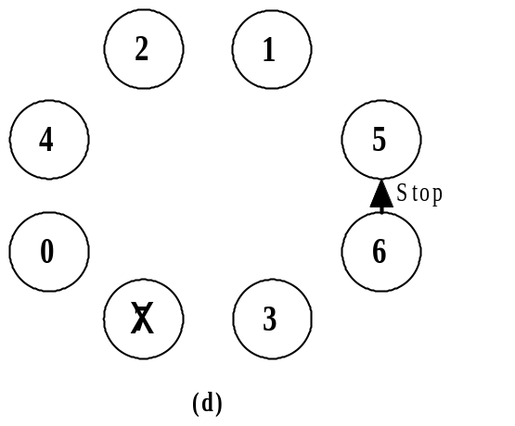
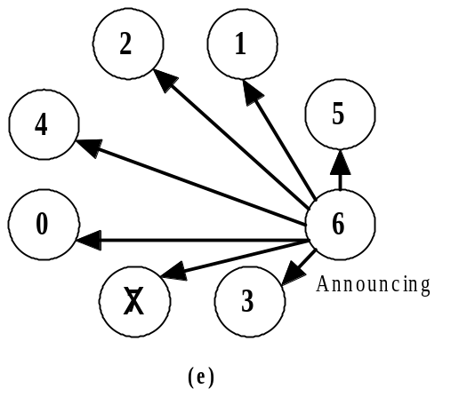
Example of Bully algorithm
DCS' Synchronization

Slide 39
A Ring Algorithm
Unlike many ring algorithm, this algorithm does not need a token.
Precondition:
the processes are physically or logically ordered and each process knows its successor.
Time: When any process notices that the coordinator is no longer responding to request, it initiates an election.
Evaluating:
Best:
Worst
All up processes start election synchronously. 2*((n-1)*n)
Rules:
(1) The starter builds a message containing its PID and send the message to its successor.
(2) If the successor is down, the sender skips over the successor and goes to the next member along the ring, or the one after that, until a running process is located.
(3) At each step, the sender adds its own PID to the list in the message effectively making itself a candidate to the elected as coordinator.
(4) Eventually, the message gets back to the starter. Then the message contains all the PID in the system and starter transforms the message into a coordinator message and send it to its successor.
Just only one process start election . 2*n
DCS' Synchronization

Slide 40
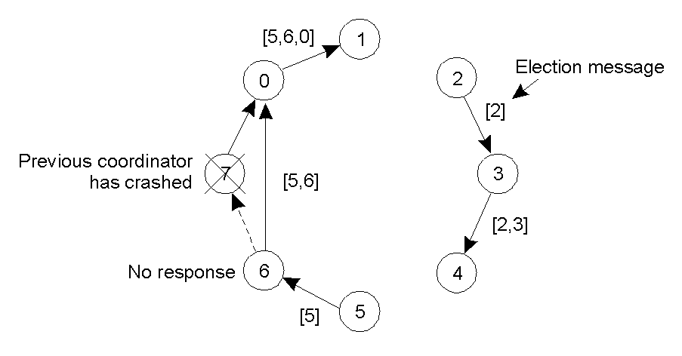
Example of ring algorithm
DCS' Synchronization

Slide 41
Deadlock in DCS – Introduce
Deadlock is a foundational problem of computer sci&eng.
Deadlock is a events of small probability, but leads system into a incorrect state.
Deadlock in DCS is more incident and subtler, and it is more difficult to find it out.
Two types:
(1). Communication deadlock
(2) Resources deadlock
Both types are deadlock due to resources
access at all.
DCS' Synchronization

Slide 42
The ways to deal with deadlock
Deadlock ignore: ignore deadlocks maybe happen. When they happen,
administrator delete some processes.
Deadlock Prevention: Make the deadlocks can not happen structurally.
Deadlock avoid: Allocate various distributed resources carefully to avoid
deadlock . EX: Banker algorithm
Deadlock detection: System detects its state automatically. And when deadlock
happens, system will restore health.
DCS' Synchronization

Slide 43
Deadlock Prevention
Stand-alone
  Destroy the conditions of deadlock
    A process uses only one resource in any time.
    Allocate all resources once
    Use resources orderly.
Distributed system
  idea
    Use global timestamp
    When two process race for a resource, firstly compare their timestamp, and the early holds the resource and the later waits.
  algorithm
    Wait-die
    Wound-wait
DCS' Synchronization

Slide 44
Deadlock Detection
Centralized
    Precondition: Every center node keeps a system resources map, which describes all processes and resources of the system.
    Method：Coordinator detects whether there exist a process-resource waiting loop in system. If so, coordinator will kill a process within the loop and resume system.
    Difficulties：
      Lack of knowledge of global state
      Lack of a global time-frame
      Non-determinism of communication delay
    Countermeasure：Make a order for all event allocating resource based on global time.
Distributed
    State: Many researchers have proposed some algorithms.
    Difficulties: There exists a larger gap between preconditions and real environment.
    Key:
      How to guarantee these algorithms’ validation and practicability?
may cause false deadlock.
DCS' Synchronization

Slide 45


DCS' Synchronization

