Slide 1
分布计算系统
Distributed Computing System
西北工业大学计算机学院 周兴社 杨刚

Slide 2

Case Study

Slide 3
Case 1:

Slide 4
Case 1: Google Computer
Your computer's idle time is too precious to waste.

Slide 5
What is GC?
The Google Compute detects when a computer is idle and puts it to work on complex mathematical problem from such fields as drug design and global climate modeling.

Slide 6
GC’s Running Mode
Standard Mode: run in the background all the time (as long as the machine is powered on and not in standby mode), at the lowest priority.
Conservation Mode: run only when the user is away from his/her machine. It does not run while the user is actively working at the computer (i.e. using the keyboard or mouse).

Slide 7
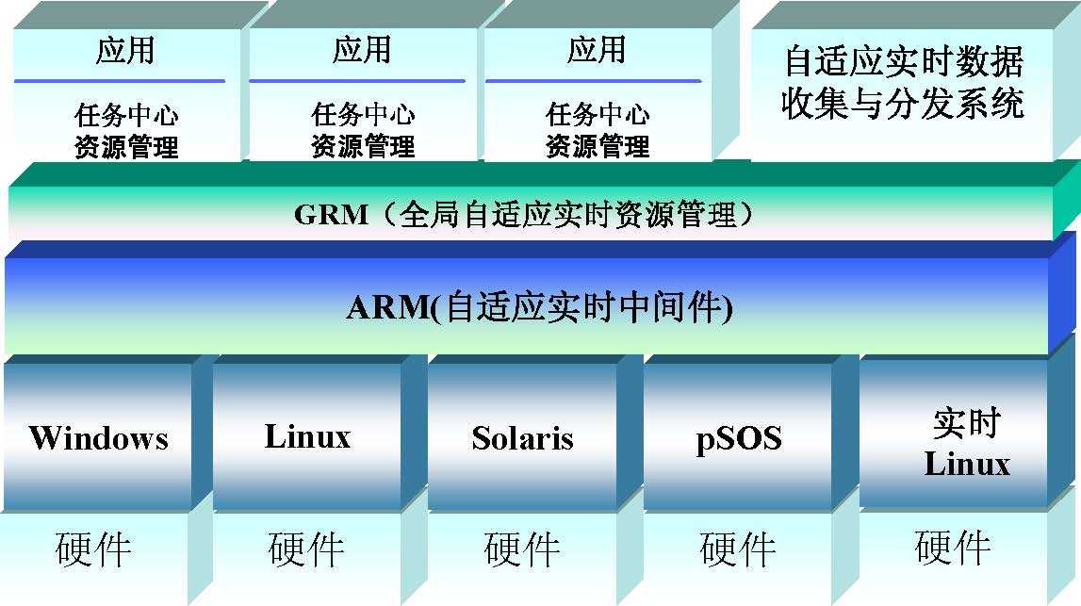
Case 3: HADOC (1)

Slide 8
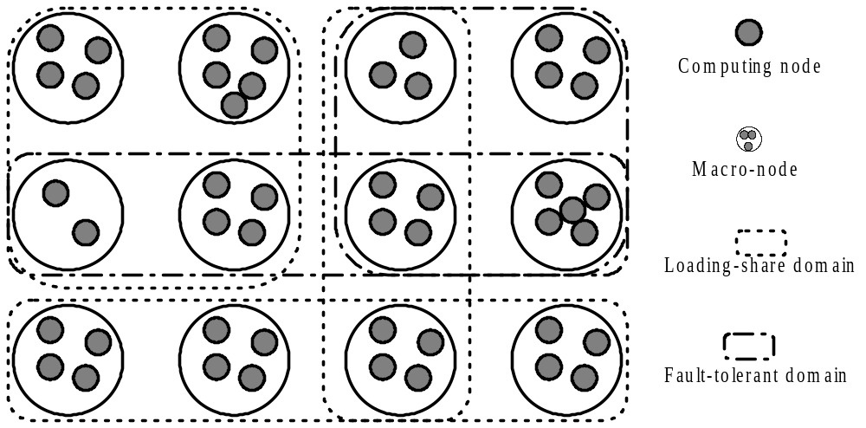
Case 3: HADOC (2)

Slide 9
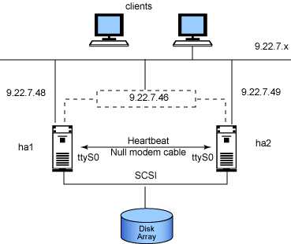
Case 4: Heartbeat on IBM’s HA Middleware

Slide 10

This course just is an introduction to Distributed Computing System for you and what we give you is a seeding merely like the figure.
If you are interesting in DCS, let us explore the subject hand in hand.
Our email is: dcel@nwpu.edu.cn .

