Slide 1
分布计算系统
Distributed Computing System
西北工业大学计算机学院 周兴社 杨刚
CORBA

Slide 2

Distributed Object-Based System and CORBA Case Study
CORBA

Slide 3
Motivation
Limits of MP/Socket/IPC etc.
  less transparent
  difficult to extend
  not adopt OO technical
  not adapt to heterogeneous computing environment
  difficult to programming
  inherit legacy code
  …
Come from
  Object( Inheritance, encapsulation and polymorphism)
  RPC( distribution, heterogeneity, data marshalling and unmashalling )
CORBA

Slide 4
Goals
improve distributed computing system’s transparency
shield heterogeneity
  architecture
  OS
  language
  network
providing a powerful programming interface and flexile structure
inherit legacy code
make developing easier
…
CORBA

Slide 5
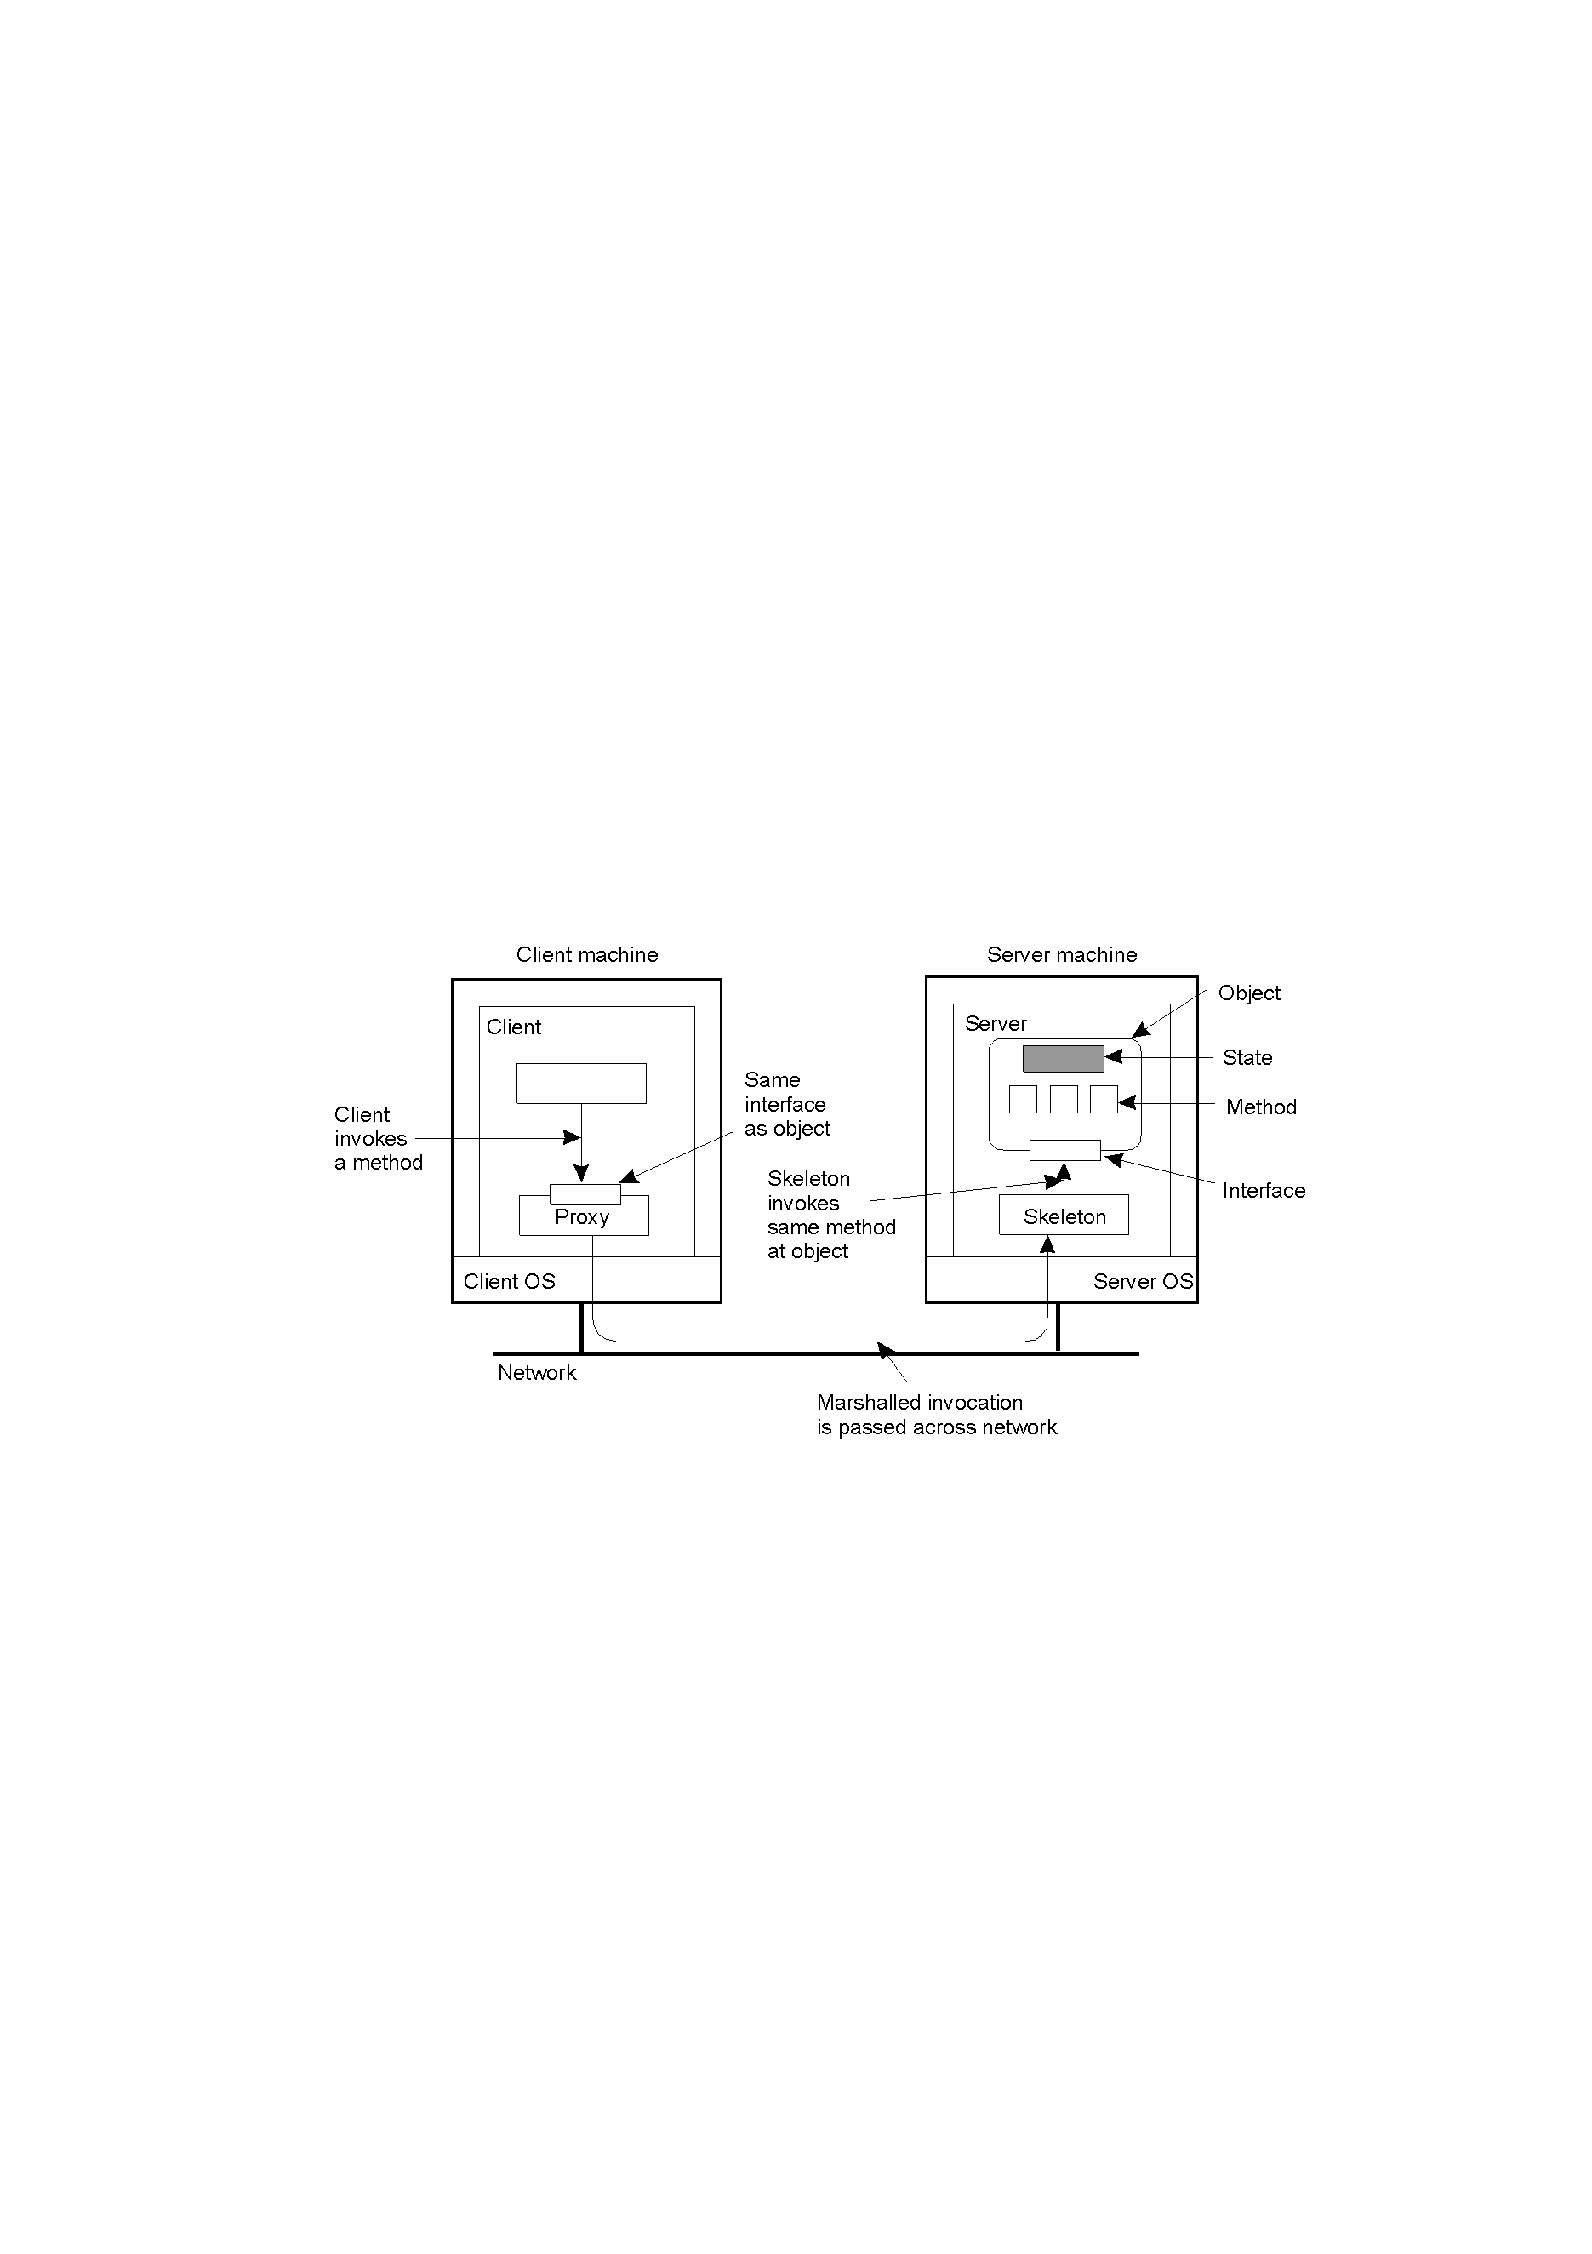
Model of DOC
CORBA

Slide 6
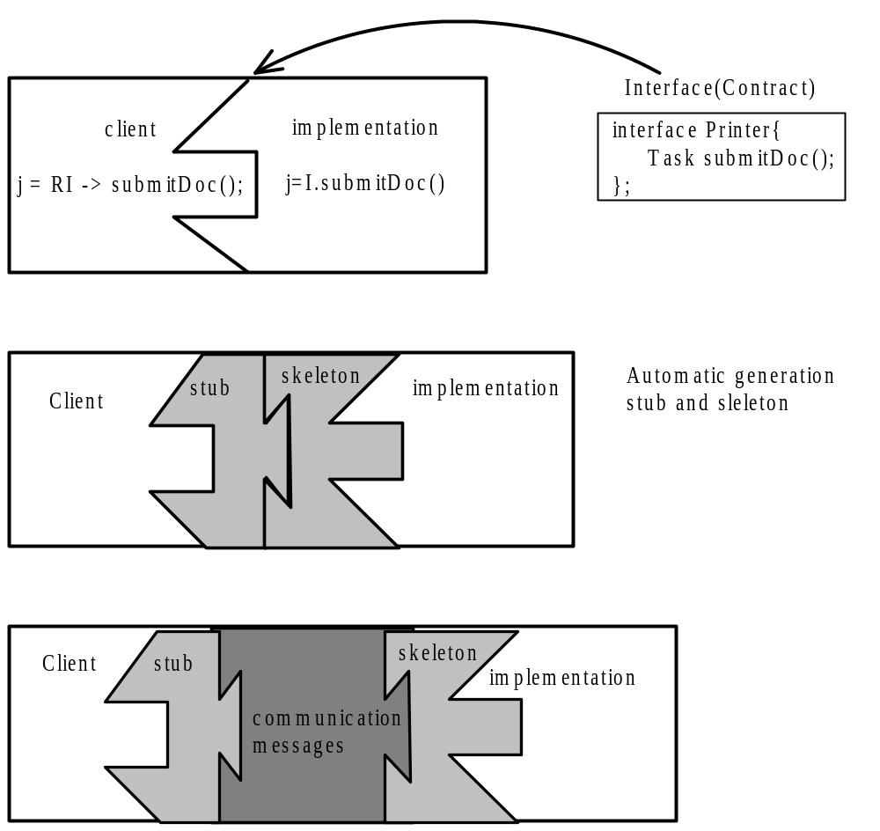
Principle of Distributed Object
CORBA

Slide 7
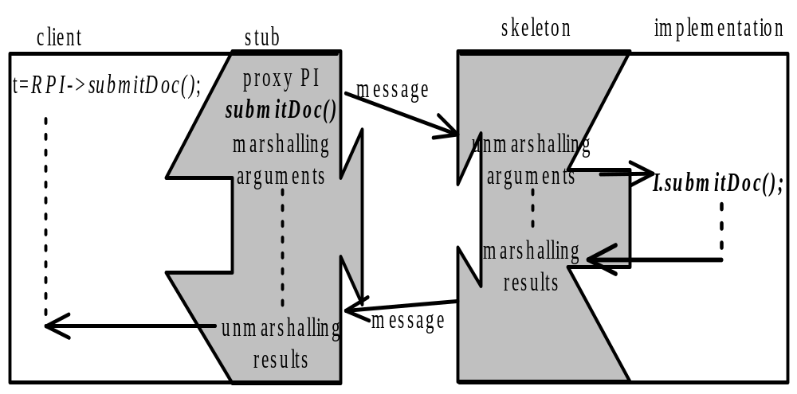
Stub and Skeleton
Request semantics:
synchronous: client is blocked during call
“at most once”
CORBA

Slide 8
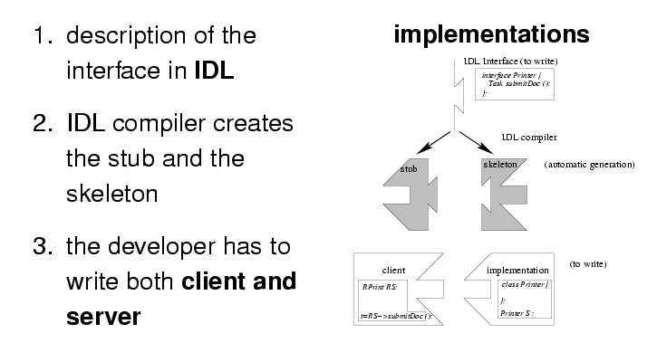
Development principles
CORBA

Slide 9
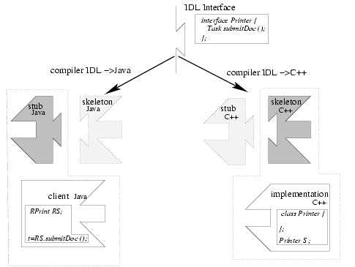
Multi-languages( or Multi-ORBs, Multi-OSs)
CORBA

Slide 10
ORB – Object Request Broker
Assign to each object a object reference
Is in charge of object location
automatic activate of server object
transport requests
CORBA

Slide 11
State of arts
OMG CORBA
  SUN RMI
  Microsoft DCOM
  Microsoft .NET
CORBA

Slide 12
Introduce to CORBA
Common Object Request Broker Architecture
The Object Management Group (OMG) was formed in 1989. Its aims were:
  to make better use of distributed systems
  to use object-oriented programming
  to allow objects in different programming languages to communicate with one another
  about 800 members
The object request broker (ORB) enables clients to invoke methods in a remote object
CORBA is a specification of an architecture supporting this.
  CORBA 1 in 1990 and CORBA 2 in 1996.
CORBA

Slide 13
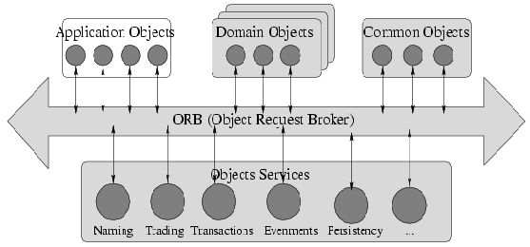
Global Architecture of CORBA
Vertical facilities, consist of high-level services that are targeted to
a specific application domain such as electronic commerce, banking,
manufacturing, etc.
Horizontal facilities, general-purpose high-level services
that are independent of application domains
Specific to each application
Requests transportation between Objects
General system services useful in distributed applications
CORBA

Slide 14
CORBA Services
Service | Description
Collection | Facilities for grouping objects into lists, queue, sets, etc.
Query | Facilities for querying collections of objects in a declarative manner
Concurrency | Facilities to allow concurrent access to shared objects
Transaction | Flat and nested transactions on method calls over multiple objects
Event | Facilities for asynchronous communication through events
Notification | Advanced facilities for event-based asynchronous communication
Externalization | Facilities for marshaling and unmarshaling of objects
Life cycle | Facilities for creation, deletion, copying, and moving of objects
Licensing | Facilities for attaching a license to an object
Naming | Facilities for systemwide name of objects
Property | Facilities for associating (attribute, value) pairs with objects
Trading | Facilities to publish and find the services on object has to offer
Persistence | Facilities for persistently storing objects
Relationship | Facilities for expressing relationships between objects
Security | Mechanisms for secure channels, authorization, and auditing
Time | Provides the current time within specified error margins
CORBA

Slide 15
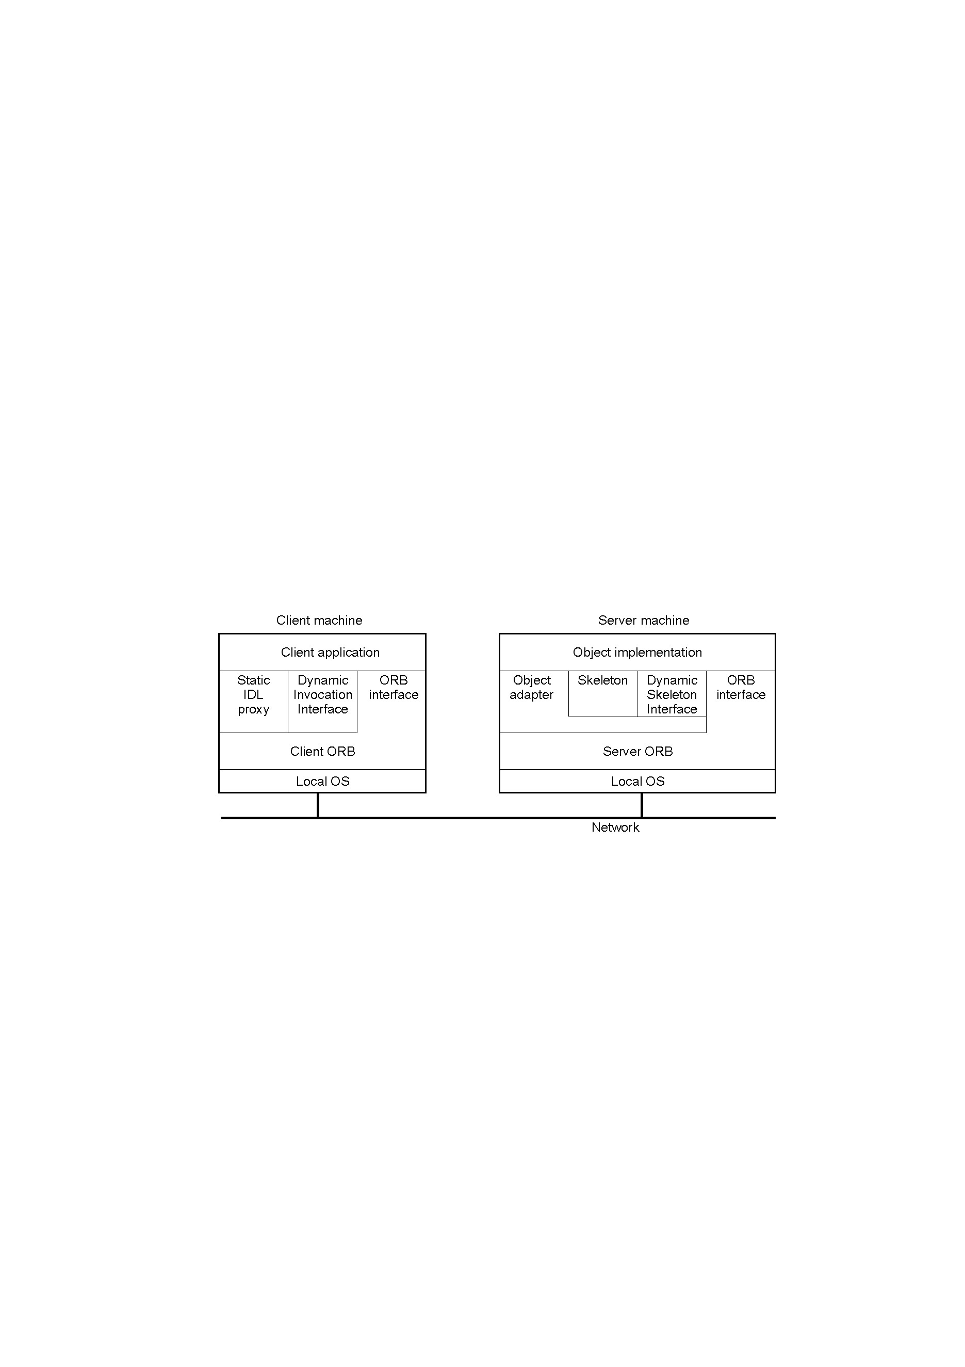
CORBA Object Model
CORBA object identifies by IOR
defined by IDL
is a “virtual” object, just a contract
incarnated by a servant
CORBA Object’s implement, location, incarnation …
are transparent.
CORBA

Slide 16
The Main Components of CORBA Architecture
Dynamic invocation interface
In some applications (e.g. browsers), a client without the appropriate proxy class may need to invoke a method in a remote object.
CORBA does not allow classes for proxies to be downloaded at run time as in Java RMI.
The dynamic invocation interface is CORBA’s alternative. (we will discuss it later with the Interface Repository)
The CORBA architecture is designed to allow clients to invoke methods in CORBA objects
  clients and objects can be implemented in a variety of programming languages
  it has the following additional components
    object adapter, implementation repository and interface repository
Client stubs/proxies
these are in the client language.
an IDL compiler for the client language uses an IDL interface to generate one of the following:
  for object-oriented languages the class of a proxy
  for procedural languages a set of stub procedures.
as before, the client stubs/proxies marshal the arguments in invocation requests and unmarshal exceptions and results in replies.
ORB core
- ORB is a communication medium, shield the details of OS and net communication, separate the interface/implementation and servee and server and reduce the difficulty of DA’s developmetn.
- operations enabling it to be started and stopped;
- operations to convert between remote object references and strings;
- operations to provide argument lists for requests using dynamic invocation.
Implementation repository
  activates registered servers on demand and locates running servers
  uses the object adapter name to register and activate servers.
  more about this later
Object adapter
an object adapter bridges the gap between
  CORBA objects with IDL interfaces and
  the programming language interfaces of the corresponding servant classes.
it does the work of the remote reference and despatcher modules
more about the object adapter later.
Skeletons
  skeleton classes (for OO languages) are generated in the language of the server by an IDL compiler.
  remote method invocations are dispatched via the appropriate skeleton to a particular servant,
  the skeleton unmarshals the arguments in request messages and marshals exceptions and results in reply messages.
Interface repository
  the interface repository provides information about registered IDL interfaces to clients
  And servers that require it. More about this later.
Servant
CORBA’S incarnation and implement the interface using implement lanaguage
client
implementation
interface
server
repository
repository
object
skeleton
adapter
client
proxy
ORB
Request
ORB
Servant
program
for A
core
core
A
Reply
or dynamic invocation
or dynamic skeleton
CORBA

Slide 17
IDL
Interface Definition Language
Just a descriptive language but not a implementary language
Can be mapped into other implement language and shield the difference of various implement language (C++, Java, Smalltalk, COBOL, ADA, C )
IDL compiler generates Stub/Skeleton automatically
Independent of hardware, OS and implementation
Details refers to CORBA standard
interface Remote_Hello_World{
void Hello( in string msg, out string peer_name ) raise(Reject);
oneway Hello_maybe(in string name);
readonly attribute string myself_;
attribute string def_msg;
};
CORBA

Slide 18
Some explanation about Remote_Hello_World
module
interface
operation and attribute
readonly
in/out/inout
raise
oneway
CORBA

Slide 19
Stub/Skeleton
origin from RPC’s stub
generate automatically by idl-complier
is a “glue” between client/server and ORB/POA
stub is local proxy of remote server
  marshal requests
  unmarshal reply
  start a remote method call
skeleton is local proxy of client
  marshal reply, out/inout parameters and exception
  unmarshal request
  dispatch request to relevant servant
shield the heterogenic and net communication’s details
CORBA

Slide 20
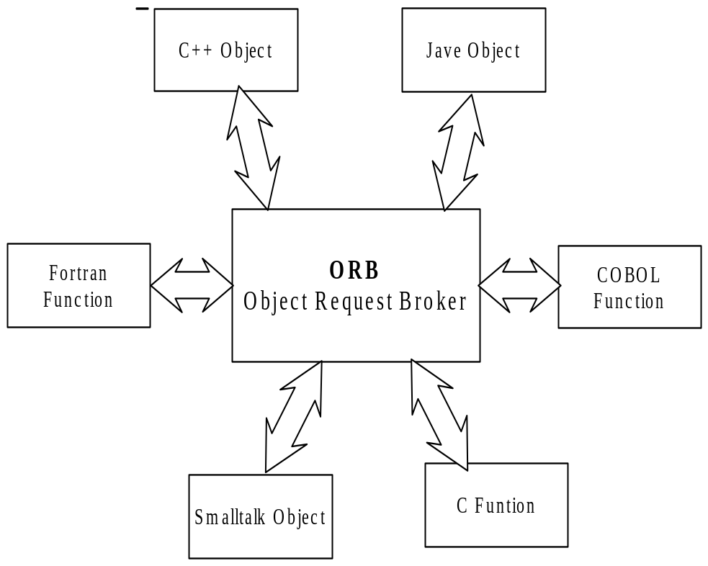

ORB core
Is CORBA’s core and response for communication
Provide a lot of useful operations for both client and server
  initialization
  get a list of CORBA common service
  store IOR in string or reverse
Support multiple communication semantic
Support static and dynamic method call
CORBA

Slide 21
Object Adapter(1) - Introduce
Adapter between CORBA object and Servent object
Positioned between servent and ORB
Lighten the ORB’s burden
Three type:
  BOA
  POA
  LOA
CORBA

Slide 22
Object Adapter(2) - Function
Link between the ORB and Servant
Activation and deactivation of servants
Creation and interpretation of object reference
Register of servant
Dispatch of invoked methods
Client authentification
CORBA

Slide 23
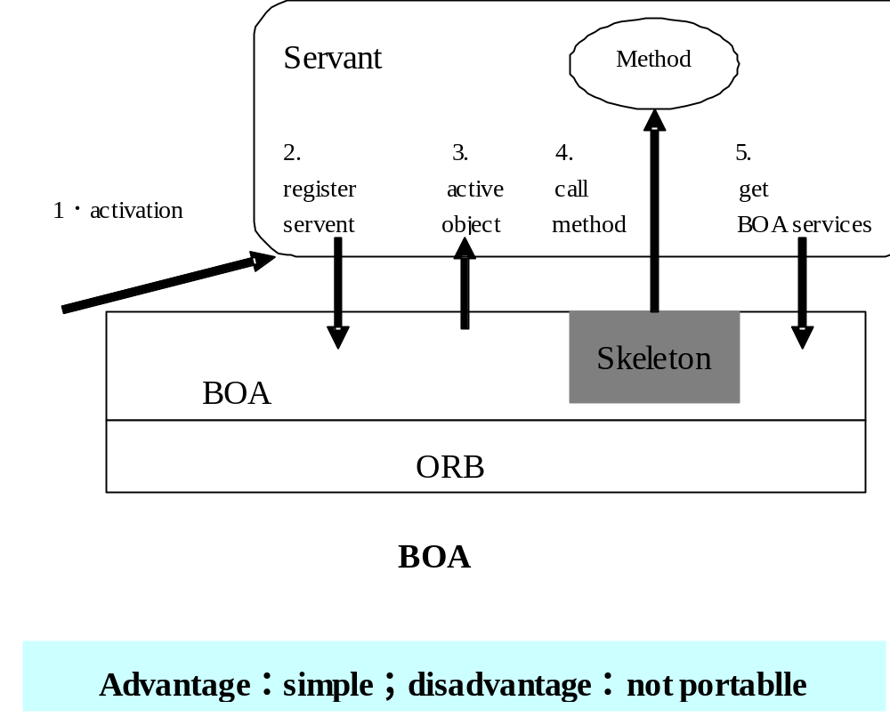
Object Adpater(3) - BOA
CORBA

Slide 24
Object Adpater(3) - POA
Programmer can build portable servant on various ORB
Support object’s transparent activation
Allow multiple servant supporting a single object simultaneous
Allow multiple POA co-locate in the same server
Support temporary objcet
Support default servant managed by POA
Provide policy mechanism to control POA
  Thread policy
  Lifecycle policy
  Object ID unique policy
  ID assignment policy
  Request handling policy
  Implicit activation policy
CORBA

Slide 25
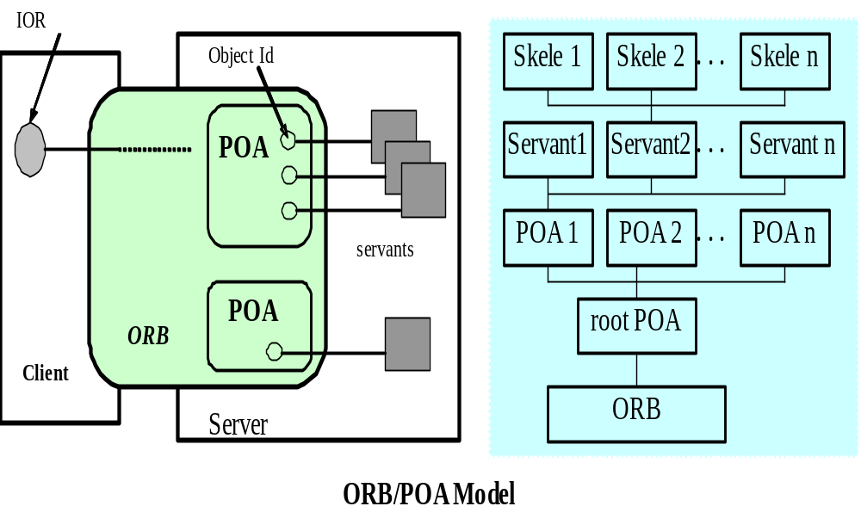
Object Adpater(3) - POA
CORBA

Slide 26
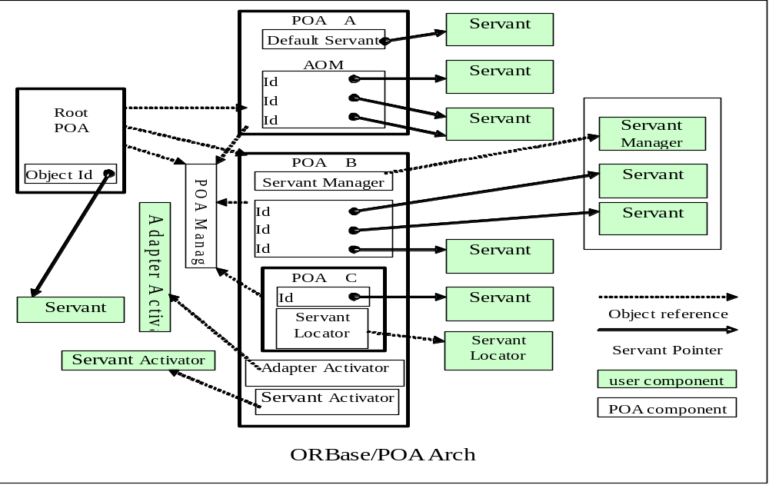
Object Adpater(3) - POA
CORBA

Slide 27
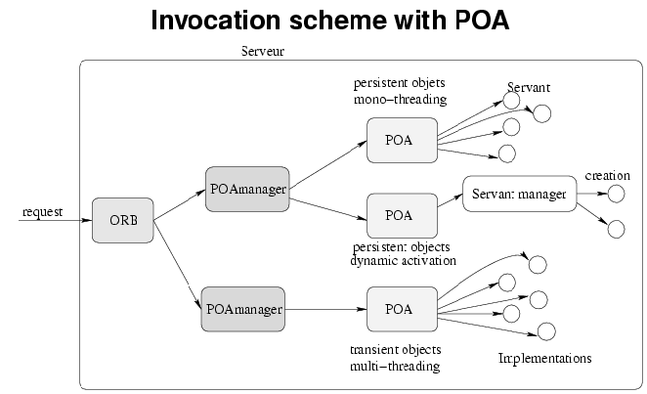
Object Adpater(3) - POA
CORBA

Slide 28
ORB’s Three Keys
Object binding
  locate servent
  Link the IOR and server and direct the client’s request to server correctly
  Interface repository, implement repository, ORB, OA
RMI
  Call a method located remote server
  Stub/skeleton, Dynamic invoke interface/dynamic skeleton interface, interface repository
Interoperation
  Multiple ORB comply with common protocol and semantic
  ORB
CORBA

Slide 29
Object Binding(1) – Identifying CORBA Object
Standalone
  C++ : Object pointer
  Java: Object Reference
CORBA
  IOR
    Interoperate Object Reference
    Distributed smart object pointer
    Containing all necessary information to position object
  Two classes
    Transient IOR – Transientobject
    Persistent IOR - Persistent object
CORBA

Slide 30
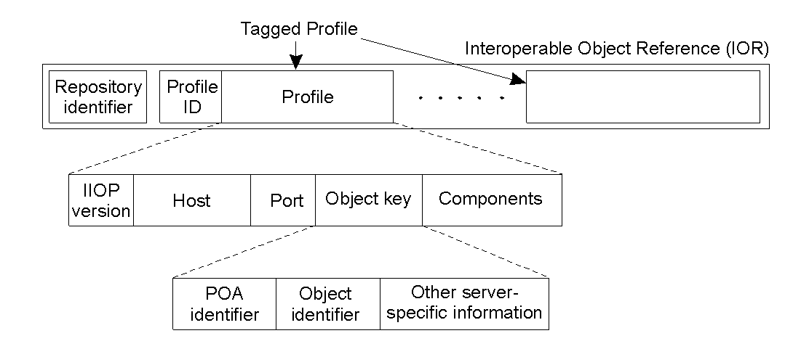
Object Binding(2) – IOR Format
IOR format
IDL interface type name
Protocol and address details
Object key
interface repository
IIOP
host domain
port number
adapter name
object name
identifier
name
CORBA

Slide 31
Object Binding(3) – ways to Get IOR
CORBA object location services
  Naming service
  Trading service
Other ways
  Using object reference strings
    CORBA::ORB::object_to_string()
    CORBA::ORB::string_to_object()
  Using factory Objects
  ORB-Specific approaches
    IONA: _bind()
  Bootstrapping
    CORBA::ORB::resolve_initial_references()
CORBA

Slide 32
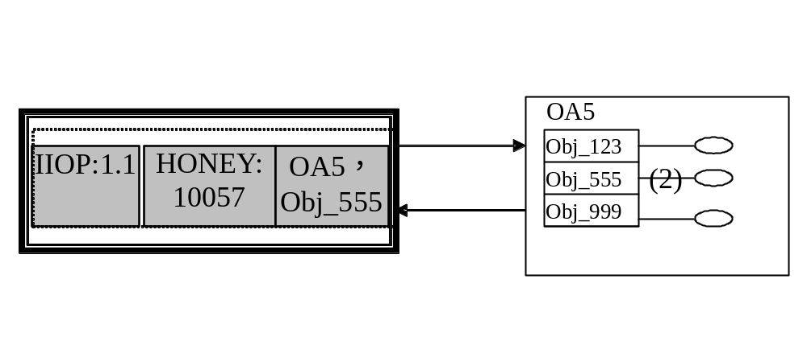
Object Binding(4) – Transient IOR binding
Transient object and transient reference
  Transient IORs are for objects that last as long as the host process
  they contain the address of the server hosting the CORBA object
    The server ORB core receives the request message containing the object adapter name and object name of the target. It uses the object adapter name to locate the object adapter, which uses the object name to locate the servant.
Transient binding is simple and only IOR is enough
CORBA

Slide 33
Object Binding(5) – Persistent IOR binding(1)
Persistent IORs last between activations
  they contain the address of the implementation repository
  the implementation repository receives the request and uses the object adapter name to activate the object, then gives the server address to the client
  the client sends subsequent invocations to the server
CORBA

Slide 34
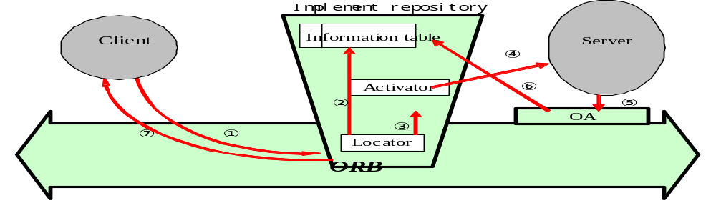
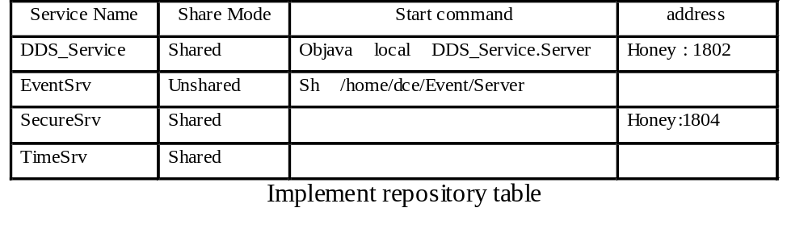
Object Binding(5) – Persistent IOR binding(2)
CORBA

Slide 35
CORBA RMI(1) - Introduce
Remote Method Invoke
Two invoke types
  Static invoke
  Dynamic invoke
Three invoke models
Request type | Failure semantics | Description
Synchronous | At-most-once | Caller blocks until a response is returned or an exception is raised
One-way | Best effort delivery | Caller continues immediately without waiting for any response from the server
Deferred synchronous | At-most-once | Caller continues immediately and can later block until response is delivered
CORBA

Slide 36
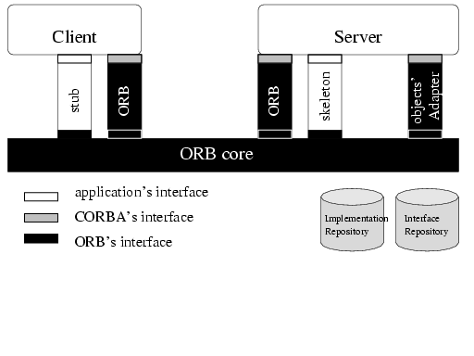
CORBA RMI(2) – Static invoke
CORBA

Slide 37
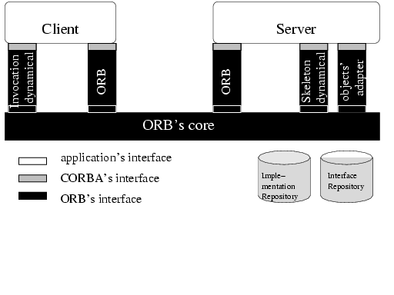
CORBA RMI(3) – Dynamic invoke
CORBA

Slide 38
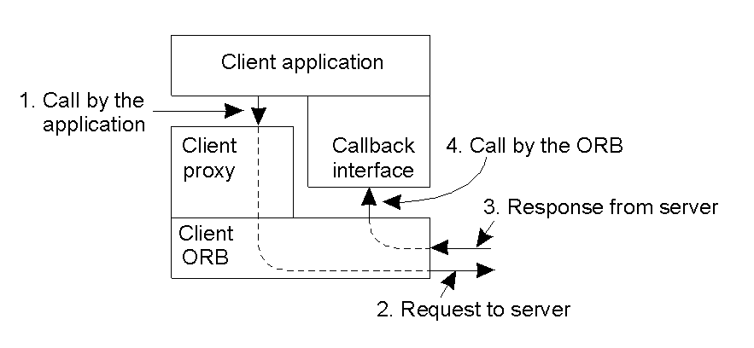
CORBA RMI(4) – Synchronous call
CORBA

Slide 39
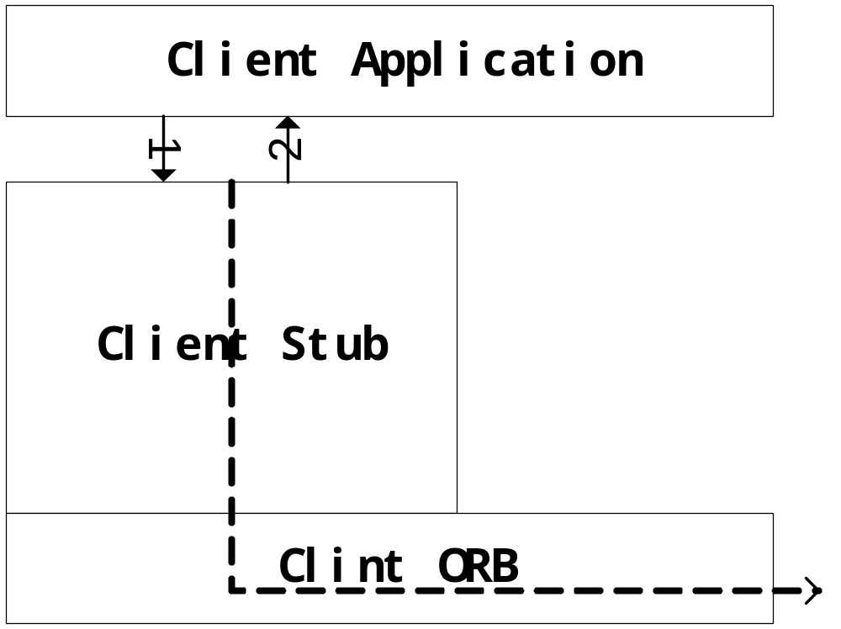
CORBA RMI(5) – Oneway call
CORBA

Slide 40
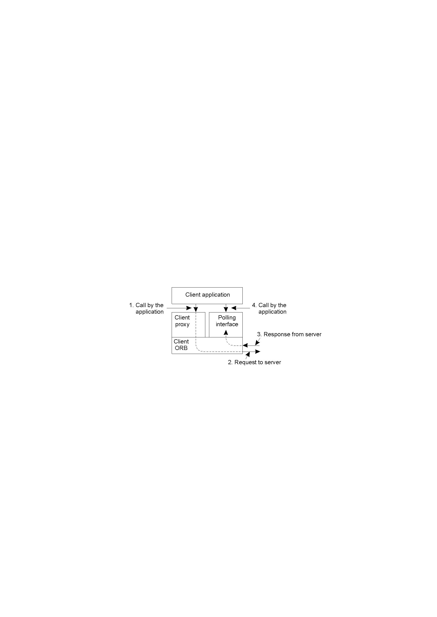
CORBA RMI(6) – Deferred synchronous call
CORBA

Slide 41
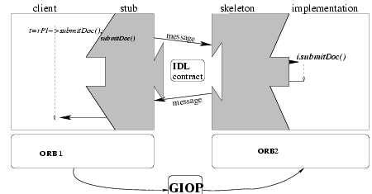
Interoperation (1) - Introduce
IDL – interoperablity between client and server
GIOP – interoperablity among ORBs
CORBA

Slide 42
Interoperation (2) – GIOP functions
CDR : Common Data Representation
IOR : Interoperable Object Reference
IOP : Inter ORB Protocol(8 messages types)
Applied to different transport protocols ( connection oriented, reliable, ordered data flows)
CORBA

Slide 43
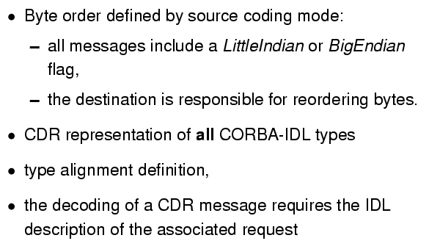
Interoperation (4) – CDR
CORBA

Slide 44
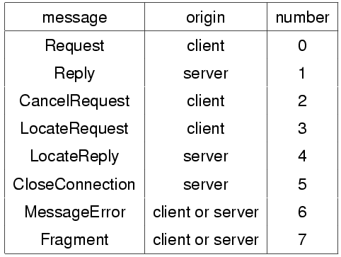
Interoperation (4) – GIOP message
CORBA

Slide 45
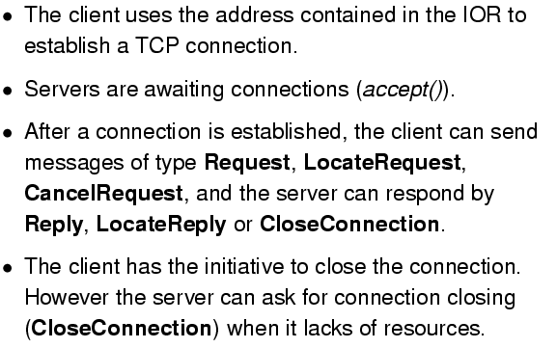
Interoperation (4) – IIOP
CORBA

Slide 46
Some advanced topic
POA and policy
Interceptor
Transaction
Multicast message
Common services
Scalability
  Managing server resources
  Loading balancing
  Fault tolerance
  System management and maintenance
CORBA

Slide 47
Some ORBs
Commercial
  Orbix IONA
  ORBacus IONA
  VisiBroker Borland
  DAIS PeerLogic
  ORB Plus HP
  M3 BEA
Free for non commercial user
  MICO Frankfort university
  TAO Washington university
  JDK 1.3 SUN
  OMiniORB AT&T
  ORBit RHAD Lab
CORBA

Slide 48
Thinking, task and paper
Thinking: Please evaluate CORBA
Task: Download MICO or TAO form internet and write a simple distributed application
  Rewrite the previous homework on CORBA platform.
Paper: Read the MICO or TAO’s code and write paper
  Paring IOR
  Initializing ORB
  RMI
  Marshal and Unmarshal
  Object locating
  …
CORBA

