Slide 1
Distributed Systems
Data Networking &
Client-Server Communication
Paul Krzyzanowski
pxk@cs.rutgers.edu
ds@pk.org
Except as otherwise noted, the content of this presentation is licensed under the Creative Commons Attribution 2.5 License.

Slide 2
Distributed systems
Independent machines work cooperatively without shared memory
They have to talk somehow
Interconnect is the network

Slide 3
Modes of connection
Circuit-switched
  dedicated path
  guaranteed (fixed) bandwidth
  [almost] constant latency
Packet-switched
  shared connection
  data is broken into chunks called packets
  each packet contains destination address
  available bandwidth ≤ channel capacity
  variable latency

Slide 4
What’s in the data?
For effective communication
  same language, same conventions
For computers:
  electrical encoding of data
  where is the start of the packet?
  which bits contain the length?
  is there a checksum? where is it?
  how is it computed?
  what is the format of an address?
  byte ordering

Slide 5
Protocols
These instructions and conventions
are known as protocols

Slide 6
Protocols
Exist at different levels
  understand format of address and how to compute checksum
  request web page
  humans vs. whales
  different wavelengths
  French vs. Hungarian
versus

Slide 7
Layering
To ease software development and maximize flexibility:
  Network protocols are generally organized in layers
  Replace one layer without replacing surrounding layers
  Higher-level software does not have to know how to format an Ethernet packet
    … or even know that Ethernet is being used

Slide 8
Layering
Most popular model of guiding
(not specifying) protocol layers is
  OSI reference model
Adopted and created by ISO
7 layers of protocols

Slide 9
OSI Reference Model: Layer 1
Transmits and receives raw data to communication medium.
Does not care about contents.
voltage levels, speed, connectors
Physical
1
Examples: RS-232, 10BaseT

Slide 10
OSI Reference Model: Layer 2
Detects and corrects errors.
Organizes data into packets before passing it down. Sequences packets (if necessary).
Accepts acknowledgements from receiver.
Data Link
2
Physical
1
Examples: Ethernet MAC, PPP

Slide 11
OSI Reference Model: Layer 3
Relay and route information to destination.
Manage journey of packets and figure out intermediate hops (if needed).
Network
3
Data Link
2
Physical
1
Examples: IP, X.25

Slide 12
OSI Reference Model: Layer 4
Provides a consistent interface for end-to-end (application-to-application) communication. Manages flow control.
Network interface is similar to a mailbox.
Transport
4
Network
3
Data Link
2
Physical
1
Examples: TCP, UDP

Slide 13
OSI Reference Model: Layer 5
Services to coordinate dialogue and manage data exchange.
Software implemented switch.
Manage multiple logical connections.
Keep track of who is talking: establish & end communications.
Session
5
Transport
4
Network
3
Data Link
2
Physical
1
Examples: HTTP 1.1, SSL, NetBIOS

Slide 14
OSI Reference Model: Layer 6
Data representation
Concerned with the meaning of data bits
Convert between machine representations
Presentation
6
Session
5
Transport
4
Network
3
Data Link
2
Physical
1
Examples: XDR, ASN.1, MIME, MIDI

Slide 15
OSI Reference Model: Layer 7
Application
Collection of application-specific protocols
7
Presentation
6
Session
5
Transport
4
Network
3
Data Link
2
Examples:
email (SMTP, POP, IMAP)
file transfer (FTP)
directory services (LDAP)
Physical
1

Slide 16
Some networking terminology

Slide 17
Local Area Network (LAN)
Communications network
  small area (building, set of buildings)
  same, sometimes shared, transmission medium
  high data rate (often): 1 Mbps – 1 Gbps
  Low latency
  devices are peers
    any device can initiate a data transfer with any other device
Most elements on a LAN are workstations
  endpoints on a LAN are called nodes

Slide 18
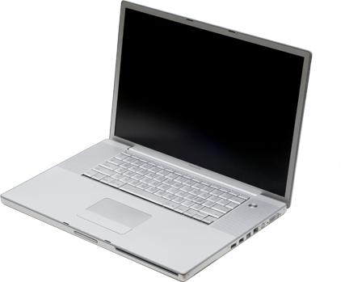

Connecting nodes to LANs
network
computer
?

Slide 19
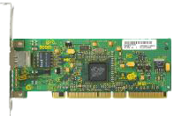
Connecting nodes to LANs
network
computer
Adapter
  expansion slot (PCI, PC Card, USB dongle)
  usually integrated onto main board
Network adapters are referred to as
Network Interface Cards (NICs) or adapters
or Network Interface Component

Slide 20
Media
Wires (or RF, IR) connecting together the devices that make up a LAN
Twisted pair
  Most common:
    STP: shielded twisted pair
    UTP: unshielded twisted pair
    (e.g. Telephone cable, Ethernet 10BaseT)
Coaxial cable
  Thin (similar to TV cable)
  Thick (e.g., 10Base5, ThickNet)
Fiber
Wireless

Slide 21
Hubs, routers, bridges
Hub
  Device that acts as a central point for LAN cables
  Take incoming data from one port & send to all other ports
Switch
  Moves data from input to output port.
  Analyzes packet to determine destination port and makes a virtual connection between the ports.
Concentrator or repeater
  Regenerates data passing through it
Bridge
  Connects two LANs or two segments of a LAN
  Connection at data link layer (layer 2)
Router
  Determines the next network point to which a packet should be forwarded
  Connects different types of local and wide area networks at network layer (layer 3)

Slide 22
Networking Topology
Bus Network

Slide 23
Networking Topology
Tree Network

Slide 24
Networking Topology
Star Network

Slide 25
Networking Topology
Ring Network

Slide 26
Networking Topology
Mesh Network

Slide 27
Transmission networks
Baseband
  All nodes share access to network media on an equal basis
  Data uses entire bandwidth of media
Broadband
  Data takes segment of media by dividing media into channels (frequency bands)

Slide 28
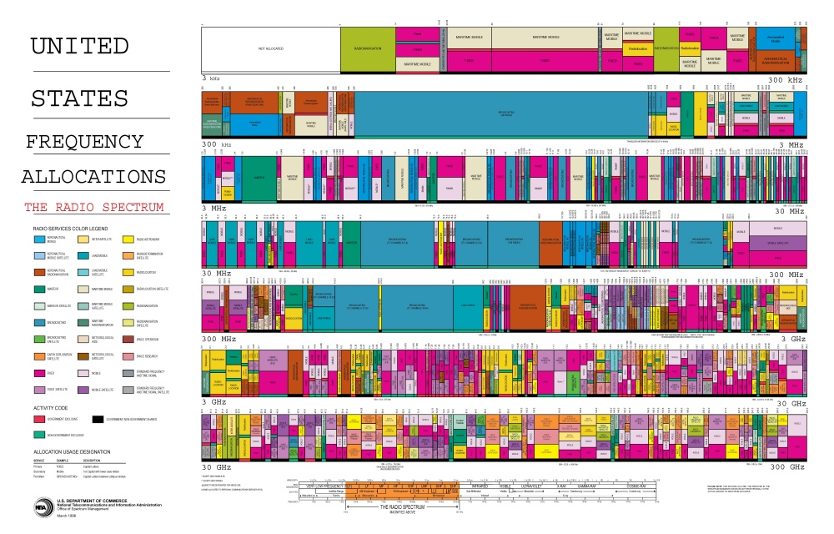
Broadband: RF broadcasts
http://www.ntia.doc.gov/osmhome/allochrt.pdf

Slide 29
Broadband/Baseband: Cable TV
Broadband
audio
+5.75 MHz
55-552 MHz: analog channels 2-78
553-865 MHz: digital channels 79-136
video
6 MHz
+1.25 MHz
Baseband within Broadband
DOCSIS: Data Over Cable Service Interface Specification (approved by ITU in 1998; DOCSIS 2.0 in 2001)
Downstream: 50-750 MHz range, 6 MHz bandwidth
- up to 38 Mbps
- received by all modems
Upstream: 5-42 MHz range
- 30.72 Mbps (10 Mbps in DOCSIS 1.0, 1.1)
- data delivered in timeslots (TDM)
DOCSIS 3.0 features channel bonding for greater bandwidth

Slide 30
DOCSIS Modem
tuner
demodulator
MAC
cable
modulator
network interface
CPU
ethernet interface
(to PC)
Restrictions on upload/download rates set by transferring a configuration file to the modem via TFTP when it connects to the provider.

Slide 31
Baseband: Ethernet
Standardized by IEEE as 802.3 standard
Speeds: 100 Mbps - 1 Gbps typical today
  Ethernet: 10 Mbps
  Fast Ethernet: 100 Mbps
  Gigabit Ethernet: 1 Gbps
  10 Gbps, 100 Gbps
Network access method is
Carrier Sense Multiple Access with Collision Detection (CSMA/CD)
  Node first listens to network to see if busy
  Send
  Sense if collision occurred
  Retransmit if collision

Slide 32
Ethernet media
Bus topology (original design)
  originally thick coax (max 500m): 10Base5
  then… thin coax (<200m): 10Base2
    BNC connector
Star topology (central hub or switch)
  8 pit RJ-45 connector, UTP cable, 100 meters range
  10BaseT for 10 Mbps
  100BaseT for 100 Mbps
  1000BaseT for 1 Gbps
  Cables
    CAT-5: unshielded twisted pair
    CAT-5e: designed for 1 Gbps
    CAT-6: 23 gauge conductor + separator for handling crosstalk better

Slide 33
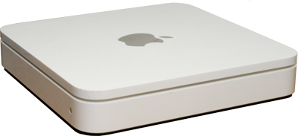
Wireless Ethernet media
Wireless (star topology)
  802.11 (1-2 Mbps)
  802.11b (11 Mbps - 4-5 Mbps realized)
  802.11a (54 Mbps - 22-28 Mbps realized)
  802.11g (54 Mbps - 32 Mbps realized)
  802.11n (108 Mbps - 30-47 Mbps realized)
ethernet
Access Point

Slide 34
Connecting to the Internet
DOCSIS modem via cable TV service
DSL router
  Ethernet converted to ATM data stream
  Up to 20 Mbps up to ~ 2 km.
  POTS limited to 300-3400 Hz
  DSL operates > 3500 Hz
Modem
  Data modulated over voice spectrum
  (300-3400 Hz)
  Serial interface to endpoint
  V.92: 48 kbps downstream, near 56 kbps up
  Use PPP or SLIP to bridge IP protocol

Slide 35
Connecting to the Internet
Dedicated T1 or T3 line
  T1 line: 1.544 Mbps
  (24 PCM TDMA speech lines @ 64 kbps)
  T3 line: 44.736 Mbps (672 channels)
  CSU/DSU at router presents serial interface
    Channel Service Unit / Data Service Unit
Phone
network
LAN
router
CSU/DSU
T1 line
RS-232C, RS-449, V.xx
serial line

Slide 36
Connecting to the Internet
Fiber to the Home, Fiber to the Curb
  Ethernet interface
  E.g., Verizon’s FiOS 30 Mbps to the home
Long Reach Ethernet (LRE)
  Ethernet performance up to 5,000 feet
Wireless:
  WiMax
  EDGE (70-135 Kbps)
  GPRS (<32 Kbps)

Slide 37
Clients and Servers
Send messages to applications
  not just machines
Client must get data to the desired process
  server process must get data back to client process
To offer a service, a server must get a transport address for a particular service
  well-defined location

Slide 38
Machine address
versus
Transport address

Slide 39
Transport provider
Layer of software that accepts a network message and sends it to a remote machine
Two categories:
  connection-oriented protocols
  connectionless protocols

Slide 40
Connection-oriented Protocols
establish connection
[negotiate protocol]
exchange data
terminate connection

Slide 41
Connection-oriented Protocols
analogous to phone call
establish connection
[negotiate protocol]
exchange data
terminate connection
dial phone number
[decide on a language]
speak
hang up
virtual circuit service
  provides illusion of having a dedicated circuit
  messages guaranteed to arrive in-order
  application does not have to address each message
vs. circuit-switched service

Slide 42
Connectionless Protocols
- no call setup
- send/receive data
  (each packet addressed)
- no termination

Slide 43
Connectionless Protocols
analogous to mailbox
- no call setup
- send/receive data
  (each packet addressed)
- no termination
drop letter in mailbox
  (each letter addressed)
datagram service
  client is not positive whether message arrived at destination
  no state has to be maintained at client or server
  cheaper but less reliable than virtual circuit service

Slide 44
Ethernet
Layers 1 & 2 of OSI model
  Physical (1)
    Cables: 10Base-T, 100Base-T, 1000Base-T, etc.
  Data Link (2)
    Ethernet bridging
    Data frame parsing
    Data frame transmission
    Error detection
Unreliable, connectionless communication

Slide 45
Ethernet
48-byte ethernet address
Variable-length packet
  1518-byte MTU
    18-byte header, 1500 bytes data
Jumbo packets for Gigabit ethernet
  9000-byte MTU
dest addr
src addr
frame
type
data (payload)
CRC
6 bytes
6 bytes
2
46-1500 bytes
4
18 bytes + data

Slide 46
IP – Internet Protocol
Born in 1969 as a research network of 4 machines
Funded by DoD’s ARPA
Goal:
build an efficient fault-tolerant network that could connect heterogeneous machines and link separately connected networks.

Slide 47
Internet Protocol
Connectionless protocol designed to handle the interconnection of a large number of local and wide-area networks that comprise the internet
IP can route from one physical network to another

Slide 48
IP Addressing
Each machine on an IP network is assigned a unique 32-bit number for each network interface:
  IP address, not machine address
A machine connected to several physical networks will have several IP addresses
  One for each network

Slide 49
IP Address space
32-bit addresses → >4 billion addresses!
Routers would need a table of 4 billion entries
Design routing tables so one entry can match multiple addresses
  hierarchy: addresses physically close will share a common prefix

Slide 50
IP Addressing: networks & hosts
cs.rutgers.edu
128.6.4.2
80 06 04 02
remus.rutgers.edu
128.6.13.3
80 06 0D 03
network #
host #
first 16 bits identify Rutgers
external routers need only one entry
  route 128.6.*.* to Rutgers

Slide 51
IP Addressing: networks & hosts
IP address
  network #: identifies network machine belongs to
  host #: identifies host on the network
use network number to route packet to correct network
use host number to identify specific machine

Slide 52
IP Addressing
Expectation:
  a few big networks and many small ones
  create different classes of networks
  use leading bits to identify network
class | leading bits | bits for net # | bits for host
A | 0 | 7 (128) | 24 (16M)
B | 10 | 14 (16K) | 16 (64K)
C | 110 | 21 (2M) | 8 (256)
  To allow additional networks within an organization:
  use high bits of host number for a
  “network within a network” – subnet

Slide 53
IP Addressing
IBM: 9.0.0.0 – 9.255.255.255
00001001 xxxxxxxx xxxxxxxx xxxxxxxxx
network #
8 bits
host #
24 bits
Subnet within IBM (internal routers only)
00001001 10101010 11 xxxxxx xxxxxxxxx
network #
18 bits
host #
14 bits

Slide 54
Running out of addresses
Huge growth
Wasteful allocation of networks
  Lots of unused addresses
Every machine connected to the internet needed a worldwide-unique IP address
Solutions: CIDR, NAT, IPv6

Slide 55
Classless Inter-Domain Routing (CIDR)
Replace class A, B, C addresses:
  Explicitly specify # of bits for network number
  rather than 8 (A), 16 (B), 24 (C) bits
Better match for organizational needs
  machine that needs 500 addresses:
  get a 23-bit network number (512 hosts) instead of a class B address (64K hosts)

Slide 56
Classless Inter-Domain Routing
How does a router determine # bits?
CIDR address specifies it:
32-bit-address/bits-for-network-prefix
  128.6.13.3/16
  /27 : 1/8 of a class C (32 hosts)
  /24 : class C
  /16 : class B
managing CIDR addresses & prefixes can be a pain

Slide 57
IP Special Addresses
All bits 0
  Valid only as source address
  “all addresses for this machine”
  Not valid over network
All host bits 1
  Valid only as destination
  Broadcast to network
All bits 1
  Broadcast to all directly connected networks
Leading bits 1110
  Class D network
127.0.0.0: reserved for local traffic
  127.0.0.1 usually assigned to loopback device

Slide 58
IPv6 vs. IPv4
IPv4
  4 byte (32 bit) addresses
IPv6:
  16-byte (128 bit) addresses
  3.6 x 10³⁸ possible addresses
  8 x 10²⁸ times more addresses than IPv4
  4-bit priority field
  Flow label (24-bits)

Slide 59

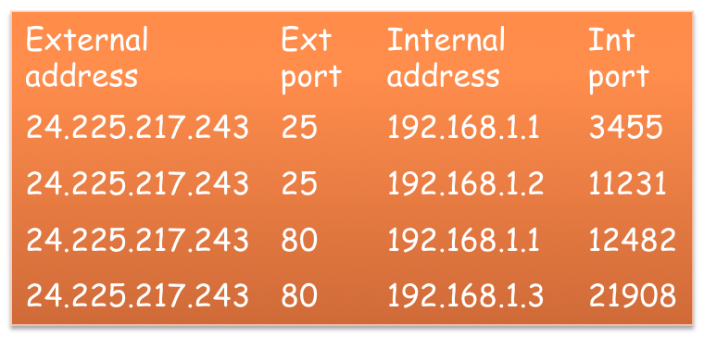
Network Address Translation (NAT)
External IP address
24.225.217.243
Internal
IP address
192.168.1.x
.1
.2
.3
.4
.5

Slide 60
Getting to the machine
IP is a logical network on top of multiple physical networks
OS support for IP: IP driver
receive data
send data
IP driver
receive packet
send packet
network driver
from wire
to wire

Slide 61
IP driver responsibilities
Get operating parameters from device driver
  Maximum packet size (MTU)
  Functions to initialize HW headers
  Length of HW header
Routing packets
  From one physical network to another
Fragmenting packets
Send operations from higher-layers
Receiving data from device driver
Dropping bad/expired data

Slide 62
Device driver responsibilities
Controls network interface card
  Comparable to character driver
Processes interrupts from network interface
  Receive packets
  Send them to IP driver
Get packets from IP driver
  Send them to hardware
  Ensure packet goes out without collision
bottom half
top half

Slide 63
Network device
Network card examines packets on wire
  Compares destination addresses
Before packet is sent, it must be enveloped for the physical network
device
header
IP header
IP data
payload

Slide 64
Device addressing
IP address → ethernet address
Address Resolution Protocol (ARP)
  Check local ARP cache
  Send broadcast message requesting ethernet address of machine with certain IP address
  Wait for response (with timeout)

Slide 65
Routing
Router
  Switching element that connects two or more transmission lines (e.g. Ethernet)
  Routes packets from one network to another
  (OSI layer 2)
  Special-purpose hardware or a general-purpose computer with two or more network interfaces

Slide 66
Routing
Packets take a series of hops to get to their destination
  Figure out the path
Generate/receive packet at machine
  check destination
    If destination = local address, deliver locally
  else
    Increment hop count (discard if hop # = TTL)
    Use destination address to search routing table
    Each entry has address and netmask. Match returns interface
    Transmit to destination interface
Static routing

Slide 67
Dynamic Routing
Class of protocols by which machines can adjust routing tables to benefit from load changes and failures
Route cost:
  Hop count (# routers in the path)
  Time: Tic count – time in 1/18 second intervals

Slide 68
Dynamic Routing Examples
RIP (Routing Information Protocol)
    Exchange routing tables with neighboring routers on internal networks
    Choose best route if multiple routes exist
OSPF (Open Shortest Path First)
    Tests status of link to each neighbor. Sends status info on link availability to neighbors.
    Cost can be assigned on reliability & time
BGP (Border Gateway Protocol)
    TCP connection between pair of machines
    Route selection based on distance vector
    Exchanges information about reachable networks
    Periodic keep-alive messages

Slide 69
Transport-layer protocols over IP
IP sends packets to machine
  No mechanism for identifying sending or receiving application
Transport layer uses a port number to identify the application
TCP – Transmission Control Protocol
UDP – User Datagram Protocol

Slide 70
TCP – Transmission Control Protocol
Virtual circuit service
(connection-oriented)
Send acknowledgement for each received packet
Checksum to validate data
Data may be transmitted simultaneously in both directions

Slide 71
UDP – User Datagram Protocol
Datagram service (connectionless)
Data may be lost
Data may arrive out of sequence
Checksum for data but no retransmission
  Bad packets dropped

Slide 72
IP header
device
header
IP header
TCP/UDP
header
IP data
payload
vers
hlen
svc type (TOS)
total length
fragment identification
flags
fragment offset
TTL
protocol
header checksum
20 bytes
source IP address
destination IP address
options and pad

Slide 73
Headers: TCP & UDP
device
header
IP header
TCP/UDP
header
IP data
payload
TCP header
UDP header
src port
dest port
src port
dest port
seq number
seg length
checksum
ack number
20 bytes
8 bytes
hdr
len
-
flags
window
checksum
urgent ptr
options and pad

Slide 74
Device header (Ethernet II)
device
header
IP header
TCP/UDP
header
IP data
payload
dest addr
src addr
frame
type
data
CRC
6 bytes
6 bytes
2
46-1500 bytes
4
18 bytes + data

Slide 75
Quality of Service Problems in IP
Too much traffic
  Congestion
Inefficient packet transmission
  59 bytes to send 1 byte in TCP/IP!
  20 bytes TCP + 20 bytes IP + 18 bytes ethernet
Unreliable delivery
  Software to the rescue – TCP/IP
Unpredictable packet delivery

Slide 76
IP Flow Detection
Flow detection in routers:
  Flow: set of packets from one address:port to another address:port with same protocol
  Network controls flow rate by dropping or delaying packets
  With flow detection:
    drop TCP packets over UDP
    Discard UDP flow to ensure QoS for other flows
With flow detection:
  Traffic Shaping
    Identify traffic flows
    Queue packets during surges and release later
    High-bandwidth link to low-bandwidth link
  Traffic Policing
    Discard traffic that exceeds allotted bandwidth

Slide 77
Dealing with congestion
FIFO queuing
Priority queues
Flow-based weighted fair queuing
  Group all packets from a flow together
Class-based weighted fair queuing
  Based on protocols, access control lists, interfaces, etc.
Custom queues

Slide 78
Inefficient Packets
Lots of tiny packets
  Head-of-line blocking
  Nagle’s algorithm:
    buffer new data if unacknowledged data outstanding
Header/packet compression
  Link-to-link
  Header compression (RFC 3843)
  Payload compression (RFC 2393)
  $ delivery vs. $ compression

Slide 79
Differentiated Services (soft QoS)
Some traffic is treated better than others
  Statistical - no guarantees
  TOS bits & Diff-Serv
Use on Internet is limited due to peering agreement complexities

Slide 80
TOS bits
Advisory tag in IP header for use by routers
TOS: Type Of Service, 4 bits
  Minimum Delay [0x10]
    FTP, telnet, ssh
  Maximum Throughput [0x08]
    ftp-data, www
  Maximum reliability [0x04]
    SNMP, DNS
  Minimum cost [0x02]
    NNTP, SMTP
RFC 1349, July, 1992

Slide 81
Differentiated Services (Diff-Serv)
Revision of interpretation of ToS bits
ToS field in IP header
  Differentiated Sevices Control Point (DSCP)
p
p
p
d
t
r
-
-
Reliability: normal/high
Priority: 0-7
Throughput: normal/high
Delay: normal/low
RFC 2475, December 1998

Slide 82
Guaranteed QoS (hard QoS)
Guarantee via end-to-end reservation

Slide 83
Reservation & Delivery Protocol
RSVP: ReSerVation Protocol
  Hosts request specific quality of service
  Routers reserve resources
  RFC 2205

Slide 84
Media Delivery Protocols
Real-Time Control Protocol (RTCP)
  Provides feedback on QoS (jitter, loss, delay)
  RFC 3550
RTP: Real-Time Transport Protocol
  Not a routing protocol
  No service guarantees
  Provides:
    Payload identification
    sequence #
    time stamp
RTP/RTCP do not provide QoS controls

Slide 85
ATM: Asynchronous Transfer Mode
Late 1980’s
Goal: Merge voice & data networking
low but constant
bandwidth
high but bursty
bandwidth

Slide 86
ATM
Traditional voice networking
  Circuit switching
    Too costly
    Poor use of resource
    Does not lend to multicasting
ATM
  Based on
  fixed-size packets over virtual circuits
  Fixed-size cells provide for
  predictive scheduling
  Large cells will not hold up smaller ones
  Rapid switching

Slide 87
ATM
Current standard:
  53-byte cell: 48-byte data, 5-byte header
Sender specifies traffic type upon connecting:
CBR | Constant bit-rate | bandwidth | Uncompressed video, voice
VBR | Variable bit-rate | Avg, peak bandwidth | Compressed video, voice
ABR | Available bit-rate | -none- | ftp, web access

Slide 88
ATM
Small cells → lots of interrupts
  >100,000/second
ATM hardware supports an
ATM Adaptation Layer (AAL)
  Converts cells to variable-sized (larger) packets:
  AAL 1: for CBR
  AAL 2: for VBR
  AAL 3/4: ABR data
  AAL 5: ABR data, simplified
  AAL 6: MPEG-2 video

Slide 89
Programming Interfaces

Slide 90
Sockets
IP lets us send data between machines
TCP & UDP are transport layer protocols
  Contain port number to identify transport endpoint (application)
One popular abstraction for transport layer connectivity: sockets
  Developed at Berkeley

Slide 91
Sockets
Attempt at generalized IPC model
Goals:
  communication between processes should not depend on whether they are on the same machine
  efficiency
  compatibility
  support different protocols and naming conventions

Slide 92
Socket
Abstract object from which messages are sent and received
  Looks like a file descriptor
  Application can select particular style of communication
    Virtual circuit, datagram, message-based, in-order delivery
  Unrelated processes should be able to locate communication endpoints
    Sockets should be named
    Name meaningful in the communications domain

Slide 93
Programming with sockets

Slide 94
Step 1
Create a socket
int s = socket(domain, type, protocol)
AF_INET
SOCK_STREAM
SOCK_DGRAM
useful if some families have more than one protocol to support a given service

Slide 95
Step 2
Name the socket (assign address, port)
int error = bind(s, addr, addrlen)
socket
Address structure struct sockaddr*
length of address structure

Slide 96
Step 3a (server)
Set socket to be able to accept connections
int error = listen(s, backlog)
socket
queue length for pending connections

Slide 97
Step 3b (server)
Wait for a connection from client
int snew = accept(s, clntaddr, &clntalen)
socket
pointer to address structure
length of address structure
new socket
for this session

Slide 98
Step 3 (client)
Connect to server
int error = connect(s, svraddr, svraddrlen)
socket
Address structure struct sockaddr*
length of address structure

Slide 99
Step 4
Exchange data
Connection-oriented
read/write
recv/send (extra flags)
Connectionless
sendto, sendmsg
recvfrom, recvmsg

Slide 100
Step 5
Close connection
shutdown(s, how)
how:
0: can send but not receive
1: cannot send more data
2: cannot send or receive (=0+1)

Slide 101
Sockets in Java
java.net package
Two major classes:
  Socket: client-side
  ServerSocket: server-side

Slide 102
Step 1a (server)
Create socket and name it
ServerSocket svc =
new ServerSocket(port)

Slide 103
Step 1b (server)
Wait for connection from client
Server req = svc.accept()
new socket for client session

Slide 104
Step 1 (client)
Create socket and name it
Socket s = new Socket(address, port);
obtained from:
getLocalHost, getByName,
or getAllByName
Socket s =
new Socket(“cs.rutgers.edu”, 2211);

Slide 105
Step 2
Exchange data
obtain InputStream/OutputStream from Socket object
BufferedReader in =
new BufferedReader(
new InputStreamReader(
s.getInputStream()));
PrintStream out =
new PrintStream(s.getOutputStream());

Slide 106
Step 3
Terminate connection
close streams, close socket
in.close();
out.close();
s.close();

Slide 107
Socket Internals

Slide 108
Protocol Control Block
Client only sends data to {machine, port}
How does the server keep track of simultaneous sessions to the same {machine, port}?
OS maintains a structure called the
Protocol Control Block (PCB)

Slide 109
Server: svr=socket()
Create entry in PCB table
Local addr | Local port | Foreign addr | Foreign port | L?
Client
Server
Local addr | Local port | Foreign addr | Foreign port | L?
svr

Slide 110
Server: bind(svr)
Assign local port and address to socket
bind(addr=0.0.0.0, port=1234)
Local addr | Local port | Foreign addr | Foreign port | L?
Client
Server
Local addr | Local port | Foreign addr | Foreign port | L?
0.0.0.0 | 1234
svr

Slide 111
Server: listen(svr, 10)
Set socket for listening
Local addr | Local port | Foreign addr | Foreign port | L?
Client
Server
Local addr | Local port | Foreign addr | Foreign port | L?
0.0.0.0 | 1234 |  |  | *
svr

Slide 112
Server: snew=accept(svr)
Block – wait for connection
Local addr | Local port | Foreign addr | Foreign port | L?
Client
Server
Local addr | Local port | Foreign addr | Foreign port | L?
0.0.0.0 | 1234 |  |  | *
svr

Slide 113
Client: s=socket()
Create PCB entry
Local addr | Local port | Foreign addr | Foreign port | L?
Client
s
Server
Local addr | Local port | Foreign addr | Foreign port | L?
0.0.0.0 | 1234 |  |  | *
svr

Slide 114
Client: s=bind(s)
Assign local port and address to socket
bind(addr=0.0.0.0, port=7801)
Local addr | Local port | Foreign addr | Foreign port | L?
0.0.0.0 | 7801
Client
s
Server
Local addr | Local port | Foreign addr | Foreign port | L?
0.0.0.0 | 1234 |  |  | *
svr

Slide 115
Client: connect(s)
Send connect request to server
[135.250.68.3:7801] to [192.11.35.15:1234]
Local addr | Local port | Foreign addr | Foreign port | L?
0.0.0.0 | 7801
Client
s
Server
Local addr | Local port | Foreign addr | Foreign port | L?
0.0.0.0 | 1234 |  |  | *
192.11.35.15 | 1234 | 135.250.68.3 | 7801
svr
snew

Slide 116
Client: connect(s)
Server responds with acknowledgement
[192.11.35.15:1234] to [135.250.68.3 :7801]
Local addr | Local port | Foreign addr | Foreign port | L?
0.0.0.0 | 7801 | 192.11.35.15 | 1234
Client
s
Server
Local addr | Local port | Foreign addr | Foreign port | L?
0.0.0.0 | 1234 |  |  | *
192.11.35.15 | 1234 | 135.250.68.3 | 7801
svr
snew

Slide 117
Communication
Each message from client is tagged as either data or control (e.g. connect)
If data – search through table where FA and FP match incoming message and listen=false
If control – search through table where listen=true
Server
Local addr | Local port | Foreign addr | Foreign port | L?
0.0.0.0 | 1234 |  |  | *
192.11.35.15 | 1234 | 135.250.68.3 | 7801
svr
snew

Slide 118
The end.

