Slide 1
Distributed Systems
Clock Synchronization:
Physical Clocks
Paul Krzyzanowski
pxk@cs.rutgers.edu
ds@pk.org
Except as otherwise noted, the content of this presentation is licensed under the Creative Commons Attribution 2.5 License.

Slide 2
What’s it for?
Temporal ordering of events produced by concurrent processes
Synchronization between senders and receivers of messages
Coordination of joint activity
Serialization of concurrent access for shared objects

Slide 3
Physical clocks

Slide 4
Logical vs. physical clocks
Logical clock keeps track of event ordering
  among related (causal) events
Physical clocks keep time of day
  Consistent across systems

Slide 5
Quartz clocks
1880: Piezoelectric effect
  Curie brothers
  Squeeze a quartz crystal & it generates an electric field
  Apply an electric field and it bends
1929: Quartz crystal clock
  Resonator shaped like tuning fork
  Laser-trimmed to vibrate at 32,768 Hz
  Standard resonators accurate to 6 parts per million at 31° C
  Watch will gain/lose < ½ sec/day
  Stability > accuracy: stable to 2 sec/month
  Good resonator can have accuracy of 1 second in 10 years
    Frequency changes with age, temperature, and acceleration

Slide 6
Atomic clocks
Second is defined as 9,192,631,770 periods of radiation corresponding to the transition between two hyperfine levels of cesium-133
Accuracy:
better than 1 second in six million years
NIST standard since 1960

Slide 7
UTC
UT0
  Mean solar time on Greenwich meridian
  Obtained from astronomical observation
UT1
  UT0 corrected for polar motion
UT2
  UT1 corrected for seasonal variations in Earth’s rotation
UTC
  Civil time measured on an atomic time scale

Slide 8
UTC
Coordinated Universal Time
Temps Universel Coordonné
  Kept within 0.9 seconds of UT1
  Atomic clocks cannot keep mean time
    Mean time is a measure of Earth’s rotation

Slide 9
Physical clocks in computers
Real-time Clock: CMOS clock (counter) circuit driven by a quartz oscillator
  battery backup to continue measuring time when power is off
OS generally programs a timer circuit to generate an interrupt periodically
  e.g., 60, 100, 250, 1000 interrupts per second
  (Linux 2.6+ adjustable up to 1000 Hz)
  Programmable Interval Timer (PIT) – Intel 8253, 8254
  Interrupt service procedure adds 1 to a counter in memory

Slide 10
Problem
Getting two systems to agree on time
  Two clocks hardly ever agree
  Quartz oscillators oscillate at slightly different frequencies
Clocks tick at different rates
  Create ever-widening gap in perceived time
  Clock Drift
Difference between two clocks at one point in time
  Clock Skew

Slide 11
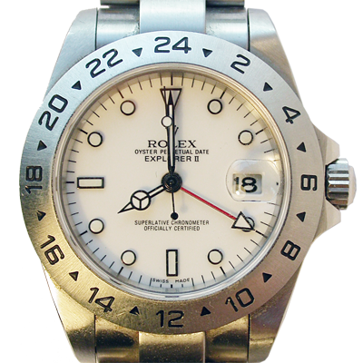
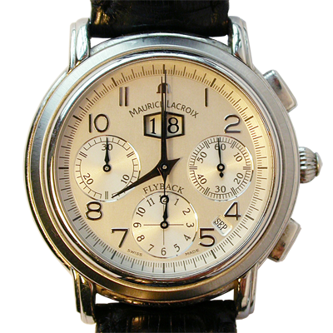
8:00:00
8:00:00
Sept 18, 2006
8:00:00

Slide 12
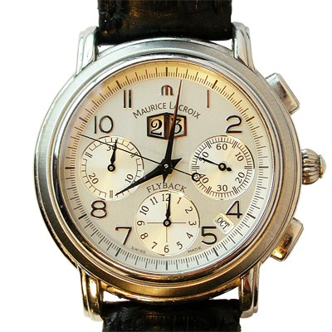
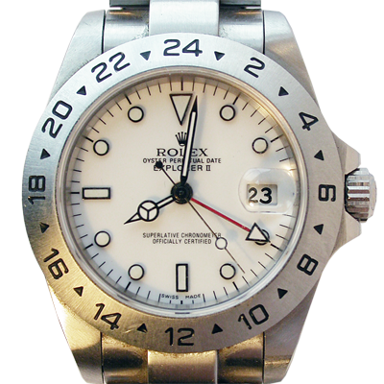
8:01:24
8:01:48
Skew = +84 seconds
+84 seconds/35 days
Drift = +2.4 sec/day
Oct 23, 2006
8:00:00
Skew = +108 seconds
+108 seconds/35 days
Drift = +3.1 sec/day

Slide 13
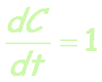
Perfect clock
Computer’s time, C
UTC time, t

Slide 14
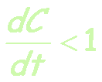
Drift with slow clock
skew
Computer’s time, C
UTC time, t

Slide 15

Drift with fast clock
skew
Computer’s time, C
UTC time, t

Slide 16
Dealing with drift
Assume we set computer to true time
Not good idea to set clock back
  Illusion of time moving backwards can confuse message ordering and software development environments

Slide 17
Dealing with drift
Go for gradual clock correction
  If fast:
    Make clock run slower until it synchronizes
  If slow:
    Make clock run faster until it synchronizes

Slide 18
Dealing with drift
OS can do this:
  Change rate at which it requests interrupts
  e.g.:
  if system requests interrupts every
  17 msec but clock is too slow:
  request interrupts at (e.g.) 15 msec
  Or software correction: redefine the interval
Adjustment changes slope of system time:
  Linear compensating function

Slide 19
Compensating for a fast clock
Clock synchronized
skew
Computer’s time, C
Linear compensating
function applied
UTC time, t

Slide 20
Compensating for a fast clock
Computer’s time, C
UTC time, t

Slide 21
Resynchronizing
After synchronization period is reached
  Resynchronize periodically
  Successive application of a second linear compensating function can bring us closer to true slope
Keep track of adjustments and apply continuously
  e.g., UNIX adjtime system call

Slide 22
Getting accurate time
Attach GPS receiver to each computer
  ± 1 msec of UTC
Attach WWV radio receiver
  Obtain time broadcasts from Boulder or DC
  ± 3 msec of UTC (depending on distance)
Attach GOES receiver
  ± 0.1 msec of UTC
Not practical solution for every machine
  Cost, size, convenience, environment

Slide 23
Getting accurate time
Synchronize from another machine
  One with a more accurate clock
Machine/service that provides time information:
Time server

Slide 24
RPC
Simplest synchronization technique
  Issue RPC to obtain time
  Set time
client
what’s the time?
server
3:42:19
Does not account for network or processing latency

Slide 25
Cristian’s algorithm
Compensate for delays
  Note times:
    request sent: T₀
    reply received: T₁
  Assume network delays are symmetric
T_{server}
server
request
reply
client
T₀
T₁
time

Slide 26

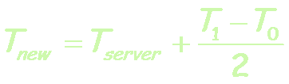
Cristian’s algorithm
Client sets time to:
T_{server}
server
request
reply
client
T₀
T₁
time
= estimated overhead
in each direction

Slide 27
Error bounds
If minimum message transit time (T_{min}) is known:
Place bounds on accuracy of result

Slide 28

Error bounds
T_{server}
server
request
reply
client
T₀
T₁
time
T_{min}
T_{min}
Earliest time message arrives
Latest time message leaves
range = T₁-T₀-2T_{min}
accuracy of result =

Slide 29
Cristian’s algorithm: example
Send request at 5:08:15.100 (T₀)
Receive response at 5:08:15.900 (T₁)
  Response contains 5:09:25.300 (T_{server})
Elapsed time is T₁ -T₀
  5:08:15.900 - 5:08:15.100 = 800 msec
Best guess: timestamp was generated
  400 msec ago
Set time to T_{server}+ elapsed time
  5:09:25.300 + 400 = 5:09.25.700

Slide 30

Cristian’s algorithm: example
If best-case message time=200 msec
T₀ = 5:08:15.100
T₁ = 5:08:15.900
T_{s} = 5:09:25:300
T_{min} = 200msec
T_{server}
server
request
reply
client
T₀
T₁
time
200
200
800
Error =

Slide 31
Berkeley Algorithm
Gusella & Zatti, 1989
Assumes no machine has an accurate time source
Obtains average from participating computers
Synchronizes all clocks to average

Slide 32
Berkeley Algorithm
Machines run time dæmon
  Process that implements protocol
One machine is elected (or designated) as the server (master)
  Others are slaves

Slide 33
Berkeley Algorithm
Master polls each machine periodically
  Ask each machine for time
    Can use Cristian’s algorithm to compensate for network latency
When results are in, compute average
  Including master’s time
Hope: average cancels out individual clock’s tendencies to run fast or slow
Send offset by which each clock needs adjustment to each slave
  Avoids problems with network delays if we send a time stamp

Slide 34
Berkeley Algorithm
Algorithm has provisions for ignoring readings from clocks whose skew is too great
  Compute a fault-tolerant average
If master fails
  Any slave can take over

Slide 35
Berkeley Algorithm: example
3:00
3:25
2:50
9:10
3:25
2:50
9:10
1. Request timestamps from all slaves

Slide 36
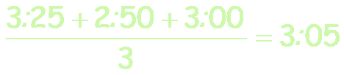
Berkeley Algorithm: example
3:00
3:25
2:50
9:10
3:25
2:50
9:10
2. Compute fault-tolerant average:

Slide 37
Berkeley Algorithm: example
+0.15
3:00
-0:20
-6:05
+0:15
3:25
2:50
9:10
3. Send offset to each client

Slide 38
Network Time Protocol, NTP
1991, 1992
Internet Standard, version 3: RFC 1305

Slide 39
NTP Goals
Enable clients across Internet to be accurately synchronized to UTC despite message delays
  Use statistical techniques to filter data and gauge quality of results
Provide reliable service
  Survive lengthy losses of connectivity
  Redundant paths
  Redundant servers
Enable clients to synchronize frequently
  offset effects of clock drift
Provide protection against interference
  Authenticate source of data

Slide 40
NTP servers
Arranged in strata
  1st stratum: machines connected directly to accurate time source
  2nd stratum: machines synchronized from 1st stratum machines
  …
1
2
3
4
SYNCHRONIZATION SUBNET

Slide 41
NTP Synchronization Modes
Multicast mode
  for high speed LANS
  Lower accuracy but efficient
Procedure call mode
  Similar to Cristian’s algorithm
Symmetric mode
  Intended for master servers
  Pair of servers exchange messages and retain data to improve synchronization over time
All messages delivered unreliably with UDP

Slide 42
NTP messages
Procedure call and symmetric mode
  Messages exchanged in pairs
NTP calculates:
  Offset for each pair of messages
    Estimate of offset between two clocks
  Delay
    Transmit time between two messages
  Filter Dispersion
    Estimate of error – quality of results
    Based on accuracy of server’s clock and consistency of network transit time
Use this data to find preferred server:
  lower stratum & lowest total dispersion

Slide 43
NTP message structure
Leap second indicator
  Last minute has 59, 60, 61 seconds
Version number
Mode (symmetric, unicast, broadcast)
Stratum (1=primary reference, 2-15)
Poll interval
  Maximum interval between 2 successive messages, nearest power of 2
Precision of local clock
  Nearest power of 2

Slide 44
NTP message structure
Root delay
  Total roundtrip delay to primary source
  (16 bits seconds, 16 bits decimal)
Root dispersion
  Nominal error relative to primary source
Reference clock ID
  Atomic, NIST dial-up, radio, LORAN-C navigation system, GOES, GPS, …
Reference timestamp
  Time at which clock was last set (64 bit)
Authenticator (key ID, digest)
  Signature (ignored in SNTP)

Slide 45
NTP message structure
T₁: originate timestamp
  Time request departed client (client’s time)
T₂: receive timestamp
  Time request arrived at server (server’s time)
T₃: transmit timestamp
  Time request left server (server’s time)

Slide 46
NTP’s validation tests
Timestamp provided ≠ last timestamp received
  duplicate message?
Originating timestamp in message consistent with sent data
  Messages arriving in order?
Timestamp within range?
Originating and received timestamps ≠ 0?
Authentication disabled? Else authenticate
Peer clock is synchronized?
Don’t sync with clock of higher stratum #
Reasonable data for delay & dispersion

Slide 47
SNTP
Simple Network Time Protocol
  Based on Unicast mode of NTP
  Subset of NTP, not new protocol
  Operates in multicast or procedure call mode
  Recommended for environments where server is root node and client is leaf of synchronization subnet
  Root delay, root dispersion, reference timestamp ignored
RFC 2030, October 1996

Slide 48

SNTP
T₂
T₃
server
request
reply
client
T₁
T₄
time
Roundtrip delay:
  d = (T₄-T₁) - (T₂-T₃)
Time offset:

Slide 49
SNTP example
T₂=800
T₃=850
server
request
reply
time
client
T₁=1100
T₄=1200
Offset =
  ((800 - 1100) + (850 - 1200))/2
  =((-300) + (-350))/2
  = -650/2 = -325
Set time to T₄ + t
= 1200 - 325 = 875
Time offset:

Slide 50
Cristian’s algorithm
T₂=800
T₃=850
server
request
T_{s}=825
reply
time
client
T₁=1100
T₄=1200
Offset = (1200 - 1100)/2 = 50
Set time to T_{s} + offset
= 825 + 50 = 875

Slide 51
Key Points: Physical Clocks
Cristian’s algorithm & SNTP
  Set clock from server
  But account for network delays
  Error: uncertainty due to network/processor latency: errors are additive
  ±10 msec and ±20 msec = ±30 msec.
Adjust for local clock skew
  Linear compensating function

Slide 52
The end.

