Slide 1
Distributed Systems
Smart Cards, Biometrics, & CAPTCHA
Paul Krzyzanowski
pxk@cs.rutgers.edu
ds@pk.org
Except as otherwise noted, the content of this presentation is licensed under the Creative Commons Attribution 2.5 License.

Slide 2
Carrying certificates around
How do you use your [digital] identity?
  Install your certificate in browser
  On-computer keychain file
Need there be more?

Slide 3
Smart cards
Smart card
  Portable device
    credit card, , key fob, button with IC on it
Communication
  Contact-based
  Contactless
    Near Field Communication (NFC)
    Communication within a few inches of reader
    May draw power from reader’s EMF signal
    106-424 kbps
  Hybrid: contact and contactless

Slide 4
Smart cards
Capabilities
  Memory cards
    Magnetic stripe: stores 125 bytes
    Smart cards typically store 32-64 KB
    Optional security for data access
  Microcontroller cards
    OS + programs + cryptographic hardware + memory

Slide 5
Smart card advantages
Security
  on-board encryption, hashing, signing
  data can be securely transferred
  Store biometric data & verify against user
  key store
    store public keys (your certificates)
    do not divulge private keys
    perform digital signatures on card
Convenience
  more data can be carried on the card
Personalization
  e.g. GSM phone card

Slide 6
Smart card applications
Stored-value cards (electronic purses)
  Developed for small-value transactions
  Mid 1990s in Europe and Asia
GSM phone SIM card
Credit/Debit
  Stored account numbers, one-time numbers
  EMV System (Europay, MasterCard, VISA)
Passports
  Encoded biometric information, account numbers
Toll collection & telephone cards
  Account number (EZ-Pass) or stored value (mass transit)
Cryptographic smart cards
  Authentication: pin-protected signing with private key

Slide 7
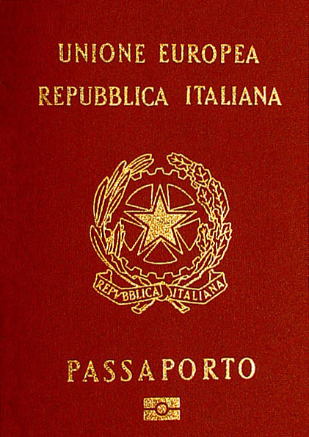
Example: Passport
Contactless communication
Stores:
  Descriptive data
  Digitized facial image
  Fingerprints, iris scan, etc. optional
  Certificate of document signer & personal
  public key
Basic Access Control (BAC)
  Negotiate session key using:
  passport #, date of birth, expiration date
  This data is read optically – so you need physical access
  Generates 3DESS “document basic access keys”
    Fixed for life
  German proposal to use Diffie-Hellman key negotiation
Public domain passport image from http://en.wikipedia.org/wiki/Image:Passaportoitaliano2006.jpg

Slide 8
Example: Octopus
Stored value card - contactless
  Provision for automatic replenishment
  Asynchronous transaction recording to banks
  Two-way authentication based on public keys
    All communications is encrypted
Widely used in Hong Kong & Shenzen
  Buses, stores, supermarkets, fast food, parking
  Logs $10.8 million per day on more than 50,000 readers
Available in:
  Cards, fobs, watches, toys

Slide 9
Biometric authentication

Slide 10
Biometrics
Statistical pattern recognition
  Thresholds
Each biometric system has a characteristic ROC plot
  (receiver operator curve, a legacy from radio electronics)
secure
false rejects
(false non-match)
trade-off
convenient
false accepts
(false match)

Slide 11
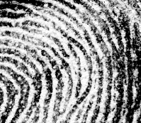


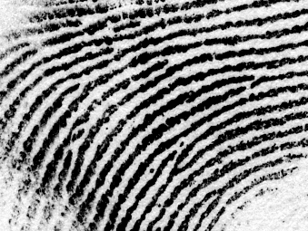


Biometrics: forms
Fingerprints
  identify minutia
Enclosure
Ridge ending
Island
Bifurcation

Slide 12
Biometrics: forms
Iris
  Analyze pattern of spokes: excellent uniqueness,
  signal can be normalized for fast matching
Retina scan
  Excellent uniqueness but not popular for non-criminals
Fingerprint
  Reasonable uniqueness
Hand geometry
  Low guarantee of uniqueness: generally need 1:1 match
Signature, Voice
  Behavioral vs. physical system
  Can change with demeanor, tend to have low recognition rates
Facial geometry

Slide 13
Biometrics: desirable characteristics
Robustness
  Repeatable, not subject to large changes
Distinctive
  Wide differences in the pattern among population
Fingerprints: highly distinctive, not very robust
Fingerprints: typically 40-50 distinct features
Irises: typically >250 distinct features
Hand geometry: highly robust, not very distinctive
(~1 in 100 people might have a hand with measurements close to yours)

Slide 14
Irises vs. Fingerprints
Number of features measured:
  High-end fingerprint systems: ~40-60 features
  Iris systems: ~240 features
Ease of data capture
  More difficult to damage an iris
  Feature capture more difficult for fingerprints:
    Smudges, gloves, dryness, …

Slide 15
Irises vs. Fingerprints
False accept rates
  Fingerprints: ~ 1:100,000 (varies by vendor)
  Irises: ~ 1:1.2 million
Ease of searching
  Fingerprints cannot be normalized
  1:many searches are difficult
  Irises can be normalized to generate a unique IrisCode
  1:many searches much faster

Slide 16
Biometrics: desirable characteristics
Cooperative systems (multi-factor)
  User provides identity, such as name and/or PIN
Non-cooperative
  Users cannot be relied on to identify themselves
  Need to search large portion of database
Overt vs. covert identification
Habituated vs. non-habituated
  Do users regularly use (train) the system

Slide 17
Biometric: authentication process
1. Sensing
  User’s characteristic must be presented to a sensor
  Output is a function of:
    Biometric measure
    The way it is presented
    Technical characteristics of sensor
2. Signal Processing
  Feature extraction
  Extract the desired biometric pattern
    remove noise and signal losses
    discard qualities that are not distinctive/repeatable
    Determine if feature is of “good quality”

Slide 18
Biometric: authentication process
3. Pattern matching
  Sample compared to original signal in database
  Closely matched patterns have “small distances” between them
  Distances will hardly ever be 0 (perfect match)
4. Decisions
  Decide if the match is close enough
  Trade-off:
  ↓ false non-matches leads to ↑false matches

Slide 19
Detecting Humanness

Slide 20
Gestalt Psychology (1922-1923)
Max Wertheimer, Kurt Koffka
Laws of organization
  Proximity
    We tend to group things together that are close together in space
  Similarity
    We tend to group things together that are similar
  Good Continuation
    We tend to perceive things in good form
  Closure
    We tend to make our experience as complete as possible
  Figure and Ground
    We tend to organize our perceptions by distinguishing between a figure and a background
Source: http://www.webrenovators.com/psych/GestaltPsychology.htm

Slide 21

Gestalt Psychology
18 x 22 pixels

Slide 22
Gestalt Psychology

Slide 23
Gestalt Psychology
HELLO

Slide 24
Authenticating humanness
Battle the Bots
  Create a test that is easy for humans but extremely difficult for computers
CAPTCHA
  Completely Automated Public Turing test to tell Computers and Humans Apart
  Image Degradation
    Exploit our limits in OCR technology
    Leverages human Gestalt psychology: reconstruction
  2000: Yahoo! and Manuel Blum & team at CMU
    EZ-Gimpy: one of 850 words
  Henry Baird @ CMU & Monica Chew at UCB
    BaffleText: generates a few words + random non-English words
Source: http://www.sciam.com/print_version.cfm?articleID=00053EA7-B6E8-1F80-B57583414B7F0103
http://tinyurl.com/dg2zf

Slide 25
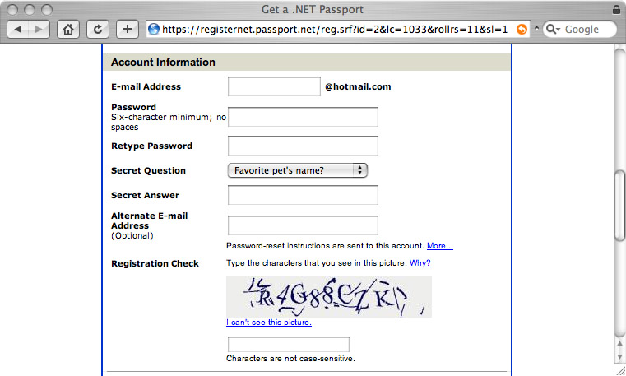

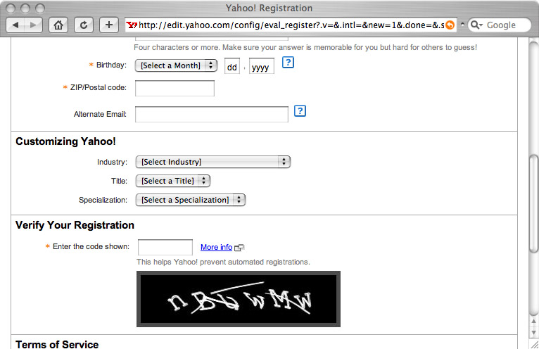

CAPTCHA Examples
Hotmail
Yahoo
See captchas.net

Slide 26
The end.

