Slide 1
Distributed Systems
Steganography
Paul Krzyzanowski
pxk@cs.rutgers.edu
ds@pk.org
Except as otherwise noted, the content of this presentation is licensed under the Creative Commons Attribution 2.5 License.

Slide 2
cryptography
κρυπό ς
γραφία
hidden
writing
A secret manner of writing, … Generally, the art of writing or solving ciphers.
— Oxford English Dictionary

Slide 3
cryptology
κρυπός
λογια
hidden
speaking
1967 D. Kahn, Codebreakers p. xvi, Cryptology is the science that embraces cryptography and cryptanalysis, but the term ‘cryptology’ sometimes loosely designates the entire dual field of both rendering signals secure and extracting information from them.
— Oxford English Dictionary

Slide 4
steganography
στεγανός
γραφία
covered
writing
The art of secret (hidden) writing

Slide 5
Steganography
Art and science of communicating in a way that hides the existence of a message
signal or pattern imposed on content
  persistent under transmission
  not encryption
    original image/file is intact
  not fingerprinting
    fingerprinting leaves separate file describing contents

Slide 6
Classic techniques
Invisible ink (1st century AD - WW II)
Tatoo message on head
Overwrite select characters in printed type in pencil
  look for the gloss
Pin punctures in type
Microdots (WW II)
Newspaper clippings, knitting instructions, XOXO signatures, report cards, …

Slide 7
Motivation
Steganography received little attention in computing
Renewed interest because of industry desire to protect copyrighted digital work
  audio
  images
  video
  Text
Detect counterfeiter, unauthorized presentation, embed key, embed author ID
Steganography ≠ Copy protection

Slide 8
Null Cipher
Hide message among irrelevant data
Confuse the cryptoanalyst

Slide 9
Null Cipher
Hide message among irrelevant data
Confuse the cryptoanalyst
Big rumble in New Guinea.
The war on
celebrity acts should end soon.
Over four
big ecstatic elephants replicated.

Slide 10
Null Cipher
Hide message among irrelevant data
Confuse the cryptoanalyst
Big rumble in New Guinea.
The war on
celebrity acts should end soon.
Over four
big ecstatic elephants replicated.
Bring two cases of beer.

Slide 11
BBC News 27 April 2006
Judge creates own Da Vinci code
The judge who presided over the failed Da Vinci Code plagiarism case at London's High Court hid his own secret code in his written judgement.
Seemingly random italicised letters were included in the 71-page judgement given by Mr Justice Peter Smith, which apparently spell out a message.
Mr Justice Smith said he would confirm the code if someone broke it.
"I can't discuss the judgement, but I don't see why a judgement should not be a matter of fun," he said.
Italicised letters in the first few pages spell out "Smithy Code", while the following pages also contain marked out letters.
http://news.bbc.co.uk/go/pr/fr/-/1/hi/entertainment/4949488.stm

Slide 12
Chaffing & Winnowing
Separate good messages from the bad ones
Stream of unencoded messages with signatures
  Some signatures are bogus
  Need key to test
Alice
Bob
M₃
M₂
M₁
M₀
M₃
M₂
M₁
M₀
Irene
×
OK
×
×
M₃
M₂
M₁
M₀
?
?
?
?

Slide 13
Image watermarking
Spatial domain watermarking
  bit flipping
  color separation
Frequency domain watermarking
  embed signal in select frequency bands (e.g. high frequency areas)
  apply FFT/DCT transform first
  e.g. Digimarc
  watermark should alter the least perceptible bits
    these are the same bits targeted by lossy image compression software

Slide 14
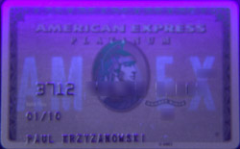
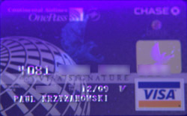
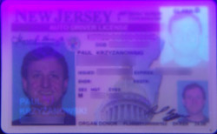

UV Watermarking

Slide 15

Machine ID codes in laser printers
See http://www.eff.org/Privacy/printers/

Slide 16

Machine ID codes in laser printers

Slide 17
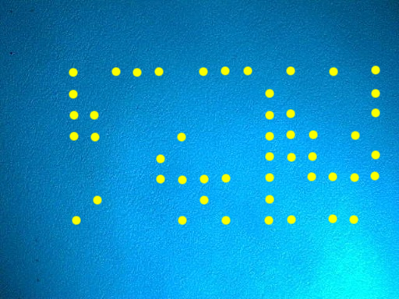
Machine ID codes in laser printers

Slide 18
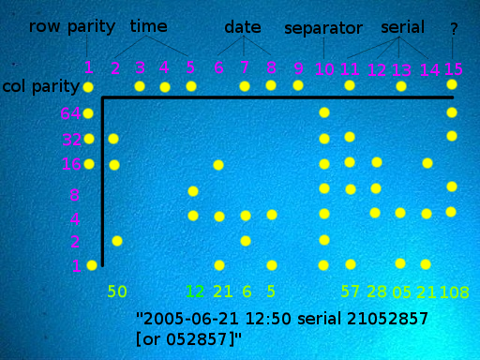
Machine ID codes in laser printers

Slide 19

Text
Text lines shifted up/down (40 lines text ⇒ 2⁴⁰ codes)
word space coding
character encoding - minor changes to shapes of characters

Slide 20

Text
Text lines shifted up/down (40 lines text ⇒ 2⁴⁰ codes)
word space coding
character encoding - minor changes to shapes of characters
works only on “images” of text e.g., PDF, postscript

Slide 21
Audio
Perceptual coding
  inject signal into areas that will not be detected by humans
  may be obliterated by compression
Hardware with copy-protection
  not true watermarking - metadata present on media
  DAT
  minidisc
  presence of copy protection mechanisms often failed to give the media wide-spread acceptance

Slide 22
Video
Coding still frames - spatial or frequency
data encoded during refresh
  closed captioning
visible watermarking
  used by most networks (logo at bottom-right)

Slide 23
Watermarking vs. Steganography
Goal of steganography
  Intruder cannot detect a message
  Primarily 1:1 communication
Goal of watermarking
  Intruder cannot remove or replace the message
  Primarily 1:many communication

Slide 24
The end.

