Slide 1
Distributed Systems
Protection & Security
Paul Krzyzanowski
pxk@cs.rutgers.edu
ds@pk.org
Except as otherwise noted, the content of this presentation is licensed under the Creative Commons Attribution 2.5 License.

Slide 2
You need to get into a vault
Try all combinations.
Try a subset of combinations.
Exploit weaknesses in the lock’s design.
Open the door (drilling, torch, …).
Back-door access: walls, ceiling, floor.
Observe someone else opening
- note the combination.
Notes:
Open the lock by trying all combinations. Most vault lock dials are divided into 100 graduations with 3-4 dialed numbers in the combination. This means there are 1 million or 100 million combinations. But gradations ｭ mechanical positions. In reality, we might have 51,200 or 242,406 combinations with a three-wheel lock.
Try a subset of all combinations - assume people will use "good" combinations, not 20-20-20, for example.
Exploit weaknesses in the design of the lock. Listen for proper positioning of the wheel gates under the fence.
Open the door (drilling, torch). Avoid triggering relock devices.
Access via a "back door" (side walls, ceiling, and floor may not be as secure).
Observe someone opening the vault and note the combination.6a. Pretend you're from the vault company and ask someone to open the door.
Find a combination lying around and use it.
Steal a computer or file folder that might have the combination.
Look through the trash to see if you can find the combination in some discarded papers.
Ask someone for a combination. You might need to impersonate as a bank official or the vault company or the FDIC ...
What can the bank do?
Install a better lock. (What if yours is good? What if the lock isn't the problem?)
Secure physical access to the vault. (Position guards.) You can still get accessﾊ the vault through social engineering.

Slide 3
You need to get into a vault
Ask someone for the combination.
  Convince them that they should give it.
  Force it (gunpoint/threat).
Convince someone to let you in
Find a combination lying around
Steal a computer or file folder that has the combination.
Look through the trash
Notes:
Open the lock by trying all combinations. Most vault lock dials are divided into 100 graduations with 3-4 dialed numbers in the combination. This means there are 1 million or 100 million combinations. But gradations ｭ mechanical positions. In reality, we might have 51,200 or 242,406 combinations with a three-wheel lock.
Try a subset of all combinations - assume people will use "good" combinations, not 20-20-20, for example.
Exploit weaknesses in the design of the lock. Listen for proper positioning of the wheel gates under the fence.
Open the door (drilling, torch). Avoid triggering relock devices.
Access via a "back door" (side walls, ceiling, and floor may not be as secure).
Observe someone opening the vault and note the combination.6a. Pretend you're from the vault company and ask someone to open the door.
Find a combination lying around and use it.
Steal a computer or file folder that might have the combination.
Look through the trash to see if you can find the combination in some discarded papers.
Ask someone for a combination. You might need to impersonate as a bank official or the vault company or the FDIC ...
What can the bank do?
Install a better lock. (What if yours is good? What if the lock isn't the problem?)
Secure physical access to the vault. (Position guards.) You can still get accessﾊ the vault through social engineering.

Slide 4
What can the bank do?
Install a better lock
  What if theirs is already good?
Restrict physical access to the vault (guards)
  You can still use some methods
Make the contents of the vault less appealing
  Store extra cash, valuables off-site
  This just shifts the problem
Impose strict policies on whom to trust
Impose strict policies on how the combination is stored
  Policies can be broken

Slide 5
Firewalls and
System Protection

Slide 6
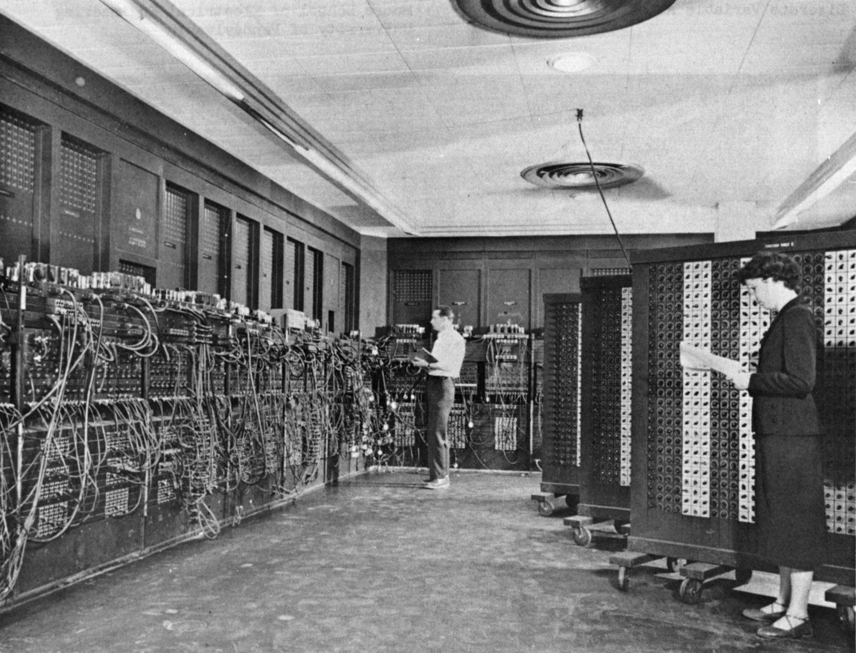
Computer security… then
Issue from the dawn of computing:
Colossus at Bletchley Park: breaking codes
ENIAC at Moore School: ballistic firing tables
single-user, single-process systems
data security needed
physical security
Public domain image from http://en.wikipedia.org/wiki/Image:Eniac.jpg

Slide 7
Computer security… now
Sensitive data of different users lives on the same file servers
Multiple processes on same machine
Authentication and transactions over network
  open for snooping
We might want to run other people’s code in our process space
  Device drivers, media managers
  Java applets, games
  not just from trusted organizations

Slide 8
Systems are easier to attack
Automation
  Data gathering
  Mass mailings
Distance
  Attack from your own home
Sharing techniques
  Virus kits
  Hacking tools

Slide 9
Attacks
Fraud
Destructive
Intellectual Property Theft
Identity Theft
Brand Theft
  VISA condoms
  1-800-COLLECT, 1-800-C0LLECT
  1-800-OPERATOR, 1-800-OPERATER
Surveillance
Traffic Analysis
Publicity
Denial of Service

Slide 10
Cryptographic attacks
Ciphertext-only attack
  Recover plaintext given ciphertext
  Almost never occurs: too difficult
  Brute force
  Exploit weaknesses in algorithms or in passwords
Known plaintext attack
  Analyst has copy of plaintext & ciphertext
  E.g., Norway saying “Nothing to report”
Chosen plaintext attack
  Analyst chooses message that gets encrypted
    E.g., start military activity in town with obscure name

Slide 11
Protocol attacks
Eavesdropping
Active attacks
  Insert, delete, change messages
Man-in-the-middle attack
  Eavesdropper intercepts
Malicious host

Slide 12
Penetration
Guess a password
  system defaults, brute force,
  dictionary attack
Crack a password
  Online vs offline
  Precomputed hashes (see rainbow tables)
    Defense: Salt

Slide 13
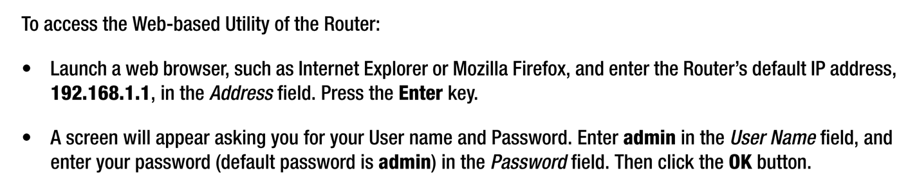
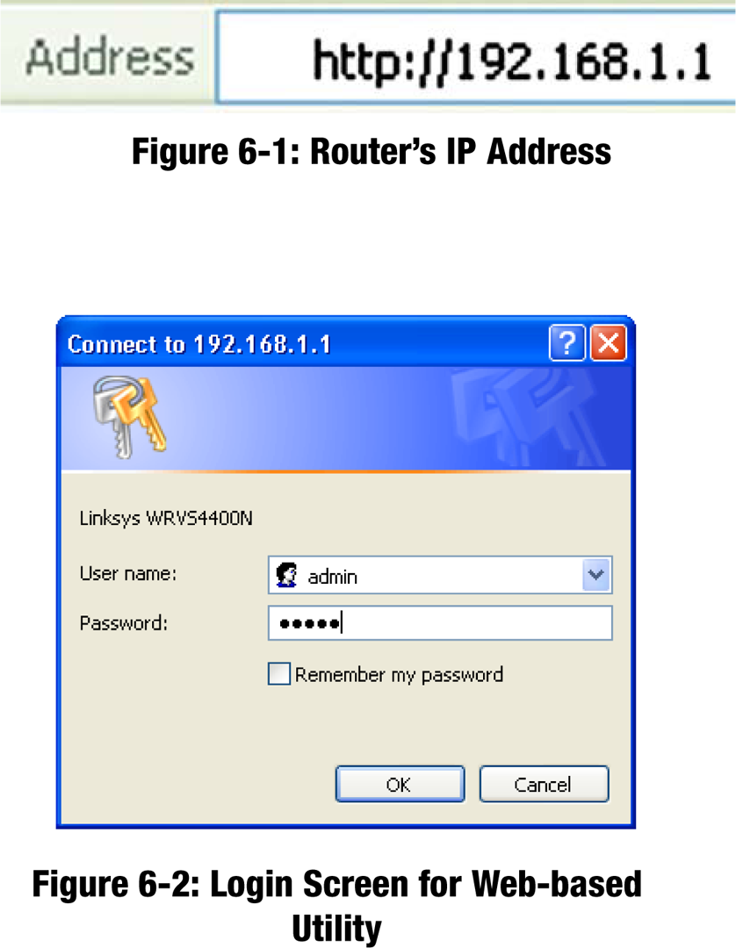
Penetration: Guess/get a password
Page 29 of the
Linksys Wireless-N Gigabit
Security Router with VPN
user guide

Slide 14
Penetration: Guess/get a password
Check out
  http://www.phenoelit-us.org/dpl/dpl.html
  http://www.cirt.net/passwords
  http://dopeman.org/default_passwords.html

Slide 15
Penetration
Social engineering
  people have a tendency to trust others
  finger sites – deduce organizational structure
  myspace.com, personal home pages
  look through dumpsters for information
  impersonate a user
  Phishing: impersonate a company/service

Slide 16
Penetration
Trojan horse
  program masquerades as another
  Get the user to click on something, run something, enter data
*****************************************************************
The DCS undergrad machines are for DCS coursework only.
*****************************************************************
Getting "No valid accounts?" Go to
http://remus.rutgers.edu/newaccount.html
and add yourself back.
login: pxk
Password:
Login incorrect

Slide 17

Trojan horse
Disguising error messages
New Windows XP SP2 vulnerability exposed
Munir Kotadias
ZDNet Australia
November 22, 2004, 12:50 GMT
A vulnerability in Microsoft's Windows XP SP2 can allow an executable file to be run by hackers on target machines, according to security researchers
… it is possible to craft a special error message that is able to bypass a security function in IE that was created to warn users before they download potentially harmful content. … a malicious Web site could prompt all its visitors with a standard grey dialogue box welcoming a user to the site before allowing access to the site's content. If a user clicks on the welcome box they could unknowingly install a file that gives control of their computer to a third party.
http://tinyurl.com/5mj9f

Slide 18
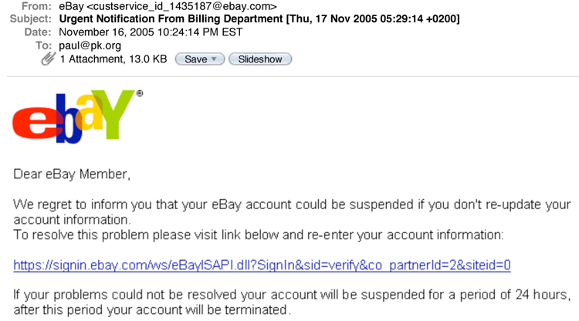
Phishing
Masqueraded e-mail

Slide 19
Malicious Files and Attachments
Take advantage of:
  Programs that automatically open attachments
  Systems that hide extensions yet use them to execute a program – trick the user
love-letter.txt.vbs
resume.doc.scr

Slide 20
Exploiting bugs
Exploit software bugs
  Most (all) software is buggy
  Big programs have lots of bugs
    sendmail, wu-ftp
  some big programs are setuid programs
    lpr, uucp, sendmail, mount, mkdir, eject
Common bugs
  buffer overflow
  (blindly read data into buffer)
    e.g., gets
  back doors and undocumented options

Slide 21
The classic buffer overflow bug
gets.c from V6 Unix:
gets(s)
char *s;
{ /* gets (s) - read a string with cgetc and store in s */
char *p;
extern int cin;
if (nargs () == 2)
IEHzap("gets ");
p=s;
while ((*s = cgetc(cin)) != '\n' && *s != ’\0')
s++;
if (*p == '\0') return (0);
*s = '\0';
return (p);
}

Slide 22
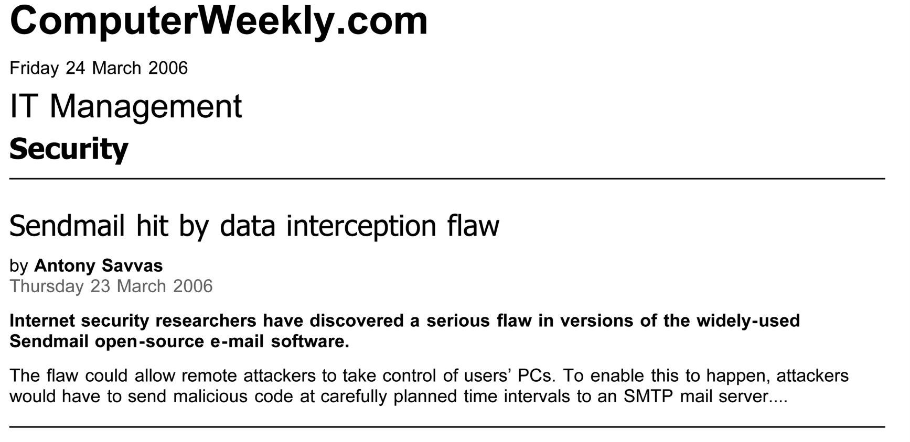
Buggy software
sendmail has been around since 1983!

Slide 23

Buggy software
Hackers Promise 'Nude Britney Spears' Pix To Plant .ANI Exploit
April 4, 2007
The lure? The e-mails are promising users nude pictures of pop star Britney Spears if they follow the link to a Web site. Initially, the e-mails only contained text, but in the past day or so they've begun to contain an embedded image of a scantily clad Spears.
Sophos reported in an advisory that the malicious site contains the Iffy-A Trojan that points to another piece of malware, which contains the zero-day .ANI exploit. Sophos detects this Trojan as Animoo-L.
…
The .ANI vulnerability involves the way Windows handles animated cursor files and could enable a hacker to remotely take control of an infected system. The bug affects all the recent Windows releases, including its new Vista operating system. Internet Explorer is the main attack vector for the exploits.
Microsoft: Vista Most Secure OS Ever!
http://tinyurl.com/yvxv4h

Slide 24

Buggy software
October 30, 2006
New Windows attack can kill firewall
By Robert McMillan, IDG News Service, 10/30/06
Hackers have published code that could let an attacker disable the Windows Firewall on certain Windows XP machines.
The code, which was posted on the Internet early Sunday morning, could be used to disable the Windows Firewall on a fully patched Windows XP PC that was running Windows' Internet Connection Service (ICS). This service allows Windows users to essentially turn their PC into a router and share their Internet connection with other computers on the local area network (LAN.) It is typically used by home and small-business users.
http://www.networkworld.com/news/2006/103006-new-windows-attack-can-kill.html

Slide 25
Buggy software
Microsoft Security Advisory (927892)
Vulnerability in Microsoft XML Core Services Could Allow Remote Code Execution
Published: November 3, 2006
Microsoft is investigating public reports of a vulnerability in the XMLHTTP 4.0 ActiveX Control, part of Microsoft XML Core Services 4.0 on Windows. We are aware of limited attacks that are attempting to use the reported vulnerability.
http://www.microsoft.com/technet/security/advisory/927892.mspx

Slide 26
Buggy Software
TIFF exploits for iPhone Safari, Mail released
By Justin Berka | Published: October 18, 2007 - 08:21AM CT
One of the big questions surrounding the iPhone has been just how secure the device is. Apple has already fixed some security issues, and the upcoming iPhone SDK may introduce more of the vulnerabilities Steve Jobs was loath to avoid. In the meantime, hacker HD Moore has released details about the TIFF-based exploits for MobileSafari and MobileMail as part of the Metasploit Framework.
Although the explanation of the code looks like a lot of scary memory addresses, the basic point of the exploit is that, because of the vulnerability, a TIFF file can be crafted to include a malicious payload that can be run on an iPhone. The exploit can be triggered from MobileSafari and MobileMail, and works on any version of the iPhone so far.

Slide 27
Mistakes (?)
HP admits to selling infected flash-floppy drives
Hybrid devices for ProLiant servers pre-infected with worms, HP says
Gregg Keizer 08/04/2008 07:08:06
Hewlett-Packard has been selling USB-based hybrid flash-floppy drives that were pre-infected with malware, the company said last week in a security bulletin.
Dubbed "HP USB Floppy Drive Key," the device is a combination flash drive and compact floppy drive, and is designed to work with various models of HP's ProLiant Server line. HP sells two versions of the drive, one with 256MB of flash capacity, the other with 1GB of storage space.
This is extra bad when combined with Windows’ autorun when a USB drive is plugged in!
– The autorun feature cannot be disabled easily
http://tinyurl.com/5sddlg

Slide 28
Penetration: the network
Fake ICMP, RIP packets
(router information protocol)
Address spoofing
  Fake a server to believe it’s talking to a trusted machine
ARP cache poisoning
  No authentication in ARP; blindly trust replies
  Malicious host can provide its own Ethernet address for another machine.

Slide 29
Penetration: the network
Session hijacking
  sequence number attack: fake source address and TCP sequence number responses

Slide 30
Penetration
UDP
  no handshakes, no sequence numbers
  easy to spoof

Slide 31
Penetration
Many network services have holes
  fake email with SMTP
  sendmail bugs
  snoop on telnet sessions
  finger
    old versions have gets buffer overflow
    social engineering
  unauthenticated RPC
    access remote procedures
    fake portmapper, causing your programs to run instead of real service

Slide 32
Penetration
IE
Malformed URLs
Buffer overflows
ActiveX flaws
PNG display bugs
Jscript
Processing of XML object data tags
Registry modification to redirect URLs

Slide 33
Penetration
NFS
  stateless design
  once you have a file handle, you can access files or mount the file system in the future
  data not encrypted
rlogin, rsh
  modify .rhosts or /etc/hosts.equiv
  snoop on session
  fake your machine or user name to take advantage of .rhosts

Slide 34
Penetration
X windows
  tap into server connection (port 6000+small int) [hard!]
    get key strokes, contents of display
Remote administration servers
  E.g. Microsoft BackOffice
Java applets
Visual Basic scripts
Shell script bugs
URL hacking
et cetera, et cetera ….

Slide 35
Denial of Service (DoS)
Ping of death
take a machine out of service
  IP datagram > 65535 bytes is illegal but possible to create
  Reassembly of packets causes buffer overflow on some systems

Slide 36
Denial of Service: SYN Flooding
SYN flooding
take a machine out of service
Background:
  3-way handshake to set up TCP connection
    Send SYN packet
      receiver allocates resources – limit to number of connections
      new connections go to backlog queue
      further SYN packets get dropped
    Receiver sends acknowledgement (SYN/ACK) and waits for an ACK
    Sender sends ACK

Slide 37
Denial of Service: SYN Flooding
Send SYN masqueraded to come from an unreachable host
  receiver times tries to send SYN/ACK
  times out eventually
    23 minutes on old Linux systems
    BSD uses a Maximum Segment Life = 7.5 sec
    Windows server 2003 recommends 120 sec.

Slide 38
Denial of Service and DDoS
Other denial of service attacks:
  Software bugs (esp. OS)
  ICMP floods
  ICMP or RIP redirect messages to alter routes to imposter machines
  UDP floods
  application floods
Distributed Denial of Service (DDoS) attacks
  Multiple compromised machines attack a system
  (e.g., MyDoom)

Slide 39
Direct System Access
Boot alternate OS to bypass OS logins
  E.g., Linux on a CD
Third-party drivers with backdoors or bugs
Then … Modify system files
  Encrypted file system can help
Rogue administrators

Slide 40
Worms
Type of process that spawns copies of itself
  potentially using system resources and hurting performance
  possibly exploiting weaknesses in the operating system to cause damage

Slide 41
Example: 1988 Internet worm
Robert Tappan Morris Jr.’s Internet worm
  exploit finger’s gets bug to load a small program (99 lines of C)
  program connects to sender and downloads the full worm
  worm searches for other machines:
    .rhost files
    finger daemon
    sendmail DEBUG mode
    password guessing via dictionary attack: 432 common passwords and combinations of account name and user name

Slide 42
Virus
Does not run as a self-contained process
code is attached onto another program or script
File infector
  primarily a problem on systems without adequate protection mechanisms
Boot-sector
Macro (most common now…VB)
Hypervisor (newest)

Slide 43
Botnets
New Kraken worm evading harpoons of antivirus programs
By Joel Hruska | Published: April 08, 2008 - 01:42PM CT
ars technica
Researchers at Damballa Solutions have uncovered evidence of a powerful new botnet they've nicknamed Kracken. The company estimates that Kraken has infected 400,000 systems ....
Specific details on the newly discovered botnet are still hard to come by, but rhetoric isn't. Damballa currently predicts that Kraken will continue to infect new machines (up to 600,000 by mid-April). Compromised systems have been observed sending up to 500,000 emails a day, and 10 percent of the Fortune 500 are currently infected. The botnet appears to have multiple, redundant CnC (Command and Control) servers hosted in France, Russia, and the United States.
http://tinyurl.com/5y2x8g

Slide 44
Penetration from within the system
Malicious software in your computer
  Can access external systems
  Internal network, data, other computers
Dialers
  Dial 900 number, alternate telephony provider, modify dialing preferences
  Not interesting now that modems are practically extinct
Remote access
Adware
  Deliver ads via program or another program
Spyware
  Scan system, monitor activity
  Key loggers

Slide 45
Key loggers
Record every keystroke
Windows hook
  Procedure to intercept message traffic before it reaches a target windows procedure
  Can be chained
  Installed via SetWindowsHookEx
  WH_KEYBOARD and WH_MOUSE
    Capture key up, down events and mouse events
Hardware loggers

Slide 46
Rootkits
Replacement commands (or parts of OS) to hide the presence of an intruder
  ps, ls, who, netstat, …
Hide the presence of a user or additional software (backdoors, key loggers, sniffers
OS can no longer be trusted!
E.g., Sony BMG DRM rootkit (October 2005)
  Creates hidden directory; installs several of its own device drivers; reroutes Windows system calls to its own routines
  Intercepts kernel-level APIs and disguises its presence with cloaking (hides $sys$ files)

Slide 47
Protection Mechanisms

Slide 48
Operating system protection
OS and hardware give us some protection
access to…
CPU |  | process scheduler
memory |  | MMU, page table per process
peripherals |  | device driver, buffer cache
logical regions of persistent data |  | file systems
communication networks |  | sockets

Slide 49
Protection via authorization
Operating system enforces access to objects
  access matrix
objects
file F
file G
printer H
user A
R
RW
W
user B
RX
domains of protection
user C
group X
RW
group Y

Slide 50
Protection: access control list
access controls associated with object
objects
file F
file G
printer H
user A
R
RW
W
user B
RX
user C
domains of protection
group X
RW
group Y

Slide 51
Protection: capability list
  access controls associated with domain
  present a “capability” to access an object
objects
file F
file G
printer H
user A
R
RW
W
user B
RX
user C
domains of protection
group X
RW
group Y

Slide 52
Security
AAA
The Three A’s (traditional):
  Authentication
  Authorization
  Accounting

Slide 53
Security
AAAA
The Four A’s (there’s really a fourth):
  Authentication
  Authorization
  Accounting
  Auditing

Slide 54
Authentication
Identification & Network-safe authentication
  Cleartext passwords – bad idea
  One-time passwords
  Challenge-response
  Shared secret keys (distribution must be secure)
  Trusted third party
    E.g., Kerberos tickets
  Public key authentication, certificates
  Source address validation (may be spoofed)
  Establish covert communication channel first
    Diffie Hellman common key
    Public keys
    Kerberos
    … then use cleartext passwords
vulnerable to
man-in-the-middle
attacks

Slide 55
Identification versus Authentication
Identification:
  Who are you?
  User name, account number, …
Authentication:
  Prove it!
  Password, PIN, encrypt nonce, …
Biometrics
  Identification: 1 out of many
    Who is this?
  Authentication: 1:1
    Let me scan your fingerprint and validate it’s you.

Slide 56
…versus Authorization
Access Control
Once we know a user’s identity:
  Allow/disallow request
  Operating system enforces system access based on user’s credentials
    Network services usually run in another context
    Network server may not know of the user
    Application takes responsibility
  Contact authorization server
    Trusted third party that will grant credentials
    Kerberos ticket granting service
    RADIUS (centralized authentication/authorization)

Slide 57
Accounting
If security has been compromised
  … what happened?
  … who did it?
  … how did they do it?
Log transactions
  Logins
  Commands
  Database operations
  Who looks at audits?
Log to remote systems
  Minimize chances for intruders to delete logs

Slide 58
Network Access Control (NAC)
Authenticate before the switch will route your packets
Common for Wi-Fi hotspots
NAC sometimes uses ARP poisoning to relay ARP requests so that traffic will go through the gateway
Query RADIUS or LDAP server to determine what a user is authorized to access

Slide 59
Intrusion Detection
External
  Network activity
  Network-application protocols
Internal
  Host-based

Slide 60
Network Intrusion Detection
Examine traffic going through a network choke (hub, switch, or router)
  Software on device or routed through port mirroring
Detect:
  Dangerous code (viruses, buffer overflow)
  Port scans (including stealth port scans)
  Web server attacks
  SMB probes
  Excess network traffic
Log and/or drop packets that are deemed dangerous

Slide 61
Testing an IP port
TCP/IP:
Test by connect() call or sending a SYN packet
  Open (accepts connections
  Denied (host sends reply that connections will be denied)
  Dropped (no reply from host)
UDP/IP:
  Systems will often send ICMP packets as a reply informing you that a port is not in service

Slide 62




Intrusion Detection Proxies
Application-specific proxies
  Specific to a protocol
  Network interface to proxy instead of application
External Access
Email IDS Proxy
Email Server
Logging/Alerting

Slide 63
Host-Based Intrusion Detection
Host-resident software
Analyze/log:
  file changes
  system call activity
  logins
  admin operations
Off-host logging is better
Detect “unusual activity”

Slide 64
Virus Scanning
Search for a “signature”
  Extract of the virus that is (we hope!) unique to the virus and not any legitimate code.
Some viruses are encrypted
  Signature is either the code that does the decryption or the scanner must be smart enough to decrypt the virus
Some viruses mutate to change their code every time they infect another system
  Run the code through an emulator to detect the mutation

Slide 65
Virus Scanning
You don’t want to scan through hundreds of thousands of files
  Search in critical places likely to be infected (e.g., \windows\system32 or removable media)
Passive disk scan or active I/O scan

Slide 66
Worm Scanning
Worms do not attach themselves to files
  Searchfor worm files (standalone programs)
Search incoming email

Slide 67
Defense from malicious software
Access privileges
  Don’t run as administrator
  Warning: network services don’t run with the privileges of the user requesting them
Signed software
  Validate the integrity of the software you install
Personal firewall
  Intercept and explicitly allow/deny applications access to the network
  Application-aware
    What program is the network access coming from?

Slide 68
Code Integrity: Signed Software
Signed software
Per-page signatures
  Check hashes for every page upon loading
  OS X & Vista: codesign command to sign
  XP/Vista: (Microsoft Authenticode)
    Hashes stored in system catalog (Vista) or signed & embedded in file
  OS X:
    Hashes & certificate chain stored in file

Slide 69
Microsoft Authenticode
A format for signing executable code
(dll, exe, cab, ocx, class files)
Notes:
Microsoft’s Authenticode technology is simply a specification for affixing a digital signature to a block of code (that is typically downloaded over a network). The signature validates that the code was not modified since the signature was affixed and that it came from the signatory.
Authenticode works on various binary formats, such as dll, exe, cab, ocx, and class files.
The steps in creating a signed file are:
Generate a public/private key pair (this is something the organization does once)
Get a digital certificate. A digital certificate is just a public key + identification credentials, signed (has the data and encrypt it with a private key) by a trusted party. In this case, the trusted party is VeriSign - a class 3 Commercial Software Publisher’s certificate (again, this is done once by the organization).
Generate a hash of the code to create a fixed-length digest.
Encrypt the digest with the private key.
Combine the encrypted digest with the certificate into a structure known as the Signature block.
Embed this in the executable.
The recipient (client side) can call the Win32 function called WinVerifyTrust to validate the signature. This validates the certificate, decrypts the digest using the public key in the certificate and compares it with the hash of the downloaded code.

Slide 70
Microsoft Authenticode
Software publisher:
  Generate a public/private key pair
  Get a digital certificate: VeriSign class 3 Commercial Software Publisher’s certificate
  Generate a hash of the code to create a fixed-length digest
  Encrypt the hash with your private key
  Combine digest & certificate into a Signature Block
  Embed Signature Block in executable
Recipient:
  Call WinVerifyTrust function to validate:
    Validate certificate, decrypt digest, compare with hash of downloaded code
Notes:
Microsoft’s Authenticode technology is simply a specification for affixing a digital signature to a block of code (that is typically downloaded over a network). The signature validates that the code was not modified since the signature was affixed and that it came from the signatory.
Authenticode works on various binary formats, such as dll, exe, cab, ocx, and class files.
The steps in creating a signed file are:
Generate a public/private key pair (this is something the organization does once)
Get a digital certificate. A digital certificate is just a public key + identification credentials, signed (has the data and encrypt it with a private key) by a trusted party. In this case, the trusted party is VeriSign - a class 3 Commercial Software Publisher’s certificate (again, this is done once by the organization).
Generate a hash of the code to create a fixed-length digest.
Encrypt the digest with the private key.
Combine the encrypted digest with the certificate into a structure known as the Signature block.
Embed this in the executable.
The recipient (client side) can call the Win32 function called WinVerifyTrust to validate the signature. This validates the certificate, decrypts the digest using the public key in the certificate and compares it with the hash of the downloaded code.

Slide 71
Microsoft Vista code integrity checks
Check hashes for every page as it’s loaded
  Done by file system driver
Hashes in system catalog or embedded in file along with X.509 certificate.
Check integrity of boot process
  Kernel code must be signed or it won’t load
  Drivers shipped with Windows must be certified or contain a certificate from Microsoft

Slide 72
Auditing
Go through software source code and search for security holes
  Need access to source
  Experienced staff + time
  E.g., OpenBSD
Complex systems will have more bugs
  And will be harder to audit

Slide 73
System complexity
Windows complexity: lines of code
OS version | Year | Lines
3.1 | 1992 | 3 million
NT | 1992 | 4 million
95 | 1995 | 15 million
NT 4.0 | 1996 | 16.5 million
98 | 198 | 18 million
2000 | 2000 | 35-60 million
XP | 2001 | 35 million
Vista | 2007 | 50 million
Source: Secrets & Lies, Schneier
InformationWeek, April 3, 2006, p. 34-35, BigSoftware Rides Again

Slide 74
System complexity
OS complexity: number of system calls
OS version | Year | Sys calls
Unix 1st edition | 1971 | 33
4.3 BSD Net 2 | 1991 | 136
Linux 1.2 | 1996 | 211
SunOS 5.6 | 1997 | 190
Linux 2.0 | 1998 | 229
Win NT 4.0 sp3 | 1999 | 3,433
Source: Secrets & Lies, Schneier

Slide 75
Other security needs
Access control: privacy
  Multilevel security
    Unclassified, Confidential, Secret, Top Secret, Top Secret/Special Compartmented Intelligence
    Generally does not map well to the civilian world
  Restrict access to systems, network data
Anonymity
Integrity

Slide 76
Dealing with application security
Isolation & memory safety
  Rely on operating system
Code auditing
Access control checking at interfaces
  E.g., Java security manager
Code signing
  E.g., ActiveX
Runtime/load-time code verification
  Java bytecode verifier, loader
  Microsoft CLR

Slide 77
Firewalls: Defending the network

Slide 78
inetd
Most UNIX systems ran a large number of tcp services as dæmons
  e.g., rlogin, rsh, telnet, ftp, finger, talk, …
Later, one process, inetd, was created to listen to a set of ports and then spawn the service on demand
  pass sockets as standard in/standard out file descriptors
  servers don’t run unless they are in use
Notes:
As various network services started becoming available on UNIX systems (and its variants), they simply ran as processes, listening on their particular service ports and processing requests as they came in. As the number of services expanded, there seemed to be an overabundance of these processes around – consuming space in the process table and consuming system memory, even if the services were not in use most of the time. Worse yet, starting all these services led to a significant increase in boot time.
To solve this problem, a program called inetd was created. Instead of having all these servers start up at boot-time, a single process – inetd – is started. It listens on all service ports listed in its configuration file (/etc/inetd.conf). When a request comes in on one of these ports, inetd starts the appropriate server. It passes the connected socket via the standard in and standard out file descriptors.

Slide 79
TCP wrappers (tcpd)
Plug-in replacement to inetd
Restrict access to TCP services
  Allow only specified machines to execute authorized services
  Monitor and log requests
Specify rules in two files:
  hosts.allow and hosts.deny
  access:
    grant access if service:client in /etc/hosts.allow
    deny access if service:client in /etc/hosts.deny
    otherwise allow access
support for booby traps (honeypots)
Notes:
Since inetd provides a single point of entry to a set of TCP-based services, we can take advantage of this and perform access control checks before starting the service.
TCP wrappers (also known as the tcpd program) were created to restrict access to TCP-based Internet services that would normally be launched via inetd.
Here’s how it works:
- When a request for a service arrives, inetd is told to run the tcpd program instead of the desired server.
- tcpd logs the reqest and performs access control checks
- if everything is fine, then tcpd runs the appropriate server program
Access control is pattern-based. It allows checks against hostnames as well as hosts that pretend to have someone else’s host name.
Connections are logged via the syslog facility (which supports remote logging – useful if someone breaks in and wipes out your logs).

Slide 80
Firewalls
Isolate trusted domain of machines from the rest of the untrusted world
  move all machines into a private network
  disconnect all other systems
  untrusted users not allowed
not acceptable – we want to be connected
Solution:
protect the junction between a trusted internal network of computers from an external network with a firewall

Slide 81
Firewalls
Two major approaches to building firewalls:
packet filtering
proxies

Slide 82
Packet filtering
Selective routing of packets
  Between internal and external hosts
By routers, kernel modules, or firewall software
Allow or block certain types of packets
Screening router
  determine route and decide whether the packet should be routed
Notes:
Packet filtering is the selective routing of packets between internal and external hosts. It can be done by most of today’s routers (even small ones such as a Linksys cable modem/DSL switch) as well as dedicated firewall software or kernel modules (e.g. Linux’s IP chains).
The function of packet filtering is to either allow or block certain types of packets in a way that reflects the security policy of a cite.
These types of routers are known as screening routers. An ordinary router looks at the destination address of each packet and figures out where (which output interface) to send the packet (based on a routing table). A screening router does the same sort of route determination but also decides whether the packet should be routed or discarded.
If packets are filtered strictly by the filter criteria of source/destination addresses and ports, we are using stateless inspection. This means that past packets do not affect future filtering rules (e.g. we cannot have a rule that says: “if you get a connection to TCP port 999 then open up a connection from the same host to TCP port 998”).

Slide 83
Packet filtering: screening router
Filter by
  IP source address, IP destination address
  TCP/UDP source port, TCP/UDP destination port
  Protocol (TCP, UDP, ICMP, …)
  ICMP message type
  interface packet arrives on
  destination interface
Allow or block packets based on any/all fields
  Block any connections from certain systems
  Disallow access to “dangerous services”
IP packet data
Notes:
Packet filtering is the selective routing of packets between internal and external hosts. It can be done by most of today’s routers (even small ones such as a Linksys cable modem/DSL switch) as well as dedicated firewall software or kernel modules (e.g. Linux’s IP chains).
The function of packet filtering is to either allow or block certain types of packets in a way that reflects the security policy of a cite.
These types of routers are known as screening routers. An ordinary router looks at the destination address of each packet and figures out where (which output interface) to send the packet (based on a routing table). A screening router does the same sort of route determination but also decides whether the packet should be routed or discarded.
If packets are filtered strictly by the filter criteria of source/destination addresses and ports, we are using stateless inspection. This means that past packets do not affect future filtering rules (e.g. we cannot have a rule that says: “if you get a connection to TCP port 999 then open up a connection from the same host to TCP port 998”).

Slide 84
Packet filtering
Stateless inspection
  filter maintains no state
  each packet examined on its own

Slide 85
Packet filtering
Stateful inspection
  keep track of TCP connections
  (SYN, SYN/ACK packets)
      e.g. no rogue packets when connection has not been established
  “related” ports: allow data ports to be opened for FTP sessions
  Port triggering (outbound port triggers other port access to be redirected to the originating system)
    Generally used with NAT (Network Address Translation)
  limit rates of SYN packets
    avoid SYN flood attacks
  Other application-specific filtering
    Drop connections based on pattern matching
    Rewrite port numbers in data stream

Slide 86
Packet filtering
Screening router
  allows/denies access to a service
  cannot protect operations within a service

Slide 87
Packet filtering: rules
Src addr=42.15.0.0/16, dest port=*
Reject
Reject everything from 42.15.*.*
Src addr=192.168.1.0/24, dest port=25
Accept
Accept email (port 25) requests from 192.168.1.*
Dest addr=192.168.1.0/24, dest port=*
Reject
Reject all other requests from 192.168.1.*
Src addr=128.6.0.0/16, Dest addr=192.168.2.3,
dest port=22
Accept
Accept ssh (port 22) requests from 128.6.*.* to 192.168.2.3
Dest addr=192.168.2.2, dest port=80
Accept
Accept web (port 80) requests to a server at 192.168.2.2
*
Reject

Slide 88
Proxy services
Application or server programs that run on firewall host
  dual-homed host
  bastion host
Take requests for services and forward them to actual services
provide replacement connections and act as gateway services
Application-level gateway
Stateful inspection and protocol validation
Notes:
A proxy service is a specialized application or server program that runs on a firewall host. This machine is known as a bastion host – a system that is specifically made secure for use in a firewall. These machines are generally dual-homed so that packets from the outside (untrusted) network cannot flow directly to the internal (trusted) network.
A proxy generally provides a replacement connection for the actual service (e.g. email) and is capable of inspecting the data as well as the packets. Hence, it can keep track of the state of the communication and validate that the protocol conforms to the rules (e.g. no attempts on buffer overflow or using invalid headers/commands).
Proxies are often known as application-level gateways.

Slide 89
Proxy services
Proxies are effective in environments where direct communication is restricted between internal and external hosts
  dual-homed machines and packet filtering
Notes:
A proxy service is a specialized application or server program that runs on a firewall host. This machine is known as a bastion host – a system that is specifically made secure for use in a firewall. These machines are generally dual-homed so that packets from the outside (untrusted) network cannot flow directly to the internal (trusted) network.
A proxy generally provides a replacement connection for the actual service (e.g. email) and is capable of inspecting the data as well as the packets. Hence, it can keep track of the state of the communication and validate that the protocol conforms to the rules (e.g. no attempts on buffer overflow or using invalid headers/commands).
Proxies are often known as application-level gateways.

Slide 90
Proxy example
Checkpoint Software Technologies’ Firewall-1
mail proxy:
  mail address translation: rewrite From:
  redirect To:
  drop mail from given address
  strip certain mime attachments
  strip Received info on outbound mail
  drop mail above given size
  perform anti-virus checks on attachments
does not allow outsiders direct connection to a local mailer

Slide 91
Dual-homed host architecture
Built around dual-homed host computer
Disable ability to route between networks
  packets from Internet are not routed directly to the internal network
  services provided by proxy
  users log into dual-homed host to access Internet
  user accounts present security problems
Internet
dual-homed host
internal network
internal machines

Slide 92
Screened host architecture
Provides services from a host attached to internal network
Security provided by packet filtering
  only certain operations allowed (e.g. deliver email)
  outside connections can only go to bastion host
allow internal hosts to originate connections over Internet
if bastion host is compromised…
Internet
screening router
internal network
bastion host
internal machines

Slide 93
Screened subnet architecture
Add extra level of isolation for internal network
  Place any externally visible machines on a separate perimeter network (DMZ)
Internet
exterior router
DMZ network
bastion hosts
externally-visible services
interior router
internal network
internal machines
Notes:
A simple firewall architecture may contain a single screening router that performs packet filtering or route all requests to a bastion host. We can achieve a greater degree of protection by placing any machines that are externally accessible on a separate network. Such a network is known as a perimeter network, or DMZ (demilitarized zone).
This design consists of two screening routers
- one between the external network (Internet) and the DMZ
- one between the internal network and the DMZ
An attacker would have to penetrate through both routers to get to the internal systems. There is no single point of vulnerability that will compromise the internal network. Even if an attacker would succeed in penetrating a service on a bastion host, she will not be able to see packets on the internal network.
The key filtering rules are:
exterior router:
disallow packets from the Internet that masquerade as packets from the internal network or the DMZ
Disallow packets that are not destined for a DMZ machine
Allow only packets destined for allowed services on the DMZ
Interior router:
Allow only packets that originate from the DMZ network.

Slide 94
Screened subnet architecture
Exterior router (access router)
  protects DMZ and internal network from Internet
  generally… allow anything outbound … that you need
  block incoming packets from Internet that have forged source addresses
  allow incoming traffic only for bastion hosts/services.
Interior router (choke router)
  protects internal network from Internet and DMZ
  does most of packet filtering for firewall
  allows selected outbound services from internal network
  limit services between bastion host and internal network
Notes:
A simple firewall architecture may contain a single screening router that performs packet filtering or route all requests to a bastion host. We can achieve a greater degree of protection by placing any machines that are externally accessible on a separate network. Such a network is known as a perimeter network, or DMZ (demilitarized zone).
This design consists of two screening routers
- one between the external network (Internet) and the DMZ
- one between the internal network and the DMZ
An attacker would have to penetrate through both routers to get to the internal systems. There is no single point of vulnerability that will compromise the internal network. Even if an attacker would succeed in penetrating a service on a bastion host, she will not be able to see packets on the internal network.
The key filtering rules are:
exterior router:
disallow packets from the Internet that masquerade as packets from the internal network or the DMZ
Disallow packets that are not destined for a DMZ machine
Allow only packets destined for allowed services on the DMZ
Interior router:
Allow only packets that originate from the DMZ network.

Slide 95
Single router DMZ
Internet
Interface 2
DMZ
exterior router
Interface 1
Internal
DMZ network
bastion hosts
externally-visible services
internal network
internal machines
Notes:
A simple firewall architecture may contain a single screening router that performs packet filtering or route all requests to a bastion host. We can achieve a greater degree of protection by placing any machines that are externally accessible on a separate network. Such a network is known as a perimeter network, or DMZ (demilitarized zone).
This design consists of two screening routers
- one between the external network (Internet) and the DMZ
- one between the internal network and the DMZ
An attacker would have to penetrate through both routers to get to the internal systems. There is no single point of vulnerability that will compromise the internal network. Even if an attacker would succeed in penetrating a service on a bastion host, she will not be able to see packets on the internal network.
The key filtering rules are:
exterior router:
disallow packets from the Internet that masquerade as packets from the internal network or the DMZ
Disallow packets that are not destined for a DMZ machine
Allow only packets destined for allowed services on the DMZ
Interior router:
Allow only packets that originate from the DMZ network.

Slide 96
Firewalling principles
It is easier to secure one or a few machines than a huge number of machines on a LAN
Focus effort on bastion host(s) since only they are accessible from the external network
All traffic between outside and inside must pass through a firewall
Deny overall
  Turn everything off, then allow only what you need
Private network should never see security attacks
Be prepared for attacks from within
  Infected machines

Slide 97
Virtual Private Networks

Slide 98
Private networks
Problem
  You have several geographically separated local area networks that you would like to have connected securely
Solution
  Set up a private network line between the locations
  Routers on either side will be enabled to route packets over this private line
Notes:
As organizations began to network their computers together in the 1980’s, one problem that arose was that many organizations were split into a number of geographically separated offices, each office having its own local area network. The problem now was: how do you connect these local area networks together while maintaining security. Even if making the machines accessible to a public network such as the Internet was an option, it wasn’t attractive because
(a) you are exposing every machine to the Internet, requiring it to have a public address and
(b) the Internet is a public network, so the data is not secure.
You may have your applications encrypt the data, which can be a pain, but someone can still glean information just by observing which machines are communicating with each other.
Luckily, there was an easy solution to this: just lease a private network line between the locations that need to be networked. Each end of the line is plugged into a router that will know to direct any packets to the other local area network via this line.

Slide 99
Private networks
Private network line
LAN A (New York)
LAN B (London)
Problem: $$$¥¥¥£££€€€ !
Notes:
The private line solution works great. The only problem is the expense. You are paying for a dedicated circuit (with dedicated copper or fiber) and dedicated switch resources at the phone company whether you’re using the line heavily, lightly, or not at all.

Slide 100
Virtual private networks (VPNs)
Alternative to private networks
  Use the public network (internet)
Service appears to users as if they were connected directly over a private network
  Public infrastructure is used in the connection
Notes:
An alternative to using a private network is to use the public infrastructure (Internet) that we earlier shunned. The trick will be to provide the networking service in such a way that it appears to users (and systems) on the local area networks as if they really are connected over a private network (except, perhaps, for the consistency and quality of service).

Slide 101
Building a VPN: tunneling
Tunneling
  Links two network devices such that the devices appear to exist on a common, private backbone
  Achieve it with encapsulation of network packets
Notes:
The key to building a virtual private network is the idea of tunneling. Tunneling is a way of linking two devices on networks (e.g., routers on two local area networks) in such a way that they appear to be connected on a shared private line.
We achieve this by simply taking any packet from one local area network and encapsulating the entire packet (IP header and data, appletalk header, whatever…) as data within an IP packet for the external network.

Slide 102
Tunneling
external address:
129.42.16.99
external address:
17.254.0.91
Internet
LAN A (New York)
192.168.1.x
LAN B (London)
192.168.2.x
src:
192.168.1.10
dest:
192.168.2.32
data

Slide 103
Tunneling
LAN A (New York)
192.168.1.x
LAN B (London)
192.168.2.x
Internet
external address:
129.42.16.99
external address:
17.254.0.91
- route packets for 192.168.2.x to VPN router
- envelope packet
- send it to remote router
src:
129.42.16.99
dest:
17.254.0.91
src:
192.168.1.10
dest:
192.168.2.32
data

Slide 104
Tunneling
LAN A (New York)
192.168.1.x
LAN B (London)
192.168.2.x
Internet
external address:
129.42.16.99
external address:
17.254.0.91
accept packets from 129.42.16.99
extract data (original IP packet)
send on local network
src:
129.42.16.99
dest:
17.254.0.91
src:
192.168.1.10
dest:
192.168.2.32
data

Slide 105
Building a VPN: tunneling
Operation
  LAN-1 and LAN-2 each expose a single outside address and port.
  A machine in the DMZ (typically running firewall software) listens on this address and port
  On LAN-1, any packets addressed to LAN-2 are routed to this system.
    VPN software takes the entire packet that is destined for LAN-2 and, treating it as data, sends it over an established TCP/IP connection to the listener on LAN-2
  On LAN-2, the software extracts the data (the entire packet) and sends it out on its local area network
Notes:
To see how tunneling works, let’s consider two local area networks, LAN-1 and LAN-2.
One machine on LAN-1 has a connection to some ISP (Internet service provider) and is given a known fixed IP address.
The same is true of one machine on LAN-2.
These two machines will be located in the DMZ (of course, since they are accessible from the untrusted outside world). They each only need to listen on one well-defined port number – that for the VPN service.
Routers on LAN-1 are set up so that any packets that are targeted for local addresses in LAN-2 are directed to this VPN machine.
Routers on LAN-2 are set up so that any packets targeted for local addresses in LAN-1 are directed to its VPN machine.
The VPN software on the machine in LAN-1 has a TCP connection established with the VPN software on the machine in LAN-2.
When the machine running the VPN software on LAN-1 receives a packet that is targeted for some machine in LAN-2, it will grab that entire packet (e.g., IP header, TCP header, data) and, treating the entire packet as one blob of data, send it over the established TCP connection to the VPN software on LAN-2.
On LAN-2, the VPN software, upon receiving data from LAN-1 will extract the data from the incoming packet. This data is a complete packet that it now sends to its internal network.
The outside world only sees traffic between one machine and port on LAN-1 and one machine on LAN-2. It need know that there are other machines inside the network.

Slide 106
Building a VPN: security
No need to make all machines in the local area networks accessible to the public network … just the router
BUT… an intruder can:
  examine the encapsulated packets
  forge new encapsulated packet
Solution:
  encrypt the encapsulated packets
    Symmetric algorithm for encryption using session key
  need mechanism for key exchange
Notes:
The benefit of tunneling is that we have made it possible for machines on two local area networks to communicate without having to expose all the machines to the public network (Internet).
The problem is that anyone who is capable of seeing our packets on the public network will have full exposure to the contents (data and machine addresses). Moreover, it may be possible for an intruder to forge these encapsulated packets.
To make the virtual private network private we need to resort to encryption.
The encapsulated packet (the data of the packets leaving the VPN software) can be encrypted before being placed on the public network and decrypted upon receipt. This will offer not only security from eavesdroppers but also security against injected packets: an intruder will need to know the key to be able to inject a packet.
We will generally opt for the faster symmetric encryption algorithms to encrypt the data (RC4, DES3, IDEA) and use a session key for each new communication session. Key management may be done in several ways: manual out-of-band key propagation, RSA public key key exchange, or Diffie-Hellman key exchange.

Slide 107
IPSEC: RFC 1825, 1827
IP-layer security mechanism
Covers authentication and encryption
Application gets benefits of network encryption without modification
Additional header added to packet:
  IP Authentication header
    Identifies proper source and destination – basis of point-to-point authentication
    Signature for IP header
Encapsulating Security Protocol (ESP)
    Tunnel mode: encrypt entire IP packet (data and IP/TCP/UDP headers)
    or Transport mode: encrypt only IP/TCP/UDP headers (faster)
Encryption via RC4. DES. DES3, or IDEA
Key management: manual, Diffie-Hellman, or RSA
Notes:
IPSEC is probably the most popular protocol for VPNs. Its definition is covered in RFC 1825 and 1827. It was designed to provide an IP-layer security mechanism that covers both packet authentication and encryption. As with other VPNs, the benefit is to allow the application the benefit of secure (encrypted & authenticated) communication without modifying the application.
IPSEC adds an additional header to the IP datagram, an IP Authentication Header. Authentication information is calculated using all the fields of the IP datagram (except that hop count, time-to-live, and checksum are considered to be 0. Its purpose is to authenticate the proper source and destination of the packet.
The rest of the packet is the IP datagram (including the TCP or UDP header and data). This may be completely encrypted if IPSEC is operating in tunnel mode or only the headers may be encrypted in transport mode. The latter is slightly faster but should not be used if the network is vulnerable to intruders (it may be useful for a VPN between two LANs within a larger trusted network).
The protocol provides for the selection of different symmetric encryption algorithms, including RC4, DES, triple-DES, and IDEA. Key management may be manual (store the keys in both places) or negotiated via a Diffie-Hellman key exchange or RSA public key cryptography.

Slide 108
IPSEC
simple tunnel
src:
129.42.16.99
dest:
17.254.0.91
src:
192.168.1.10
dest:
192.168.2.32
data
with AH
signature
src:
129.42.16.99
dest:
17.254.0.91
src:
192.168.1.10
dest:
192.168.2.32
data
Authentication header. Validate:
Packet not modified
Packet originated from peer
with AH+ESP
src:
129.42.16.99
dest:
17.254.0.91
src:
192.168.1.10
dest:
192.168.2.32
data
signature

Slide 109
PPTP
PPTP: point-to-point tunneling protocol
Extension to PPP developed by Microsoft
Encapsulates IP, IPX, NetBEUI
Conceptually similar to IPSEC
  Flawed security

Slide 110
The end

