Slide 1
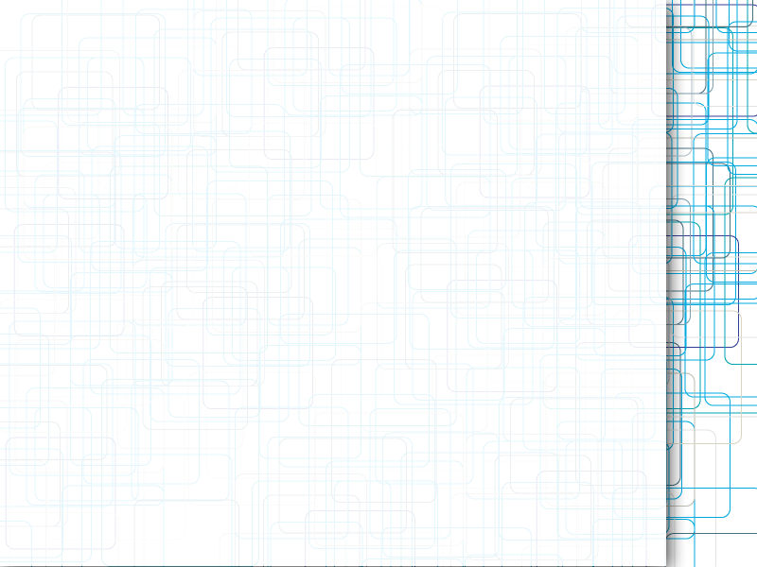
MMO Design Challenges
STS Technical Thesis
Domenic Tessari
STS 4600

Slide 2
Why Does It Matter?
Games Industry worth $74billion and growing
Social gaming through Facebook, Mobile
World of Warcraft - 11.1million players
Star Wars: The Old Republic - $80million to create
Designers as social architects

Slide 3
Pursuit of Avatar Capital
Game mechanics impact social dynamics
Rare/powerful items act as status symbols
“Welfare Epics” - worth of items devalued as they become common, cause conflict between players and designers
Avatar Capital – a virtual character's value to a player
Pursuit of capital becomes main goal

Slide 4
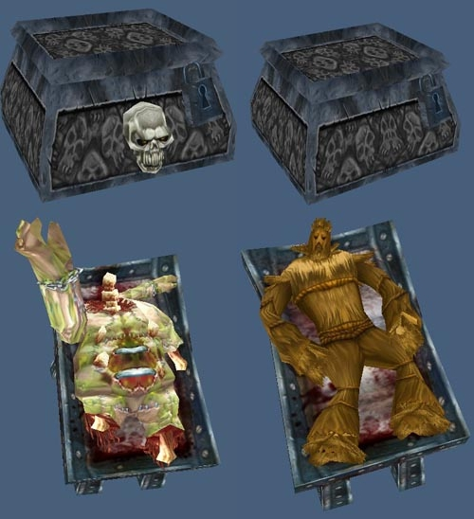
Cultural Sensitivity
Expanding demographics and world markets
China - 1/3 of global revenue for online games
Culture Conflict – Pandaren, Lich King

Slide 5
Exploits, Glitches, Bugs
How should designers respond to exploits?
Ensidia incident – cheating vs. innovating
Look to another genre for perspective: Fighting Games
Akuma & Kara-Throwing
Tipping points – Crashing, unequal, undermines game mechanics

Slide 6
Looking Forward
Games becoming a bigger part of social interaction
Role and impact of designers increasing
Must consider implications of media and the medium
Questions, Comments, ect.?

