Slide 1
Speech Recognition
Kyle Limbaga, Nicholas Riggins, Dawson Tocarchick

Slide 2
TABLE OF CONTENTS
01
04
About the Project
Project Stages
02
05
Major Requirements
Quick Startup Guide
03
06
References
Project Goals
Speech Recognition background and what we learned
Project and team organization
The task at hand, and DSP requirements
Here you could describe
the topic of the section
Here you could describe
the topic of the section

Slide 3
About Project
Speech
Recognition
Our Speech Recognition project underlines the importance of Digital Signal Processing in real world products such as Speech Recognition. This project has not only taught us the importance, but the necessary aspects that Digital Signal Processing has to offer.

Slide 4
Overall Process
BeagleBone
Input Speech
Microphone
Pattern Matching
Text Output
Feature Extraction
Google API
Send Email

Slide 5
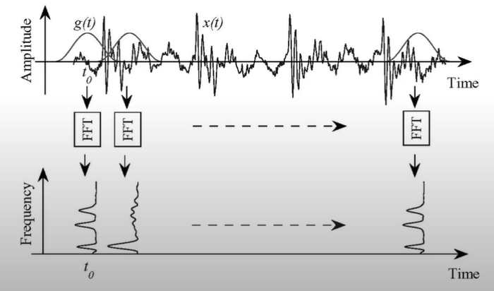
Feature Extraction
Framing
20ms
Windowing
0 < n < N-1
FFT
Mel Filter Bank
DCT

Slide 6
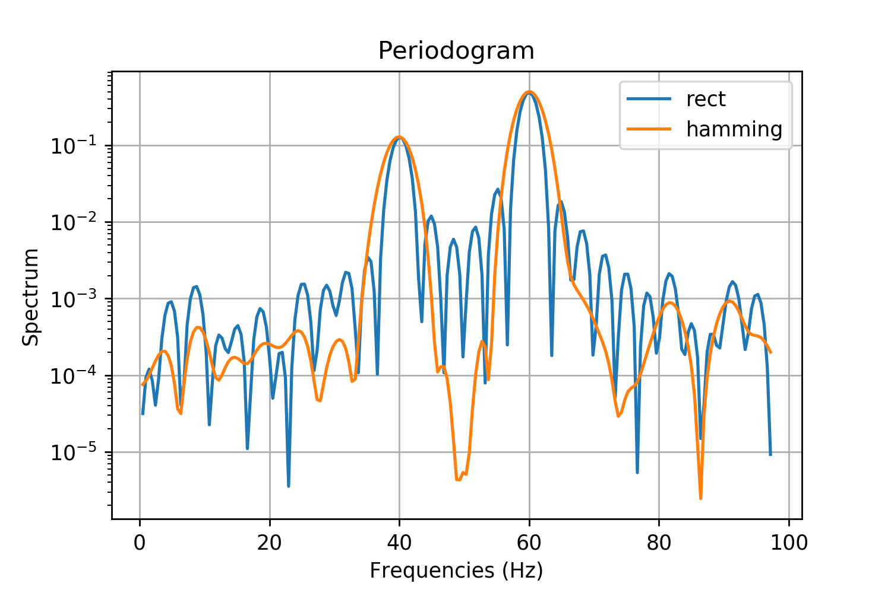
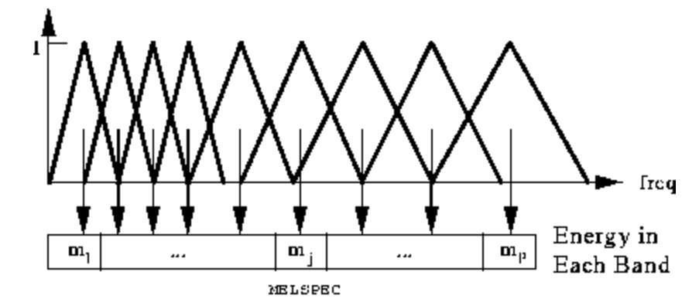
Examples

Slide 7
Machine Learning
Phonemes
Deep Neural
Network
Hidden Markov
Model
HMM uses statistical probability to reconstruct the phrase that has just been said so by putting the right phonemes each other
A unit of sound that distinguishes one word from another in a particular language
This is also known as deep learning which is an Artificial Neural Network (ANN) with multiple layers between input and output

Slide 8
Major Requirements
Speech to Text Output
Quick Data Transfer
Fast Fourier Transforms
We want to speak into a microphone and our Beagle Bone Black to output the transcript into the console
Performing FFT functions on our .wav file that is created
Using Email to send and display sample data

Slide 9
Project Goals
The goal of our project is to make use of the Beagle Bone Black and use our knowledge of Digital Signal Processing to further our knowledge on speech recognition and how it works.

Slide 10
— ”The Great” Richard Pederson
“Pretty darn good at Sudoku.”

Slide 11
Project Stages
Our Design Timeline
Programming
Testing

Slide 12
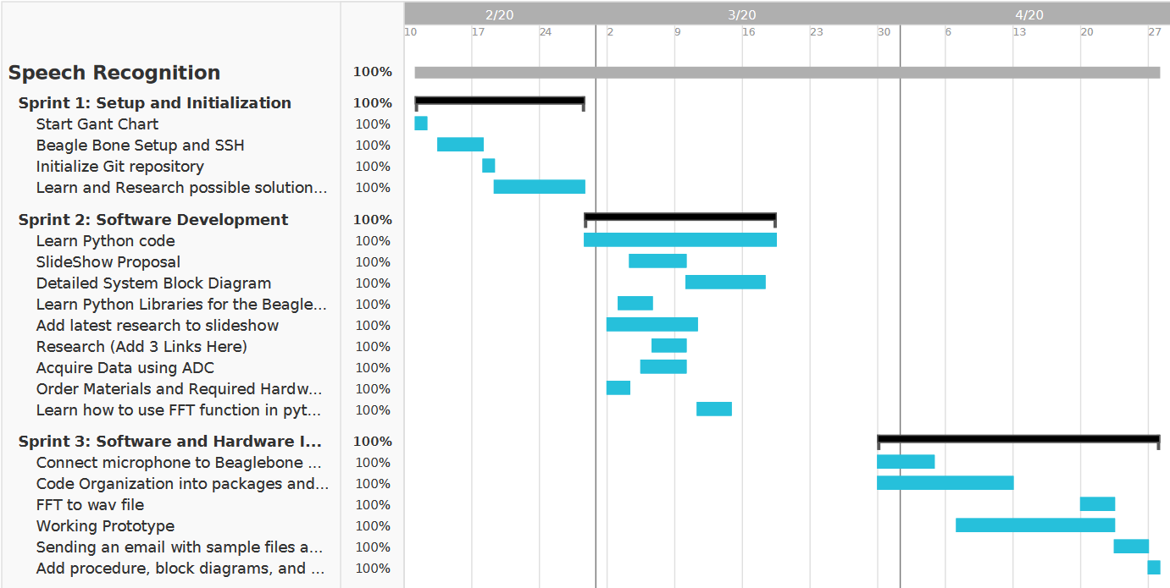
OUR TIMELINE

Slide 13
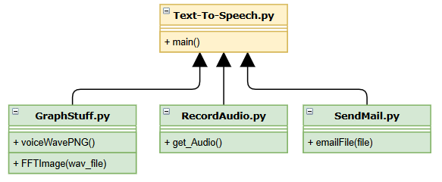
Program Outline
Text-To-Speech.py
Main Program File, which integrates the entire project into an orderly program
GraphStuff.py
voiceWavePNG(): Generates a png file of the .wav file
FFTImage(wav_file): Generates visual graph of single and dbl FFT waveform.
RecordAudio.py
get_Audio() : Records the audio file using speech recognition library
SendMail.py
emailFile(file) : Sends an email to the user with a selected file attachment
Testing Process:
Each module in green is located in the “Setup” package. Therefore, the advantage of creating a package is that the developers can test code individually and later implement into the main program.

Slide 14
Quick Start Guide
Run Putty/SSH
Creating and Navigating Directories
Run Program

Slide 15
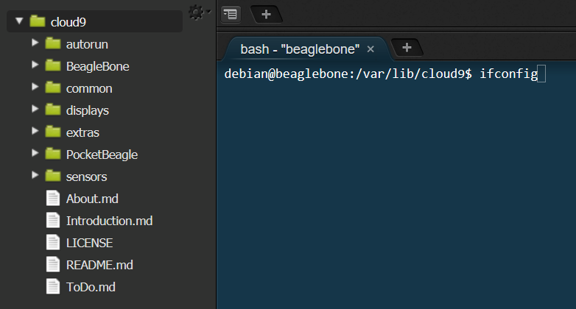
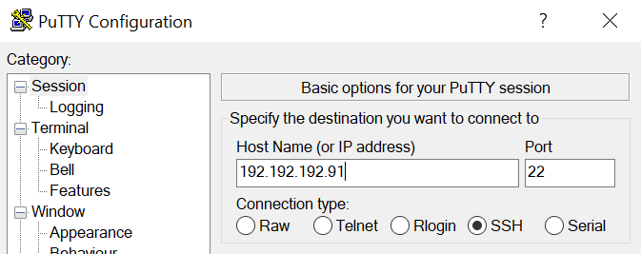
Running Putty: SSH tool
Step One:
ifconfig
Step Two:
Start SSH
Software and type ip address acquired from ifconfig command

Slide 16
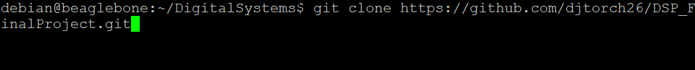
Creating .git Directory
Step Three: Clone Repository command:
“git clone https://github.com/djtorch26/DSP_FinalProject.git”
Navigation commands:
ls: shows a list of files and folders inside a directory
cd: change directory ie. cd DigitalSystems

Slide 17
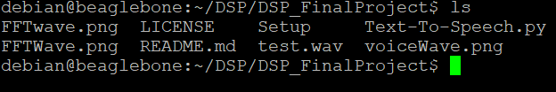
Navigating the .git directory
Step Four:
“cd DSP_FinalProject”
Navigation commands:
ls: shows a list of files and folders inside a directory
cd: change directory ie. cd DigitalSystems

Slide 18
Running the Program
Step Five:
“sudo python3 Text-To-Speech.py”
This command will run the python program and will send back data based off of the .wav file created.
Navigation commands:
ls: shows a list of files and folders inside a directory
cd: change directory ie. cd DigitalSystems

Slide 19
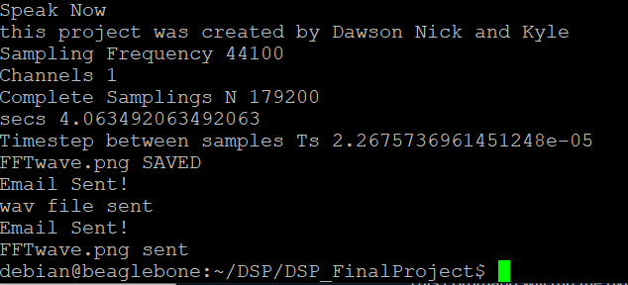
Program Return
This is the return when the user says “This project was created by Dawson, Nick, and Kyle.”

Slide 20
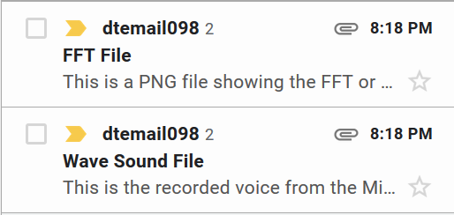


Program Return
*Audio File sent by email*

Slide 21
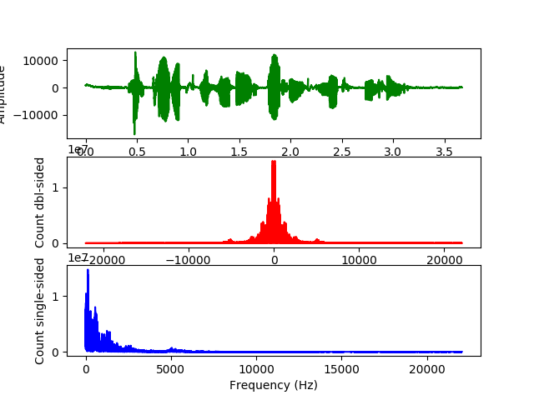
Program Return
*PNG File sent by email*
“This Project was created by Dawson Nick and Kyle”

Slide 22
Future Improvements
Fixing bugs
Data Transfer
USABILITY
When recording your voice, there is an awkward period of time where you don’t know when to speak. This is in regards to the ALSA library printing to console. This would also include improving code and removing unnecessary code and packages.
Adding a change email feature, so when the program is running, you can send the data to any selected email, including multiple emails.
Creating a UI, user interface, to make it easier for the user to operate this program. This would mean the user would not have to SSH into the console. The user would only need to push a button

Slide 23
RESOURCES
These are some of the sources that helped us with our project
Websites
Github
The Fundamentals of FFT-Based Signal Analysis and Measurement
Audio Processing: Speech Synthesis and Recognition
Speech Recognition Library
Python For Scientists and Engineers
How to use Email in Python Project
Deep Learning Material
Speech Recognition and Deep Learning
Libraries
Numpy
Pyaudio
Scipy
time
Matplotlib

Slide 24
THANKS!
Does anyone have any questions?

