Slide 1
PRICE COLLECTION ANALYSIS
Prices rose 36% over 11 years, 2.8% a year
supermarket_price_collection
6,600 observations · 87 items · 10 categories · Jan 2015 to Dec 2025 · 230 data faults repaired
Generated by PriceLab. Every figure is reproducible from the exported configuration.
Notes:
Open on the headline number, then say what the collection is and over what period. Do not read the subtitle aloud, it is there for the reader.

Slide 2
What the data shows
230 observations (3.5%) are unit errors, and they are recoverable
1
230 of 6,600 records (3.5%); 0 residual outliers after repair
Prices rose 36% overall, 2.8% a year
2
index 135.6 at Dec 2025, 2.83% annualised
Inflation peaked at 3.5% in October 2020 and has since eased to 2.7%
3
peak 3.5% (Oct 2020), latest 2.7%, trough 1.8% (Jul 2016)
Ignoring item replacement would misstate Sun cream by 15 percentage points
4
Sun cream -15.1pp · Coffee -11.2pp · Chicken -9.9pp · Pasta +9.4pp
Notes:
Four findings, ranked by materiality. Say each headline once and move on; the detail comes on the slides that follow.

Slide 3
The headline numbers
136
2.8%
3.5%
230
All items index at Dec 2025, Jan 2015 = 100
Average annual rate of change
Peak twelve period rate, Oct 2020
Data faults detected and repaired
Figures are produced from the cleaned collection using a matched model index. The aggregate is equally weighted, as no expenditure weights were supplied.
Notes:
The headline numbers, gathered in one place before the detail. Figures are produced from the cleaned collection using a matched model index. The aggregate is equally weighted, as no expenditure weights were supplied.

Slide 4
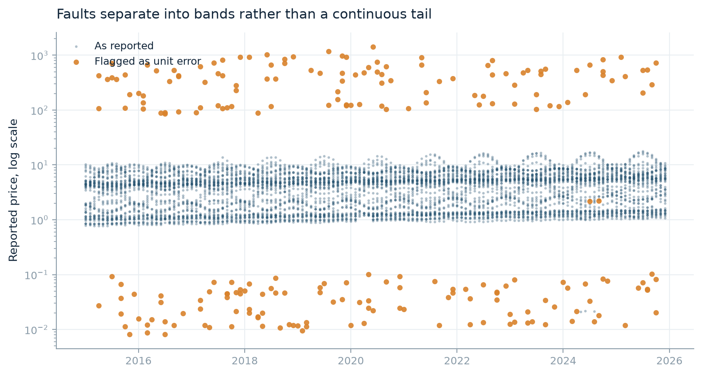
DATA QUALITY
230 observations (3.5%) are unit errors, and they are recoverable
117 values sit around one hundred times the level of their own item and 113 sit around one hundredth of it. The multipliers cluster tightly rather than forming a continuous tail, which is the signature of a unit of measurement fault rather than genuine price volatility. Because the mechanism is known, the true value can be restored by rescaling. The observations were repaired rather than deleted. Deleting them would have broken the item continuity that a matched index depends on.
230 of 6,600 records (3.5%); 0 residual outliers after repair
Notes:
117 values sit around one hundred times the level of their own item and 113 sit around one hundredth of it. The multipliers cluster tightly rather than forming a continuous tail, which is the signature of a unit of measurement fault rather than genuine price volatility. Because the mechanism is known, the true value can be restored by rescaling. The observations were repaired rather than deleted. Deleting them would have broken the item continuity that a matched index depends on.
Recommended action: Review the flagged list before publication. If the collection system can be changed, a field-level unit validation at entry would remove this class of error at source.

Slide 5
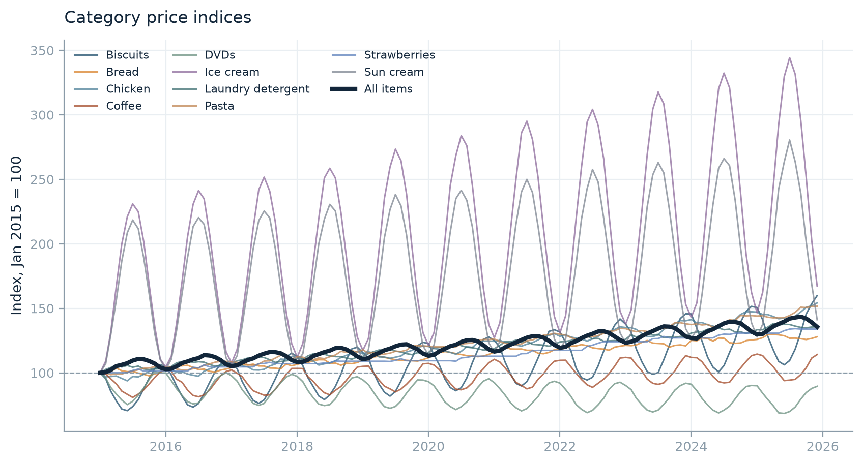
PRICE TREND
Prices rose 36% overall, 2.8% a year
The all-items index reaches 135.6 at December 2025 against a base of 100 at January 2015. With no expenditure weights supplied this aggregate is an equally weighted geometric mean of the category indices, so it is indicative of direction and broad magnitude rather than an authoritative headline rate.
index 135.6 at Dec 2025, 2.83% annualised
Notes:
The all-items index reaches 135.6 at December 2025 against a base of 100 at January 2015. With no expenditure weights supplied this aggregate is an equally weighted geometric mean of the category indices, so it is indicative of direction and broad magnitude rather than an authoritative headline rate.
Recommended action: Supply expenditure weights to turn this into a publishable headline rate.

Slide 6
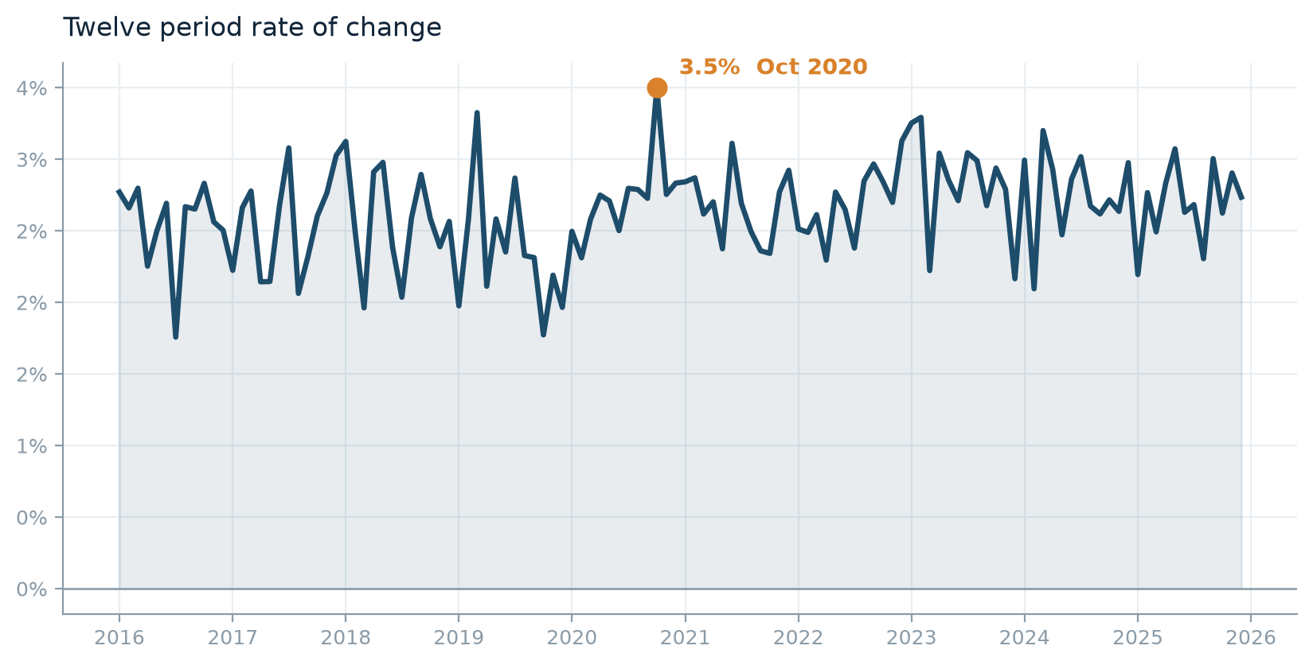
PRICE TREND
Inflation peaked at 3.5% in October 2020 and has since eased to 2.7%
The twelve period rate traces a clear cycle rather than a steady trend. The peak sits in October 2020 and the rate at the end of the series is 2.7%. A single average over the whole period would hide this shape entirely.
peak 3.5% (Oct 2020), latest 2.7%, trough 1.8% (Jul 2016)
Notes:
The twelve period rate traces a clear cycle rather than a steady trend. The peak sits in October 2020 and the rate at the end of the series is 2.7%. A single average over the whole period would hide this shape entirely.

Slide 7
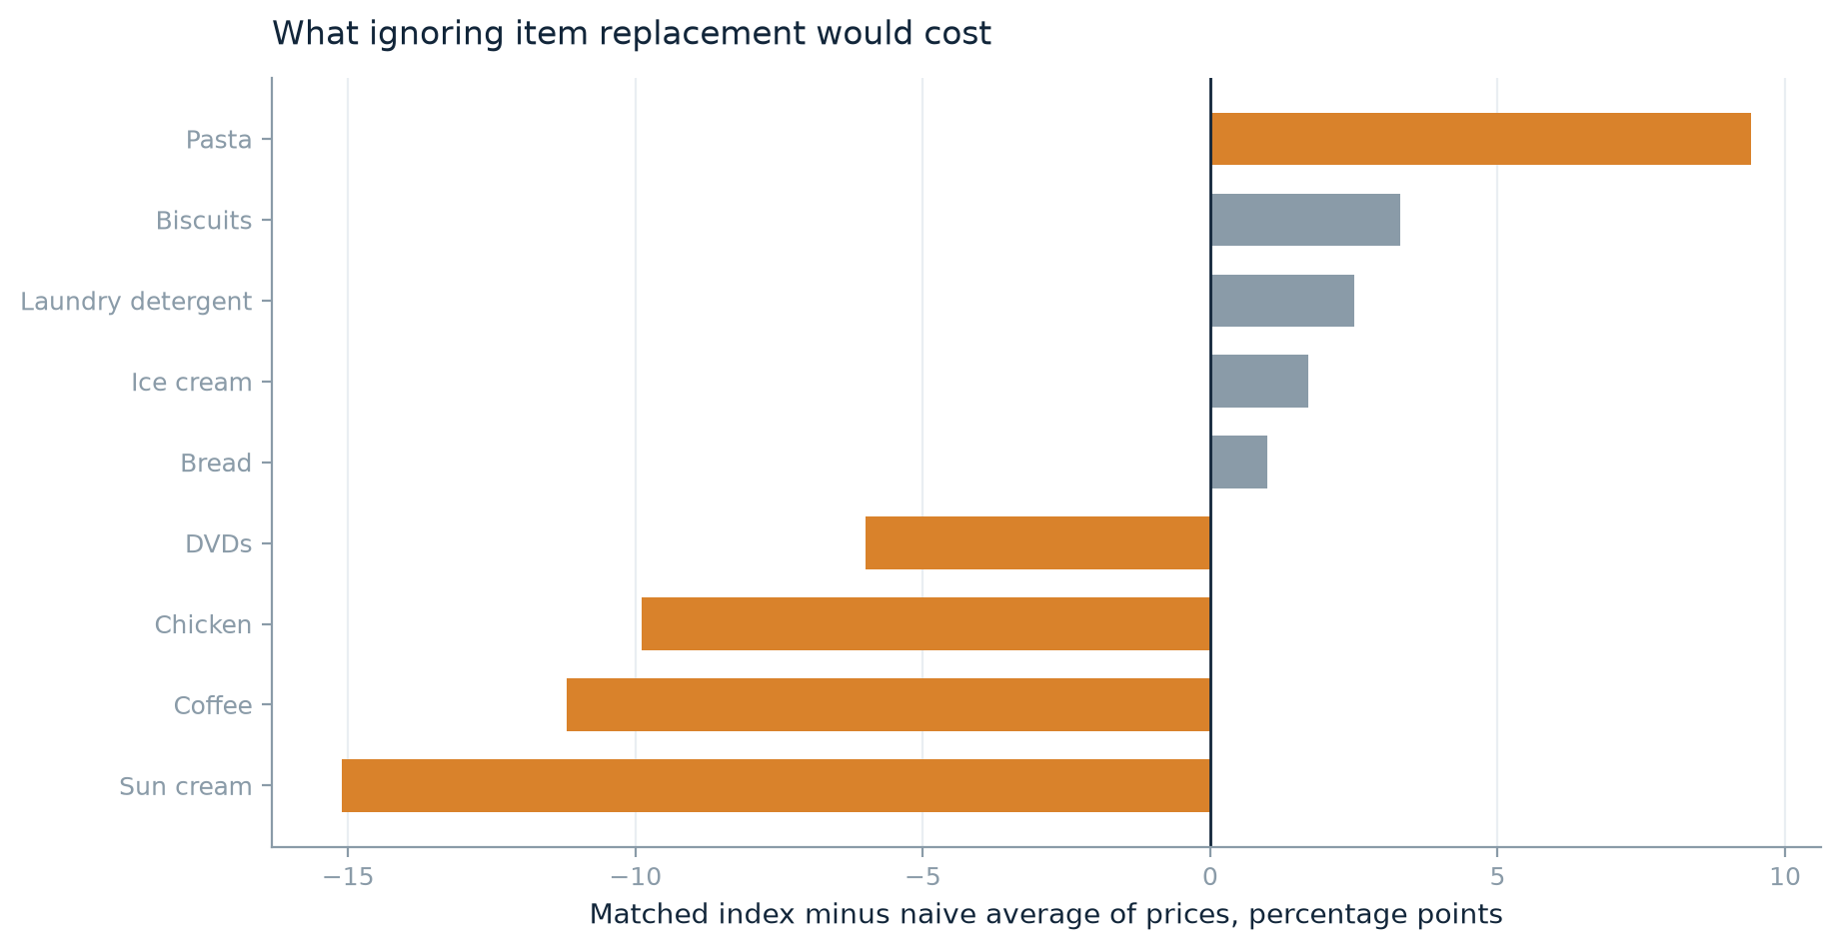
METHOD
Ignoring item replacement would misstate Sun cream by 15 percentage points
Comparing a simple average of prices from one period to the next overstates Sun cream, Coffee, Chicken and understates Pasta, Biscuits, Laundry detergent against the matched comparison. Where replacements enter dearer than the items they replace, the naive measure counts the change in the sample as inflation; where they enter cheaper it does the reverse. Over a long collection this choice moves the answer further than any outlier rule.
Sun cream -15.1pp · Coffee -11.2pp · Chicken -9.9pp · Pasta +9.4pp
Notes:
Comparing a simple average of prices from one period to the next overstates Sun cream, Coffee, Chicken and understates Pasta, Biscuits, Laundry detergent against the matched comparison. Where replacements enter dearer than the items they replace, the naive measure counts the change in the sample as inflation; where they enter cheaper it does the reverse. Over a long collection this choice moves the answer further than any outlier rule.
Recommended action: Keep the matched comparison. If a naive average is required for continuity with an older series, publish both.

Slide 8
PRICE TREND
Category rates diverge by 5.8 percentage points a year, from Ice cream to DVDs
Ice cream runs at 4.8% a year while DVDs runs at -1.0%. Divergence of this size means the aggregate conceals more than it reveals, and any weighting decision will move the headline materially.
Ice cream 4.8% · Biscuits 4.4% · Chicken 4.0% … DVDs -1.0%
Notes:
Ice cream runs at 4.8% a year while DVDs runs at -1.0%. Divergence of this size means the aggregate conceals more than it reveals, and any weighting decision will move the headline materially.

Slide 9
PRICE TREND
DVDs is in sustained deflation
Prices fall at 1.0% a year over the full period, against a rising aggregate. A category moving persistently against the general trend usually reflects something structural in the product rather than the price environment, though this data cannot establish what.
DVDs -1.0% a year
Notes:
Prices fall at 1.0% a year over the full period, against a rising aggregate. A category moving persistently against the general trend usually reflects something structural in the product rather than the price environment, though this data cannot establish what.

Slide 10
DATA QUALITY
Strawberries is seasonally unavailable, not seasonally priced
308 observations are absent, recurring in the same calendar months (January, February, March, April, October, November, December) across the collection period and affecting every item at once. This is a product that leaves the shelf, not a price that falls. That distinction matters because a category whose seasonality lives in availability needs a seasonal index treatment, whereas one whose seasonality lives in price does not.
308 gaps across 77 periods, January, February, March, April, October, November, December
Notes:
308 observations are absent, recurring in the same calendar months (January, February, March, April, October, November, December) across the collection period and affecting every item at once. This is a product that leaves the shelf, not a price that falls. That distinction matters because a category whose seasonality lives in availability needs a seasonal index treatment, whereas one whose seasonality lives in price does not.
Recommended action: Apply an explicit seasonal method to Strawberries and state it. Holding the level across the out-of-season gap is defensible, but it must be a stated choice rather than a side effect.

Slide 11
What to do about it
230 observations (3.5%) are unit errors, and they are recoverable
Review the flagged list before publication. If the collection system can be changed, a field-level unit validation at entry would remove this class of error at source.
Prices rose 36% overall, 2.8% a year
Supply expenditure weights to turn this into a publishable headline rate.
Ignoring item replacement would misstate Sun cream by 15 percentage points
Keep the matched comparison. If a naive average is required for continuity with an older series, publish both.
Strawberries is seasonally unavailable, not seasonally priced
Apply an explicit seasonal method to Strawberries and state it. Holding the level across the out-of-season gap is defensible, but it must be a stated choice rather than a side effect.
Notes:
Close on actions rather than findings. Each one names something the reader can change.

Slide 12
How this was produced
Cleaning
Aggregation
Missing sentinels recoded before calculation. Outliers judged against a 13 period centred rolling median of each item's own series, so a trending price is not mistaken for a fault. 230 scale errors repaired by rescaling rather than deleted; 0 unexplained residuals remain.
Jevons elementary index, matched model, chained. Items entering or leaving between two periods are excluded from that comparison, so replacement does not enter as price change.
Imputation
Limitations
Default no imputation. Biscuits: class mean; Bread: class mean; Chicken: class mean; Coffee: class mean; DVDs: class mean; Ice cream: class mean; Laundry detergent: class mean; Pasta: class mean; Strawberries: seasonal hold; Sun cream: class mean
No quality adjustment between a departing item and its replacement, so a change in specification is treated as price change. No expenditure weights, so the aggregate is equally weighted and indicative.
Configuration exported alongside this deck reproduces every figure.
Notes:
Closing method slide. Use this to answer 'how do I know this is right': every setting named here is in the exported configuration file, so the analysis can be reproduced exactly, and every judgement call (imputation, formula, chaining) is a stated default rather than something inferred from the data.

