Slide 1
Regular Expressions and Languages
代立云

Slide 2
Regular Expressions
Now we switch our attention from machine like descriptions of languages deterministic and nondeterministic finite automata to an algebraic description the regular expression
However regular expressions offer something that automata do not a declarative way to express the strings we want to accept

Slide 3
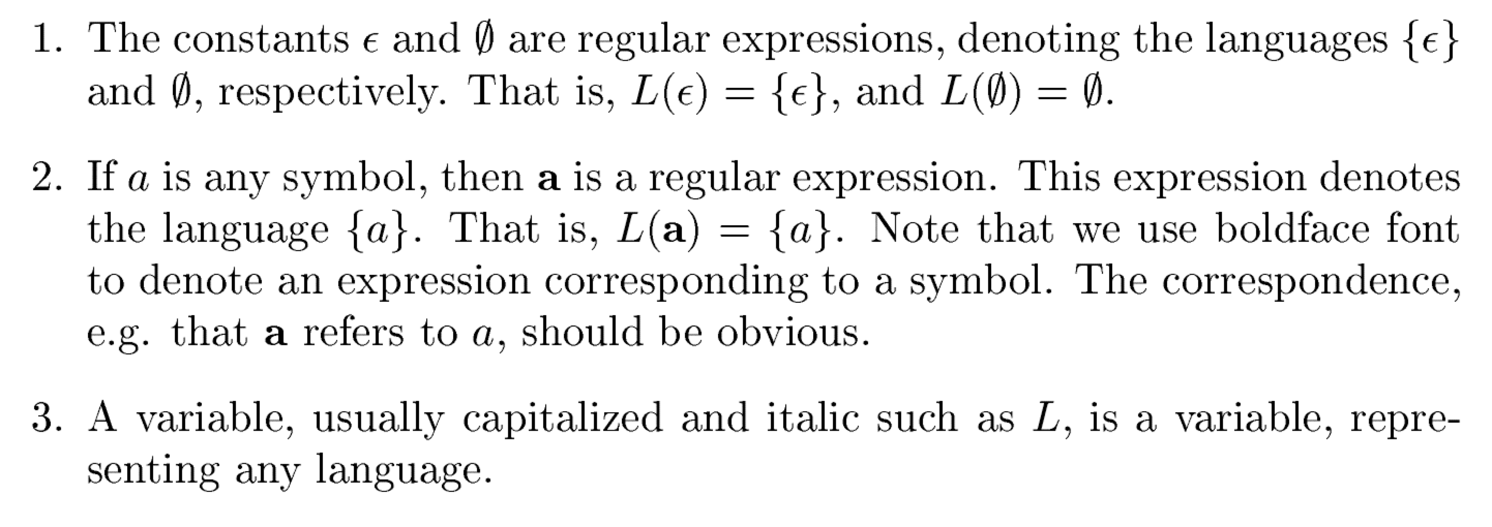
BASIS

Slide 4
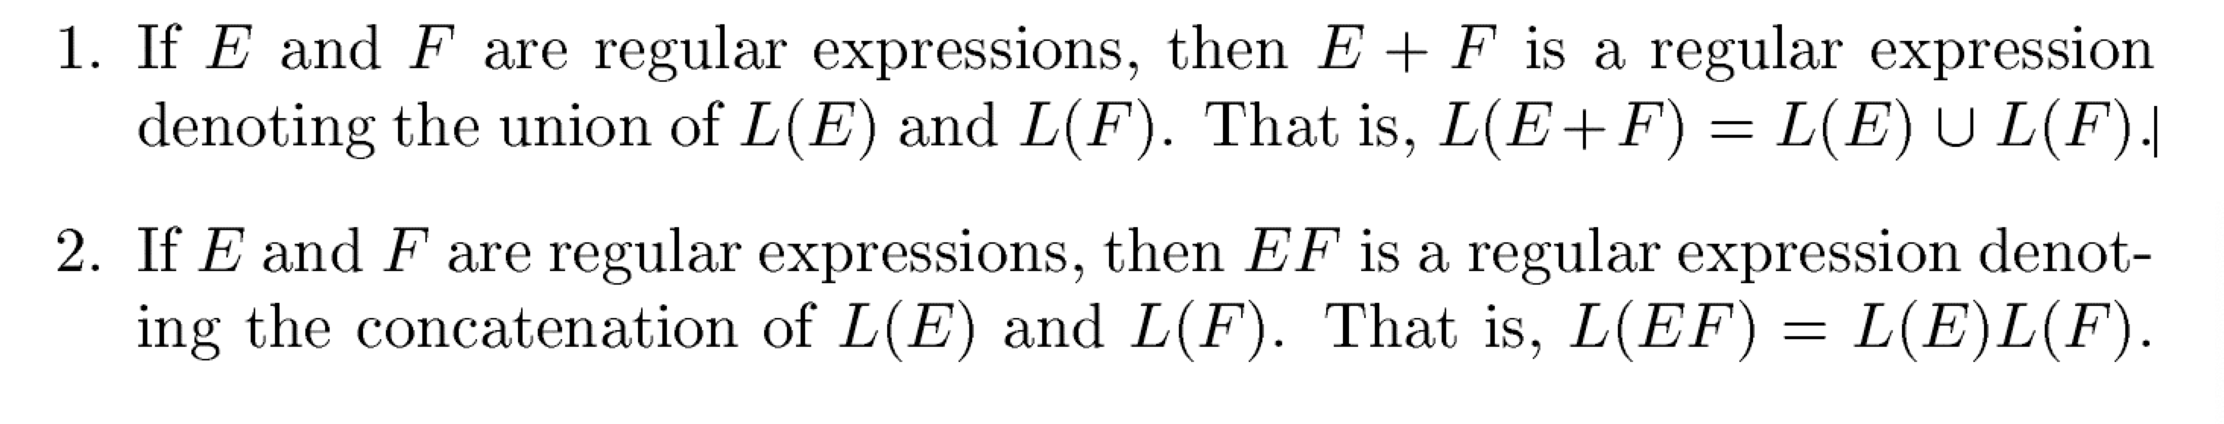
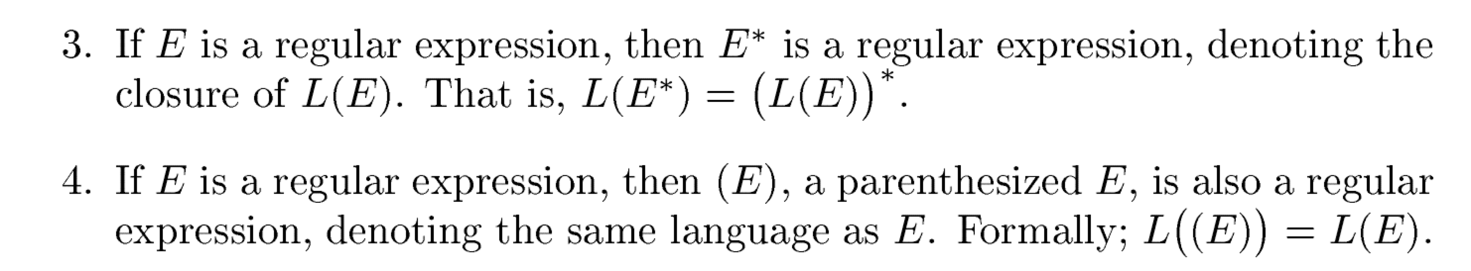
INDUCTION

Slide 5
Example 3.2
Let us write a regular expression for the set of strings that
consist of alternating 0`s and 1`s？

Slide 6
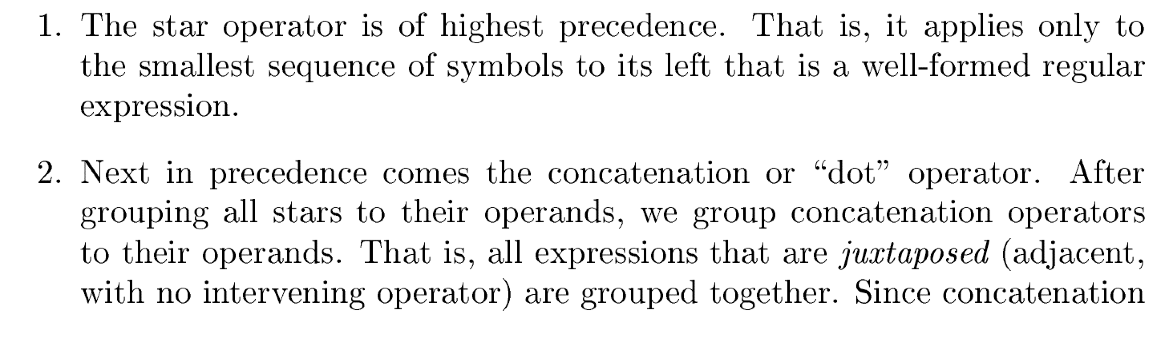
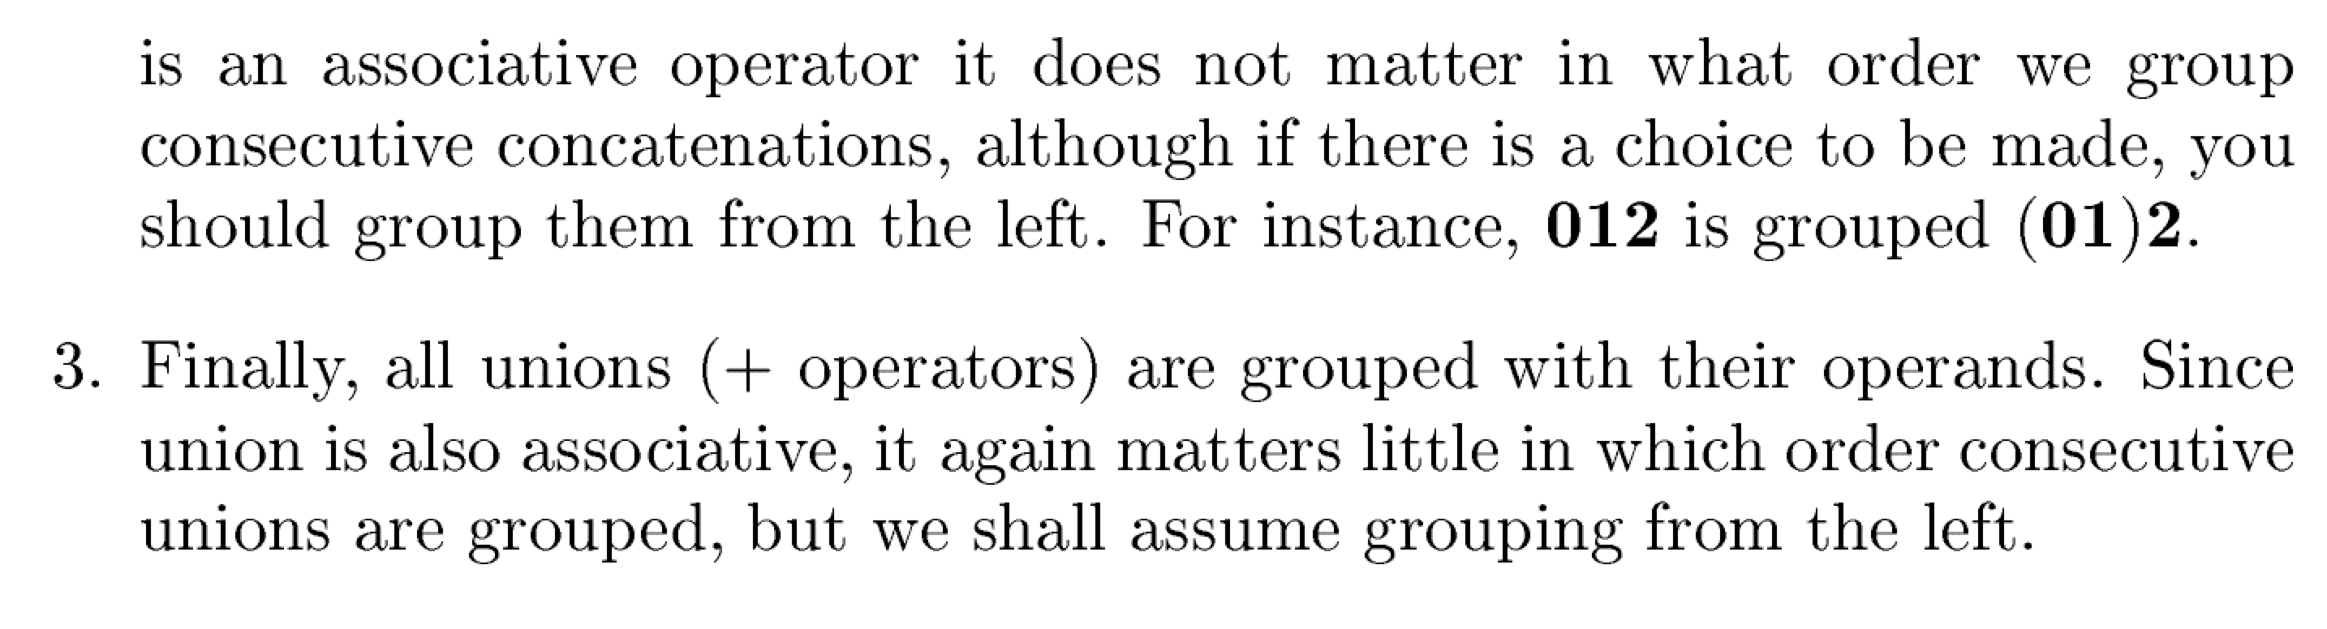
Precedence of Regular Expression Operators

Slide 7
Example
How about the expression 01* + 1 group?

Slide 8
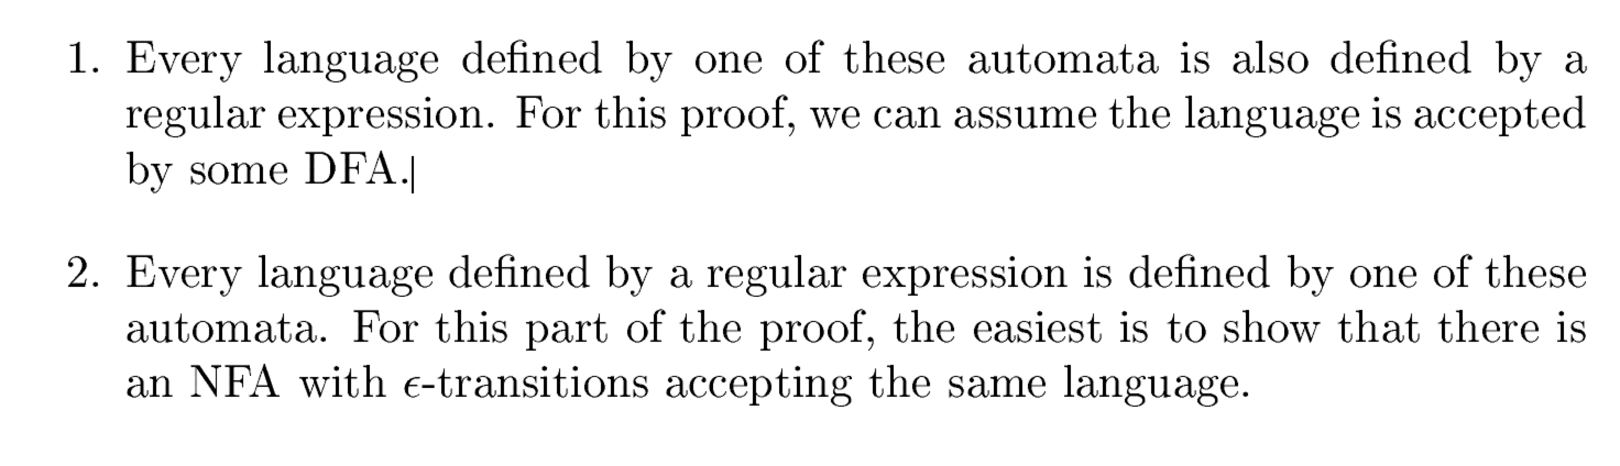
Finite Automata and Regular Expressions

Slide 9
Exercise
The set of strings over alphabet {a,b,c} containning at least one a at least one b.

Slide 10
Exercise
The set of all strings of 0’s and 1’s not containing 101 as a substring

Slide 11
Theorem

Slide 12
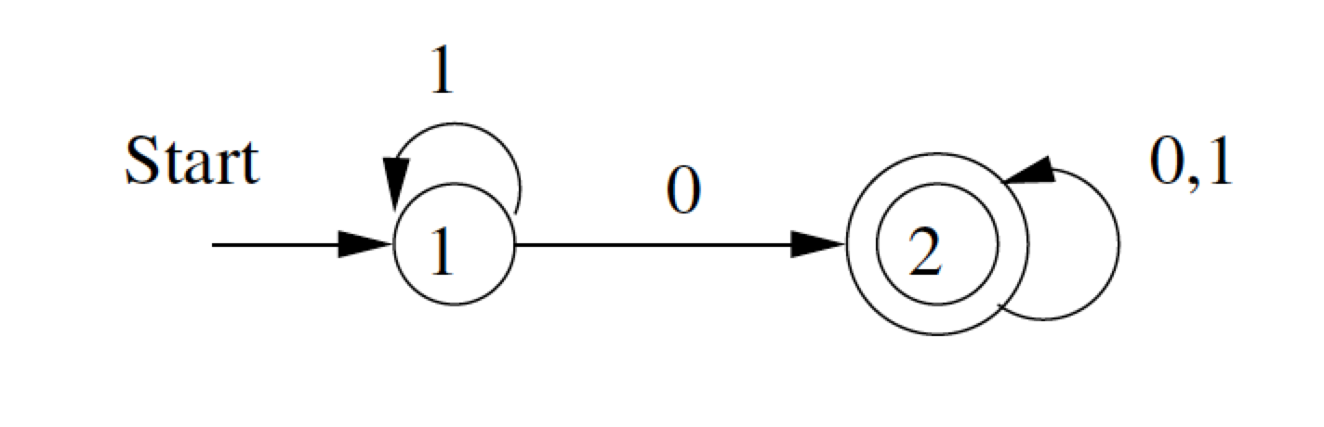
Example

Slide 13
Converting Regular Expressions to Automata

