Slide 1
C++ Programming
Dai Liyun
dailiyun@swu.edu.cn
Slide 1- <number>

Slide 2
Grading Policy
Programming Assignments: (40%)
  Performance in class:(10%)
  Homework: (20%)
  Stage Test: (10%)
Test: (60%)
Slide 1- <number>

Slide 3
WebSite
https://github.com/djuanbei/CPLUSPLUS
Slide 1- <number>

Slide 4
Reference
Problem Solving with C++(text book)
C++ Primer (book)
The C++ Programming Language (book)
http://www.cplusplus.com/reference/
Slide 1- <number>

Slide 5
The contents
Chapter 1: Introduction (3 Lessons)
Chapter 6: I/O Stream as an Introduction to Objects and Classes (6)
TOOL and debug (add) (3)
Chapter 7: Arrays (3)
Chapter 8: String and Vectors (6)
Chapter 9: Pointers and Dynamic Arrays(3)
Chapter 10: Defining Classes (3)
Chapter 11: Friends, Overloaded Operators, and Arrays in Classes (6)
Chapter 15: Inheritance （6）
Chapter 17: Templates (6)
Slide 1- <number>

Slide 6
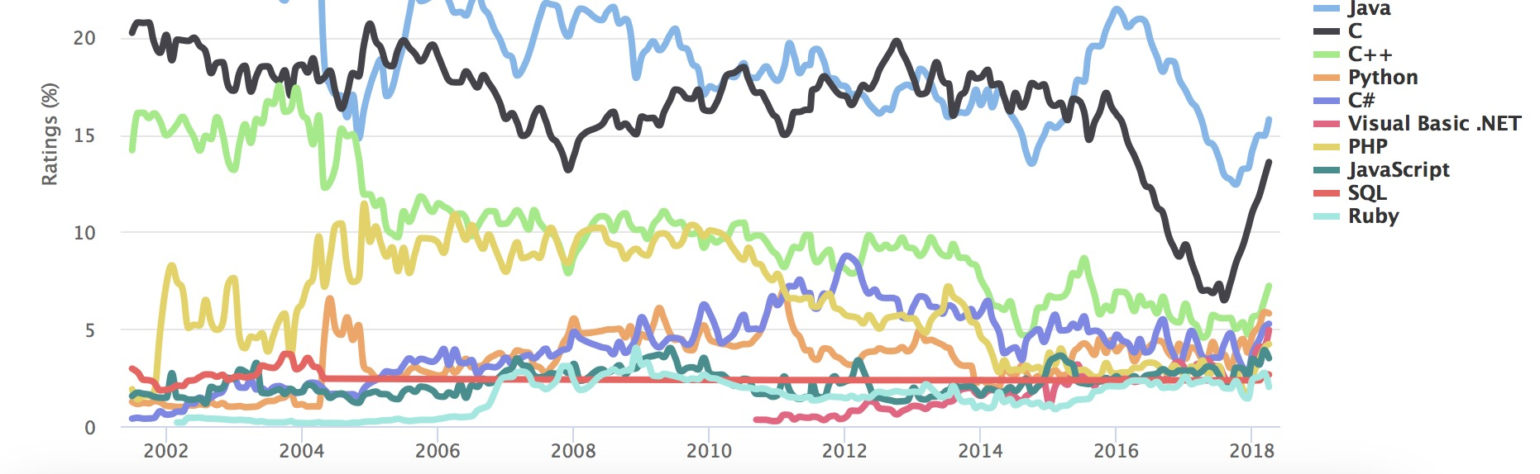
Why learn C++
TIOBE Index
Slide 1- <number>

Slide 7


Many companies use C++
Slide 1- <number>

Slide 8
Overview
1.1 Introduction to C++
1.2 Program Style
Slide 1- <number>

Slide 9
Introduction to C++
Where did C++ come from?
  Derived from the C language
Slide 1- <number>

Slide 10
C++ History
C++ developed by Bjarne Stroustrup at AT&T
Bell Labs in the 1980s.
  Overcame several shortcomings of C
  Incorporated object oriented programming
  C remains a subset of C++
Slide 1- <number>

Slide 11
The difference between C and C++
malloc (free) new(delete)
struct class
gcc g++
Slide 1- <number>

Slide 12
The difference between C and C++
Fast
Simple
Cross-platform
Had high level features
Slide 1- <number>

Slide 13
C++ and Object Oriented Programming
Abbreviated OOP
Used for many modern programs
Program is viewed as interacting objects
  Each object contains algorithms to describe
  its behavior
  Program design phase involves designing
  objects and their algorithms
Slide 1- <number>

Slide 14
OOP Characteristics
Encapsulation(封装)
  Information hiding
  Objects contain their own data and algorithms
Inheritance（继承）
  Writing reusable code
  Objects can inherit characteristics from other objects
Polymorphism（多态）
  A single name can have multiple meanings depending
  on its context
Slide 1- <number>

Slide 15
Our first C++ Programming
#include<iostream>
int main()
{
std::out<<“Hello World!”<<std::endl;
return 0;
}
Slide 1- <number>

Slide 16
A Sample C++ Program
A simple C++ program begins this way
#include <iostream>
using namespace std;
int main()
{
And ends this way
return 0;
}
Slide 1- <number>

Slide 17
Explanation of code (1/5)
Variable declaration line
int number_of_pods, peas_per_pod, total_peas;
  Identifies names of three variables to name numbers
  int means that the variables represent integers
Slide 1- <number>

Slide 18
Explanation of code (2/5)
Program statement
cout << “Press return after entering a number.\n”;
  cout (see-out) used for output to the monitor
  “<<“ inserts “Press…a number.\n” in the data
  bound for the monitor
  Think of cout as a name for the monitor
    “<<“ points to where the data is to end up
  ‘\n’ causes a new line to be started on the monitor
Slide 1- <number>

Slide 19
Explanation of code (3/5)
Program statement
cin >> number_of_pods;
  cin (see-in) used for input from the keyboard
  “>>” extracts data from the keyboard
  Think of cin as a name for the keyboard
    “>>” points from the keyboard to a variable where the data
    is stored
Slide 1- <number>

Slide 20
Explanation of code (4/5)
Program statement
total_peas = number_of_pods * peas_per_pod;
  Performs a computation
  ‘*’ is used for multiplication
  ‘=‘ causes total_peas to get a new value based on
  the calculation shown on the right of the equal sign
Slide 1- <number>

Slide 21
Explanation of code (5/5)
Program statement
cout << number_of_pods;
  Sends the value of variable number_of_pods to the monitor
Slide 1- <number>

Slide 22
Program Layout (1/3)
Compiler accepts almost any pattern of line
breaks and indentation
Programmers format programs so they
are easy to read
  Place opening brace ‘{‘ and closing brace ‘}’
  on a line by themselves
  Indent statements
  Use only one statement per line
Slide 1- <number>

Slide 23
Program Layout (2/3)
Variables are declared before they are used
  Typically variables are declared at the beginning of
  the program
  Statements (not always lines) end with a semi-colon
Include Directives
#include <iostream>
  Tells compiler where to find information about items
  used in the program
  iostream is a library containing definitions of cin and cout
Slide 1- <number>

Slide 24
Program Layout (3/3)
using namespace std;
Tells the compiler to use names in iostream in
a “standard” way
To begin the main function of the program
int main()
{
To end the main function
return 0;
}
  Main function ends with a return statement
Slide 1- <number>

Slide 25
Running a C++ Program
C++ source code is written with a text
editor
The compiler on your system converts
source code to object code.
The linker combines all the object code
into an executable program.
Slide 1- <number>

Slide 26
Run a Program
Obtain code in Display 1.3
Compile the code
Fix any errors the compiler indicates and
re-compile the code
Run the program
Now you know how to run a program on
your system
Slide 1- <number>

Slide 27
Section 1.1 Conclusion
Can you…
  Describe the output of this line?
  cout << “C++ is easy to understand.”;
  Explain what this line does?
  cin >> peas_per_pod;
  Explain this? #include <iostream>
Slide 1- <number>

Slide 28
Program Style
A program written with attention to style
  is easier to read
  easier to correct
  easier to change
  Ref:
  https://users.ece.cmu.edu/~eno/coding/CppCodingStandard.html
Slide 1- <number>

Slide 29
Program Style - Comments
// is the symbol for a single line comment
  Comments are explanatory notes for the programmer
  All text on the line following // is ignored by the
  compiler
  Example: //calculate regular wages
  gross_pay = rate * hours;
/* and */ enclose multiple line comments
  Example: /* This is a comment that spans
  multiple lines without a
  comment symbol on the middle line
  */
Slide 1- <number>

Slide 30
Program Style - Constants
Number constants have no mnemonic value
Number constants used throughout a program
are difficult to find and change when needed
Constants
  Allow us to name number constants so they have
  meaning
  Allow us to change all occurrences simply by
  changing the value of the constant
Slide 1- <number>

Slide 31
Constants
const is the keyword to declare a constant
Example:
const int WINDOW_COUNT = 10;
declares a constant named WINDOW_COUNT
  Its value cannot be changed by the program like a variable
  It is common to name constants with all capitals
Slide 1- <number>

Slide 32
Section 1.2 Conclusion
Can you
  Create a named constant of type double?
  Determine if a program can modify the value of a constant?
  Describe the benefits of comments?
Slide 1- <number>

Slide 33
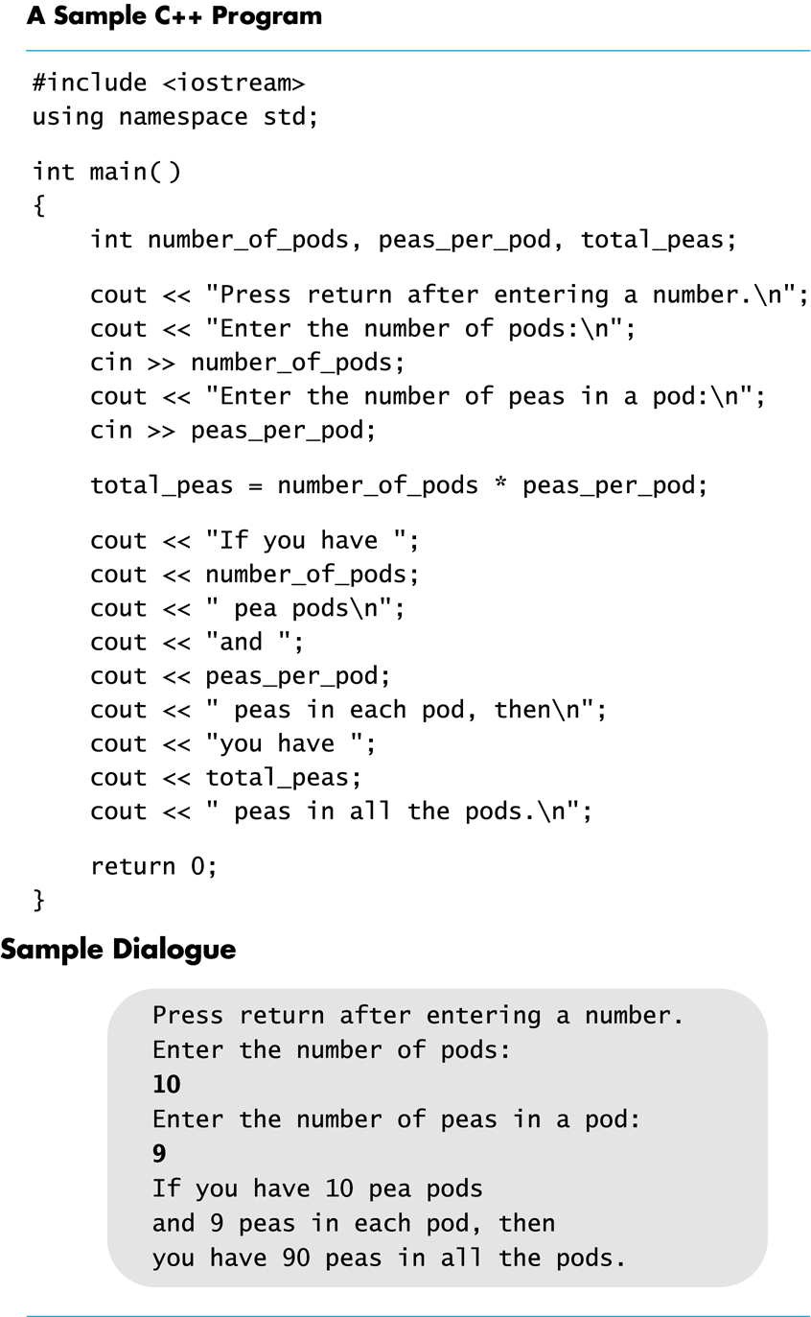
Display 1.1
Back
Next
Slide 1- <number>

Slide 34
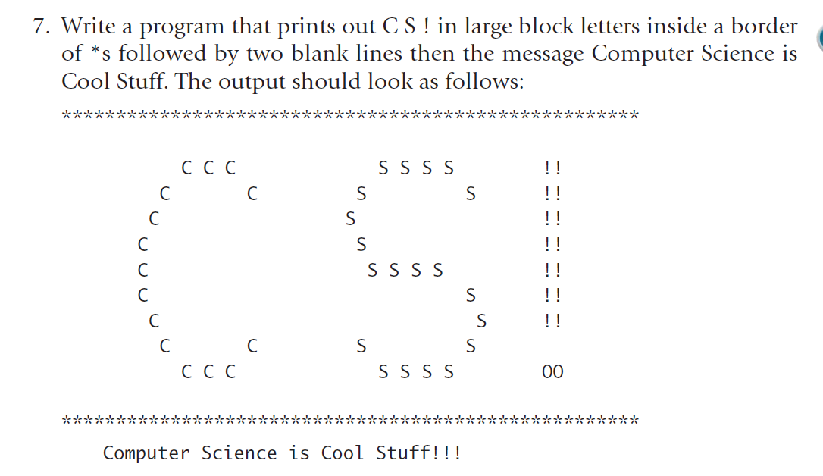
Exercise (page 37 exercise 7)
Slide 1- <number>

Slide 35
Next Time
I/O Stream
Slide 1- <number>

