Slide 1
Project
Dai Liyun

Slide 2
Test
(ppt) chapter 6 page 58
(ppt) Chapter 7 page 24
(ppt) Chapter 10 page 71
(ppt) Chapter 11 page 71
(ppt) Chapter 11 page 72

Slide 3
Project 1: (ppt) chapter 6 page 39 “Split long file to many short files”
Project 2: (ppt) chapter 7 page 25 “Using SVG to count the people occurring time”
Project 3: (ppt) chapter 11 page 72 “Define a class for complex numbers. “
Project 4: (ppt) chapter 15 page 62 “Definite class Hero using inheritance“

Slide 4
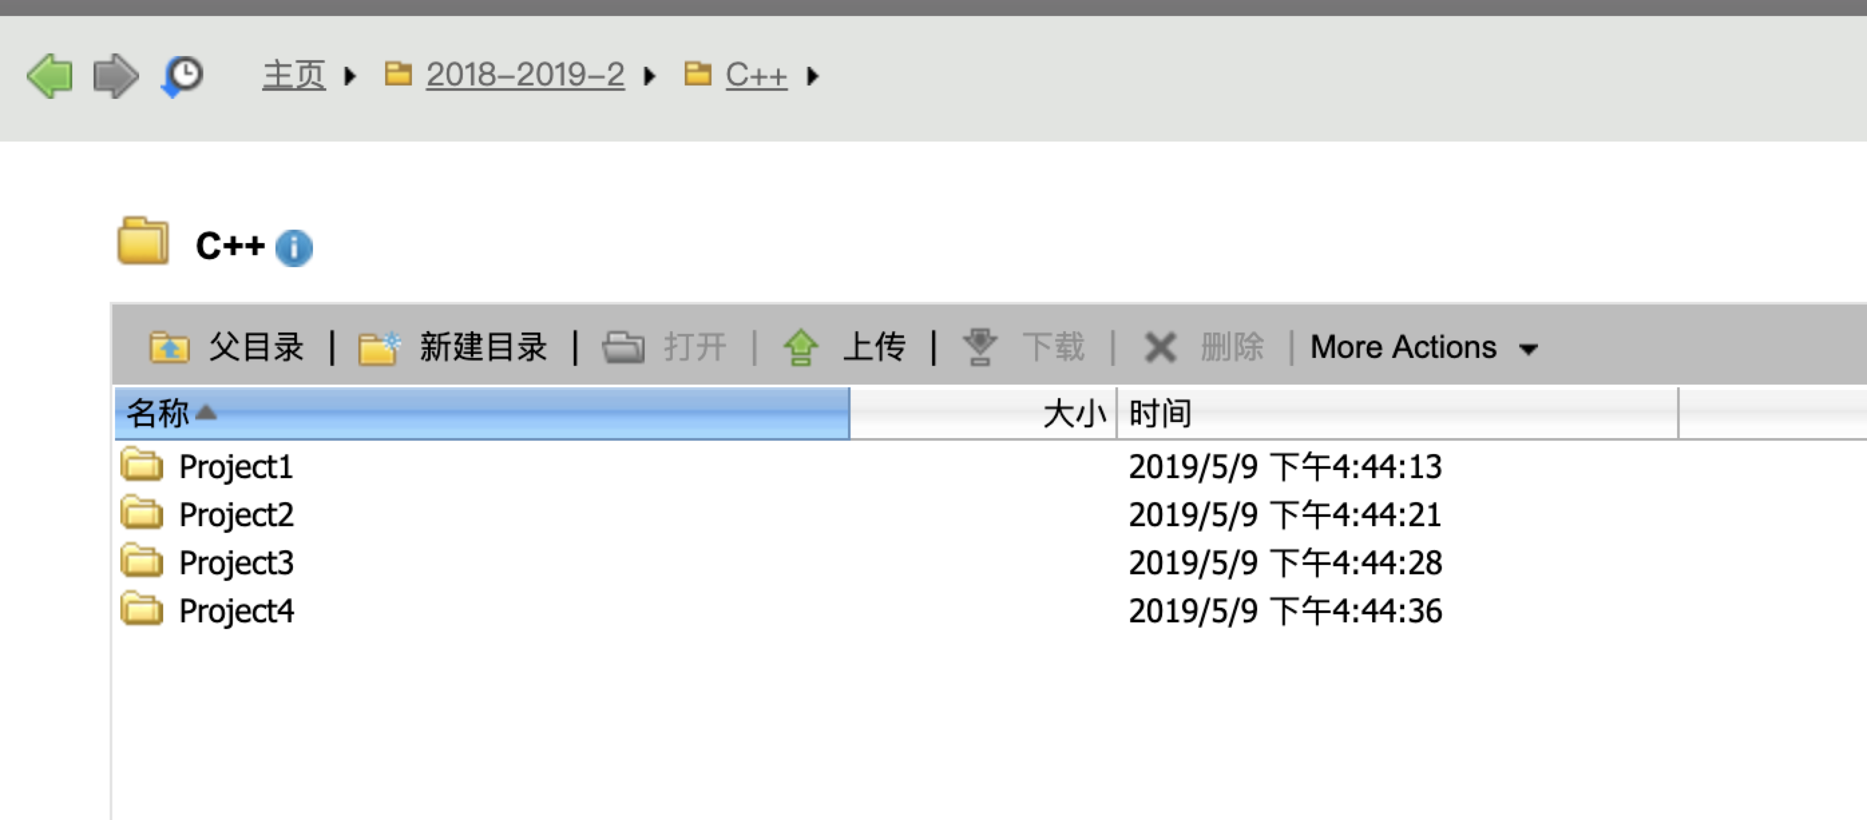
Project submit
172.18.5.102
User: dailiyun
Password: dailiyun

