Slide 1
ITMD 527- DATA ANALYTICS
GROUP - 56
ANUHYA KODURI – A20386751
DHRUVA JULOORI – A20377948
RAJESH AZMEERA – A20370347
Notes:
Product classification is task of automatically predicting the product categories based on description, features of product and other related attributes

Slide 2
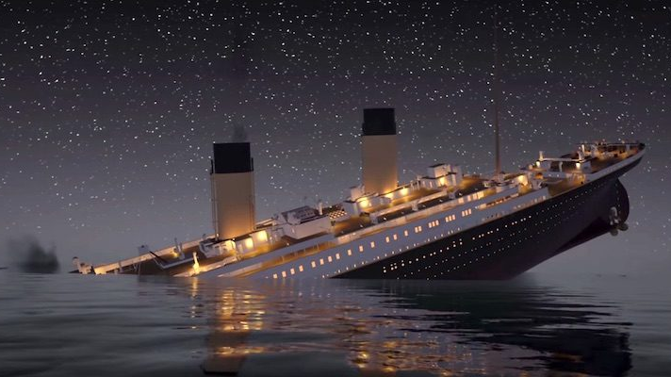
TITANIC
On April 15, 1912, Titanic sank after colliding with an iceberg, killing majority of the passengers and crew. This sensational tragedy shocked the international community and led to better safety regulations for ships.
Notes:
We take a look at scenarios where product classification is widely used. Read from sled

Slide 3
OVERVIEW
OBJECTIVE
VISUAL INTERPRETATIONS
LOGISTIC REGRESSION MODEL
MODEL SELECTION AND EVALUATIONS
RANDOM FOREST CLASSIFICATION ALGORITHM
LEARNINGS

Slide 4
OBJECTIVE
The main objective of this project is to compute the analysis of what sorts of people were likely to survive by applying classification techniques.

Slide 5
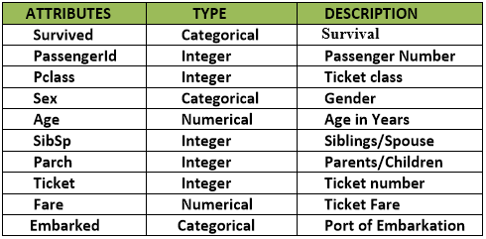
DATASET
Data Source: https://www.kaggle.com/c/titanic/data
Number of Records: 1224
Port of Embarkation: C = Cherbourg, Q = Queenstown, S = Southampton
Sex: M = Male, F = Female
Survived: Y = Yes, N = No
Notes:
We chose our dataset from KAGGLE where this was used as part of a product classification challenge.

Slide 6
DATA PREPROCESSING
Filled the missing values of column age by replacing with the mean value.
Filled the missing values of column Fare by replacing with the mean value.
Notes:
Data was already preprocessed

Slide 7
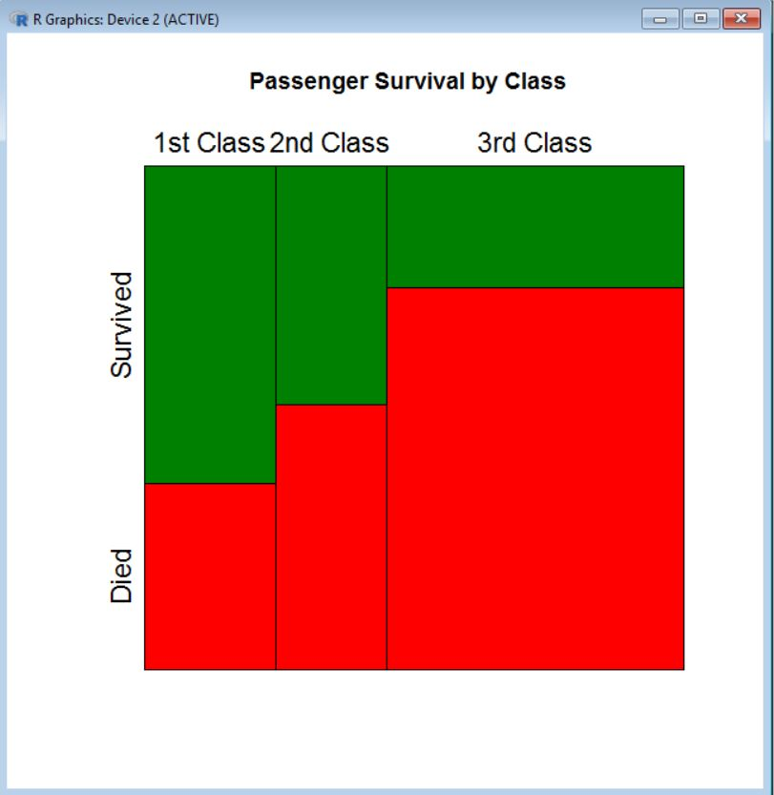

Slide 8
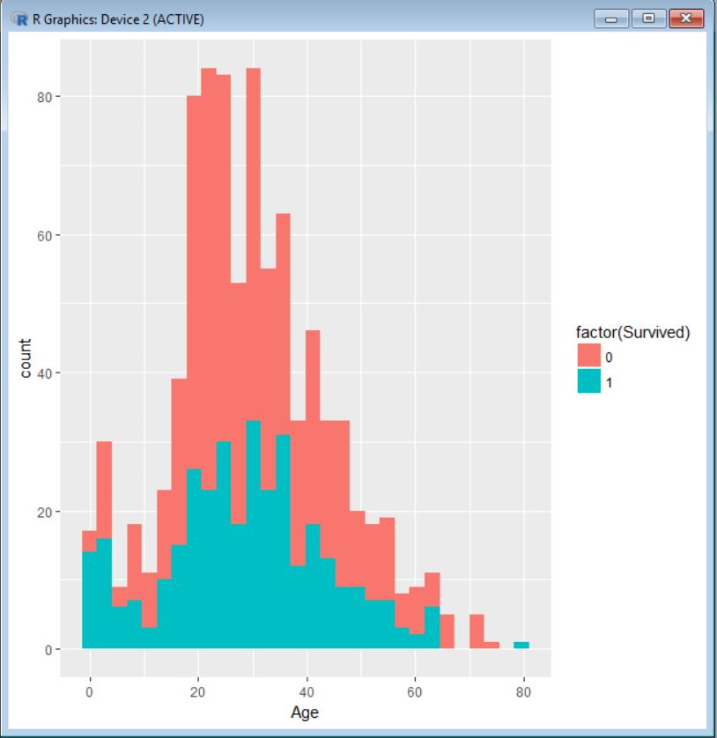

Slide 9
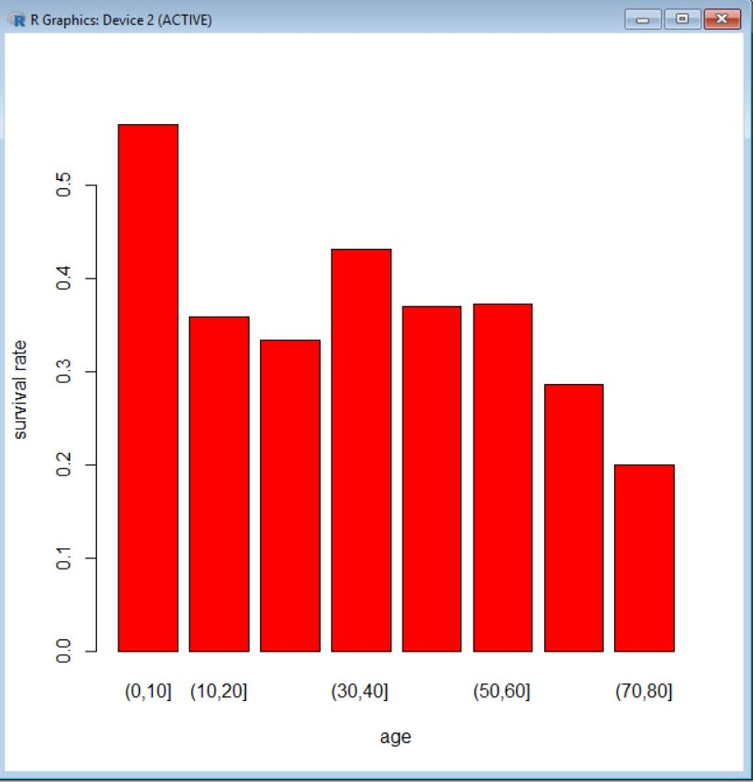

Slide 10
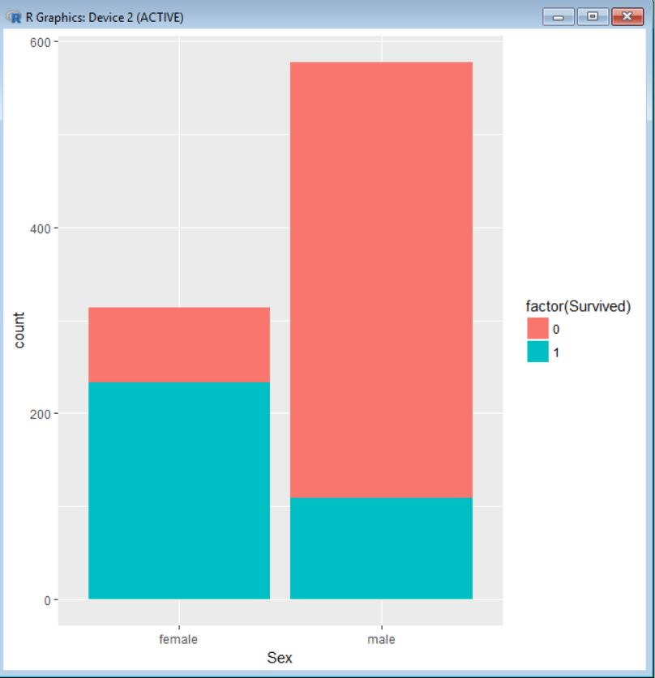

Slide 11
Logistic Regression Model
DATA ANALYSIS
Load data, and run numerical and graphical summaries
Split the data into training and testing
Fit a logistic regression model using training data
Use the fitted model to do predictions for the test data
Create a confusion matrix , and compute the misclassification rate.

Slide 12
BACKWARD ELEMINATION
Start with the full model and eliminates one variable at the time until a reasonable candidate regression model is found. It typically uses a criterion based on the goodness-of-fit F-test. The metric could be p-value, AIC, BIC.
Notes:
Shows how 9 product categories are distributed

Slide 13
STEPWISE REGRESSION
Works by comparing the AIC improvements from dropping each candidate variable, and adding each candidate variable between the upper and lower bound regressor sets supplied, from the current model, and by dropping or adding the one variable that leads to the best AIC improvement.

Slide 14
MODEL EVALUATION
Pseudo R^2
Unlike linear regression with ordinary least squares estimation, there is no R2 statistic which explains the proportion of variance in the dependent variable that is explained by the predictors. However, there are a number of pseudo R2 metrics that could be of value. Most notable is McFadden’s R2, which is defined as 1−[ln(LM)/ln(L0)] where ln(LM) is the log likelihood value for the fitted model and ln(L0) is the log likelihood for the null model with only an intercept as a predictor. The measure ranges from 0 to just under 1, with values closer to zero indicating that the model has no predictive power.

Slide 15
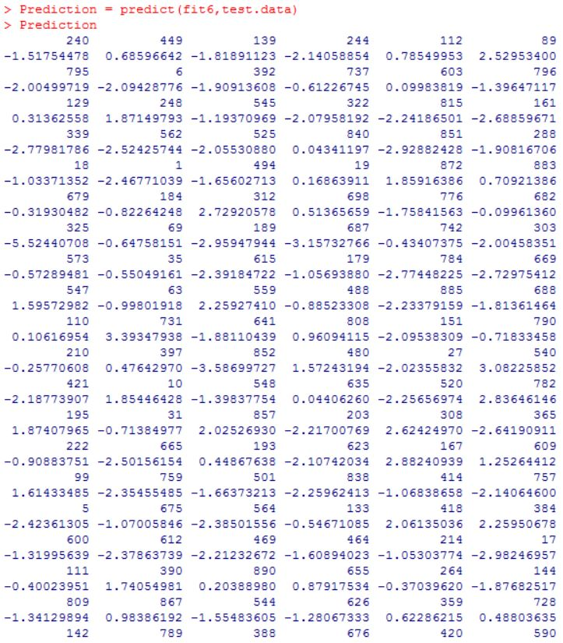
CHALLENGE!

Slide 16
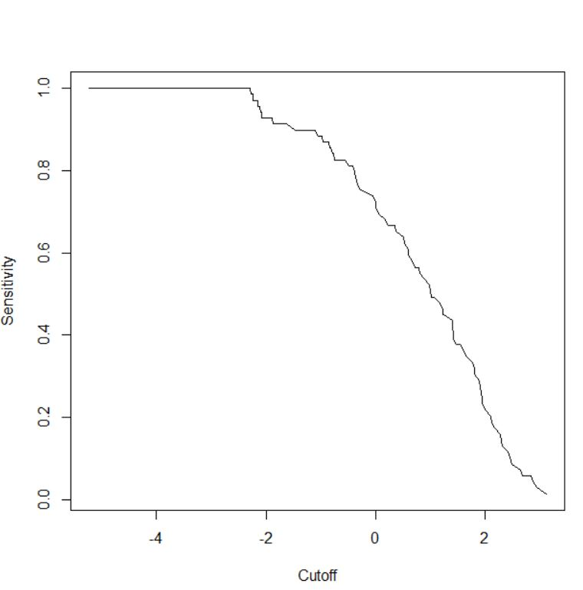
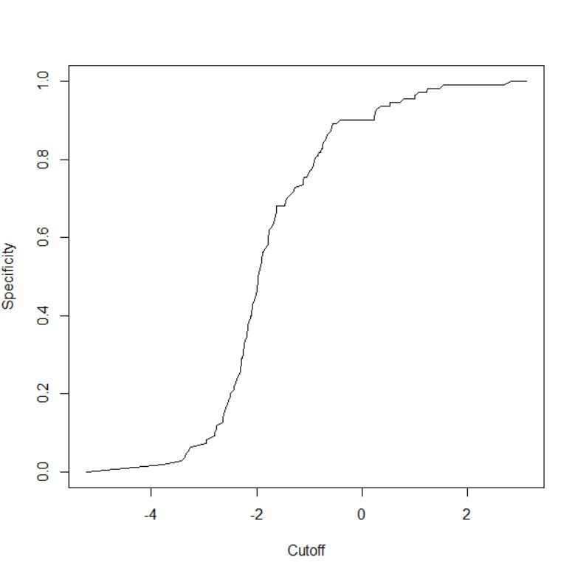
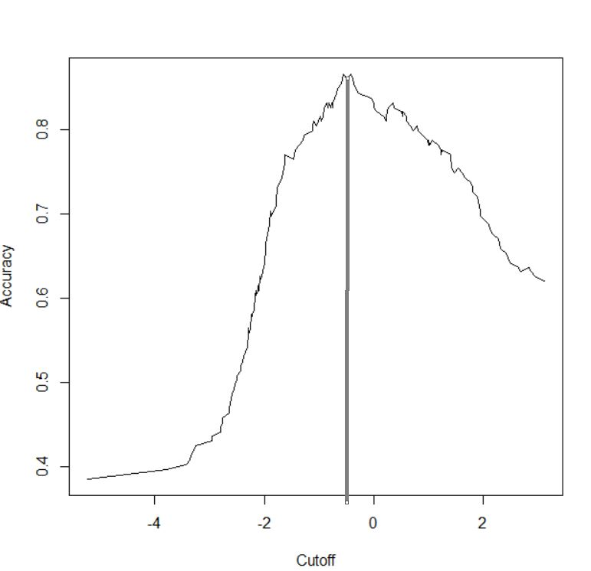
THRESHOLD VALUE

Slide 17
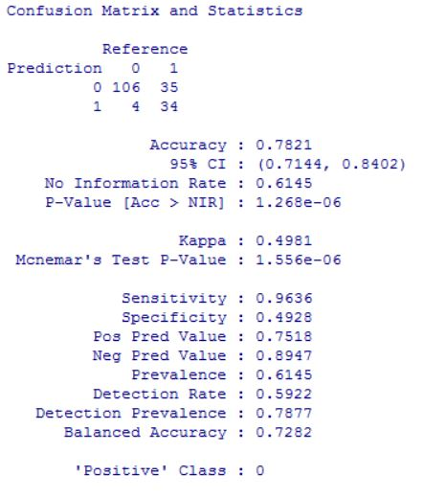
ANALYSIS

Slide 18
RANDOM FOREST ALGORITHM
Random Forest is one of the most widely used machine learning algorithm for classification
It can also be used for regression model(i.e: Continuous target variable) but it mainly performs well on classification model
It is operated by constructing a multitude of decision trees at training time and outputting the class that is the mode of the classes (classification) or mean prediction (regression) of the individual trees
It gives estimates of what variables are important in the classification.
It has an effective method for estimating missing data and maintains accuracy when a large proportion of the data are missing.
Key advantage is it reduces the chances of overfitting
High Model Performance and Accuracy
Notes:
One of the widely used algorithms for classification is Random Forest.
Each tree is trained on roughly 2/3rd of the total training data (exactly 63.2%) .
For each tree, using the leftover (36.8%) data, calculate the misclassification rate - out of bag (OOB) error rate. Aggregate error from all trees to determine overall OOB error rate for the classification.
Each tree gives a classification, and we say the tree "votes" for that class. The forest chooses the classification having the most votes over all the trees in the forest.

Slide 19
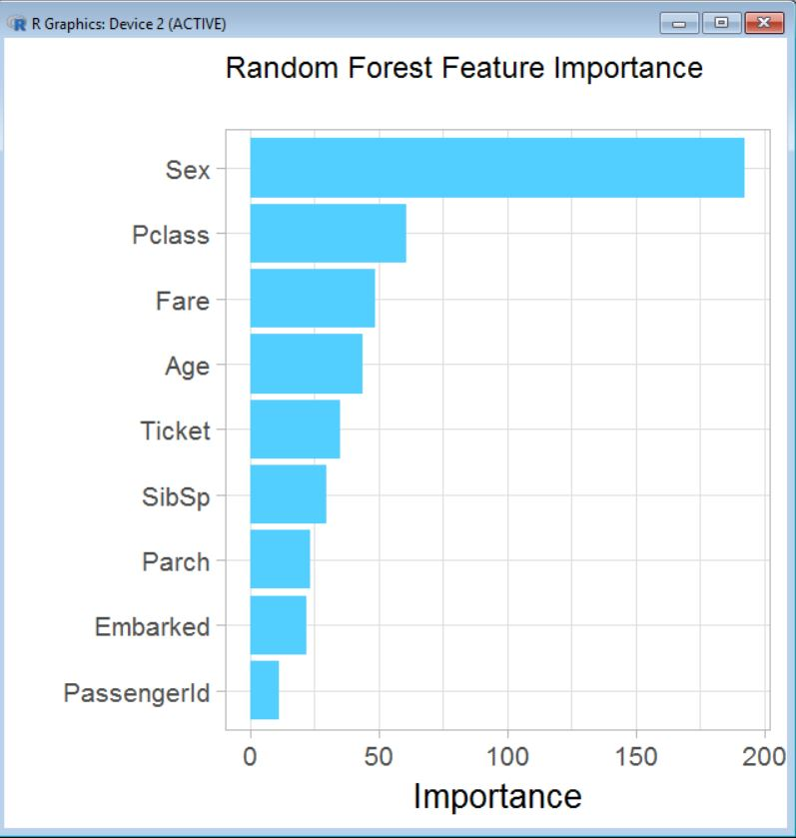
VARIABLE IMPORTANCE PLOT

Slide 20
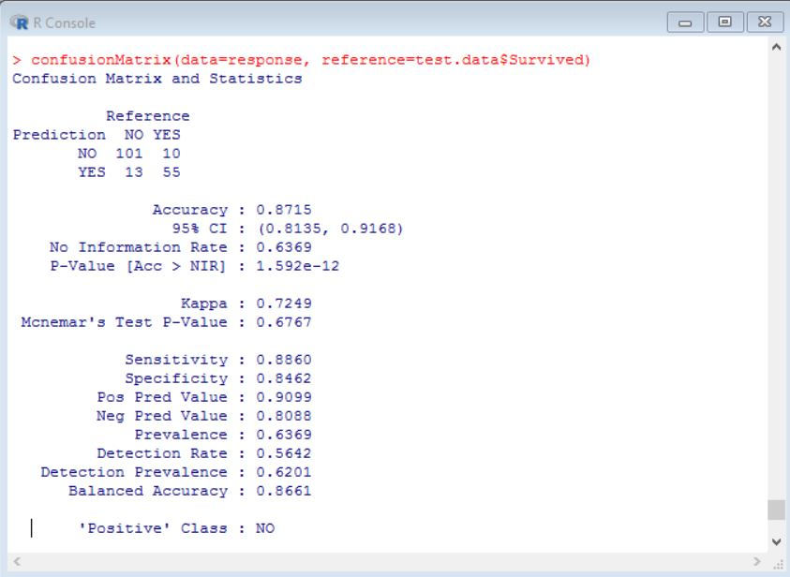
ANALYSIS OF RANDOM FOREST ALGORITHM

Slide 21
LEARNINGS
Mosaic and ggplot (ggplot + histogram)
Common metric to determine the accuracy of random forest fit and logistic fit is done by creating confusion matrix.
Explored and learned about SVM (Support Vector Machine) Algorithm.
Learned the concepts of Sensitivity and Specificity to determine the threshold value while predicting the accuracy.
dev.off()

Slide 22
THANK YOU!
QUESTIONS AND FEEDBACK?

