Slide 1
ITMD 525- DATA MINING
GROUP - 88
ANUHYA KODURI – A20386751
DHRUVA JULOORI – A20377948
Notes:
Product classification is task of automatically predicting the product categories based on description, features of product and other related attributes

Slide 2

Opinion Mining – Text Classification
Notes:
We take a look at scenarios where product classification is widely used. Read from sled

Slide 3
OBJECTIVE
The main objective of this project is to determine whether a review is Positive or Negative and
decide the polarity of views in customer reviews using different classification techniques and analyze which technique is better.

Slide 4
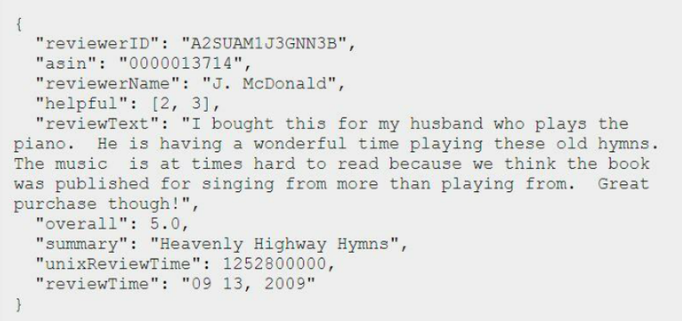
DATASET
Data Source: http://jmcauley.ucsd.edu/data/amazon/
Number of Records: 8032
Notes:
We chose our dataset from KAGGLE where this was used as part of a product classification challenge.

Slide 5
DATA PREPROCESSING
Removed HTML from the text
Non-Letters removal
Converting the words into a lowercase
Stemming and Stop words removal
Notes:
Data was already preprocessed

Slide 6
Text Classification
DATA MINING
Load data, and run numerical summaries
Split the data into training and testing
Generate Features by computing TF-IDF scores.
Fit the model using Classifiers by injecting the features.
Compute accuracies.

Slide 7
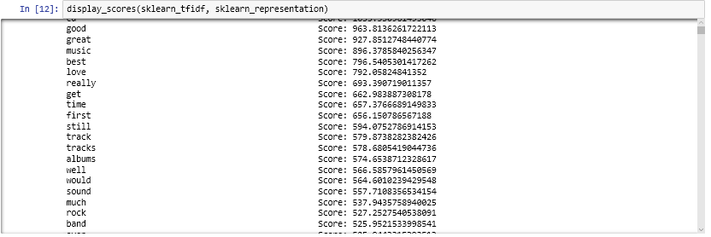
TF-IDF
Term Frequency: The number of times a term occurs in a particular document.
Inverse Document Frequency: It is used to diminish the weight of the terms that occur very frequently in the document set and increases the weight of terms that occur rarely.
Notes:
Shows how 9 product categories are distributed

Slide 8
NAIVE BAYES CLASSIFIER
Probabilistic Classifier Based on Bayes theorem.
Can be used for both binary and multiclass classification problems.
Key Advantage is It needs less training data to estimate the parameters of classification.
It is very useful in email and gender classification
Highly Scalable and easy to implement.

Slide 9
DECISION TREE CLASSIFIER
The goal is to create a model that predicts the value of a target variable based on several input variables
It has an effective method of dealing with missing values and will not prevent splitting the data for building trees
Decision trees are very intuitive and easy to explain.
They don’t make any assumptions about the dataset so they are pretty accurate for large datasets.

Slide 10
RANDOM FOREST CLASSIFIER
Random Forest is one of the most widely used machine learning algorithm for classification
It can also be used for regression model(i.e: Continuous target variable) but it mainly performs well on classification model
It is operated by constructing a multitude of decision trees at training time and outputting the class that is the mode of the classes (classification) or mean prediction (regression) of the individual trees
It gives estimates of what variables are important in the classification.
It has an effective method for estimating missing data and maintains accuracy when a large proportion of the data are missing.
Key advantage is it reduces the chances of overfitting
High Model Performance and Accuracy
Notes:
One of the widely used algorithms for classification is Random Forest.
Each tree is trained on roughly 2/3rd of the total training data (exactly 63.2%) .
For each tree, using the leftover (36.8%) data, calculate the misclassification rate - out of bag (OOB) error rate. Aggregate error from all trees to determine overall OOB error rate for the classification.
Each tree gives a classification, and we say the tree "votes" for that class. The forest chooses the classification having the most votes over all the trees in the forest.

Slide 11
MODEL EVALUATION
Accuracy is used as a performance metric. This gives us the performance of the algorithms in the sense how many of the predictions made are correct. Accuracy is the basic measure to test the performance of the algorithm. The accuracy that should satisfy depends on the reliability that the customer would have on it and the costs matrix of false predictions.

Slide 12
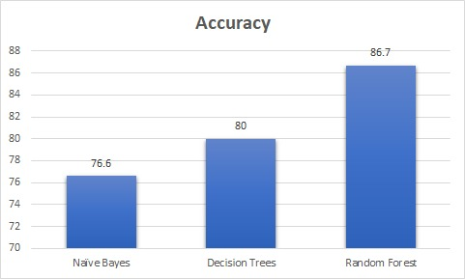
ANALYSIS

Slide 13
CHALLENGE!
Overfitting!
Interpretation of Sarcastic Reviews
Named Entity Recognition
Data Parsing
Technical issues!

Slide 14
Conclusions
Baseline Performance:
Distinguishing positive from negative reviews is relatively easily for humans, especially when the whole review is read properly. But even a random guess has a probability of 50% to be correct. We can also see that there are certain words that people use to express sentiments. This word list might suffice to depend on them to classify text. A test performed on a human generated keyword explained in the paper ‘Thumbs up? Sentiment Classification using Machine Learning Techniques’ gives accuracy of 58%. These provide us with baselines for experimental comparisons with our results.

Slide 15
LEARNINGS
Python 3
Explored and learned about SVM (Support Vector Machine) and Maximum Entropy.
Learned about ‘Bag of words’ model and concepts of unigrams, bigrams and ngrams.

Slide 16
THANK YOU!
QUESTIONS AND FEEDBACK?

