Slide 1
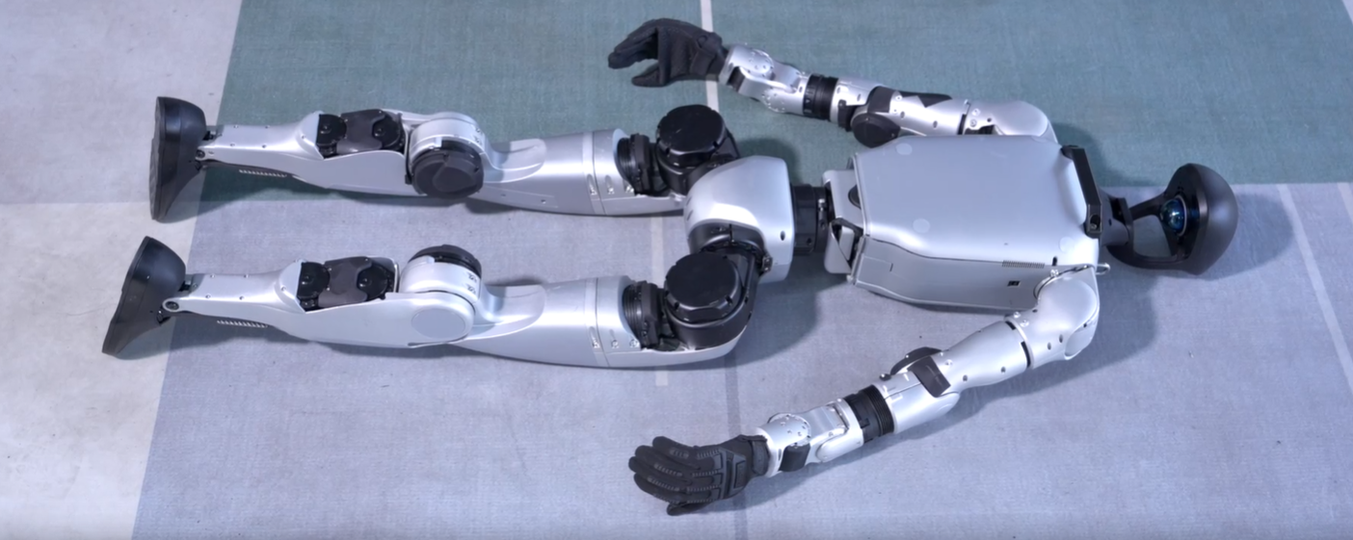
UNITREE G1
Startup, shutdown
and packing
Beginner operator training
Notes:
0:30. Explain the session sequence: identify the robot and controller, prepare a safe area, start from a face-up position, use the controller, shut down, then pack the robot.
Sources: Unitree G1 official resources at https://www.unitree.com/cn/app/g1/ and user supplied G1 and controller images. Exact commands reflect the operating sequence supplied by the user.

Slide 2
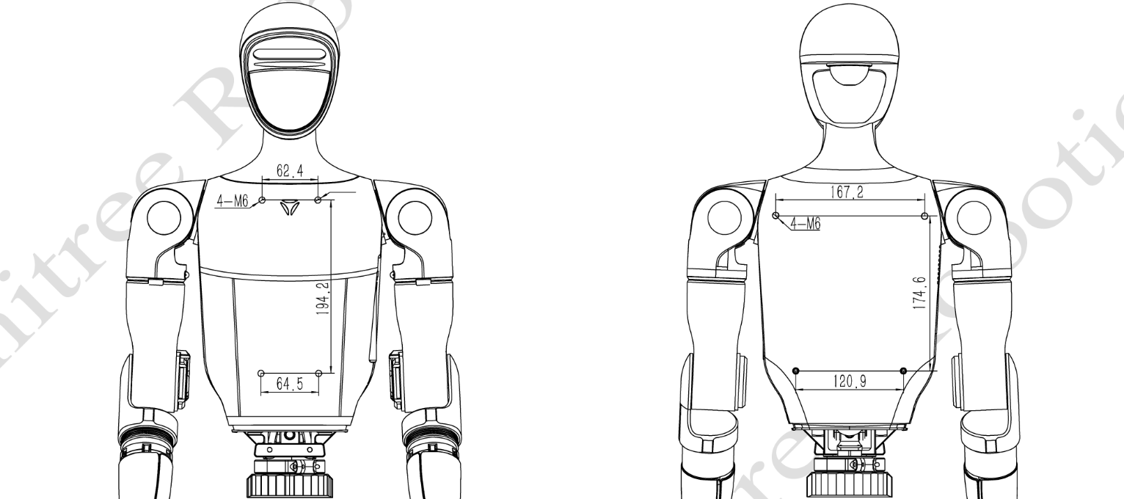
ROBOT OVERVIEW
G1 at a glance
Humanoid structure
Head, torso, arms, hands, legs and feet move as one system.
Rear battery
The battery and its power key sit on the back of the robot.
Operator control
This training uses the handheld controller for posture commands.
Notes:
1:00. Give only the operating context. Point out the body structure, the rear battery location and the fact that posture commands come from the controller.
Sources: Unitree G1 official resources at https://www.unitree.com/cn/app/g1/ and user supplied G1 and controller images. Exact commands reflect the operating sequence supplied by the user.

Slide 3
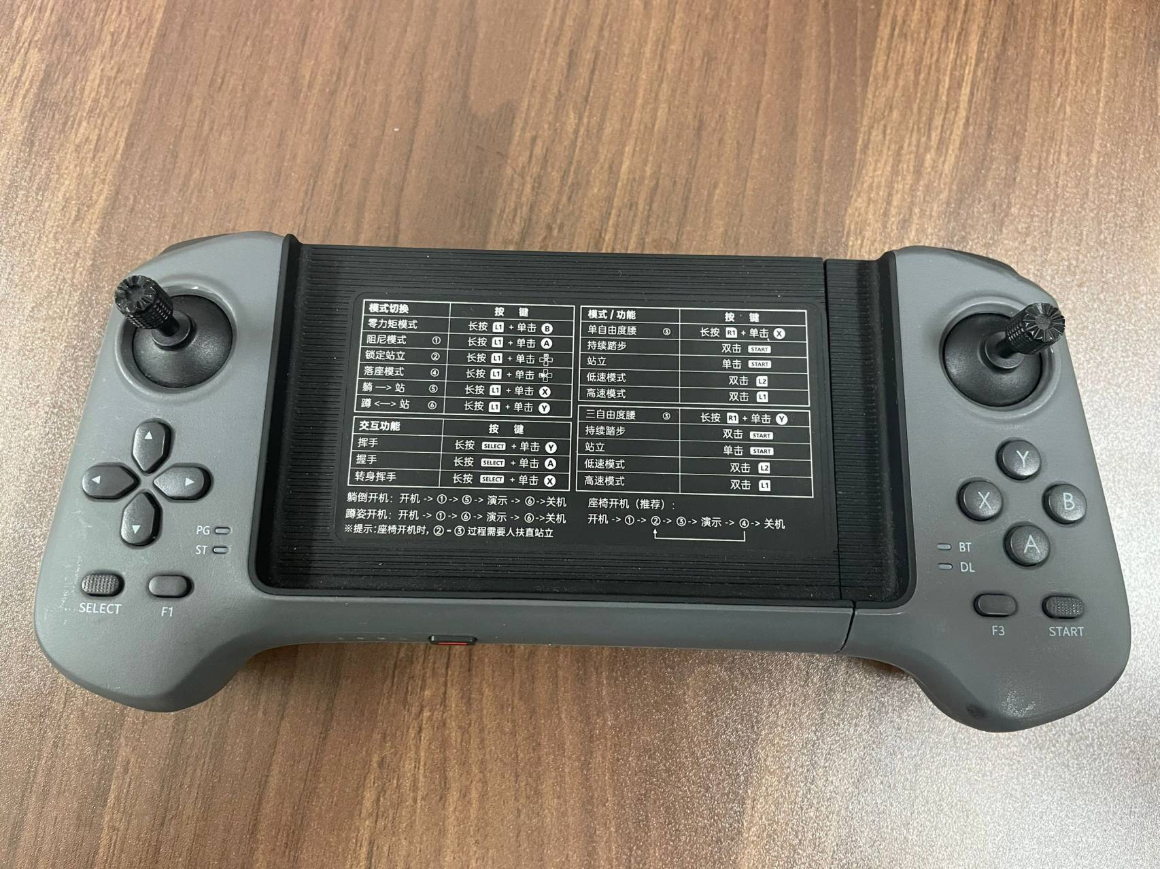
REMOTE CONTROL
Controller overview
X / A / B
Posture commands use the right-hand face buttons.
L2 shoulder key
Hold L2 while pressing the required face button.
Power key
Located on the lower front edge.
Notes:
1:30. Introduce the controller before teaching any command. Show the right-hand X, A and B buttons, explain that L2 is a shoulder key, and point out the lower front power key.
Sources: Unitree G1 official resources at https://www.unitree.com/cn/app/g1/ and user supplied G1 and controller images. Exact commands reflect the operating sequence supplied by the user.

Slide 4
SAFETY
Checks before startup
01
Clear area
Remove people, chairs, cables and other obstacles.
02
Level surface
Use a flat floor with enough room around the robot.
03
Robot condition
Check the shell, joints and cables for visible damage.
04
Power condition
Confirm the battery is secure and the controller has charge.
05
Operator position
Keep hands clear of joints when power is applied.
Stop if the robot's state or posture is unclear.
Notes:
1:30. Use this as a spoken checklist. Keep the startup area clear, check the robot and battery, and keep fingers away from moving joints.
Sources: Unitree G1 official resources at https://www.unitree.com/cn/app/g1/ and user supplied G1 and controller images. Exact commands reflect the operating sequence supplied by the user.

Slide 5
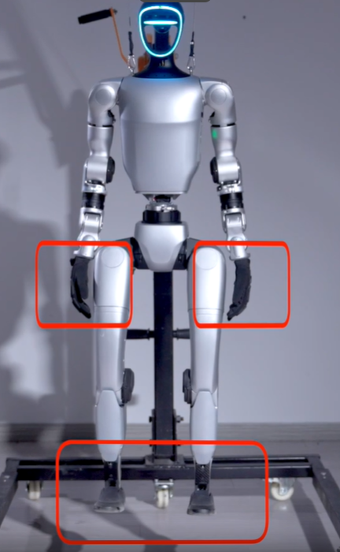
ROBOT PLACEMENT
Face-up starting position
Face up
Place the back and head support on the floor.
Arms clear
Keep both arms away from the torso and joints.
Legs aligned
Extend the legs without crossing the feet.
Notes:
1:30. Demonstrate the face-up starting posture. The head and back rest on the floor, arms remain clear of the body and the legs stay aligned. Leave space for the robot to rise.
Sources: Unitree G1 official resources at https://www.unitree.com/cn/app/g1/ and user supplied G1 and controller images. Exact commands reflect the operating sequence supplied by the user.

Slide 6
STARTUP SEQUENCE
Robot power-on
01
Battery seated
Insert in the correct direction until the latch clicks.
02
Short press
Press the battery power key once.
03
Press and hold
Press the same key for more than 2 seconds.
Wait for startup to finish before sending a controller command.
BATTERY AREA ON THE REAR TORSO
Notes:
2:00. Confirm the robot is face up and stable. Check the battery latch. Use one short press, then press and hold the battery power key for more than 2 seconds. Wait for startup to complete.
Sources: Unitree G1 official resources at https://www.unitree.com/cn/app/g1/ and user supplied G1 and controller images. Exact commands reflect the operating sequence supplied by the user.

Slide 7
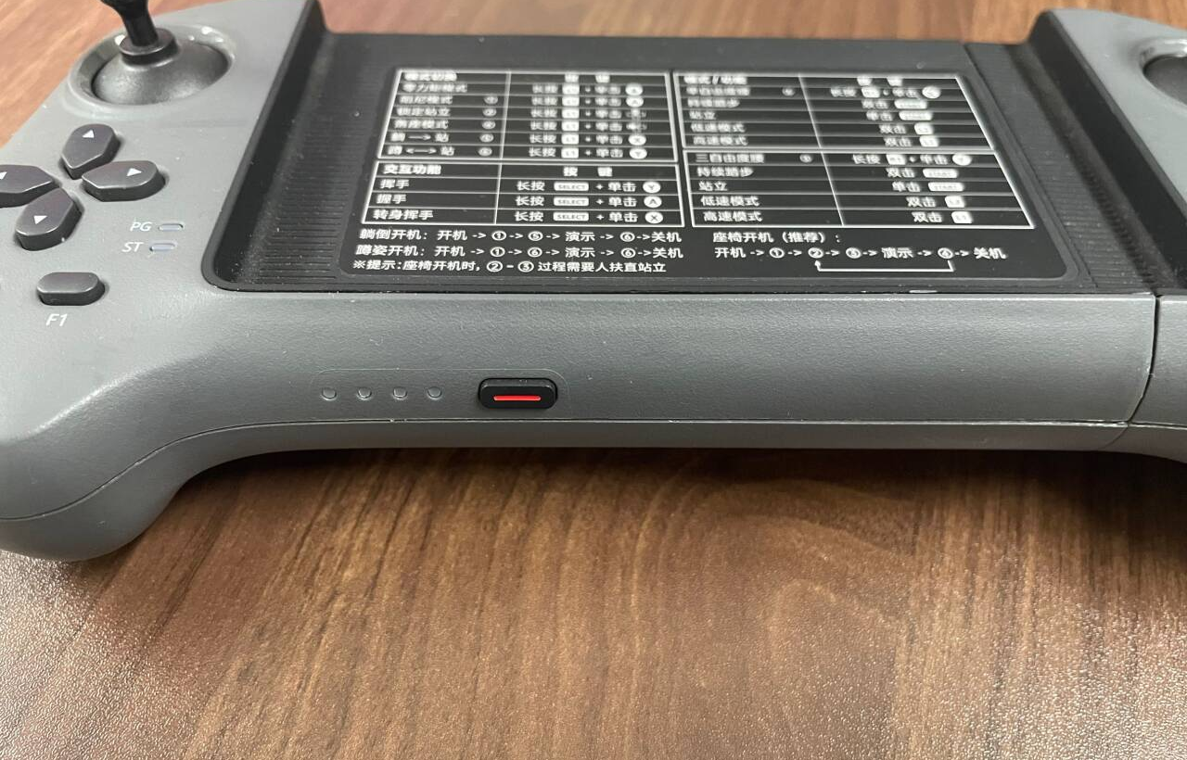
REMOTE CONTROL
Controller power-on
1
Short-press the power key once.
2
Then press and hold for more than 2 seconds.
3
Confirm the controller is ready before posture commands.
Notes:
1:30. Point to the red power key on the lower front edge. Use a short press followed by a press-and-hold longer than 2 seconds. Confirm the controller is ready before continuing.
Sources: Unitree G1 official resources at https://www.unitree.com/cn/app/g1/ and user supplied G1 and controller images. Exact commands reflect the operating sequence supplied by the user.

Slide 8
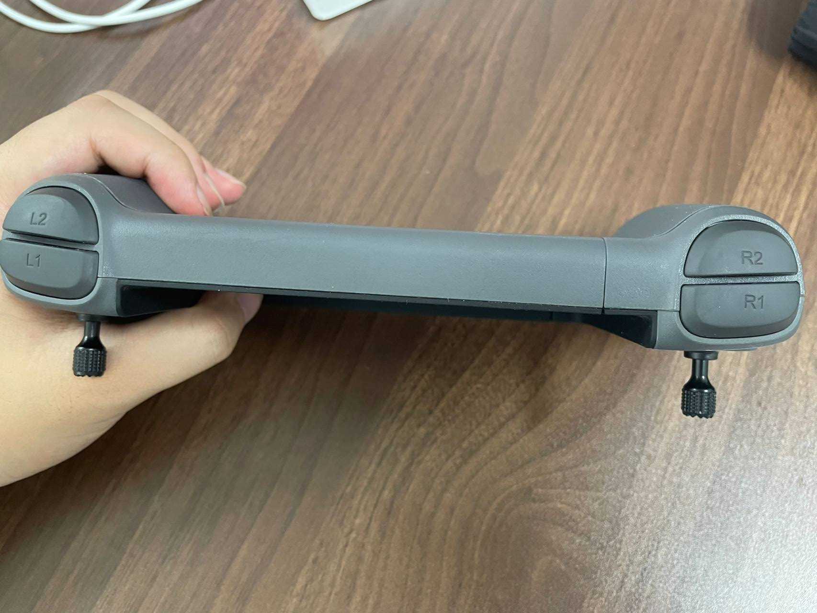
CONTROLLER OPERATION
Basic posture commands
L2 + X
Stand
L2 + A
Squat
L2 + B
Damping mode
Use damping mode only when the robot is supported and ready to be laid down.
Hold L2
Notes:
2:00. Hold L2 and use the face button: X for stand, A for squat and B for damping mode. Explain that damping mode can remove active joint support, so an operator must support the robot before using it.
Sources: Unitree G1 official resources at https://www.unitree.com/cn/app/g1/ and user supplied G1 and controller images. Exact commands reflect the operating sequence supplied by the user.

Slide 9
POWER-OFF SEQUENCE
Shutdown and lay-down
01
Stop movement
Wait until the robot is stable.
02
Squat
Use L2 + A.
03
Support and lay down
Guide the robot to a face-up position.
04
Damping mode
Use L2 + B only after the robot is supported.
05
Power off
Turn off the robot, then turn off the controller.
Confirm that both devices are fully off before adjusting the packing pose.
Notes:
2:15. Stop motion, squat with L2+A and support the robot. Guide it into a face-up position. Use L2+B only after it is safely supported. Follow the exact power-off procedure for the G1 revision in use, then switch off the controller.
Sources: Unitree G1 official resources at https://www.unitree.com/cn/app/g1/ and user supplied G1 and controller images. Exact commands reflect the operating sequence supplied by the user.

Slide 10
ROBOT PLACEMENT
Face-down starting position
Note
Before packing, please make sure the robot is face down as shown in the picture.
Notes:
1:30. Demonstrate the face-up starting posture. The head and back rest on the floor, arms remain clear of the body and the legs stay aligned. Leave space for the robot to rise.
Sources: Unitree G1 official resources at https://www.unitree.com/cn/app/g1/ and user supplied G1 and controller images. Exact commands reflect the operating sequence supplied by the user.

Slide 11
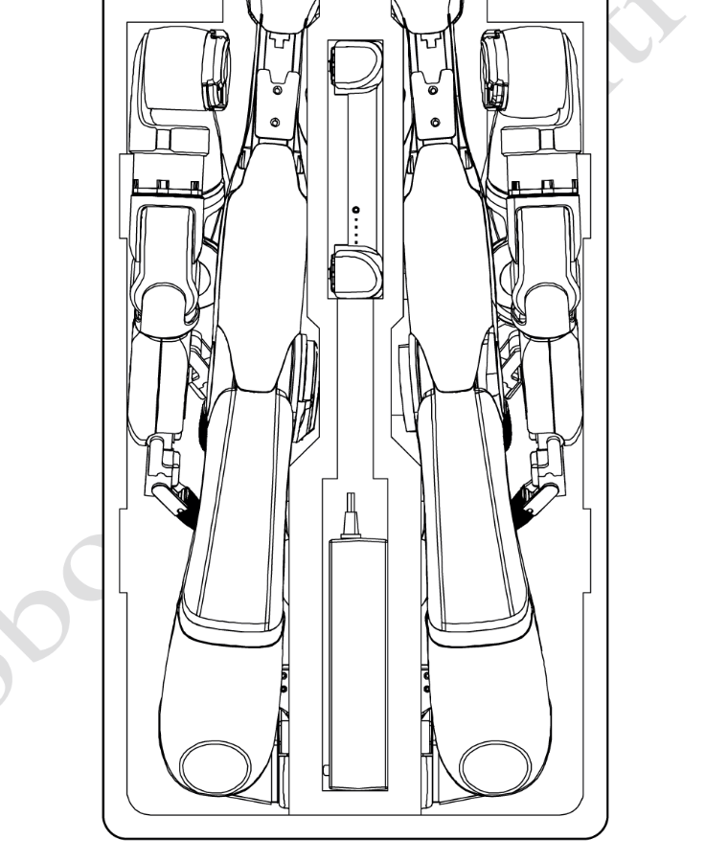
STORAGE
Packing position and final check
Adjust the pose
Align the arms and legs with the foam insert. Move each joint gently.
Protect the robot
Check that fingers, cables and covers will not be trapped.
Complete the kit
Return the controller, charger, padding and accessories to their positions.
Notes:
1:15. Confirm complete shutdown before handling. Match the robot to the packing insert, avoid forcing joints, check fingers and cables, then return the controller, charger and accessories. Total presentation time is approximately 15 minutes.
Sources: Unitree G1 official resources at https://www.unitree.com/cn/app/g1/ and user supplied G1 and controller images. Exact commands reflect the operating sequence supplied by the user.

