Slide 1
Low-Pass Filter
Derek Weitzel
Yutaka Tsutano

Slide 2
Introduction
Design a Low-Pass Filter using synthesized components.
Optimize design for power at the algorithmic level.
Test the Low-Pass filter with a functional verification version.

Slide 3
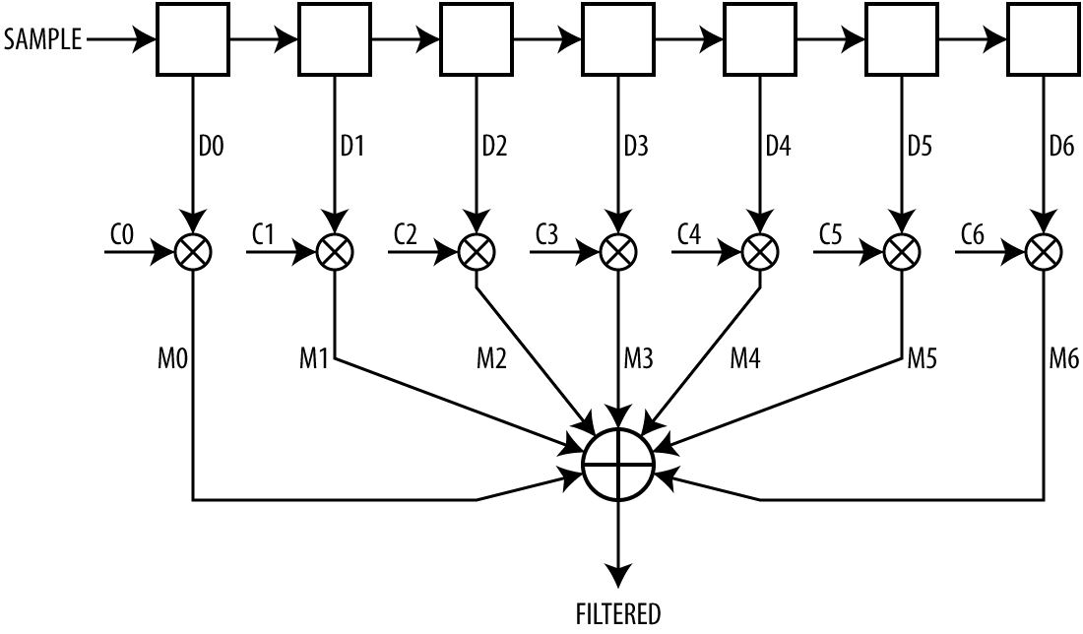
Finite Impulse Filter (FIR)
Weighted sum of the most recent N samples:
Convolution
Notes:
Yutaka

Slide 4
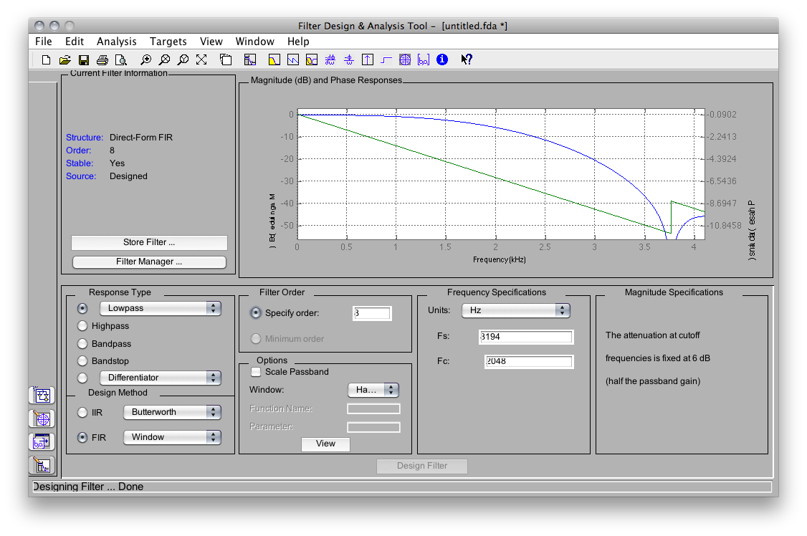
Filter Design
Designed using Matlab
Filter Properties
Finite Impulse Low-Pass Filter w/ Hamming Window
Sampling Freq: 8194 Hz
Cut-off Freq: 2048 Hz
Notes:
Yutaka

Slide 5
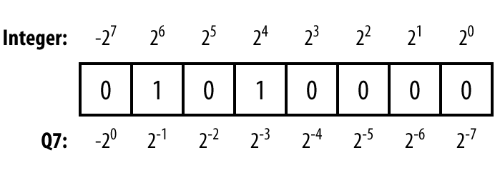
Fixed-Point Number Format “Q15”
Standard arithmetic hardware can be used
Floating-point unit is expensive
Q15 number has 15 fractional bits
Notes:
Yutaka

Slide 6
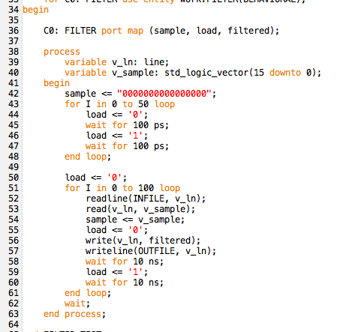
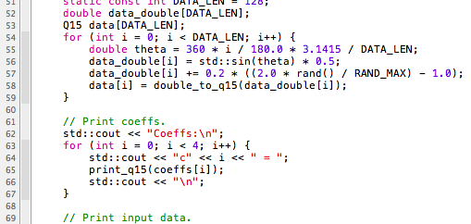
VHDL Simulation
VHDL Test Bench
ModelSim
Functional simulator was developed in C++ to generate test cases
Produced same output
C++

Slide 7
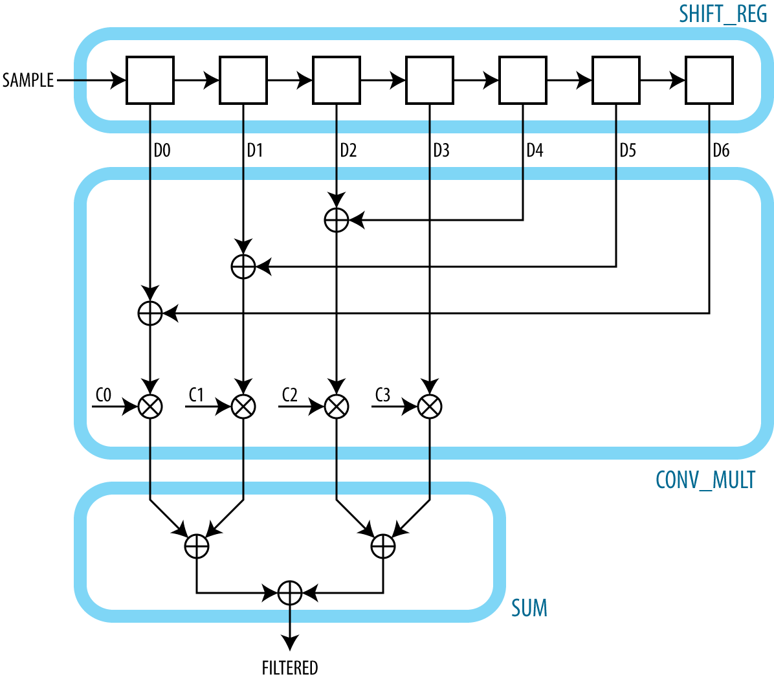
Optimization
Naive
Optimized
Typical FIR filter is symmetric
Notes:
Yutaka

Slide 8
Optimization
Removed 3 Multipliers
Replaced with optimized Adders.
Ripple-Carry adders for power optimization.
Reduced clock frequency to reduce transitions.

Slide 9
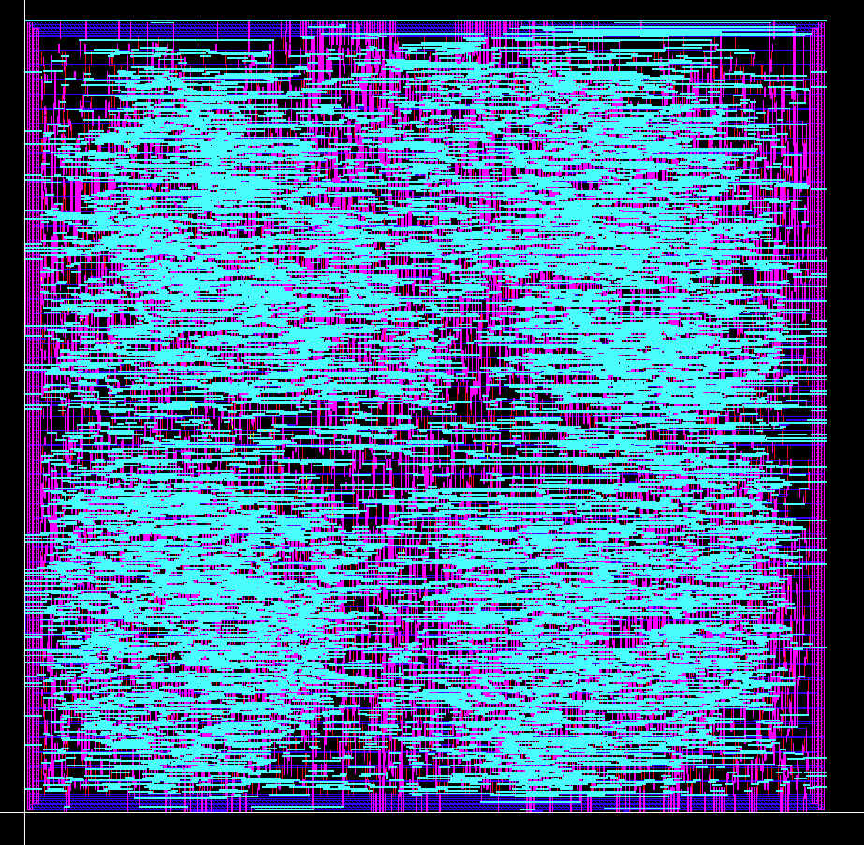
Convolution Hardware
Area = 5024508 micron²
3220 stdCells
Encounter routing introduced DRC errors.
Clearly see the four multipliers.

Slide 10
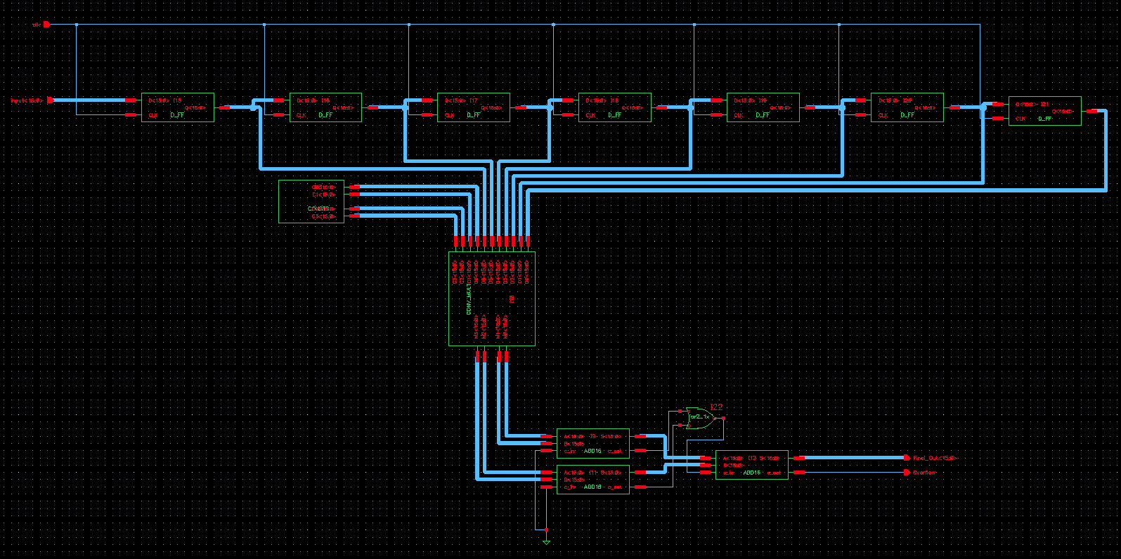
Datapath

Slide 11
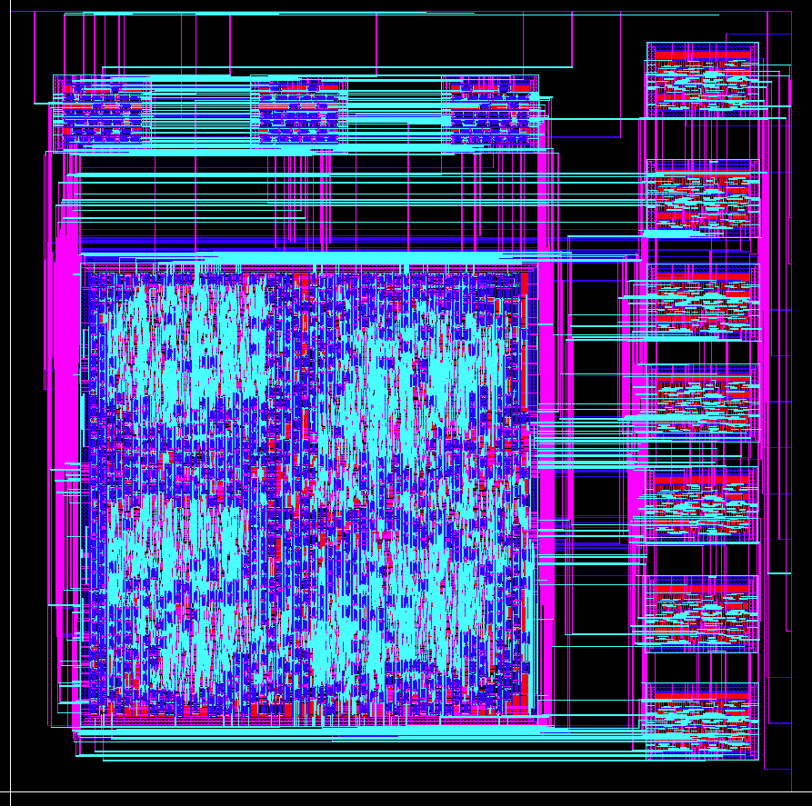
Final Chip
2500 x 2500 micron chip
Routing introduced DRC errors.
Registers on right. Adders on top.
Input on right. Output on top.

Slide 12
Conclusions
Majority of time spent working in Cadence.
LVS difficult for synthesized systems, eg. Final Layout. Requires extracted layouts of all components.
Low-Pass filter completed!

