Slide 1
Low-Pass Filter
Derek Weitzel
Yutaka Tsutano

Slide 2
Introduction
Design a Low-Pass Filter using synthesized components.
Optimize design for power at the algorithmic level.
Test the Low-Pass filter with a functional verification version.

Slide 3
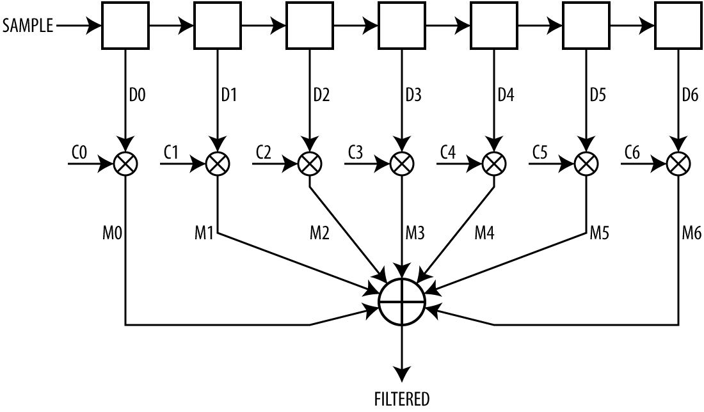
Finite Impulse Filter (FIR)
Weighted sum of the most recent N samples:
Convolution
Notes:
Yutaka

Slide 4
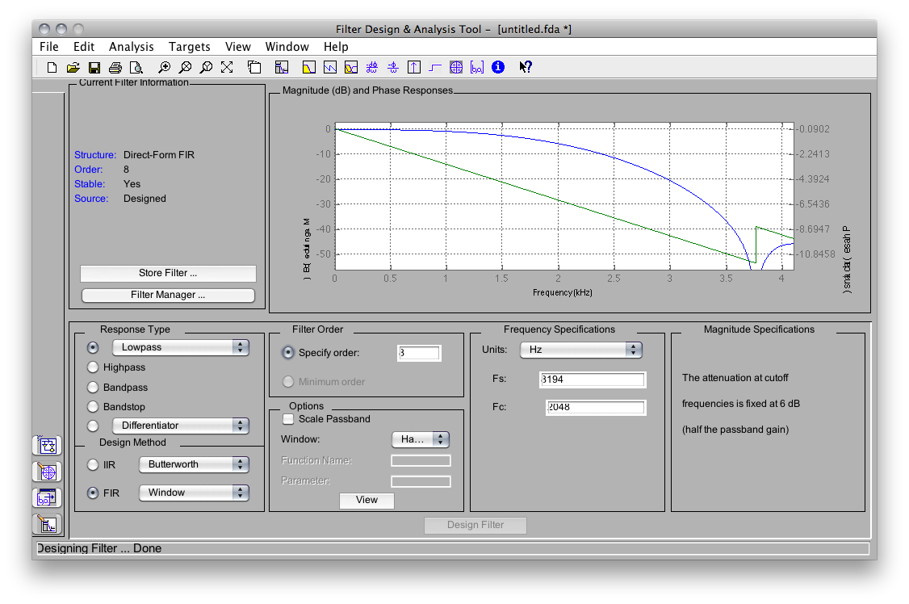
Filter Design
Designed using Matlab
Filter Properties
Finite Impulse Low-Pass Filter w/ Hamming Window
Sampling Freq: 8194 Hz
Cut-off Freq: 2048 Hz
Notes:
Yutaka

Slide 5
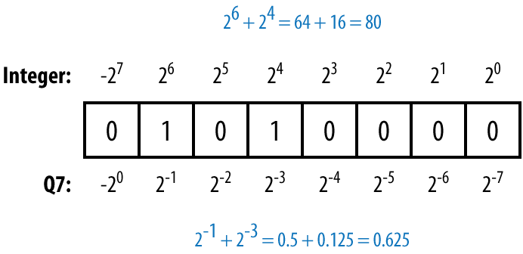
Fixed-Point Number Format “Q15”
Standard arithmetic hardware can be used
Floating-point unit is expensive
Q15 number has 15 fractional bits
Notes:
Yutaka

Slide 6
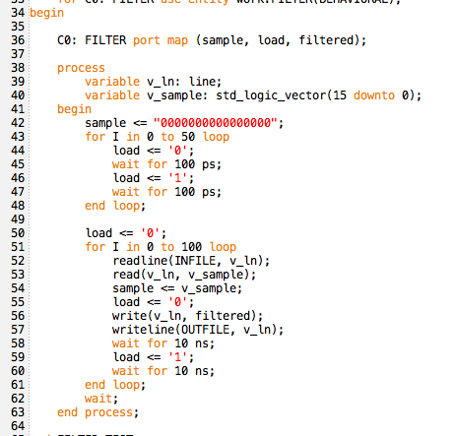
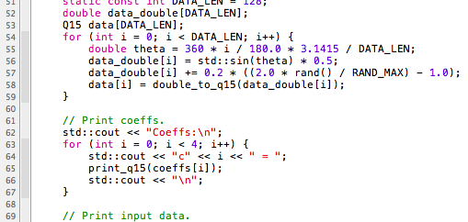
VHDL Simulation
VHDL Test Bench
ModelSim
Functional simulator was developed in C++ to generate test cases
Produced same output
C++

Slide 7
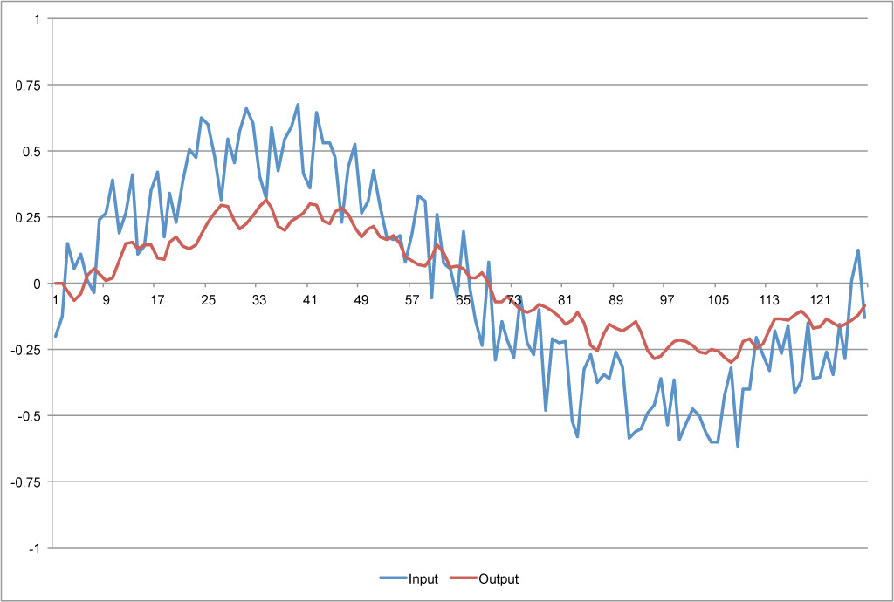
Test Case Example
Input:
1110011001100111
1111000001000111
0001001101011100
0000011101000101
0000111000101001
0000000100101001
1111101101100011
0001111010110111
0010000110101011
0011000110011110
0001100000110100
0010000111100101
0011010010000000
0000111001001011
0001000110111100
0010110001111111
0011011000000100
0001011000110110
0010101110000000
0001110100111001
0011000011111101
0100000001110100
0011110011111111
0100111111100100
Output:
0000000001001010
0000000000101101
1111110001000101
1111011101100100
1111101100010010
0000001110100011
0000011010111100
0000010010000000
0000000011111101
0000001010010010
0000101100101101
0001001011111001
0001001110111000
0001000011110001
0001001001011001
0001001010010110
0000110001001000
0000101111010010
0001001111001101
0001011000010010
0001001000011110
0001000010100000
0001001010100001
0001011111011010

Slide 8
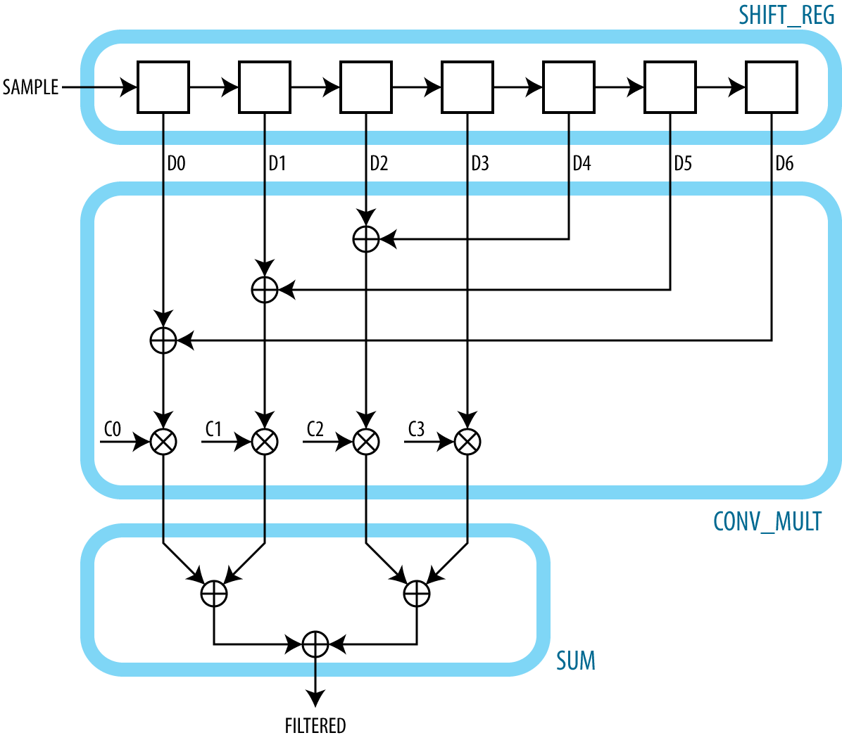
Optimization
Naive
Optimized
Typical FIR filter is symmetric
Notes:
Yutaka

Slide 9
Optimization
Removed 3 Multipliers
Replaced with optimized Adders.
Ripple-Carry adders for power optimization.
Reduced clock frequency to reduce transitions.

Slide 10
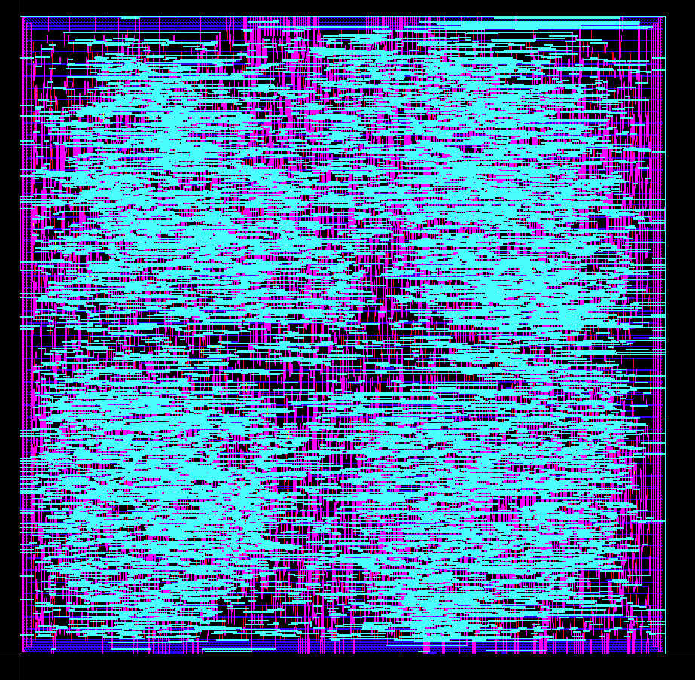
Convolution Hardware
Area = 5024508 micron²
3220 stdCells
Encounter routing introduced DRC errors.
Clearly see the four multipliers.

Slide 11
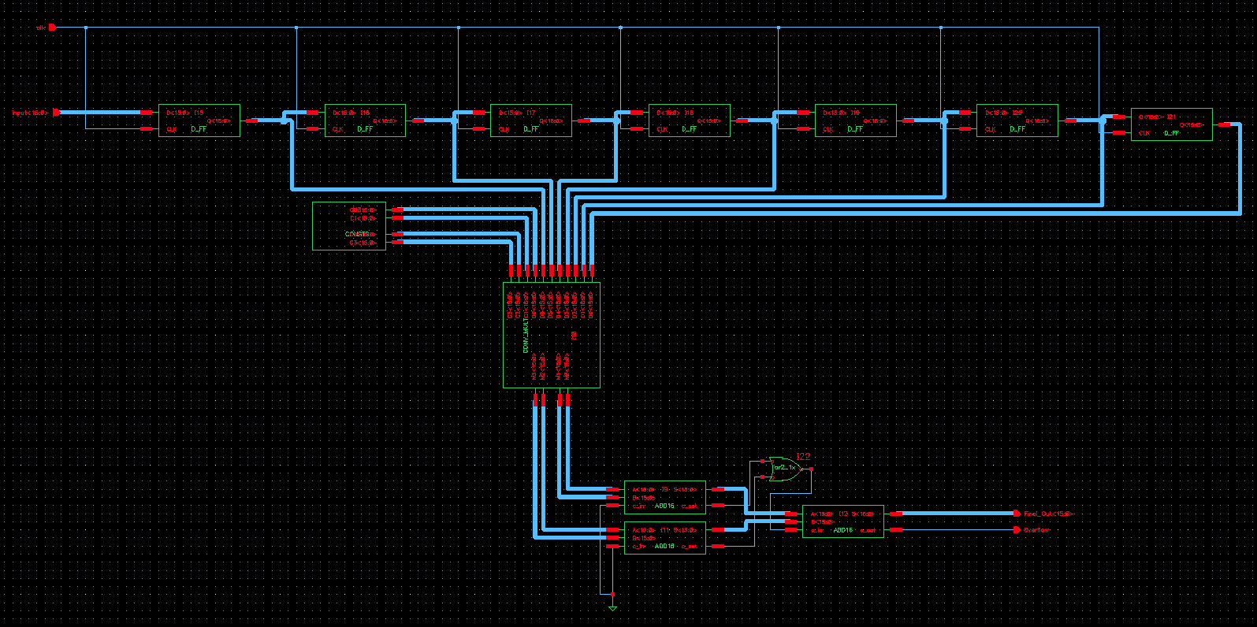
Datapath

Slide 12
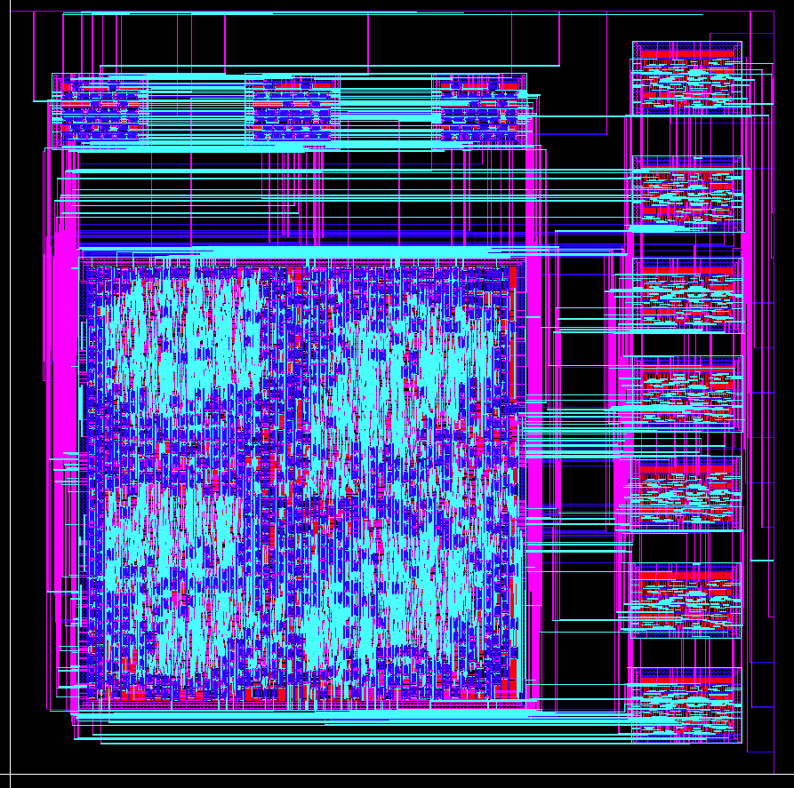
Final Chip
2500 x 2500 micron chip
Routing introduced DRC errors.
Registers on right. Adders on top.
Input on right. Output on top.

Slide 13
Conclusions
Majority of time spent working in Cadence.
LVS difficult for synthesized systems, eg. Final Layout. Requires extracted layouts of all components.
Low-Pass filter completed!

