Slide 1
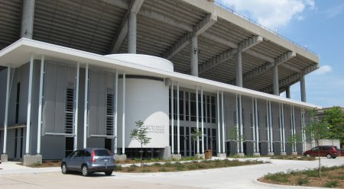
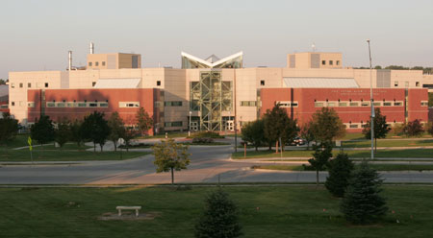
Campus Grids: A Framework to Facilitate Resource Sharing
Derek Weitzel

Slide 2
What is a Grid?
Real definition: A computational grid is a hardware and software infrastructure that provides dependable, consistent, pervasive, and inexpensive access to high-end computational capabilities (I. Foster and C. Kesselman. The grid: blueprint for a new computing infrastructure. Morgan Kaufmann, 2004.)
In practice definition: Collection of clusters that allow outside organizations access to resources (storage/computation)

Slide 3
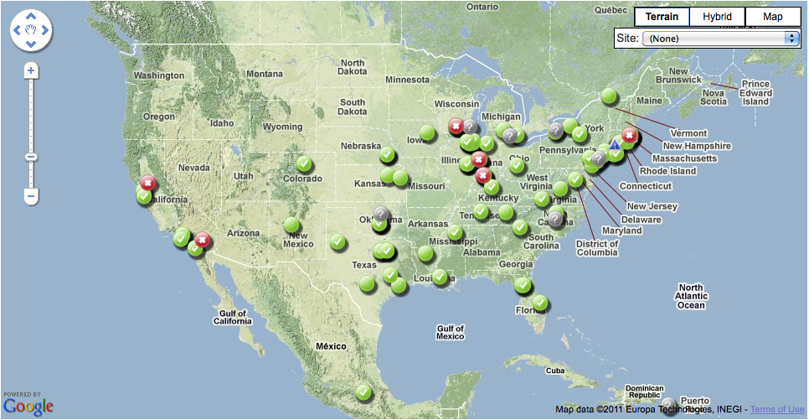
Example: Open Science Grid

Slide 4
What is a Campus Grid?
A campus grid is a specialized computation grid where resources are owned by the same organization, though can be in multiple administrative domains.

Slide 5
Campus Grids Motivation
Campuses have multiple clusters multiple departments (or groups) with little sharing.
Chemistry, Physics, CS
Workflows may require more power than available on a single cluster.
Offload single core jobs to idle resources, making room for specialized (MPI) jobs.

Slide 6
Campus Grid Challenges
Each cluster has their own policies
User Priorities
Allowed users
Clusters may have different job schedulers
Expanding outside the Campus

Slide 7
My Contributions
Survey of Campus Grids:
5 Characteristics of Campus Grids
Created Campus Grid framework implementing these characteristics
Created efficient and accurate pilot matching techniques.

Slide 8
New Model for Campus Grids
Grid
Campus
Local
Me, my friends and everyone else

Slide 9
New Model for Campus Grids
Campus Grid Factory for PBS Clusters
Bridge Campus Grids
Overflow to OSG

Slide 10
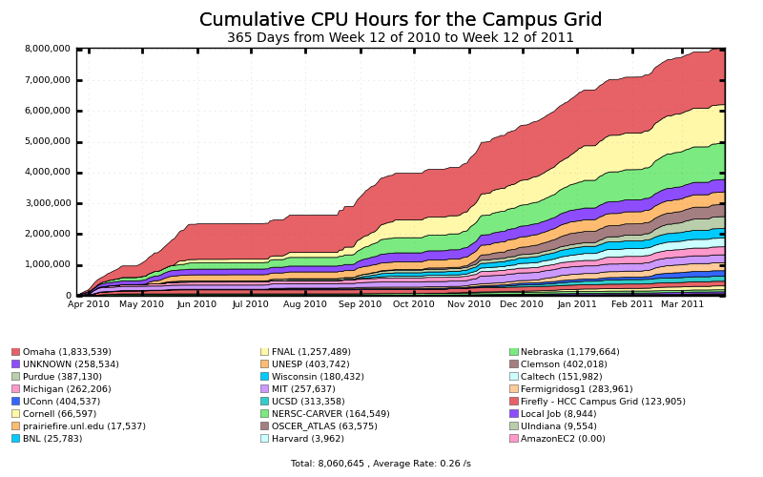
What I Accomplished – 8 Million Hours
8 Million Hours

Slide 11
Overview
Intro
Characteristics of Campus Grids
Background
Campus Grid Framework
Pilot Submission
Extending Beyond the Campus
HCC Campus Grid
Conclusions

Slide 12
Characteristics of a Campus Grid
All Campus grids can be defined by these attributes:
Trust Relationships
Job Submission
Resource Independence
Accounting
Data Management
Compare campus grids on these attributes

Slide 13
Characteristics of a Campus Grid
Trust Relationships
Security (password, trusted hosts, Kerberos…)
Allowed users

Slide 14
Characteristics of a Campus Grid
Job Submission
Central or Distributed submission hosts
Job distribution

Slide 15
Characteristics of a Campus Grid
Resource Independence
Autonomous operation
Own policies

Slide 16
Resource Independence - Policies
Machine ownership and priorities
Researchers buy hardware in the cluster
Allowed users
Cluster Schedulers
PBS | Condor
parallel/multiprocess job scheduler | High throughput job scheduler
Runs few jobs on LARGE clusters | Can run many jobs on medium size clusters

Slide 17
Characteristics of a Campus Grid
Accounting
From users perspective (How much did I use?)
From resource perspective (Who used what?)

Slide 18
Characteristics of a Campus Grid
Data Management
Central filesystem
On-Demand data distribution

Slide 19
Overview
Intro
Characteristics of Campus Grids
Background
Campus Grid Framework
Pilot Submission
Extending Beyond the Campus
HCC Campus Grid
Conclusions

Slide 20

Background: Condor
High throughput batch job scheduler
Ensembles of independent jobs
Different scheduling model:
Resource allocation separate from job execution
Usual model is 1-to-1, job gets a node, job starts.
In Condor, submitter gets node, runs as many jobs as possible

Slide 21
Background: Condor
Multiple ways to submit to outside resources
Grid – Translate jobs into another scheduler
Flocking – Condor to Condor job transfers
Glidein – Start Condor worker nodes on remote resources

Slide 22
Why not use grid software for Campus?
No transparent execution environment
Separate submission files and methods
Large infrastructure
Required authentication – Public Key Infrastructure.

Slide 23
Campus Grids Today
GLOW
Condor is Everywhere!
Global filesystem for data
Purdue
Condor & PBS on nodes
Shared Home directories, Large clusters with share file systems, Condor file transfer between departmental clusters.

Slide 24
What changes do we want?
Prefer not installing Condor on every worker node.
Less intrusive for sysadmins.
PBS and Condor should coordinate job scheduling.
Running Condor jobs look like idle cores to PBS.
We don’t want PBS to kill Condor jobs if it doesn’t have to.

Slide 25
Overview
Intro
Characteristics of Campus Grids
Background
Campus Grid Framework
Pilot Submission
Extending Beyond the Campus
HCC Campus Grid
Conclusions

Slide 26
Campus Grid Framework Goals
Encompass: The campus grid should reach all clusters on the campus.
Transparent execution environment: There should be an identical user interface for all resources, whether running locally or remotely.
Decentralization: A user should be able to utilize his local resource even if it becomes disconnected from the rest of the campus. An error on a given cluster should only affect that cluster.

Slide 27
Campus Grid Goals - Technologies
Encompassed
BLAHP
Glideins
Campus Grid Factory
Transparent execution environment
Condor Flocking
Glideins
Decentralized
Campus Grid Factory
Condor Flocking

Slide 28

Encompassed – BLAHP
Written for European Grid Initiative
Translates Condor job into PBS job
With BLAHP: Condor can provide a single interface for all jobs, whether Condor or PBS.

Slide 29
Encompassed - Glidein
Starts the worker node Condor daemons as a regular job. Runs user jobs.
Glideins will mimic a local Condor cluster.
Can use all of Condor’s high throughput, while co-scheduling with PBS/LSF.

Slide 30
Campus Grid Goals - Technologies
Encompassed
BLAHP
Glideins
Campus Grid Factory
Transparent execution environment
Condor Flocking
Glideins
Decentralized
Campus Grid Factory
Condor Flocking

Slide 31
Transparent Execution – Flocking
All interaction mimics local Condor cluster
Consistent execution environment
Direct file transfer between execution and submitter
Span network boundaries

Slide 32
Putting it all Together
Campus Grid Factory

Slide 33
Campus Grid Factory
Submit Condor worker nodes (Glideins) as jobs to PBS

Slide 34
Putting it all Together
Condor + Glideins + BLAHP + Glue
Custom daemon that interacts with Condor

Slide 35
Putting it all Together
Provides on-demand Condor pool for outside clients for Flocking.

Slide 36
Advantages for the Local Scheduler
Allows PBS to know and account for outside jobs.
Can co-schedule with local user priorities.
PBS can preempt grid jobs for local jobs.

Slide 37
Campus Factory Operation
Factory queries user queue
Submit to PBS (through Condor BLAHP)
PBS Starts the Glidein job.

Slide 38
Campus Factory Operation
Factory queries user queue
Submit to PBS (through Condor BLAHP)
PBS Starts the Glidein job.

Slide 39
Campus Factory Operation
Factory queries user queue
Submit to PBS (through Condor BLAHP)
PBS Starts the Glidein job.

Slide 40
Campus Factory Operation
Glidein reports to the factory’s collector
User queue requests idle slots from factory
Condor negotiates and starts the job.

Slide 41
Campus Factory Operation
Glidein reports to the factory’s collector
User queue requests idle slots from factory
Condor negotiates and starts the job.

Slide 42
Campus Factory Operation
Glidein reports to the factory’s collector
User queue requests idle slots from factory
Condor negotiates and starts the job.

Slide 43
Campus Grid Internals

Slide 44
Advantages of the Campus Factory
User is presented with an uniform Condor interface to resources.
Can create overlay network on any resource Condor (BLAHP) can submit to PBS, LSF,…
Uses well established technologies: Condor, BLAHP, Glidein.

Slide 45
Overview
Intro
Characteristics of Campus Grids
Background
Campus Grid Framework
Pilot Submission
Extending Beyond the Campus
HCC Campus Grid
Conclusions

Slide 46
Problem with Pilot Job Submission
Problem with Campus Factory: If it sees idle jobs, it assumes they will run on Glideins.
Jobs may require specific software, ram size.
Campus Factory will waste cycles submitting idle Glideins.
Solutions in past were complicated filters.

Slide 47
Advanced Scheduling: OfflineAds
OfflineAds were put in Condor for power management
When nodes were not needed, Condor can turn them off
Condor needs to keep track of what nodes it has turned off, and their (maybe special) abilities.
OfflineAds describe an turned off computer.

Slide 48
Advanced Scheduling: OfflineAds
Submitted Glidein = Offline Node
When a Glidein is no longer needed, turns off.
Keep Glidein description in an OfflineAd
When a match is detected with the OfflineAd, submit an actual Glidein.
It is reasonably expected that one can get a similar Glidein when you submit to the local scheduler (BLAHP).

Slide 49
Overview
Intro
Characteristics of Campus Grids
Background
Campus Grid Framework
Pilot Submission
Extending Beyond the Campus
HCC Campus Grid
Conclusions

Slide 50
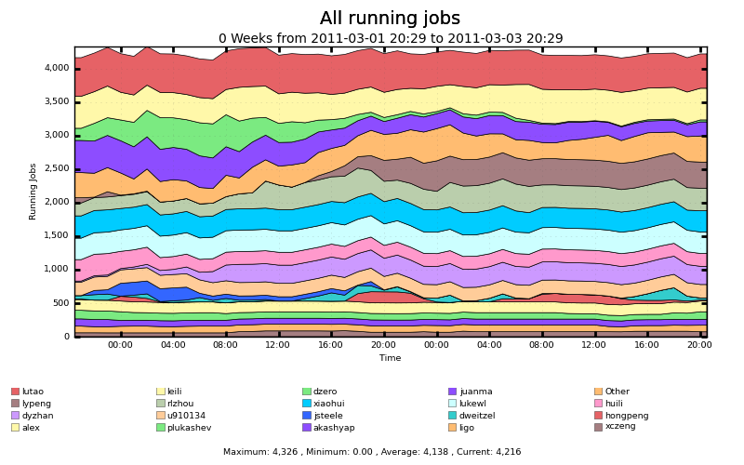
Extending Beyond the Campus
Nebraska does not have idle resources:
Running jobs on Firefly. ~4300 cores

Slide 51
Extending Beyond the Campus
There are resources available out there, just need to get there.
Users want a smooth transition to other resources.
Extend the transparent execution outside the campus.

Slide 52
Extending Beyond the Campus - Options
Extend Transparent – send Condor outside the campus.
Options for getting outside the campus
Flocking to external Condor clusters
Grid workflow manager: GlideinWMS

Slide 53
Extending Beyond the Campus: Flocking
Flocking
Need to have Condor on the other side.
Need to have mutual trust relationships.

Slide 54
Extending Beyond the Campus: GlideinWMS
Expand further with OSG Production Grid
GlideinWMS
Creates a on-demand Condor cluster on grid resources
Campus Grid can flock to this on-demand cluster
Grid credentials are sufficient

Slide 55
Overview
Intro
Characteristics of Campus Grids
Background
Campus Grid Framework
Pilot Submission
Extending Beyond the Campus
HCC Campus Grid
Conclusions

Slide 56
Campus Grid at Nebraska
Prairiefire PBS/Condor (Like Purdue)
Firefly – Only PBS
GlideinWMS interface to OSG
Flock to Purdue

Slide 57
Characteristics of a Campus Grid

Slide 58
Characteristics of a Campus Grid
Trust Relationships
Campus security (Password, trusted hosts, Kerberos,…)

Slide 59
Characteristics of a Campus Grid
Job Submission
On local clusters, transparent distribution.

Slide 60
Characteristics of a Campus Grid
Resource Independence
Strict, each resource can make own policies that are enforced locally.

Slide 61
Characteristics of a Campus Grid
Accounting
Done on the submitter side

Slide 62
Characteristics of a Campus Grid
Data Management
Per job file staging

Slide 63
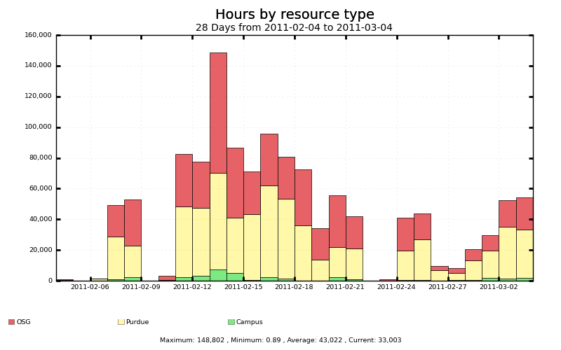
Usage of the Campus Grid
Campus Bridging to Purdue provides a lot of time
OSG resources (through GlideinWMS)

Slide 64
What I Accomplished – 8 Million Hours
8 Million Hours

Slide 65
What about Clouds?
NIST Says:
Grids = Clouds
(Platform-as-a-Service)

Slide 66
What if on Amazon EC2?
8 Million Hours

Slide 67
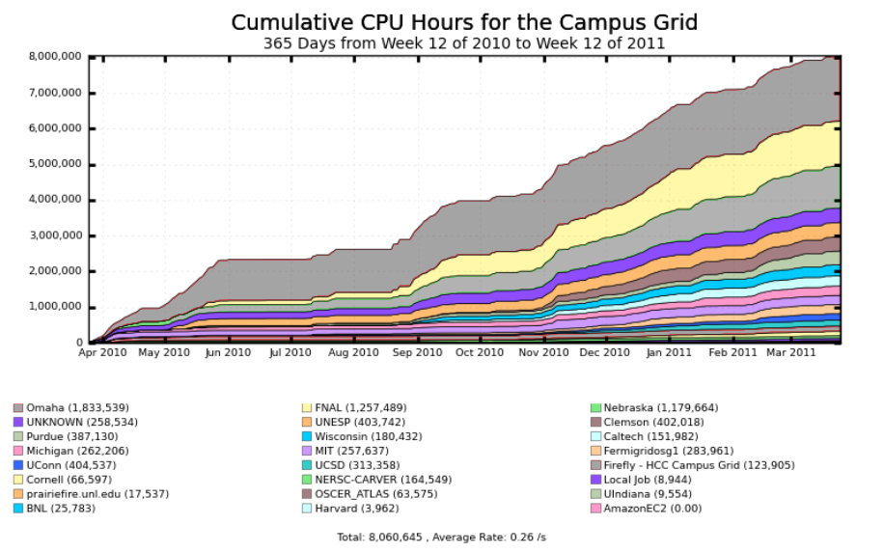
What if on Amazon EC2?
4.8M Hours

Slide 68
What if on Amazon EC2?
4.8M Hours
$634,496.40

Slide 69
Future Work
Accounting
Submission side accounting is easy, we already do it in the Campus Grid.
But, to accurately get data, we need to account on the execute site (worker nodes).
Data
Is there a better way than Condor File Transfer?
What about the cache models being proposed by CMS/Atlas?

Slide 70
Conclusions
Survey of Campus Grids:
5 Characteristics of Campus Grids
Created Campus Grid framework implementing these characteristics
In addition to HCC Goals.
Campus Grid Factory
Created efficient and accurate pilot matching techniques – OfflineAds

Slide 71

Back Page
Questions?

Slide 72
Campus Grid Goals
Encompass: The campus grid should reach all clusters managed by HCC.
Transparent execution environment: There should be an identical user interface for all resources, whether running locally or remotely.
Decentralization: A user should be able to utilize his local resource even if it becomes disconnected from the rest of the campus. An error on a given cluster should only affect that cluster.

Slide 73
Introduction – HCC Clusters
Firefly
5500 cores
Infiniband interconnect
Prairiefire
500 Cores
Infiniband interconnect
CMS T2 – Red
2300 Cores

Slide 74
Grid Overview
Use on-campus resources (Prairiefire & Firefly)
Go to remote resources (OSG & Peered Campuses)

Slide 75
Open Problems
Accounting
Submit vs. Execute
Submit side accounting currently used.
Data Management
Current strategy is ship everything for each job
Can also use HTTP (squid) caches at each cluster

Slide 76
Campus Grid Goals
Allow users to submit jobs to all campus clusters.
May be running different schedulers
Job submissions should be distributed to available resources
Each cluster should determine it’s own policies.

Slide 77
What is a Grid?
Real definition: A computational grid is a hardware and software infrastructure that provides dependable, consistent, pervasive, and inexpensive access to high-end computational capabilities (I. Foster and C. Kesselman. The grid: blueprint for a new computing infrastructure. Morgan Kaufmann, 2004.)
In practice definition: Collection of clusters that allow outside organizations access to resources (storage/computation)

Slide 78
What is a Grid?
Examples of National Grids:
Open Science Grid
87 Sites
All job/data communication through Globus Interfaces
High Throughput Grid (Lots of not so powerful machines)
TeraGrid
11 Sites
Submission through login and Globus
High Performance Grid (Think HUGE!!!! Machines)

Slide 79
Motivation for a Campus Grid
Increase available resources by distributing jobs around the campus.
Offload single core jobs to idle resources, making room for specialized (MPI) jobs.
Independence from resource failures.

Slide 80
Campus Grid Factory
Submit Condor worker nodes (Glideins) as jobs to PBS
Condor + Glideins + BLAHP + Glue
Custom daemon that interacts with Condor
Provides on-demand Condor pool for outside clients for Flocking.

