Slide 1
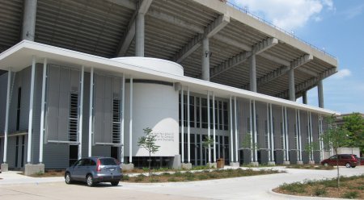
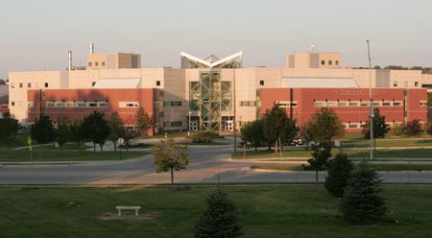
Campus Grids: A Framework to Facilitate Resource Sharing
Derek Weitzel

Slide 2
Campus Grids Motivation
Campuses have multiple clusters multiple departments (or groups) with little sharing.
  Chemistry, Physics, CS
Offload single core jobs to idle resources, making room for specialized (MPI) jobs.
Workflows may require more power than available on a single cluster.

Slide 3
Campus Grid Challenges
Each cluster has their own policies
  User Priorities
  Allowed users
Clusters may have different job schedulers
Expanding outside the Campus

Slide 4
My Contributions
Survey of Campus Grids:
  5 Characteristics of Campus Grids
Created Campus Grid framework implementing these characteristics
Created efficient and accurate pilot matching techniques.

Slide 5
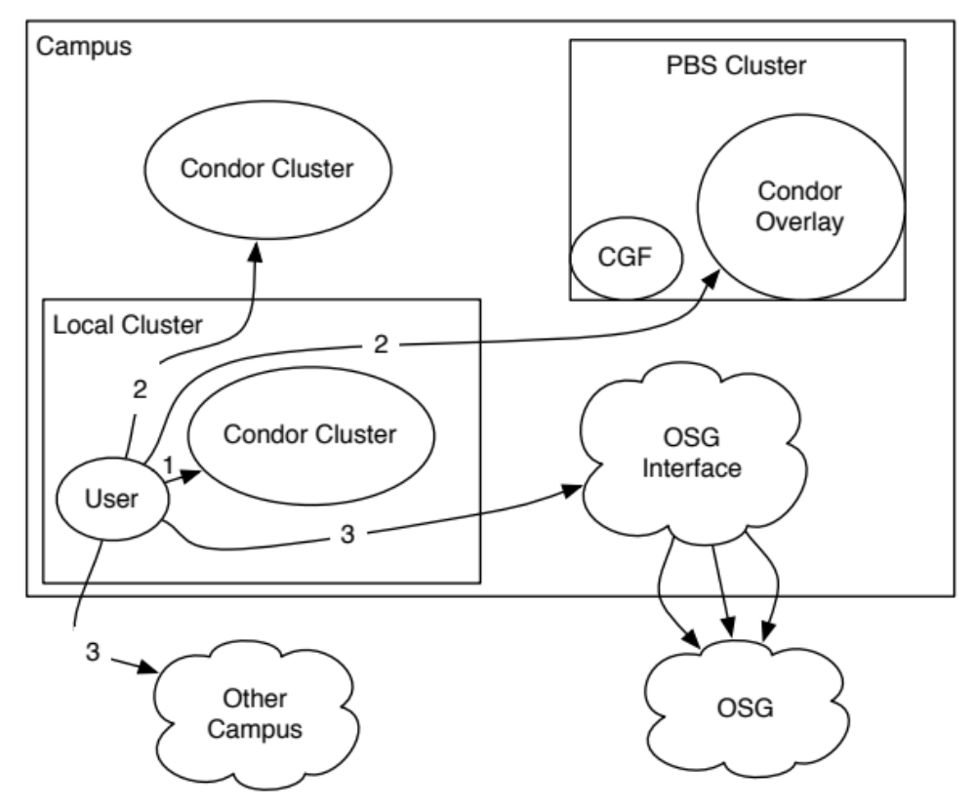
New Model for Campus Grids
Campus Grid Factory for PBS Clusters
Bridge Campus Grids
Overflow to OSG

Slide 6
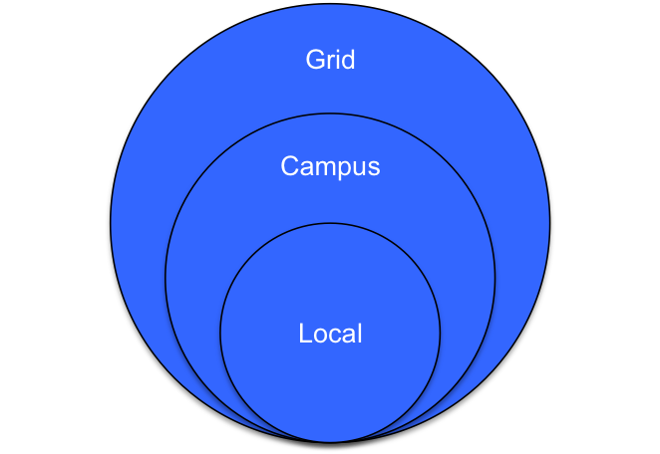
New Campus Grid Model
Me, my friends and everyone else

Slide 7
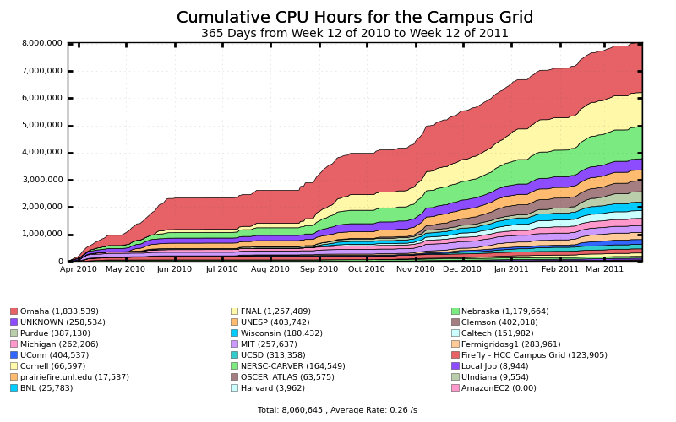
What I Accomplished – 8 Million Hours
8 Million Hours

Slide 8
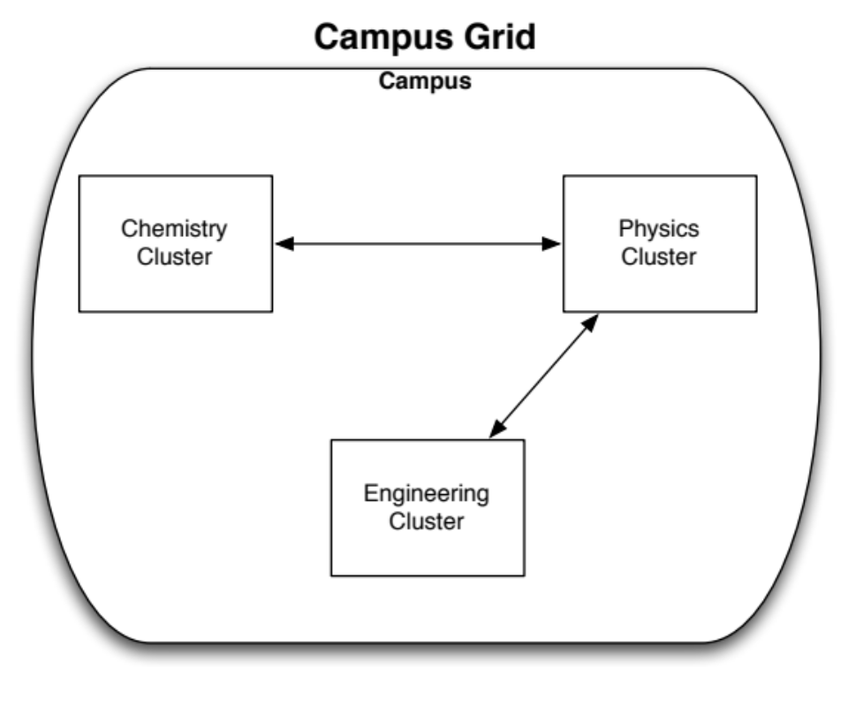
What is a Campus Grid?
A campus grid is a specialized computation grid where resources are owned by the same organization, though can be in multiple administrative domains.

Slide 9
Characteristics of a Campus Grid
All Campus grids can be defined by these attributes:
  Trust Relationships
  Job Submission
  Resource Independence
  Accounting
  Data Management
Compare campus grids on these attributes

Slide 10
Characteristics of a Campus Grid
Trust Relationships
  Security (password, trusted hosts, Kerberos…)
  Allowed users
Job Submission
  Central submission host
  Distributed submitters
  Job distribution

Slide 11
Characteristics of a Campus Grid
Resource Independence
  Autonomous operation
  Own policies
Accounting
  Usage of resources
    From users’ perspective (How much did I use?)
    From resource perspective (Who used what?)

Slide 12
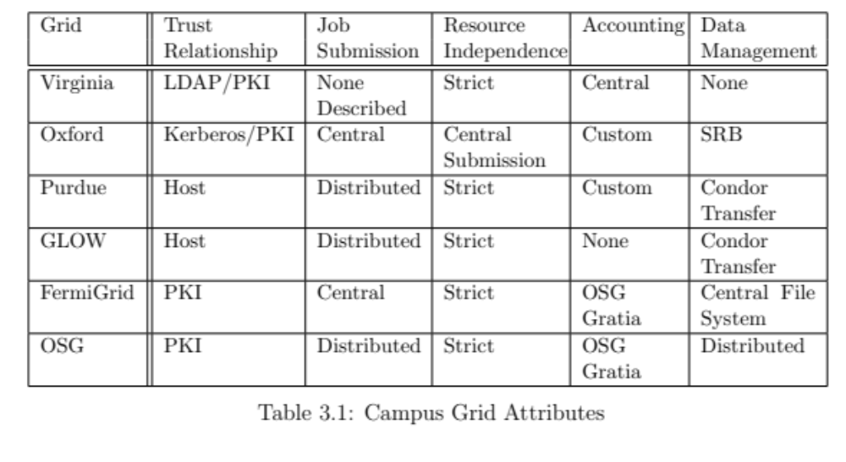
Characteristics of a Campus Grid
Data Management
  Central filesystem
  On-Demand data distribution

Slide 13
Resource Independence - Policies
Cluster Schedulers
  PBS:
    parallel/multiprocess job scheduler
    Runs on VERY LARGE clusters
  Condor:
    High throughput job scheduler
Machine ownership and priorities
  Researchers buy hardware in the cluster
Allowed users

Slide 14
Background: Condor
High throughput batch job scheduler
  Ensembles of independent jobs
Different scheduling model:
  Resource allocation separate from job execution
  Usual model is 1-to-1, job gets a node, job starts.
  In Condor, submitter gets node, runs as many jobs as possible

Slide 15
Background: Condor
Multiple ways to submit to outside resources
  Grid – Translate jobs into another scheduler
  Flocking – Condor to Condor job transfers
  Glidein – Start Condor worker nodes on remote resources

Slide 16
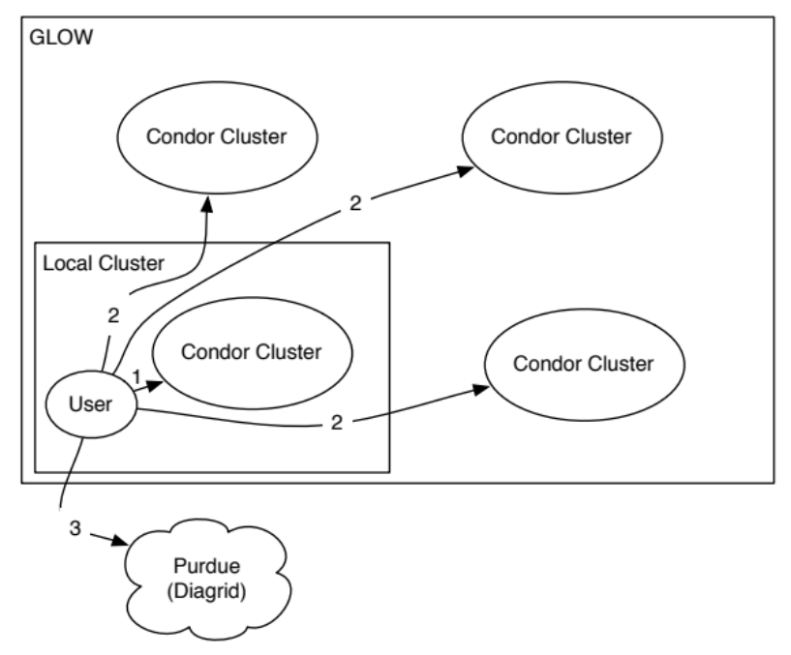
Campus Grids Today
GLOW
  Condor is
  Everywhere!
  Global filesystem
  for data
Purdue
  Condor & PBS
  on nodes
  Shared Home directories, Large clusters with share file systems, Condor file transfer between departmental clusters.

Slide 17
What changes do we want?
Prefer not installing Condor on every worker node.
  Less intrusive for sysadmins.
PBS and Condor should coordinate job scheduling.
  We don’t want PBS to kill Condor jobs if it doesn’t have to.
  Running Condor jobs look like idle cores to PBS.

Slide 18
Campus Grid Framework Goals
Encompass: The campus grid should reach all clusters on the campus.
Transparent execution environment: There should be an identical user interface for all resources, whether running locally or remotely.
Decentralization: A user should be able to utilize his local resource even if it becomes disconnected from the rest of the campus. An error on a given cluster should only affect that cluster.

Slide 19
Campus Grid Goals - Technologies
Encompass
  BLAHP
  Glideins
  Campus Grid Factory
Transparent execution environment
  Condor Flocking
  Glideins
Decentralization
  Campus Grid Factory
  Condor Flocking

Slide 20
Encompass – BLAHP
Written for European Grid Initiative
Translates Condor job into PBS job
With BLAHP: Condor can provide a single interface for all jobs, whether Condor or PBS.

Slide 21
Encompass - Glidein
Starts the worker node Condor daemons as a regular job. Runs user jobs.
Glideins will mimic a local Condor cluster.
Can use all of Condor’s high throughput, while co-scheduling with PBS/LSF.

Slide 22
Campus Grid Goals - Technologies
Encompass
  BLAHP
  Glideins
  Campus Grid Factory
Transparent execution environment
  Condor Flocking
  Glideins
Decentralization
  Campus Grid Factory
  Condor Flocking

Slide 23
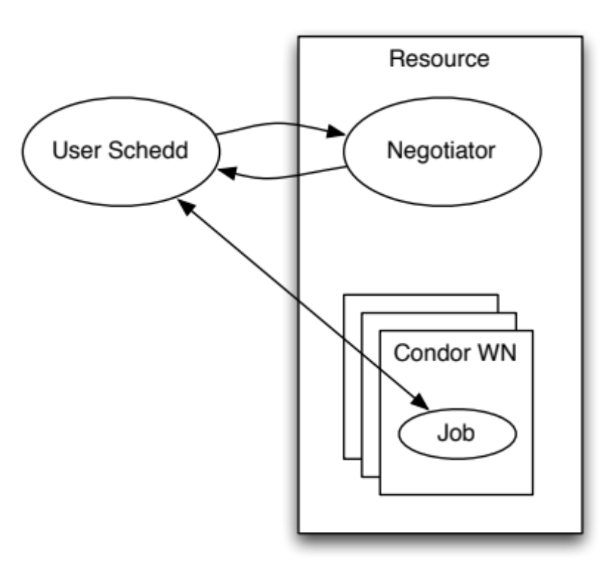
Transparent Execution – Flocking
All interaction mimics local Condor cluster
  Consistent execution environment
  Direct file transfer between execution and submitter
  Span network boundaries

Slide 24
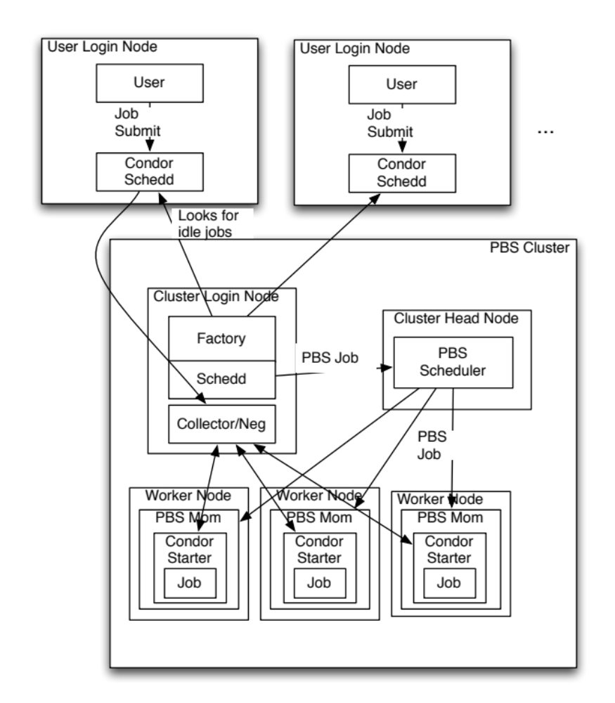
Putting it all Together
Campus Grid Factory

Slide 25
Campus Grid Factory
Submit Condor worker nodes (Glideins) as jobs to PBS
Condor + Glideins + BLAHP + Glue
  Custom daemon that interacts with Condor
Provides on-demand Condor pool for outside clients for Flocking.

Slide 26
Advantages for the Local Scheduler
Allows PBS to know and account for outside jobs.
Can co-schedule with local user priorities.
PBS can preempt grid jobs for local jobs.

Slide 27
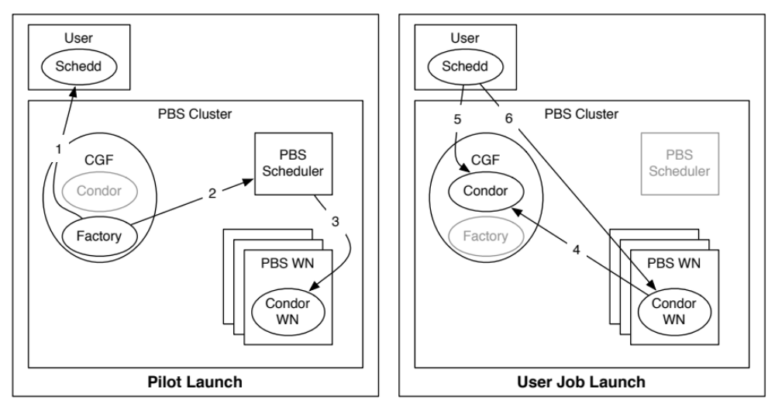
Campus Factory Operation
Factory queries user queue
Submit to PBS (through Condor BLAHP)
PBS Starts the Glidein job.

Slide 28
Campus Factory Operation
Glidein reports to the factory’s collector
User queue requests idle slots from factory
Condor negotiates and starts the job.

Slide 29
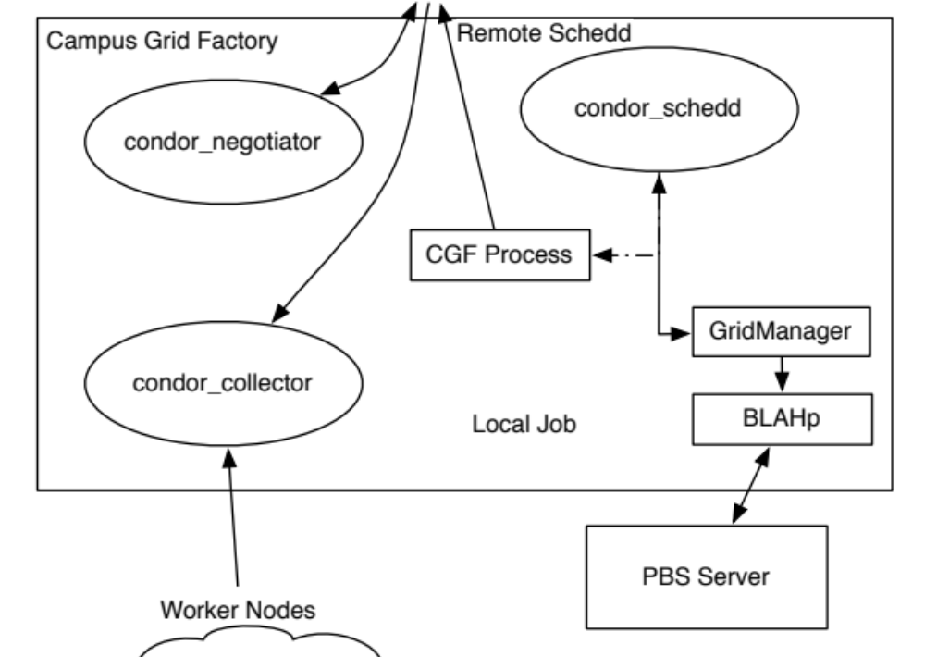
Campus Grid Internals

Slide 30
Advantages of the Campus Factory
User is presented with an uniform Condor interface to resources.
Can create overlay network on any resource Condor (BLAHP) can submit to (PBS, LSF,…)
Uses well established technologies: Condor, BLAHP, Glidein.

Slide 31
Problem with Pilot Job Submission
Problem with Campus Factory: If it sees idle jobs, it assumes they will run on Glideins.
  Jobs may require specific software, ram size.
  Campus Factory will waste cycles submitting idle Glideins.
  Solutions in past where complicated filters.

Slide 32
Advanced Scheduling: OfflineAds
OfflineAds where put in Condor for power management
  When nodes where not needed, Condor can turn them off
  Condor needs to keep track of what nodes it has turned off, and their (maybe special) abilities.
OfflineAds describe an turned off computer.

Slide 33
Advanced Scheduling: OfflineAds
Submitted Glidein = Offline Node
  When a Glidein is no longer needed, turns off.
  Keep Glidein description in an OfflineAd
  When a match is detected with the OfflineAd, submit an actual Glidein.
  It is reasonably expected that one can get a similar Glidein when you submit to the local scheduler (BLAHP).

Slide 34
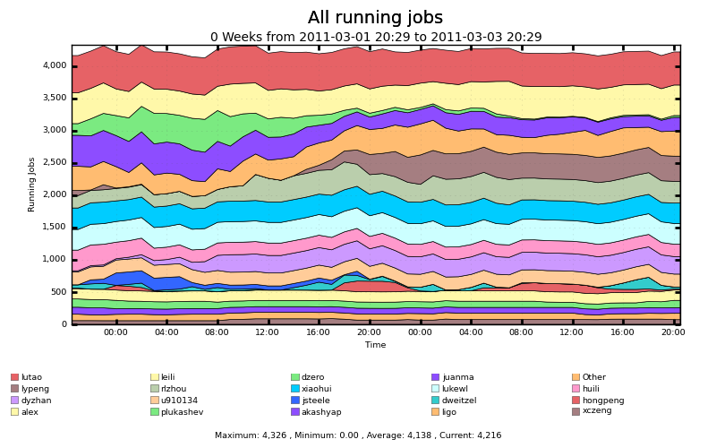
Getting Outside the Campus
Nebraska does not have idle resources:
Running jobs on Firefly. ~4300 cores

Slide 35
Getting Outside the Campus
There are resources available out there, just need to get there.
Users want a smooth transition to other resources.
Extend the transparent execution outside the campus.

Slide 36
Getting Outside the Campus - Options
Extend Transparent – send Condor outside the campus.
Options for getting outside the campus
  Flocking to external Condor clusters
  Grid workflow manager: GlideinWMS

Slide 37
Getting outside the Campus: Flocking
Flocking
  Need to have Condor on the other side.
  Need to have mutual trust relationships.

Slide 38
Getting outside the Campus: GlideinWMS
Expand further with OSG Production Grid
GlideinWMS
  Creates a on-demand Condor cluster on grid resources
  Campus Grid can flock to this on-demand cluster
  Trust Relationships are explicit, need grid credentials

Slide 39
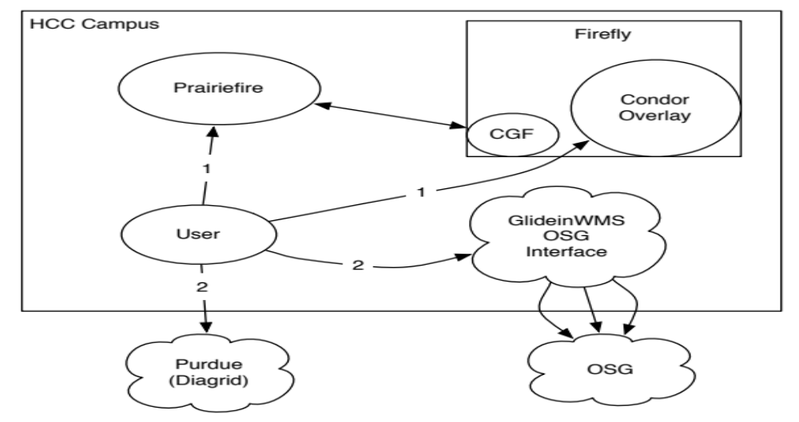
Campus Grid at Nebraska
Prairiefire PBS/Condor (Like Purdue)
Firefly – Only PBS
GlideinWMS interface to OSG
Flock to Purdue

Slide 40
Characteristics of a Campus Grid
All Campus grids can be defined by these attributes:
  Trust Relationships
  Job Submission
  Resource Independence
  Accounting
  Data Management

Slide 41
Characteristics of a Campus Grid
All Campus grids can be defined by these attributes:
  Trust Relationships
    Campus security (Password, trusted hosts, Kerberos,…)
  Job Submission
    On local clusters, transparent distribution.
  Resource Independence
    Strict, each resource can make own policies that are enforced locally.

Slide 42
Characteristics of a Campus Grid
All Campus grids can be defined by these attributes:
  Accounting
    Done on the submitter side
    See future work for more
  Data Management
    Per job file staging
    See future work for more

Slide 43
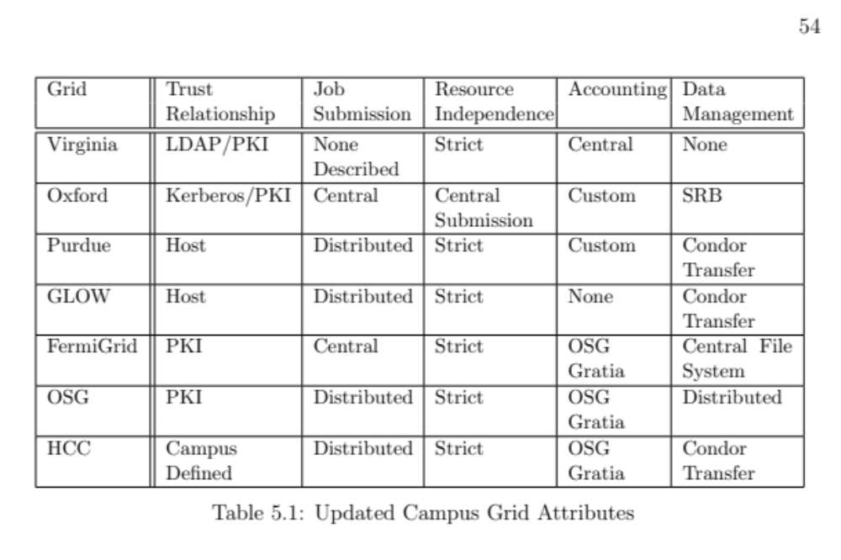
Characteristics of a Campus Grid

Slide 44
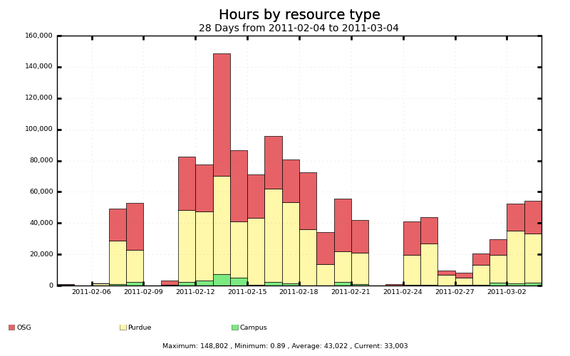
Usage of the Campus Grid
Campus Bridging to Purdue provides a lot of time
OSG resources (through GlideinWMS)

Slide 45
What I Accomplished – 8 Million Hours
8 Million Hours

Slide 46
Future Work
Accounting
  Submission side accounting is easy, we already do it in the Campus Grid.
  But, to accurately get data, we need to account on the execute site (worker nodes).
Data
  Is there a better way than Condor File Transfer?
  What about the cache models being proposed by CMS/Atlas?

Slide 47
Conclusions
Survey of Campus Grids:
  5 Characteristics of Campus Grids
Created Campus Grid framework implementing these characteristics
  In addition to HCC Goals.
Created efficient and accurate pilot matching techniques – OfflineAds

Slide 48

Back Page
Questions?

Slide 49
Campus Grid Goals
Encompass: The campus grid should reach all clusters managed by HCC.
Transparent execution environment: There should be an identical user interface for all resources, whether running locally or remotely.
Decentralization: A user should be able to utilize his local resource even if it becomes disconnected from the rest of the campus. An error on a given cluster should only affect that cluster.

Slide 50
Introduction – HCC Clusters
Firefly
  5500 cores
  Infiniband interconnect
Prairiefire
  500 Cores
  Infiniband interconnect
CMS T2 – Red
  2300 Cores

Slide 51
Grid Overview
Use on-campus resources (Prairiefire & Firefly)
Go to remote resources (OSG & Peered Campuses)

Slide 52
Open Problems
Accounting
  Submit vs. Execute
  Submit side accounting currently used.
Data Management
  Current strategy is ship everything for each job
  Can also use HTTP (squid) caches at each cluster

Slide 53
Campus Grid Goals
Allow users to submit jobs to all campus clusters.
  May be running different schedulers
Job submissions should be distributed to available resources
Each cluster should determine it’s own policies.

Slide 54
What is a Grid?
Real definition: A computational grid is a hardware and software infrastructure that provides dependable, consistent, pervasive, and inexpensive access to high-end computational capabilities
(I. Foster and C. Kesselman. The grid: blueprint for a new computing infrastructure. Morgan Kaufmann, 2004.)
In practice definition: Collection of clusters that allow outside organizations access to resources (storage/computation)

Slide 55
What is a Grid?
Examples of National Grids:
  Open Science Grid
    87 Sites
    All job/data communication through Globus Interfaces
    High Throughput Grid (Lots of not so powerful machines)
  TeraGrid
    11 Sites
    Submission through login and Globus
    High Performance Grid (Think HUGE!!!! Machines)

Slide 56
Motivation for a Campus Grid
Increase available resources by distributing jobs around the campus.
Offload single core jobs to idle resources, making room for specialized (MPI) jobs.
Independence from resource failures.

