Slide 1
Clojure
Usable Lisp

Slide 2
http://github.com/djwhitt/cposc2009
Notes:
Gah, I knew this would happen, you're reading my notes. I should never have put my slides on github.

Slide 3
Agenda
Why Clojure
Clojure intro (actual code + hacking)
Cool bonus material
Questions are welcome at any point (especially during the code section later) but I may have to move on if they take too long
Notes:
Presentation is going to cover why and then how.
Why is the crazy hand wavy part.
How is the part where you can tell I'm not lying.
In the why I sell you on Lisp and the Clojure over other Lisps.

Slide 4

What is Clojure?
Lisp dialect
JVM hosted
Functional
Deep concurrency support
Created by Rich Hickey →
Notes:
Lisp dialect – this is what attracted me to Clojure in the first place – like Common Lisp, Scheme, elisp; we'll talk about this more in a second
JVM hosted – designed for it; calling Java is direct, fast, no wrapper; writing “Java” in Clojure is often more succinct than writing it in Java.
Functional – unlike Common Lisp Clojure emphasizes functional programming; this is good, functional code is easier to test and think about.
Deep concurrency support – You can keep using threads but drop the locks. Clojure built in mechanisms for correctly managing shared state.

Slide 5
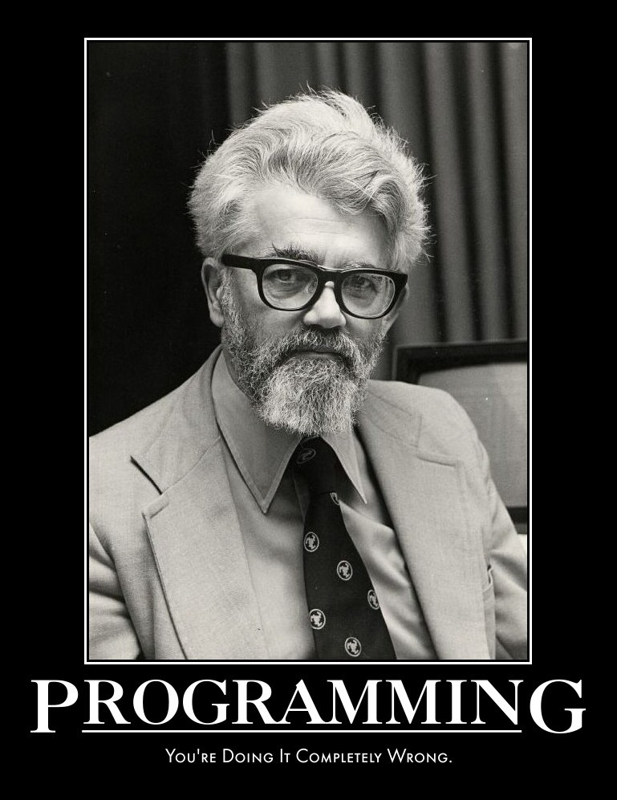
Why Lisp?
Simple syntax
Few special cases
Syntactic abstraction
Interactive development
Lisp is fun
Notes:
Simple syntax means not a lot of corner cases. It's easy to learn. Syntactic opposite of Perl.
Syntactic abstraction means the language is easy to extend. Code is data so it can be manipulated just like any other data. Want a new control structure? No problem, write a macro!
Interactive development means it's easy to experiment and try things in the language.

Slide 6
Expressions
(fn arg1 arg2 … argn)

Slide 7
Compilation and Evaluation
Most languages:
Text → [compiler] → bytecode
Lisp:
Text → [reader] → data structure → [compiler] → bytecode
This is what enables macros.
Notes:
Macros are simpler than meta programming in languages like Ruby because macros themselves are generally functional (form goes in form comes out).

Slide 8
Macros
(macroexpand '(and false 123))
→
(let* [and__3307__auto__ false] (if and__3307__auto__ (clojure.core/and 123) and__3307__auto__))

Slide 9
The JVM is your friend
Lots of libraries
Lots of languages
Very good performance
Sorry, the classpath still sucks

Slide 10
Why not Scheme or CL?
No literal for maps (or vectors in CL afaik)
Vectors, sets, and maps are generally harder to work with in Scheme and CL (not persistent, no sequence abstraction)
JVM has lots of libraries
Working with the JVM is simpler using Clojure compared with other JVM Lisps
Clojure is designed for concurrency
Notes:
Please don't crucify me if your a Lisp person and I say something wrong here.

Slide 11
Identity and State
Process - program that includes change over time
State - value of identity at a time
Identity - succession of values over time
Notes:
Clojure tries to keep identity and state separate
In most OO languages they're the same
This is sort of ok in a single threaded app
Breaks badly when you bring in concurrency. You have to manually manage who writes/reads what and when.
Changes need to happen all at once. There should be no way to see an incoherent version of and “object”.
Readers should be able to see coherent snapshots at a point in time.

Slide 12
Identity and State
State and identity in your favorite OO language
Point object
x = 4
y = 3
How do you change this while
preserving identity?
foo
Typically you mutate this thing

Slide 13
Identity and State
State and identity in Clojure
reference
Point
x = 4
y = 3
foo
State is changed by atomically replacing referenced values.

Slide 14


Hickey's hair

