Slide 1
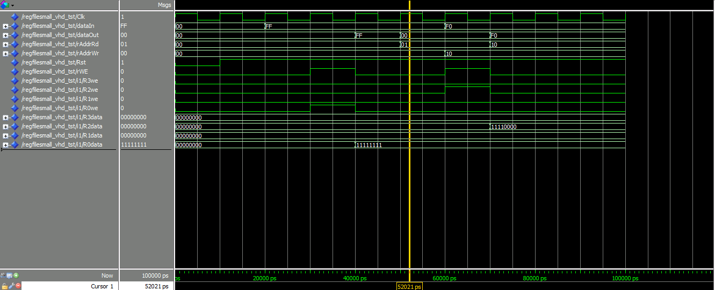
Externally entered data waiting to be read
Registers storing data
(R0-R3)
R0 is written to once the write enable is activated (FF)
(rising clock edge)
Reads from R1 (00) No rWE needed read
Reads previously stored data (F0)
Starts writing dataIn to R2
(rWE up)

