Slide 1
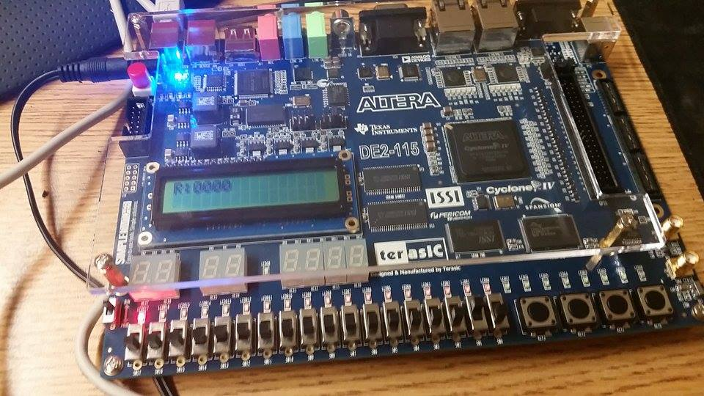
Reset, Run= ‘0’, R2=0000

Slide 2
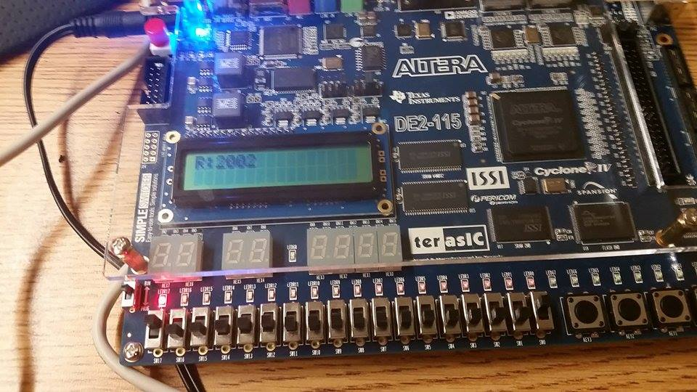
Run=‘1’, R1= 2002

Slide 3
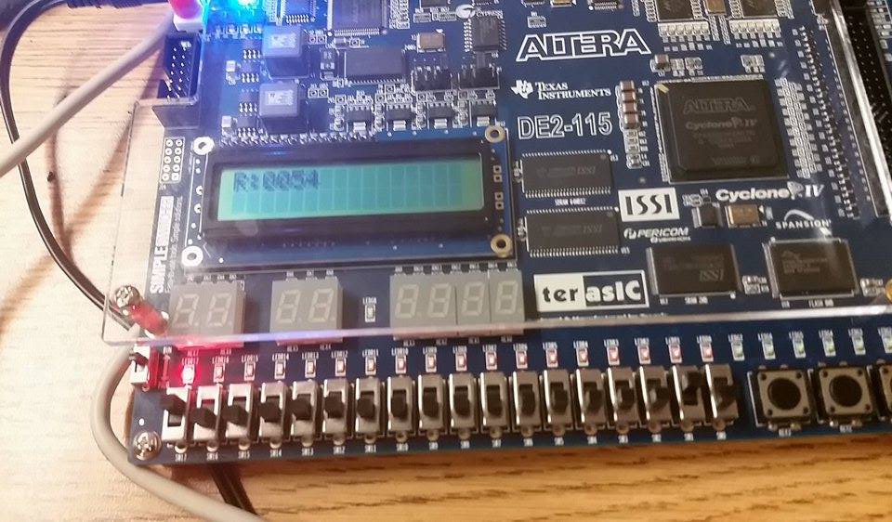
R2= 0054= ‘T’ (coincidental)

Slide 4
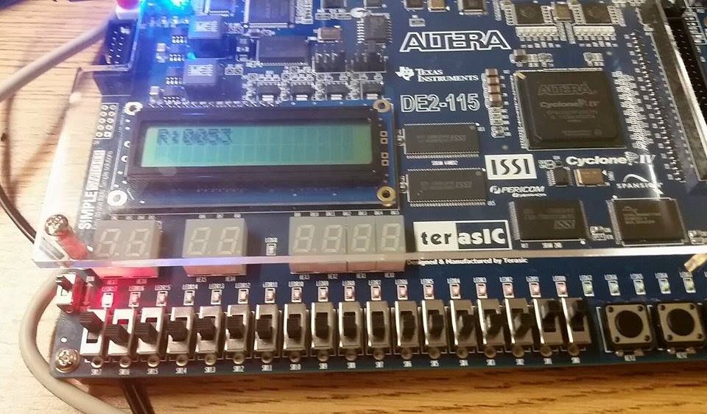
R3= 0053= ‘R’

Slide 5
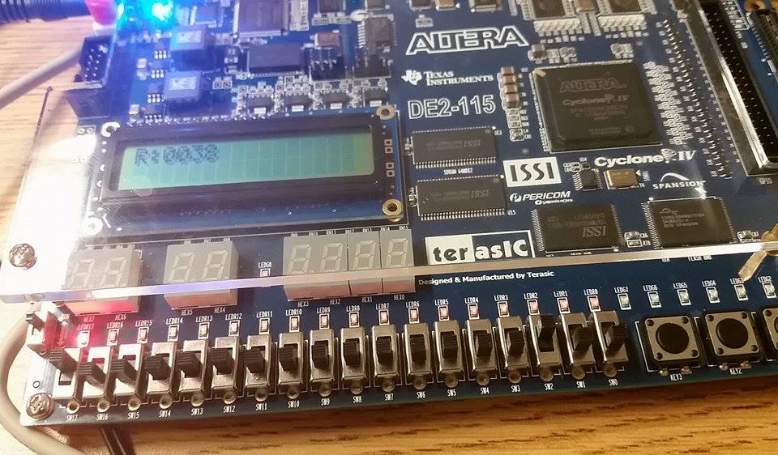
R4= 0038= ‘8’

Slide 6
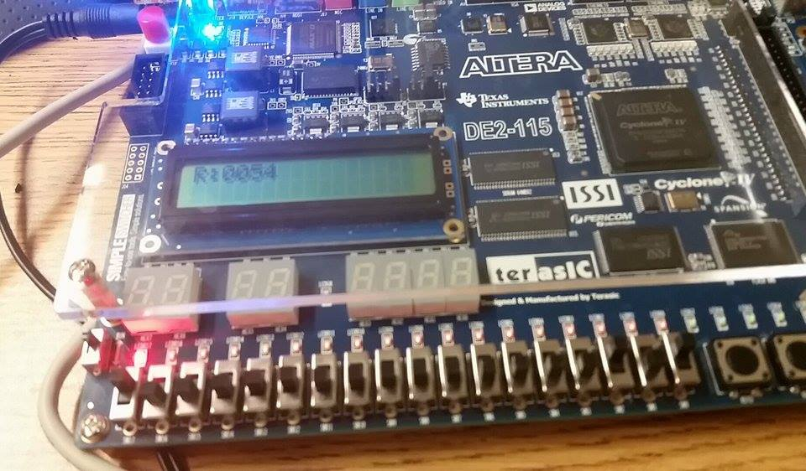
R5= 0054= ‘T’

Slide 7
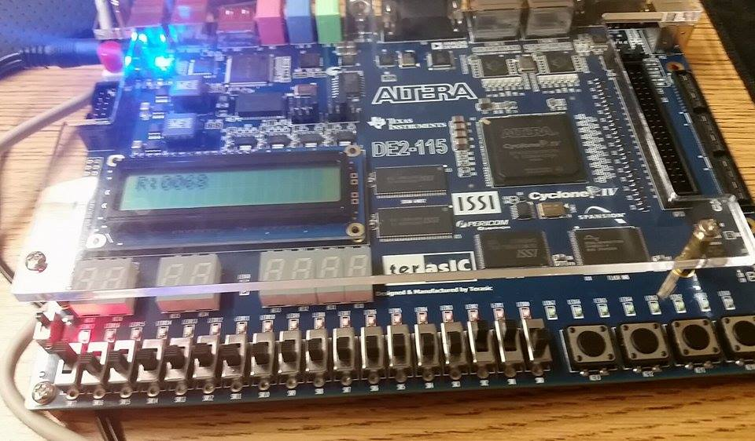
R6= 0068= ‘h’

Slide 8
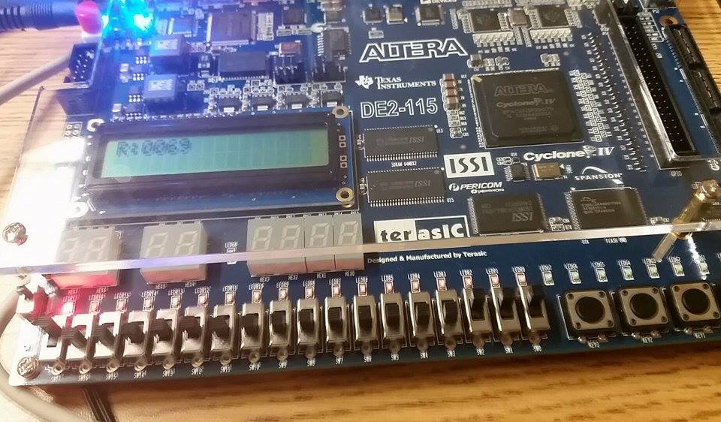
R7= 0069= ‘i’

