Slide 1
Test prompts
Same two prompts for LTX-2.3 and LTX-2.5 · text only (no keyframes) · 768×512, 2 s, seeds 42, 43, 44
Prompt 1 · Red ball (left → right)
“A single bright red ball rolls from the left side to the right side of a wooden table, moving steadily across the whole table until it reaches the right edge. The ball remains round and keeps the same size and color throughout the shot. A plain beige wall is visible in the background. Soft daylight enters from a window on the left. The camera stays completely still, showing the entire table surface in one continuous shot.”
「一顆鮮紅色的球從木桌的左側滾向右側，平穩地滾過整張桌子，直到抵達右側邊緣。整個鏡頭中，球始終保持圓形，大小和顏色都不變。背景是一面素色的米色牆壁。柔和的日光從左側的窗戶照進來。鏡頭完全固定不動，以一個連續鏡頭拍攝整個桌面。」
Prompt 2 · Blue toy car (right → left)
“A small blue toy car drives from the right side to the left side of a white desk, moving steadily across the whole desk until it reaches the left edge. The car keeps the same shape, size and color throughout the shot. A plain light-grey wall is visible in the background. Soft daylight comes from above. The camera stays completely still, showing the entire desk surface in one continuous shot.”
「一輛藍色的小玩具車從白色書桌的右側開往左側，平穩地駛過整張書桌，直到抵達左側邊緣。整個鏡頭中，玩具車的形狀、大小和顏色都保持不變。背景是一面素色的淺灰色牆壁。柔和的日光從上方灑下。鏡頭完全固定不動，以一個連續鏡頭拍攝整個桌面。」
1
Notes:
English prompts copied from the benchmark scripts that ran (round5/ltx25-mlx-redball and -bluecar; identical for LTX-2.3). The Traditional Chinese lines are translations for reading only; the models were prompted in English.

Slide 2
Benchmark results
LTX-2.3 vs LTX-2.5 distilled · MacBook Pro M4 Pro, 24 GB · 768×512, 2 s video, text only, seeds 42, 43, 44
Model | Weights | Mean performance (avg time / video) | TTFT (ms) | Avg memory GiB | Memory while making a video GiB | Avg peak memory GiB | Peak memory GiB | Correct
LTX-2.3 · red ball | MLX 4-bit | 108.97 s/clip | — | 5.89 | 6.30 | 14.58 | 14.59 | 3 of 3
LTX-2.3 · blue car | MLX 4-bit | 109.64 s/clip | — | 6.86 | 7.45 | 14.56 | 14.57 | 3 of 3
LTX-2.5 · red ball | MLX 4-bit | 175.14 s/clip | — | 6.34 | 6.72 | 15.46 | 15.47 | 3 of 3
LTX-2.5 · blue car | MLX 4-bit | 168.30 s/clip | — | 6.29 | 7.65 | 15.47 | 15.48 | 3 of 3
平均效能（Mean performance）：模型與提示詞皆已載入時（暖機後執行），seed 42–44 每支影片的平均生成時間。
平均記憶體（Avg memory）：1 個提示詞，在同一次執行中連續生成多支影片（提示詞只讀取一次）；取每支影片最高記憶體的平均值（seed 42–44）。「Memory while making a video」為其中的最高值。
平均峰值記憶體（Avg peak memory）：1 個提示詞，每次執行只生成 1 支影片（每次都重新載入模型並讀取提示詞）；取每支影片峰值的平均值（seed 42–44）。「Peak memory」為其中的最高單一數值。24 GB Mac 的 macOS GPU 上限為 17.8 GiB。
2
Notes:
LTX-2.3 red: 3/3, fresh-run time 126.44 s, avg peak 14.580 GiB (estimate), peak 14.585 GiB, while making 6.295 GiB, warm mean 108.97 s
LTX-2.3 blue: 3/3, fresh-run time 124.06 s, avg peak 14.560 GiB (estimate), peak 14.571 GiB, while making 7.449 GiB, warm mean 109.64 s
LTX-2.5 red: 3/3, fresh-run time 196.66 s, avg peak 15.457 GiB (measured, round5/ltx25-mlx-fresh), peak 15.470 GiB, while making 6.717 GiB, warm mean 175.14 s
LTX-2.5 blue: 3/3, fresh-run time 191.89 s, avg peak 15.466 GiB (measured, round5/ltx25-mlx-fresh), peak 15.482 GiB, while making 7.651 GiB, warm mean 168.30 s
LTX-2.3 average peak is an estimate within the 14.56–14.63 GiB measured in 12 earlier fresh runs (its weights were removed, so it was not re-run). LTX-2.3 red-ball avg memory is from its same-settings run on seeds 45–50. TTFT applies to language models only (—). Correct = the object moves the right way. LTX-2.3 red ball ran on AC power, the others on battery (Low Power Mode off).

Slide 3
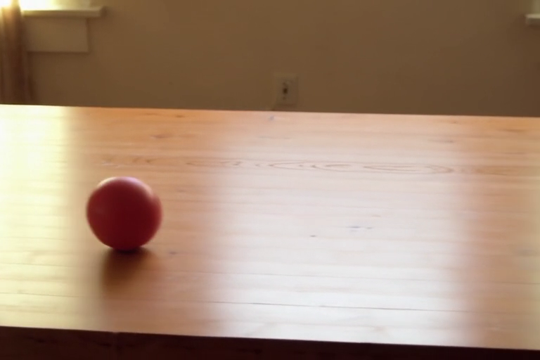
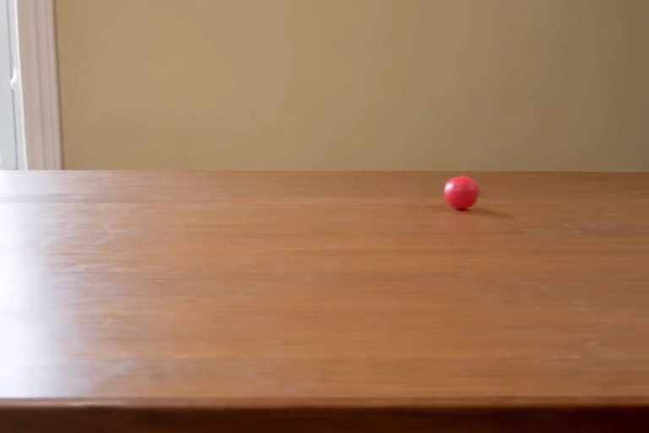
Red ball: LTX-2.3 vs LTX-2.5
Same prompt, same seed (43) · click a video to play it (2 s)
LTX-2.3 distilled
LTX-2.5 distilled
Correct · 3 of 3 seeds correct
Correct · 3 of 3 seeds correct
avg time 109 s · avg memory 5.89 GiB · avg peak memory 14.58 GiB
avg time 175 s · avg memory 6.34 GiB · avg peak memory 15.46 GiB
3
Notes:
LTX-2.3: seed 43 One round red ball enters from the left edge and rolls steadily to the right (x 0.00→0.47); slight camera drift. LTX-2.5: seed 43 One round red ball rolls steadily from the left-centre to the right and out past the right edge in the last frames.

Slide 4
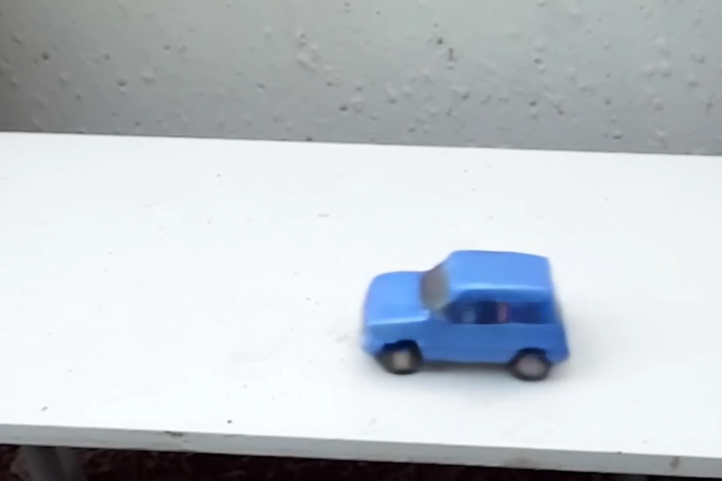
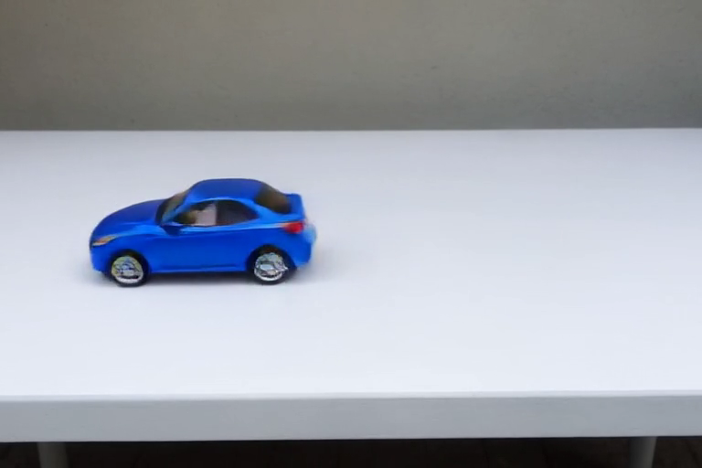
Blue car: LTX-2.3 vs LTX-2.5
Same prompt, same seed (43) · click a video to play it (2 s)
LTX-2.3 distilled
LTX-2.5 distilled
Correct · 3 of 3 seeds correct
Correct · 3 of 3 seeds correct
avg time 110 s · avg memory 6.86 GiB · avg peak memory 14.56 GiB
avg time 168 s · avg memory 6.29 GiB · avg peak memory 15.47 GiB
4
Notes:
LTX-2.3: seed 43 One blue toy car enters from the right edge, drives steadily left and leaves at the left edge; same car shape throughout. LTX-2.5: seed 43 One blue toy car enters at the right edge, drives steadily left and leaves at the left edge; same shape throughout.

